Slide 1
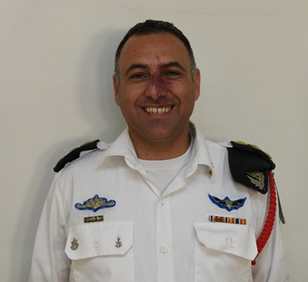
Colonel Nadav Turgeman
Training Base Commander in the Navy
Professional
background
Deputy Commander flotilla 13
All the jobs of a Lieutenant Colonel: מפל"ג אגמ, מפל"ג הדרכה , מפל"ג לוחמים
Academic
background
Degree in Computer Science and Multidisciplinary
Master’s degree
Courses and educational programs
Year of birth: 1978 Residence: Hadera
Personal
Background
Married with two children
Hobbies: Ocean, fishing

Slide 2
Mr. Harel Sharabi
Senior deputy commissioner of capital market
Professional
background
Director of pension department
responsible on pension policy, Capital Market department
Academic
Background
BA- business administration, expertise in accounting, funding and banking
Master’s degree in Economics and Accounting, graduated with honors- the Hebrew University
Courses and educational programs- 2013: directors and senior corporate executives course- Lahav, Faculty of Management, Tel Aviv U University.
2014: Executive Development course עתודה לסגל הבכיר – אלכא המכון למנהיגות ולממשל, ג'וינט ישראל.
2018 : קורס מובילים דיגיטאליים בשלטון המרכזי – מטה ישראל דיגיטלית ואלכא המכון למנהיגות ולממשל, ג'וינט ישראל.
2019 : תוכנית "וקסנר" למנהלים בכירים בשירות הציבורי – קרן "וקסנר".
Personal
Background
Year of birth: 1977 Residence: Rosh Tzurim
Married with six children
Army service: 1998-2001. course in paratrooper, command course and commanding recruits

Slide 3
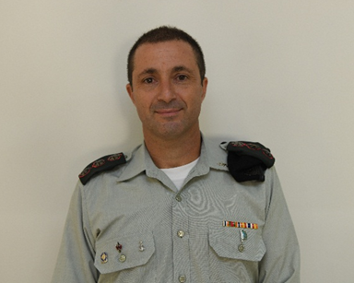
Colonel Yossi Matzliach
Current position- Mietav commander
Professional
Background
Pervious position- קמש"פ צפון
Previous position-Mietav recruitment Deputy Commander
BA in Mathematics from Ben Gurion university
Academic
Background
Master’s degree in Business Administration from the university of Tel Aviv
Courses and educational programs- פו"ם אפק
Year of birth: 1973 Residence: Liman
Personal
Background
Married to Mazi with four children
Hobbies and additional background: running

Slide 4
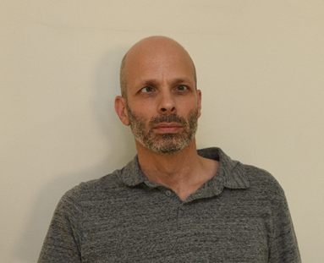
Mr. bar צ'צ'ק
Current position- Head of investigation office in the prime minister’s office
Professional
Background
Previous position- סרמ''ח במשרד ראש הממשלה
Previous position- רע''ן במשרד ראש הממשלה
BA in Political Science from the Hebrew University in Jerusalem (1994-1997)
Academic
Background
Year of birth: 1971 Residence: Ashkelon
Personal
background
Married to Natali and father to Roni (15) and Shiri (13)
Hobbies and additional background- originally from Petah Tikva.
Ten years of study at the Municipal Conservatory. A fan of history, American politics, foreign news websites and English
Soccer.

Slide 5
Mrs. Simona Halperin
Current position- ambassador in Taiwan
Professional
background
Previous positon- head of representation in Taiwan
Previous position- Director of the department of international human rights organizations.
BA in Economy and Business Administration from the University of Haifa
Academic
background
Master’s degree in Public Policy and Law from the Hebrew University
Personal
background
Year of birth:1969 Residence: Mavzert Zion
Married with five children

Slide 6
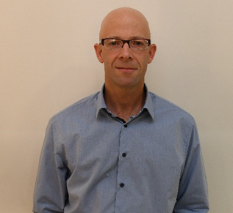
Mr. Ram Erez
2016-present: head of Policy and Strategy unit, Headquarters מטה עוזר שר הביטחון להתגוננות, משרד הביטחון
Professional
Background
2009-2016: assistant for policy and strategy to the assistant of the defense minister, Ministry of Defense
2005-2009: Senior policy assistant, Atomic Energy Commission
2001-2005: researcher at “Yafa” center for Strategic Studies, university of Tel Aviv
2018-present: Research fellow at Haifa center for Maritime Policy and Strategy Studies
Academic
Background
2010: Ph.D. in International Relations from the Hebrew University in Jerusalem
2007: International Visitor Leadership Program on U.S. Foreign Policy and National Security, U.S. State Dep.
2001: MA in in International Relations (graduated with honors), the Hebrew university in Jerusalem
1997: BA in International Relations, the Hebrew University in Jerusalem

Slide 7
Mr. Ram Erez
Year of birth- 1971. Residence- Tel Aviv
Personal
Background
Married with three children
Hobbies- sailing

Slide 8
Colonel Haim Mizrahi
Professional
Background
Current position- קל"פ דרום.
Previous position-
Previous position-
BA in Logistics and Economics from Bar Illan university
Academic
Background
Master’s degree in National Security and Administration from university of Haifa
Courses and educational programs- פו"ם כללי וקורס מח"טים.
Personal
Background
Year of birth- 1974. residence- Mirav
Married with five children

