Slide 1

Economic Field
National Defense College
Leading Instructure: Eran Kamin
47th Class 2019-2020

Slide 2
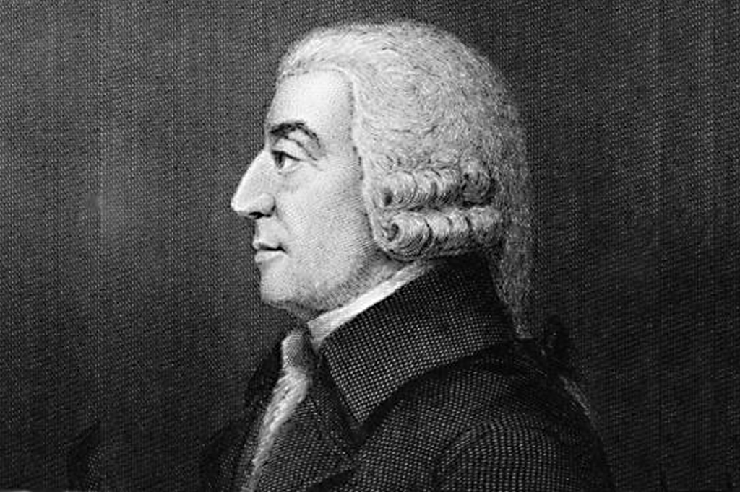
“Man is an animal
that makes
bargains:
no other animal
does this-no dog exchanges
bones with
another”
(Adam Smith, The wealth of nation)

Slide 3
The Goals
Understanding the interplay between economics and national security and acquiring basic concepts in economics.
Analyzing and understanding of the main economic processes in the Israeli economy, the economic challenges facing decision makers and familiarity with the tools for managing economic policy.
Understanding the international and regional economy.
Engaging in topical economic questions.
Understanding the relationship between economics and strategic thinking

Slide 4
The Priory's Idea
National Security Economics
Economic Policy Issues
Economics and Globalization
Economics and National Security - Research
Seminars on Economic Issues
Senior Lecture
Tours

Slide 5
Timeline
Senior Lectures
Locally
Geographical Tours
Economics and Globalization
Economic Policy Issues
Team Processing
Choice
Integration
Seminars on Economic Issues
Economic Investigation
Globally

Slide 6
Global Economy

Slide 7
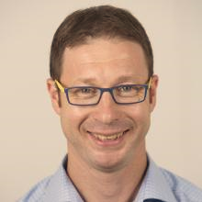
Economics and Globalization
Dr. Lior Herman, Head of Political Economy and International Relations, in the Department of International Relations at the Faculty of Social Sciences of the Hebrew University

Slide 8

Guest Lecturer
Dr. Alex Komen is a senior lecturer in the Faculty of Management of Tel Aviv University and the Tel Aviv-Jaffa Academic College. His research field is information systems and economic value creation.

Slide 9
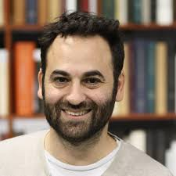
Guest Lecturer
Dr. Eli Cook is a historian of American capitalism, a lecturer in the Department of General History and head of the American Studies program at the University of Haifa.
Research Areas: Modern American History, History of American Capitalism, Slavery, Consumer Culture, Economic History, Neoliberalism, Business History, Economic Thought.

Slide 10
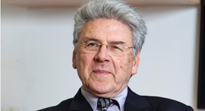
Guest Lecturer
Professor Shalom Sherman, Head of the International MBA Program at the University of Haifa

Slide 11
Israeli Economy

Slide 12
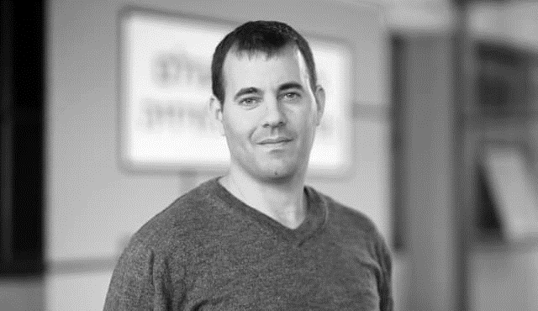
Economic Policy Issues
Mr. Noah Hecker, served as senior deputy to the Treasury Budget Controller and was responsible for managing the Defense Ministry staff in the Treasury including the Ministry of Justice, the Treasury, the Prime Minister's Office and the Foreign Ministry. As part of his role, he was a partner in drafting the state budget, accompanying large-scale national projects, representing the government in the Knesset in budget discussions and more. Prior to that, he held a variety of economic positions at the Treasury and the Bank of Israel. Hacker is studying for a PhD in economic resources from the University of Haifa and is a graduate of the National Security College.

Slide 13
2.1.20 – 08:30-12:00
Economics and National Security
Processing
7.1.20 – 08:30-12:00
Processing
Economics and National Security

Slide 14
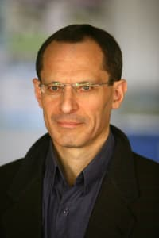
Guest Lecturer
Professor Eugene Kendall, is an Israeli economist who heads the Startup Nation Central Association and serves as a professor of finance at the Hebrew University's School of Business. From 2009 to 2015, he served as chairman of the National Economic Council in the Prime Minister's Office.

Slide 15
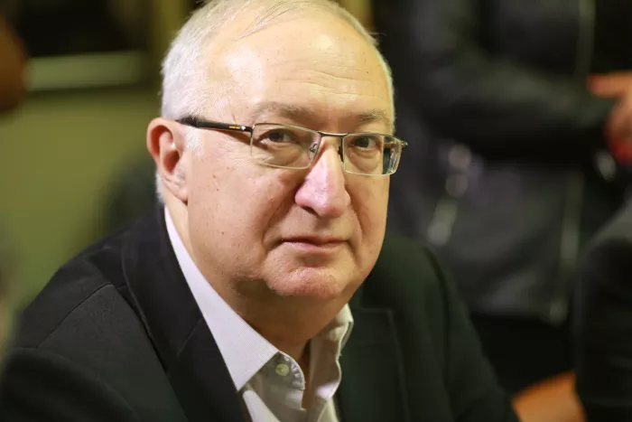
Guest Lecturer
Professor Manuel Trachtenberg, an Israeli economist, and formerly chair of the Planning and Budgeting Committee of the Council for Higher Education. In August 2011, he was chaired by the Trachtenberg Commission.

Slide 16
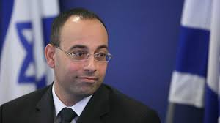
Guest Lecturer
Professor Yaron Zelekha, an Israeli economist. He served as General Accountant in the Ministry of Finance from 2003-2007. Professor and Head of the Department of Accounting at UNO Academic College.

Slide 17
The Selection Season

Slide 18
Seminar on Economic Issues

Slide 19
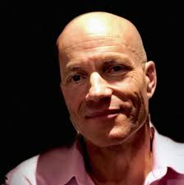
Professor Omar Moab
2 שש"ס :
Economic Policy in Israel: The Roots of Debate.
Poverty alleviation in the world: hope, disappointment, success.
The big gaps in per capita GDP across countries: deep roots.

Slide 20
Seminar on Economic Issues
Omar Moab is an economics professor at the Interdisciplinary Center in Herzliya and at the University of Warwick in England.
Prof. Moab holds a bachelor's degree, a graduate degree and a doctorate from the Hebrew University of Jerusalem. After a postdoctoral fellowship at MIT, Moab returned in 2000 as a lecturer at the Hebrew University, advancing there to the rank of Associate Professor within a decade, during which he won the Oak scholarship for outstanding young scientists, and the Hebrew University's Rector's Award for Excellence in Research and Teaching. In 2014, he moved to the Interdisciplinary Center.
Moab's research deals with economic growth, inequality, immigration, poverty, the history of state formation, and the Israeli economy. His articles have been published in the world's leading economic journals and are ranked in the top two percent of economists in the world.

Slide 21
25.2.20 – 13:00-16:00
Economic policy in Israel
Processing
26.2.20 – 08:30-12:00
Processing
3.3.20 – 13:00-16:00
Processing
4.3.20 – 08:30-12:00
Processing
11.3.20 – 08:30-12:00
Processing
Economic policy in Israel
Economic policy in Israel
The eradication of poverty in the world
The big gaps between countries

Slide 22
Policy and Budget Seminar

Slide 23
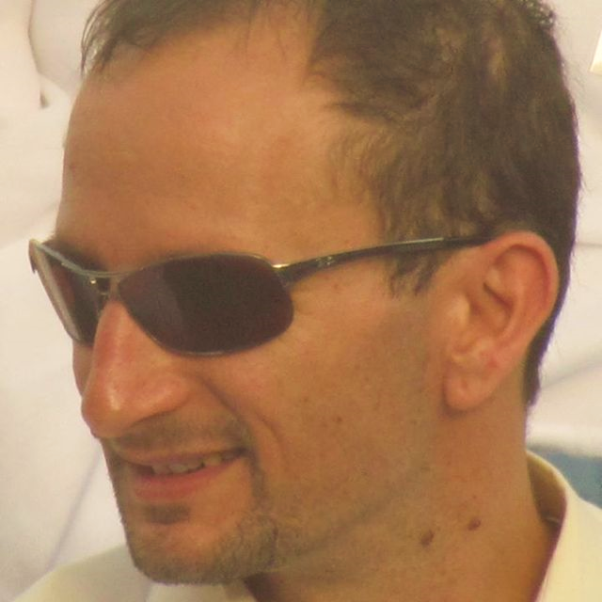
Dr. Eyal Argov
  Head of Macro and Economic Activities, Research Division - Bank of Israel. Graduate of the INDC, CW.
  Dr. in Economics, Hebrew University, Master of Economics, Hebrew University and Master of Political Science with specialization in National Security and Strategy, University of Haifa

Slide 24
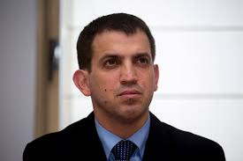
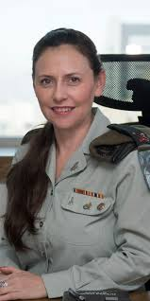
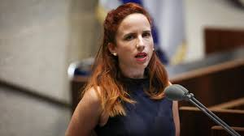
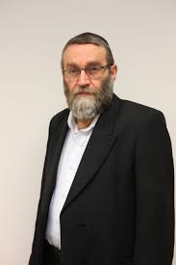

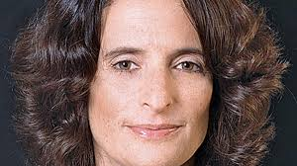

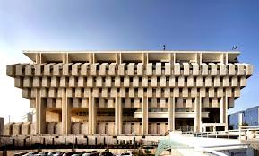
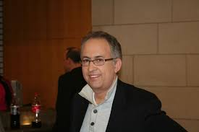
Hasadna

Slide 25
17.3.20 – 13:00-16:00
Processing
18.3.20 – 08:30-12:00
Processing
24.3.20 - – 13:00-16:00
Processing
25.3.20 – 08:30-12:00
Processing
31.3.20– 13:00-16:00
Processing
1.4.20 – 08:30-12:00
Processing

Slide 26
The Integrative Season

Slide 27
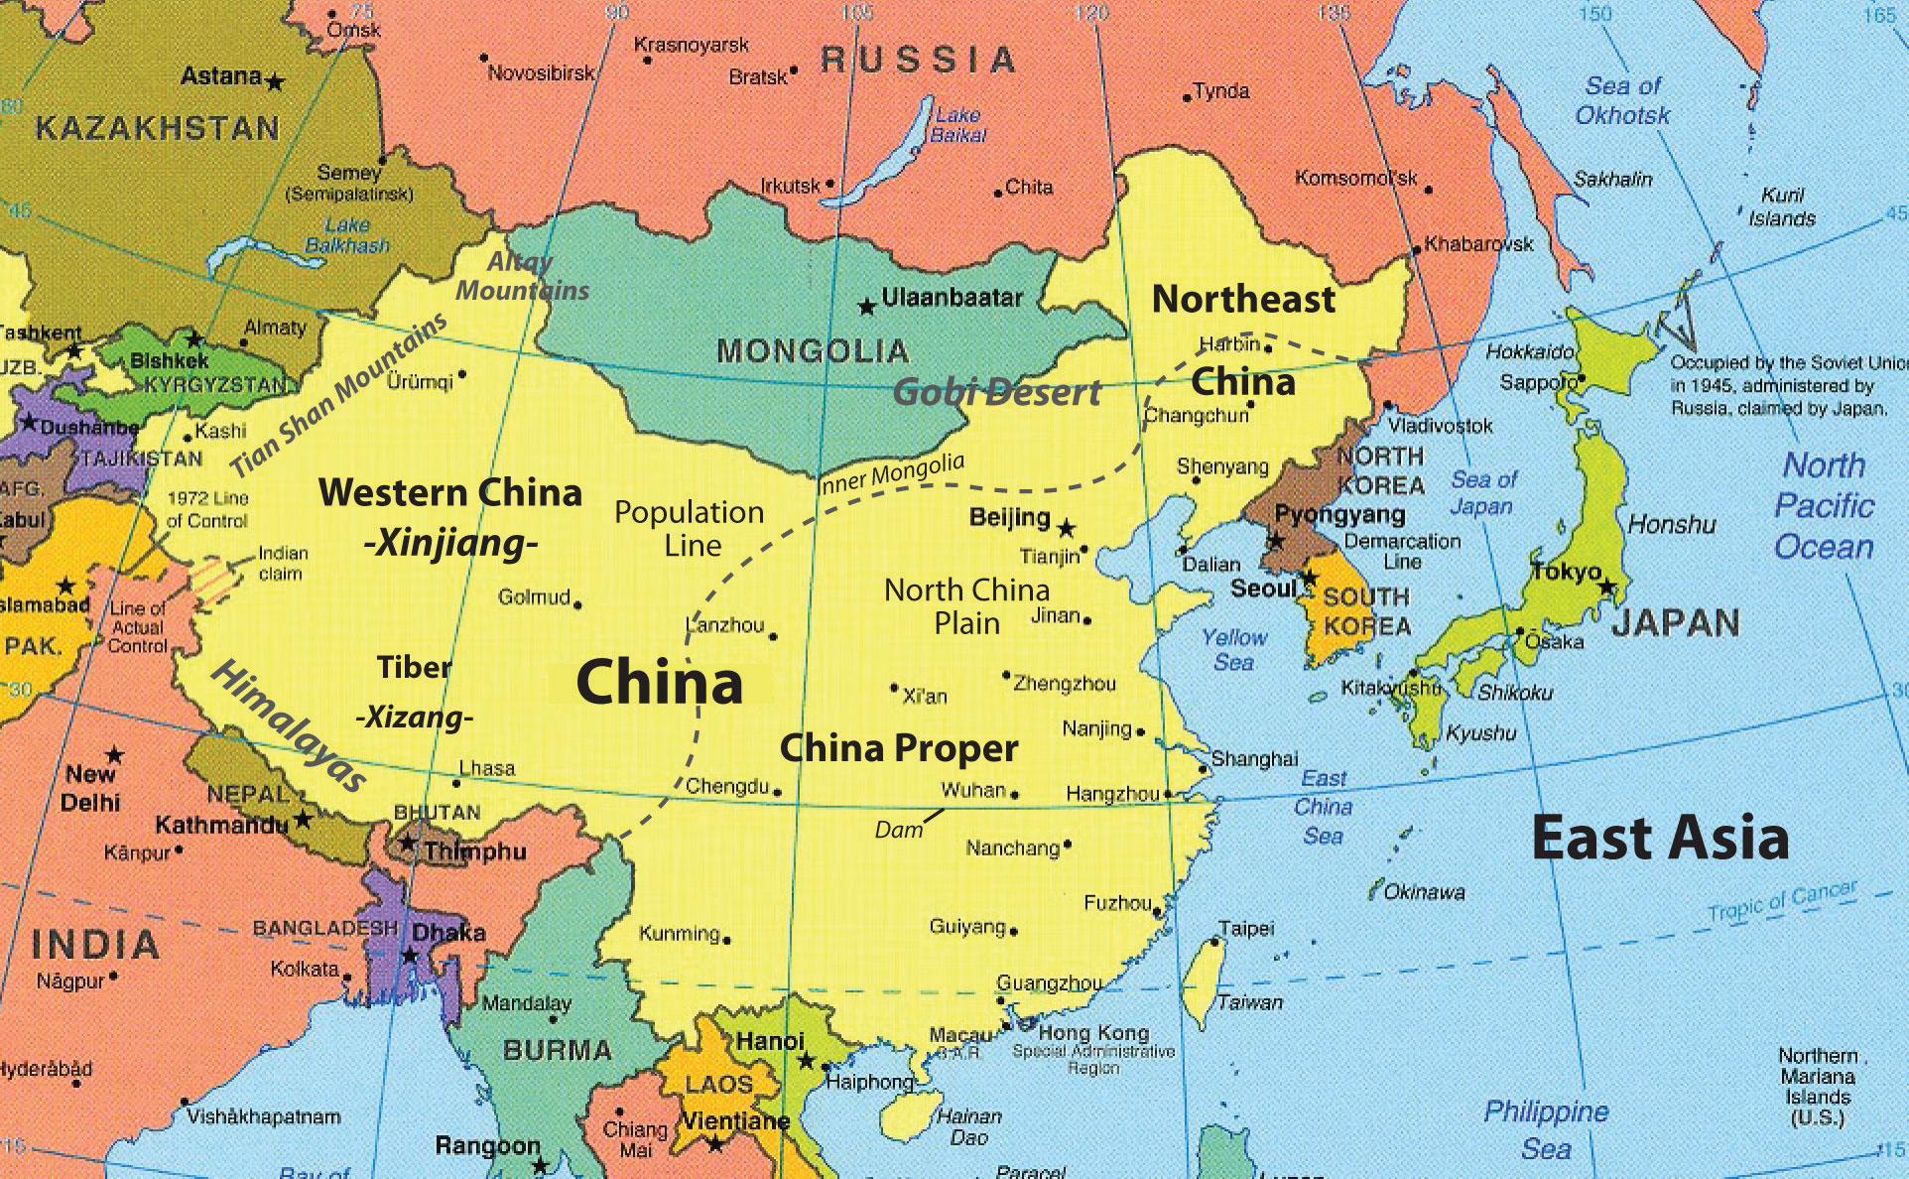
21.4.20 - 7.5.20 - Seminar and East Tour

Slide 28
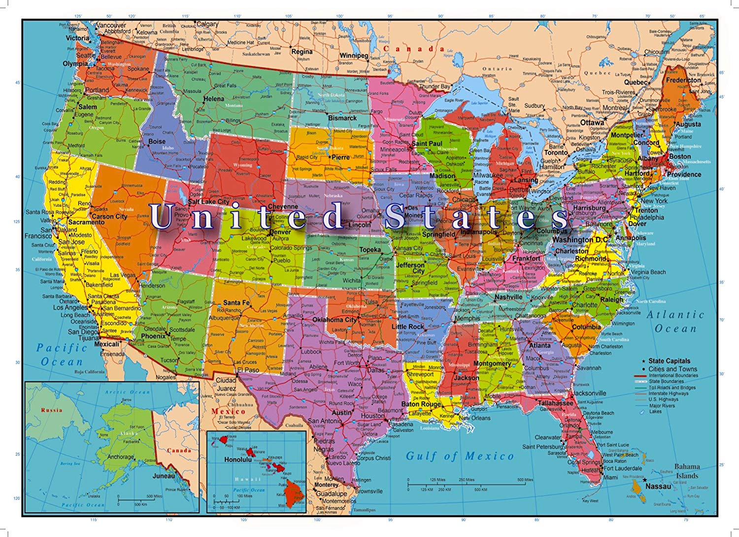
3.6.20-25.6.20 - US Seminar and Tour

