Slide 1
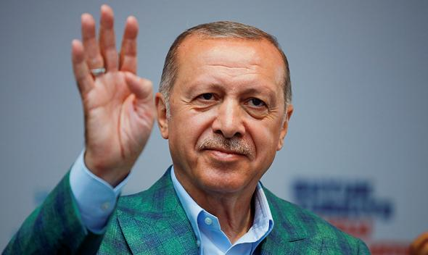
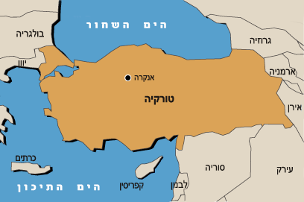
Erdogan's Turkey 2002-?
Black Sea
Ankara
Turkey
Mediterranean Sea

Slide 2
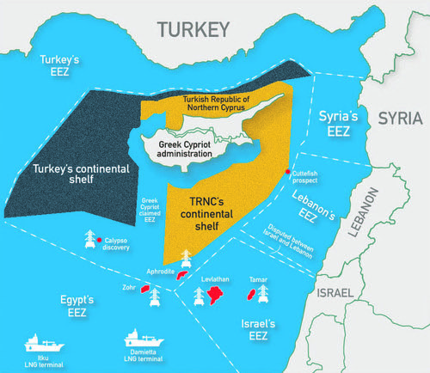

Slide 3
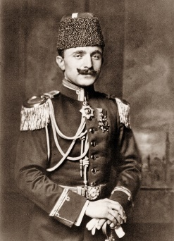
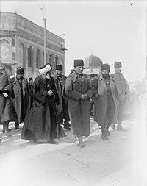
Turkey: Between East and West ?
"East or West ": between Asia, the Middle East and the “West”
The Young Turks - Enver Pasha
Turkish Nationalism: Pan Turanism (According to Turanism, all the Turkish peoples: from the Uzbek and the Crimea to the Balkans are interconnected) End of World War I:
Treaty of Sèvres, Treaty of Lausanne, Treaty of Versailles
War of Independence - "The West Will Divide Turkey"

Slide 4
Turkey - Turkish Nationalism: The Limits of "National Consent"

Slide 5
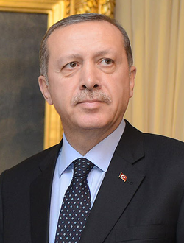
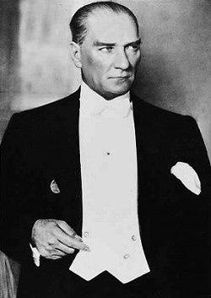
Kamalism - Erdoganism: Continuity or Breakage?
רֵגֵ'פּ טָאִיפּ אֶרְדוֹאָן (בטורקית: Recep Tayyip Erdoğan‏, [ɾeˈd͡ʒep tajˈjip ˈæɾdo.an]; נולד ב-26 בפברואר 1954) הוא נשיא טורקיה ה-12, מאז 28 באוגוסט 2014. קודם לכן כיהן כראש ממשלת טורקיה ה-26
Principle of the Republic
Principle of Nationalism / Islamic Nationalist Islam - Pan Turan
Populism
Revolutionary
Secularism / Islam
Atheism (state-controlled economics)
Reforms

Slide 6
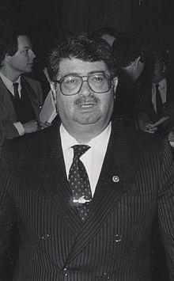
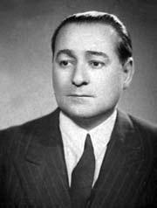
From Atatürk to Erdogan / Return of the Islam
Adnan Menderes - The Rise of Islam & 1960 Coup: Islam goes back and forth from present to absent
1976 – 1980 – The War of Right on the Left - Chaos, Economic Crisis, Coups
Revolution of 1980 - Secularism, Army and What’s in Between.
Turgut Ozal ("I am a Muslim - The State is Secular"):
Economic turnover: 19% growth in 1981
The 1990s. Gulf War: The Kurdish Uprising & the Economic Crisis
1996: Welfare, Justice and Development: Erbakan and Political Islam
1997: “The White Revolution”
2002 - Elections: IT IS THE ECONOMY

Slide 7
Rise of Erdogan: Reforms - The West and the Weakening of the Army
2002 - 2007 The Great Reformer
Demo Islam
Economic Reform
“Housing and Construction”: Economic Development and Growth
Economics, Higher Education, Infrastructure
2007 - 2013 Weakening of the Army, Erdogan and Fethullah Gülen

Slide 8
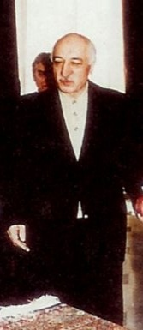
2013-2019: The Beginning of the End?
פֶטְהוּללה גוּלֵן (בעברית גם גילן; בטורקית: Fethullah Gülen; נולד ב-27 באפריל
2013 GEZI PARK Riot. ("The street against the regime")
2014 - Islamic coup d'état? "Gulen against Erdogan and his government"
2016 pro-Gulenist coup in the army "Gulen against Erdogan and his family"
2017 regime change and transition to authoritarian presidential regime
2019 Erdogan loses control of Ankara, Istanbul and major cities

Slide 9
Turkish Attribution Threats
Kurdish separatism
Russia - Problematic History vs. Present Saturated with Interests.
Iran - "Tight Tango Dance" and 400 Years of Peace.

Slide 10
Turkey - Foreign Relations: From "zero problems with neighbors" to problems with all neighbors
2003 "Strategic Depth": The Middle East and the Balkans - Neo-Ottoman "Hung Over Imperial"
From "Don't Taste of Damascus Sweets, lest I have to see the Arab's face" to - "Damascus, the gateway to the Middle East" and back ...: Assad is in love with the enemy.
The Arab Spring - "Broken Dreams” ("New Muslim Brotherhood Middle East")
Loneliness: “The Turk’s best friend is - Turkish."

Slide 11
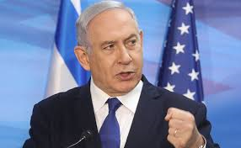
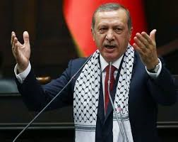
“Spill Your Internal Problems Outside"
“The Angry Man on the Bosphorus”:
Erdogan - Greece: "Lausanne agreements robbed from Turkey islands in the Aegean"
Erdogan - USA: "We Will Recognize the Native American Holocaust"
Erdogan - Europe: "We will only be accepted to the EU if we convert"
The West - Turkey: "Problematic ally"
Erdogan - Egypt, Saudi Arabia - Islamic Rift: Moderate Sunni – Sunni Muslim Brotherhood
And:
Erdogan - Israel

Slide 12
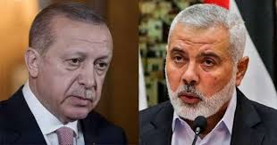
"Tell me who your friends are and I will tell you who you are"
Erdogan - Hamas
Erdogan's military adviser:
Turkey must help the Palestinians establish an army that can fight in Israel
Erdogan - Qatar: Turkey has established a military base in Qatar
Erdogan - Libya (Sarraje): Gas. Turkey is examining the establishment of a military base in Libya
Erdogan - Bashir (Sudan)

Slide 13
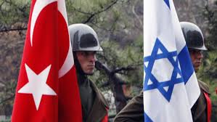
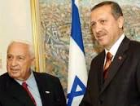
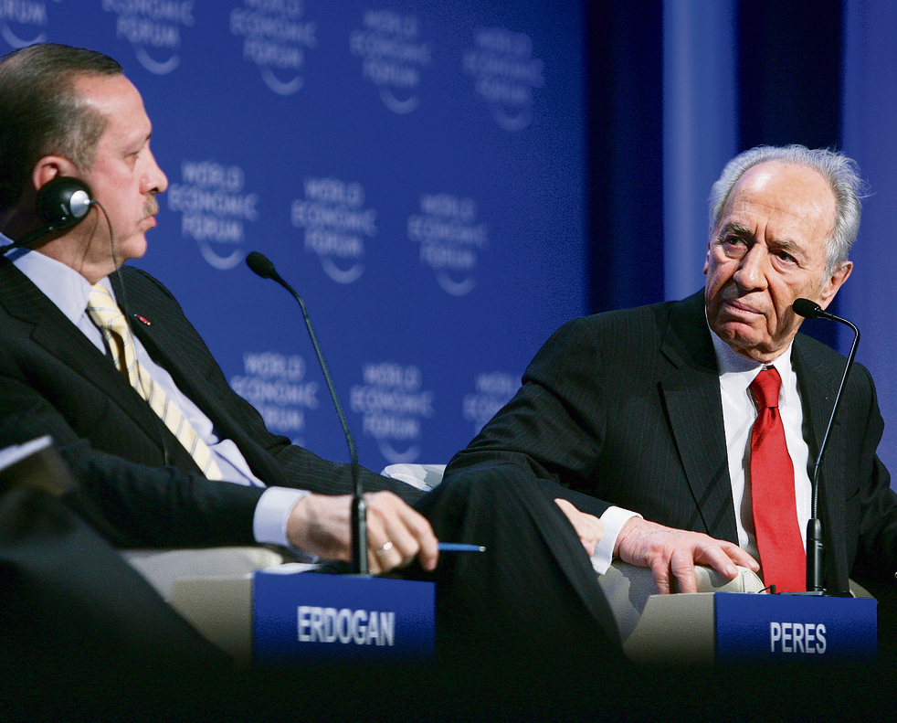
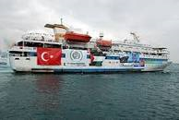
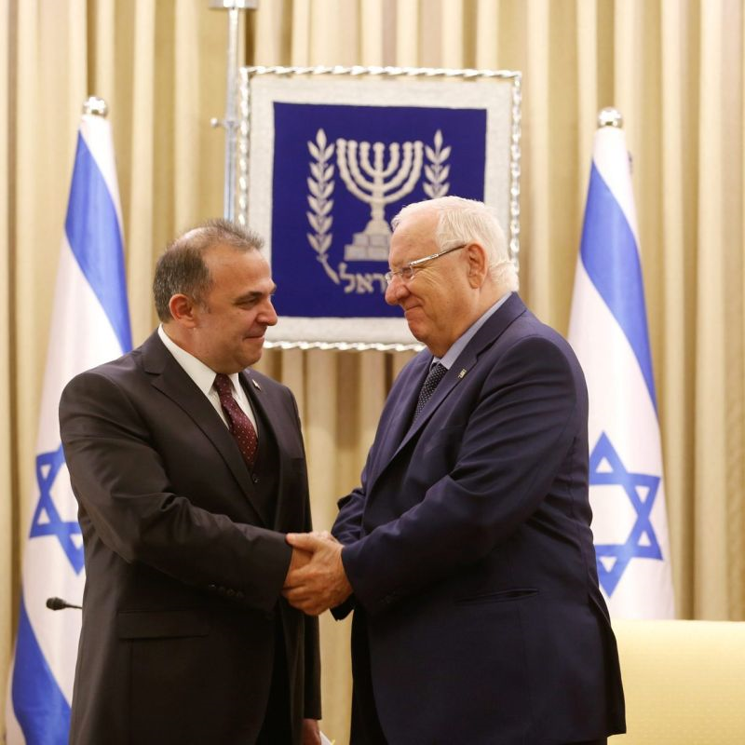
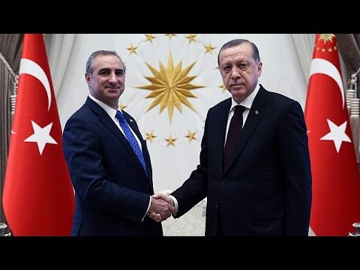
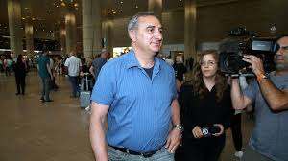
Turkey - Israel "or" with such friends, who needs enemies "...
1952 - "As far as Turkey is concerned, the army marches forward" (M. Sharett in his diary)
The 1958 Peripheral Alliance
"Honeymoon" in the 90's
2005 - The withdrawal from Gaza:
2006 - Second Lebanon War
2008 - "Cast Lead"
2010 - "The Marmara"
FRENEMIES- 2016 Interests / Gas
2018 - "LEAVE FOR A WHILE"
Ideological consideration is mounting

Slide 14
Gas in the Mediterranean : More To Come

Slide 15
What’s Next?
Q & A

