Slide 1
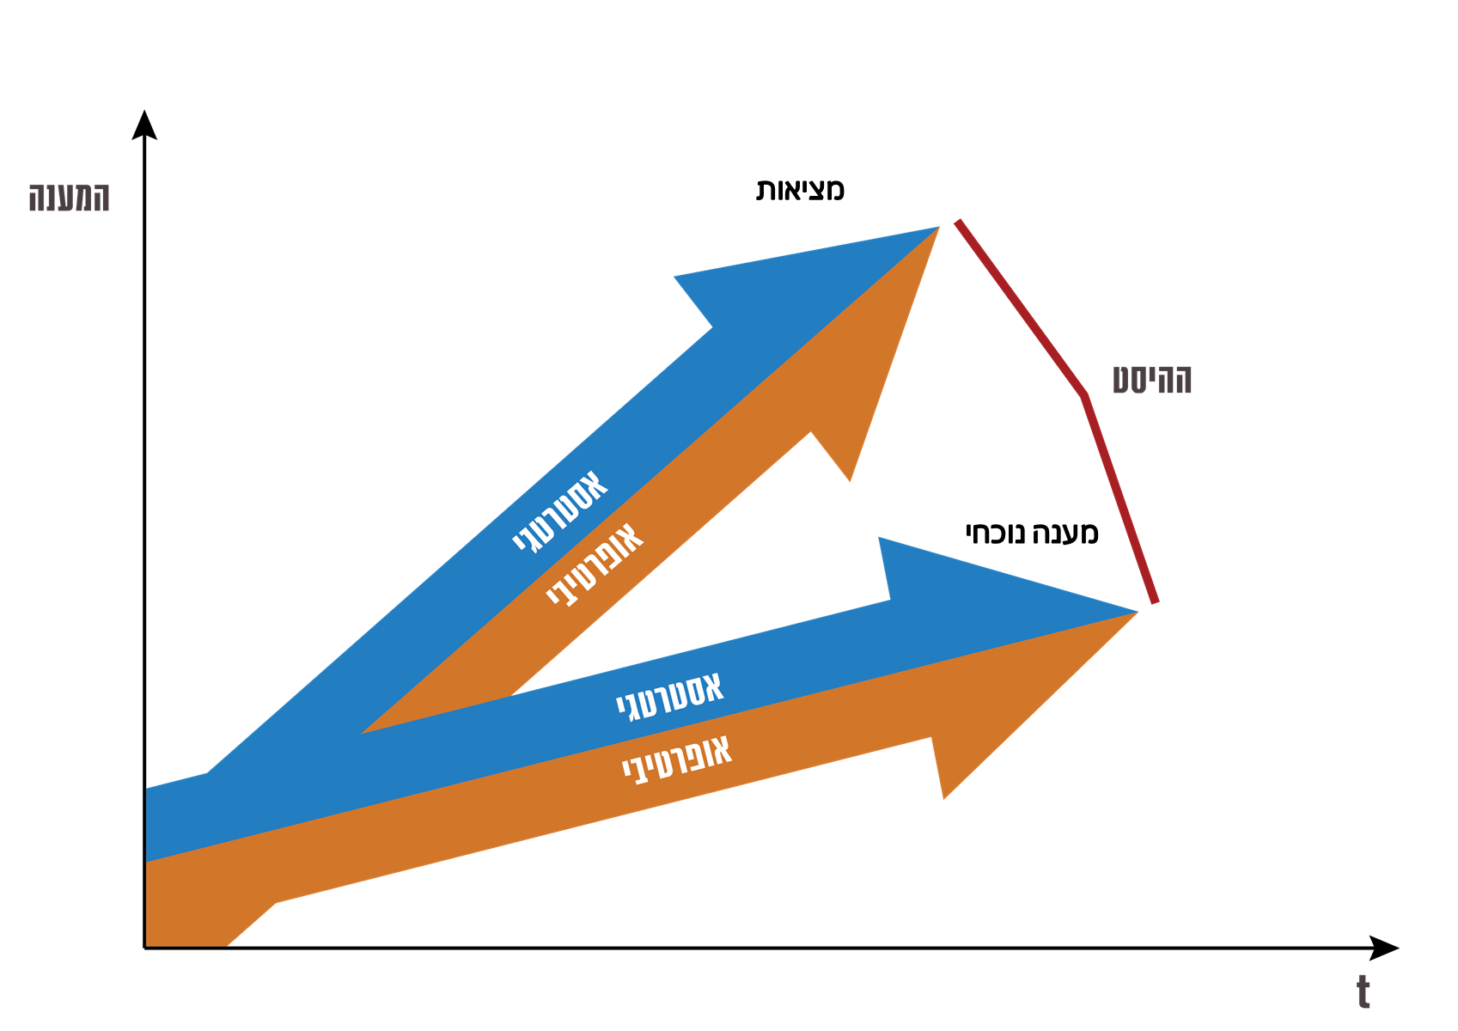
Strategic thinking in INDC
Reality
Response
Offset
Strategic
Current response
Operative
Strategic
Operative

