Slide 1
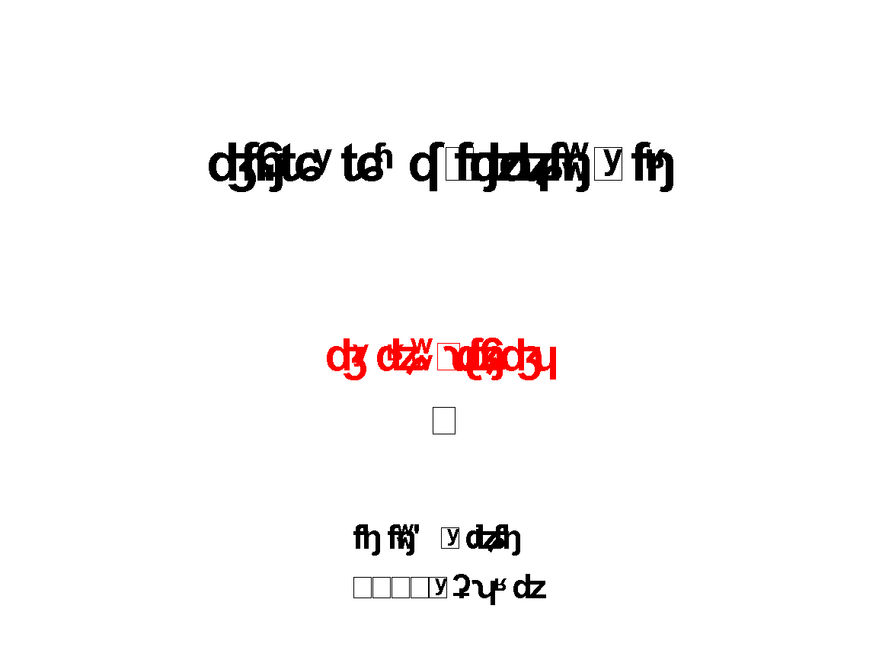
Strategic Studies Echelon
From Logic to Form
Lesson 3
2019 December
Notes:
1

Slide 2
CASE STUDY – TRANSFORMATION OF THE ISRAEL NATIONAL DEFENSE COLLEGE (INDC)

Slide 3
Lesson Content
What Bothers Us? – Make the discomfort evident
Genealogy of Learning at the INDC
INDC 2019 – On Offset (Relevance Gap) in the “Victory Workshop” era
The Way Forward – From System to Campaign, from Logic to Form
Key Concepts – Genealogy, Emergent System, Inherited System, Offset, Potentials, Opposition, System & Campaign, Initial Strategy

Slide 4
Intro to Strategy
Lessons 1- 2
Discomfort
Genealogy
Strategic Studies Echelon
Current Lesson (3)
Offset (Relevance Gap)
From System to Campaign
Lesson 4
Experience

Slide 5
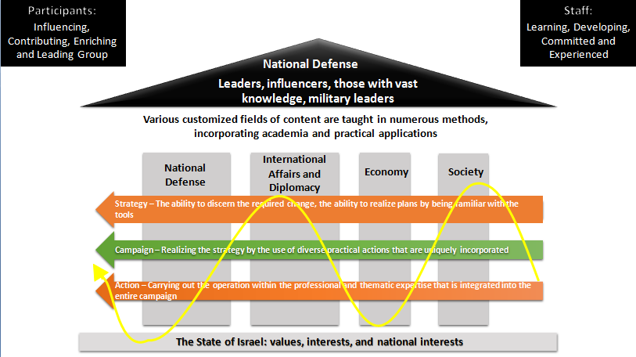
The Dilemma – How to Teach at the INDC?
?
Past
Future

Slide 6
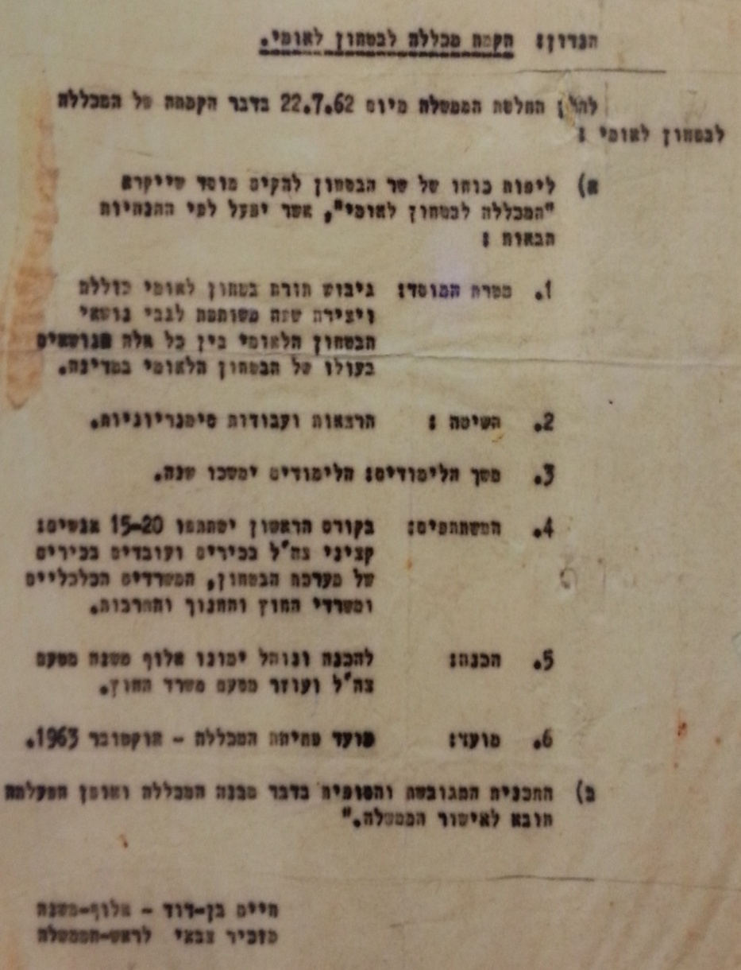
“Formation of a comprehensive national security doctrine and the creation of a common language regarding national security issues, among all those who bear the burden of national security in the country.” – Government decision of July 22, 1962.

Slide 7
Discomfort
Genealogy
Offset and Relevance Gap
Discomfort
From System to Campaign

Slide 8
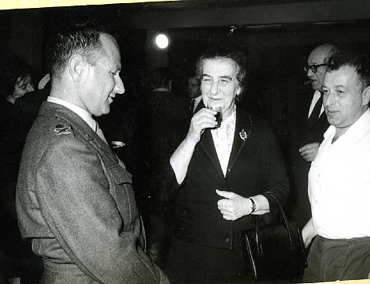
Meeting Leaders

Slide 9
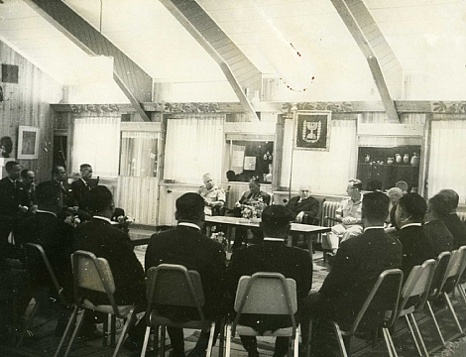
Plenary Discussions

Slide 10
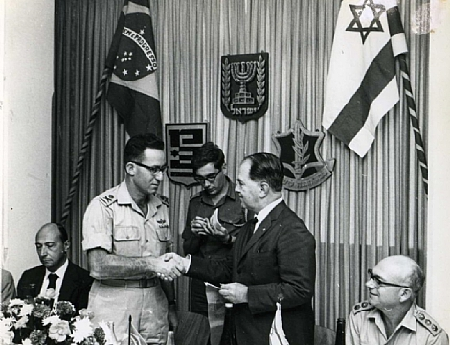
Discourse with Foreigners

Slide 11
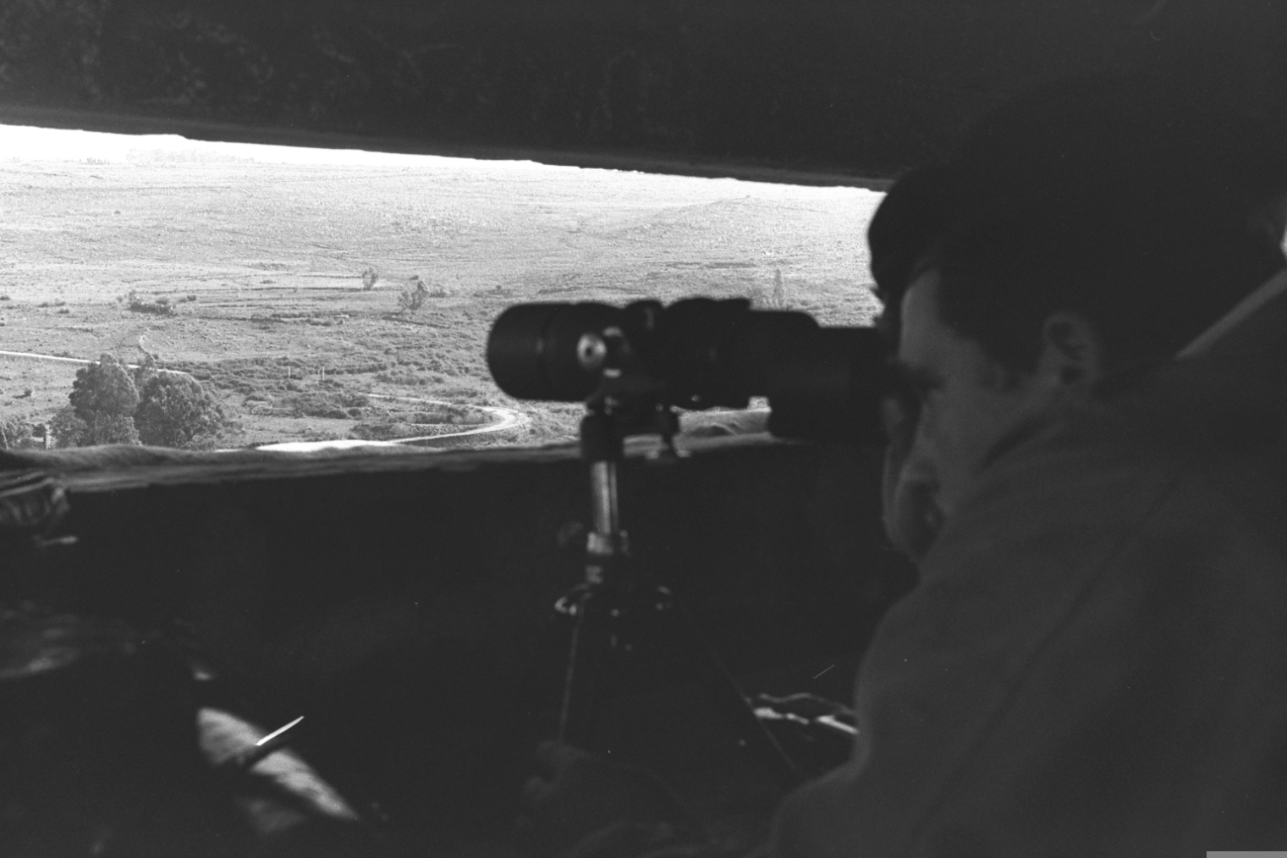
Border Patrols

Slide 12
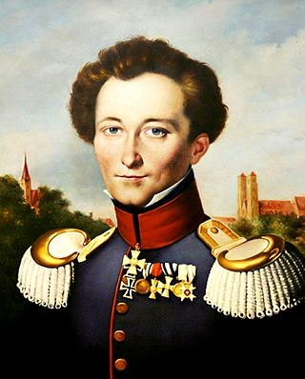
Learning Strategy

Slide 13
And in 2019…

Slide 14
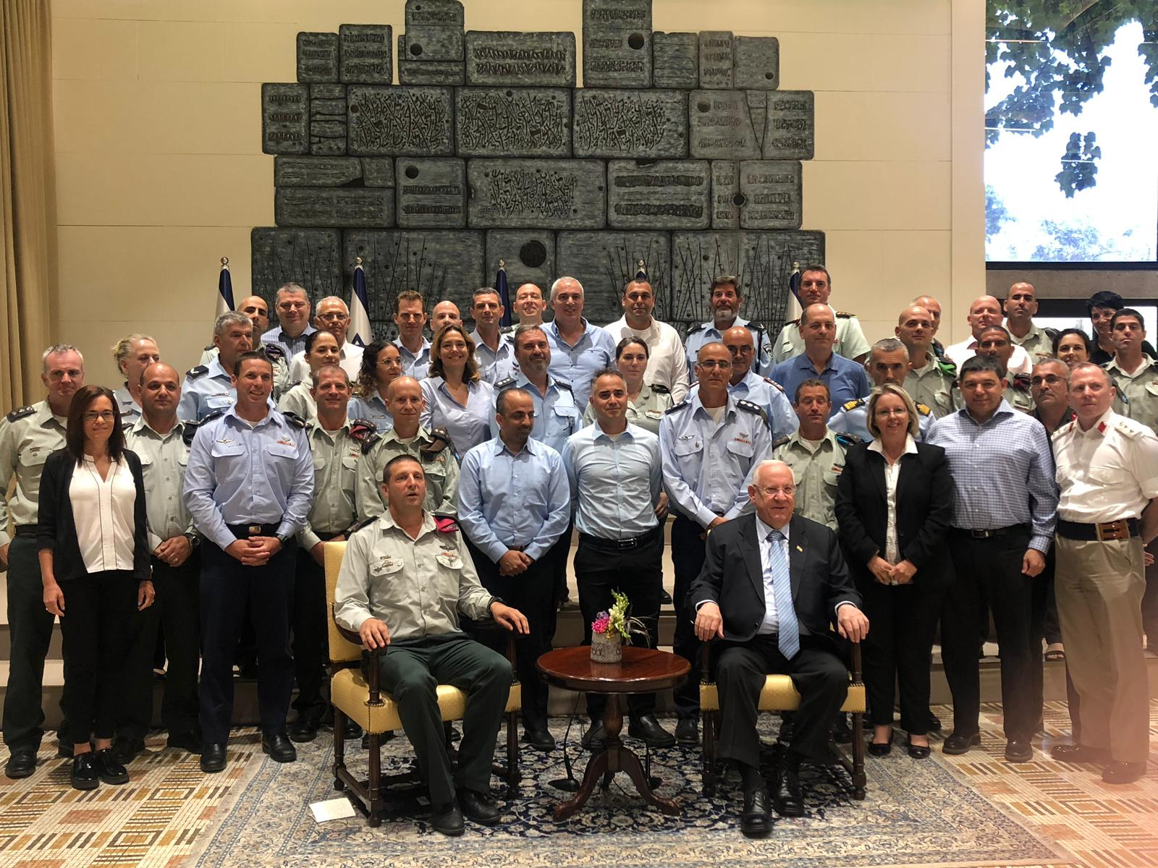
Meetings Leaders

Slide 15
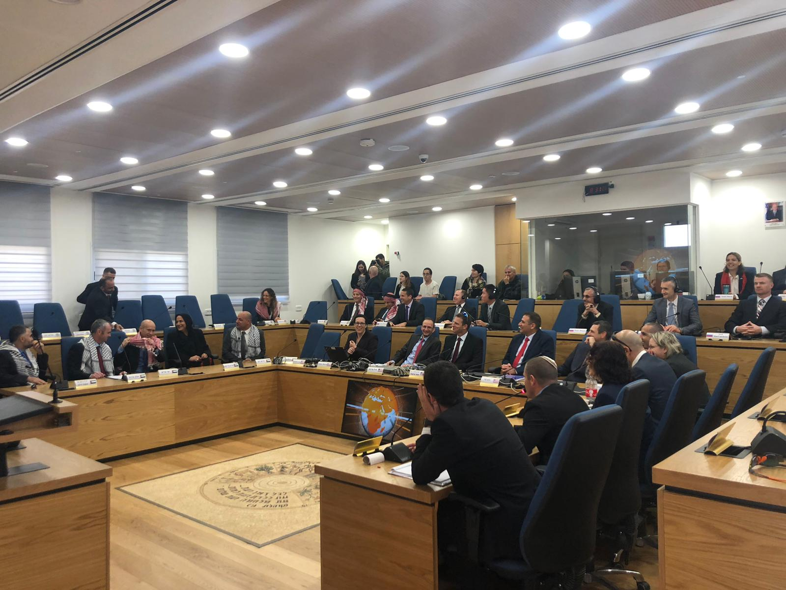
Plenary Discussions

Slide 16
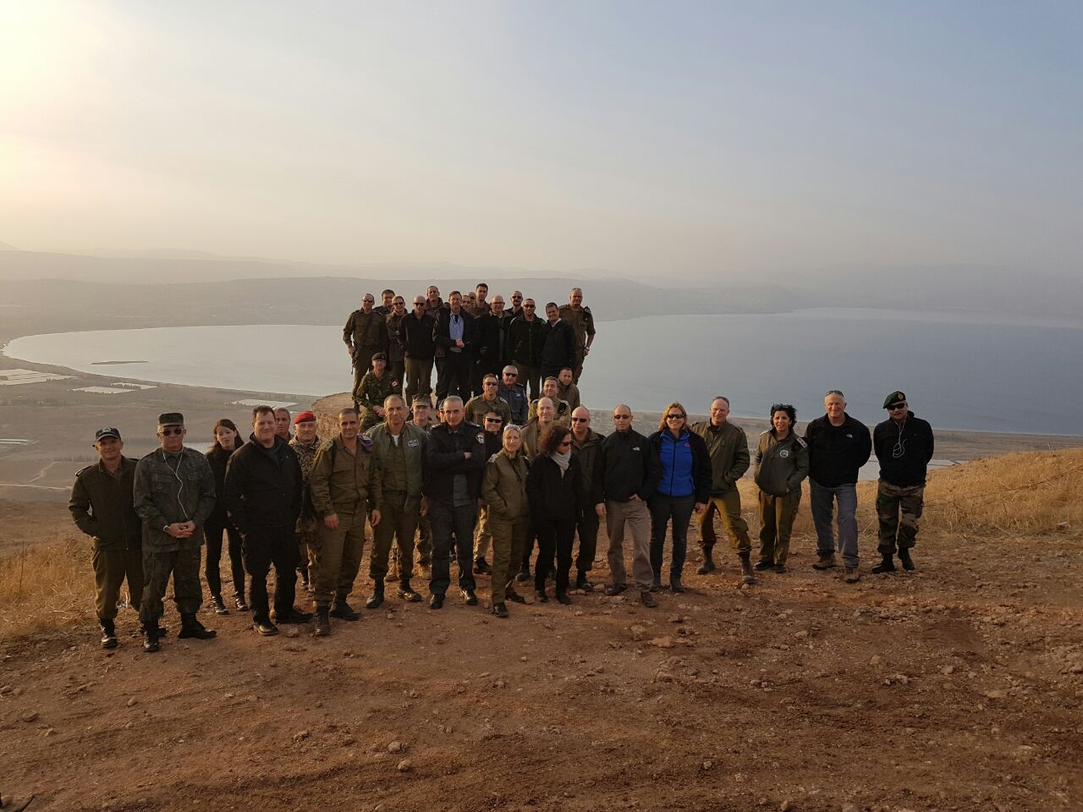
Patrolling the Borders

Slide 17
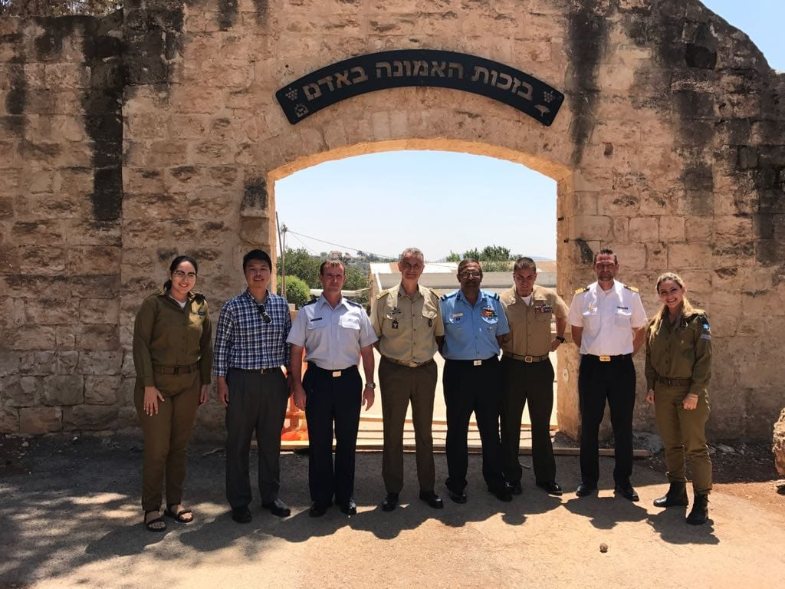
Discourse with Foreigners

Slide 18
Learning Strategy

Slide 19
Discomfort
Genealogy
Offset (Relevant Gap)
Genealogy of Commanders Learning at the INDC
(1995 – 2019)
From System to Campaign

Slide 20
Discomfort
Genealogy
Genealogy – A Critical-Developmental Historical Study. A Historical Description of Our Current Perception, Organization, and Action with the aim to Enable a Critical Discussion and to Change Them.
Offset (Relevant Gap)
גנאלוגיה של למידת מפקדים במב"ל (1995-2019)
From System to Operation

Slide 21
“Today's problems stem from yesterday's solutions.”3 According to this philosophy, in order to set the conditions for a critical discussion about ourselves, we must first find out the sources of our logic and “solutions” of today. To this end, a method of genealogical inquiry has been developed, designed to expose the premise failures hidden from the eye and to critically discuss them. In this method, we have dealt with clarifying the development of our organizational logic by looking at the timeline and systematically investigating the gap created between the circumstances in which organizational logic was shaped in the past and current circumstances.4
Aviv Kochavi and Eran Ortal, “Intelligence Case Study - Permanent Change in an Emerging Reality”, Bein HaKtavim 2, Dado Cener, July, 2014

Slide 22
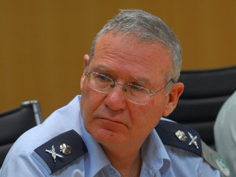
“As a result of the natural continuation of discussions on the future of the INDC...; The INDC is supposed to teach the strategic level of the military profession ...”
From - Summary of a Strategic Workshop at the Israel National Defense College, headed by Gen. (res.), Amos Yadlin, October 2002

Slide 23
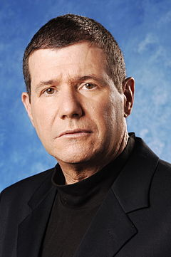
“...Will put an emphasis on developing systemic thinking ... with the aim of improving the ability to analyze and understand large systems and their connections.”
Maj. Gen. (Res.) Eyal Ben-Reuven, 2004

Slide 24
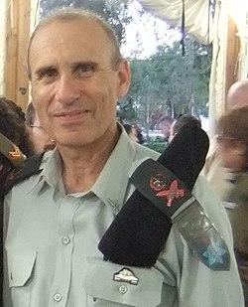
“What should be taught? You are taught to consciously think about the wide range of activities in the military and in the country... cases that demonstrate the appropriate way to think and act in an event of strategic dimensions ...”
Maj. Gen. (Res.) Gershon Hacohen, 2011

Slide 25
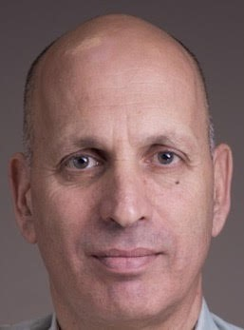
“Developing strategic and systemic thinking among the learners who are part of the senior leadership in the national security systems in Israel ... and to make them significant partners in shaping the national security of the State of Israel.”
From the opening presentation for the 41st class under the command of Maj. Gen. (res.) Yossi Baidatz (2012/2013)

Slide 26
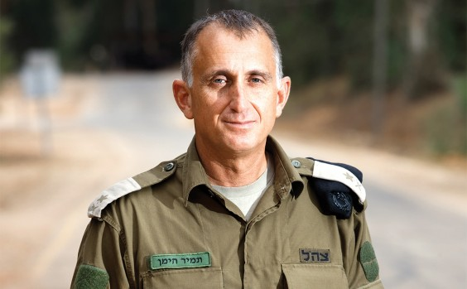
"The strategist... is capable of sustaining an advanced thinking and learning process through which he explores reality and tries to understand it... Understanding enables him to discern relevancy gaps... To properly and intelligently define his objectives...”
Maj. Gen. Tamir Heyman, “Spirit of the Military Colleges" Document, 2017

Slide 27
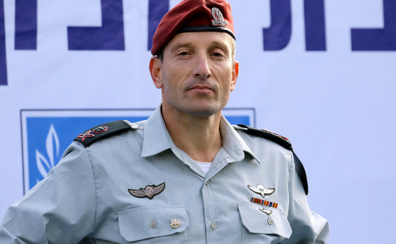
“... It has to be honestly said that to some extent the IDF is a non-intellectual army ... its officers lack the theoretical foundation ...”.
“Strategy is not only the living spirit of the place and an ideal imperative that looks to the future, but also the way in which we strive to adapt the action to the required reality and the necessary changes...”.
Gen. Amir Baram, “On The Balcony“ Document, 2018

Slide 28
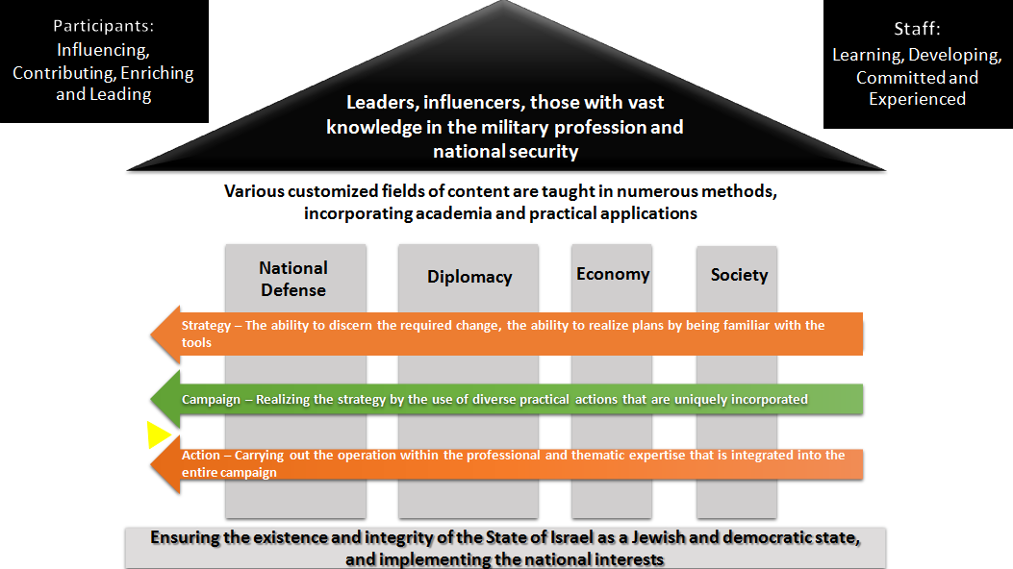
The visual image of the INDC Course ("The Pantheon") since 2015

Slide 29
Strategy Learning at the INDC
Design-based strategic thinking
(Epistemology)
Courses on the art of war, systemic approach and strategic thinking (Epistemology)
Courses on the art of war and systemic thinking
(Epistemology)
Courses on the Art of War (Epistemology)
War and Strategy Course (Ontology)
Strategy Course (Ontology)
1995-2002
2002-2006
2006-2011
2011-2015
2015-2019
Period

Slide 30
Continued increase in volume ("load") of Strategy Studies (content and ways of thinking)
Strategic Studies at INDC
Design-based strategic thinking
(Epistemology)
Courses on the art of war, systemic approach and strategic thinking
(Epistemology)
Period C -Learning as Strategists?
Period B - Strategic Studies
Courses on the art of war, systemic approach (Epistemology)
Courses on the art of war (Epistemology)
Period A -"Strategic" content
Strategy & war Course (Ontology)
Strategy Course (Ontology)
1995-2002
2002-2006
2006-2011
2011-2015
2015-2019
Period

Slide 31
Insights from Newsletter Analysis by LTC Oren Shoham (2002/3-2016/17):
Less choice and depth
Less independent research
Less flexibility (workload as a guiding principle, more content and more tours)
Conservatism and Continuity (Content, assignments, weekly schedule structure)
What is being taught at the INDC?
Newsletter Analysis
LTC Oren Shoham

Slide 32
Discomfort
Genealogy
Offset (Relevance Gap)
Offset (Relevance Gap)
From System to Campaign

Slide 33
Discomfort
Genealogy
Offset (Relevance Gap) – The subjective meaning that provides the key of knowledge to the gap created between our current perception and its period, in relation to the new situation.
Offset (Relevance Gap)
Offset (Relevance Gap)
From System to Operation

Slide 34
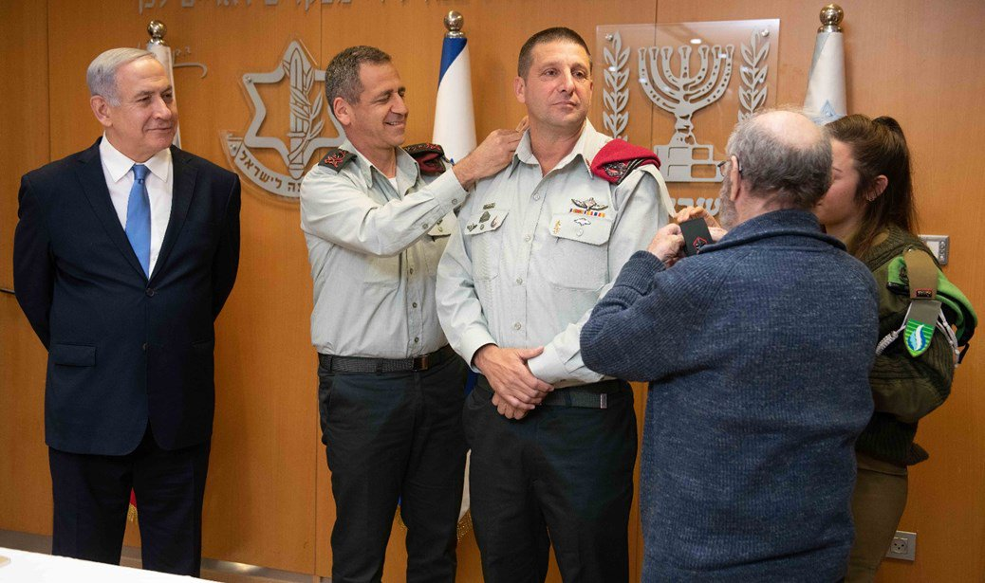
Appointment to the Position of Commander of the Military Colleges in March 2019

Slide 35
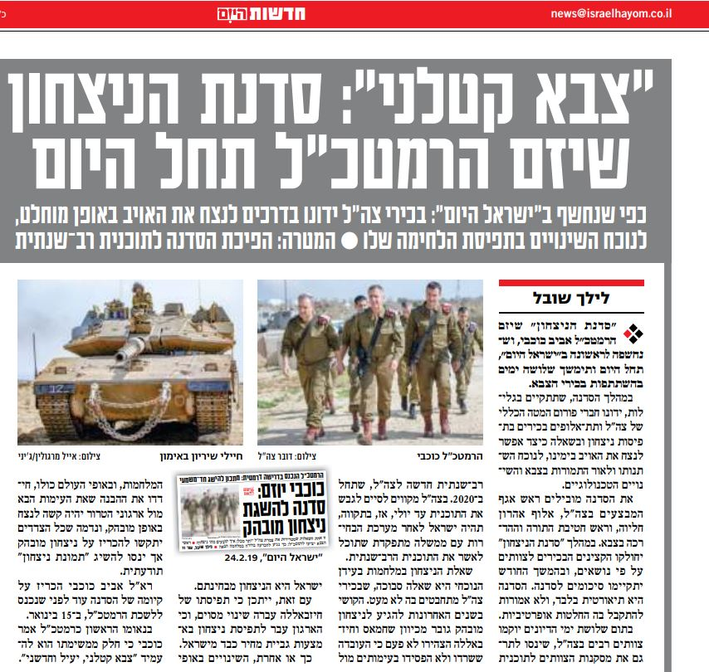
The Victory Workshop in 2019 as a Challenge and as an Opportunity (Potential)
“A Deadly Military”: The Victory Workshop initiated by the Chief of Staff will Begin Today

Slide 36
30 Years of Operations
The Victory Workshop

Slide 37
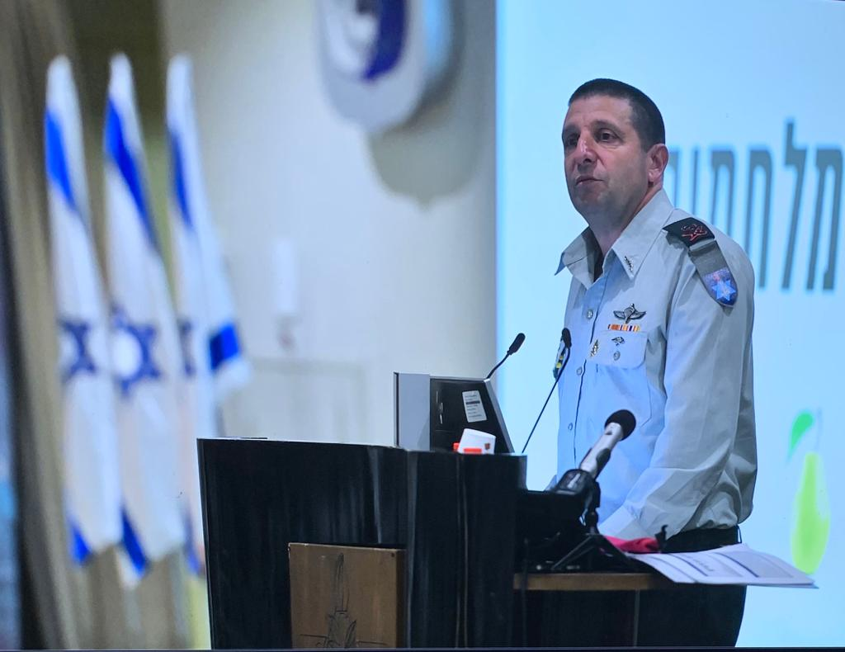

Slide 38
Offset 3
Stemming from a strategy of reducing friction we chose to avoid deep and decisive attacks on enemy territory.
We chose a “standoff war”
In an ongoing process, the enemy moves the war to the Israeli border through fire, then deepens it to the heart of the state, and is currently developing its concept of a maneuvering offensive to conquer communities. The enemy moved the war to our territory.

Slide 39
The Paradigm Tension
UAV
Logical Heritage -Destruction of high - powered Syrian armored combat vehicle
Adjustments to the changing scenario – attack cells at the Northern Command, warheads aimed at individuals, “Roof Knocking”
Missile Guidance
Logical Heritage - Destruction of Syrian Army Command Infrastructure in the Golan Heights
Adjustments to the changing scenario – target bank of Hezbollah and Hamas infrastructures
Advanced Tanks
Logical Heritage –
An armored means of maneuvering during battle in open spaces
Adaptations to the changing scenario – Anti-individual munitions, active shielding, control and command

Slide 40
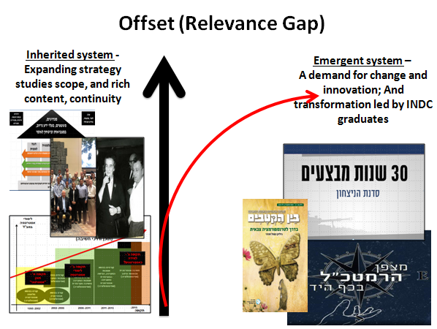
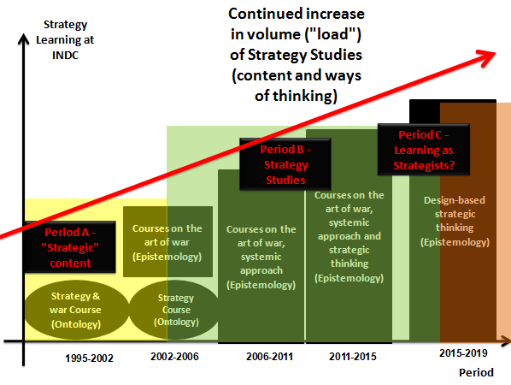
Offset (Relevance Gap)
Inherited system – Expanding the scope of strategic studies scope, and rich content, continuity
Emergent system –
A demand for change and innovation; And transformation led by INDC graduates

Slide 41
Offset (Relevance Gap)
Inherited system - Expanding strategy studies scope, and rich content, continuity
Emergent system –
A demand for change and innovation; And transformation led by INDC graduates
Inherited System – Our Organizational and Conceptual Heritage (Legacy).
Emergent System – The New Emerging Circumstances.

Slide 42
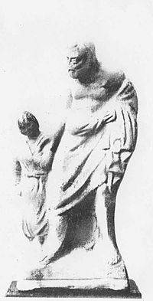
Between Pedagogy and Independent Adult Learning
The Learning Adult (Androgyny)
Pedagogy

Slide 43
Offset (Relevance Gap)
Heritage system - Expanding strategy studies, scope and rich content, continuity
While strategic studies (which were prolonged) encourage students of the INDC to adopt the practices of “senior learning”, “responsibility for learning” and “military leadership”, the form of learning has remained largely the same – structured courses, passive lectures, academic assignments and exercises in large groups. We add more hours, but teach less creative, independent and critical thinking capabilities for the military leader.
Spirit of the Chief of Staff and Changes in the IDF, as depicted in 2019 (Victory Workshops, concept of operation), require the training of independent and creative senior executives.
The nascent system - a demand for change and innovation; And transformation led by graduates

Slide 44
What Will Allow Me to Make a Change?
Discomfort
Genealogy
Offset (Relevance Gap)
From System to Operation

Slide 45
What is the System?
Warfare Intelligence Based
Urban Warfare
Changes in the Pace of Technological Change
Technological
Revolution 4.0
Cyber as a dimension and tool of warfare
RMA 4.0
INDC
Long Range Fire
Transition to Jerusalem
Commander Exchange
Pedagogy
Material
Instability in the Instruction faculty
Change of Material in MA Degree
Competitive Programs
Polarity & social atomization in Israel
“Victory Workshop”
Gideon Multi-Year Program & momentum
Continued regional fluctuations
Transition to Multi-Polarity

Slide 46
What is the System?
Warfare Intelligence Based
Urban Warfare
Changes in the Pace of Technological Change
4.0 Technological Revolution
Cyber as a dimension and tool of warfare
RMA 4.0
INDC
Long Range Fire
Transition to Jerusalem
Commander Exchange
Pedagogy
Material
Instability in the Instruction faculty
Change of Material in MA Degree
Competitive Programs
Polarity & social atomization in Israel
“Victory Workshop”
Gideon Multi-Year Program & momentum
Continued regional fluctuations
Transition to Multi-Polarity

Slide 47
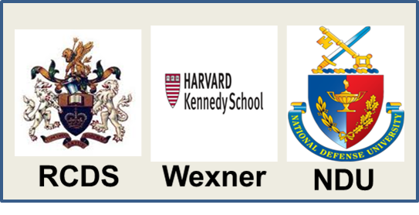
What is the System?
Warfare Intelligence Based
Urban Warfare
Changes in the Pace of Technological Change
Technological
4.0 Revolution
Cyber as a dimension and tool of warfare
RMA 4.0
INDC
Long Range Fire
Transition to Jerusalem
Commander Exchange
Pedagogy
Material
Instability in the Instruction faculty
Change of Material in MA Degree
Competitive Programs
Polarity & social atomization in Israel
“Victory Workshop”
Gideon Multi-Year Program & momentum
Continued regional fluctuations
Transition to Multi-Polarity

Slide 48
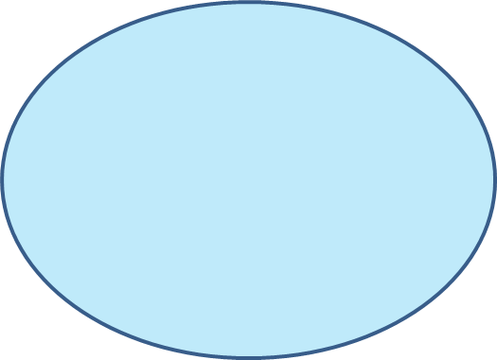
“System Boundaries”
Warfare Intelligence Based
Urban Warfare
Changes in the Pace of Technological Change
Technological Acceleration
Changes in the Phenomenon of War
4.0 Technological Revolution
Cyber as a dimension and tool of warfare
RMA 4.0
INDC
Long Range Fire
Transition to Jerusalem
Commander Exchange
Pedagogy
Material
Instability in the Instruction faculty
Organizational & Management Changes
Change of Material in MA Degree
Competitive Programs
Polarity & social atomization in Israel
“Victory Workshop”
Transformation in IDF
Multi-Year Program Gidon & momentum
Continued regional fluctuations
Geo – Political Changes
Transition to Multi-Polarity

Slide 49
“Boundaries of the Campaign”
Warfare Intelligence Based
Urban Warfare
Changes in the Pace of Technological Change
Technological Acceleration
Changes in the Warfare Phenomenon
4.0 Technological Revolution
Cyber as a dimension and tool of warfare
Boundaries of the campaign – While the boundaries of the system allow us to understand through framing/delineation, the boundaries of the campaign delineate the system components that I want and can influence.
RMA 4.0
Fire Against
INDC
Transition to Jerusalem
Commander Exchange
Pedagogy
Material
Instability in the Instruction faculty
Organizational & Management Changes
Change of Material in MA Degree
Competitive Programs
Polarity & social atomization in Israel
“Victory Workshop”
Transformation in IDF
Multi-Year Program Gidon & momentum
Continued regional fluctuations
Geo – Political Changes
Transition to Multi-Polarity

Slide 50
Potentials
Exploiting the potential of participants
Initial Strategy
Academic load reduction & increasing freedom of choice
Adapting the learning characteristics of INDC (the form) to a perception (logic) based on learning that enables the development of knowledge and perceptions in the face of constant (and accelerated) processes in the commander’s environment.
Constructing independent learning
Providing methodological knowledge and methodological tools for technological change
Changing and diversifying learning methods (from plenum to teams and back)
Self - Adaptation
Openness to self-criticism

Slide 51
Potentials
Exploiting the potential of participants
Initial Strategy
Academic load reduction & increasing freedom of choice
Adapting the learning characteristics of INDC (the form) to a perception (logic) based on learning that enables the development of knowledge and perceptions in the face of constant (and accelerated) processes in the commander’s environment.
Potentials - The range of positive and negative possibilities inherent in the nascent system that should be used to influence them for our benefit.
Constructing independent learning
Providing methodological knowledge and methodological tools for technological change
Changing and diversifying learning methods (from plenum to teams and back)
Self - Adaptation
Openness to self-criticism

Slide 52
Potentials
Exploiting the potential of participants
Initial Strategy
Academic load reduction & increasing freedom of choice
Adapting the learning characteristics of INDC (the form) to a perception (logic) based on learning that enables the development of knowledge and perceptions in the face of constant (and accelerated) processes in the commander’s environment.
Initial Strategy - General lines and principles for a strategy or different alternatives to a strategy that will serve our interests.
Constructing independent learning
Providing methodological knowledge and methodological tools for technological change
Changing and diversifying learning methods (from plenum to teams and back)
Self - Adaptation
Openness to self-criticism

Slide 53
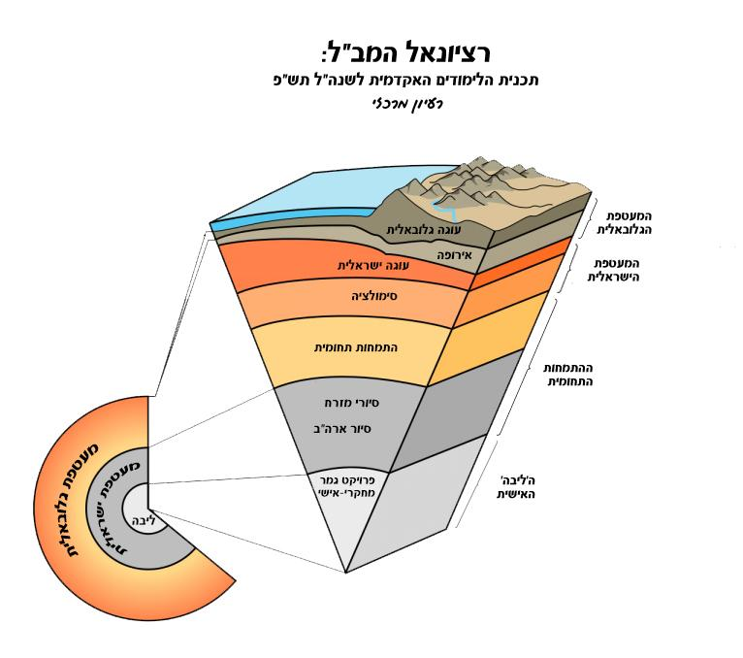
Contrast – An Important Tool for Implementing the Initial Strategy

Slide 54
Contrast – An Important Tool for Implementing the Initial Strategy
Contrast- A critical discussion of the initial strategic idea with an aim of improving it. The idea must be attacked, for example, by discussing the various barriers that may impair its implementation.

Slide 55
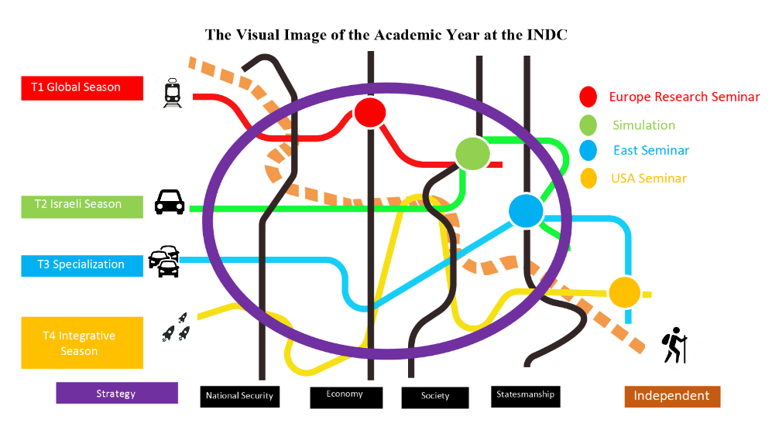
From Logic to Form (The Plan)
From the 2019 INDC Rational Presentation
Strategy

Slide 56
From Logic to Form (The Plan)
From the 2019 INDC Rational Presentation
The process of formulating a concept that answers the question of what will enable the strategy to be implemented, including the organizational forms, forms of operation and fundamental changes that are needed in the force.
Strategy

Slide 57
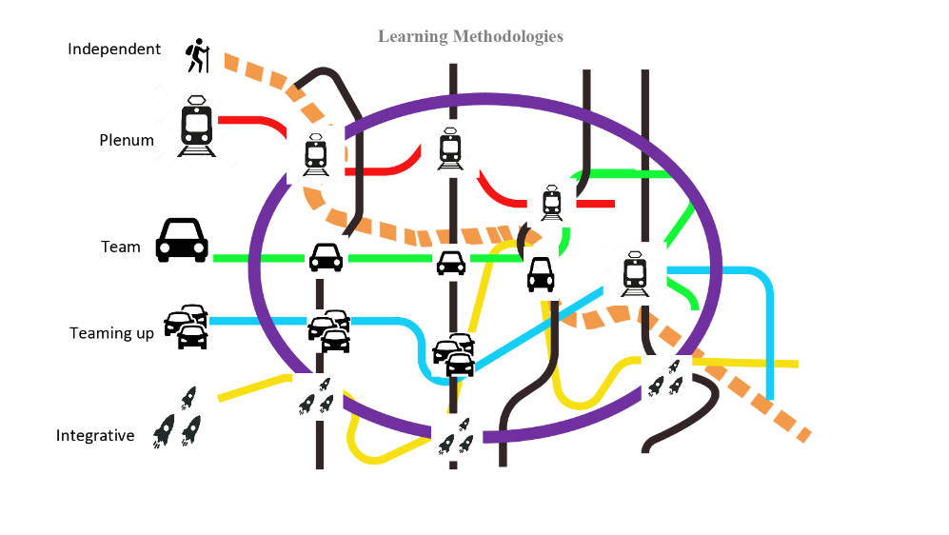
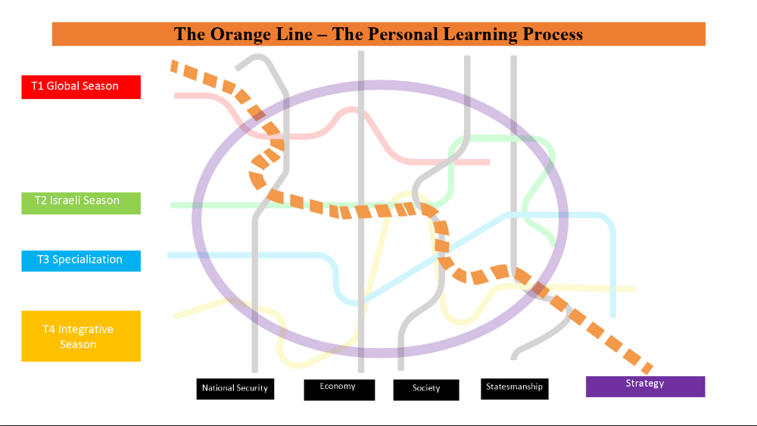
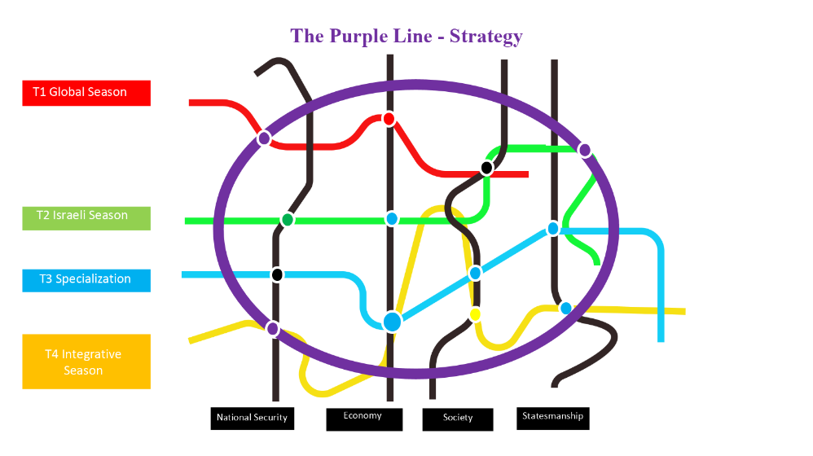
Are We Changing Enough?

Slide 58
Summary
Defining an Offset (Relevance Gap ) of the INDC
Genealogy of Strategic Learning at the INDC
Embarrassment
“More of the Same”
From Logic to Form; Operative Concepts
Defining initial strategy and identifications of potential
Defining the system and the campaign

