Slide 1
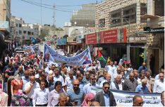
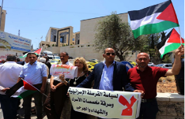
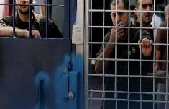
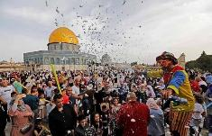
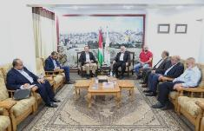
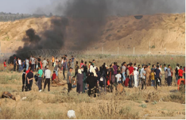
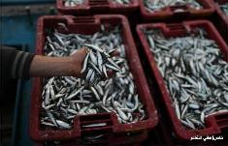
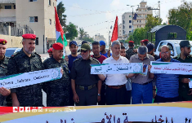
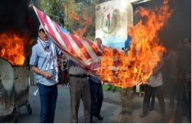
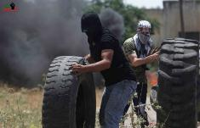
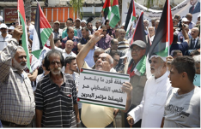
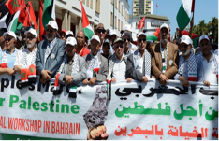
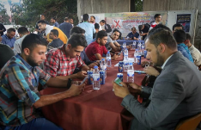
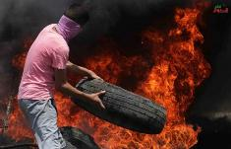
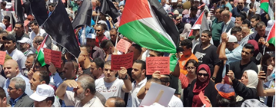
Judea & Samaria
January 22nd, 2020
Coordinator of the
Government Activities in the Territories
שמור |
מחלקת מבצעים ויע"פ/ ענף מבצעים | הערכת מצב שנתית – רמטכ"ל

Slide 2
Data
Territory
Demographics
22 Government Offices
28 Government Authorities
5 Security Mechanisms
24 Courts of Justice
5m Palestinians in the “Territories”
(3 Judea & Samaria, 2 Gaza)
51 Hospitals
587 Clinics
1.3 beds per 1000
Approx. 1,000,000 Young People in Judea & Samaria
(aged 15-29)
Social Media
3.9 Facebook Users
Education
2,200 Schools
55 Higher Education Institutions

Slide 3
Economy and Trade in Judea & Samaria
Foreign aid has decreased from 4.5b NIS in 2014 to 2b NIS in 2019
Main Factors
Indicator
2018
2019
GDP growth has slowed down (in 2018, GDP per capita decreased to 0.1% as opposed to 1.9% in 2017) we believe that in 2019, it will remain around 0%).
Continued decline in unemployment rates – 13.3% as opposed to 17% in the same quarter of the previous years.
Record of employment in Israel (approx. 90,000)
GDP per Capita
1st-3rd Quarters
$ 3,588.1
$ 3,588.5
Foreign trade: import/export negative ratio – import is *5 higher than export (mainly Israeli)
Employment Rates
3rd Quarter
17.0%
13.3%
Growing contribution of Israeli Arabs to the Judea & Samaria economy. (Approximately 4,000,000 vehicles per year; 3b NIS per year revenue)
Average Daily Salary
3rd Quarter
110.4 ₪
127.8 ₪

Slide 4
Employment in the Palestinian Authority – Third Quarter 2019 vs. Third Quarter of 2018
%
24.6%
13.3%
45.1%
Unemployment Rates
(26.9%)
(17.0%)
(45.9%)
334,100
117,000
217,100
(353,300)
(147,000)
(206,300)
Unemployed Quantity
1,005,500
750,900
254,600
(938,450)
(702,900)
(235,550)
Employed Quantity

Slide 5
Government “Octopus” – Chairperson to Citizen
PA Chairperson
Supreme Justice Council
Palestinian Government
Advisers
Legislative Council
Main Government Officers -22 (Ramallah)
Justice Ministry
Courts
Governors (11)
Legislating Bureau
Prosecution
Authorities and Government Associations
Local Councils
District Government Offices
Security Mechanisms
Infrastructure System (Water, Electricity)

Slide 6
Connections Between Israel and the PA
Trade
Banking
Defrayal Funds
In 2018, the scope of import from Israel is ~ 3,308 million dollars. The scope of export to Israel is ~ 1,097 million dollars
Corresponding ties between banks in Israel and the Palestinian Authority
Approx. 8 billion NIS per year; 6 after offset
Civilian Coordination
Security Coordination
Employment
Governmental offices, passageways, movement, permits, infrastructure and more
Coordinating Palestinian Police activity, sharing intelligence, extraditing weapons etc.
About 90,000 Palestinian workers in Israel, and about 35,000 in settlements
Health System
Palestinian Movement in Israel
Infrastructure & Fuel
Palestinian patients receiving treatment in Israel
Electricity – 4700 mA per year
Water – 70 million cubic meters per year
About 20 million passages (entering and exiting) annually through all Judea & Samaria passageways

Slide 7
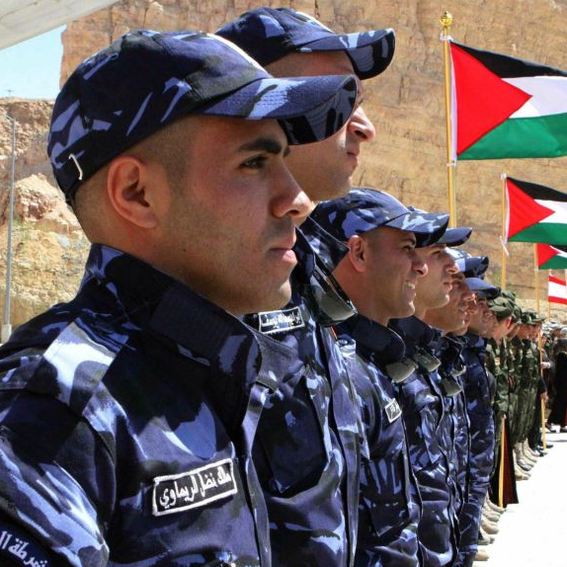
Mechanisms and Security Coordination
Security Coordination (2019)
Data
698 coordination meetings
5 Mechanisms
8,494 Activity Coordinations
11 Districts
2,948 arrests against Hamas
30,000 operatives
422 weapons extraditions
A directive that opposes terrorism and violence by Abu Mazen
“Leapfrog” in professionalism and in the capabilities of the mechanisms
Security coordination – shared interest, disconnected from political strife

Slide 8
Strategic framework
Regional attentiveness is marginal
All about Iran
PA-Israel Relations
“Crisis follows
crisis”
A System on Hold
Israel Elections
US Elections
PA Elections
Deal of the Century
External
Financial challenges in the PA, economic stability in the public
Challenges in governance-public relations
“Semi-State” System
A decade since the establishment of the government facilities
Internal

Slide 9
The Stability Triangle in the PA
Political Horizon
Stagnation
שחקן חדש בשכונה – אשתיה (DNA פוליטי) המייצר כללי משחק חדשים
Coordination
(Security and
Civilian)
Economic Condition
יציבות בתיאום
"מכות בכנף"
דה-לגיטימציה ציבורית
כספי הסילוקין
"קיפאון" בהסכמי פריז
דשדוש כלכלי
לקראת אתגרים משמעותיים (היום שאחרי, פרסום תכנית המאה) - נדרשת יציבות במרכיבים הנ"ל כדי "לעבור את הסיבוב"

Slide 10
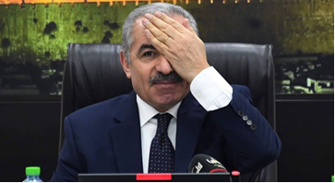
Mohammad Shtayyeh’s Plan
Disengagement from Israel and reducing economic
dependency on Israel.
Increasing productivity capacities of the Palestinian economy.
Dividing the West Bank into designated investment and development clusters.
Diversifying import sources.
Strengthening trade ties with Arab countries.
Erasing the artificial lines of areas A, B and C.

Slide 11
Political layer – scope of operation
Aggressive Hostility
Claiming a Price from Israel
Israel’s Moves
Legal Campaign
Diplomatic Campaign
Compromising Coordination
Encouraging and Promoting Terror
Secession of Security Coordination
Cancelling Paris Protocol
Encouraging Resistance
Economic Boycotts
In the absence of a significant change in the status quo by Israel (with emphasis on annexation of Judea & Samaria and the Valley), the PA will continue to operate in the "legitimate" resistance space, while “testing the waters" and attempting to expand its limited variety of tools, yet without resorting to escalating means
Survival mode and unwillingness to deepen crises

Slide 12
Relationship between the Judea & Samaria and Gaza Strip systems
Repercussions on Judea & Samaria of actions to maintain a state of calm in Gaza
(“The righteous suffer while the wicked prosper”)
Elections? Deep crisis in the reconciliation process
Increased Abbas sanctions – undermining civic stability

Slide 13
Internal Arena Between ‘the morning after’ and the elections
Has managed to get his own people into key positions in Fatah and PA institutions and he maintains power bases in the secret service
Enjoys his closeness to PA decision-making centers and influence on Abbas. Shtayyeh- "black horse"?
Camp Faraj-
Aloul-
Alsheikh
Camp Rajoub
*Shtayyeh
His status in prison was compromised and his associates were removed from decision-making centers.
The "prisoner's aura" allows him to continue to enjoy consistent public support in the polls
Strengthens its status in the Gaza Strip and enjoys some support in the refugee camps in Judea & Samaria, despite the removal of his loyalists from key positions in the Fatah
Camp Bargouti
Camp Dahlan
The active wait of all players continues to be reshaped by the PA system - whether through elections or following the disappearance of Abbas. All factors will continue to "improve positions" without challenging Abbas’ power

Slide 14
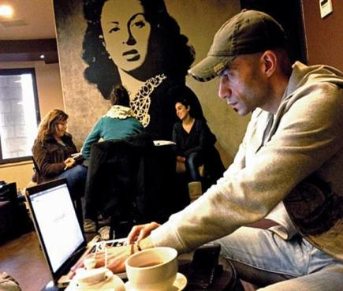
Trends in the Judea & Samaria Public
מיקוד בשימור מרקם החיים, והעדפת היציבות בשטח על קידום המאבק הלאומי
ניכור מול ההנהגה,
הנתפסת כמושחתת ומסואבת
הדור הצעיר - דור אוסלו החצוי, "זכרון טראומה קולקטיבי" מוגבל
תמיכה עקרונית בלעומתיות מול ישראל ללא נכונות לשלם המחיר הכרוך בה
חוסר אמון גובר באפשרות מימוש "חזון שתי המדינות" והתחזקות גישת "המדינה האחת"
(מ6% 2014 ל 19% ב 2018)
אכזבה "מבגידת" העולם הערבי והפנמת מגמת הנורמליזציה
הגישה הפרגמטית-אינדיבידואליסטית, המיקוד במרקם/איכות החיים, הניכור מול ההנהגה והניתוק הגובר מול הרצועה, דוחקים את המאווים הלאומיים לשוליים ומקטינים את הסבירות להתפרצות עממית רחבה.

Slide 15
Stabilizers and destabilizers
Economy
Stabilizers
Destabilizers
Employment at its peek
REDUCTION OF INTERNATIONAL AID
העדר אופק מדיני
Trade with Israel
NOT A TOP INTERNATIONAL PRIORITY
העברת השגרירות
Institutions
ENTRY OF Israeli arabs
עסקת המאה
CHOSING LIFE
השלכות ההרגעה על הרש"פ
Coordination
החלטות ישראל
ANTI-VIOLENCE DIRECTIVE
תיאום יציב וחזק
משבר עגלים
כספי סילוקין
שת"פ בשטח למרות המשבר בהנהגה
STRONG MECHANISMS
באב אלרחמה
משבר חברון
כניסה ל A
מערכה על C
STABLE GOVERNMENT INSTITUTIONS
פשיעה לאומנית
משבר חשמל
Civilian crises are potential security destabilizers

Slide 16
Judea & Samaria – Bottom Lines
1
Era of “unilateral decisions” created challenges and crises over time
2
Election Year (US, Israel and possibly the PA) – the systems enters a waiting period
3
Assuring the PA – “Relief to Hamas and a Siege on the PA”
Palestinian “semi-state” system, strong governmental institutes that may assist it in dealing with significant challenges (like the absence of Abu Mazen)
4
5
The PA chooses life while the public chooses civil rights

