Slide 1
Dr. Raz Tzimt
The Development of the Shiite Storm in the Middle East

Slide 2
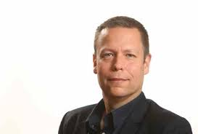
Dr. Raz Tzimt
Dr. Raz Tzimt is a research fellow at the Institute for National Security Studies at the Tel Aviv University which specializes in Iran.
He is the owner of a master’s degree and a PhD in the history of the Middle East on behalf of Tel Aviv university and a bachelor’s degree in the history of the Islamic Middle East on behalf of the Hebrew University of Jerusalem.
His doctorate work dealt with Iran’s regional policy in the Arab world of the “50s” and “60s”. He served two decades in the Military Intelligence Directorate.
Dr. Tzimt serves as an investigator also at The Alliance Center for Iranian Studies at the Tel Aviv University and the Moshe Dayan Center for Middle Eastern and African Studies at the Tel Aviv University.
He is the advertising editor of “Taking a Look at Iran” published on behalf of the Meir Amit Intelligence and Terrorism Information Center named after major general Meir Amit dealing with Iran’s regional involvement.
He wrote dozens of articles and commentaries in his research fields, lecturer in various academic and public forums and provides interpretations in the Iranian field for media in Israel and abroad.

