Slide 1
Dr. Raz Zimmt
The Rise of the Shiite Crescent in the Middle East

Slide 2
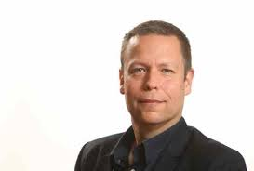
Dr. Raz Zimmt
Dr. Raz Zimmt is a research fellow at the Institute for National Security Studies at the Tel Aviv University. He specializes in Iran.
He holds a Master’s Degree and a PhD in the history of the Middle East from Tel Aviv university and a Bachelor’s Degree in the history of Islamic and the Middle East from the Hebrew University of Jerusalem.
His Doctorate work dealt with Iran’s regional policy in the Arab world during the “50s” and “60s”. He served in the Military Intelligence Directorate for two decades.
Dr. Zimmt serves as a researcher both at the Alliance Center for Iranian Studies at the Tel Aviv University and at the Network Analysis Desk of the Dayan Center for Middle Eastern and African Studies at the Tel Aviv University.
He edits the “Taking a Look at Iran” periodical, published on behalf of the Meir Amit Intelligence and Terrorism Information Center named after Major General Meir Amit, dealing with Iran’s regional involvement.
He has written dozens of articles and commentaries in his research fields, lectured in various academic and public forums and provides interpretations in the Iranian field for media outlets in Israel and abroad.

