Slide 2
4 Legs in the INDC- an Existing Condition

Slide 3
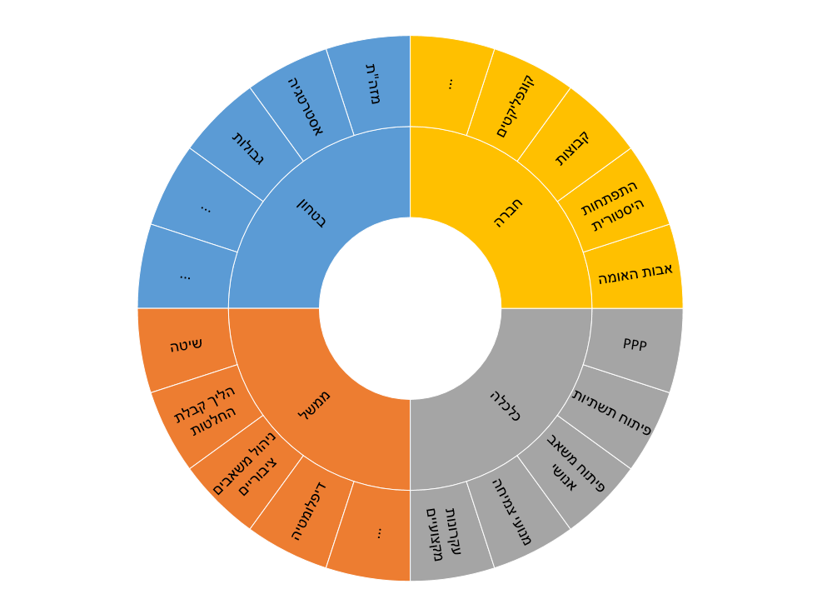
4 Legs - Offer
The Middle East
Strategy
Conflicts
Limits
Groups
Security
Society
Historical development
Founding Fathers
Method
Decision making process
Government
Economy
Infrastructure development
Development of human resources
Resource management
Diplomacy
Growth engines
Professional principles

Slide 4
4 Legs - Offer
The Middle East
Strategy
Conflicts
Limits
Groups
Security
Society
Historical development
Founding Fathers
Method
Decision making process
Government
Economy
Infrastructure development
Development of human resources
Resource management
Diplomacy
Growth engines
Professional principles

