Slide 1
Intelligence Course
Intelligence in decision-making and strategy – the Israeli case – BG Dror Shalom
Guided viewing of ZERO DARK 30 Movie
Intelligence challenges today, relevance of the intelligence and possible solutions – DG of the Ministry of Intelligence Matters
Intelligence as a tool of national policy
Relations between intelligence and decision-making, Summary
What is Intelligence? Intelligence, national security and strategy
What is Intelligence? Intelligence, national security and strategy
Intelligence Analysis + Demonstation
Intelligence failures or “why is the intelligence always wrong/surprised?”

Slide 2
What is Intelligence?
. Intelligence is information that is required and relevant for a country or organization in understanding reality, forming policy or plan actions. It can be classified or unclassified.
מידע, מודיעין ומה שביניהם: כל מודיעין הוא מידע אבל לא כל מידע הוא מודיעין.
Secrets and mysteries.
There are known knowns. These are things we know that we know. There are known unknowns. That is to say, there are things that we know we don't know. But there are also unknown unknowns. There are things we don't know we don't know
Donald Rumsfeld

Slide 3
Intelligence and Strategy
Intelligence agencies exist to serve clients.
המודיעין הכי טוב אינו שימושי אם הוא לא מגיע בזמן, באופן מובן, וכשהוא יכול לשמש בסיס לפעולה ורלוונטי.
Intelligence is a catalyst that wakens and requires thinking, and often drives the engine of policy and strategy.
“The one pulling on the sleeve” – intelligence as an agenda setter.
The role of intelligence – to present and represent the “other” in the process of situation evaluation and policy making.
Essence of policy and strategy is determining priorities in distributing limited resources (including attentiveness).
The intelligence helps the decision-maker understand in depth his opponent, the outline/structure of the system in which he operates and the rest of the players, including the possible results of his own actions. In addition, helps determine against what you need to face at the moment, what in the future and what can we ignore? (this is the essence of strategic planning)
Intelligence is also a monitoring mechanism for policy and strategy. What policy steps work or don’t work, or will or won’t work? (Not very popular …)
Intelligence, as stated, is also an implementation tool for policy and not only an investment for the process of determining strategy policy.
Good intelligence is not always a guarantee of good policy.

Slide 4
Estimation and Intelligence Analysis – Process, Outcomes and Results
תיאור - DESCRIPTION
הסבר - EXPLANATION
חיזוי- PREDICTION
"At its best, explains what is happening, how, why and to what purpose, as well as aids in predicting possible futures".

Slide 5
Politicization
Distortion of facts and judgements that result in or stem from a policy bias
Every analyst has his own beliefs, personality and preconceptions: the question is whether he is able to be aware of them, suspend them and be objective in his analysis. Good analysts can, bad analysts can't. "We are all entitled to our own opinion but not our own facts" (James Schlesinger). Motivated and unconscious biases.
Pressure from consumers and sometimes from senior management, to produce analysis which supports a certain direction of policy.
Analysis which goes against government policy/ideology can be scrutinized/held to a higher standard, and vice versa.
When the analysis is unpleasant/unpalatable for the consumer or contradicts his ideology or stated position, the analyst is often accused of politicization.
Pressure to present "just the facts" and refrain from analytical judgements.
More and more, governments use the selective release of intelligence information to promote or justify policy directions – use of intelligence as an instrument of public persuasion. Intelligence is therefore sometimes forced into policy-justification rather than policy-informing mode. (“PR Intelligence”)

Slide 6
Politicization (2)
The closer the relationship between intelligence and policy-making, the greater the risk the process will be politicized. Writing analysis to please the reader.
Once you are guilty or accused of politization once, you lose your effectiveness as an analyst (no longer seen as objective). Shabak on PLO.

Slide 7
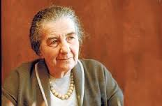
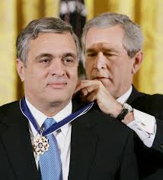
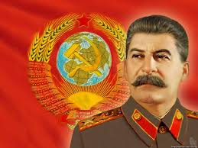
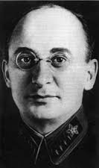
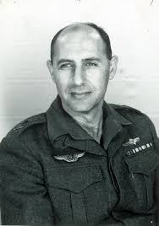
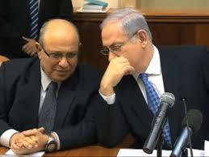
יחסים בין מודיעין לקברניט

Slide 8
בד"כ, חסר דיאלוג/היזון משמעותי בין איש המחקר ומקבל ההחלטות.
תחרות על קשב הקברניט ("מושך בשרוול").
פילטרים.

Slide 9
Differences in Perceptions / Culture (1)
"Expertise without authority" meets “authority without expertise ".
Lowenthal: two closely related tribes that believe, mistakenly, they speak in the same language and work in the same manner for agreed outcomes.
Intelligence products do always help the leader do a better job and also, not always the intelligence products reduce uncertainty.
"Kill the Messenger" - sometimes the truth hurts. Intelligence often does not deliver what was expected
Policy people expect facts and view with suspicion estimation and forecasts ("conjecture, speculation"). "Why do you think your judgment is better than my own?"
Common feeling that Intelligence officials are irrelevant or "not living in the real world."
Decision-makers do not like ambiguity and complexity because they delay or compolicate making decisions. They demand answers, not more questions. On the other hand, they like ambiguity because it allows them to choose what to believe in. They can choose the evaluation that is congruent with their own biases / desired policies.
.

Slide 10
Differences in Perceptions / Culture (2)
They do not like "complications" that may bring them to reconsider decisions that have been already made; intelligence can complicate their policy agendas.
Politicians do not always appreciate intelligence analysts. They think they know better (and they are often right – statesmen tend to understand other statesmen better than researchers)
Tendency to demand to see raw intelligence (WOHLSTETTER). The information revolution brought many decision-makers to believe that they can be their own intelligence officers.
In order to be of value the decision-maker, the intelligence officer has to provide an "added value / comparative advantage” vis-à-vis the decision makers
Decision-makers are very suspicious towards analysis / assessments which are "objective / impartial". Sometimes they believe that the intelligence tries to reduce the room for maneuver / options.
Decision-makers are very protective of their prerogratives - do not want intelligence to engage in policy / recommendations.
חוסר יכולת לשכנע (הכישור הכי חשוב לאיש מודיעין).

Slide 11
פערי תפישות/תרבות (2)
לא תמיד מוצרי המודיעין שמקבל הקברניט מצמצם אי-ודאות או מאפשר לו לעשות את תפקידו טוב יותר.
מקבלי החלטות לא אוהבים דו-משמעות ומורכבות כי הם מעקבים קבלת החלטות. רוצים תשובות, לא עוד שאלות. מצד שני, אוהבים דו-משעמות כי הוא מאפשר להם לבחור במה להאמין. בוחרים את ההערכה שמתאימה לדעותיהם הקדומות/קווי המדיניות הרצויים (הצד האפל של הפלורליזם).
"להרוג את השליח" – לפעמים האמת כואבת. המודיעין פעמים רבות לא מספק את הסחורה שמצפה הקברניט או מקלקל/משבית שמחות.
לא אוהבים "סיבוכים" שעלולים להביאם לבחון מחדש החלטות שכבר התקבלו; מודיעין יכול לסבך את סדרי היום שלהם במדיניות.
מקבלי החלטות חשדניים מאד כלפי ניתוחים/הערכות "אובייקטיביים/חסרי פניות". לעתים חושבים שהמודיעין מנסה לצמצם את מרחב התמרון/האופציות שלהם. חושדים תמיד שיש אג'נדה.
מקבלי החלטות קנאים מאד לתחום אחריותם – לא רוצים שהמודיעין יעסוק במדיניות/בהמלצות.

