Slide 1
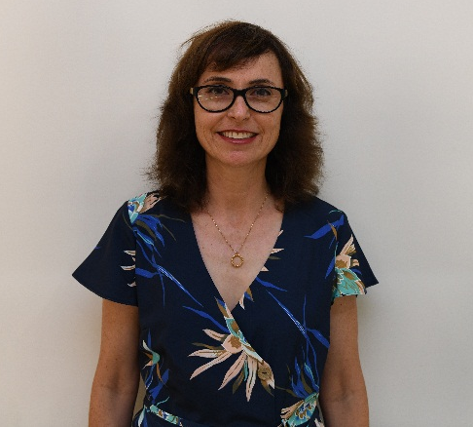
Ms. Michal Mastey
Current position - legal advisor to the Ministry of the Diaspora
Professional Background
Previous position – responsible for legal counsel at the Prime Minister's office
Previous position - independent lawyer
B.A. Law-LL. B Hebrew University of Jerusalem
Academic Background
M.A. in Law LL. M. The Hebrew University of Jerusalem
Courses and Training - Corporate Training Course in Corporate Certification as a Director, Graduate of the Executive Program for Senior Officials in the Public Service of the Wexner Foundation, Executive Training Course for Senior Lawyers in Government Offices, Tender Law Course, Academic Center for Law and Business, Courses in various areas of Public Service, Law, Ministry of Justice, Courses at the Israel Institute of Law, of the Israel Bar and the Faculty of Law, Tel Aviv University and Mediation Course, The Hebrew University of Jerusalem
Birth year and city of residence- 1970, Moshav Aderet.
Marital status - married with four children.
Personal Background
Hobbies: Reading sports and touring.

Slide 2
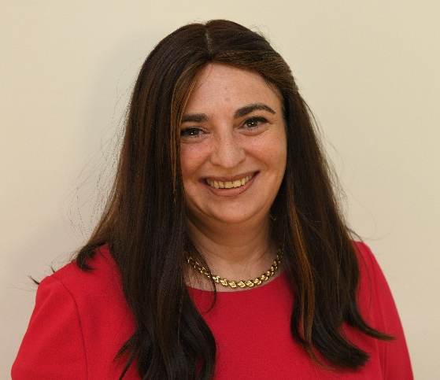
Ms. Sima Spitzer
Current position - manager of new licensing and bank control of banks.
Previous position - Manager of Audit unit – money laundering and the financing of terrorism and supervision of Bank of Israel banks.
Professional Background
Previous position-Manager of the Institutional Evaluation Unit supervising Bank of Israel banks.
B.A. - Economics with Honors
Academic Background
M.A., in Economics, specializing in business economics as part of a direct-to-PhD track in Economics
Birth and residential city-1971 Givat Shmuel.
Married with three children
Personal Background
Hobbies: Reading, spinning, cooking and baking

Slide 3
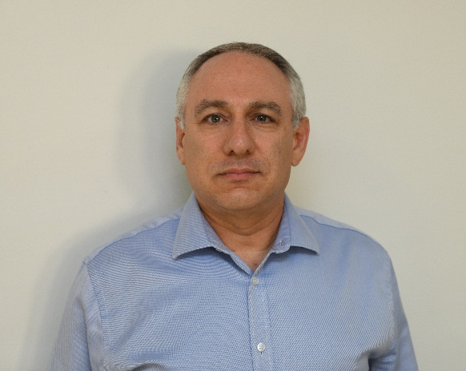
Mr. Amir Sagie
Current position - head of the political headquarters of the Foreign Minister's Office 2018-19
Previous position abroad - deputy consul General – New York 2014-2018
Professional Background
Additional Headquarters - Director of Civil Service Operations,
Deputy Director of Arms Control, Deputy Director of Internet and Information,
Northeast Asia - China, Mongolia and Korea desks.
Other overseas positions: Deputy Ambassador to Lisbon, Portugal (2006-2010),
Spokesman and Director of Public Diplomacy Department in Beijing, China (1999-2003)
B.A - Hebrew University - East Asian Studies and General Studies
M.A- Tel Aviv University - Political Science (Diplomacy and Security Studies for Senior Leaders(
Academic Background
Foreign Ministry cadet course
Chinese Language Studies (China and Taiwan)
Business Administration Studies - College of Business Administration
Was born in January 1968, Israel. Resident of Mevaseret Zion
Married to Michal and father of Roy, Noa and Tomer
Personal Background
Loves traveling in Israel and around the world, enjoys reading, watching movies, and solving logic and trivia puzzles

Slide 4
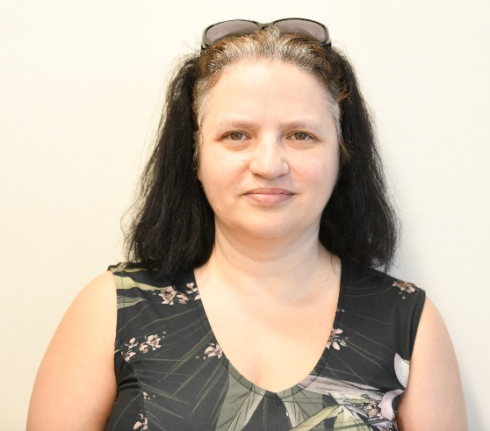
Ms. Simona Halperin
Current position - ambassador in Singapore.
Previous position - Head of the delegation in Taiwan.
Professional Background
Past position - Director of the Department of International Human Rights Organizations.
B.A. - Economics and Business Administration at the University of Haifa.
Academic Background
M.A. – Public Policy and Law, Hebrew University.
Date and city of birth :Rishon LeZion 1969
Personal Background
Family status: married, 5 kids

Slide 5
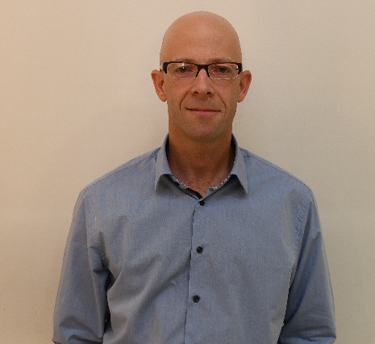
Mr. Ram Erez
2016-today, head of the Department of Policy and Strategy Headquarters Assistant of Defense Minister for Defense Department
2009-2016 assisting the Assistant defense Minister's policy and strategy
Professional Background
2005-2009 Senior Assistant to the Atomic Energy Commission policy
2001-2005 researcher at the Yaffe Center for Strategic Studies Tel Aviv University
2018-today: a colleague in the Research Center for Maritime Studies and strategy at Haifa University
2010. ph. D. In International Relations, the Hebrew University of Jerusalem
2007: International Visitor Leadership Program on U.S. Foreign Policy and National Security, U.S. State Dep.
Academic Background
2001 MA degree in International relations with honors from the Hebrew University of Jerusalem
1997 BA in International Relations, Hebrew University of Jerusalem
Born in 1971 lives in Tel Aviv
Married with three children
Personal Background
Hobbies: sailing

Slide 6
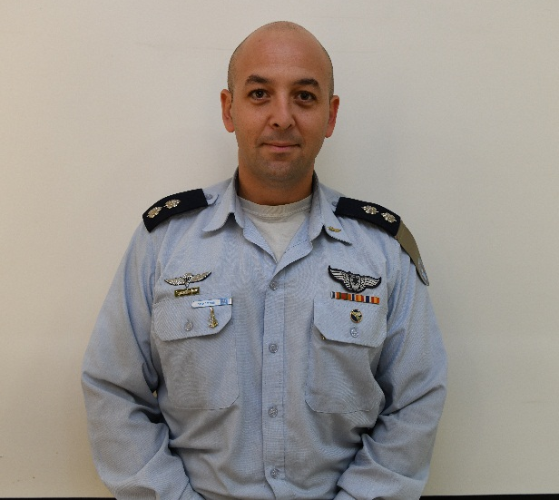
Lt. Col. Amihai Levin
Current Position - Commander 102 Squadron
Previous position - Head of Operational Planning Section, Participation Department
Professional
Background
Previous Position - Commander of First Combat Squadron
B.A- Business and General History
Academic
Background
Courses and Advanced Training – Command and Staff College Alon, Mati Course, Flight Instructors Course
Year of birth, city of residence - 1980, Yaffa camp
Personal
Background
Marital status – Married with two children
Hobbies - reading, cooking, skiing and running

Slide 7
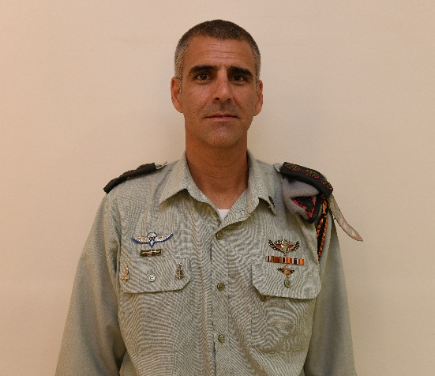
COL. Ido Mizrahi
Current position: Commander of the -Combat Engineering Corps School
Previous position - the engineering commander of Central Command
Professional Background
Past position – Commander of the U. M. – The engineering unit for special missions
B.A. – of the Hebrew University of Jerusalem, Faculty of Humanities the History of Specialization
M.Sc. in the field of "Military Research and Art" at the U.S. Army of Fort Leavenworth, Kansas
Academic Background
Courses-Research seminar in the field of Israel Wars Research seminar in the field of terrorism and guerrilla studies
The year of birth and residential city-1978 lives in military housing at the base of the Air Force.
Marital status-married to Noa with 3 kids (Amit Hilly and Yoav)
Personal Background
Hobbies and other backgrounds - loves sports of all kinds with an emphasis on basketball, love to travel in Israel and around the world and love the military field

Slide 8
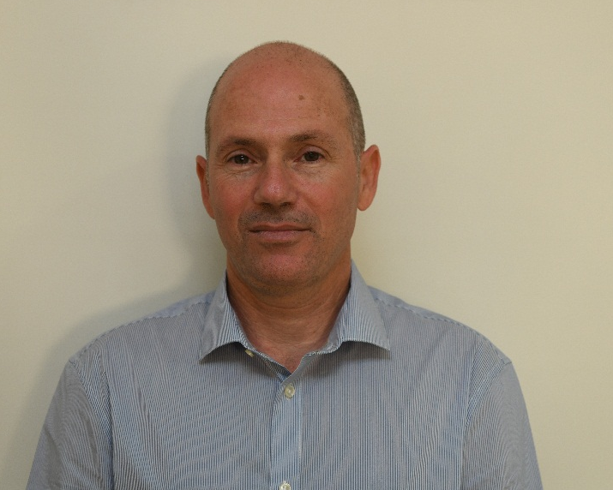
Mr. Gal Shekel
Professional Background
Last position - Nuclear Process Unit Director at Nuclear Research Center Negev (NRCN)
.
B.Sc. In Chemical Engineering with honors, Ben-Gurion University of the Negev.
M.Sc. In Environmental Engineering, Ben-Gurion University of the Negev.
Academic Background
M.Sc. In Material Engineering with honors, Ben Gurion University of the Negev.
Year of birth, city of residence- 1968, Meitar
Marital status – Married with 3 kids
Personal Background
Hobbies- Mountain biking

