Slide 1
Mr. Amir Sagi
Current position- Political chief of staff of the deputy minister of foreign affairs (2018-19)
Professional
Background
Previous position abroad- Deputy of the general consul - New York (2014-2018)
Additional Staff Positions- Director of activity in civil society, deputy director of weapon control department, deputy director of internet and information department, Northeast Asia department - China, Mongolia and Korea.
Additional abroad positions- Deputy ambassador in Lisbon, Portugal. (2006-2010)
Spokesperson and director of the public diplomacy department in Beijing, China. (1999-2003)
BA in East Asia studies and general studies from the Hebrew University of Jerusalem
Academic
Background
Master’s degree in Political Science (diplomatic and Senior Security studies) from the Tel Aviv University
State cadet course of the Ministry of Foreign Affairs, Chinese language studies (in China and Taiwan), Business Administration studies in the Jerusalem College of Management

Slide 2
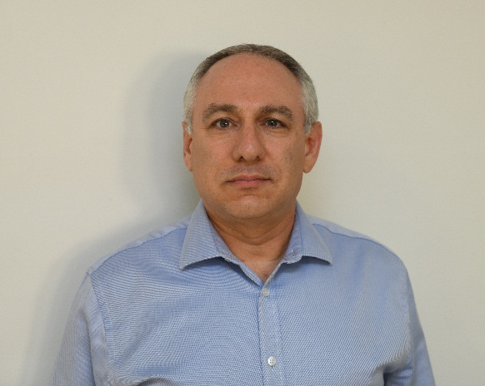
Mr. Amir Sagi
Year of birth, city of residence- January, 1968 Israel, Mevaseret Zion
Personal
Background
Married to Michal and father to Roy, Noah and Tomer
Hobbies- Loves traveling in Israel and around the world, reading, watching cinema, solving logic puzzles and trivia

Slide 3
Mr. Udi Shiloh
Current position- Head of the Samaria Desk Department
Professional
Background
Previous position- Different management positions, the majority in the operative counterterrorism desk division
BA- In Humanities (Talmud) in Bar-llan University (graduated with honors)
Academic
Background
Master’s degree- Senior Management course (approximately two months)
Courses and educational programs- Junior management course
Year of birth, city of residence- Born 1976, Lod
Personal
Background
Family situation- Married to Tamar, father to five (Adi, Ori, Itai, Noam, and Yael)
Hobbies- Traveling in Israel and around the world, sports (mainly running and Enduro riding), reading

Slide 4
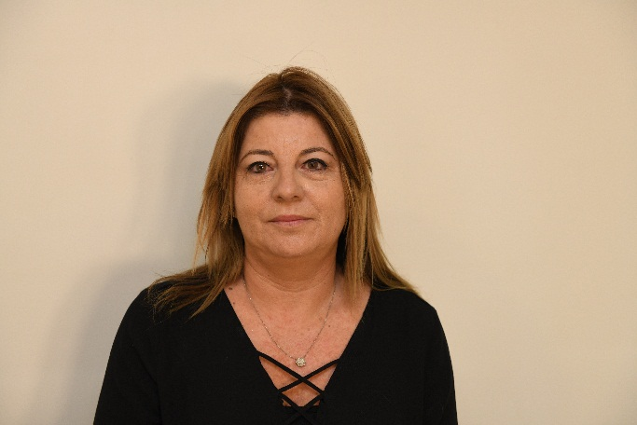
Mrs. Heli Kontente
Current position- Central district manager in Israel Land Authority
Professional
Background
Previous position- Tel Aviv district manager in Israel Land Authority
Previous position- Central district transactions department manager
Bachelor’s Degree- BA in Social Sciences and Humanities on behalf of Beit Berel College
Academic
Background
Year of birth, place of residence- 1969, Rishon Letzion
Personal
Background
Family situation- Married + 3 children
Hobbies- Sports, reading and baking

Slide 5
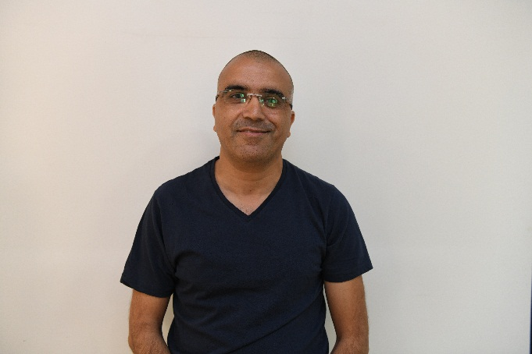
Commander Moshe Edri
Current position- Head of the Israeli police sabotage department
Professional
Background
Previous position- Deputy head of the Israeli police sabotage department
Previous position- Head of training and operations section, sabotage department
Academic
Background
BA- The Middle East and history
Teaching diploma on behalf of The Kerem Institute for Teacher Training
Courses and educational programs- Pum Israeli Police course, Israel police Israeli commanders course
Personal
Background
Year of birth, city of residence- 1967, Tzur Hadassah
Family situation- Married and father to three children
Hobbies- Riding on dirt bikes, history with an emphasis on World War II

Slide 6
Mrs. Nitza Rogozinski
Current position- Electrical company reviewer and ombudsman (deputy general manager)
Professional
Background
Previous position- “members of the veteran pension fund” and sister company, Opal Technologies Ltd.- Primary internal critic
Previous position- “Koala”, an experiential and development center for parents and children- project manager and owners
BA in Business administration, majoring in accounting
Academic
Background
Master’s degree in accounting law
Advanced directors course- Tel Aviv University (Lahav)
Management courses- Tel Aviv University (Lahav)
Business real estate diploma studies- Tel Aviv University (Lahav)
Year of birth, city of residence- 1973, Rishon Letzion
Personal
Background
Family situation- Married + 3

Slide 7
COL Avi Keinan
Current position- Northern command Intelligence officer ranking as a lieutenant colonel.
Professional
Background
Previous position- Head of filed intelligence department in the IDF- in colonel rank
Previous position- Intelligence officer 36th division Ramat HaGolan ranking as a COL
BA in humanities from the university of Ben Gurion, graduate of the faculty of law at the academic college
Academic
Background
Master’s degree in law on behalf of Bar llan university
Courses and educational programs- English course in Tel Aviv University
Personal
Background
Year of birth, city of residence- 1973, Ramat HaSharon
Family situation- Married + 4
Hobbies- basketball

Slide 8
COL Roman Guffman
Current position- Brigade 7 commander
Professional
Background
Previous position- Etzion brigade commander
Previous position- Officer at Operations Branch at GHQ
BA- Social studies from the university of Ramat Gan
Academic
Background
Year of birth, city of residence- 1976, Ashdod
Personal
Background
Family situation- Married + three children

Slide 9
COL Guy Goldfarb
Current position- Flotilla 3 commander.
Professional
Background
Previous position- Ashdod base commander.
Pervious position- Flotilla 3 deputy commander.
BA- Political Science, University of Haifa.
Academic
Background
Master’s degree in Business Administration from the university of Haifa.
Courses and educational programs- Damascus-Senior Jurisdiction, sexual harassment
jurisdiction and brigade commanders course
Year of birth, city of residence- 1975, Haifa
Personal
Background
Family situation- Married + three children

Slide 10
COL Idan Katz
Current position- Efrayim brigade commander
Professional
Background
Previous position- Unit 5101 commander
BA- L.L.B in law, the I.D.C
Academic
Background
Courses and educational programs- Spoken Arabic, Damascus senior Jurisdiction,
worthiness of operation
Year of birth, city of residence- 1977, Sde Nitzan
Personal
Background
Family situation- Married + four children

