Slide 1
Notes and main events | Period | Timeline
Era of the patriarchs; invasion of the people of the sea | Late Bronze | 1550-1250
Egypt Exodus; settlement; Kings Saul and David | Iron age I | 1250- 1000
722 Exile of Israeli; 701 Sennacherib Campaign | Iron age II | 1000-700
586 Destruction of the First Temple of Jerusalem | Iron age III | 700-586
Return to Zion; Construction of the Second Temple on Jerusalem | Persian | 586-332
322 Alexander the Great conquest | Hellenic | 332-167
167 Hasmonean Revolt and establishment of the State | Hasmonean | 167-63
The birth of Christ and the year 0. Romans conquer the land of Israel | Ancient Roman | 63-0
70 - 9th of Av, The Great Revolt and Destruction of the Second Temple | Ancient Roman | 70-67
Bar Kokhba Revolt | Ancient Roman | 135-132
Cultural Prosperity, Tannaim literature, Sanhedrin | Later Roman | 313-135
Christianity becomes the state’s official religion | Byzantine | 640-313
The Muslims conquer the land; Umayyad and Abbas Caliphates | Early Muslim | 1099-640
Crusaders Conquer the land | Crusaders | 1187-1099
1187 Saladin conquests; Ayyubid , Fatimid and Mamluk Caliphates | Later Muslim | 1517-1187
Part of the Ottoman Empire | Ottoman Empire | 1917-1517
BC
0
AD

Slide 2
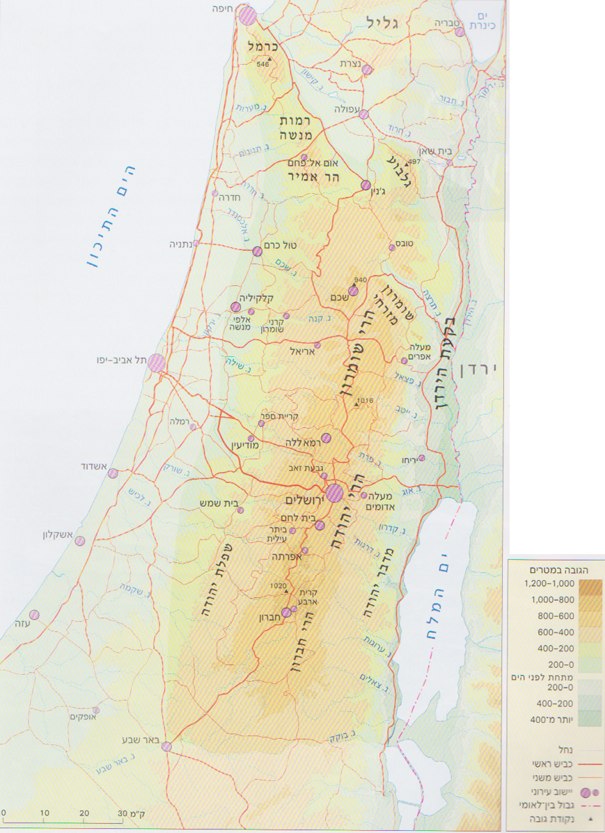
Hebron
Jerusalem
Samaria
Shiloh
Nablus

