Slide 1
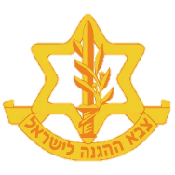
IDF - Strategic Brief
Created by IDF MC
FOUO

Slide 2
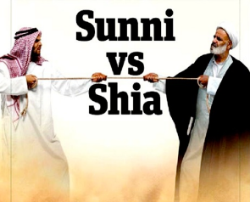
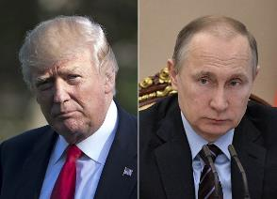
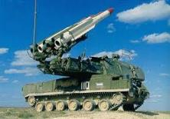
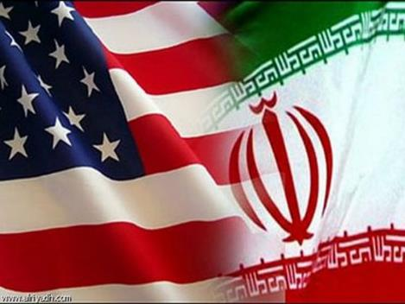
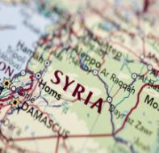
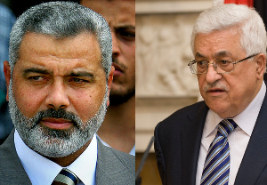
Regional Players & Undercurrents
Riyadh vs Teheran
Clash
of World Powers
Proliferation of Advanced Weapons and Equipment
Iranian
Power Projection
Syria
2019
Hamas vs PA
Notes:
Sunni-Shia Conflict: As of 2018, an estimated 85% of Muslims worldwide are Sunni, with the remaining 15% identifying as Shia. In recent years, the relations between the two sects have been increasingly marked by conflict – particularly the Saudi Arabia-Iran Proxy Conflict. This conflict is struggle between the two nations for influence throughout the Middle East, and its surrounding regions. Both countries have provided various degrees of support to opposing sides in nearby conflicts, including the Yemenite Civil War, the Iraqi Civil War, and the internal fighting in Syria. The rivalry also extends to disputes in Lebanon, Qatar, and Afghanistan, as well as North Africa, South Asia, and Central Asia, in what has been described as a modern-day Cold War and the true largest conflict in the Middle East (the conflict has been waged on multiple levels over geopolitical, economic, and religious influence in the region).
AWE (Advanced Weapons & Equipment): Parties affiliated with both the Sunni Coalition, as well as the Shiite Axis, have continued their efforts to gain and develop advanced weaponry needed to maintain their military advantages in the various conflicts. This trend has been noticeable in both Lebanon and Syria, which both received transfers of Iranian and Russian arms. This arms race is a threat to regional stability, with potential to cause deterioration.
Presence of Powers: Russia has continued to express its support of Assad’s regime in Syria, both by deploying Russian Military Police forces to southern Syria in order to support the ongoing restoration campaign there, as well as conducting an extensive military exercise in the Mediterranean Sea, off the coast of Syria. Russia, Syria, Turkey and Iran additionally held multiple summits throughout August and September seeking to end the Syrian conflict and fully restore Assad to power.
In September, the United States decided to maintain its troops in Syria, in order to guarantee the departure of Iranian forces from the region, and establish a stable government in Damascus. This decision was made due to increasing doubts about Russia’s efforts and willingness to remove the Axis forces from the region.
PA-Hamas Conflict: In July 2018, with Egyptian backing, Hamas and the PA entered a reconciliation process to end the decade-long rupture between both parties. However, as of September 2018, the unification has not been finalized. This tension harms the ability to restore stability and calm in cooperation with Israel.
Iran Power Projection: Despite the crumbling Iranian economy, the Islamic Republic has continued to fund and support its military proxies throughout the Middle East, (at the expense of the Iranian citizens). Iran has continued to strengthen its relations with both Assad’s regime in Syria (signing a military cooperation agreement during August), as well as Hezbollah in Lebanon and the Houthi rebels in Yemen in order to expand its power projection and operate in regions it previously possessed no access to, such as the Mediterranean. However, on the 5th of November, the United States restored US sanctions that were lifted under a 2015 nuclear deal negotiated by the administration of President Barack Obama, and added 300 new designations in Iran's oil, shipping, insurance and banking sectors. This has further fueled the series of strikes occurring in Iran in regards to the declining economic situation.
Syria 2019: As of September, Assad’s forces completed their conquest of southern Syria, and are now operating to retake Idlib in the north. With the return of full-control to Assad, many questions have been raised regarding the future of Syria, such as handling of refugees, reestablishment of infrastructure, and the continued presence of Iranian and Russian forces in the country.

Slide 3
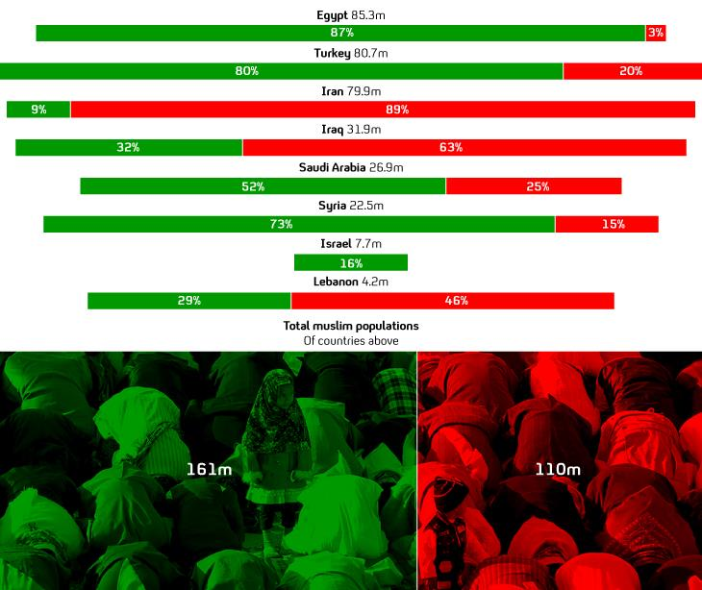
The Sunni – Shiite divide in the Middle East
Sunni
Shia
Sunni: Majority of the worlds Muslims, 85%- 90% across Africa, Middle East and Asia
Shi’ite: Countries with Shi’ite majority: Iran, Iraq, Azerbaijan, Bahrain.
Notes:
Sunni-Shia Conflict: As of 2018, an estimated 85% of Muslims worldwide are Sunni, with the remaining 15% identifying as Shia. In recent years, the relations between the two sects have been increasingly marked by conflict – particularly the Saudi Arabia-Iran Proxy Conflict. This conflict is struggle between the two nations for influence throughout the Middle East, and its surrounding regions. Both countries have provided various degrees of support to opposing sides in nearby conflicts, including the Yemenite Civil War, the Iraqi Civil War, and the internal fighting in Syria. The rivalry also extends to disputes in Lebanon, Qatar, and Afghanistan, as well as North Africa, South Asia, and Central Asia, in what has been described as a modern-day Cold War and the true largest conflict in the Middle East (the conflict has been waged on multiple levels over geopolitical, economic, and religious influence in the region).

Slide 4
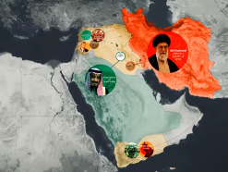
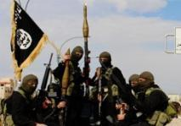
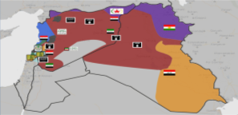
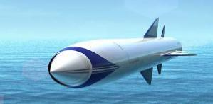
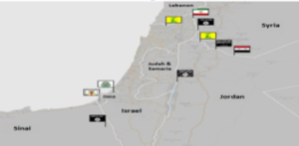
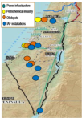
Threat Chart
Regional
Instability
Violent Non
State Parties
Regional
Arms Race
Precision
Munitions
Border
Security
Vulnerable Strategic Infrastructure
Notes:
1. Regional Instability: The past few years have been defined by continued governmental instability throughout the Middle East (such as the Jordanian and Iranian protests in Summer 2018, and the lack of an established Lebanese government as of September 2018), as well as outright internal wars (Yemenite Civil War, Syrian Internal Conflict).
2. Violent Non-State Actors: This instability has allowed the rise of multiple Violent Non-State Actors, among them the Islamic State (in Syria and Sinai), as well as the Houthis, with no governmental forces to combat them.
3. Regional Arms Race: The conflict has led to a regional “arms race”, with all groups acquiring advanced arms both for defense and offense, and often outright terrorism.
4. Strategic Vulnerability: In addition to currently being the 48th smallest country in the world (20,770 square Km), Israel borders many of countries embroiled in the various conflicts in the Middle East. Israel is threatened by LH and Syria (in addition to Iranian proxies) in the north, and Hamas and IS Sinai cells in the south. Israel’s lack of strategic depth leaves much of its critical infrastructure (such as power-plants located in southern Israel) vulnerable to attacks from all fronts (especially through the use of extremely advanced arms, such as the Yakhont Missile, capable of precise strikes from several thousand kilometers away).

Slide 5
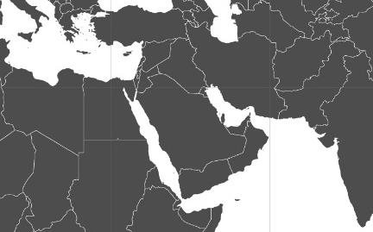
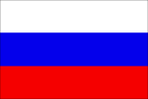
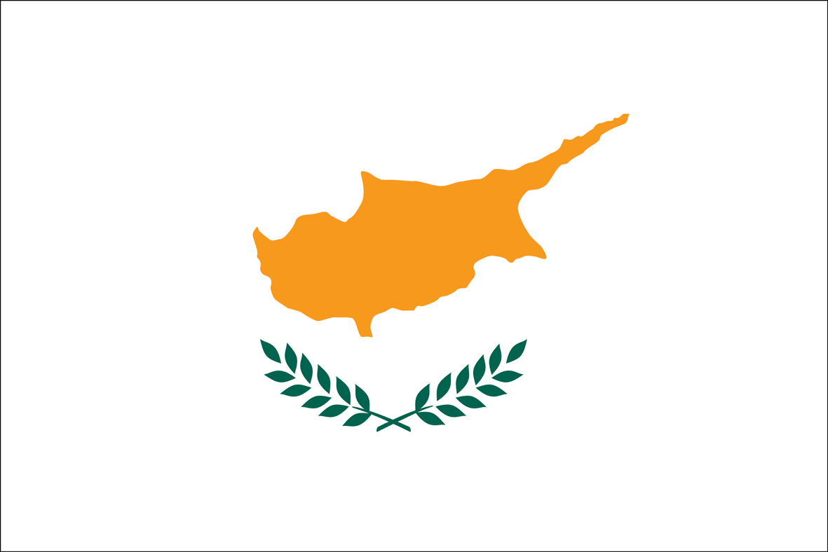
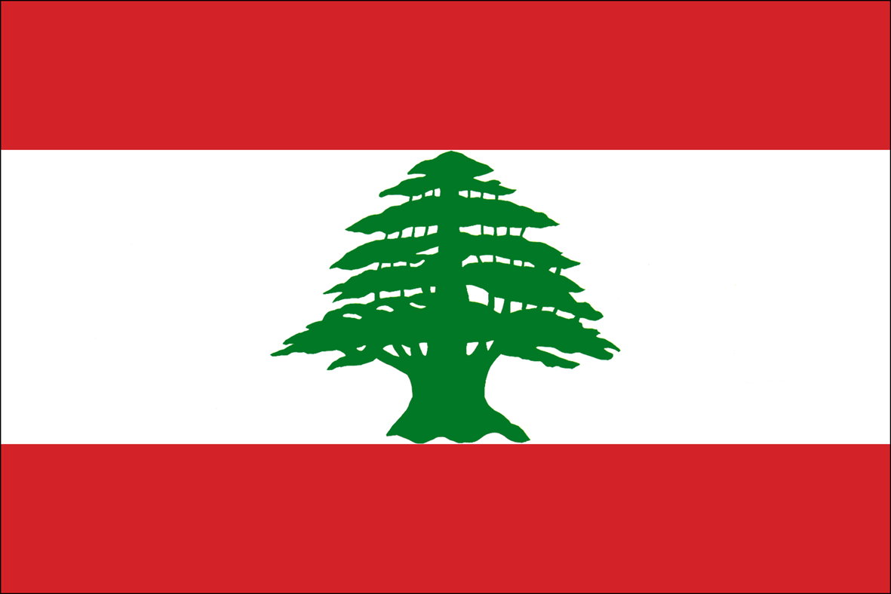
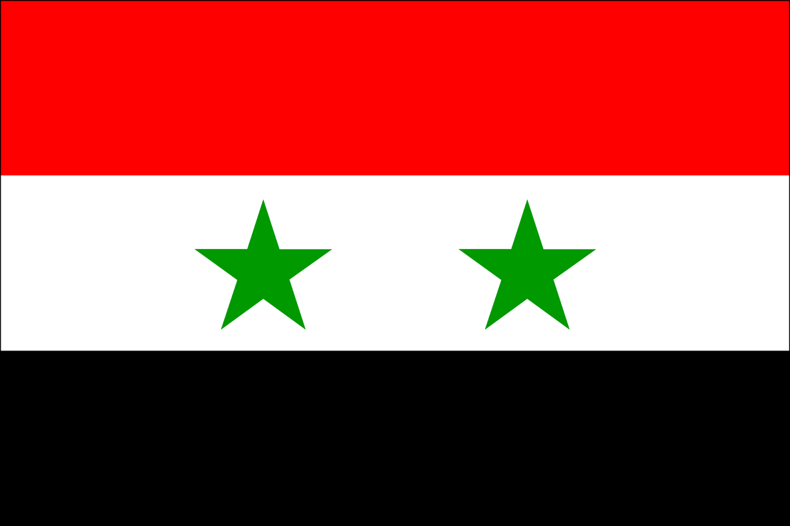
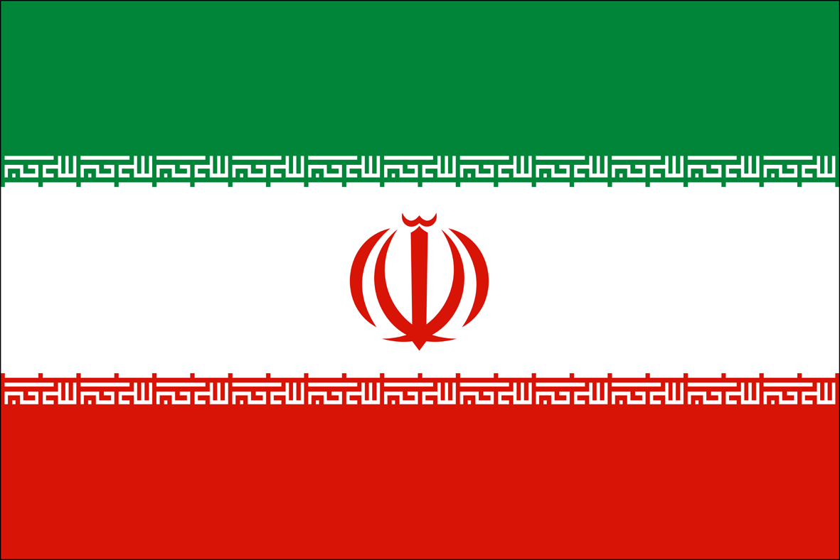
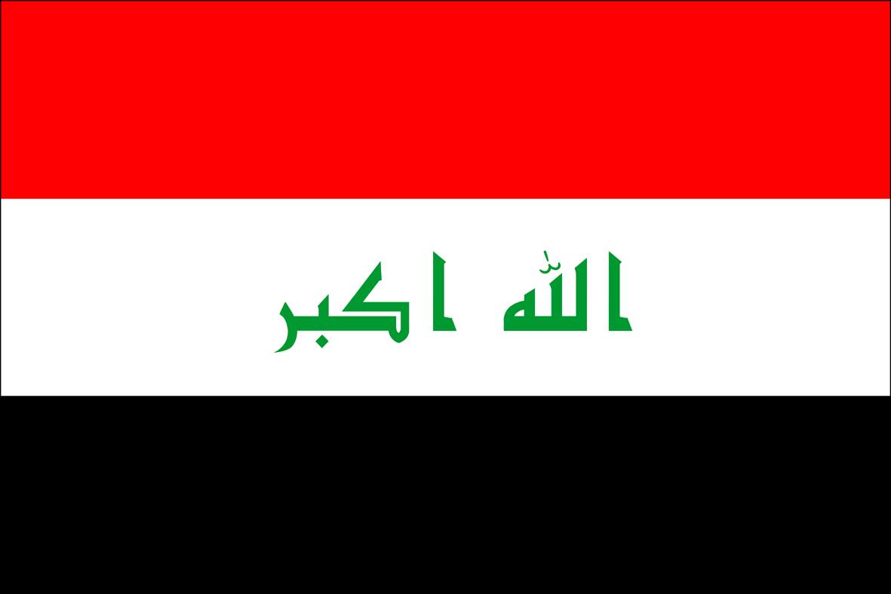
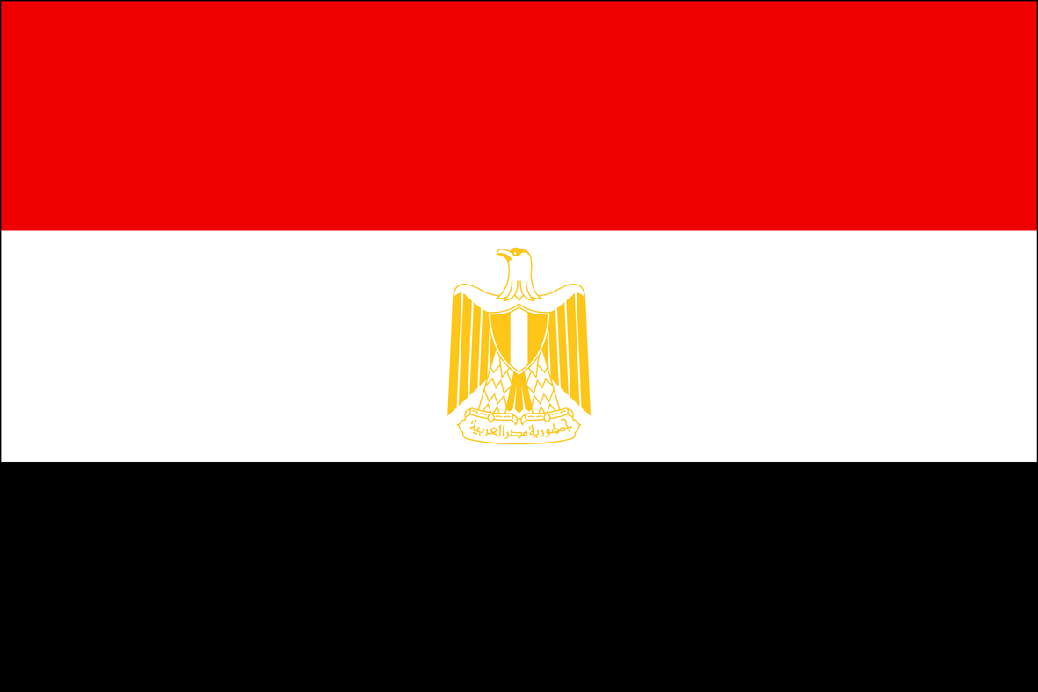
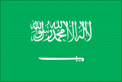
Regional and Intl. Interests
Key
Iranian LOC
Strategic LOC
Regional COG
Regional COG
Turkish LOC
Notes:
Following Recep Tayyip Erdoğan’s party’s victory in the elections, the Turkish president began expanding his autocratic policies in the country. These policy changes accompanied a growing rift between the United States and Turkey due to the imprisonment of an American pastor, who is accused of assisting the attempted Turkish military coup that occurred in 2016. Turkey’s refusal to release him had led to the U.S imposing trade tariffs on Turkey and Turkey boycotting American products. These two factors are the main causes for Western banks turning on Turkey, causing the lira to lose 40% of its value and plunge Turkey into an economical crisis.
On October 2nd, Jamal Khashoggi, a Saudi writer and US resident, was killed upon entering the Saudi Arabian consulate in Turkey. After weeks of repeated denials that it had anything to do with his disappearance, the kingdom of Saudi Arabia eventually acknowledged that the murder was premeditated. The whereabouts of his body are still unknown. Countries gathered at the UN in Geneva to review the rights record of Saudi Arabia as it faces a torrent of international condemnation over Khashoggi's murder.
As the Yemen Civil War entered its third year, an anti-Houthi coalition, lead by Saudi Arabia and the UAE, bombed a bus school bus in an air strike on August 9th. The strike killed 51 people, among them 40 children. On September 1st, the coalition released the results of a probe, which admitted that “mistakes were made” during the strike. The probe came after the air attack sparked widespread international condemnation and calls for an independent investigation from United Nations Secretary-General Antonio Guterres. Despite the probe, the Human Rights Watch released a report accusing Saudi Arabia and the UAE of covering up war crimes and downplaying aerial attacks, and called for an end to all weapons sales to the coalition.
However, neither of these developments have deterred Iran nor Turkey’s efforts to expand their power. Throughout 2018, Turkey has become one of the leading forces in what has been called “the new scramble for Africa” – a race by non-western countries to gain influence in the continent and project their power across it. Turkey has invested millions of dollars (as well as tripling the number of embassies opened throughout the continent in the past decade) in projects throughout the region, with emphasis on Muslim African countries, as well as the Horn of Africa. This interest extends to other regions, such as Qatar, with whom they maintain growing ties in various fields due to the Qatar Crisis and Turkey’s economic hardships. Turkey has also operated in the Mediterranean region, threatening Cyprus on their 58th Independence Day: “In Cyprus and the Aegean no move can be made without Turkey. Those that try to ignore us in this region place their existence in jeopardy.” These remarks follow Turkey’s intentions to drill for gas within Cyprus’ EEZ under claims that they belong to northern, Turkish Cyprus.
Simultaneously, Iran has pursued deeper relations with their various proxies throughout the Middle East. These efforts include increased supplies of ballistic missiles and drones to the Houthi rebels in Yemen (in violation of UN Resolution 2216), growing their ties with Hamas in the Gaza Strip following their fallout regarding the internal Syrian Conflict (Hamas supported rebel forces, while Iran supports the Assad Regime), and their financial and political support of Shiite organizations (Lebanese Hezbollah and the Assad Regime) throughout the Middle East.

Slide 6
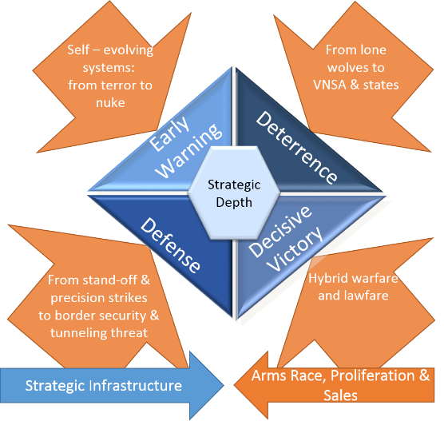
Challenges to Israel’s National Security Concept

Slide 7
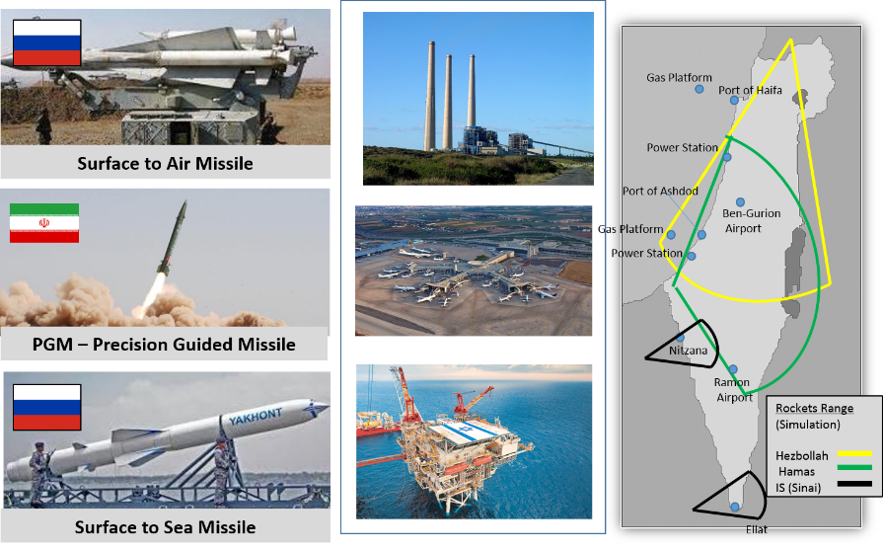
Threats to Strategic Israeli Infrastructure
Electricity Infrastructure
Ben Gurion Airport
Offshore Gas Rig
Notes:
Regional Arms Race: The conflict has led to a regional “arms race”, with all groups acquiring advanced arms both for defense and offense, and often outright terrorism.
Strategic Vulnerability: In addition to currently being the 48th smallest country in the world (20,770 square Km), Israel borders many of countries embroiled in the various conflicts in the Middle East. Israel is threatened by LH and Syria (in addition to Iranian proxies) in the north, and Hamas and IS Sinai cells in the south. Israel’s lack of strategic depth leaves much of its critical infrastructure (such as power-plants located in southern Israel) vulnerable to attacks from all fronts (especially through the use of extremely advanced arms, such as the Yakhont Missile, capable of extremely precise strikes from several thousand kilometers away).

Slide 8
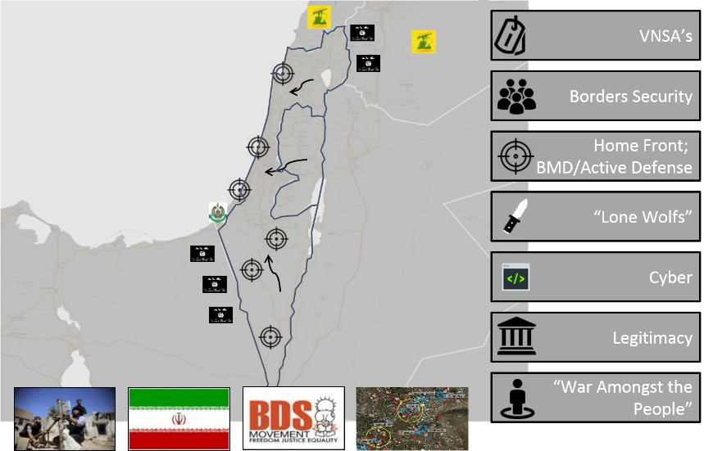
IDF – On the Front Line of the Emerging Battlefield
Violent Non-State Actors
Notes:
Violent Non-State Actors: Violent Non-State Actors pose a threat to various groups throughout the Middle East, including Israel. Lebanese Hezbollah (LH) currently pose one of the largest threats to Israeli security due to their multiple violations of the Blue Line (BL), and threats of ground invasion into the Galilee. In addition, Israel faces arson kites and incendiary balloons aimed at its southern region by Hamas, as well as mortar and rocket fire. Israel is also under threat by Islamic State cell operating in Sinai, and their terrorist operations.
Border Security: Many of these violent non-state actors operate near the Israeli border, directly or indirectly (such as spillover fire from the Syrian Internal Conflict) harming Israel.
Homefront: Due to the Israeli Homefront’s vulnerability to attack, Israel has greatly enhanced its defensive capabilities to compensate, such as its advanced “Iron Dome” batteries.
Lone Wolves: An additional threat posed to Israel are Palestinian “Lone Wolf” attacks, perpetrated by people who prepare and commit violent acts alone, especially in Judea and Samaria. The IDF is constantly maintaining vigilance to combat and prevent similar attacks in the future.
Cyber: Israel also faces hundreds of cyber attacks from both regional hostile organizations, as well as international groups. However, the IDF is constantly advancing its technological capabilities to combat this threat.
Legitimacy: A total of 32 countries do not recognize the existence of Israel, in addition to multiple countries and NGOs that denounce the country’s activity. Israel constantly operates to verify and demonstrate its sovereignty and justify all actions.

Slide 9
Uncertainty = Influence on Planning
Level of Uncertainty
Lack of Certainty and Ambiguity
From Planning Based on Scenarios to Planning Based on Capabilities and Changing Tides of Interests
Wide Range of Future Possibilities
Limited Range of Future Possibilities
Sufficiently Clear Future
Time
80s
90s
00s
2019
Notes:
This slide demonstrates the changes in the various threats to Israel during the past 40 years. The current lack of certainty complicates future planning, and forces Israel and the IDF to develop new techniques to prepare for a wide range of threats.

Slide 10
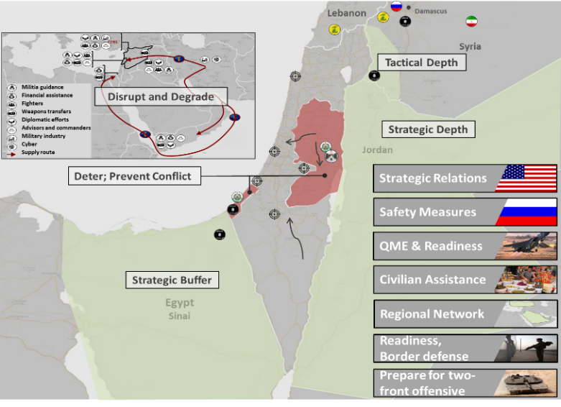
IDF Military Strategy
Notes:
Strategic Relations: Israel strives to continue to both maintain and enhance its relations with its greatest strategic ally and partner, the United States.
Safety Measures: Israel continues to maintain its communications with Russia regarding their presence near the Israeli border and relations with the Assad Regime.
Qualitative Military Edge: The IDF continues to operate to maintain its readiness, as well as its technological and tactical advantages, in order to deter and prevent a wide variety of threats.
Civilian Assistance: Israel and the IDF constantly operate to strengthen the Homefront by conducting emergency drills and enhancing Israel’s defense systems and capabilities. Israel has also acted in order to assist foreign civilians, such as operation “Good Neighbor” in the Golan Heights, and supplying and allowing entry of humanitarian relief to the Gaza Strip.
Regional Network: Israel engages with neighboring countries in order to promote regional stability.
Two-Front Offensive: Israel faces enemies both on both its northern (LH and Axis Forces) and southern (Hamas) fronts. Thus, the IDF operates to prepare itself for the possibility of deterioration and hostilities on both fronts, possibly even simultaneously.

Slide 11
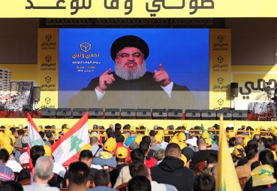
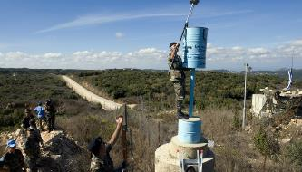
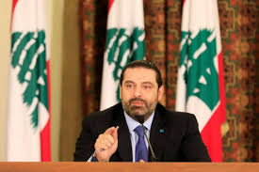
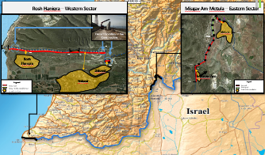
Lebanon
Hezbollah
UNIFIL & LAF
Economic and Political Instability
Improving Border Defences
Notes:
Economic Instability: Despite six months having passed since Lebanon’s governmental elections in May 2018, the country has yet to establish a new stable government (it is currently managed by a surrogate, temporary government). The lack of an established parliament is further proof that the Lebanese government is disorganized and structurally insecure at this time. The lack of government has led to economical instability, due to inability to settle on a national budget, or create the necessary reforms to improve Lebanon’s financial systems.
Lebanese Hezbollah (LH) Economic Crisis: The economical instability has not only harmed Lebanon, but the terror organization Hezbollah as well. The decrease in the organization’s funding has severely harmed Hezbollah’s abilities to project its power. Despite this development, Hezbollah has continued to support the efforts of the Shiite Axis by stationing troops in southern Syria (and in the AOS in particular), and LH SG continues to threaten Israel – especially through ground infiltration.
Israeli Defensive Obstacle: Israel is continuing the construction of the Defense Obstacle near the BL. The process, which is occurring within Israeli territory and with full UNIFIL coordination is in response to LH SG threats and is focused on creating tactical depth for Israeli border communities.
UNIFIL: On August 31st, the UNSCR approved the extension of UNIFIL’s mandate in southern Lebanon to August 2019. The extension was accompanied by a call for both Israel and Lebanon to refrain from any activity that could endanger the regional stability, and to engage in order to create a permanent ceasefire between the two countries.
Soon, the UN will participate in the annual vote on Resolution 1701 and decide whether or not there will be any changes made to the establishment of the Blue Line.

Slide 12
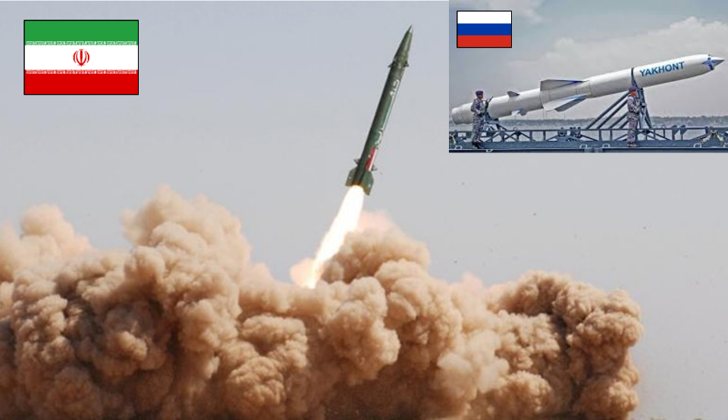
Enhanced Missile Capability
Acquisition of Precision Guided Missiles
Manufacture and Purchase of Rockets (Tens of Thousands)
Notes:
As part of its attempts to gain a military edge, Hezbollah is constantly acting to purchase and develop advance weaponry and arms, especially advanced rockets and precision-guided missiles. These efforts are promoted mostly through its strong relations with Iran, but also through its relations with Russia.

Slide 13
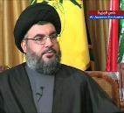
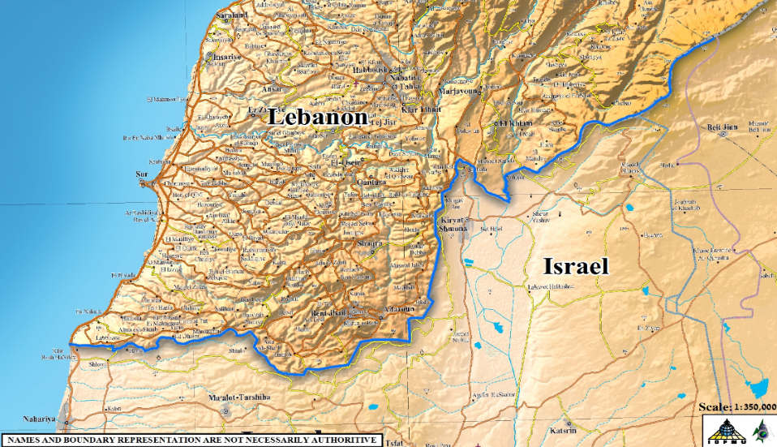
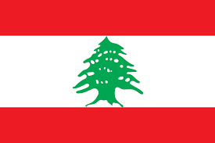
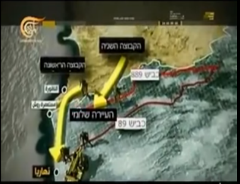
Ground Assault & Infiltration Capability
“If war begins with Israel, I will order Hezbollah’s soldiers to conquer the Galilee”
Hassan Nasrallah (2012)
LH Infiltration into Israel
Second Team
First Team
Shlomi
Nahariya
Notes:
Hezbollah has threatened Israel multiple times with ground infiltration from the north, going as far as publishing their strategy for such an operation. However, the IDF is prepared for a wide variety of threats posed by Hezbollah, and is constructing a defense obstacle near the Blue Line to defend the Israeli close-border communities.

Slide 14
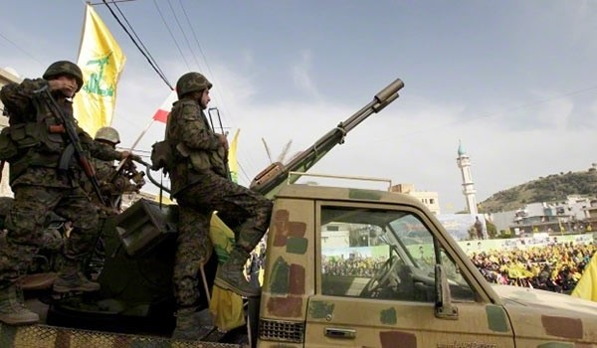
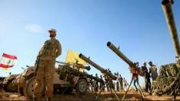
Ground Assault Defense Capabilities
Armed Hezbollah Solder in Southern Lebanon
Notes:
In order to support Assad’s regime, and the efforts of the Shiite Axis, Hezbollah sent military forces to southern Syria throughout the last few years. These units fought against rebel cells, thus gaining combat experience in the field, which Hezbollah intends to use against Israel.

Slide 15
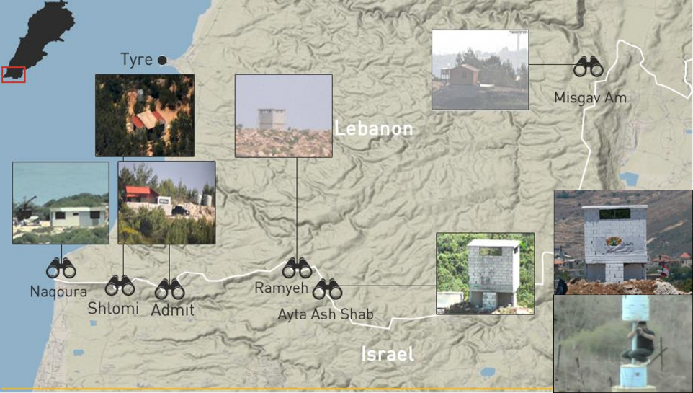
Intelligence Gathering along the Intl. Border
Armed Hezbollah Solder in Southern Lebanon
Covert observation posts
camouflaged as a Nature Reserves
Authority Watchtower
Notes:
In the last few years, the IDF exposed an LH network to gather intelligence about Israel under a civilian disguise (“Green Without Borders”). LH continues to promote these acts, while openly violating UNSCR 1701 during their efforts.
In September 2018, in addition to the locations already identified along the Israeli-Lebanese frontier, a new system of military infrastructure was discovered near civilian homes. The structures are observation posts built on the Lebanese side of the border.
Despite warnings, Hezbollah continues to operate in the Blue Line region. Israel will not allow them to use the cover of “Green Without Borders” to spy on Israel and conduct illegal activity along the Blue Line.

Slide 16
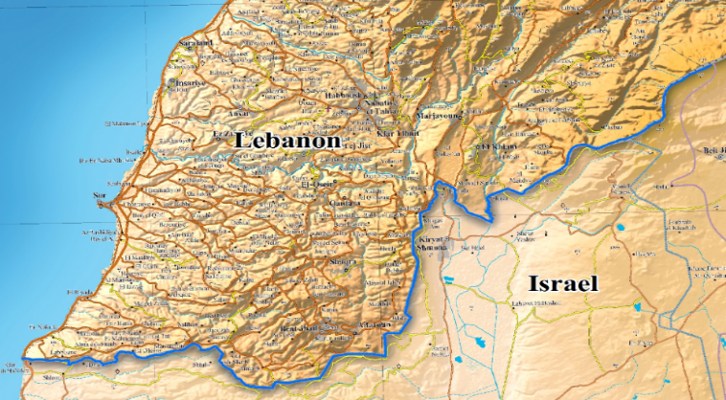
Attacks Along Intl. Border (2002-2016)
Kfar Kela (2016)
Shooting and injuring of IDF soldier
Metula (2016)
Fire at IDF soldier
Misgav Am (1980)
Hostage crisis caused by infiltrators, and murder of 3 Israelis
Misgav Am (2010)
Killing of IDF LTC.
Margaliyot (2017)
Infiltration of Lebanese Citizen into Israel
Matzuba (2002)
Infiltration into Israel and murder of 6 citizens
Rosh HaNikra (2013)
Killing of IDF soldier
Notes:
Throughout the years, Lebanese Hezbollah has constantly attempted to harm Israeli citizens, and encroach on Israeli territory. In addition to the violation of UNSCR 1701, many of these attempts have directly harmed (injuring of IDF soldier in 2016) and taken (murder of the IDF LTC. In 2010, murder of an IDF soldier in 2013) Israeli lives.

Slide 17
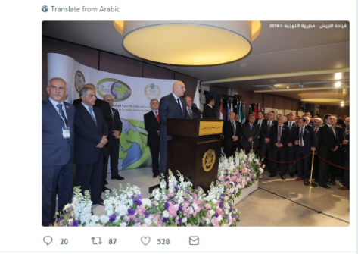
LAF
Part of the problem - Also part of the solution
“I repeat our firm rejection of any violation by the Israeli enemy of Lebanon’s sovereignty…”
LAF Commander in Chief (19/2/18)
Armed Hezbollah Solder in Southern Lebanon
Notes:
Despite the LAF’s intentions to act as an effective force in Lebanon, it is still deeply influenced by Hezbollah. Hezbollah continues to be the leading and powerful organization in Lebanon, and the LAF is incapable of preventing its presence in southern Lebanon.

Slide 18
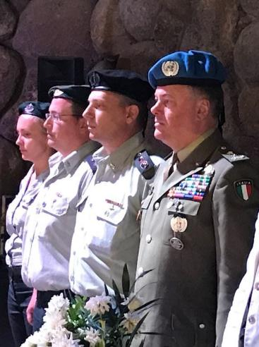
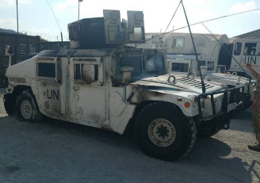
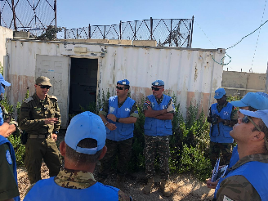
UNIFIL
Armed Hezbollah Solder in Southern Lebanon
UN Resolution 1701?
Notes:
In August 2018, MG. Stefano Del Col (of the Italian Military) entered his position as the new commander of UNIFIL. MG Del Col met with the IDF Commander in Chief, as well as his Lebanese counterpart.
UNIFIL continues to enable dialogue between the IDF and the LAF. However, they have faced resistance from the local population and are hindered in their operations due to LH attempts to limit their freedom (such as the vehicle burning incident in Majdal Zun on August 4th) .
The IDF views UNIFIL as an important force meant to maintain stability and promote resolutions related to the Lebanese frontier.

Slide 19
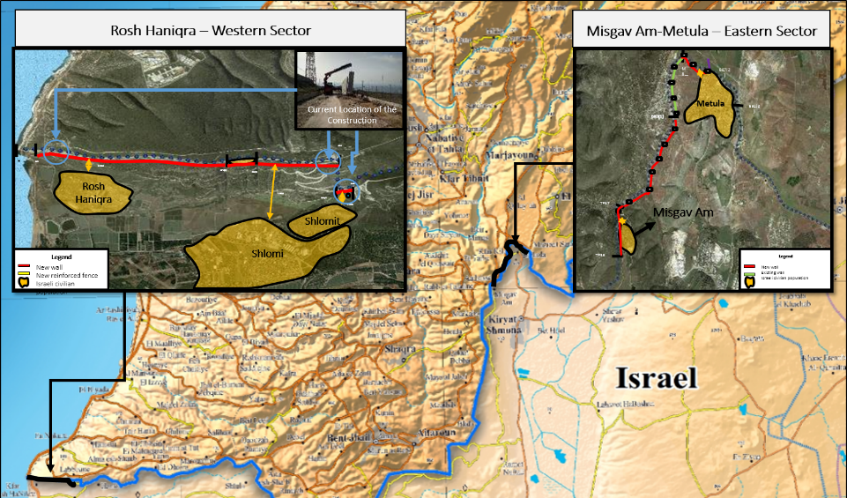
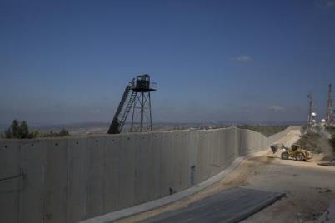
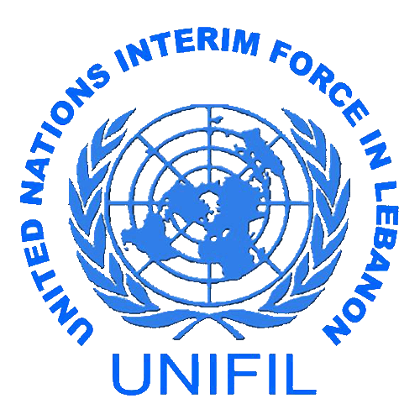
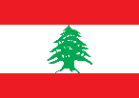
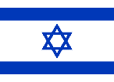
IDF Countermeasures
Notes:
In response to the threats from LH, in addition to their multiple violations of the Blue Line, Israel has begun the construction of a defensive barrier. The obstacle, which is completely constructed in Israeli territory, runs parallel to the BL, and is built in full coordination with UNIFIL.
As of November 2018, an estimated 8.5km of 11.26km has been completed. The project is slated to end within 2 years.

Slide 20
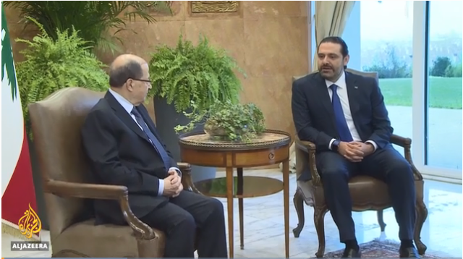
Lebanese Statehood?
Armed Hezbollah Solder in Southern Lebanon
Failed State
Notes:
Despite five months passing since Lebanon’s governmental elections in May 2018, the country has yet to establish a new stable government (it is currently managed by a surrogate, temporary government). The lack of an established parliament is further proof that the Lebanese government is disorganized and structurally insecure at this time. The lack of government has led to economical instability, due to inability to settle on a national budget, or create the necessary reforms to improve Lebanon’s financial systems.
Due to the lack of elected government, the Lebanese government cannot elect a new Chief of Staff for their military. The current Chief of Staff is due to step down in the coming months, and the government has yet to nominate his replacement.

Slide 21
Syria
Iranian Military Bases
Iranian Presence in Syria
Assad’s return to Idlib
Re-Opening of Quneitra Crossing with Israeli backing
Russian Presence
Notes:
In August 2018, President Assad’s regime had fully recaptured southern Syria, solidifying his victory and control of the country. The end of the internal conflict led to the departure of the Syria Civil Defense organization (“The White Helmets”), who, with Israeli assistance, were extracted from Syria via Israel to a third country. In addition, due to the return of the Syrian Regime, Israel has halted operation “Good Neighbor”.
As part of the Assad regime’s return, Israel, the United States, Russia, Syria, and the U.N have all expressed support for the return of UNDOF to the AOS and AOL in accordance with the 1974 agreement between Israel and Syria. UNDOF’s return to Syria has concluded with the reopening of Quneitra Crossing (the sole crossing point between Israel and Syria on October 15th.
However, despite President Assad’s insistence on Syria’s wish to return to the pre-internal conflict status quo, Syria has repeatedly violated the terms of the AOS. On July 11th, a Syrian UAV infiltrated Israeli airspace and was downed by IDF. In addition, Syria permits Iran-backed forces, such as Hezbollah cells, to enter the AOS region.
In September, Syrian forces accidentally shot down a Russian military plane after an Israeli airstrike on Syrian territory. All 15 Russians aboard the plane were killed. The accident briefly caused a crisis in Russia-Israel relations as the Kremlin blamed the Israelis, underscoring the risks of escalation from unintended consequences among the different forces operating in Syria. Two weeks after the Russian aircraft was shot down, Russia delivered four S-300s launchers to Syria, potentially making the already volatile region more dangerous.

Slide 22
Syria - UNDOF
Syria
Israel
UN OP52
Reopening of Quneitra Crossing
Notes:
In 2014, due to the danger posed by the internal conflict in Syria, UNDOF forces had evacuated southern Syria. Following Assad’s return to the region, Israel, UNDOF, and Syria (with Russia and the U.S’ support) have engaged in regional normalization attempts, including the reopening of Quneitra Crossing, the sole crossing point between Israel and Syria.
On October 15, the critical crossing point at Quneitra was reopened by Israeli and UN forces. The use of the crossing will be exclusively for UNDOF forces for the time being.

Slide 23
Jordan - 400 miles of Common Interest
Israel
Jordan
Border Security and National Stability
Notes:
The IDF is continuing to support and promote its mutual efforts with the JAF and the Hashemite Kingdom of Jordan to guard the Israeli-Jordanian border.

Slide 24
Jordan
“Israel will renegotiate the lease on lands with Jordan” – B. Netanyahu
Following Jordanian King Abdullah's decision to end Israel's lease on the Naharim (as a part of the 1994 peace treaty) (21.10.18)
Israel
Jordan
Amendments to the peace treaty
Notes:
In late October, Jordan has told Israel that it intends to reclaim two tracts of territories remained in Israeli private ownership under a 1994 peace treaty. Israel leased about 405 hectares of agricultural land in the southern sector of its border with Jordan called Tzofar, as well as the small Naharayim area near the confluence of Jordan and Yarmouk rivers. Following the king's announcement, Israeli Prime Minister Benjamin Netanyahu said that Israel would negotiate with Jordan an extension of the leases, which expire in 2019.
Despite the recent strains on the peace treaty and agreement, the IDF still maintains its cooperation with the Jordanian Armed Forces. For example, the IDF sent a number of elite forces and helicopters to assist in rescue operations at the request of Jordan during a flash flood near the dead sea. At least 18 people, mainly schoolchildren and teachers, were killed.

Slide 25
Egyptian Sinai
MFO
IS in Sinai
Border Security
Annual MFO Meeting
Notes:
The IDF continues to support its efforts with the Egyptian Armed Forces to maintain security on the Egyptian-Israeli border, as well as its cooperation with the MFO to maintain stability and peace in the Sinai Peninsula.
In November 2018, the annual conference was held in Rome between the MFO, IDF, and the USA. The conference occurs to encourage support for the MFO and spread awareness of their work in the region.

Slide 26
Gaza
Violent Mobs on the Rampage
Hamas Targeting Civillians with Rockets
Defensive Obstacle Construction
Ongoing Ceasefire Talks
Notes:
Violent Order Disruptions: The violent order disruptions and attacks that have plagued and characterized the southern region since March 2018 continue, with several thousand rioters attempting to forcefully enter Israeli territory. However, the number of arson kites and incendiary balloons has dropped, mostly due to Hamas efforts to prevent escalations during the ceasefire conferences in Egypt.
Hamas Rocket Fire: There were several small waves of rockets towards the end of September and early October, which reached a pinnacle mid-October. On the morning of October 17, two rockets were launched from Gaza; one that landed off the coast of Tel Aviv, and another that damaged a house in Beersheva. No one was harmed by the two rockets, but Israel retaliated by striking 20 targets in Gaza, including a Hamas attack tunnel in the southern Strip.
Escalation in the Southern Region: On November 11, an Israeli officer was killed and another was moderately wounded during an operation in the southern Gaza Strip. These clashes escalated throughout the 12th and 13th of November, with more than 460 missiles being fired into Israel. 28 citizens were wounded and 1 resident of Israel were killed. In response, the IDF struck over 150 military and strategic targets throughout the Gaza Strip, belonging to both Hamas and PIJ. Eventually, with the assistance of Egyptian brokers, both sides managed to reach a compromise and end the escalation.
Ceasefire Talks: The Hamas leadership agreed to an Egyptian-brokered reconciliation deal with the PA. This deal included the possibility of future ceasefire negotiations with Israel. The PA refused to cooperate due to the lack of recognition of Israel’s authority, as well as the belief that Hamas shouldn’t be a representative of the Palestinians.
Defensive Obstacle Construction: In addition the ceasefire initiative, the IDF is continuing the construction of the Indicative Wall – a subterranean barrier on its southern border in a bid to preemptively thwart threats emanating from the Gaza Strip. The Indicative Wall will further prevent Hamas from burrowing attack tunnels into Israel. The project, which consists of a 40 mile wall along the border with Gaza, is expected to be complete in 2020.

Slide 27
Ashkelon
Israel Defense Forces International Cooperation Unit Military Strategic Information Section For Official Use Only
12-13/11/18
Zikim
Gaza Report - Summary
12-13 November, 2018
Netiv Ha’Asara
House in Ashkelon struck by rocket
Sderot
Nir Am
Nahal Oz
Bus struck by Hamas rocket, leading to injury of IDF soldier
Be’eri
Netivot
Kisufim
Ein HaShlosha
Nirim
House in Netivot struck by rocket
Rockets fired by Hamas | Israelis injured by Hamas attack | Israelis killed by Hamas attack | Rockets intercepted by IDF | Gaza targets struck by IDF
460 | 85 | 1 | 100 | 150
Sufa
Kerem Shalom

Slide 29
Summary
Israel Defense Forces International Cooperation Unit Military Strategic Information Section For Official Use Only
12-13/11/18
Israel is committed to defending her interests, her citizens and her infrastructure, and retains the right to take any measures required to support this aim.
Hamas bears full responsibility for the Gaza Strip.
Egypt continues to play a major role in supporting deconfliction and maintaining stability (as far as possible) regarding the Gaza Strip.

Slide 30
Judea and Samaria
UNRWA Funding
Failed Talks between PA and Hamas
IDF Counter-Terrorism Ops
PLO Incitement
Notes:
1. PA-Hamas Talks: During July 2018, the PA and Hamas begun conducting talks in Egypt in order to end the Fatah-Hamas dispute. However, due to several disagreements between the PA and Hamas, among them negotiations with Israel regarding removal of economic sanctions on the Gaza Strip (the PA has refused to engage with Israel), and the PA’s wish that Hamas hand over the full responsibilities over the Gaza Strip, the talks were postponed to the end of August.
As of early September, the talks have yet to resume between the two parties, with the rift between Hamas and PA continuing to grow.
2. UNRWA Funding: In late August, United States President Donald Trump announced that the U.S will halt all funding of UNRWA, the UN agency responsible for Palestinian humanitarian assistance. This move is the latest in a line of cuts of foreign aid given to Palestinians by the United States (the White House had previously cut $300 million dollars of annual funding from the organization). As a response, the German government announced it would boost its funding of the UN agency, although it was not stated what amount would be donated.
3. PLO Central Council: The PLO central council held its annual meeting in Ramallah, with focus on recent developments in its relations with the United States. The council decided to enact a number of resolutions, including the Palestinian Authority’s decision to suspend its recognition of Israel, and to end their security coordination with Israel while also suspending all economic agreements.
4. Rise in Terrorism: There has been a recent rise in terror attacks, these attacks are believed to be independent of the rising tensions in Gaza. At the beginning of October, there was a terror attack in the Barkan Industrial Park, where a 23 year old Palestinian worker opened fire and killed two Israelis and critically injured a third. The PIJ called the attack a “natural response” to Israeli actions in Gaza, Jerusalem and Khan al-Ahmar. Most recently, on the 14th of November, four policemen were injured in a stabbing attack at a police station in Jerusalem’s Armon Hanatziv neighborhood. Police reported that the attacker arrived at the entrance to the police station and attacked three officers. He was subsequently shot and seriously injured.

Slide 31
Bottom Lines
Instability in the Foreseeable Future
Iranian Proxies in Syria & Lebanon are a direct threat to National Security
Proliferation of advanced weapons
Partners vs Common Interest
Solution(s) vs Management
Military Liaison Facilitates Common Ground & Improved Awareness

Slide 32
Thank you for your kind attention
Produced by IDF-MC - FOUO

