Slide 1
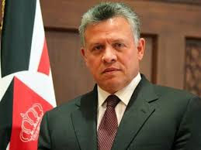
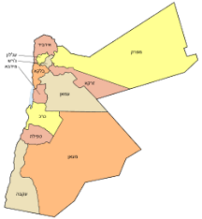
INDC Tour to Jordan
Leading Team - Michal, Avi and Levius
22-23/03/20

Slide 2
Tour Objective
The INDC students will get acquainted with Jordanian kingdom and the main strategic processes that occurred and are occurring in Jordan in the context of national security

Slide 3
Required Achievement
Exploring basic terms
Acquaintance with the social structure of the kingdom
Acquaintance with the Kingdom's Security Challenges
Acquaintance with the Kingdom's Economic Challenges
Acquaintance with the foreign policy and stabilization of the kingdom in a regional and international context
Acquaintance with the bilateral cooperation between Jordan and Israel

Slide 4
The Research Question
What is the geopolitical importance of Jordan and how is its stability preserved in face of the interior and exterior complexities of the kingdom?
Social - Tribes, Pleas, Refugees, Sunnah, Shia, Salafia
Security - Interior, Syria, Iraq, Iran
Political - Regional (Israel, Palestine, Sunni); Internationally
Economic - Trade and Industry, Unemployment, Foreign Aid

Slide 5
The Tour and Preparation Process

Slide 6
The Method
Two day tour;
Meeting with all the national security delegates
Three preparatory sessions
Background reading material

Slide 7
Materials
Shimon Shamir's book
Book in English - Tour Guide
Based on digital content
Abdullah has many faces
Historical and general overview
Refugees
Economy
Stability and challenges of the kingdom
Distribution of the content of the tour (according to the stations)

Slide 8
Three Preparatory Sessions
Hashemite Kingdom - History,
Characteristics and Challenges of the Interior and Exterior - Professor Asher Hasser (9/3)
2. The Peace Agreement and the Israel-Jordan relations - Oded Eran (19/3)
3. TBD

Slide 9
Sunday Schedule
06:00 Leaving the INDC
06:30 Pick up from Latrun
08:00 Breakfast and a brief review at the Allenby Passageway
08:30 Entering Jordan and driving to Mount Nebo (short stop for a review)
09:30 Observation and briefing on Mount Nebo
10:00 En route to Madaba
10:30 Briefing in Madaba and conversation with a senior Jordanian
12:00 En routel to Amman
13:00 Lunch at the War Museum
14:00-16:00 Museum tour and top Jordanian briefings
16:00 En route to the amphitheater
17:00 Tour and brief overview of the amphitheater (impression of the city)
18:30 Dinner in Amman
Proceed with the alternatives on the next slide

Slide 10
Sunday Night Alternatives and moving to Petra (by Priority)
Alternative A - Accommodation in Amman and early departure. Flying to Petra with the IAF.
Alternative B – Finishing the tour at the Amman landing strip. Night flight by the IAF. Accommodation in Petra.
Alternative C - Night ride after dinner at Petra. Accommodation in Petra.
Alternative D - Accommodation in Amman. Day trip to Petra (early departure).

Slide 11
Schedule for Monday (except for Wednesday alternate where the tour will start at 10:30 and will be shortened)
Morning schedule - according to alternatives
08:00 Starting the tour in Petra
14:30 End of tour and starting traveling south
16:00 Observation of Aqaba and the bay and a briefing
17:30 En route to the airport
18:45 Return flight and dispersal

Slide 12
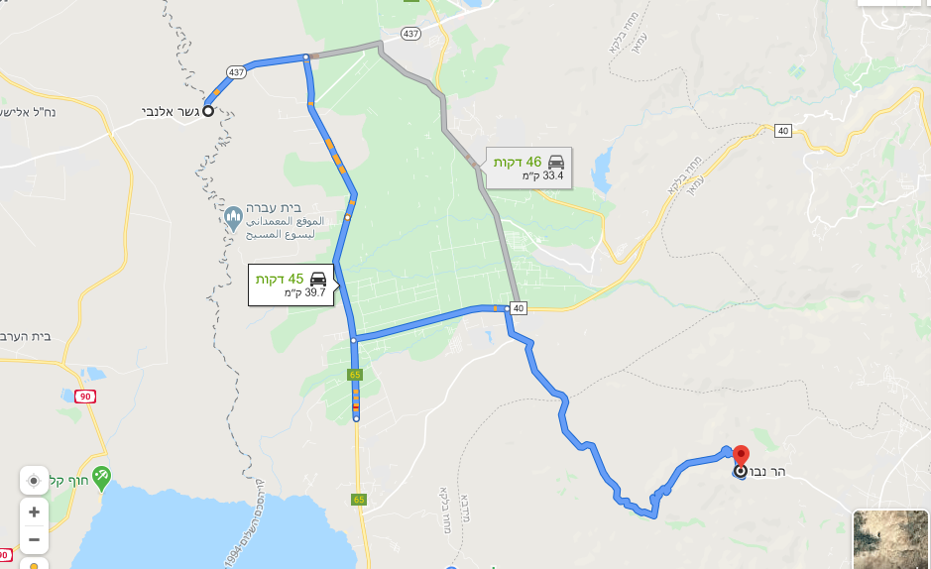
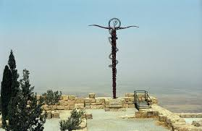
First Segment (Allenby - Mount Nebo) - 8:30 am - 9:30 am

Slide 13
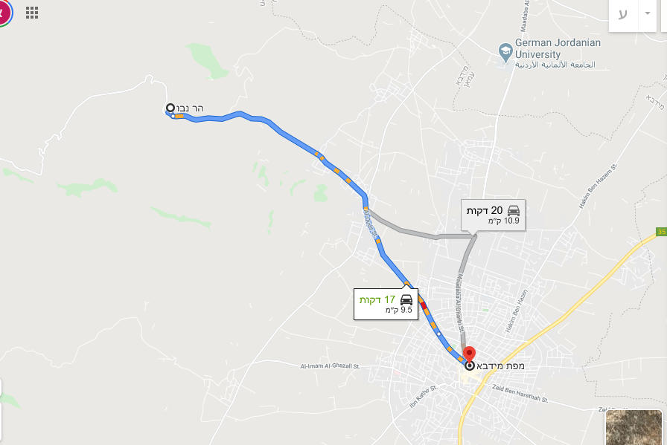
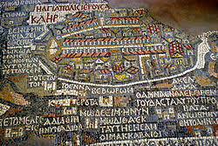
Second Segment (Mount Nebo - Madaba) - 10:00 - 10:30

Slide 14
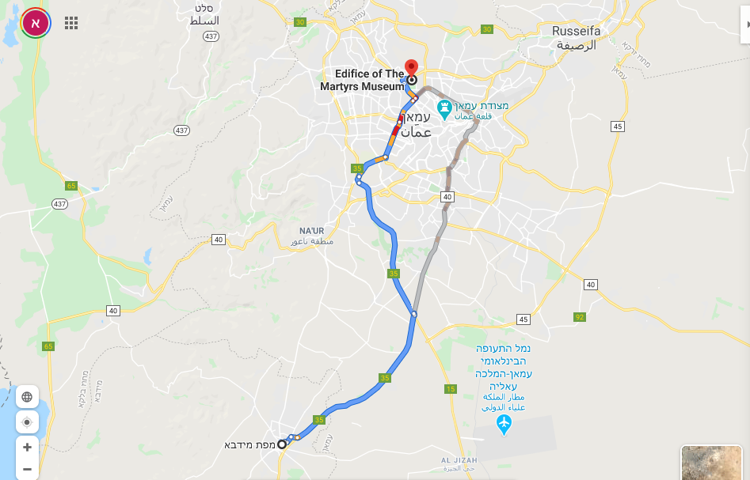
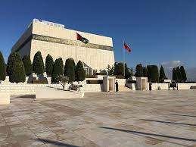
Third Section (Madaba - War Museum) - 12: 00-13: 00

Slide 15
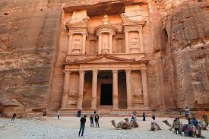
En Route to Petra (Alternatives C and D) – Via Road 15, about 3.5 hours

Slide 16
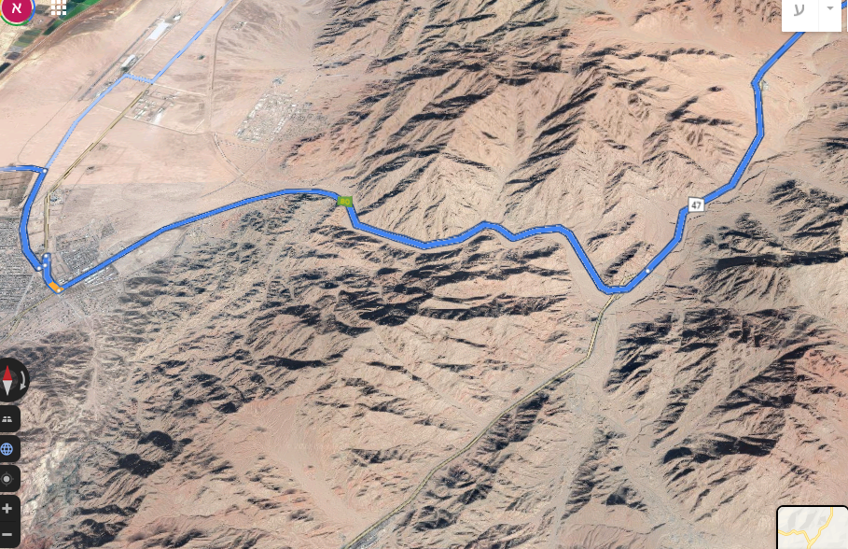
From Petra to Wadi Araba Border Road – Via Road 47, about 2 hours
Lookout on the way to
Aqaba / Eilat and the Gulf

Slide 17
Background

Slide 18
Numbers Telling a Story
3-4 million Palestinians
3 million other refugees
10 million residents minorities and tribes
74 Years of Independence (1946)
97,000 square kilometers
Most of the population is concentrated between
Amman - Irbid
Gross domestic product
$ 43 billion
Gross domestic product
per person
$ 3236
1-2 percent annual growth
18-19 percent unemployment

Slide 19
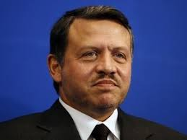
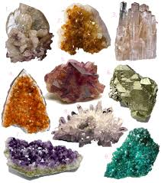
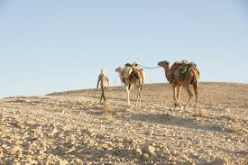
The Strategic Environment
The Inner Complex
The Regional
Complex
The Economic Complex
Palestinians
Hashemite
The Sunnis
Foreign aid
Opposition
Tribes
Unemployment
Shi'ite axis
Refugees
Monarchy
Education
The holy places
Israel
Security officials
The Palestinian Authority
Gross National Product
Salafi Movement
The International
Complex
Parliament
Agriculture
The Physical Complex
Aggregates
Tourism
Water
Energy
Desert
Natural Resources

Slide 20
Key Challenges
Economic - Unemployment, low GDP, desert, low growth potential, natural resources
Interior - refugees, opposition, Palestinians, relations with Israel
Security - Iran, Syria, Iraq, ISIL
International - US involvement in the area
Deal of the Century- Resistance
(cautious)

Slide 21
Central Tensions and Balances
Arab - Western
Israel - Palestine and Palestinians
USA - Russia
Irbid - Amman - Spar Desert (Ma'an - Zarqa)

Slide 22
Stabilizers
'Monarchy - Enlightened'
National identification
'Its strength is in its small size'
Regional ownership
International ownership
Refugees - having a stable economic background

Slide 23
Israel & Jordan

Slide 24
Peace Treaty Highlights
Borders - under the agreement it was agreed on land swaps and leases in two areas (Naharayim and Tsofar). Jordan refrained from summarizing the issue of borders in the area between Beit She'an and Ein Gedi, claiming that the PA should be involved in this agreement.
Normalization - in which it was agreed to establish diplomatic, economic, and advanced trade relations.
Security - in which it was agreed on cooperation in the prevention of terrorism and in the prevention of terrorist activity or another country threatening one of the parties.
And other sections on the Jordanian status in Jerusalem and the Temple Mount, water and displaced persons.

Slide 25
Israeli Interests
Jordan acts as a secure buffer along Israel’s longest border towards eastern countries.
Large security operation zone (aerial and other) in the Middle East.
Stabilizing factor in the Palestinian conflict and holy sites. It is potentially a component in a future political agreement with the PA.
Access to the Sunni World and other moderate countries
Jordan expands Israel's assets in relation to the US and the European Union seeking to maintain its stability.
There is economic potential in regional and bilateral projects as well as trade and transportation from the Jordanian area.
Jordan can serve as a Jewish-Arab Coexistence model

Slide 26
Jordanian Interests
A Secured and stable front.
Israel maintains an unofficial defense pact with the Hashemite's
Israel acts as a regional deterrent for protecting the stability of the Hashemite monarchy.
Israel acts as a political buffer between the Palestinian interests and Palestinian threats at home and abroad to the Hashemite Monarchy.
Israel allows further access to Western countries, with emphasis on the US
There are potential bilateral economic projects between Israel and Jordan

Slide 27
Principles For Establishing Relationships (From Shimon Shamir’s Book)
Constantly securing and sustaining the state of peace.
Fostering friendly relations and cooperation with the monarchy.
Developing the strategic dialogue between the two states
Sustaining the Hashemite Kingdom as a top priority
Proposing stable understandings between Israel, Jordan and the PA
Actively attempting to advance area advancement projects and economic cooperation
Exercise of public diplomacy vis-à-vis the Jordanians to establish peace relations and friendships.

