Slide 1
INDC 46th class tour to Jordan
February 19
Shay Fireaizen (Team 4 Instructor)

Slide 2
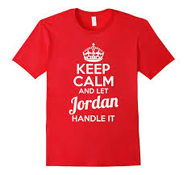
Objectives
To understand the Jordanian interests in it’s relationship with Israel and it’s neighboring countries in the current time.
Preparation for the Political-Security experience

Slide 3
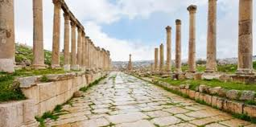
Research question
What are the interests, threats and opportunities in the Israeli/Jordanian relationship?
Preparation:
Lecture by the former Israeli ambassador to Jordan
Top 10 - MG Amir Baram
Lecture and tour of the Temple Mount
Reading material

Slide 4
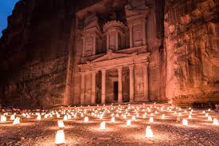
Emphasis
Departure - Sde Dov, Ramat David
Dress Code – INDC + warm clothes
Passports
No unnecessary / classified materials
Money for coffee / Baklava
Food throughout the day
How to ask questions + gift exchange

Slide 5
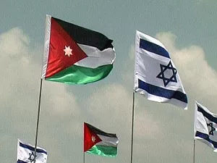
Processing
Wednesday, February 13, 2019.
Led by the Instractors
What are the interests, threats and opportunities in the Israeli/Jordanian relationship?

