Slide 1
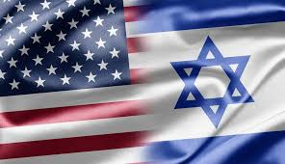
Tour of the United States
Team 4
46th Class

Slide 2
The Research Question
What is Trump’s strategy in the international arena as a whole?

Slide 5
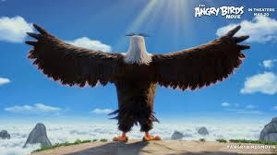
Did you get the point?

Slide 6
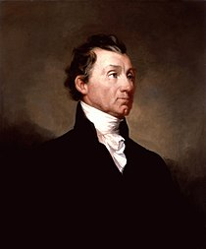
The Monroe Doctrine
The American continent is no longer open to European colonialism and any European effort to expand influence in the New World will be considered "dangerous to our safety and security." The United States will not interfere in the internal affairs of Europe and expect European countries not to interfere in the affairs of the Americas.
President James Monroe
1758-1831

Slide 7
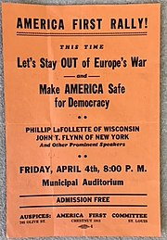
World Wars
The World War I: The US is dragged into war three years after its outbreak and after the discovery of a "Zimmerman telegram" threatening the US.
President Johnson was elected in 1916 under the slogan - "He kept us out of the war."
World War II: The US entered the war only in 1941 after the Japanese attack on Pearl Harbor and a declaration of war by Germany.
America First Movement (AFC): A mass movement opposed to the entry into World War II. Closed after Pearl Harbor.
Since then, the United States has been a world policeman promoting democratic values

Slide 8
The Obama Doctrine
Partnership
Values
Diplomacy

Slide 9
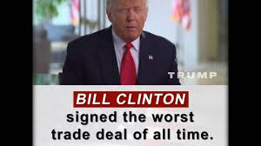
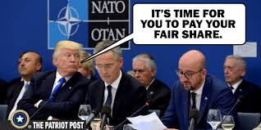
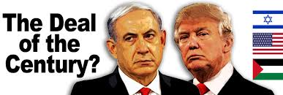
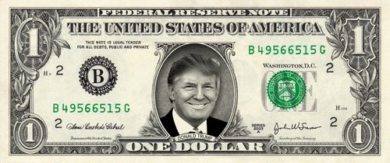
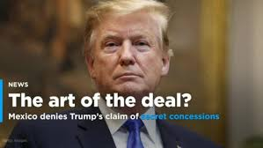
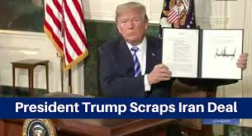
The Trump Doctrine
1. It’s All About Money

Slide 10
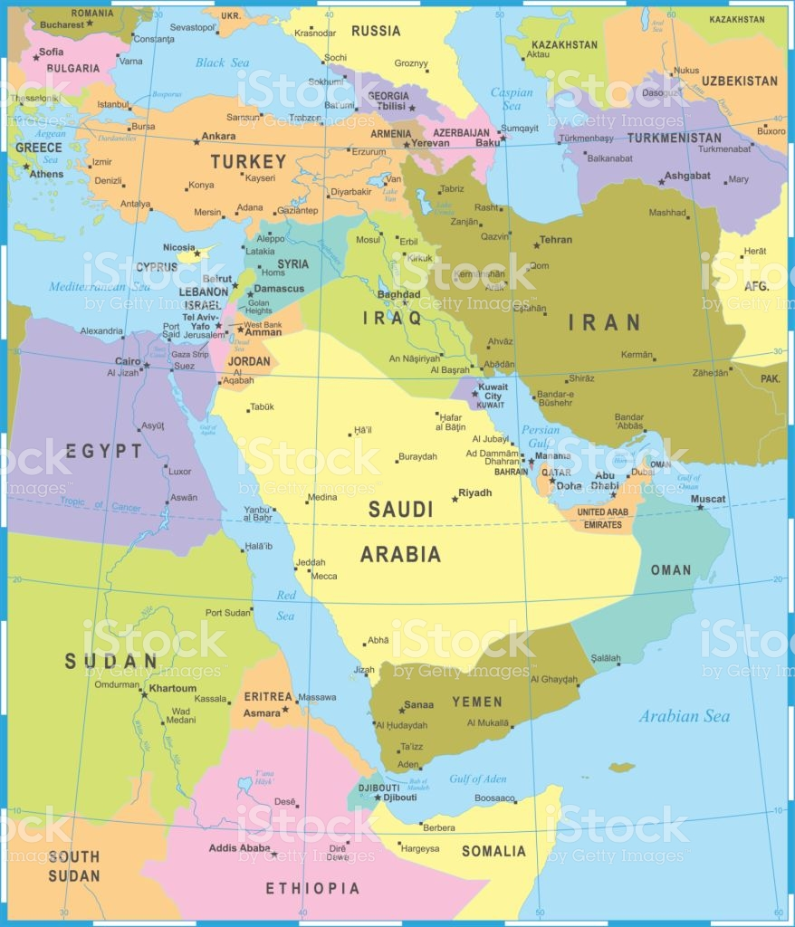
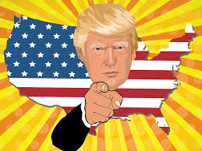
The Trump Doctrine
2. Disengagement
(no boots on the ground)

Slide 11
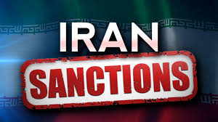
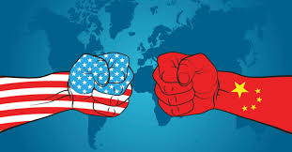
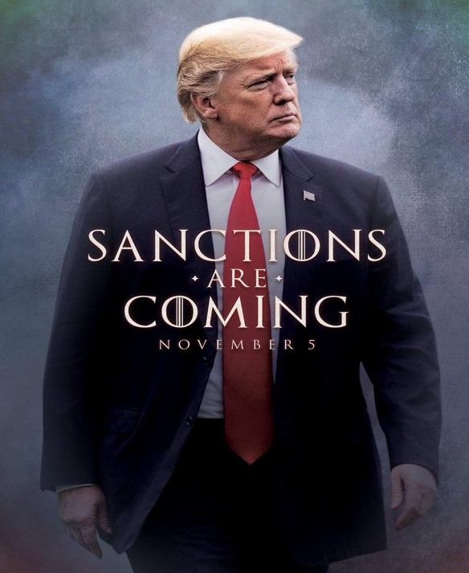
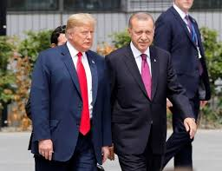
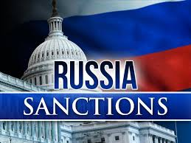
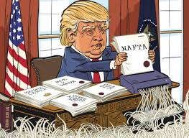
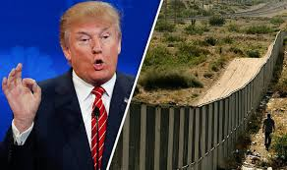
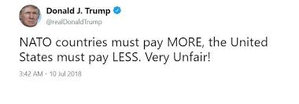
The Trump Doctrine
3. Economic Pressure
Notes:
פריזמה כלכלית מכתיבה הכל

Slide 12
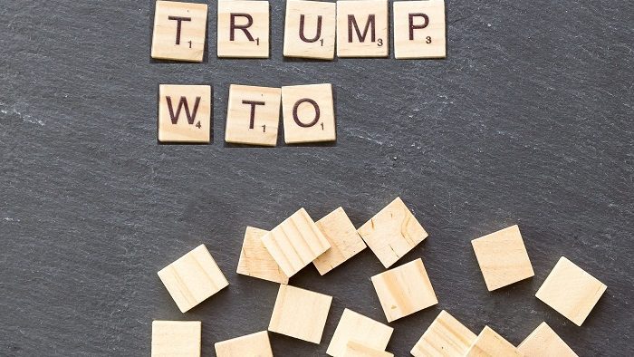
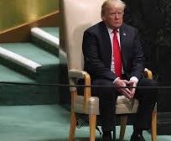
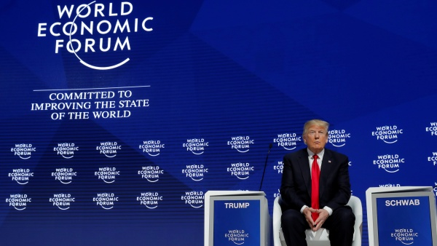
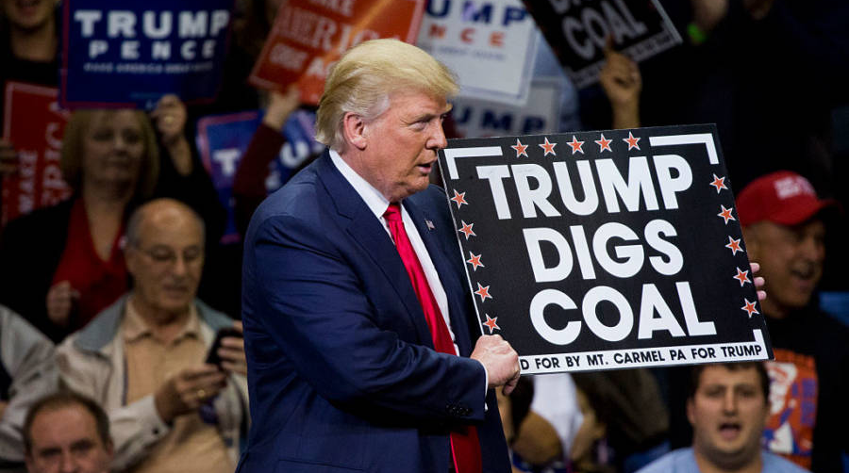
Notes:
ארגונים בינלאומיים והסכמים בינלאומיים בעידן טראמפ

Slide 13
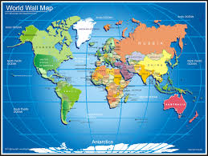
Priorities
1
China
Designers:
Technological and economic hegemony
Energy independence
Undermining stability
2
2
Russia
4
1
3
3
North Korea
Mutual influences must also deal with the problems of low preference
4
Iran

Slide 14
To Summarize
The United States will act in a foreign policy that will maximize its economic achievements, with the help of intense economic pressure and no significant military presence on the ground
Values
democracy
Human Rights
Climate problems
OUT
OUT

Slide 15
Questions?

