Slide 1
Military-Security Dangers (according to military doctrine 2014)
Expansion and empowering of NATO
Disruption of the strategic-nuclear balance
International terror
Foreign military presence/activity near borders
"Colorful Revolutions" near the Russian border
Armed conflict near the Russian border
Foreign subversive activity inside Russia
Foreign influence of Russian public awareness
Increased social and ethnic-based tensions

Slide 2
The characteristics a modern military conflict
Precise weapons, super-mach speed , electronic warfare, robotics
Potential use of public protest; external political and social manipulation
Use of military and non-military means
Shortened preparation times for action
Speed of maneuverability of forces and fire, special forces, damaging infrastructure
Simultaneously influencing the enemy on all levels and in all dimensions
Command and control - from vertical to network
Use of irregular forces and private military companies
Use of indirect and asymmetric means
Nuclear weapons - an important component to prevent conventional and non-conventional conflicts

Slide 3
Well-known myths concerning Russian forces
"Gerasimov Doctrine" is new Russian concept for the use of force.
Russia is waging hybrid warfare against its opponents.
Russia's use of force is primarily based on non-military means (especially psychological and information warfare).

Slide 4
What is the Russian military concept
Social and Political Phenomenon - not just an armed conflict.
Scientific Phenomenon - recognizing the objective laws controlling it helps the system succeed, and enables the character of the future war to be predicted.
Ways to fight the enemy - political, economic, and awareness efforts, not just military.
The character of war is influence by social, political, industrial and psychological components; and from technological developments and changes in attitudes toward war.
Categories of War (according to military doctrine):
Broad-scale war
Regional war
Local war

Slide 5
What is Military Strategy from the Russian Perspective
Science: "...the art of leading forces" ; "... a system of knowledge to prevent war, prepare for it, and manage it".
The dealings of military strategy - the armed conflict on the strategic level.
The primary content of military strategy - dealing with the use of force, consideration of, and coordination with, non-military means - but not managing them directly.
The principle of preventing war - predicting the development of the political and strategic situation to identify risks and threats in order to respond to them in time.
The principle of preparing for war - readiness and capabilities of the armed forces, ensuring strategic reserves.
The principle of managing the war - coordination between military and non-military means, with the armed forces holding a decisive role.

Slide 6
What is Russian Military Strategy
"Strategy of active defense" - a collection of actions to neutralize threats to the country's security.
"Strategy of limited action" - protecting national interests and promoting them outside of Russia (the Syrian endeavor).
The key to success on the strategic level - surprise, determination, continuity and speed.

Slide 7
Force operation - patterns and influential factors
There is not one operational model/force operation concept
Main Forms and Methods for Force Operation
Strategic preparation
Strategic action
Special operations
Peacekeeping operation
Strategic nuclear deterrence, not nuclear
Humanitarian operation
Principles of military art
Characteristics of the modern military conflict

Slide 8
Principles of Military Art
The 1970s | Beginning of the 21st century
High military readiness to carry out missions in any situation | Maintaining combat readiness and preparing for force activation (competence)
Crucial concentration of forces needed at the required time in directions that are the most important to resolve the main mission | Crucial concentration of means needed at the required time in directions that are the most important to resolve the main mission
Coordinated use and close cooperation between the military units and services. | Coordinated use and close cooperation between the military units and services
Surprise, decisiveness and aggression of military actions, with continuous efforts made to achieve and maintain the initiative. | Surprise, activeness, continuity and decisiveness in operations
 | Achieving and maintaining the initiative
Tenacity, resistance, determination and decisiveness during the mission
 | Reinforcing the achieved success
Inclusive security for combat actions | Creating reserves ahead of time, skillfully using them and returning them to previous readiness levels
Quickly returning the forces to their previous levels of combat competence | Maintaining the forces' competence and returning them to required levels quickly
Uncompromising and continuous leadership | Stability and continuity of control over the forces
Deeply destroying the enemy and everything it has prepared for, building forces at the right time and wise maneuvering of forces and means to develop a fast military action to destroy the enemy within a short time | Force maneuverability, with combat means and fire power
 | Managing active information warfare in all the preparations stages and during combat
Consideration of the moral-political element, and fully utilizing it | Constant consideration of the moral-psychological perspective, and fully utilizing it

Slide 9
Military actions
(voyennye deistviya)
Types
(vidy)
Forms
(formy)
Methods
(sposoby)
..
Operation
(operaziya)
Offensive
(nastupleniye)
Combat actions
(boyevye deistviya)
Organization and method of using forces and means to carry out missions
Defense
(oborona)
Retreat
(otstupleniye)
Campaign
(srazheniye)
Counter-attack
(kontr-nastupleniye)
Strike
(udar)
Combat
(boi)

Slide 10
Russian Use of Force - Principles and Art
Avoiding template thinking - modifying tools and methods for objectives and constraints, for example:
Decentralized maneuvers, strengthening tactical units (BTG concept)
Return to the basic formation of the division, force maneuvers on a strategic scale
Fast and surprising action while taking the initiative and defining facts on the ground.
Use of the minimal but logical amount of force
Conserving resources - concentration of efforts, overseeing efforts not to be drawn into the conflict
Reduce political and economic costs (possibly, and mainly, due to constraints)
Surprise
Emphasis on asymmetric tools and methods
Information warfare (of all types)
Deterrence - force projection as a means to influence
Not innovation, but gradual evolution of methods of action (and often a return to older methods modified for modern technology) - according to the essence of the enemy and reference threat - the result of friction and the accumulation of operational experience, in addition to various constraints and limitations.

Slide 11
Local Government:
Structure of the country and election methods
Internal division of districts
Constitution

Slide 12
General:
Russia returned to be a separate country with the breakup of the Soviet Union in 1991. Under Soviet rule, it was called "Russian Soviet Federative Socialist Republic" and became a federation after it was established. Most of the Soviet Union's land, population and industry - one of two superpowers, were in Russia. As a result, since the dissolution of the Soviet Union, when Russia inherited the permanent seat on the Security Council, it has been trying to establish itself as an important superpower, and in many ways considers itself its successor.

Slide 13
The Country's Structure and Government
Russia is a presidential federation. Russia's constitution, which was passed by public referendum in 1993 created the basis for a presidential regime. The president has wide-reaching powers and was elected in general, secret and direct elections for a term of six years. The president resides in the Kremlin. The president appoints the government and the prime minister, deputy prime minister and the ministers, who must win approval of the lower house of parliament. In addition, the president is involved in the appointment of senior officials. The president is also the commander and chief of the Russian military and the National Security Committee. The president can issue orders without approval by the parliament.
The Russian Parliament is called The Federal Assembly of Russia, and is comprised of two houses. The upper house of the Federal Assembly has 170 representatives who are appointed for a term of four years (two representatives from each of Russia's 88 federal soviets). The lower house, the Duma, has 450 deputies, who are elected for five years through proportional elections.

Slide 14
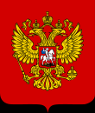
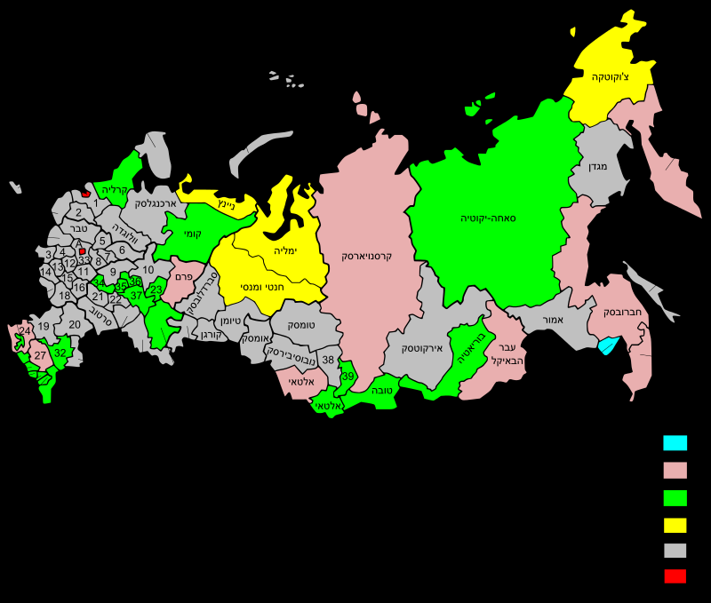
Division into Districts

Slide 15
Division into Districts
Due to its being the largest country in the world, the Russian Federation to a large number of administrative units, all subject to the federal government. There are a total of 83 federal soviets: 21 of them are republics, 46 are oblasts, 9 districts are krais, 1 autonomous oblast (the autonomous Jewish district), 4 additional districts (not oblasts) and 2 federal cities (Moscow and St. Petersburg). In 2014, after the annexation of the Crimean Peninsula, an additional republic was defined, and Sevastopol was recognized as the third federal city.
The federal soviets are equally represented in the Federal Assembly (the upper house of the Russian parliament). However, they differ in the amount of autonomy they are awarded.
Three of the federal districts are in Europe, and three are in Asia.

Slide 16
Constitution:
The constitution of the Russian Federation was adopted in a referendum on December 12, 1993. It replaced the constitution of the Soviet Union that became valid in April 1978, and the method of government that existed in Russia from 1991 until the public referendum was held. From all eligible voters, 58,187,755 (54.8%) anticipated in the referendum; 32,937,630 of these voters chose to adopt the constitution.

Slide 17
International Relations - Environment
Ukraine
Baltic states - Estonia, Lithuania, Latvia
Belarus, Georgia, North Korea
North Pole

Slide 18
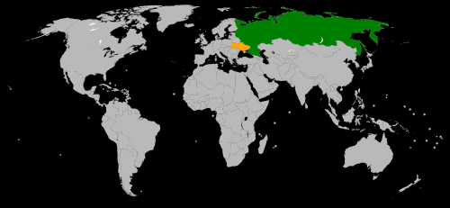
Ukraine

Slide 19
Ukraine
The complex government relations between the two countries have experienced proper relations, tensions and blatant hostility since 1991. Prior to the Euromaidan (2013- 2014), under the Ukrainian president, Viktor Yanukovych (in power from February 2010 until February 2014), relations were cooperative with various trade agreements. After the Ukrainian revolution in 2014, which overthrew the pro-Russian Yanukovych government on February 21, 2014, Russia-Ukraine relations quickly deteriorated. This led to the return of Ukraine's ambassador from Russia in March 2014. Since then, the highest diplomatic representative of Ukraine in Russia is a temporary chargé d'affaires. Similarly, since July 2016, after the Russian ambassador to Ukraine Mikhail Zurabov was relieved, Russia's highest diplomatic representation in Ukraine has also been a temporary chargé d'affaires
Military skirmishes between pro-Russian rebels, which are backed by the Russian military, and the Ukrainian armed forces began in April 2014. On September 5, 2014, the Ukrainian government and representatives from the new Donetsk People's Republic signed the Minsk Protocol - a ceasefire agreement. The ceasefire was broken when fierce battles broke out in January 2015. The new ceasefire agreement became valid in mid-February 2015, but this agreement could also not stop the fighting.

Slide 20
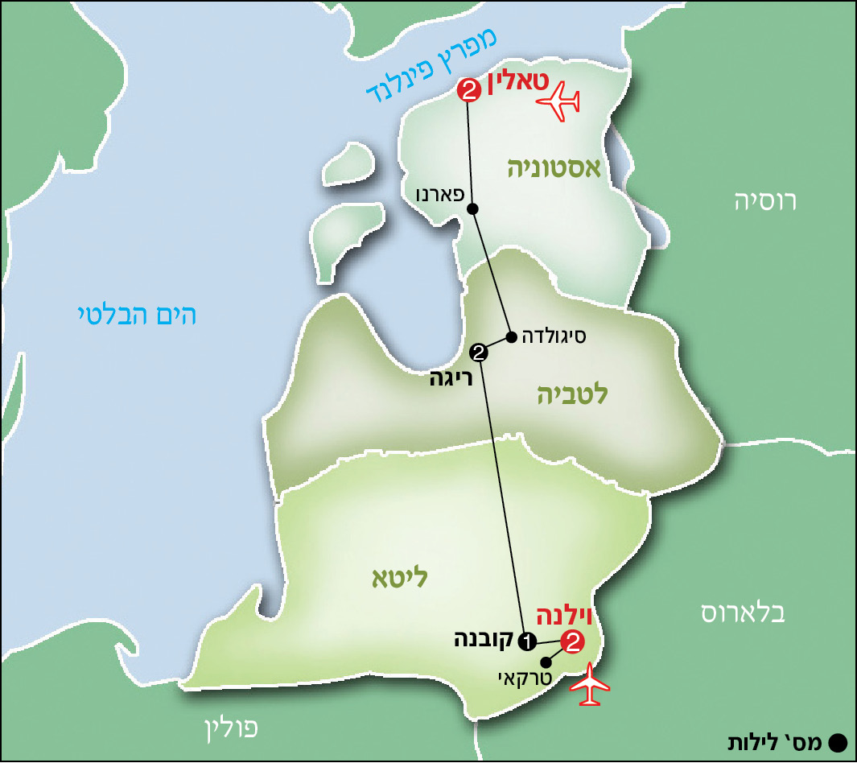
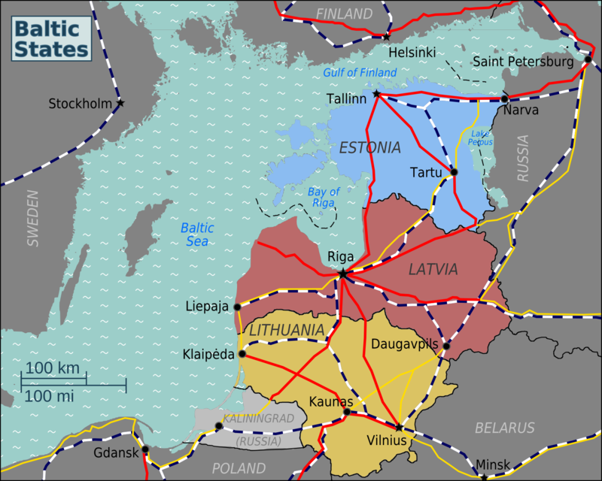
The Baltic States

Slide 21
The Baltic States
The Baltic States are three countries bordering the Baltic Sea: Lithuania, Latvia and Estonia. There are other countries lying along the Baltic Sea, but the name "Baltic States" is unique for these three countries. Before WWII, Russia treated Finland as a fourth Baltic state.
In the 19th century, the Baltic States were part of the Russian Empire. In 1918, at the end of WWI, the three countries won their independence. In 1940, according to the secret Molotov–Ribbentrop Pact that was signed on August 23, 1939 between Nazi Germany and the Soviet Union, the Soviet Union annexed the Baltic States and part of Finland. In 1941, Germany conquered these countries, and in 1944, they returned the Soviet Union's control, and the included as "social Soviet republics". In August 1991, several months after the fall of the Soviet Union, each of the Baltic States declared their renewed independence, and they were recognized by Russia and the West.
In 2002, the Baltic States began working to achieve their plan to join western Europe. On March 29, 2004, the Baltic States were accepted as NATO members, and on May 1, 2004 they were accepted as members to the European Union. In 2007, the Baltic States joined the Schengen Agreement, which in practice cancelled passport control between the borders of the Baltic States and the other countries that are members of the Schengen Agreement.

Slide 22
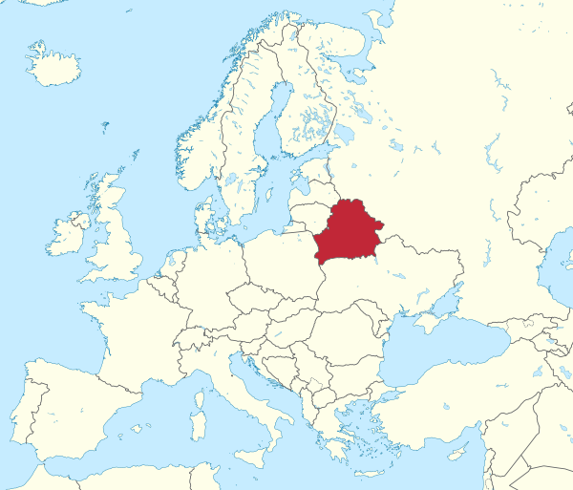
Belarus
Belarus or White Russia is a landlocked country bordered by Russia to the east, Ukraine to the south, Poland to the west, and Lithuania and Latvia to the north. It belonged to the Soviet Union, but declared its independence following the breakup of USSR. Since 1996, Belarus has signed a series of treaties with the Russian Federation to create an entity called The Union of Russia and Belarus, as the first step towards possible unification between the countries.

Slide 23
Georgia
The Georgia-Russia war was a military conflict that broke out in August 2008 following heavy exchanges of fire between Georgian military forces and rebel forces from Abkhazia and South Ossetia, the Russian military and Russian Peacekeeping forces that were serving in these districts.
The tensions that resulted in the military conflict between Georgia and Russia began at the end of July 2008. On August 1, 2008, Georgia embarked on a military operation in South Ossetia with the goal of gaining control over Tskhinvali, the capital of the breakaway republic. The tensions led to heavy exchanges of fire in the night of August 7, 2008, when Georgian military forces shelled the capital of South Ossetia, Tskhinvali. On August 8, under circumstances which are still unclear, Russia sent artillery, armor and infantry forces of the Russian military to the area following its promises to assist the Ossetian rebels. According to the Russian president, Dimitry Medvedev, Russia's intent was to protect the citizens of South Ossetia who hold Russian identity cards. The Georgian president, Mikheil Saakashvili, claimed that his country was defending itself against Russian aggression. He added that Russian forces are indiscriminately bombing civilian targets in Georgia.

Slide 24
Georgia
For several days, the armed forces of the Russian Republic, together South Ossetian and Abkhazian forces forced the Georgian military out of South Ossetian and Abkhazian areas. The Russian army even invaded Georgia itself, and for several days held several main cities in western Georgia, such as Zugdidi, Senaki, Poti and Gori. Between August 14 to 16, Russia and Georgia began to hold negotiations to calm the situation, and on August -26, Russia officially recognized the independence of South Ossetia and Abkhazia. In response, Georgia broke off diplomatic relations with Russia on September 2. However, if Georgia was a candidate to join NATO, following the war, the process of joining was frozen.
Russia completely withdrew it forces on October 8. The war caused 192,000 people to become refugees, and while many have returned to their homes, 20,272 of them remain refugees.

Slide 25
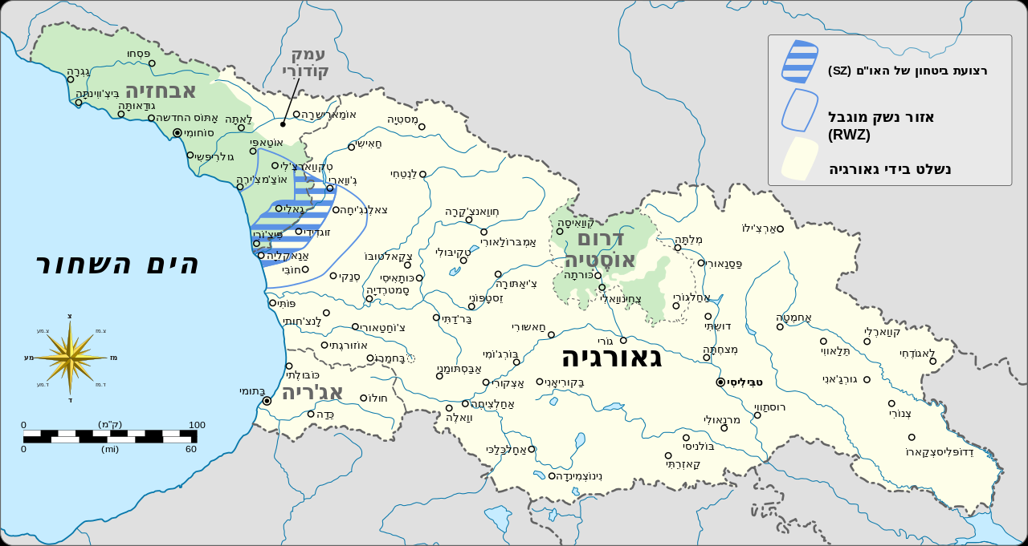
Georgia
UN Security Zone (SZ)
Restricted Weapons Zone (RWZ)
Controlled by Georgia
South Ossetia
Abkhazia
Georgia

Slide 26
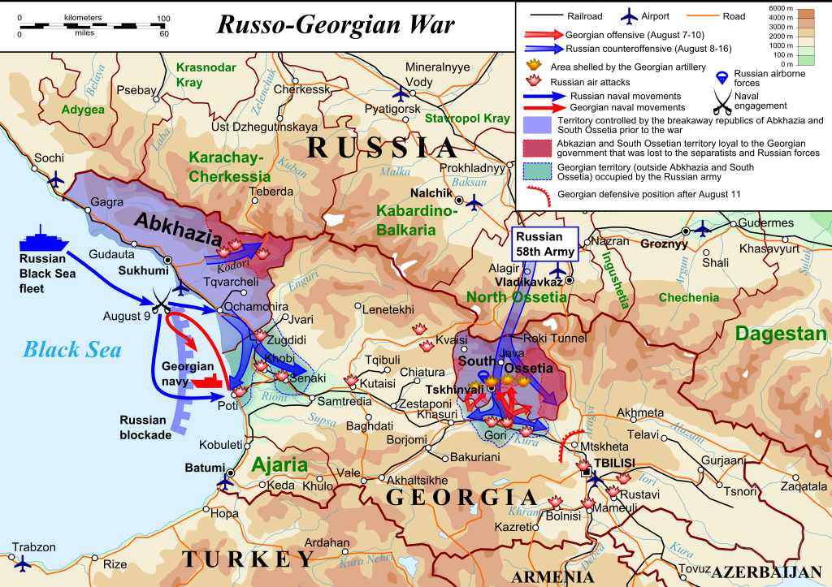
Georgia

Slide 27
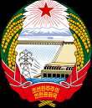
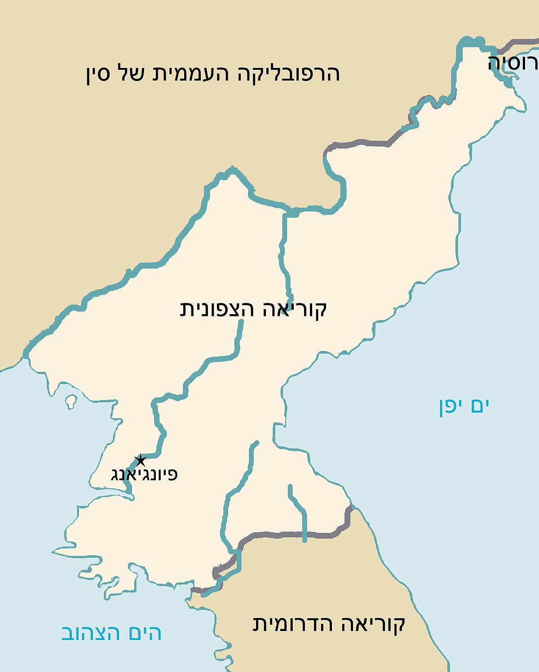
North Korea
China
North Korea, is officially known as the Democratic People's Republic of Korea (in Korean: 조선민주주의인민공화국, Chosŏn Minjujuŭi Inmin Konghwaguk) is a country in East Asia constituting the northern part of the Korean Peninsula. Pyongyang is its capital and the largest city in the country. Korean Demilitarized Zone (DMZ) in the southern part of the country separates North Korea from South Korea. The country is bordered by the People's Republic of China to the north and west, and it has a short border with Russia to the north-east.
North Korea
Pyongyang
South Korea

Slide 28
North Korea
The relations between the two countries began on October 12, 1948, when the Soviet Union recognized North Korea.
Following the dissolution of the Soviet Union, the new government, led by Boris Yeltsin, refused to support North Korea.
In 1996, the two countries agreed to return the economic cooperation between them, and to also collaborate in the fields of science, technology, light industry and transportation. This was the first time this had happened since the dissolution of the Soviet Union.
The first summit between Russia and North Korea took place following the appointment of Vladimir Putin as Russia's president. The two countries signed a joint declaration in the summit.
In 2006, Russia supported the United Nations Security Council Resolution condemning a North Korean missile test.

Slide 29
North Korea
After the North Korean nuclear test on 25 May 2009, Russia, joined China, France, Japan, South Korea, United Kingdom and the United States in starting a resolution that could include new sanctions on North Korea, as it was afraid that this missile test could cause a nuclear war. On 15 June 2009, China and Russia supported the UN sanctions on North Korea. However, the two countries stressed that they did not support the use of force.
On October 18, 2011 Russian and North Korean officials marked the 63rd anniversary of the establishment of bilateral diplomatic ties. The evening's event was attended by Russian Deputy Foreign Minister.
After Putin won the 2012 Russian presidential election, North Korea's leader, Kim Jong-un, congratulated him in writing.
In September 2012 Russia agreed to write North Korea's $11 billion of debt to Russia. In addition, the two states share a 17-km border along the lower Tumen River.

Slide 30
Russia and the North Pole
Since Vladimir Putin rose to power in Russia, the Russian Federation has turned the Arctic region to an area of national priority. This step was taken as part of its efforts to return Russia as a world-superpower, and to its historical role identified with the Czarist Russia, along with the Soviet power wielded during the Cold War. In addition, Russia is interested in leveraging the large deposits of natural resources and its geo-political positioning in the area. This is together with the opportunity to provide significant access to transportation routes and communications, and to bring the eastern and western sides of the country closer together. The prioritization of the Arctic region led Moscow to decide - together with bilateral and multilateral diplomatic cooperation with countries in the area - to broadly strengthen the civilian and military footprint in the region, and to increase activity, especially military, on its northern borders and in the Arctic Ocean. Russia's buildup, actions and military harassment towards its Arctic neighbors - together with the fact that Moscow has been determined to use military force over recent decades when needed, lead to the conclusion that Russia is interested in achieving as much as control as possible in the Arctic region, even if this is at the expense of othering bordering countries in the region that have similar claims.

Slide 31
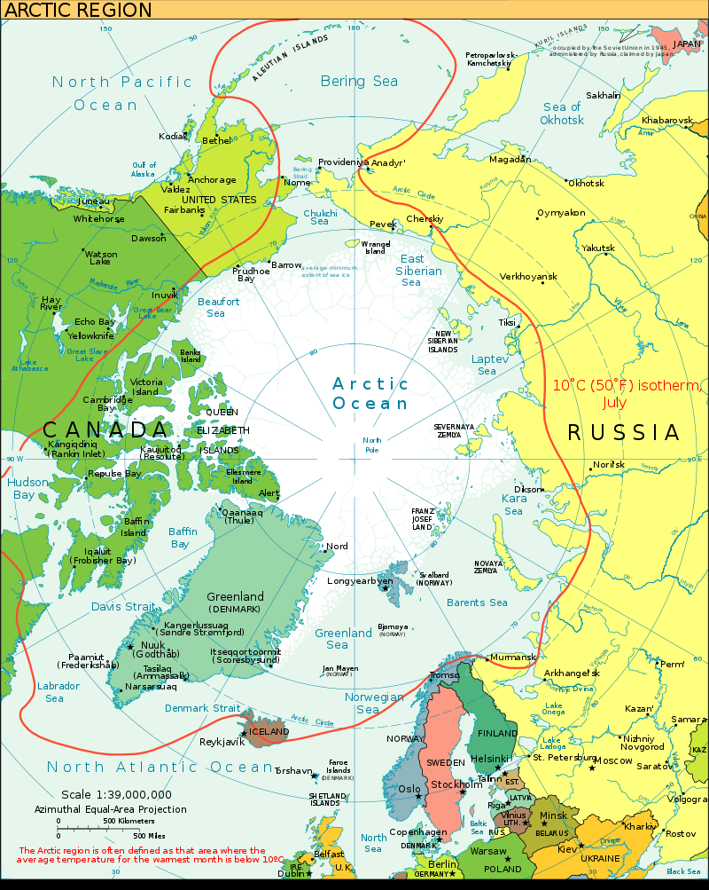

Slide 32
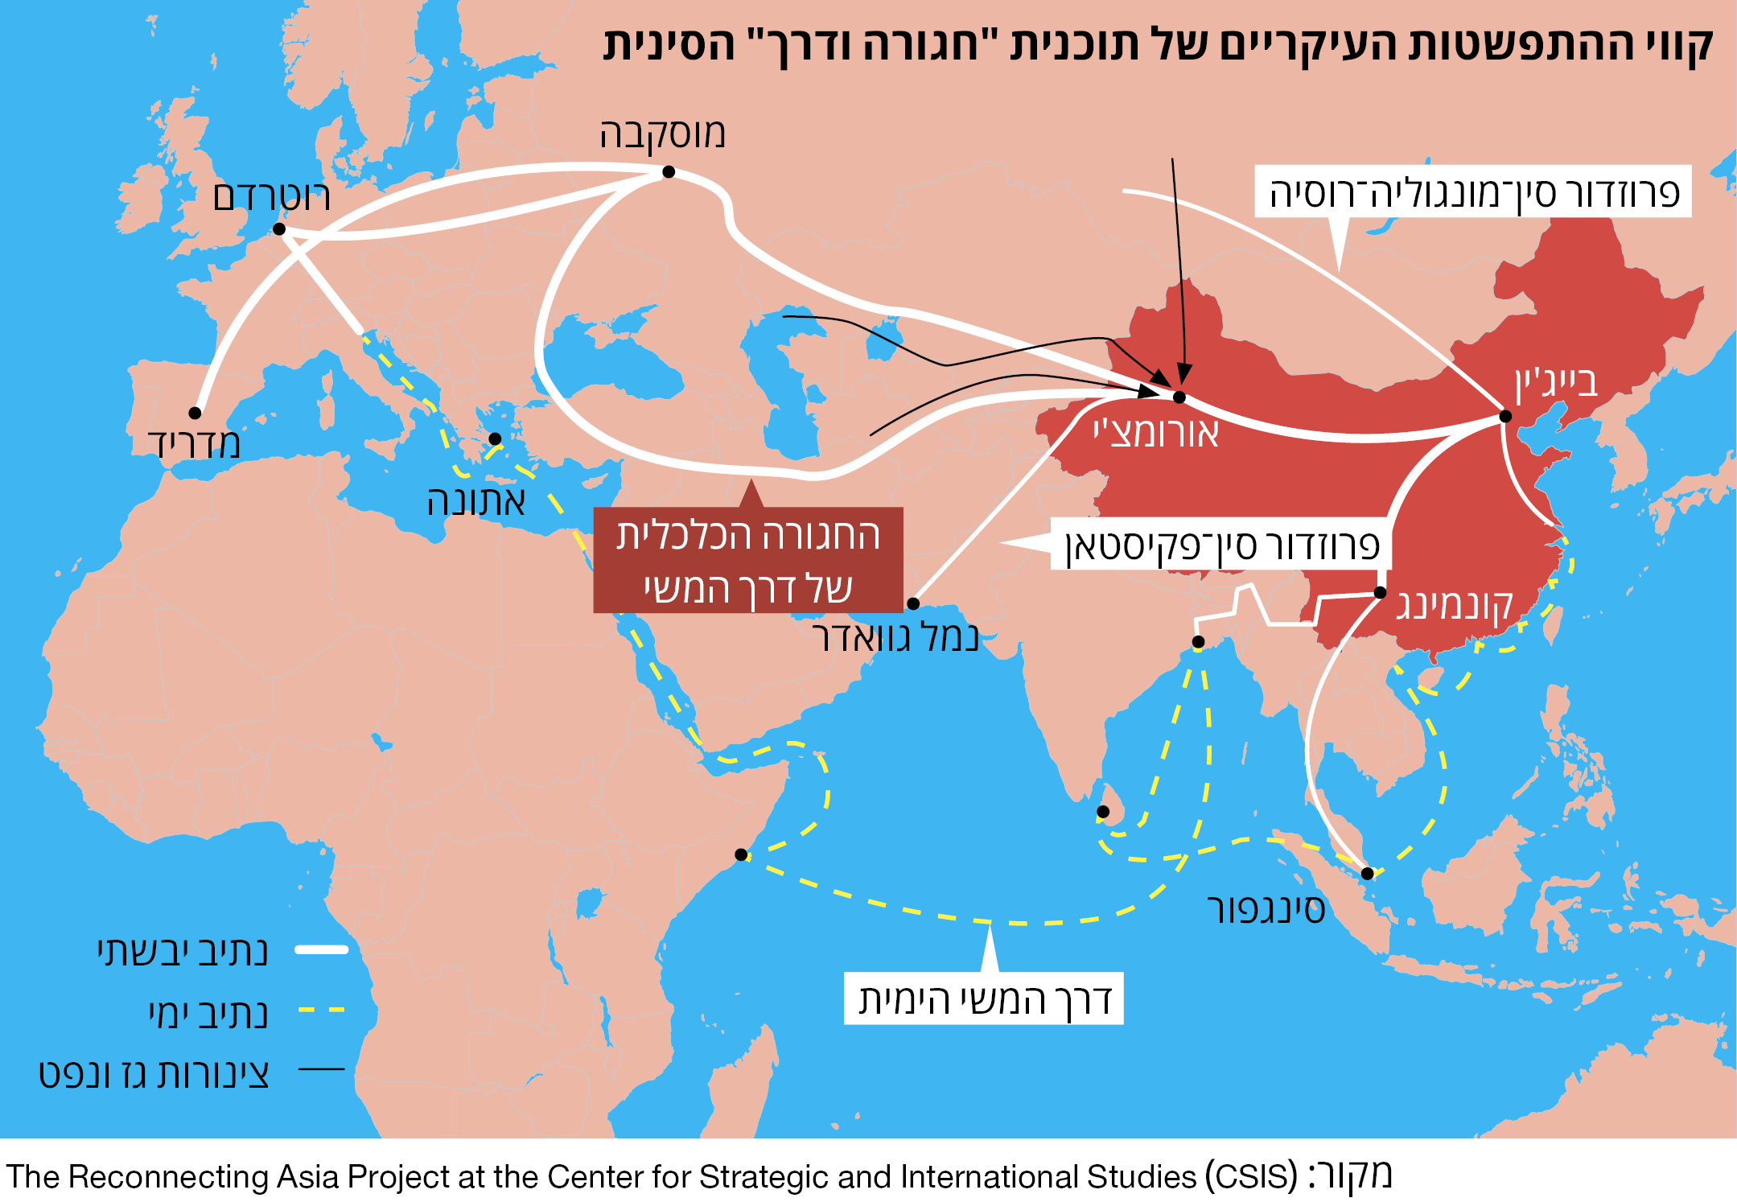
The main routes of the Chinese Belt and Road Initiative
Moscow
Rotterdam
China-Mongolia-Russia corridor
Beijing
Madrid
Ürümqi
Athens
The economic belt of the Silk Road
China-Pakistan corridor
Land route
Sea route
Gas and oil pipe

Slide 33
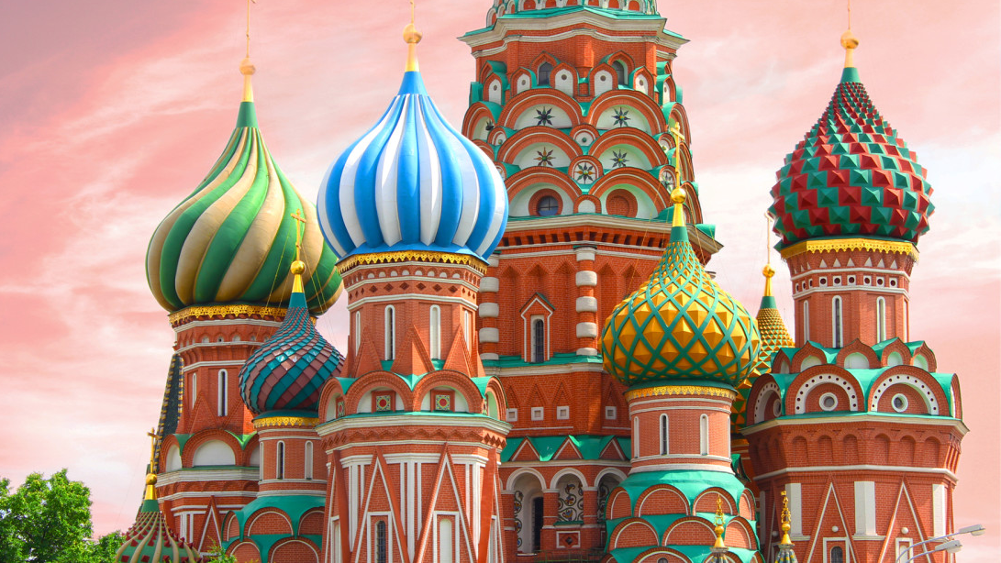
Russian economy
East Tour - INDC

Slide 34
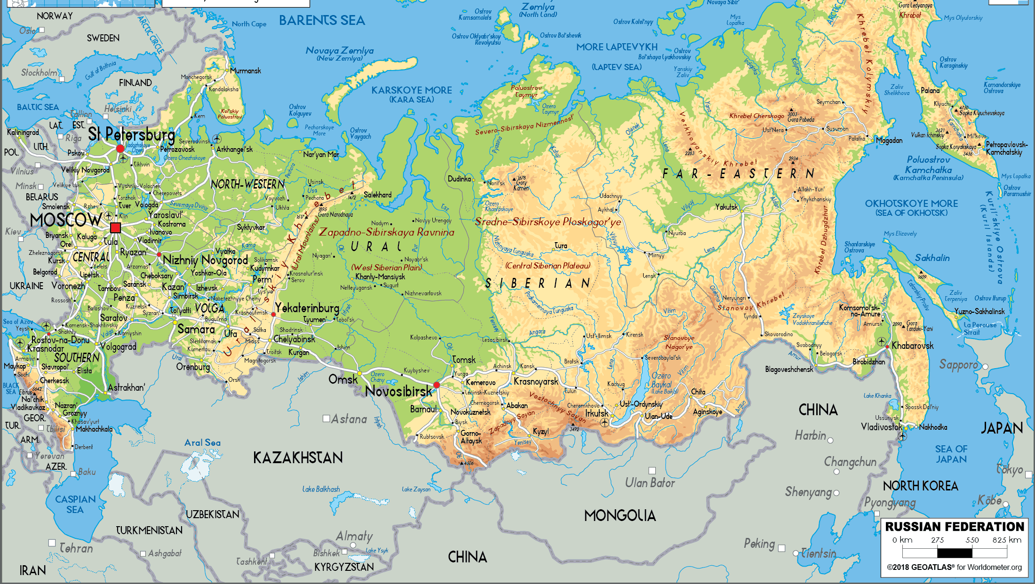
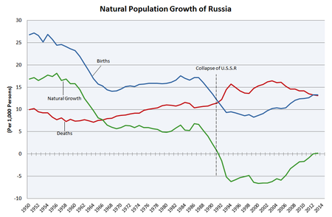
Population 147 million
Life expectancy – 72 (M67, F77.6)
Area – 17 million km² (Israel 22k km²)
Water – 13% (Israel 2%)
Main cities:
Moscow – 12M
St. Petersburg – 5M
Novosibirsk – 1.5M
Main resources:
Oil (70% of export)
Gas
Coal
Gold, Diamonds, Minerals, Timber
30% of world natural resources = 75T USD

Slide 35
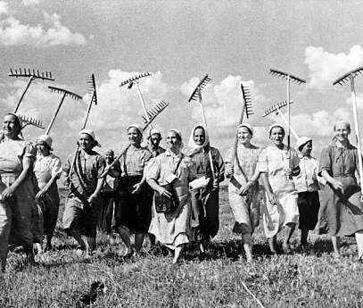
Economic History
From Command to Market
1991 privatization and oligarchy
1998 Rubal crisis: GDP -40%
1999 Putin PM, 2000 reforms:
Flat income Tax 15%
Deregulation
Balanced budget
Decrease debt 104%(1999)→8%(2006)
Poverty – 30%(2000)→14%(2008)
2014 – Crimea crisis:
US, EU, Canada, Japan sanctions
Energy, financial, defense sectors
-6% to Russian economy

Slide 36
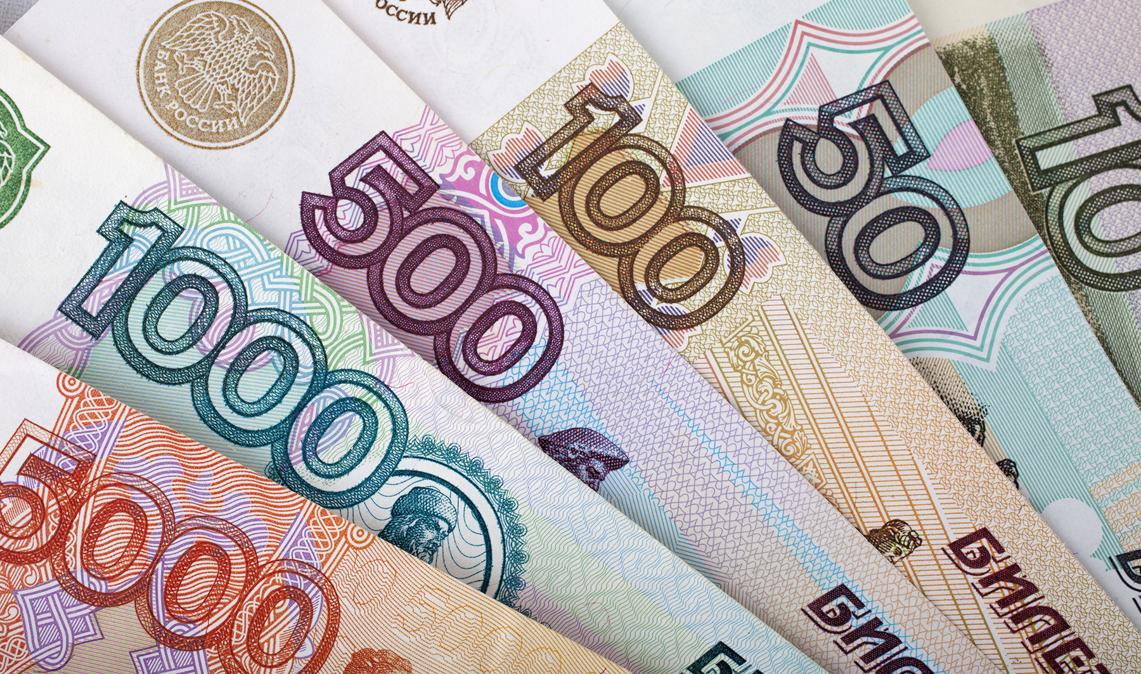
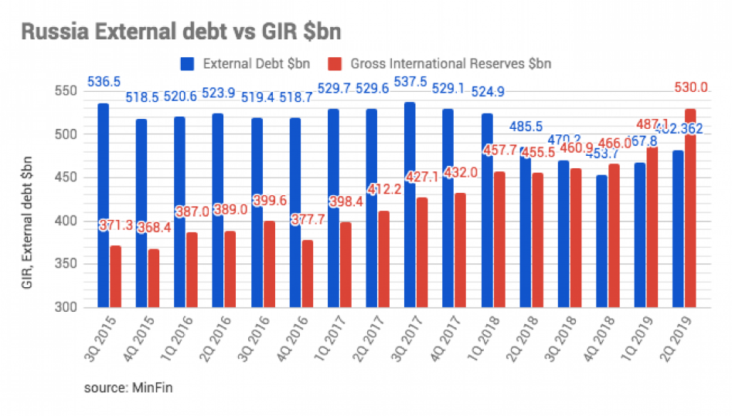
ECONOMIC FIGURES
GDP (PPP) – 1.6 T$ [11th] (4.36 T$ [6th])
GDP per Cap (PPP) – 11,163$ (29,642$)
Growth rate – 2.3% (2018)
Workforce:
Agriculture – 9.4% (4.7% GDP)
Industry – 27.6% (32.4% GDP)
Services – 63% (62.3% GDP)
Unemployment rate – 4.5%
Rubal – US Dollar – 72.4R=1$
Inflation rate – 3.5%
Credit rating – BBB-
National Debt – 15%GDP
Foreign Reserve – 540 B$

Slide 37
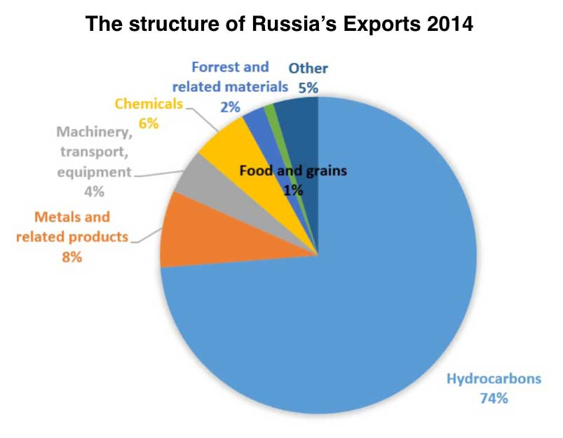
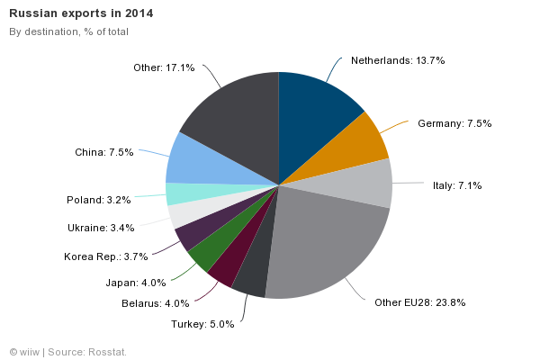
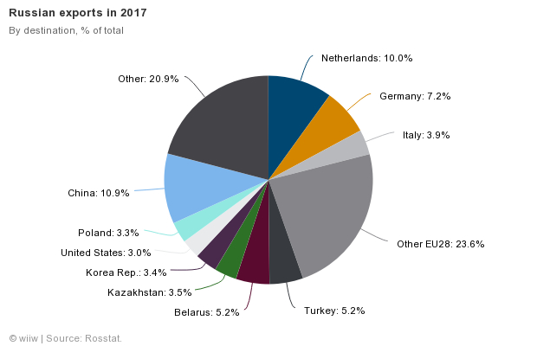
Russian Trade
Exports: Oil & gas, metal, wood, chemicals, machinery, military, nuclear
Imports: Machinery, vehicles, medicine, plastic, semi-finished metal products, meat, fruits, nuts, medical equipment, iron

Slide 38
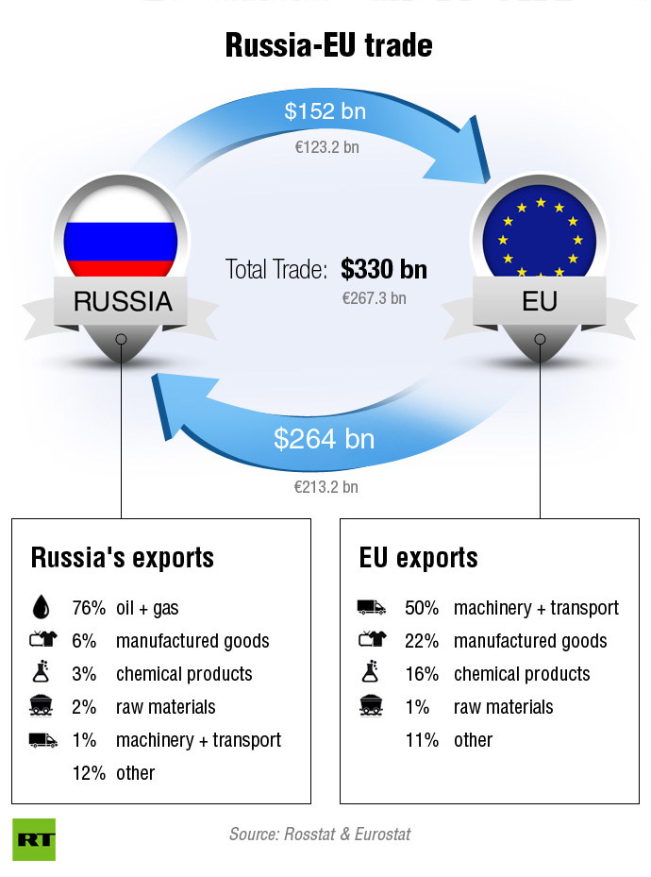
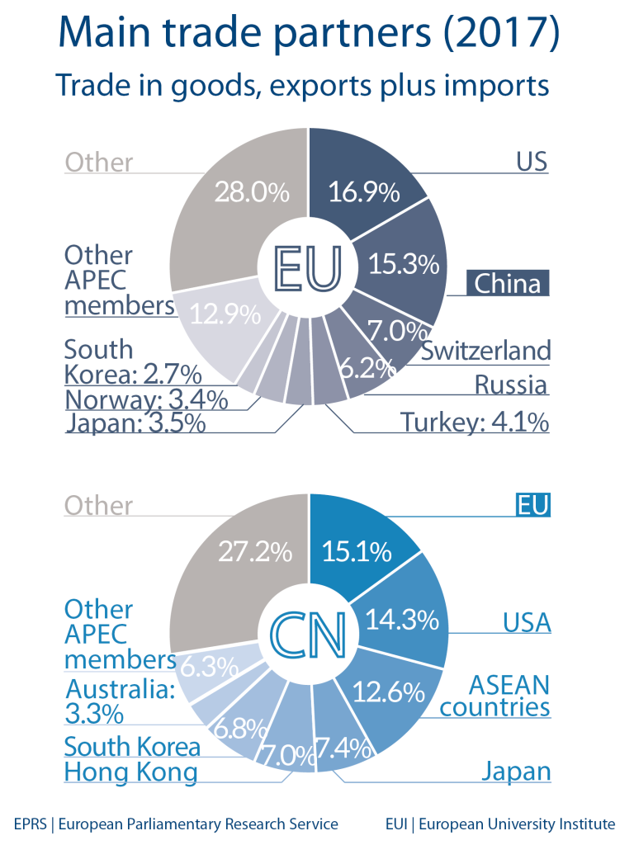
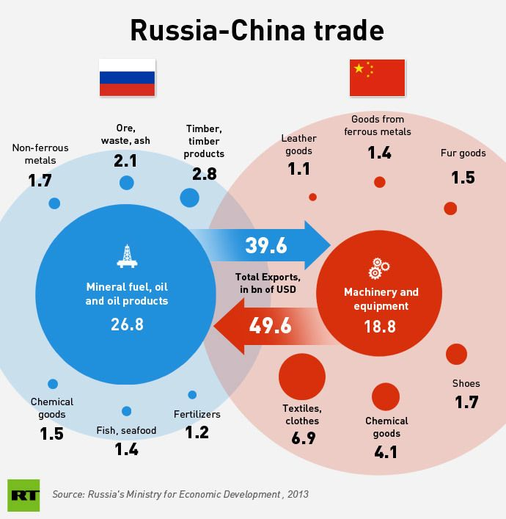

Slide 39
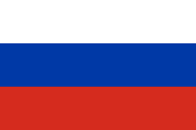
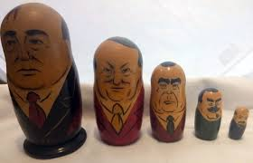

Slide 40
Vladimir Ilyich Lenin
Born - 1870
Died - 1924 aged 53
Rise to power - 1917-1924
Replaced by Josef Stalin
Reason replaced: death
Ideology - Marxism
Main events - establishing the Bolshevik party; the first leader of the Soviet Union
Quote = "One must always go forward - or go back"

Slide 41
Josef Stalin
Born - 1878
Died: 1953, aged 74
Rise to power -1922
Left power -1953
Replaced by Nikita Khrushchev
Reason replaced: death
Ideology - Communism
Main events - World War II
Quote - "When it comes time to hang the capitalists, they will sell us the rope"

Slide 42
Leon Trotsky
Born -1879
Died: 1953
Reason replaced: murdered
Positions - Foreign Minister, Minister of the Military, opposition to Stalin.
Ideology - Marxism
Main events - Minister of the Military in WWI
Quote - "Socialism needs Capitalism like the human body needs oxygen"

Slide 43
Nikita Khrushchev
Born - 1894
Died: 1971
Rise to power -1953
Left power -1964
Replaced by Leonid Brezhnev
Reason replaced: ousted
Ideology - Communism
Main events - reforms, the Cold War, Cuban missile crises

Slide 44
Leonid Brezhnev
Born - 1906
Died: 1982
Rise to power -1964
Left power -1982
Replaced by Yuri Andropov
Reason replaced: death
Ideology - communism
Main events - coexistence with the United States and continuation of world influence, invasion of Afghanistan, corruption
Quote -

Slide 45
Mikhail Gorbachev
Born - 1931
Rise to power -1985
Left power -1991
Replaced by Boris Yeltsin
Reason replaced: resignation
Ideology - Communism
Main events - dissolution of the Soviet Union, Glasnost, rebuilding, end of the Cold War.
Quote - "If what you have done yesterday still looks big to you, you haven't done much today"
The last president of the Soviet Union

Slide 46
Boris Yeltsin
Born - 1931
Died: 2007
Rise to power -1991
Left power -1999
Replaced by Vladimir Putin
Reason replaced: resignation
Ideology - Communism, believed in changing the method
Main events - the war in Chechnya
The first president of the Russian Federation that was democratically elected

Slide 47
Leo Tolstoy
Born - 1828
Died: 1910
Author and poet
Soldier in the Crimean War
Main works - War and Peace, Anna Karenina
Ideology - Marxism Believed in non-violent resistance that was later adopted by Mahatma Gandhi and Martin Luther King
Quote -

Slide 48
Pyotr Ilyich Tchaikovsky
Born - 1840
Died - 1893
Composer, conductor, choreograph, educator, author, pianist, music critic.
Main works:
Piano Concerto No. 1 in B-flat minor
Operas
Ballet music
Swan Lake, Sleeping Beauty
The Nutcracker
Romeo and Juliet
Chamber music

