Slide 1
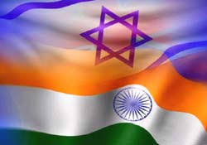
India Tour
45th class
April 22-26,2018

Slide 2
Objective
Getting to know India - its status and strategic concept as a central and developing power in the international system, a country with a great influence on the different dimensions of Israeli national defense

Slide 3
Tour objectives
Understanding the diverse, complex and deeply rooted culture.
Complex democracy - how to successfully manage a democratic state with different nationalities and religions.
Society - huge gaps in society, severe poverty alongside high classes. The role of women in society.
A political vision - the way in which India perceives itself in the emerging and future world structure.
Challenging borders, including with powers (china) - how to deal with the challenge.
A nuclear state living alongside another nuclear state (Pakistan) - how?

Slide 4
Tour objectives
Economy: what are the national economic challenges, growth rates, and economy of classes?
Strategic culture alongside traditional Indian culture - can they exist together?
Foreign policy: what is the orientation? To get closer to the East? To get closer to the West?
Attitude toward Israel - close relations, alongside a sideways view towards Israel, friendship with Arab countries and votes against Israel at the UN.

Slide 5
Logistics
Required vaccinations - in coordination with the IDF medical department.
Dress code and formal uniforms - in coordination with the IDF attachés in Delhi.
Kosher food - in coordination with the IDF attachés in Delhi (Chabad House).
Visas - in coordination with the consulate.
Conduct in the country - finances? Communication in coordination with the consulate.

Slide 6
Logistics
Bus: KTC
Nearby Hospital:
New Delhi – Primus Hospital
Amritsar – Fortis Escorts Hospital
Mumbai – Saifee Hospital

Slide 7
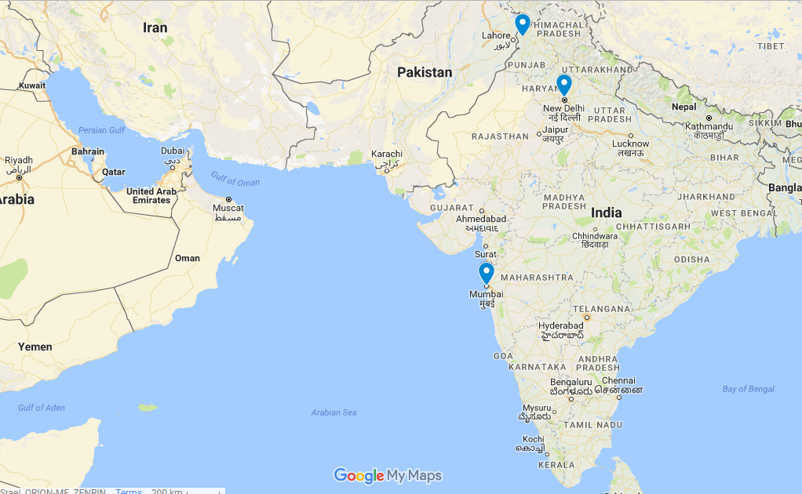

Slide 8
Tour Schedule
14:00-15:30
Tour of the Mumbai stock exchange and a brief about the Indian Economy
16:00-16:30
Visit to the laundromat
17:30-18:30
Visit to the Mumbai Metropolitan Region Development Authority
18:30-19:30
Summary
20:00
Arrival at airport

Slide 9
Preparation
8.4 | 9.4 | 11.4 | 15.4 | 16.4
 | 09:30-11:00 Sigal Manor Banga India- The cultural dimension |  |  | 09:00-10:30 Adv. Anat Bernstein- Reich Head, Israel-India Chamber of Commerce
12:30 Inoculations | Lunch at the Indian restaurant in Ramle or Ramat Hasharon )Kosher) )TBC( | 10:30-12:00 Ze’ev Mivzari Former Israeli Military Attaché to India India’s Security Challenges |  | Team meeting
13:00-14:30 Team meeting | Travel to Jerusalem | 13:00-14:00 Ze’ev Mivzari Israel- India security cooperation |  | Group presentations In the plenary
14:45-15:45 Team meeting | 15:00-16:30 Alon Ushpiz Former Israeli Amb. To India Venue: Jerusalem | 14:30-16:00 Dr. Oranit Shani Society, Democracy and Politics in India
16:00-17:00 Hardeep Bains Intro to India |  |  | Invitation to the Indian Military Attaché’s For Dinner and Lecture )TBC(

Slide 10
Expectations

Slide 11
Open topics for discussion
Student participation during the tour
Team discussion
Vacation
Research before and during the tour

