Slide 7
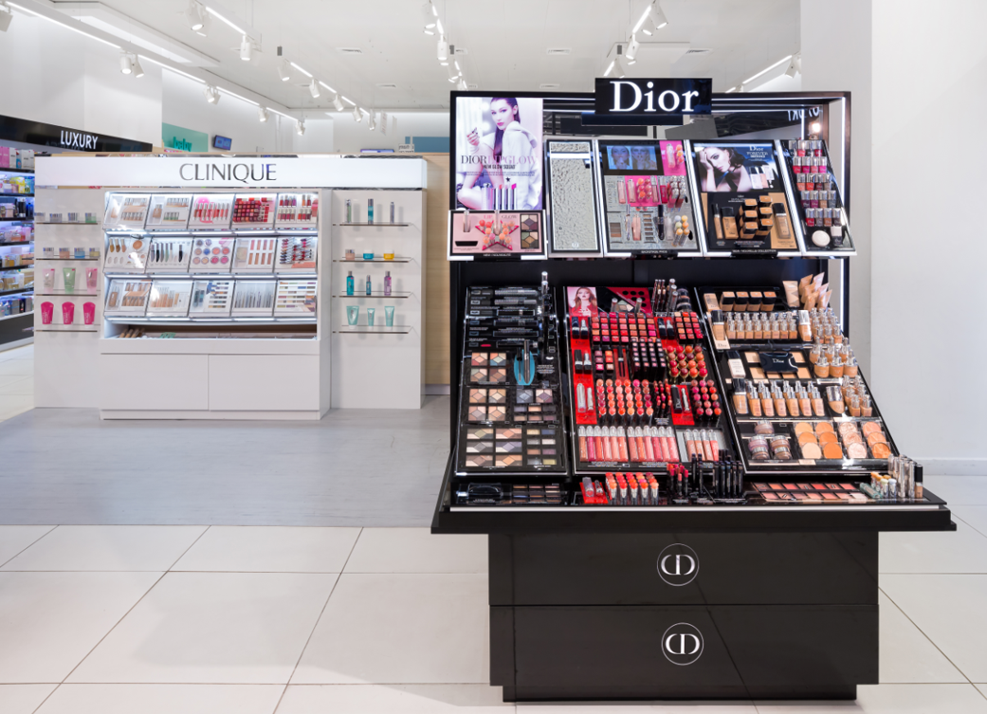
Annual number of stores (ISRAEL)

Slide 8
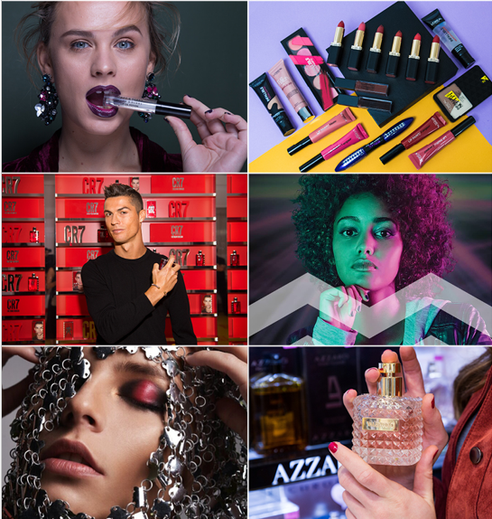
Annual number of customers (mil. ISRAEL)

Slide 10
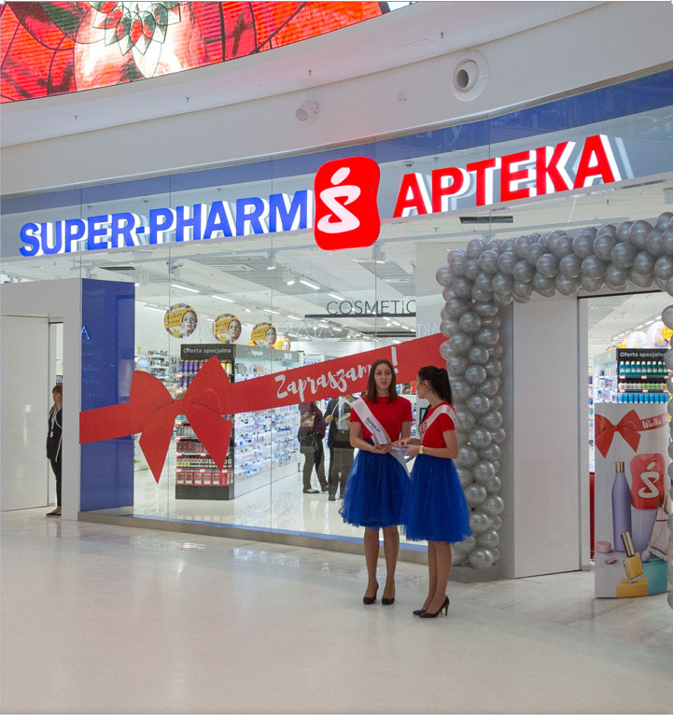
Annual number of stores (POLAND)

Slide 11
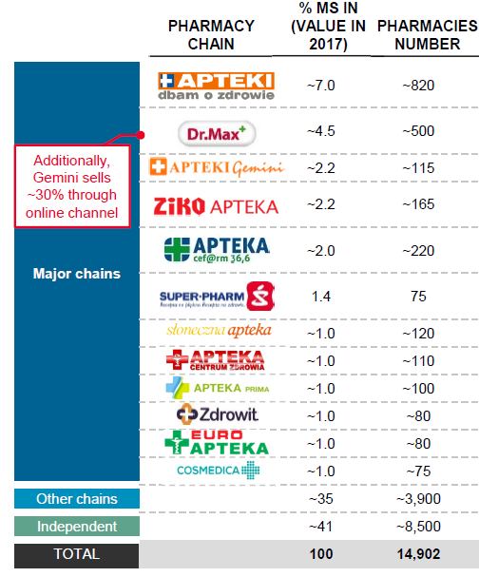
Poland-Pharmacy

Slide 12
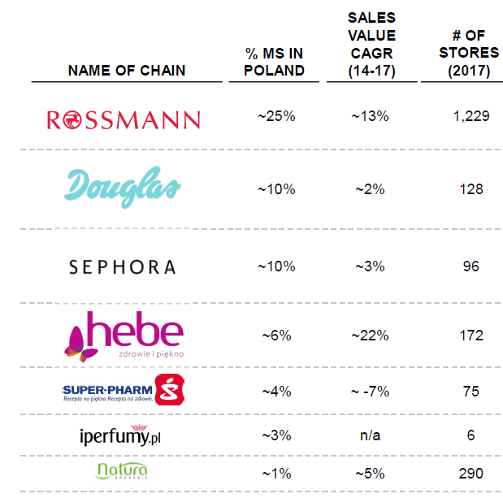
Poland-Cosmetics

Slide 13
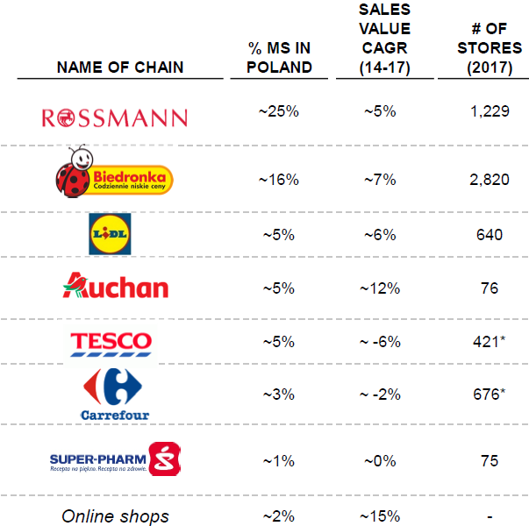
Poland-General department

Slide 14
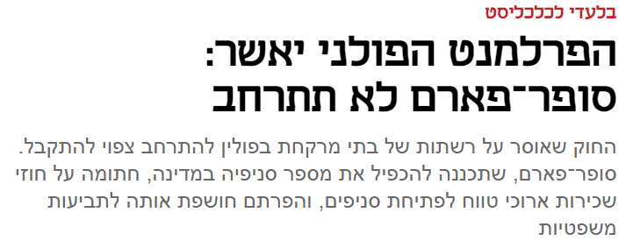
Poland-Market regulations

Slide 15
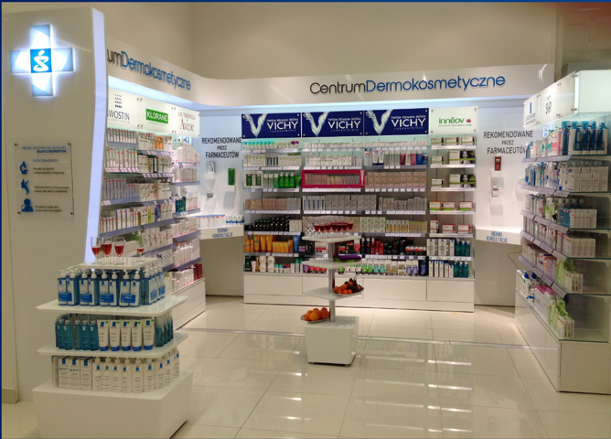
Poland-Business challenge
Poland is a frontrunner in adoption of online sales in cosmetic categories, with strong tailwinds for further growth

