Slide 1
Constant Change in the
Energy Policy of the World
Udi Adiri, Director General of the Ministry of Energy
June 2019

Slide 2
Energy Security and Geopolitics:
operational continuity;
Cyber; Foreign relations; Israel's position in the energy world; Export and economic cooperation
Economy:
Development of natural resources; Cost of living - electricity; water; fuel; LPG
Innovation:
Energy storage; Alternative energy; Renewable; electric car
Environment
Infrastructure integration; Minimizing environmental costs; Balanced interests

Slide 3
Electricity production requires strategic capital rich facilities
Generating electricity with renewable energies is very expensive
World oil reserves are about to end
No power can be stored
The electricity must be transferred from several manufacturers to millions of consumers
Protection of the electricity grid is concentrated in physical protection of facilities

Slide 4
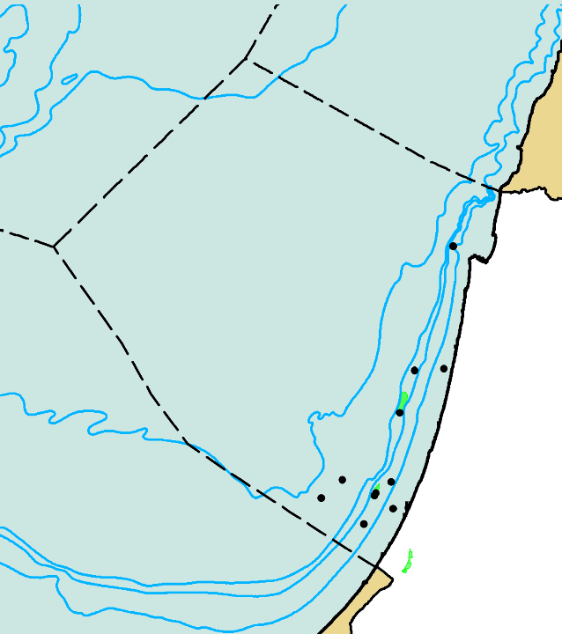
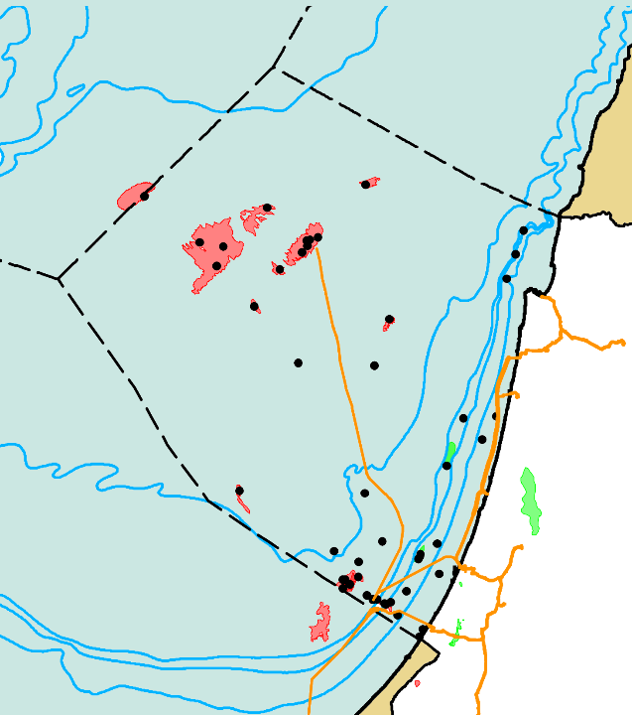
The Gas Revolution In Israel
1999
2018
-2000
Aphrodite/Ishai
Karish
Tanin
Tamar
Leviathan
Tamar SW
Dolphin
Dalit
Export
Export
--1000
Shimshon
--200
Legend:
--50
Oil Field
Noa
I s r a e l
I s r a e l
Gas Field
Gaza Marine
Legend:
Pipelines
MariB
Oil Field
(under
construction)
Export

Slide 5
Setting Policy of Technological Changes
In the World
Manufacturing
Connecting the industry to the distribution network
Halting the use of polluting fuel products and replacing them with more efficient and cleaner energy sources
Transportation
100% of the new private cars will be electric
100% of the new trucks and buses will be electric or will run on compressed natural gas (CNG)
Vehicles with gasoline or diesel fuel will not be allowed to enter the country
Electrical Power
Halting the use of coal
In generating electricity in all coal power plants
Transition to the production of electricity by natural gas
Implications
An annual benefit to the economy of NIS 5.8 billion
60% reduction in air pollution damage in Israel

Slide 6
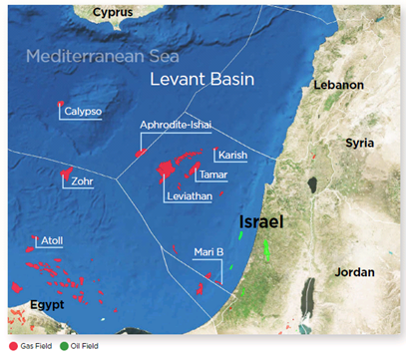
Natural Gas – The Middle East

Slide 7
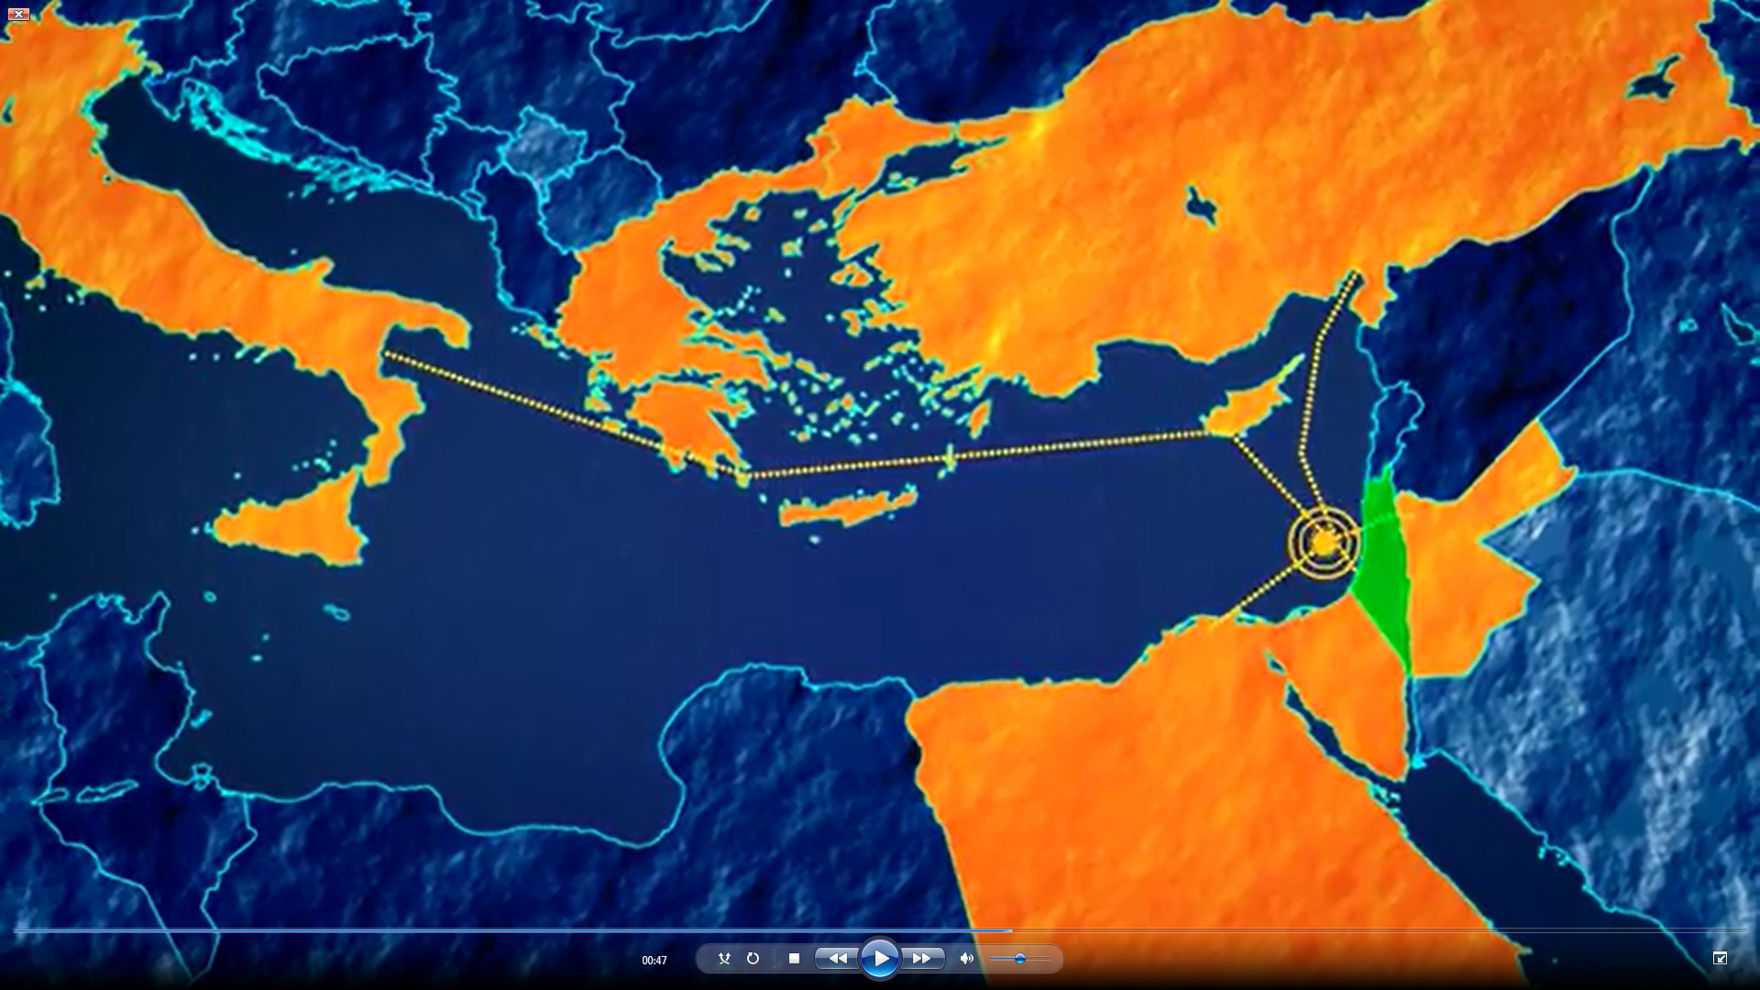
Export Options
Italy
Turkey
Cyprus
Greece
Jordan
Egypt

Slide 8
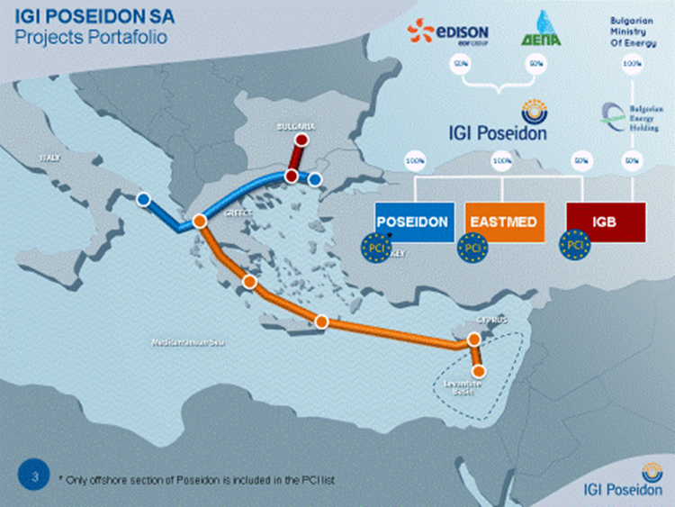
EastMed Project

Slide 9
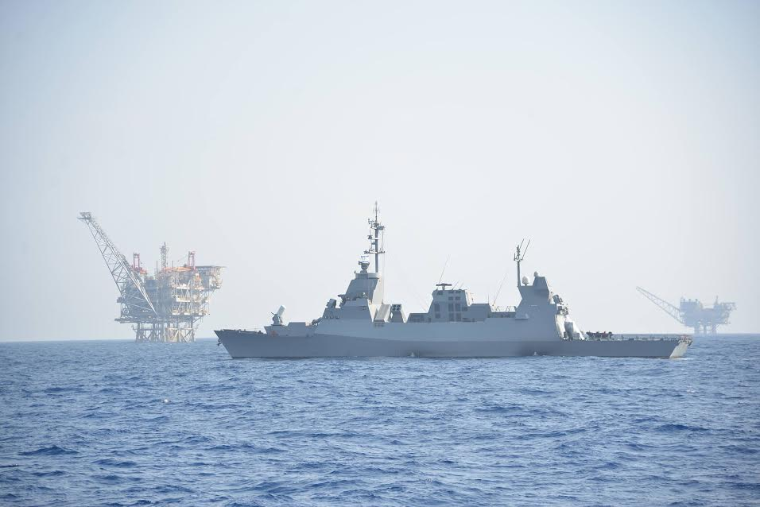
The Mix Of Fuels For Day to Day Electricity Production - 2018

Slide 10
Energy Continuity - Challenges
Energy Island
Lack of Redundancy
Physical Threat
Cyber Threats

Slide 11
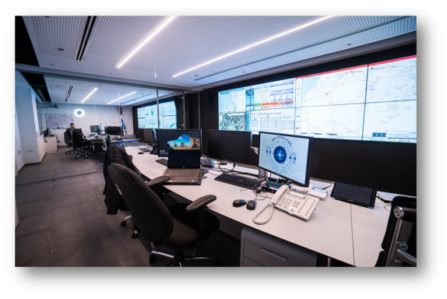
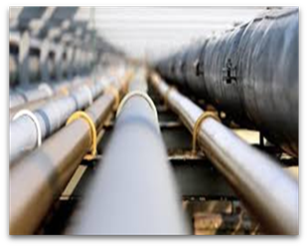
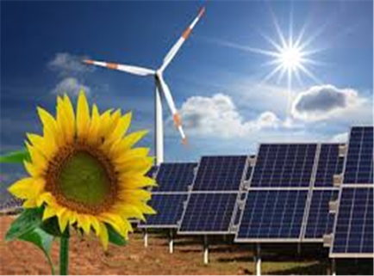
Energy Continuity - Actions and Solutions
Implementation of the protection plan
Promotion of energy security law
Implementing government decision 116 / b
Implementation of the response programs
Protection of infrastructure facilities pilot
Improving the cyber directorate
Decentralization of energy sources

Slide 12
Thank You

