Slide 1
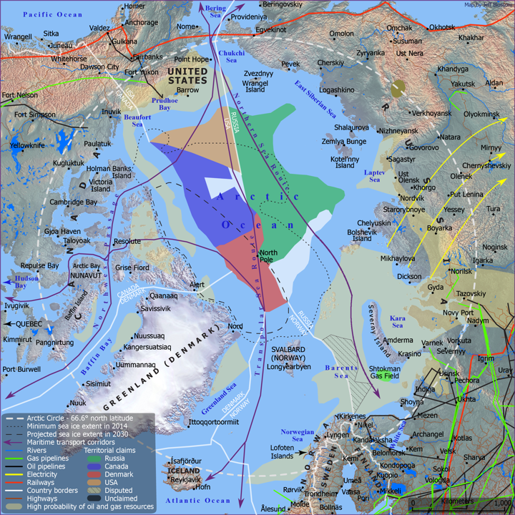
Source: Business Insider/Parag Khanna
GEOSTRATEGY OF THE ARCTIC
TEAM TWO
National Defense College & University of Haifa
Introduction to Geopolitics and Geo-Strategy from a National Security Perspective
Professor Yossi Ben-Artzi & Amb. Merav Zafary-Odiz
November 09, 2020

Slide 2
Introduction
“The world image of States are conditioned by their own geographical location and horizon; technological changes transform the strategic significance of an area; and supply lanes of energy and mineral resources tie regions together and show their vulnerability and interdependency” Ostreng, W. (n.d.).
This presentation is intended to provide a geostrategic analysis of the Arctic region, including geographical components, forces involved in the issue, geopolitical systems adopted by the parties, and geostrategic goals of Russia and China in the region.
Why the Arctic?
The Arctic provides an excellent example of a region with significant geostrategic importance. It has become increasingly geostrategically significant due to six main features:
Geographic location between American, Europe, and Asia
Abundance of strategically important natural resources
Sea lanes, particularly newly emerging sea lanes
Global warming and climate change leading to dwindling sea ice
Environmental fragility
Regulatory affinity to existing treaties, conventions, and agreements.

Slide 3
Geography and overview
Boundaries and geographic characteristics
The Arctic is 5.5. million square miles (ocean and land mass combined)
The Arctic region is the area bounded by the latitude 55°N to the North Pole. The Arctic Circle begins at 66.6°N.
Arctic border regions defined as the area where average July temperature is below 50F/10C.
It encompasses the entire Arctic Ocean and land masses from the eight arctic countries: US, Russia, Canada, Norway, Iceland Sweden, Finland, and Denmark.
The Arctic Ocean is the dominant feature in the area.
Very harsh conditions due to Earth’s axial tilt – never receives direct sunlight, only indirect rays, resulting in less solar radiation.
Flora and Fauna
Vegetation in the Arctic, limited to regions having a tundra climate, flourishes during the short spring and summer seasons.
The tundra's restrictive environment for plant life increases northward, with dwarf trees giving way to grasses (mainly mosses, lichen, sedges, and some flowering plants), the ground coverage of which becomes widely scattered toward the permanent snow line.
There are about 20 species of land animals in the Arctic, including the squirrel, wolf, fox, moose, caribou, reindeer, polar bear, musk ox, and about six species of aquatic mammals such as the walrus, seal, and whale.
Most of the species are year-round inhabitants of the Arctic, migrating to the southern margins as winter approaches. Although generally of large numbers, some of the species, especially the fur-bearing ones, are in danger of extinction.
A variety of fish is found in arctic seas, rivers, and lakes.
The Arctic's bird population increases tremendously each spring with the arrival of migratory birds.
During the short warm season, a large number of insects breed in the marshlands of the tundra.

Slide 4
Geography and overview
Geo Economics and Geo Logistical significance
22% of undiscovered petroleum is in the Arctic.
95% of natural gas reserves and 60% of oil reserves are in the Arctic.
Arctic region contains approximately 90 billion barrels of oil and 47 trillion cubic meters of natural gas.
Arctic contributes $450 billion to various national economies.
From 2005 – 2017, combined foreign direct investment in the Arctic was $1.4 trillion.
Northern Sea route reduces travel time from South Korea to the Netherlands from 48 to 35 Days.
In 2005 only 5 ships sailed the northern route. In 2013, 71 ships travelled the northern route.
Climate Change
In the last 30 years, the Arctic has warmed at twice the rate of the rest of the planet.
Recently, the Arctic Ocean has transformed from a permanent sea-ice cap to a seasonally ice-free sea.
2 million square kilometers of extant sea ice has been lost since the 1980’s.
Permafrost melt below the tundra releases significant levels of carbon and methane.
This rapid environmental change not only impacts indigenous people and residents in the arctic countries, but also is changing global perspectives and ambitions in the region.
Bottom Line
Most of the resource competition in the Arctic is due to climate change and the effects climate change.

Slide 5
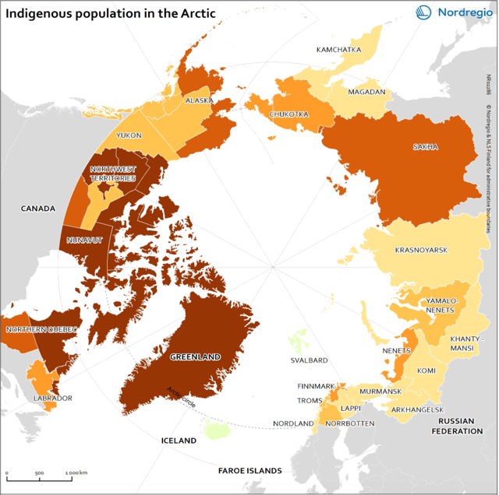
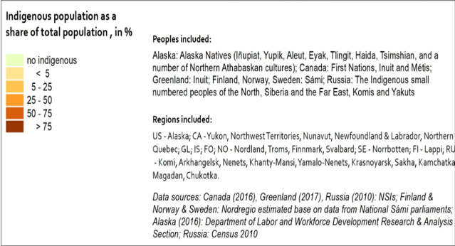
Indigenous population
Indigenous population of the Arctic
1 Million (9%) are indigenous.
More than 40 different ethnic groups.
No circumpolar definition of indigenous person, so several
national definitions are used.
Indigenous population are more reliant on the Arctic
ecosystem for survival and are more impacted by climate
change than non-indigenous populations.
www.nordregio.org
Wang, Shinan (author)

Slide 6
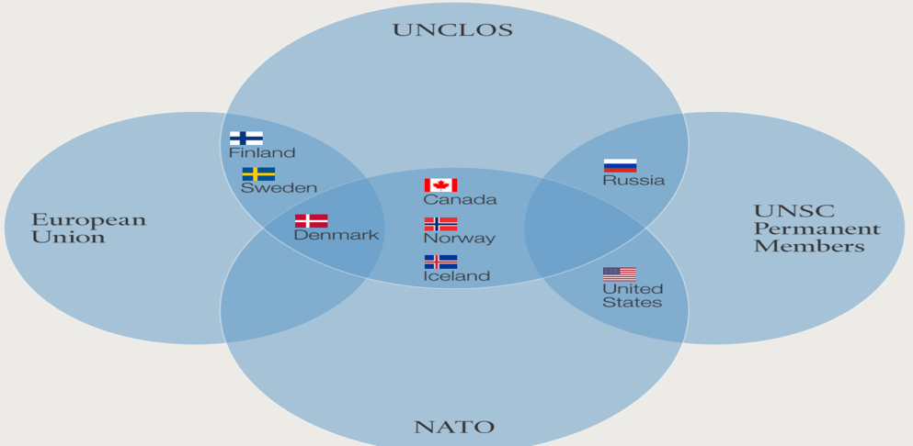
GEOPOLITICAL SYSTEMS
Arctic Council:
8 Arctic States implement policy
6 permanent participants represent the indigenous people of the Arctic
6 Working groups carry out the council activities
38 Observer Nations and NGOs
(Including China) share their expertise
8 Arctic Countries & Arctic Council Members

Slide 7
international & regional TREATIES
21 Treaties and agreements related to the Arctic.
Cover a wide variety of issues, including:
Flora and fauna
Climate change/environment
Sea/shipping/fishing
Civil/political/social rights
Sovereignty
Arctic council specific treaties
Very few treaties have full support of all Arctic State member countries.
https://arcticportal.org/images/organizations_20160314_01.png

Slide 8
International and regional GROUPS
18 different international and regional groups that have overlap in the Arctic region.
Some groups are specific to another geographic region.
For example, the European Economic Area (EEA) pertains to two Arctic member states
Only four of the cooperative groups include all Arctic States:
Arctic Council
Arctic Economic Council
United Nations
United Nations Economic Commission for Europe
Source: https://arcticportal.org/images/intl_treaties_overview.jpg

Slide 9
NATO Opportunities and challenges
The growing economic and strategic significance has led to new strategic challenges in the Arctic. Many Arctic countries have introduced measures to define and protect their economic and national security interests in the region.
Some of the coastal states have also taken steps to strengthen their military capabilities in the area. This development poses a threat to conflicts and tensions.
Five of the Arctic countries – Canada, Denmark, Iceland, Norway, and the U.S. are also part of NATO, the alliance is directly affected in the case of an upcoming conflict. That would mean that even Non-Arctic states like Germany, France or Italy were involved in a NATO article 5 scenario (collective defence). In the past NATO considered the Arctic region as a particular zone of low tension due to several declarations according to which coastal states would settle disagreements peacefully and in accordance with international law. NATO has regarded the Arctic as an area that has no direct military threats to deter.
NATO is facing a security dilemma: If member states don’t strengthen their military capabilities in the region, other actors may try to exploit their weakness and threaten their economic and security interests. On the other hand, if they increase their military capabilities to protect their national interests in the region, other actors may feel threatened by their measures and eventually introduce similar measures. However Russian militarization has transformed Arctic relations, and NATO will not want to be left unprepared.
Notes:
.

Slide 10
RUSSIAN INTERESTS
Economic Interests
Russian leadership views the “Arctic zone of the Russian Federation” (the official description of an area covering 9 million square kilometers that makes up 40 percent of the entire Arctic space) as a strategic resource base.
The area’s population is only 2.5 million, but it generates 12–15 percent of the country’s GDP: 80 percent of Russian gas, as well as nickel, diamonds, and rare earth metals are extracted there.
The Arctic provides a quarter of the country’s exports and a third of its fish caught. It contains enormous expanses and new frontiers: Russia’s new international façade and its new maritime border. Apart from significant economic interests (resources and transportation, among others).
Essential Security Interests
Nuclear deterrence remains the main guarantee of the country’s security, and the Northern Fleet retains its significance as one of the main instruments in the country’s nuclear deterrence strategy.
The Arctic is also home to the indigenous peoples of the Russian North. Military and economic activity contaminated the Arctic territories. Russia has become sensitive to the fragility of Arctic ecological systems.
Russian strategy provides for the expansion of its military presence and border control system in the region.
Moscow believes that any international system of governance in the Arctic should recognize Russia’s role and significance.

Slide 11
RUSSIAN INTERESTS
Essential Security Interests (Continued)
This stance concerns not only the protection of the region’s unique ecological system, but also the use of resources and regulation of navigation.
As far as Moscow is concerned, the Northern Sea Route should remain under Russian jurisdiction, and Russian icebreakers should be used there, as Gorbachev proposed years ago.
The Greater Eurasia Concept
Russia’s Arctic strategy aligns closely with the broader concept of Greater Eurasia, which in the mid-2010s replaced the concept of a Greater Europe.
According to this new concept, Russia is a self-sufficient geopolitical unit in the north of the Eurasian mega-continent.
The continent’s other countries—from the European Union west of Moscow to China to its east, India to the south, and the Muslim world to the southeast—are all Russia’s neighbors.
Russia created and leads the Eurasian Economic Union (EaEU) that includes several former Soviet republics, reached an agreement with China in 2015 on synergizing the EaEU and the Belt and Road initiative.
It also offers other groupings, from the Association of Southeast Asian Nations (ASEAN) to the “integration of integrations” with the EU, and the so-called Greater Eurasian partnership.

Slide 12
CHINESE INTERESTS
Interconnected Interests in the Arctic
Includes economic interests (natural resources and transport and logistics), geopolitical and closely related military-strategic, and ecological-climatic research interests, including both fundamental theoretical and various scientific-applied ones
Natural Resources
China, in terms of the total mineral and raw material potential it is 12 – 15 times inferior to Russia.
The wealth of the Arctic natural resources, particularly hydrocarbons, that are from 30 to 75 % of all forecasted reserves of the planet.
Transportation and Logistics
The importance of Chinese transportation and logistics interests in the Arctic is increasing as the export potential of the Chinese economy grows.
The Chinese leadership is fully aware of the benefits related to the development of trade communication through Arctic waters.
The Northwest Passage (a strait between Canada and Greenland) is the shortest route from the Atlantic Ocean to the Pacific Ocean, while the Northern Sea Route along the entire Arctic coast of Russia can reduce the distance between China and the Western Europe and considerably decrease the transport and logistics costs of goods and passengers’ transportation.

Slide 13
CHINESE INTERESTS
Strategic Importance
The Chinese Arctic strategy follows China’s Ice Silk Road concept, which, in turn, is part of the Belt and Road initiative.
This conceptual architecture is crowned by the idea of a common future for humanity. Moscow hasn’t put forward anything of that kind since Soviet times.
Chinese globalism, sustained by the colossal economic potential and dynamic development of the most populous nation on earth, is in stark contrast to Russia’s current agenda, which seeks to retain and defend its great power status in competition with stronger players.
Aspiring to become a leading maritime power, China is also implementing a grand shipbuilding program. As a future lord of the seas, China, like the United States, is interested in supporting the freedom of navigation principle, including sailing through the Arctic, which provides a route to Europe that is one-third shorter than traveling via the Suez Canal.
True Ambitions
Beijing’s official narrative presents China’s Arctic interests as mostly related to environmental issues, scientific research, navigation, and the surveying and development of natural resources. Indeed, thanks to air flows and other natural phenomena, Arctic climate change also affects the climate of various Chinese regions.
However, it’s evident that it is China’s global ambitions that are driving its attempts to be present in every corner of the globe and every part of the World Ocean, including the Arctic.
Under the slogan of building a common future for all humanity, China is conceiving a new world order, where, as one of the strongest global powers, it will be one of the key norm-setters and guarantors of order.

Slide 14
DEPITCTION OF SINO – RUSSIA COOPERATION
RUSSIA – RESOURCE VENDOR
CHINA – RESOURCE CLIENT
ECONOMIC
NATURAL RESOURCES
SHIPPING LANES
POLITICAL
UNRESOLVED BALANCING ACT
MILITARY SECURITY
SENSITIVE ISSUE – RUSSIANS SKEPTICAL
CHINESE AIM – POLAR CAPABILITIES AND ALTERNATIVE TO MALACCA
SHORT TERM - BENEFICIAL
DEVELOPMENT OF NSR
ALIGNING OF BRI
CHINA WANTS ACCESS TO ARCTIC RESOURCES AND POLITICAL DECISION MAKING
IMPROVING BILATERAL RELATIONS – ARTIC NATIONS
TOOL – ECONOMIC LEVERAGE
EXTRACTION OF RENEWABLE AND NON RENEWABLE RESOURCES - RARE EARTH METALS AND SEA FOOD
RUSSIA - NEEDS OUTSIDE CAPITAL TO FUND ARCTIC DEVELOPMENT BUT SEEKS TO MAINTAIN CONTROL - BOTH POLITICALLY AND OVER SPECIFIC INVESTMENT PROJECTS
ARCTIC RESOURCE DEVELOPMENT - OIL AND GAS PROJECTS

Slide 15
ANALYSIS OF COMPETITION
Relations between Russia and the four Western Arctic states will remain tense in the foreseeable future. However, the Arctic hasn’t yet become the setting for a new Great Game.
Disagreements between states are evident but cooperation has not stopped completely, and the preference for diplomatic rather than military conflict resolution still prevails.
Relations between Russia and the West in the Arctic are still somewhere between cooperation and confrontation for now but are moving in the direction of greater competition.
Even though U.S.–Russian and U.S.–Chinese relations are clearly or increasingly hostile, while relations between Russia and China are becoming increasingly close, the world is not yet witnessing the formation of opposing blocs like those seen during the Cold War.
China and Russia act in accordance with their own interests, which are not always identical. For the time being, the creation of a Russo-Chinese military alliance isn’t a viable idea.
Cooperation between China and Russia in the Arctic is exclusively economic (energy and infrastructure projects).
There is no reason to believe that this cooperation will acquire a military component in the foreseeable future.
While cooperating with China more and more closely, Russia remains careful as to the scope and terms of this cooperation. Moscow is trying to protect its sovereignty: as a general principle, as well as regarding the Arctic.
The Russian concept of a Greater Eurasia requires a maritime dimension. Russia is a major continental and even transcontinental power, considering that it spans both Europe and Asia. Its politicians and strategists are accustomed to thinking about geopolitics in land-based terms.
Up until 2014, there had been a lot of talk about a Greater Europe, but starting from the mid-2010s, the conversation shifted to a Greater Eurasia. While the maritime dimension isn’t completely ignored, it is hardly ever discussed on its own.
Generally, we talk about land-and-sea regions: the Euro-Atlantic, the Asia-Pacific, the Arctic zone, the Baltic, the Black Sea, and the Caspian regions.
Today, Russian officials are skeptical about the concept of an Indo-Pacific region. Moscow considers it an American geopolitical construct, like that of the Greater Middle East. Moreover, it is believed to be anti-Chinese and partly anti-Russian. However, this view is too narrow.
The U.S. concept of the Indo-Pacific is indeed aimed at containing China and strengthening ties with American allies and partners, and Russia has no need to join it. Nevertheless, Moscow might wish to consider the maritime dimension of its own Greater Eurasia concept. Its core idea could be a Murmansk– Mumbai connection, extending the Northern Sea Route all the way to the Indian Ocean via the Pacific.
In that way, Russia’s development of the Arctic could be more closely linked to cooperation with Asian countries. China would of course need to be part of it, but it would not have to be Moscow’s only partner.

Slide 16
CONCLUSION
The complexities of the Arctic region cannot be understated. Climate change and natural resources makes the Arctic a prime location for geographic competition among Arctic and non-Arctic states. Covering three continents, the Arctic space is government by dozens of local and international agreements that preserve order in the region. As Chinese interests in the region become more pronounced, its competition with Russia has the potential to become more adversarial compared to the relative coexistence that defines their current relationship.

Slide 17
RESOURCES
Arctic Council. (n.d.). About section. https://arctic-council.org/en/
Briney, A. (2020). A geography and overview of the Earth’s Arctic region. ThoughtCo. https://www.thoughtco.com/geography- of-earths-arctic-region-1434938
Breitenbauch, H., Kristensen, K., & Grosmeyer, J. (2019) Military and environmental challenges in the Arctic. Carnegie Europe. https://carnegieeurope.eu/2019/11/28/military-and-environmental-challenges-in-arctic-pub-80424
Bogoyavlensky, D. (n.d.). Arctic demography. Arctic Human Development Report. http://www.svs.is/static/files/images/pdf_files/ahdr/English_version/AHDR_chp_2.pdf
Gosnell, R. (2018). The future of the Arctic economy. The Maritime Executive. https://www.maritime- executive.com/editorials/the-future-of-the-arctic-economy
Humpert, M. (2020). Cargo volume on the Northern Sea route remains stable as Novatek eyes floating storage. Arctic Today.
https://www.arctictoday.com/cargo-volume-on-northern-sea-route-remains-stable-as-novatek-eyes-floating-storages/
Karlusov, V., & Yarkov, D. (2019). Russia and China: Interests, potential, and prospects of interaction in the Arctic. International Journal of Civil Engineering and Technology 10(2) p. 1740-1746. http://iaeme.com/MasterAdmin/uploadfolder/IJCIET_10_02_168/IJCIET_10_02_168.pdf
Kopra, S. (2020). China and its Arctic trajectories: The Arctic Institute’s China series 2020. The Arctic Institute. https://www.thearcticinstitute.org/china-arctic-trajectories-the-arctic-institute-china-series-2020/

Slide 18
RESOURCES (Continued)
Lanteigne, M. (2019). The changing shape of Arctic security. NATO review. https://www.nato.int/docu/review/articles/2019/06/28/the-changing-shape-of-arctic-security/index.html
Lavelle, M. (2016) Arctic shipping soars, led by Russia and lured by energy. National Geographic. http://news.nationalgeographic.com/news/energy/2013/11/131129-arctic-shipping-soars-led-by-russia.
Masters, J. (2013). The thawing Arctic: Risks and opportunities. Council on Foreign Relations. https://www.cfr.org/backgrounder/thawing-arctic-risks-and-opportunities
McDaniel, C. (2017). Russia’s Arctic strategy: An analysis of the role of diplomatic, cooperative, and domestic policies. The Arctic Institute. https://www.thearcticinstitute.org/russias-arctic-strategy-analysis-role-diplomatic-cooperative- domestic-policies/
National Snow and Ice Data Center. (2020). Climate change in the Arctic. https://nsidc.org/cryosphere/arctic- meteorology/climate_change.html
Ostreng, Willy. (n.d.). On the geopolitical significance of the Arctic States. Arctis. http://www.arctis- search.com/On+the+Geopolitical+Significance+of+the+Arctic+States
Owens, J. (2020) Emerging threat: As the Arctic melts, Russian plans to militarize could create a nuclear hotspot. The Center for Climate and Security. https://climateandsecurity.org/2020/08/emerging-threat-as-the-arctic-melts-russian-plans- to-militarize-could-create-a-nuclear-hotspot/
The Arctic. (n.d.). Wikipedia. https://en.wikipedia.org/wiki/Arctic

