Slide 1
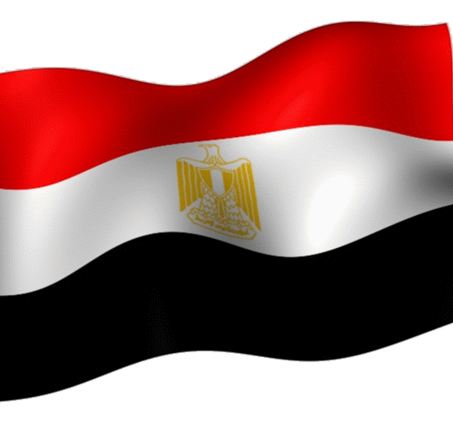

Egypt’s Strategy
الاستراتيجية المصرية

Slide 2
Learning
Commander of the Israel Southern Liaison Office
Dr. Yagil Henkin
Dado Center Coach
Shaping Process
Legacy System
Desired System
Strategy
Israel Security Agency Briefings
Emerging System
Initial strategy; contrasting; plan of action
Structuration Process
Israel Ambassador
to Egypt
4.2
6.2
5.2
J2 briefings (Head of Branch 90, Head of the Egypt Research Desk)

Slide 3

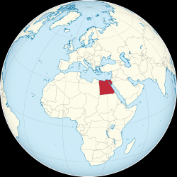

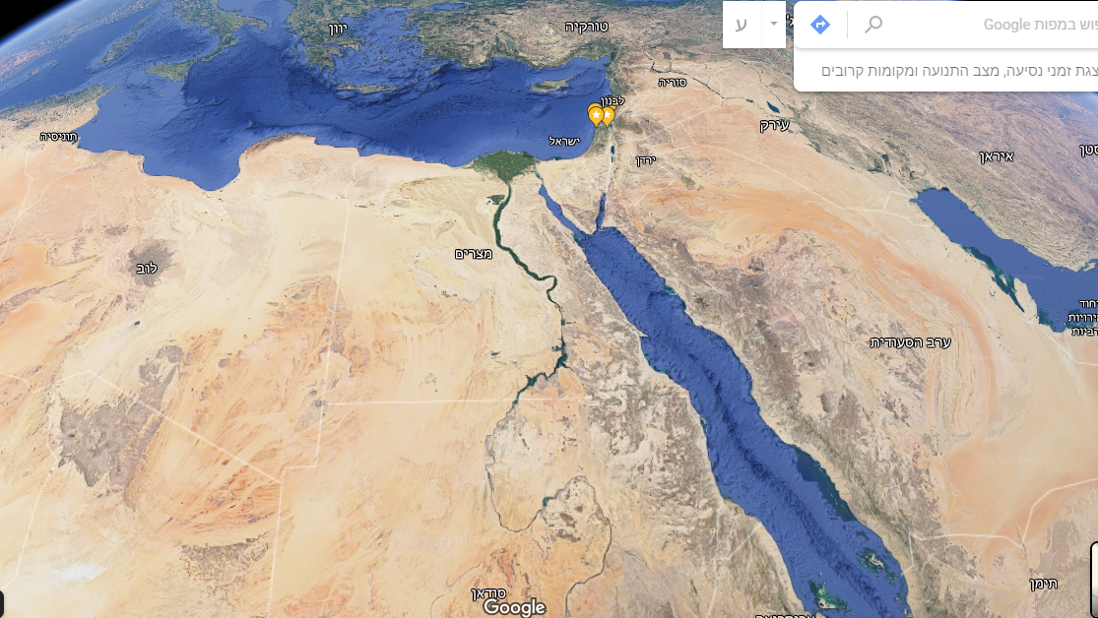
The Arab Republic of Egypt
جمهوريّة مصر العربيّة
אום-אל דוניה
ام الدنيا
Area: 1,001,450 km2
Land: 995,450 km2
Water: 6,00 km2
Borders: 2,689km
11km with Gaza, 255km with Israel, 1,150km with Libya, 1,273km with Sudan
Coastline: 2,450km
Natural resources: Oil, natural gas, iron, phosphates, manganese, limestone, gypsum, talc, asbestos, lead and zinc.

Slide 4
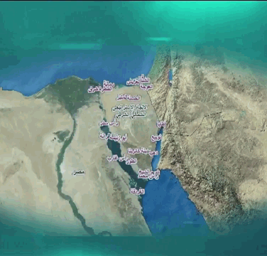
Economy & Demographics
The most populated Arab state
100 million residents in 8% of the area
Demographics – average birth rate: 2.5
Economy and state budget:
GDP - $ 302 billion, $ 3,046 per capita
25% payroll, 25% energy and water, 30% debt repayments

Slide 5









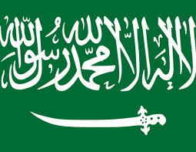



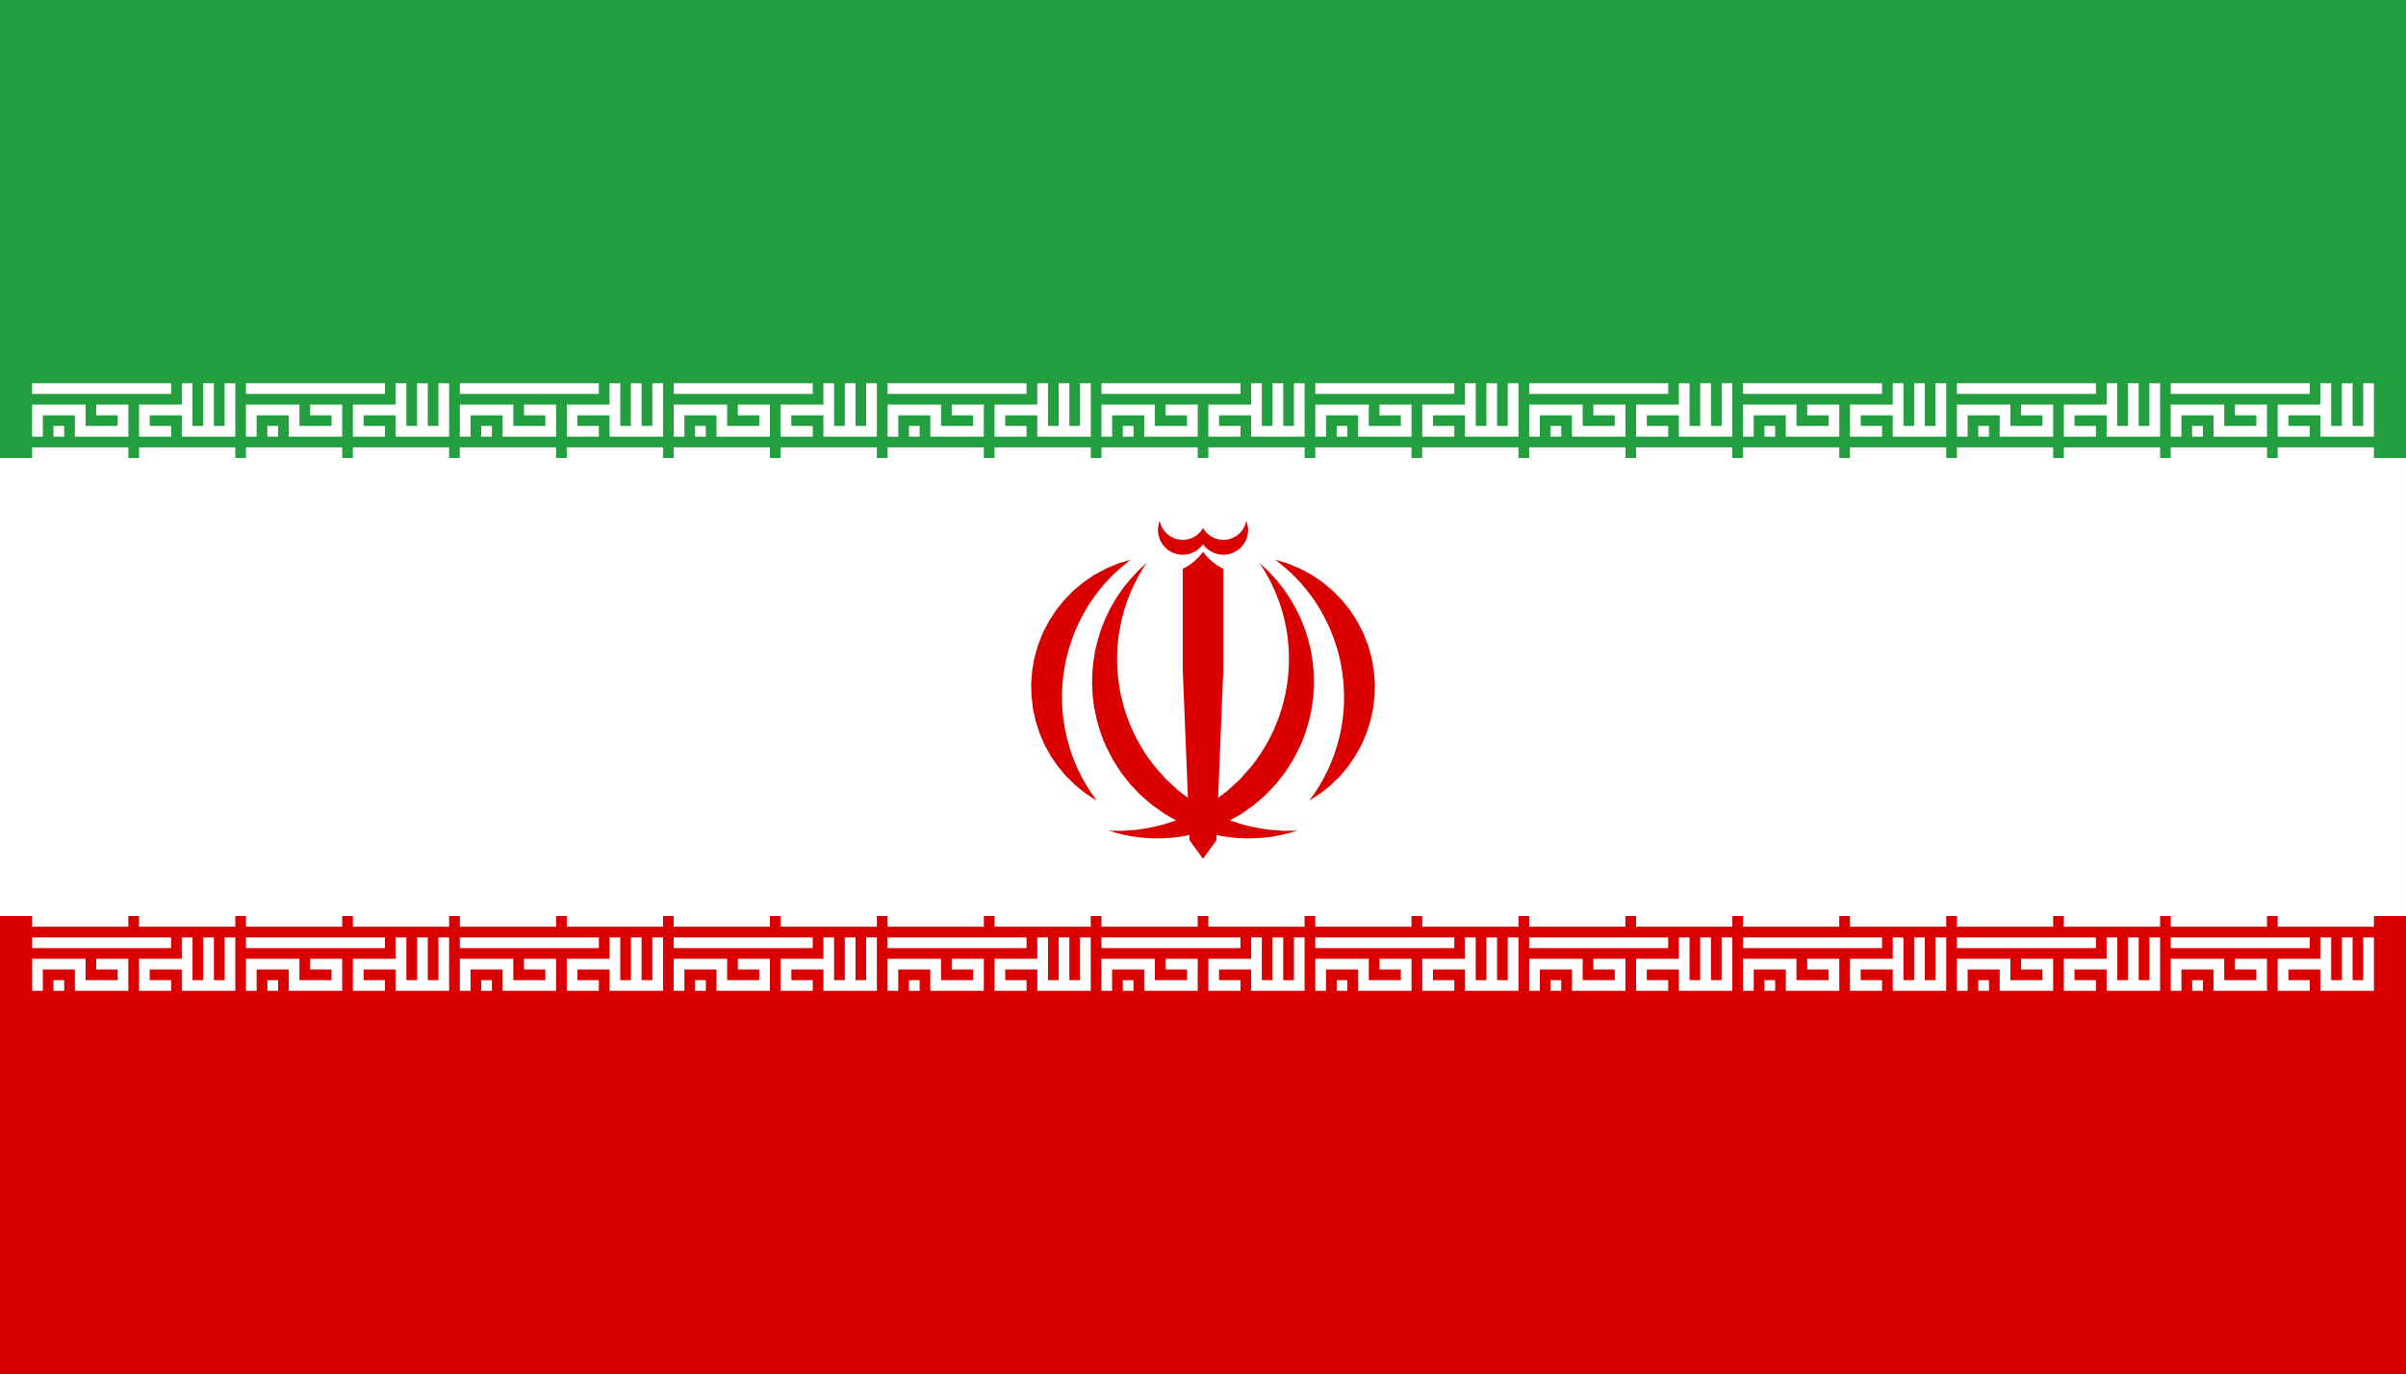
System Map
Global
Political/ Diplomatic
Brokering ability as an asset to the powers
T3
(9) Russia – weapon acquisition, support for the Deal of the Century (9)
(8) Trump’s second term – Financial aid, “chemistry” between leaders. Imposing the “Deal of the Century”, “Human Rights” Abuse
(10) China Supports the Deal of the Century
(11) EU
Security:
(1) Turkey – Enemy
(2) Ethiopia –Existential Threat (Water Dam)
(3) Israel
(4) Libya Border, Muslim Brotherhood
(5) Saudi Arabia, Jordan, Gulf - Cooperation
(6) Iran
(7) PA, Hamas
Socioeconomic:
Opening of Middle East markets to Israel
A regional security agreement against Iran
Economic cooperation in the gas sector
8
1
2
5
3
9
Regional
7
4
7
10
Domestic
7
6
Socioeconomic
Maintaining regime stability, Muslim Brotherhood
Improving the Economy

Slide 6
Interests
Political
  Regime Stability
  Iran – Turkey Regional hegemony race
  Weakening the Muslim Brotherhood
Economic
  Improving economy in the face of demographic growh
  Establishing a new city
Security
  Military build up to strengthen the regime
  Sovereignty in Sinai and milling of the Security annex to the Peace Agreement with Israel

Slide 7
Interests
Social
  Use of the regime and military control while oppressing the people and
  severe economic hardship
  Suppressing institutions; generating fear

Slide 8
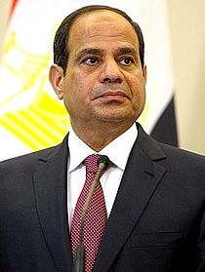
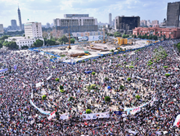
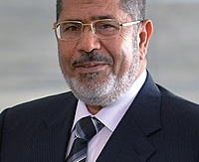
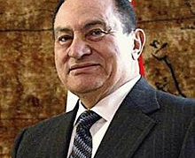
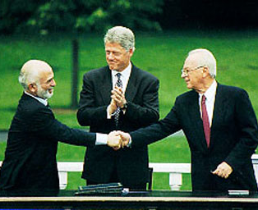
Political Progression
Abdel Fattah el-Sisi
June 8th, 2014
Morsi Ousting
July 2013
Mohamed Morsi
June 21st, 2012
Hosni Mubarak
October 14th, 1981
Peace Treaty
March 26th, 1979
Military coup and the ousting of Morsi
Tahrir Square Events
Appointment of Hizam Al Blaui as Prime Minister
The start of the trial of ousted President Morsi
'Abd al-Fatah a-Sisi resigns as defense minister and wins presidential election
After Mubarak's resignation on February 11, 2011
Military rule remains until Morsi is elected
Shifting from a non-republic to a National Democratic Party rule
1975 - "Interim Agreement", non-war regime
September 1978 - "Middle East Peace Framework"

Slide 9
Genealogy
The emerging system – reignition of the Deal of the Century in coordination with the US, Europe and Russia alongside the divided and suffering "public"
Legacy System “Umm al-Dunya”
Unique Context – Deal of the Century
2018 – "Watch Dogs"
2017
Grand Ethiopian Renaissance Dam
Tiran and Sanafir Return
2014 El-Sisi Takes Power –
2014
Campaign against Turkey
עליית טראמפ
הפשרת היחסים
2014 – "Protective Edge"
2010-2013 – Israel-Egypt Fence
Islamization Process
2012 - Military coup and the ousting of Morsi; Tahrir Square Events
Gulf States financial aid to Egypt
2011 - "The Arab Spring" - The people take to the Stseets
From a Non-Republican Republican National Democratic Party rule - 1981
2006-2007
Hamas elected in Gaza
1979 – Israel – Egypt Peace Treaty
Internal
External

Slide 10
Offset
While Egypt perceives itself
As the leader of the Arab world, "Umm al-Dunya"
(A regional power, security and economic regional stabilizer, leading the diplomatic channel as an intermediary in the Israeli-Palestinian settlement process)
Political developments, in the context of the Deal of the Century could render Egypt irrelevant

Slide 11
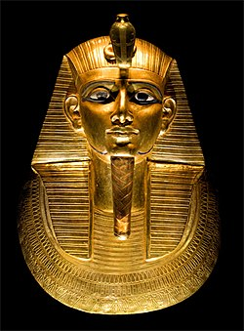
Potentials
Economic
Economic Improvement -HUB
Regional energy center (gas)
Nile water erosion, Ecological Problem
Developing modern agriculture
Energy boost (Russian reactor)
Security
Weakening the Muslim Brotherhood - Hamas
Dominance – Turkey Iran isolation
Improving sovereignty in Sinai
Diversifying buildup sources
Russian leverage over Turkey
Social
Building a city in Sinai
Oppression in the face of Globalization
Centralized control and military control
Suppression of institutions and absence of parties
Political
Regime Stability
יוקרה באמצעות שיחות וליע"ר בקהיר
Human Rights Abuse Legitimacy
Israeli assistance in the face of IS
Israel brokerage Monopoly

Slide 12
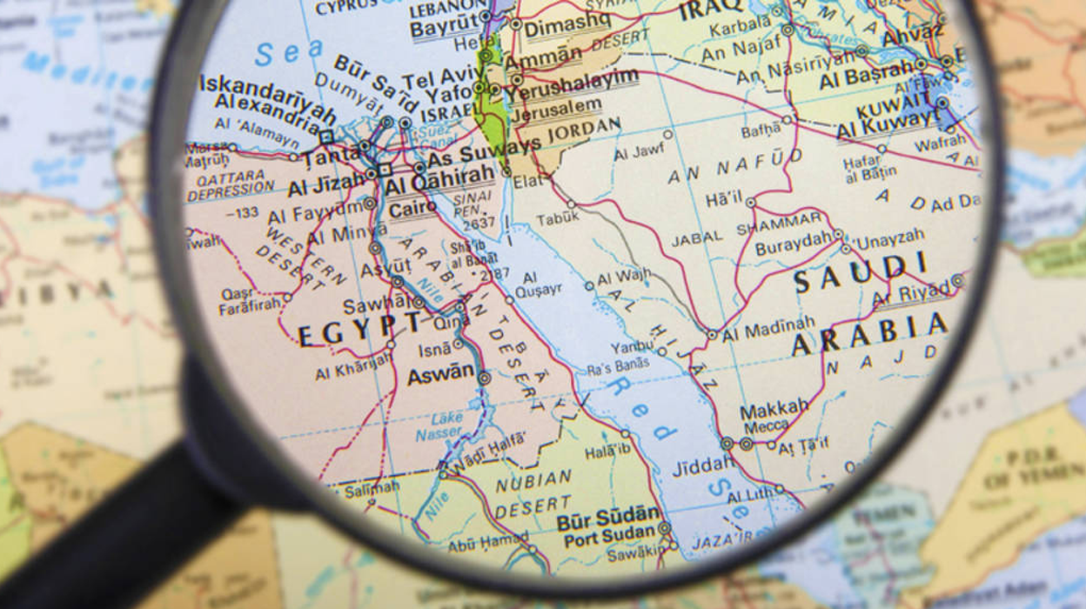
Strategy
Egypt is a regional power, essential to the stability of the Middle East. Actively coordinated with other important 'players'
Maintaining regime stability and strengthening the Egyptian economy as a regional 'pivot'
"Chairperson of the Board"
(Doesn’t have to be the owner of the company… Doesn’t issue orders however decisions are not made without them)

Slide 13
Strategy
Goals (1/2)
1
USA - Strengthening cooperation and the economic envelope
Negotiating to participate in the signing ceremony
$ 10 billion World Bank guarantee
Obtaining loans for gas development
Saudi Arabia - Creating a Middle East Management and Control Alliance
Israel
  Strengthening economic cooperation with emphasis on gas
  Continuing Military Cooperation - IS in Sinai, Muslim Brotherhood, Preventing Global Jihad
  The Israeli-Palestinian Conflict - Retention of Involvement (PA)
Hamas - Continuing influence as mediator and 'pressure factor’; agreement to prevent escalation during the ceremony
Palestinian Authority - Lack of leverage for significant for impact
Egypt is a regional power, essential to the stability of the Middle East. Actively coordinated with other important 'players'
אסטרטגיה
2
Maintaining regime stability and strengthening the Egyptian economy as a regional 'pivot'
מצרים מעצמה אזורית חיונית ליציבות המזרח התיכון. מתואמת באופן פעיל עם 'שחקנים' חשובים אחרים
שימור יציבות השלטון וחיזוק הכלכלה המצרית כ'רגל ציר' אזורית
"יושב ראש מועצת המנהלים"
(לא צריך להיות בעל החברה...לא מחלק פקודות אך לא מחליטים בלעדיו)

Slide 14
Strategy
Goals
1
USA - Strengthening cooperation and the economic envelope
Negotiating to participate in the signing ceremony
$ 10 billion World Bank guarantee
Obtaining loans for gas development
Saudi Arabia - Creating a Middle East Management and Control Alliance
Israel
  Strengthening economic cooperation with emphasis on gas
  Continuing Military Cooperation - IS in Sinai, Muslim Brotherhood, Preventing Global Jihad
  The Israeli-Palestinian Conflict - Retention of Involvement (PA)
Hamas - Continuing influence as mediator and 'pressure factor’; agreement to prevent escalation during the ceremony
Palestinian Authority - Lack of leverage for significant for impact
Egypt is a regional power, essential to the stability of the Middle East. Actively coordinated with other important 'players'
אסטרטגיה
2
Maintaining regime stability and strengthening the Egyptian economy as a regional 'pivot'
מצרים מעצמה אזורית חיונית ליציבות המזרח התיכון. מתואמת באופן פעיל עם 'שחקנים' חשובים אחרים
שימור יציבות השלטון וחיזוק הכלכלה המצרית כ'רגל ציר' אזורית
"יושב ראש מועצת המנהלים"
(לא צריך להיות בעל החברה...לא מחלק פקודות אך לא מחליטים בלעדיו)

