Slide 1
Introduction into payroll Architecture and tools
Customer
Michael Wulf, SAP / May 02, 2016

Slide 2
Payroll
Data entry
Time Management data
“Black Box”
Payment
Legal data (e.g., W4)
Pay slip
Posting to financials
Compensation data

Slide 3
Integration of HR and Payroll
All important information in the HR system is available for payroll without any additional effort
Changes to HR information automatically result in changes to payroll
If it is a change in the past, payroll picks this up
If it is not allowed due to payroll/accounting rules, it can be blocked
You can configure the system in order to specify which changes to HR information is relevant to payroll

Slide 4
Payroll: Best Business Practice
Besides the legal compliance, the payroll also follows best business practices
Examples:
Bonus payments in several countries, independent from the regular payroll
Workbench available to easily process bonus payments and automated follow-up processes
Handling of deductions, when there is not enough net to pay
Configuration available to make sure that different kinds of deductions can be treated differently according to company rules

Slide 5
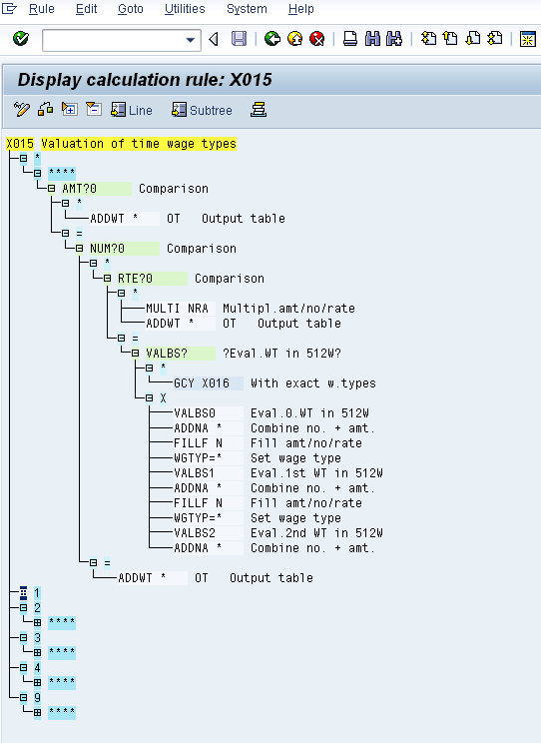
Configuring Payroll (Inside the Black Box)
The SAP payroll has a very flexible configuration concept
Simple things are done via configuration tables, some of which are delivered as examples
More complex things (like company-specific complex earning calculations) can be done via a specific configuration tool
It is always possible to enhance the payroll processing with your own logic, but stay in general processing and clearly separate SAP and customer parts

Slide 6
Integration of Payroll and Accounting
All payroll information is classified according to HR configuration to be transferred into the accounting system
The accounting system can be different from the HR system
It is also possible to use different FI/CO systems

Slide 7
The Story Continues: Payroll
At the end of the payroll period …
Mr. Miller gets his first pay slip

Slide 8
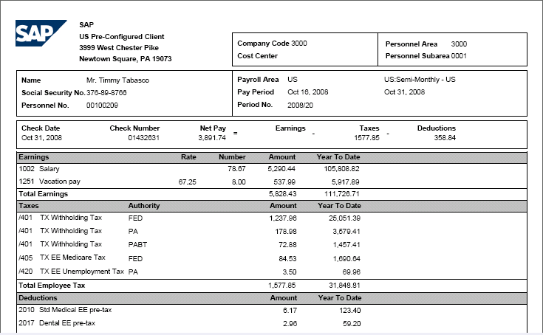
Pay Slip

Slide 9
HCM on HANA
HCM runs on HANA (as the complete ERP Suite) Has been verified with several PoC Projects
We see enhanced performance due to HANA, How much faster depends on the process
The data base size will shrink. In customer system we saw up to a factor of 2.5 down
Customer own reports can also benefit from HANA

Slide 10
Thank you

