Slide 1
National Conception on Biometrics and Identification
Roee Friedman,
Head of the Identification and Biometric Applications Unit

Slide 2

Biometrics

Slide 3

The Turning
Point

Slide 4
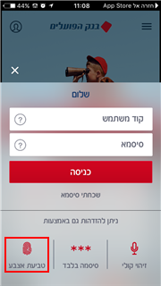
Test Yourself
Who Thinks they’re in the Biometric Database?
Biometric Databases in Israel:
  Ministry of Interior
  IDF, Police, Prison Service
  The DMV, the Employment Service, the Airports Authority, and the Ministry of Transportation
  Banks
  Different Private Organizations

Slide 5

What is Biometrics?
Biometrics - A term used to describe a feature or process
As a feature - a biological (anatomical or physiological) and measurable behavioral property that can be used for automatic identification.
As a process - automatic methods of identifying a person based on biological (anatomical and physiological) and measurable behavioral characteristics.

Slide 6
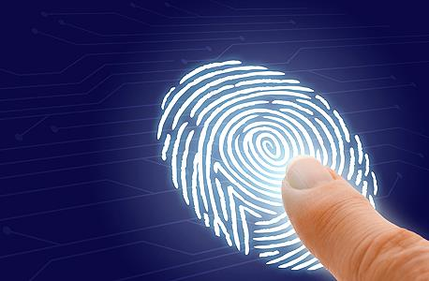
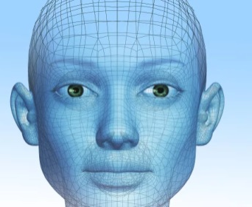


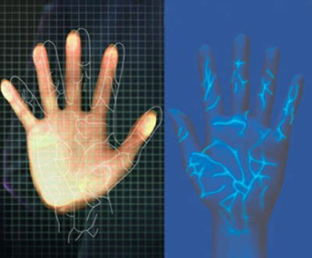

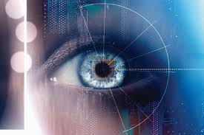

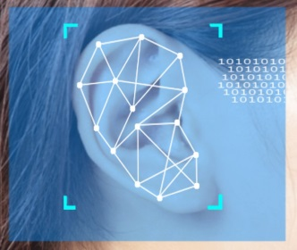

Types of Biometrics
Fingerprint
Facial
Recognition
Voice Recognition
Signature
Vein Recognition
Gate
Iris
Keystroke
Ear Shape
DNA

Slide 7
Types of Comparisons for Verification
Compare 1:Many
Compare 1:Few
Compare 1:1
  Comparing a person to another within a database
  Comparing a person to another within a group
  Comparing a person to themselves
CAN PREVENT DUPLICATES OR FRAUD

Slide 8
Examples
Biometrics in the law enforcement agencies
Allows quick and reliable answers
Biometrics in border control
Allows for quick passage, while maintaining a high level of identification of those passing through
In medicine
Prevents mistakes in identifying patients, allows personalized medicine
In Finances
Allows secure remote actions
Biometrics in the Military
Allows identifying suspects or taking biometrics from a scene for generalizing

Slide 9





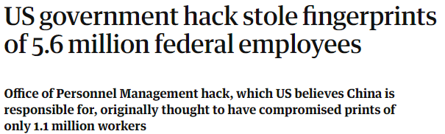
What are the Risks?
Information Leaking
Identify Theft
The Big Brother
"Identity Is The New Money"
David Birch

Slide 10
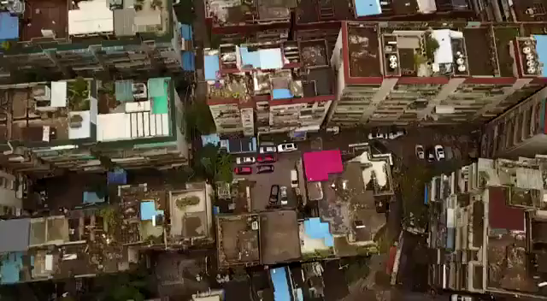
Facial Recognition - China

Slide 11

Applications and Implications at the National Level, Dilemmas and Challenges

Slide 12







Identification and Biometric Applications Unit
Secure Identification
Biometric Applications
Supervision of the
National Smart Documentation Project
National Biometric
Lab
A comprehensive approach to
the use of biometrics
at border crossings
Standardization
Research and Developing

Slide 13
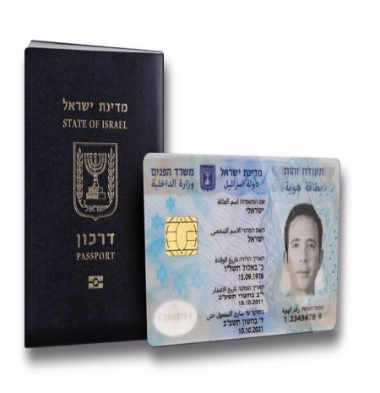

The Purpose of the Project
Issuing smart national documentation (passports and identity cards)
Authority: Inclusion of Means of Identification Act, 2009
Legislative amendments in 2017 entered into force on 1.6.2017
Responsibility: Ministry of the Interior
Population Authority
Status
Over 3.5 million people Joined
The Biometric Database Management Authority
High Court
Contents of the biometric database

Slide 14




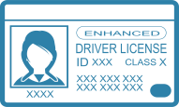






Supervision of the National Smart Documentation Project
Population and Immigration Authority
The Biometric Database Management Authority
Issuing center
2
Deliver
Citizen
Biographic
1
Biometric
AIR GAP
De-duplication
Issuance
3
6
National Registry
Encrypted temp. server
4
5
Hit/No-Hit

Slide 15
Biometric Identification and Applications Unit –
Areas of Activity
Biometric Applications
Safe identification
Biometric Applications
Supervision of the
National Smart Documentation Project
A comprehensive approach to
the use of biometrics
at border crossings
National Biometric Laboratory
Standardization
Research and development

Slide 16
National policy for biometric applications
Guidelines: Matrix for risk management, which is derived from the characterization of the system
danger level:
From which inputs are derived from the project and the involvement of the unit
Scoring:
Low
Medium
High
Diagnosis:
sector
size
Type of data
Storage location
Mandatory/
optional

Slide 17






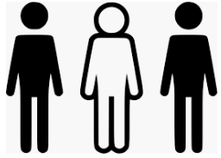

-FOUO-
Principles of policy
  Minimize data
  Privacy protection
  Information security
  Streamlining
  Dealing with exceptions
Human Dignity
  Maintaining the
  purpose
  Prevention of usage leakage

Slide 18







The challenge of identifying passengers at border crossings
Lack of connectivity to databases available worldwide
(For example, Interpol)
Lack of preliminary information about passengers
Terrorists identify weaknesses (attack in Boston, attack in Paris)
A steady increase in the number of passengers
The need for a factor with a long-term strategic vision
Databases based on biographical information (*Dublin mayor affair)
Distribution of forged passports
and fictitious identity (FOG)

Slide 19
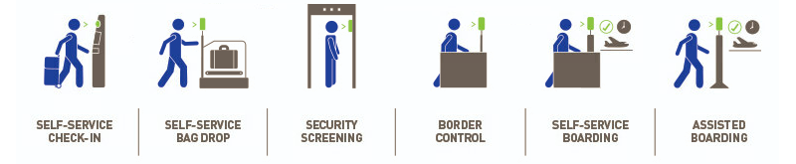
Major trends in the world
UN Security Council Resolution 2396
International cooperation for biometric information sharing (M5, Interpol)
ICAO-9303 for biometric passports, increase in the distribution of biometric passports
Implementation of face recognition technologies in end-to-end projects, from curve to gate (EU, USA, Australia)
1
2
3
4

Slide 20
Identification and Biometric Applications Unit
Secure Identification
Biometric Applications
Supervision of the National Smart Documentation Project
National Biometric
Lab
A comprehensive approach to
the use of biometrics
at border crossings
Standardization
Research and Developing

Slide 21








A national infrastructure for safe identification
Kiosks
Mobile
Online
Biometric Identification 1: 1
Private sector
Public sector
Government
sector

Slide 22

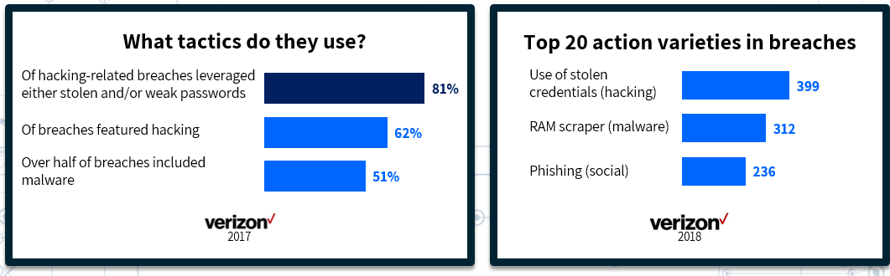
Why is it important that digital identification will be safe ?

Slide 23


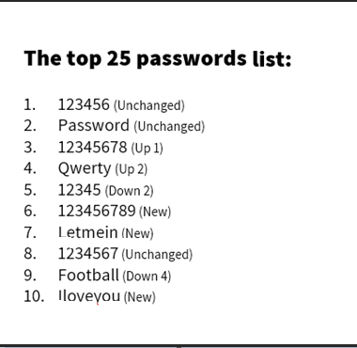

25%
Use one of the 25 most popular passwords
60%
Reuse the same passwords

Slide 24
Jimmy Kimmel

Slide 25
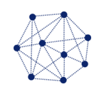
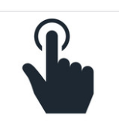




-בלמ״ס-
Principles of policy
  Technological compatibility and open systems
  Privacy protection
  Information security
  Usability and simplicity
  Lack of a link to the "biometric database"
  Use of means of identification
Transparency
  Classification of services

Slide 26


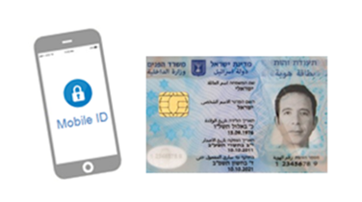
Program anchors
Establishing a national infrastructure for identification. To access services online
The smart identity card will serve as an anchor to identify services in the State of Israel
A unified system of national identification that will allow identification of services from anywhere in a safe manner
The possibility of identification is safe, not through the ID card
    Access to infrastructure for expanding the use of the identity card in the entire economy
    Mobile ID - Implementation of a mobile application based on the smart ID card

Slide 27









How to use the program
8
1
Establishing a National Identity Infrastructure A unified identification system (including mobile)
7
Awareness and Explanation
2
Implementation of the system in government ministries and in the public sector
ID Second generation
Program Components
6
3
Realization of ID on consoles
(Biometric authentication)
Making the system accessible to the private sector
Realization of identity cards in government self service positions (kiosks)
4
5
Staff work on IDP and its implementation

Slide 28
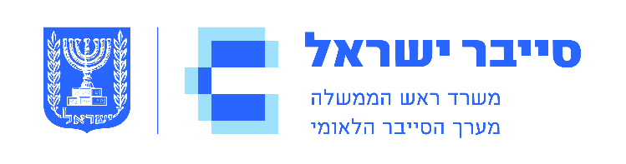


Thank you!
Roy Friedman
RoyF@cyber.gov.il

