Slide 1
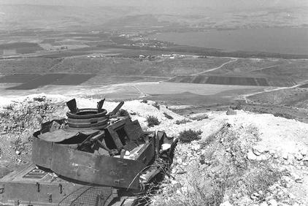
2040 – Designing the Environment According to
National Security

Slide 2
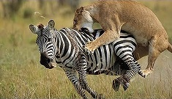
Setting Expectations
National Security is not the for the weak
Looking for the pony….

Slide 3
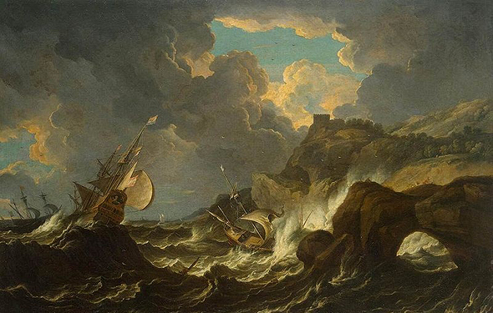

Slide 4
Goals of the Tour
Familiarity with the Northern arena on all the components of National Security
Learning about the different players and influencers in National Security
Learning in the context of leadership position in shaping the space and realizing the vision
Learning the process of designing the Northern arena in the National Security arena
Clarify “What is national in National Security” in Northern Israel

Slide 5
Secondary Goals
Political | Societal | Financial | Security
Wars | Israeli Arabs | Driving forces and barriers to growth | Northern Rival System
Border design | Druze (Golan Heights and the Galilee) | Industry | Green line settlements
Occupied territories | Settlement and periphery - local government, health, planning, transportation | Agriculture | Internal Security
UNIFIL | Struggle for land | Tourism
 |  | Water and infrastructure (electricity and gas)

Slide 6
Method - Geographical Case Studies
Wadi Ara
Presenting the topic/challenges
View the development of the topic on the timeline
Introducing an affinity system and interactions
Leadership position
Bezeq Reviews "What is National ..." in the Northern Territory
Tiberias
Golan Heights
The Galilee
Political | Cultural | Financial | Security
Creating borders | Israeli Arabs | Driving forces and barriers to growth | Northern Rival System
Occupied lands | Druze (Golan Heights and the Galilee) | Industry | Green line settlements
 | Settlement and periphery - local government, health, planning, transportation | Agriculture | Internal Security
 | Struggle for land | Tourism

Slide 7
Method - Case Study "Northern Gates"
Wadi Ara
Israeli Arabs
Local Authority
Internal Security
Construction Planning
Political | Societal | Financial | Security
Wars | Israeli Arabs | Driving forces and barriers to growth | Northern Rival System
Border design | Druze (Golan Heights and the Galilee) | Industry | Green line settlements
Occupied territories | Settlement and periphery - local government, health, planning, transportation | Agriculture | Internal Security
UNIFIL | Struggle for land | Tourism

Slide 8
Method - Case Study "The Capital of the Periphery?"
Tiberias
Local Government - Potential Versus realization
Mixed city
Health
Tourism
Wars | Israeli Arabs | Driving forces and barriers to growth | Northern Rival System
Border design | Druze (Golan Heights and the Galilee) | Industry | Green line settlements
Occupied territories | Settlement and periphery - local government, health, planning, transportation | Agriculture | Internal Security
UNIFIL | Struggle for land | Tourism
 |  | Water and infrastructure (electricity and gas)

Slide 9
Method - Case Study “Golan Heights”
Golan Heights
Border Design
From military to civilian
Druze
Agriculture
Wars | Israeli Arabs | Driving forces and barriers to growth | Northern Rival System
Border design | Druze (Golan Heights and the Galilee) | Industry | Green line settlements
Occupied territories | Settlement and periphery - local government, health, planning, transportation | Agriculture | Internal Security
UNIFIL | Struggle for land | Tourism
 |  | Water and infrastructure (electricity and gas)

Slide 10
Method - Case Study Galilee/Teppen
Galilee/Teppen
Northern rival system
Industry as a growth engine
Struggle for space
Druze
Wars | Israeli Arabs | Driving forces and barriers to growth | Northern Rival System
Border design | Druze (Golan Heights and the Galilee) | Industry | Green line settlements
Occupied territories | Settlement and periphery - local government, health, planning, transportation | Agriculture | Internal Security
UNIFIL | Struggle for land | Tourism
 |  | Water and infrastructure (electricity and gas)

Slide 11
Principles of Training
Reference booklets
Diverse experience - opinions, eyes, mental and emotional, individual conversations and panels
Senior Learning

Slide 12
Schedule for the Prep Day
Notes | Event | Time
Distribute booklets and books | Presenting the tour - Roman Goffman | 8:00-8.30
 | Introduction to the Tour - Prof. Yossi Ben Artzi | 8:30-9:00
Presentation by Heli Kontante | The North 2040- Mr. Uri Ilan | 9:00-10.00
Presentation by Avi Keynan | The Development of the North within the National Vision - Minister Ari Deri | 10.30-12.00
 | Lunch | 12:00-13.00
Presentation Roman Goffman | The 2nd Lebanon War- Mr. Ehud Olmert | 13.00-14.30
Presentation Nitza Rogozinski | Geographical Review - Prof. Rasem Hamayasi | 15.00-16.00
Presentation Moshe Edri | Security in the North - Deputy Commissioner Shimon Lavi | 16.15-17.30

Slide 13
Schedule for Tuesday 26/11
Notes | Event | Time
 | Gathering and breakfast | 7.30-8.00
 | A talk with Mr. Muder Yunes, Head of the Coucil and Knesset Member Osama Saadi | 8.30-10.30
 | Observation post – Mr. Avi Cohen, Deputy Director General of the Finance Ministry | 10.45-11.30
 | Travel to Tiberias | 11.30-12.30
Decks Restaurant | Working lunch and coffee | 12.30-14.30
 | Briefing In view of the periphary - Director of "Poria" Medical Center, Dr. Erez On | 14.30-15.30
 | Tour and panel "Tiberias between potential and realization" | 15.45-18.00
 | Tour - "Where the INDC stops, limits will be set." | 18.00-21.30
 | Evening conversation and dinner in Ein Gev | 21.30-23.00
 | Sleep | 23.00

Slide 14
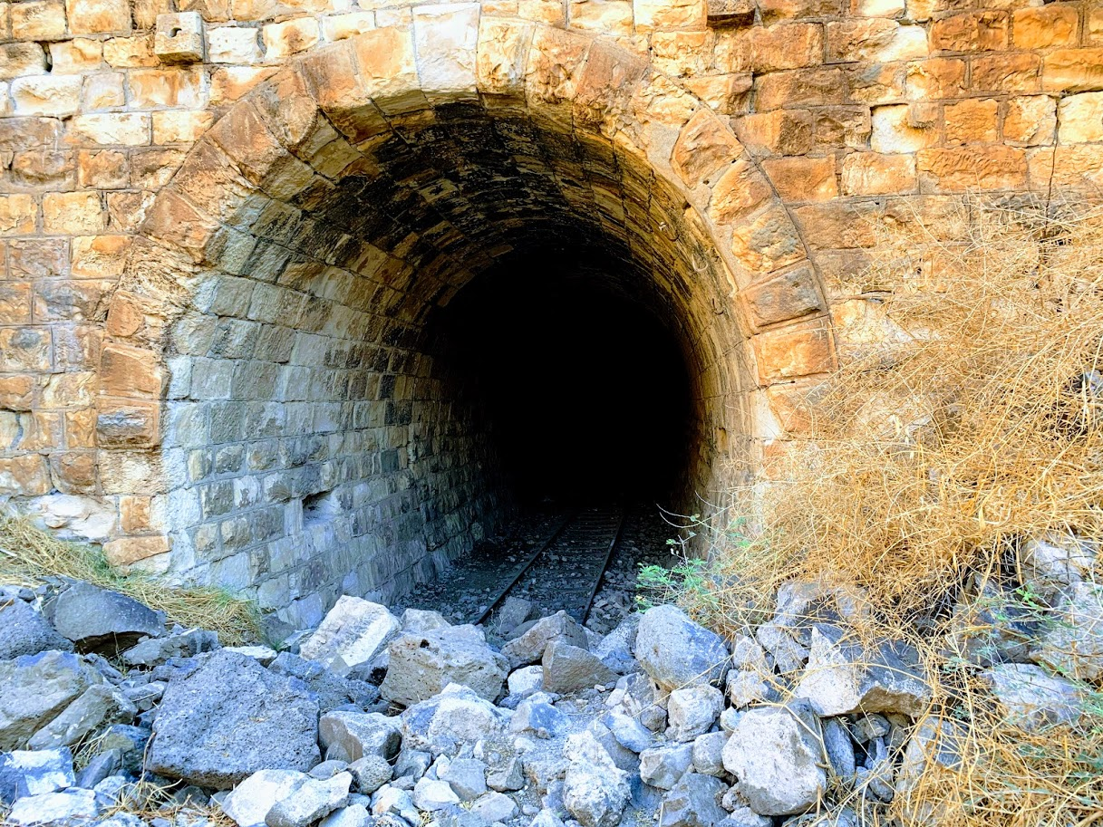
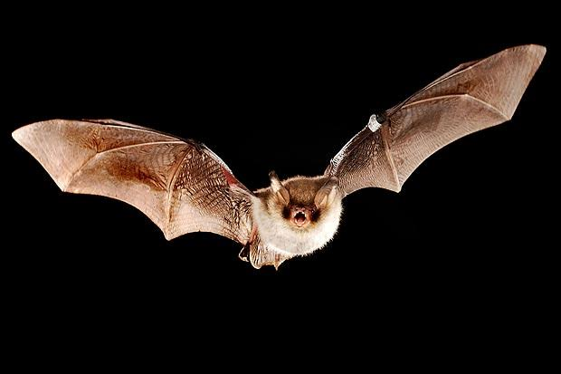
The Hejaz Railway

Slide 15
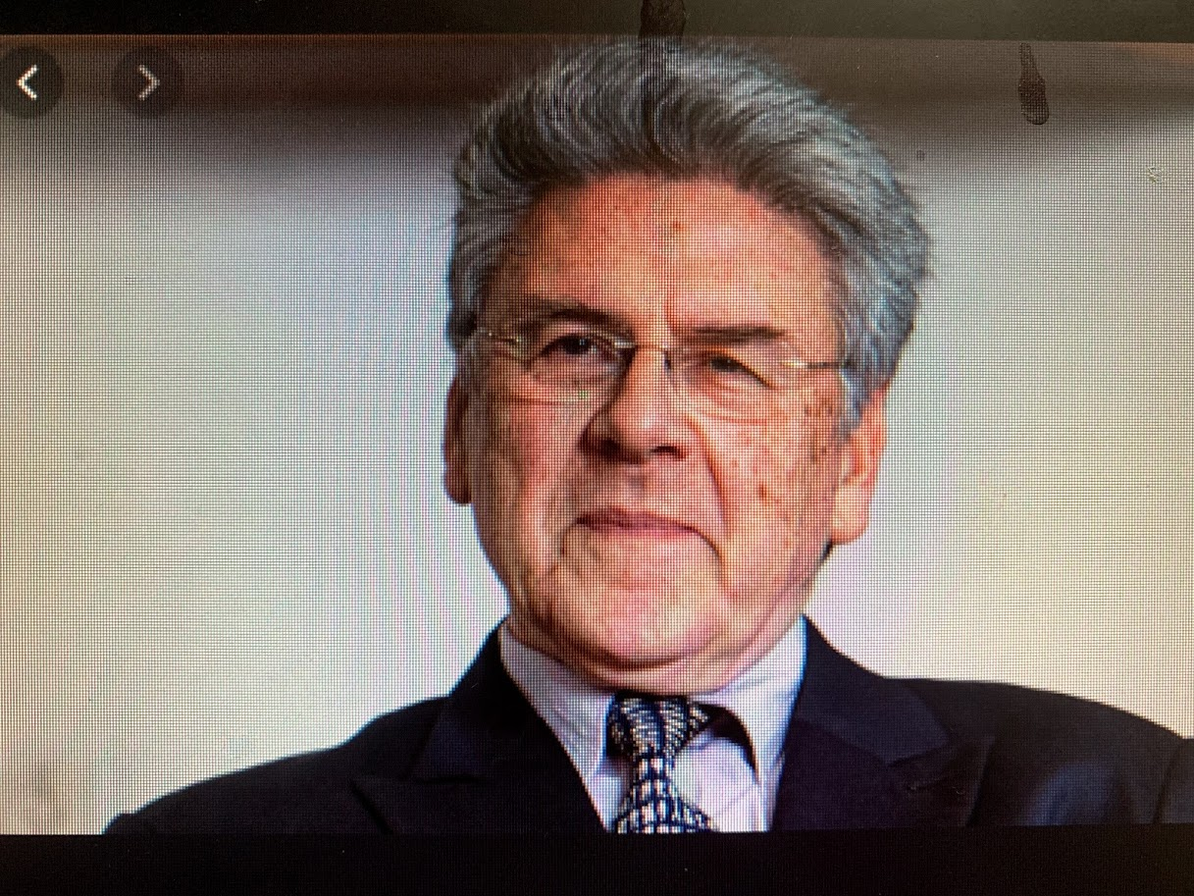
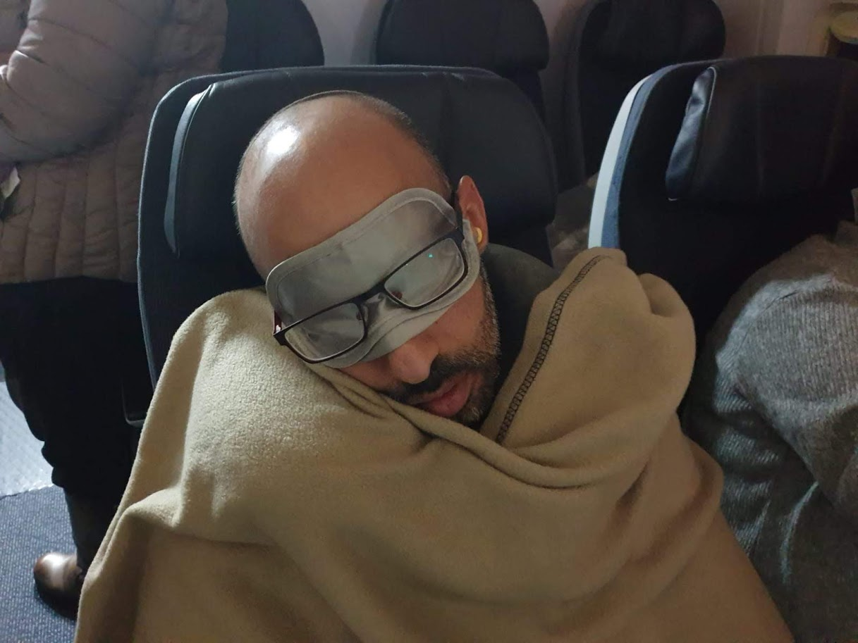
Intellectual Deepening

Slide 16
Schedule for Wednesday 27/11
Notes | Event | Time
 | Breakfast and travel to Bental | 7.00-8.30
 | What is National in National Security - Bezeq Reviews | 8.30-9.15
 | Conversation with Mr. Haim Rokach | 9.15-10.30
Majdal Shams | Conversation with Sheikh Taher Abu Saleh | 11.00-12.00
 | Working Lunch and coffee | 12.00-14.00
 | Driving along the North Road and Border lookout point | 14.00-15.30
 | Visit in the Ramia tunnel | 15.30-17.00
 | Conversation with the Commander of the Northern Command- Major General Amir Baram | 17.30-19.00
Ma’alot | Dinner and working time in teams | 20.00-21.00
 | Evening with Yotam Regev | 21.00-23.00

Slide 17
Schedule for Thursday 28/11
Notes | Event | Time
 | Breakfast and travel to Iscar | 7.30-8.00
 | Vision Review - Vice President of Iscar Mr. Aryeh Baron | 9.00-10.00
 | Factory Tour | 10.00-11.00
 | The “Struggle for Space” Panel | 11.30-12.45
 | Lunch | 13.00-13.45
 | Discussion with Brigadier General (Res). Amal Assad | 14.00-15.00
 | Aerial helicopter tour | 15.00-17.00
 | Snacks and end of the tour | 17.30

Slide 18
Topics for Continued Instruction at Mabal
Methods | Subject
Full day | Water as a national resource
 | National infrastructure- gas and electricity
UNIFIL | Peacekeeping Forces

Slide 19
Packing List
Dress Code- Mabal code, hiking pants, hiking shoes (closed toes)
Warm clothes, umbrella
Workout clothes

