Slide 1
46th Class Graduation Ceremony Presentation

Slide 2
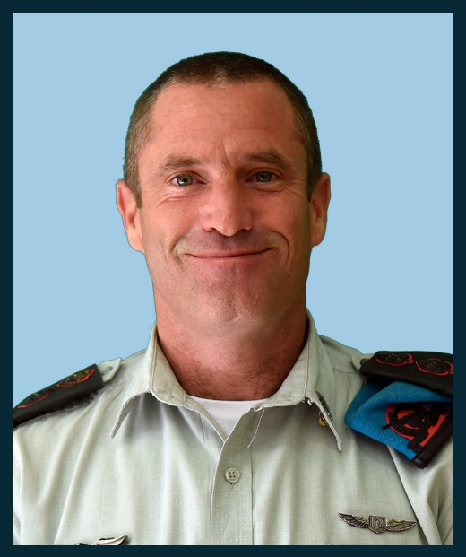
Col. Hen Almog
In his thesis he wrote about the establishment of another international airport in Israel. Successfully led the East Tour to Russia. A well-known host of international wine tours in the north.

Slide 3
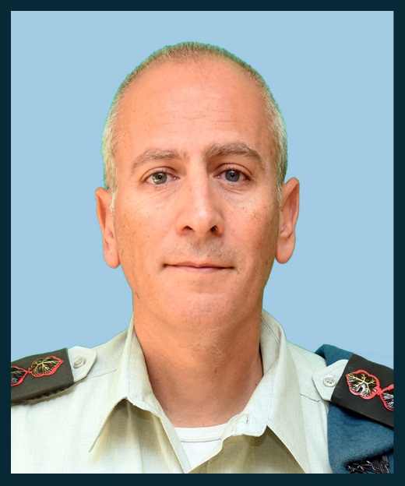
Col. Yehuda Elmakais
In his thesis he wrote about the use of artificial intelligence in the IDF.

Slide 4
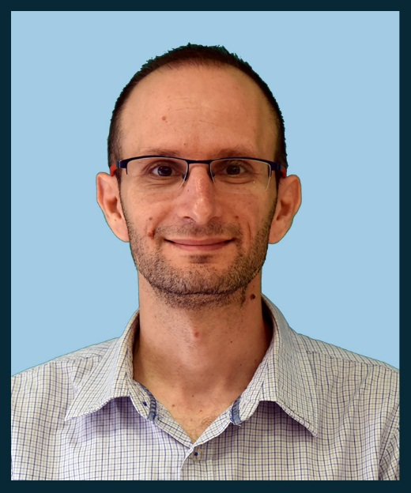
Dr. Eyal Argov
Head of Sector at the Bank of Israel. In his thesis he wrote about the employment of Haredi men in the Israeli economy. Among his hobbies he lectures on macroeconomics, economic growth and monetary policy.

Slide 5
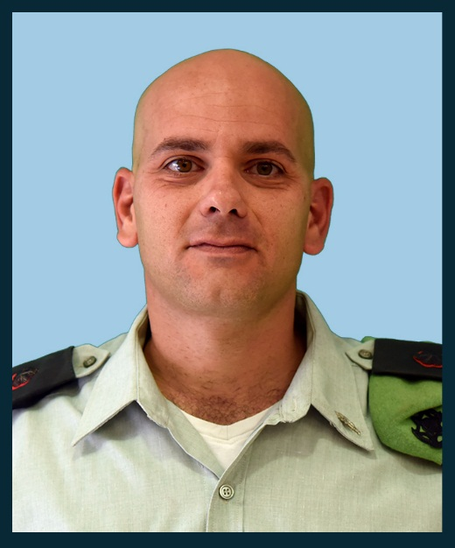
Col. Samuel Bumendil
Head of the Education Department. In the Thesis, he studied the moral behavior of soldiers and commanders in the IDF. Member of the Presidium of the 46th Class.
During the tour in the US he made a moving speech at the synagogue in New York.

Slide 6
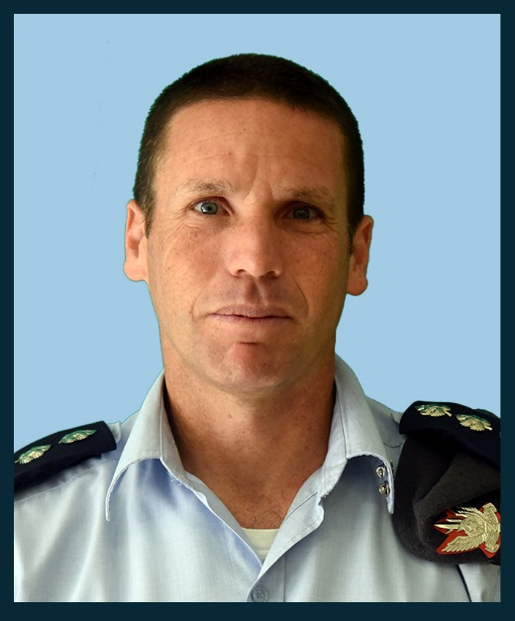
Col. Gilad Biran
Commander of the Air Defense School. In the final paper he wrote about the Soviet missile defense system's learning. Participated in the "Dov Hatzafon" seminar. At The political simulation he was the only Israeli participant in the Russian delegation.

Slide 7
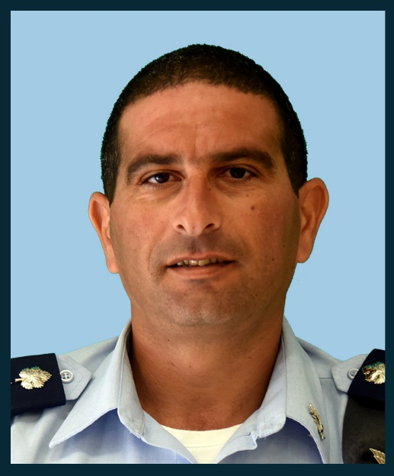
Col. Yariv Ben Ezra
Instructor at the Command and Staff College.
Wrote an annual work on the impact of the economic situation in the territories on terror activity and was among the tour guides to Jerusalem.

Slide 8
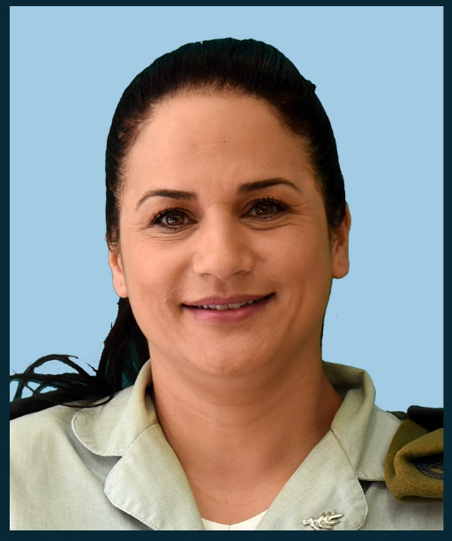
Brigadier General Meirav Brickman
Headquarters of the Unified Supply Center. In her thesis she wrote about cooperative economics and its application in the IDF. Member of the Presidium of the 46th Class. Infrastructure patrol leader.

Slide 9
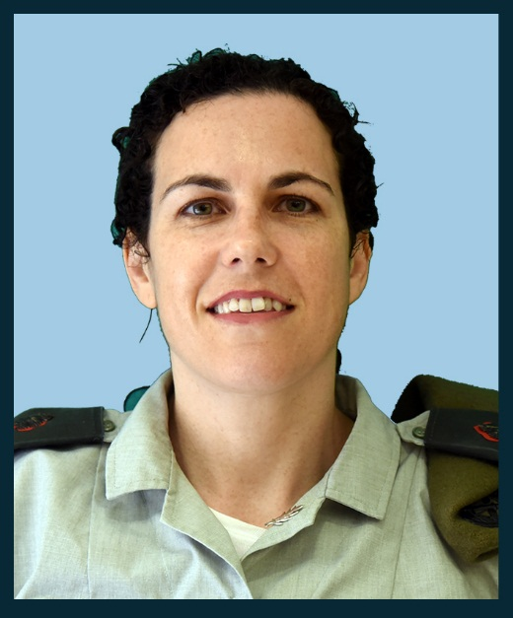
Lt. Col. Maya Goldschmidt
Military judge. In her thesis she wrote about the legal status of career soldiers. First summarizes the plenum. Led the "Army and Justice" seminar.

Slide 10
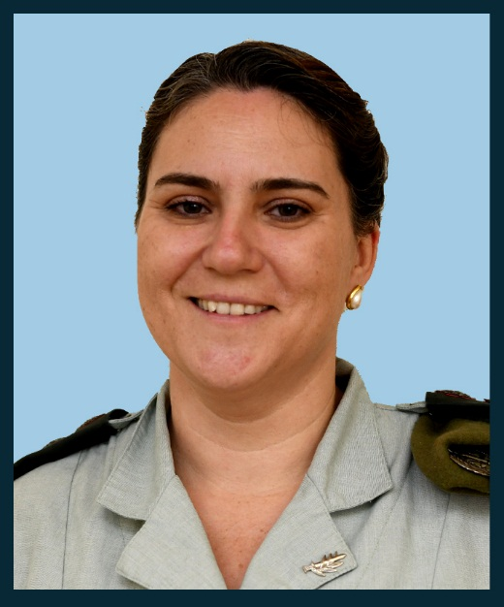
Col. Inbal De Paz
In her thesis she wrote about the right to organize Permanent servants. Led the "Army and Justice" seminar. Was the prime minister of Israel in the political simulation. She got married in New York on the tour of the United States.

Slide 11
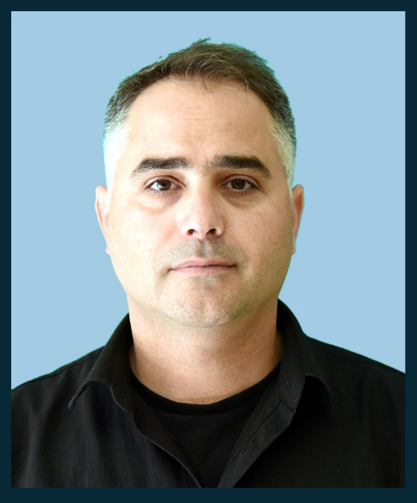
Ofir Dayan
He is a project leader at the weapons development authority.
In his thesis he wrote about Iron Dome.

Slide 12
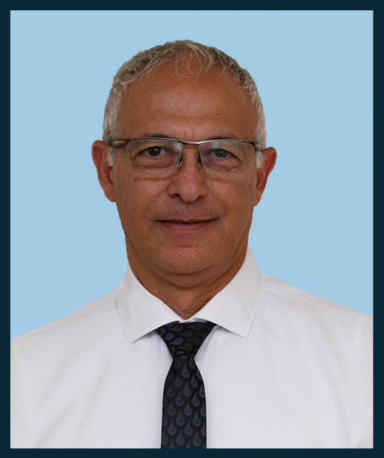
Dr. Ronen Harari
The Atomic Energy Commission.
In the annual work, he wrote about the owners of the interest in the establishment of a nuclear power plant and was among the south tour operators.
Senior project manager at the Nuclear Research Institute, the Atomic Energy Commission.

Slide 13
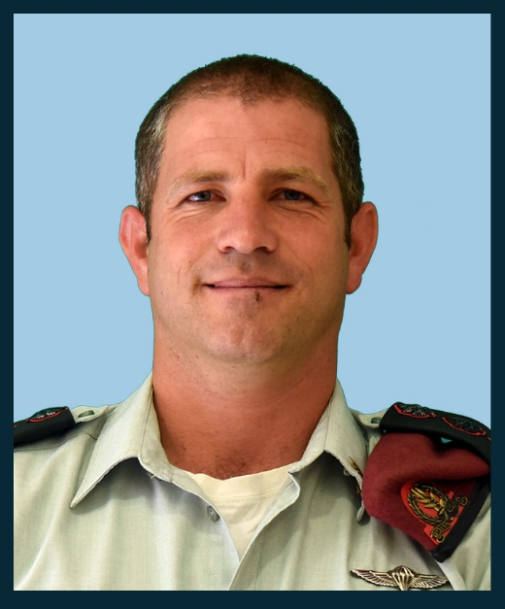
Col. Yehuda Vach
Commander of the Hiram formation. In his thesis he wrote about the security fences on the borders of Israel. When he was on a tour of the United States, His son was born in good fortune, the sixth child in the family.

Slide 14
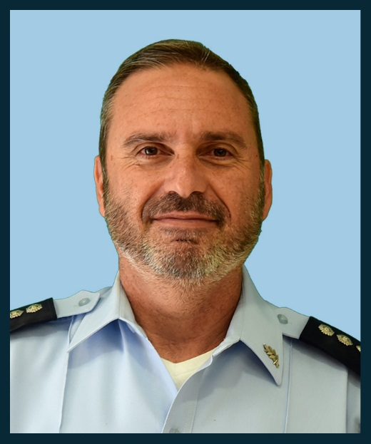
Commander Yigal Hadad
Wrote a thesis on illegal possession of weapons in the Arab sector.
He completed his position as commander of the Kinneret region of the Israel Police

Slide 15
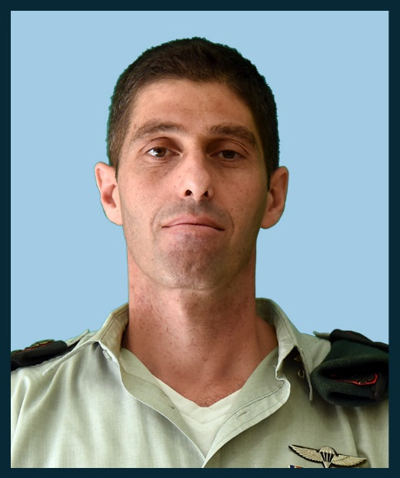
Col. Shai Chanuna
Intelligence officer in the Northern Command. In his thesis he wrote about the information revolution in the civil service. In the school year in the INDC, his princess daughter was born.

Slide 16
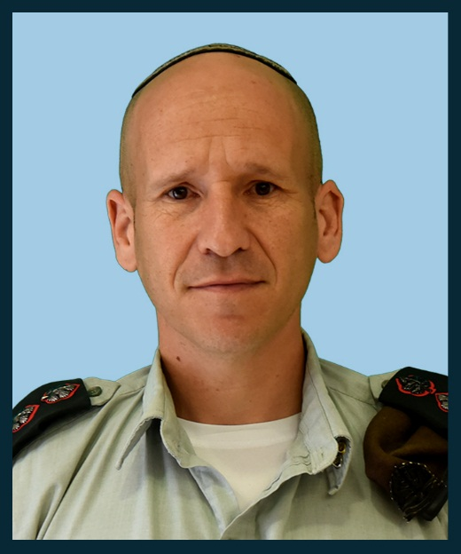
Col. Shay Tayeb
Head of the regular service department.
In his thesis he wrote about "The Ethos of the Warrior" in the context of military revolutions. He entered the plenum always at the beginning of the lesson.

Slide 17
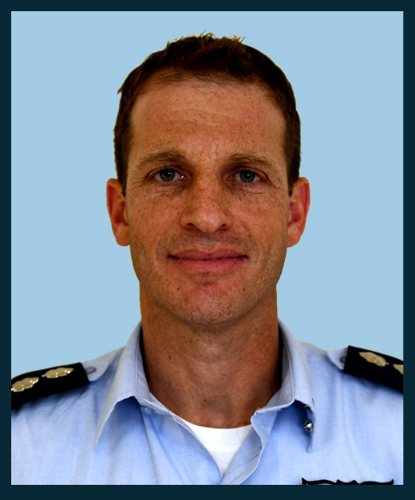
Brigadier General Omer Tishler
Commander of the Nevatim Base. Wrote an annual work on the relationship, combining intelligence with an emphasis on the northern arena. Member of the Presidium of the 46th Class. One of the leaders of the South Tour. In the political simulation he played Donald Trump.

Slide 18
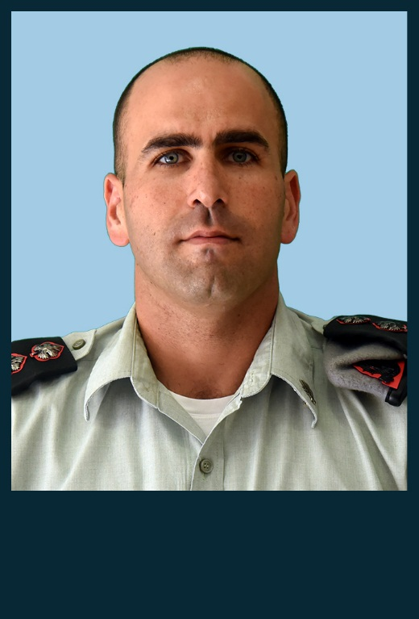
Col. Manor Yanai
Yahalom commander.
He wrote an annual work on the civil war in Syria.

Slide 19
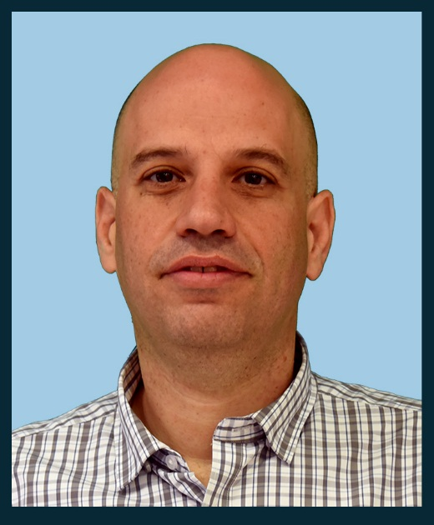
Zvika Israeli
Prime Minister's Office.
Wrote annual work on Russian influence. Participated in "Dov Hatzafon" seminar. Led the tour to India. Won first place in the costume competition at a Purim party.

Slide 20
Col. Itzik Cohen
Commander of the Givati Brigade.
In his thesis he wrote about Jordan.

Slide 21
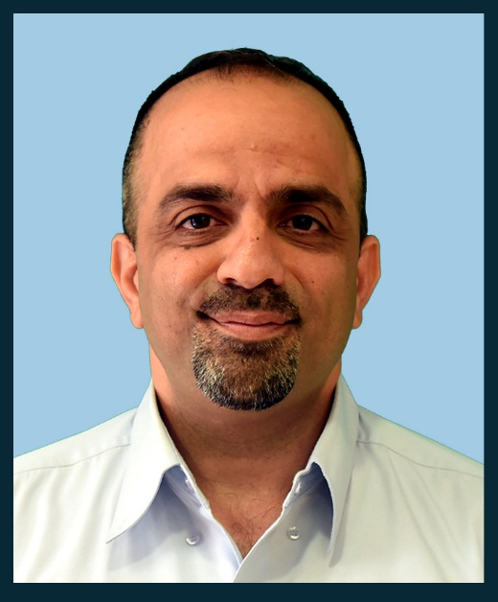
Eyal Calif
Wrote annual work on defense exports. He has filmed close to 20,000 pictures documenting all the experiences of the Year in the INDC.

Slide 22
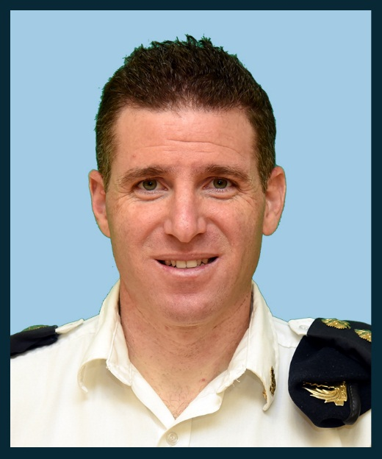
Col. Guy Levi
Commander of the Shayetet 3. In his thesis he wrote about the Chinese involvement in the Haifa port and will be published in Haifa University's Chaikin Chair. Successfully led the East China tour.

Slide 23
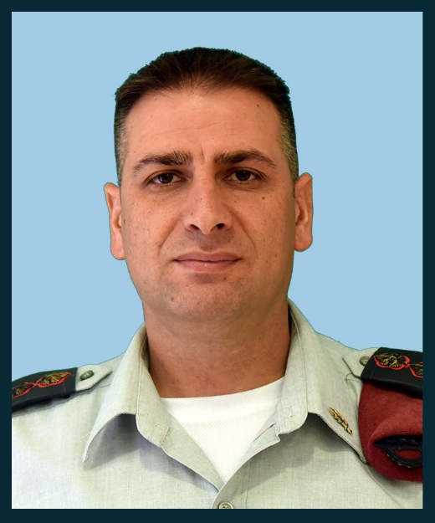
Col. Guy Levi
Commander of the Training Base 1.
Wrote an annual work on the battle between the wars

Slide 24
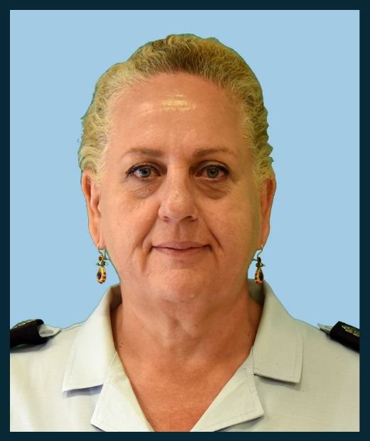
Subgondar Levy Shay Levana
Israel Prison Service.
She wrote an annual work on the living space of prisoners. Leading a company tour. This year she became a grandma for a cute prince.

Slide 25
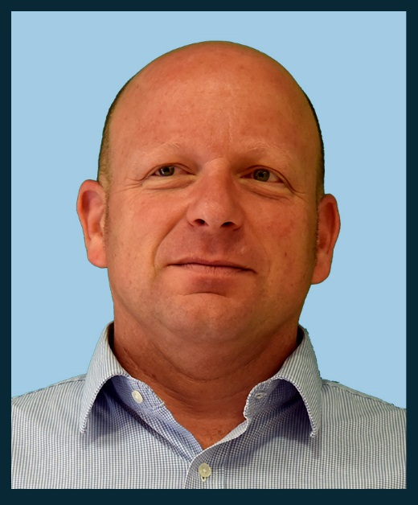
Eliaz Loff
Ministry of Foreign Affairs. He is writing a research thesis on the supervision of trade in arms and defense equipment

Slide 26
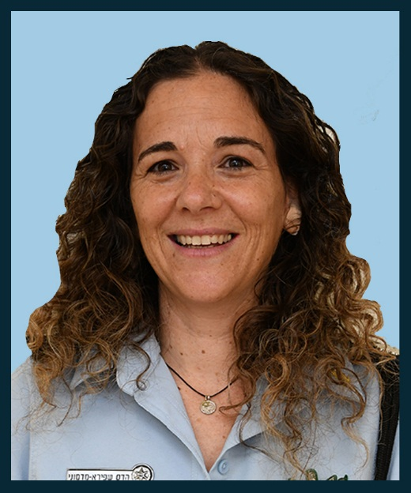
Commander Hadas Madmoni
She wrote an annual work on public trust in the Israel Police. She was one of the leaders of the Jerusalem tour and a police patrol. She invested in writing personal birthday blessings. A champion in rhyming and running.

Slide 27
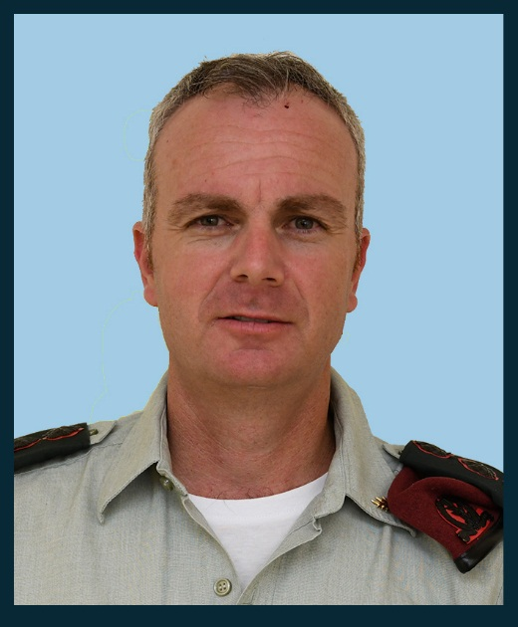
Col. Alon Madanes
A dry attaché in Washington.
Wrote a thesis paper, at a record time of three months, on the Palestinian demographic campaign. Has successfully led the United States tour.

Slide 28
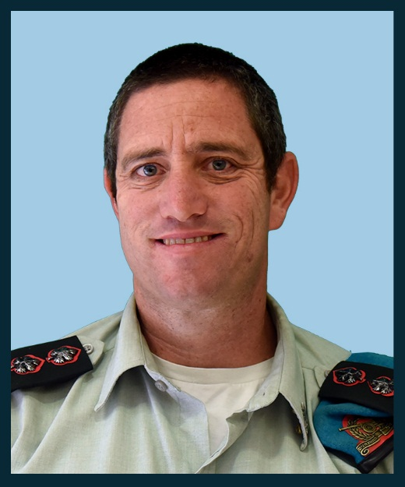
Col. Nathans Yair
Egged commander 282. Wrote annual work on reserve duty in the IDF in light of the challenges of the hour, the first to submit the annual work. And the first to be completed by the INDC in the 46th class..

Slide 29
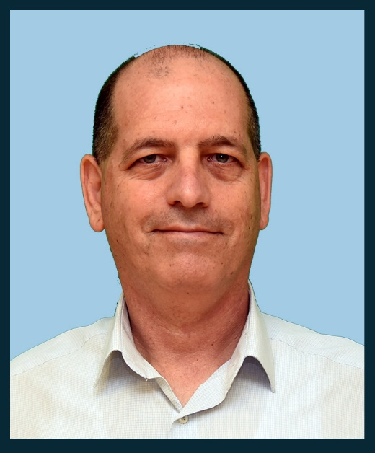
Peer Kobi
Atomic Energy Commission. Wrote annual work on the preservation of technological personnel in security organizations. In the plenum it is customary to say: "When Kobi says Kobi knows." Every morning of "Birthday" opens with a message from Kobi.

Slide 30
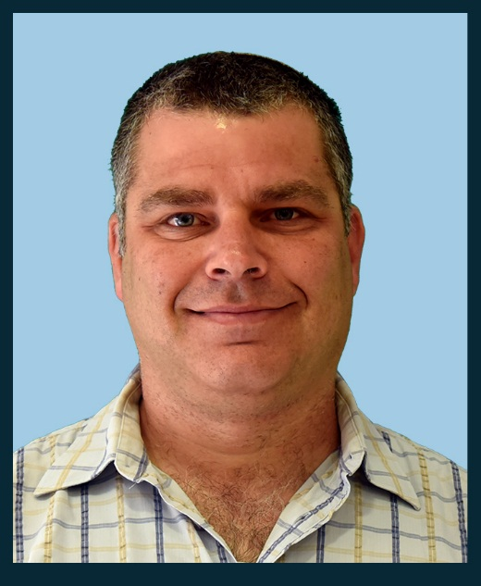
Dror Friedler
Prime Minister's Office.
In his thesis he wrote about artificial intelligence.

Slide 31
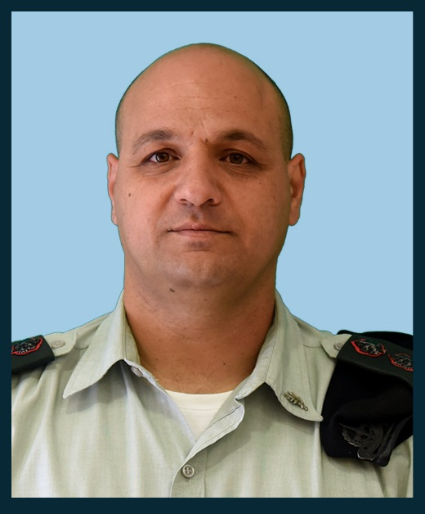
Col. Haim Raban
Wrote annual work on the "Profession for Life" project, which trains soldiers to work in the Israeli economy.

Slide 32
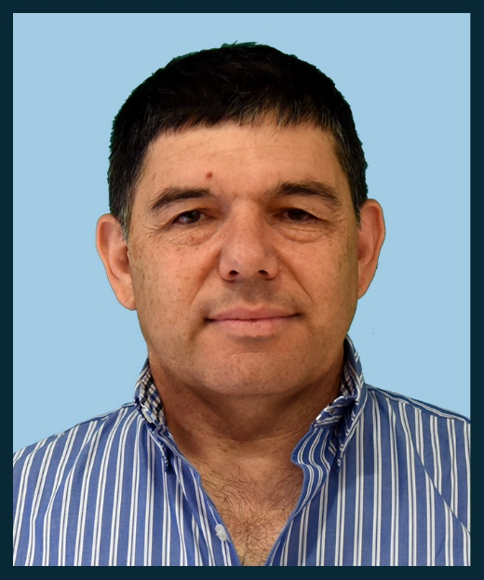
Assaf Raffeld
Israel Lands Authority.
Wrote an annual work on the housing crisis.
In the political simulation he was the "King of Jordan" ".

Slide 33
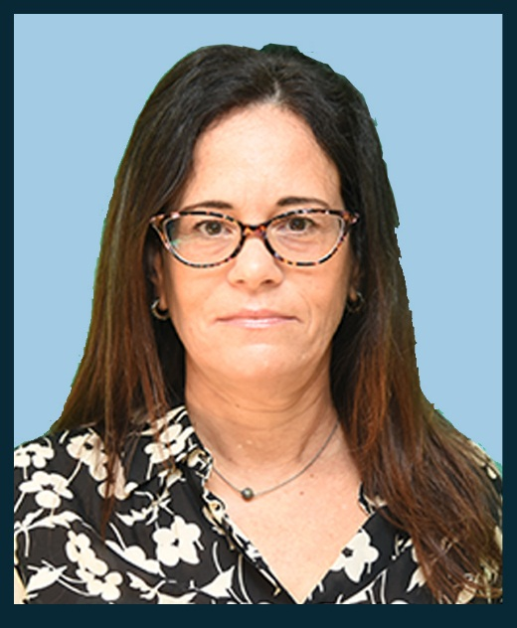
Shay Deganit
State Comptroller's Office. She wrote an annual work on political appointments in the service of the state.

Slide 34
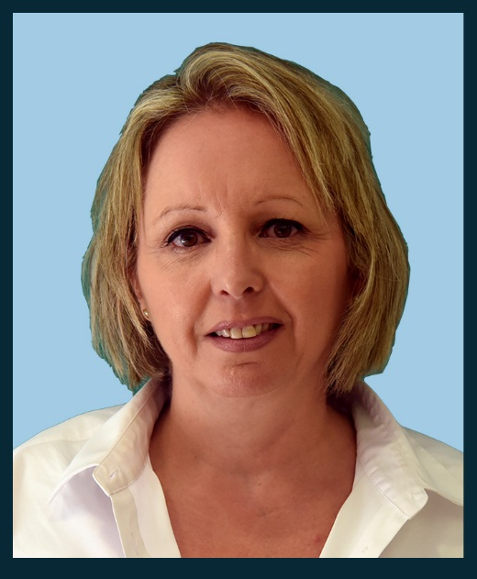
Rachel Shani
Ministry of Foreign Affairs.
She wrote an annual work on the responsibility of the state towards its citizens living outside its borders. The President of 46th class.
Warmly embraced the international participants and hosted them in the evening "Memory in the living room"....

Slide 35
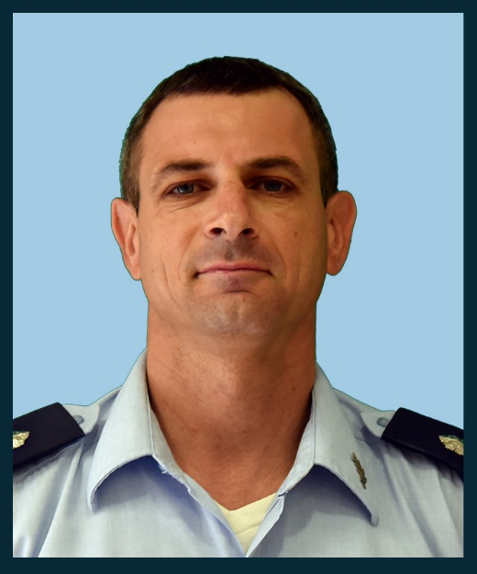
Lt. Col. Dr. Shahar Shapira
Wrote annual work on a program to promote health in the IDF.

Slide 36
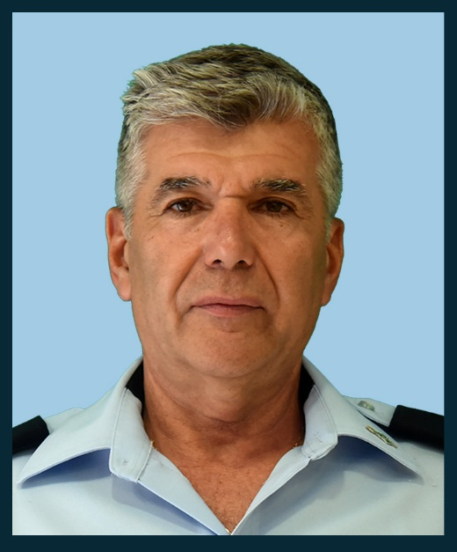
Brigadier General Michael Shafshak
In his thesis he wrote about the training of senior police officers. In the middle of the year he became the grandfather of his first granddaughter.

Slide 37
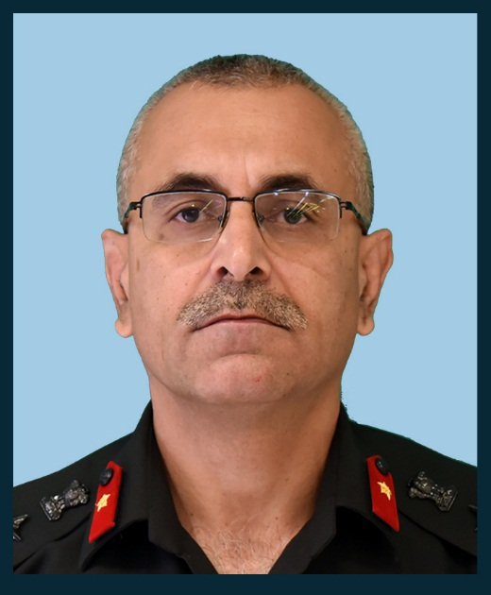
Brigadier General Raju Bagel
Wrote the longest thesis in the 46th class.
Studied the persecution of the Rohingya in Myanmar and contributed greatly to the success of the India Tour.

Slide 38
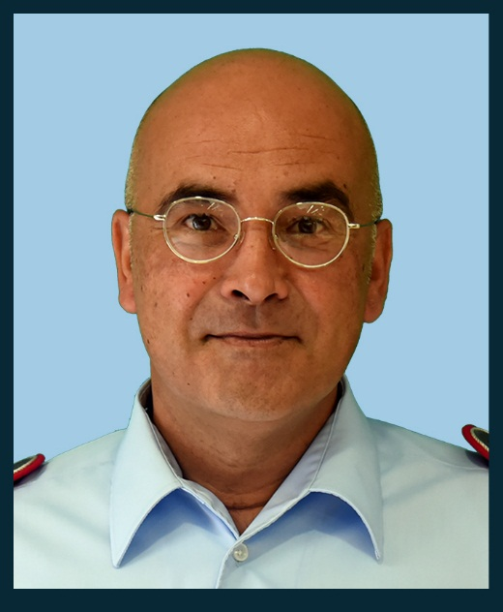
Col. Klaus Herrer
Wrote his thesis on Israel-NATO relations. In the political simulation he led the Russian team as prime minister and Vladimir Putin.

Slide 39
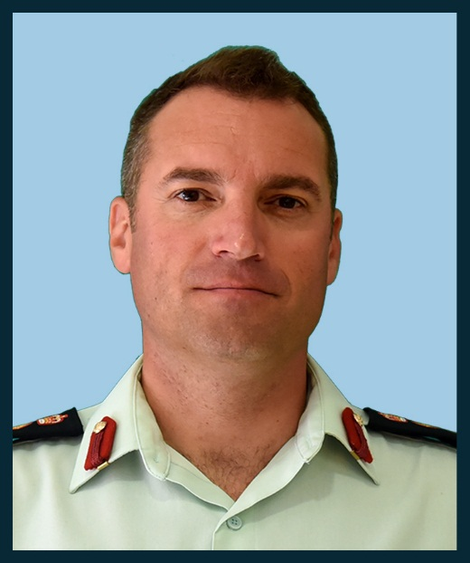
Col. Patrick Lemier
Wrote his thesis on immigration policy of Canada.

Slide 40
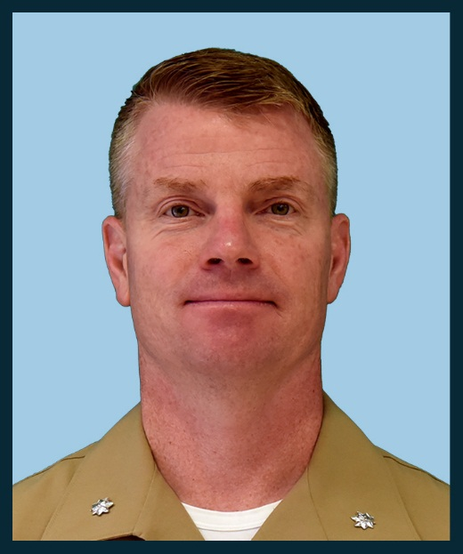
Lit. Col. Seth Macchutan
Wrote his thesis on the US attitude towards Russia's actions in the Middle East. Has contributed greatly to the success of the United States tour including a lecture on baseball.

Slide 41
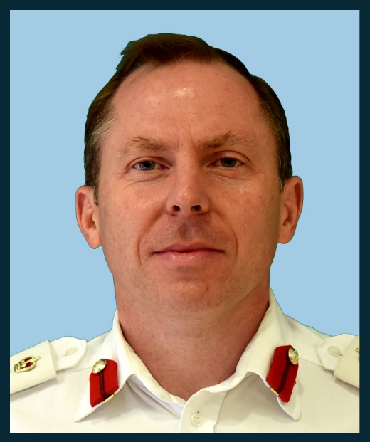
Col. James Priest
Wrote his thesis on anti-Semitism in England today. Contributed greatly to the success of the tour in England.

Slide 42
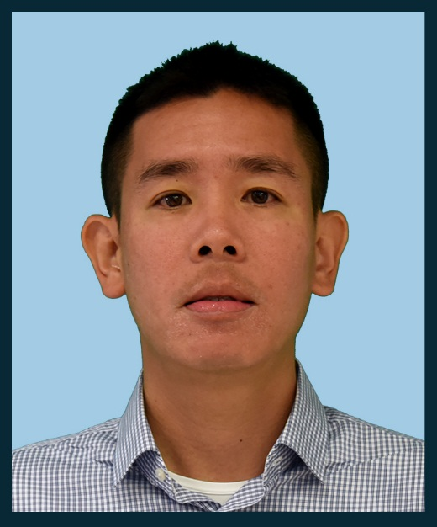
Col. Shin Fong Teng
Wrote his thesis on social resilience in Israel compared to Singapore.

Slide 43
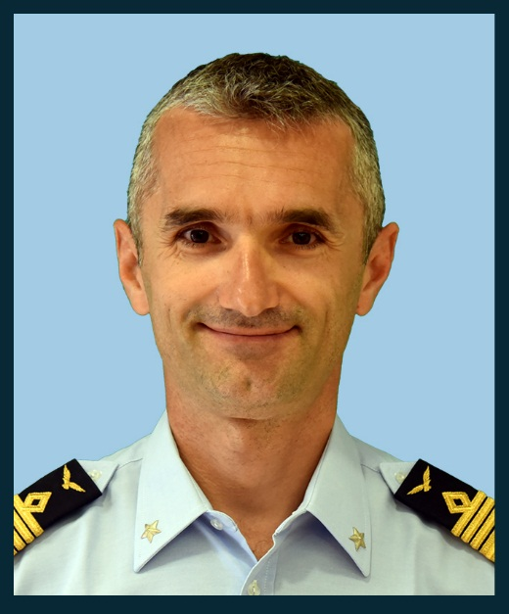
Col. Eros Zaniboni
He wrote his thesis on a 35-F plane.

