Slide 1

On current challenges and operational simulation

Slide 2




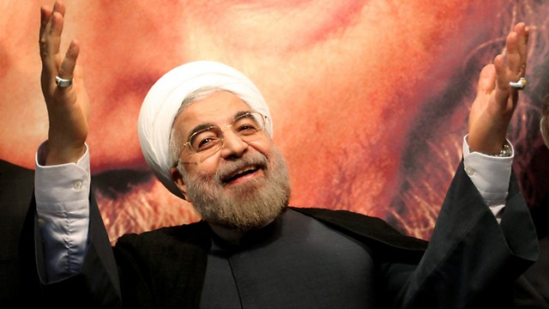

Regional Threats
Iran | Nuclear, Missiles, Regional influence
Advanced Threats | PGM, Cyber, EW, A2/AD
Hezbollah and Hamas |challenging Israeli military capabilities
Instability and Internal Challenges |Palestinian arena, Regional and Global

Slide 3









Nuclear
PGM
Advanced
Air Defense
UAV
The enemy’s
force design
Underground
Warfare
Cyber
Anti-Tank
Warfare
EW
Offensive
Approach
Of-the-shelf
products

Slide 4
The operational imperative:
Decisive victory in a short time at minimal cost
Desirable Position
Achievement
Undesirable
Position
Achievement
Time
Time
Cost
Cost

Slide 5
Quick Elimination of Enemy Capabilities
Preventing enemy’s effective functioning
Diminishing enemy’s will to fight
Enforcing our desired end state

Slide 6
A theory of victory
Multi-Domain
Maneuver
Multi-Domain
Strike
Multi-Domain
Defense
Simultaneous operation
Growing pace and power
Dismantling the enemy’s system
Strategic surprise
Eliminating capabilities by hitting CoG
Disproportional affectivity
Eliminating enemy’s capabilities ⬄ Taking damage

Slide 7

Force design vectors
Simultaneous operations
Shared Digital Domain
Tactical Technological Capabilities
Autonomy, Automation and Robotics
Data-Science, AI & ML
Advanced Munition
Defense from Ballistic Threats

Slide 8

Operational Simulation
Knowledge building
Force design
Operational planning
Training

Slide 9
Knowledge building
Testing how to affect the battle:
Innovative technologies
Future CONOPS
Possible changes to red-side
Identify weak-spots of CONOPS
Force design
Operational planning
Training

Slide 10
Knowledge building
Understanding operational turnout
Comparing competing projects
Calibrating operational requirement
Understanding cross-effects
Force design
Operational planning
Training

Slide 11
Knowledge building
Comparing operational alternatives
Assessing future achievements
Characterizing force needs:
Logistics, support, etc.
Identify weak-spots
Force design
Operational planning
Training

Slide 12
Knowledge building
Simulating the battle-field
Enemy, Civilians, Other…
Nearby forces, Supporting forces
Future capabilities
Realistic BDA
Force design
Operational planning
Training

Slide 13

Operational Simulation Challenges
Exponential complexity (resources)
Verification of models
Outcome reliability
Loss of transparency

Slide 14
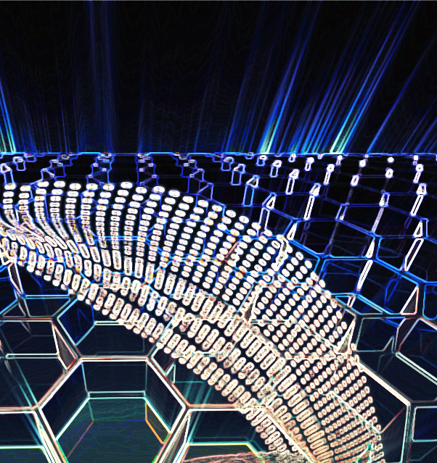
Takeaways
A changing environment
New technological opportunities
A major leap in capabilities
Taking the first step
We welcome cooperation

