Slide 1

Israel National Defense College
Welcome!
September 2020

Slide 2
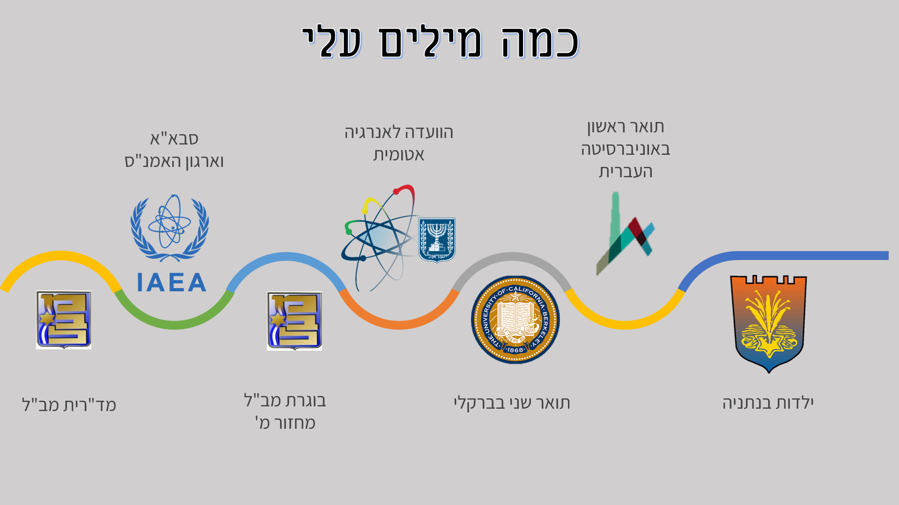
A Few Words About Myself
International Atomic Energy Agency and Comprehensive Nuclear‑Test‑Ban Treaty Organization
Atomic Energy Commission
B.A in the Hebrew University
INDC Chief Instructor
INDC Graduate 40th class
M.A at UC Berkeley
Childhood in Netanya

Slide 3
Israel Military Colleges Structure
Commandant
MG Itai Veruv
National Defense College
Command and Staff Colleges Commander
(BG Rafi Milo)
BG Course
Tactical Command College
Command and Staff College “Alon”
Command and Staff College “Afek”
Command and Staff College “Gidon”

Slide 4
What Else Is There in This Base?
INDC Commandant
MG Itai Veruv
Research and Legitimacy Branch
Command and Staff Colleges Commander
‘Ma’arachot’
Publication
“Cathedral”
Instruction Branch
IDF Library
Senior Learning and
Development
Center
Literacy
Logistics Branch
Physical Culture
Publishing

Slide 5
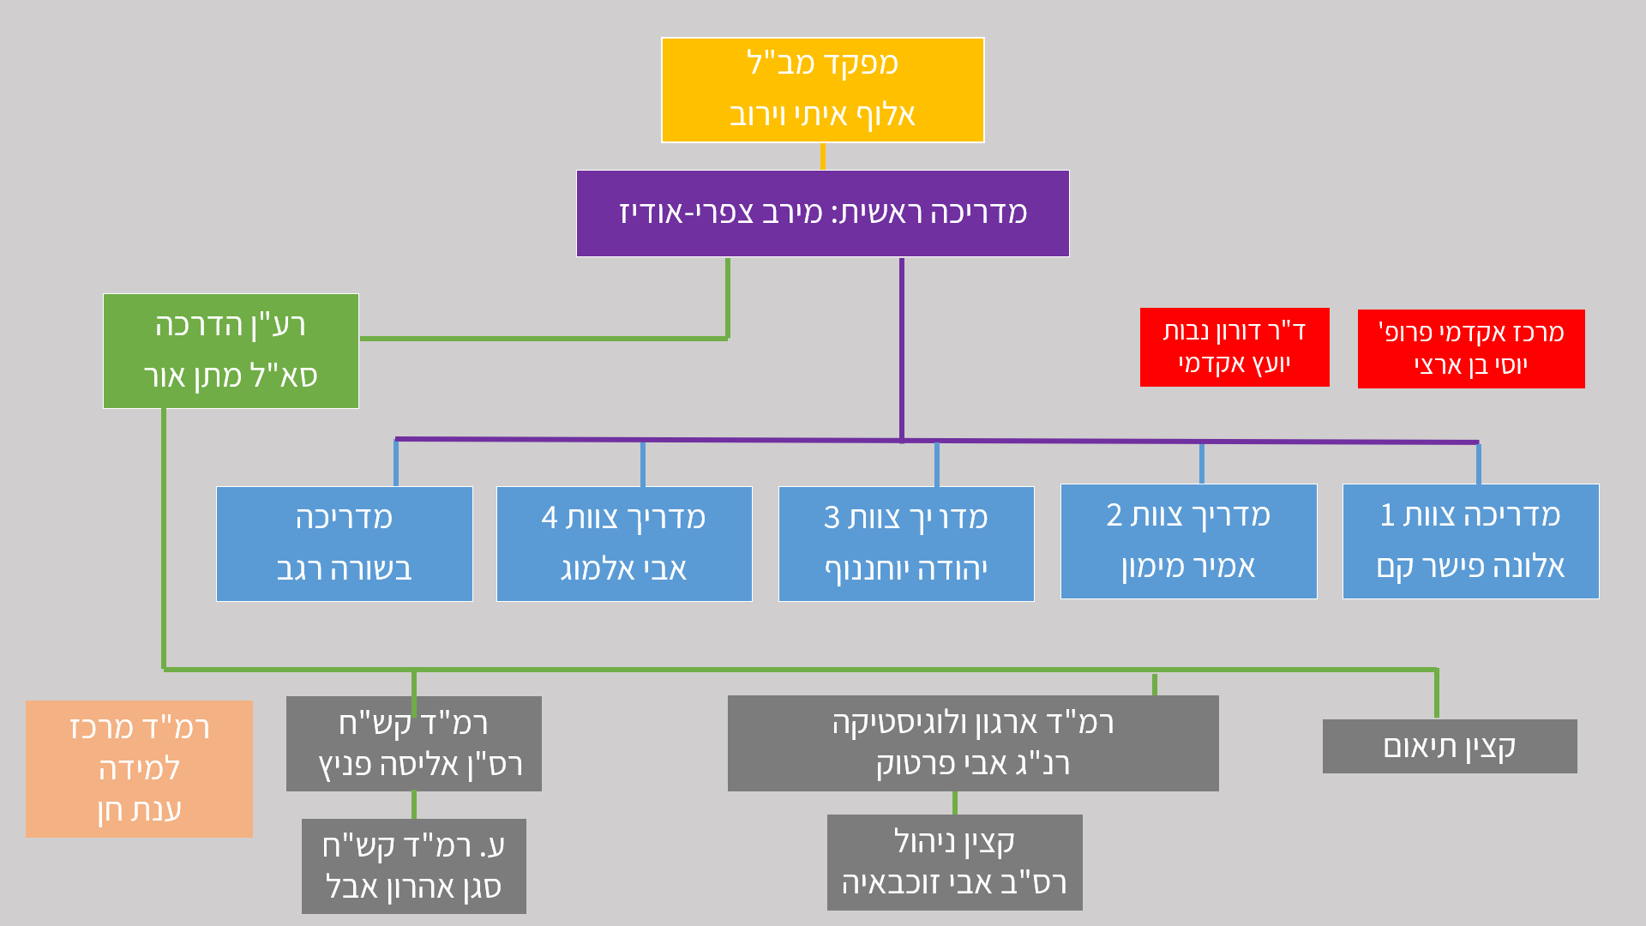
The INDC Structure
INDC Commandant
MG Itai Veruv
Chief Instructor
Amb. Merav Zafary-Odiz
Academic Adviser
Dr. Doron Navot
Head of Academic Program Prof. Yossi Ben- Artzi
Executive Officer
Matan Or
Instructor Team 1 Amb. Dr. Alona Fisher-Kam
Instructor Team 2 Amb. Amir Maimon
Instructor Team 3 Yehuda Yohananof
Instructor Team 4 Avi Almog
Instructor
Dr. Besora Regev
Head of Senior Learning Center
Dr. Anat Chen
Head of ISMO
MAJ Alisa Fenych
Head of Organization and Logistic CWO Avi Partuk
Coordination Officer
Deputy Head of ISMO
LT Aaron Abel
Management Officer
CSM Avi Zochbaia

Slide 6
The Uniqueness of the INDC
The institute and its role
Class composition
Program of study
Learning methods

Slide 7
Principles of Team Formation
Two teams with international participants
Dispersal of participants from the same organization among the teams
Separation between an Instructor and a participant from the same organization
Heterogeneous teams:
  Military - Civilians
  Positions / Field of Occupation
  Gender

Slide 8
Team Formation
Team 1 Alona Fisher Kam | Team 2 Amir Maimon | Team 3 Yehuda Yohananof | Instructor Team 4 Avi Almog
Rob Sinram | Tim Scott | Hanan Edri | Eran Fire
Nicola Mandolesi | Christian Bauer | Eran Reuveni | Yossi Karadi
Nikolaos Skourellos | Mohit Trivedi | Amir Ofek | Shlomit Sufa
Yaron Yungman | Olga Polyakov | Edna Iliya | Idit Almaliha
Liat Pearl | Alon Mazliah | Omri Dor | Asaf Vardi
Shraga Glicksman | Guy Davidson | David Shapira | Eliad Maor
Shai Siman Tov | Itamar Ben Haim | Yair Hacohen | Yaniv Avitan
Gilad Amit | Guy Itzhaki | Ohad Buchris | Roy Levy
Tal Politis | Yoav Torjanski | Oded Zemach | Uri Arnon
Doron Slovatizky | Eitan Menashe | Yoni Roth | Ronen Cohen
Gil Barket | Doron Abrahami | Eran Peled | Yossi Yehoshua

Slide 9
Areas of Study at INDC
National Defense
Statesmanship
Technology
Economics
Society
Strategy

Slide 10
The International Season
Basic concepts in national security - Dr. Doron Navot and BG (Res.) Itai Brun
"Network meetings" - personal introduction
Geo-strategy - Prof. Yossi Ben-Artzi and Merav Zafary-Odiz
Ministry of Foreign Affairs day
National Security team study tour
Iran Day
English Sessions
Europe seminar and study tour

Slide 11
Seminar and Study Tour in Europe
November 2020 1-5
  Team 1- Serbia
  Team 2 – Lithuania
  Team 3 - Cyprus
  Team 4 – Greece/Finland
  The whole class - Brussels (NATO, European Union)

Slide 12
The Israeli Season
Zionism Seminar: Founding Fathers - Prof. Yossi Ben-Artzi and Dr. Anat Chen
Strategy Studies - Dr. Dima Adamski, Dado Center, Commandant
Geography and National Security Tours (North, South, Judea and Samaria, Jerusalem, The Seam Line and the Jordan Valley) - Prof. Yossi Ben-Artzi
Politics, Diplomacy and Foreign Policy - Dr. Emanuel Navon (Haifa)
Approaches and Schools in Political Science - Dr. Doron Navot (Haifa)

Slide 13
The Israeli Season
Extended Elective Seminar:
  Public Law - Prof. Amnon Reichman (Haifa)
  Israeli Society and National Security - Dr. Aviad Rubin (Haifa)
2. Elective Seminar:
  Israeli society - Dr. Neri Horowitz
  Energy and Geopolitics - Dr. Elai Rettig
  Medicine and National Security - Prof. Itzik Kreis
3. Negotiation / Persuasion skills and standing in front of the camera
4. A Concluding Security Policy Simulation

Slide 14
Specialization Season
The Digital World for Decision Makers – Prof. Dani Raz
Tours of the Security Organizations
Elective Seminar
  Israel’s Economics - Dr. Omar Moab
  Communication - Dr. Ofir Reichman
  Cyber ​​- Prof. Eviatar Matanya
  Seminars: Government Corruption, International Law, Cyber
  Seminar and Study Tour in the East

Slide 15
The Integrative Season
  National Security Tours: Eilat, Arava and Infrastructure
  Seminar and Study Tour in the US
  Final Project

Slide 16
English Sessions
4Levels
Teaching English vs. Conversation on national security related topics
Method

Slide 17
Expectations
  Duties - Active participation, leading and submitting assignments
  Farwell to “home organization” and vacation planning according to INDC schedule
  From Ego-system to Eco-system
  Setting goals for personal development
  Information security
  Studies in the Shadow of COVID 19 – personal responsibility

Slide 18
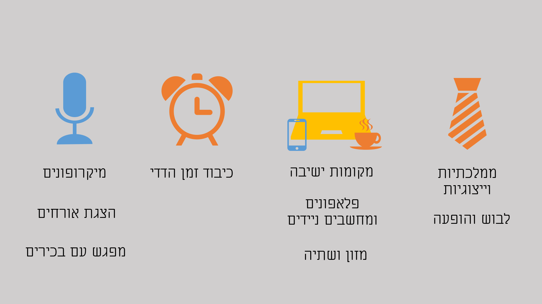
INDC Code
Microphones
Introducing Guests
Meeting with Seniors
Mutual Respect for Time
Seating arrangement
Cell phones and Laptops
Food and Drink
Statesmanship and Representation
Dress code and Appearance

Slide 19
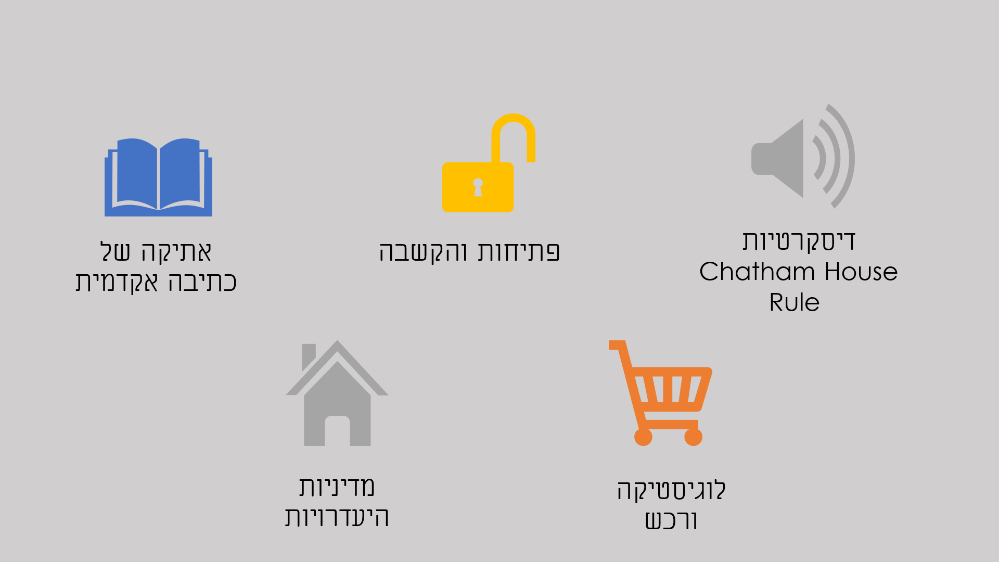
INDC Code
Discretion
Ethics of Academic Writing
Openness and Listening
Absence Policy
Logistics and Acquisitions

Slide 20
Class Officials
Class presidents
Note-Taker (Hebrew and English)
Photographer
Treasurer

Slide 21
Weekly Structure (in principle) INDC
Hour/Day | Sunday | Monday | Tuesday | Wednesday | Thursday
08:30-10:00 | Independent Learning | Session 1 | Session 1 | Session 1 | Session 1
10:30-12:00 |  | Session 2 | Session 2 | Session 2 | Session 2
13:00-14:15 |  | Session 3 | Session 3 | Session 3 | Team Hour
14:45-16:15 |  | Session 4 | Session 4 | Session 4 | Until 15:00

Slide 22
Opening Week
Hour/Day | Wednesday 2.9 | Thursday 3.9 | Sunday 6.9 | Monday 7.9 | Tuesday 8.9
Session 1 | Opening Discussion with the INDC Commandant | Chairman of Foreign Affairs & Security Committee | Independent Learning | Coffee and Reading | Network Meetings
Session 2 | Opening Discussion with Chief Instructor | The Head of the National Security Council |  | 2 Sessions: Basic concepts in national security | Network Meetings
Session 3 | Professor Aaron Ciechanover | Introducing the Learning Center to Seniors
 |  |  |  | Teamwork | Guest Lecturer
Session 4 | Team Hour
 |  |  |  | English Sessions | Introducing the Fields of Study

Slide 23
Good Luck!

