Slide 1
U.N. Security Council Rejects U.S. Proposal to Extend Arms Embargo on Iran (14 August)
U.S. Heads to United Nations to Demand ‘Snapback’ of Sanctions Against Iran (19 August)
Instead of Isolating Iran, U.S. Finds Itself on the Outside Over Iran Nuclear Deal (20 August)
Security Council Leader Rejects U.S. Demand for U.N. Sanctions on Iran (25 August)

Slide 2
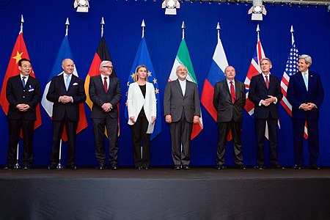
The Nuclear Agreement with Iran

Slide 3
The Nuclear Agreement
Signed: 14 July, 2015 (159 pages, 5 appendices)
Name: JCPOA - Joint Comprehensive Plan of Action
Parties:
Iran
6 countries (US, UK, France, Russia, China and Germany - P5 + 1)
The European Union

Slide 4
The Purpose of the Agreement
Ensuring that Iran's nuclear program is for peaceful purposes only

Slide 5
UNSC Resolution 2231
Adopted the JCPOA
Valid for 10 years, until closure of the Iranian file

Slide 6
The Essence of the Deal
Limitations on the nuclear program for a defined period of time in exchange for partial and gradual removal of sanctions (conventional – 5 years, missiles – 8 years)
Tight safeguards by the International Atomic Energy Agency
“Snapback mechanism” – substantial violation

Slide 7
What Happens Now
The U.S. withdrew from the agreement on 8 May, 2018 and re-imposed US sanctions (“maximum pressure” campaign)
Iran has gradually withdrawn from its obligations under the agreement
US failed to extend arms embargo (2:2:11)

Slide 8
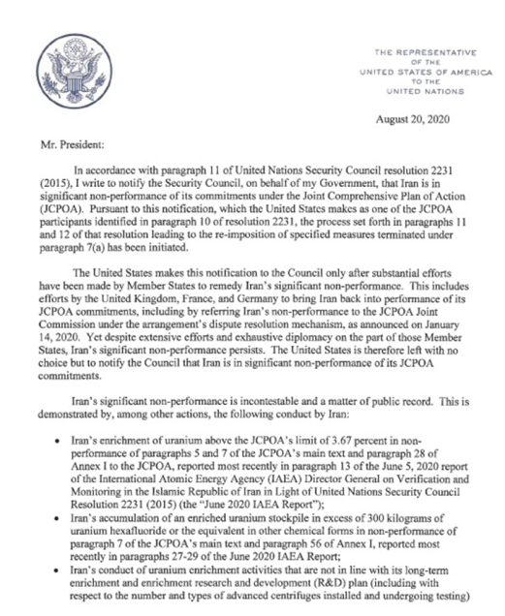
What Happens Now (Cont.)
U.S. requested to reinstate sanctions lifted by the agreement (effective 20 September)
Legal debates on US being a “JCPOA participant State” (U.S. against all the others)
If a resolution is introduced – U.S. will veto

