Slide 1
Special Report by the Research Division: Raising the Standard of Living in Israel by Increasing Labor Productivity
Dr. Eyal Argov
Head of Macro and Economic Activity - Research Division - Bank of Israel
INDC – 47TH Class – March 17th, 2020

Slide 2

It is Customary to Measure the Standard of Living Using GDP Per Capita
GDP Per Capita in Israel compared to GDP Per Capita in the US
1950-2018
71 years of Israeli economy:
There is something to be proud of!

Slide 3
It is Customary to Measure the Standard of Living Using GDP Per Capita
GDP Per Capita in Israel compared to GDP Per Capita in the US
1950-2018
But we got “a little bit” stuck and there is something to strive for ...

Slide 4
What Constitutes the GDP Per Capita
Per Capita GDP consists of labor intensity (employment per capita) and labor productivity (product per employee or hour of work).
GDP per Capita
GDP
POP
Labor Productivity
Labor Intensity
GDP
L
L
POP

Slide 5
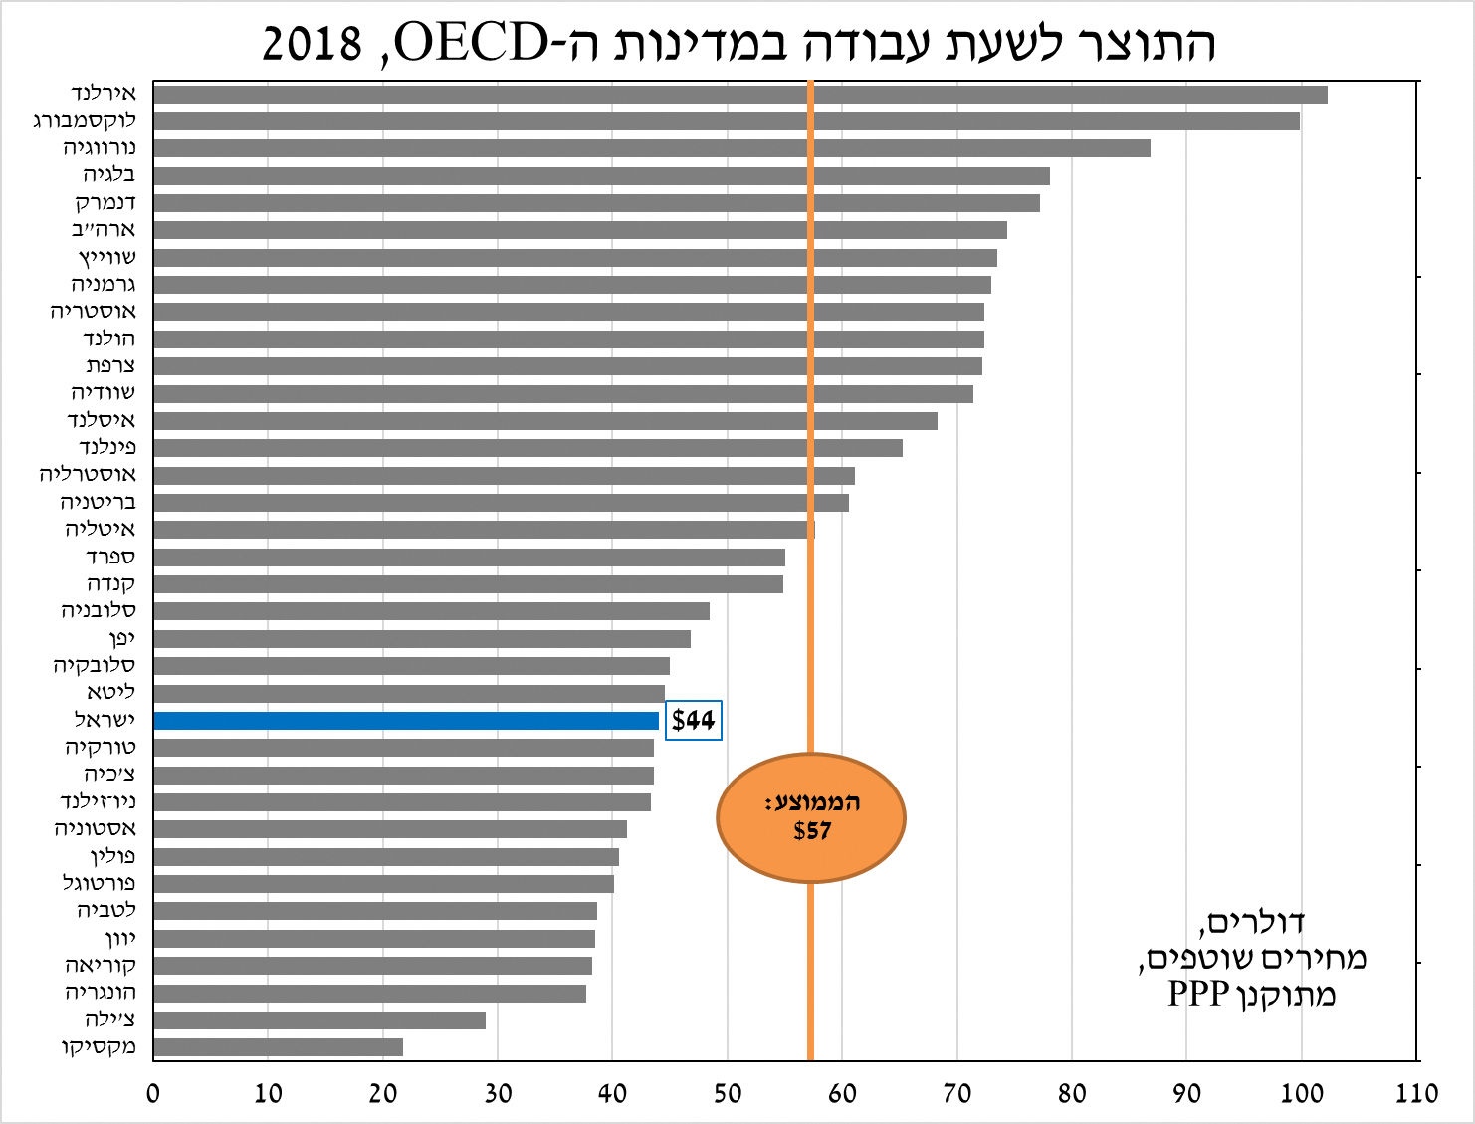
Labor Productivity –
Israel Versus the OECD Countries
Ratio between GDP per employee in Israel and the US:
GDP Per Working Hour in OECD Countries, 2018
Ireland
Luxembourg
Norway
Belgium
Denmark
U.S
Switzerland
Germany
Austria
Netherlands
France
Sweden
Iceland
Finland
Australia
UK
Italy
Spain
Canada
Slovenia
Japan
Slovakia
Lithuania
Israel
Turkey
Czech Republic
New Zealand
Estonia
Poland
Portugal
Latvia
Greece
Korea
Hungary
Chile
Mexico
Labor productivity (GDP per working hour) in Israel is low relative to that of developed countries, and is the key to a continuous rise in living standards in Israel.
Year | Ratio
1985 | 67%
1990 | 70%
1995 | 68%
2000 | 65%
2005 | 61%
2010 | 61%
2015 | 60%
2018 | 62%
Average:
Dollars, current prices, standardized PPP

Slide 6


Special Report by the Research Division:
"Raising Living Standards in Israel By Increasing Labor Productivity"
Physical Infrastructure
Human Capital
Business & Physical Capital
Additional
Factors:
Foreign workers
Business environment
Regulation

Slide 7

What is Labor Productivity Anyway?
Why
Are We Inefficient Workers?

Slide 8

Human Capital

Slide 9

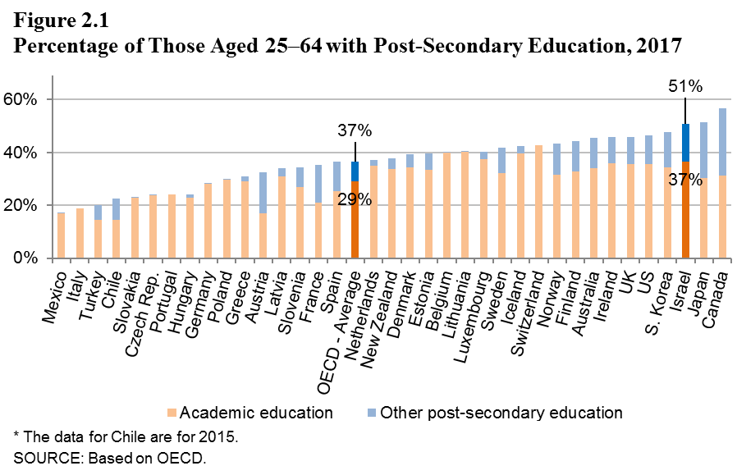
The Number of School Years in Israel is High in International Comparison
In Israel you learn a lot. The rate of higher education diploma holders in Israel is among the highest in the Western world
Source: OECD and Bank of Israel calculations

Slide 10
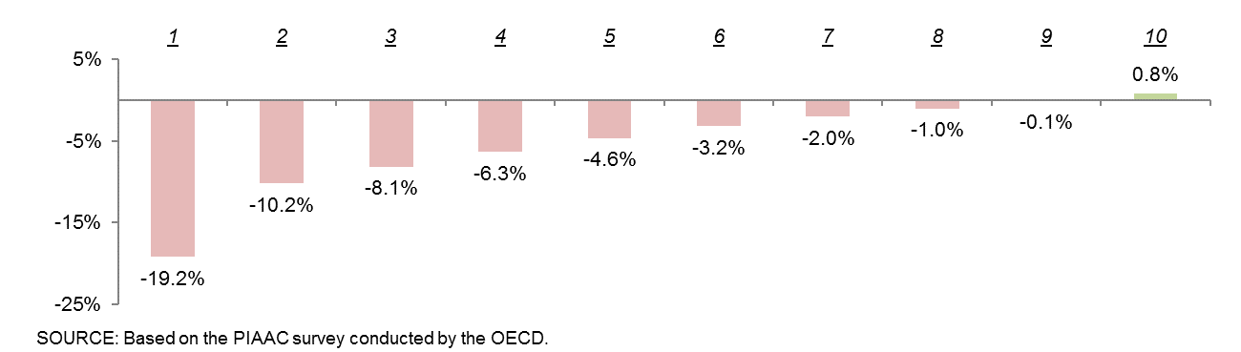
There is a Clear Weakness in Israel Regarding Workers’ Basic Skills
Skills gap between Israel and OECD countries
Spain
Italy
Israel
France
Greece
Korea
Ireland
Poland
UK
Average
Czech Republic
Estonia
Slovakia
Belgium
Norway
Denmark
Netherlands
Finland
Japan
Italy
Greece
Spain
Israel
France
Korea
Poland
Ireland
Czech
Republic
Average
Denmark
Slovakia
Estonia
UK
Belgium
Norway
Netherlands
Finland
Japan
Figure 2.3
Skills Gap between Israel and the OECD, by Decile, 2015
10
10
Notes:
רואים כאן שני דברים:
איור ראשון: יש לנו פער גדול באופן כללי.
ב. הפער הולך ומתעצם עם העוני.
ציון הPIAAC מנורמל ל100 (מהציון של כל תצפית הוחסר הממוצע, ואז חולק בסטיית התקן + קבוע בגודל 0.5 * 100)

Slide 11

The Gaps Within Israeli Society are Not Only between the “Tribes" but also Within Them
Ranked 1 among the 36 OECD countries in general inequality
Ranked 2 among the 36 OECD countries in inequality within state regulated religious education
Ranked 4 among the 36 OECD countries in inequality within the Jewish sector
Ranked 9 among the 36 OECD countries in inequality within state regulated education
Source: PISA and Bank of Israel calculations
Notes:
גם "בניכוי חרדים וערבים" אנחנו רחוקים מהמוצע בפער גדול.

Slide 12
The Education Budget has Grown in Recent Years, But Student Spending is Still Low Compared to the OECD Average
Spending per student in Israel (as of 2016) is about 7.5% lower than the average in OECD countries.
Gaps in student spending compared to other countries have narrowed in recent years.
The rise in the education budget in recent years only brought the level of expenditure per student back to where it was in the early 2000s

Slide 13

But is the Budget Effectively Allocated?
Parity Index: The ratio of the number of students with a "passing" grade in PISA coming from a weak socio-economic background, and the number from a strong background
Psychometric scores of new teachers by socio-economic cluster (2017)
Teachers from communities of strong background
Source: The OECD, Central Bureau of Statistics and Bank of Israel calculations
13
Notes:
השקף הראשון הוא סיבה: בפריפריה המורים פחות איכותיים.
השקף השני תוצאה: שוויון ההיזדמנויות אצלנו נמוך מאד מהמוצע

Slide 14
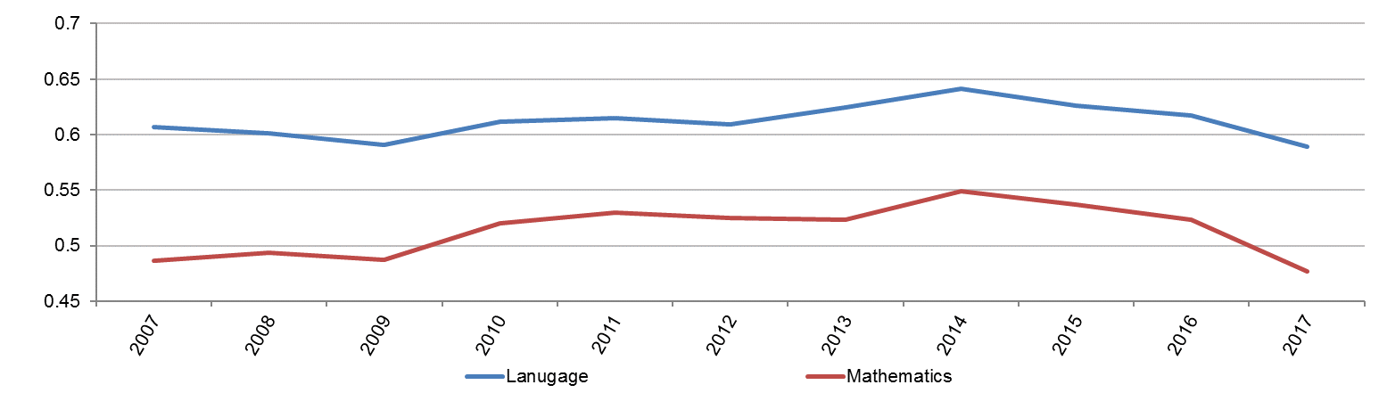
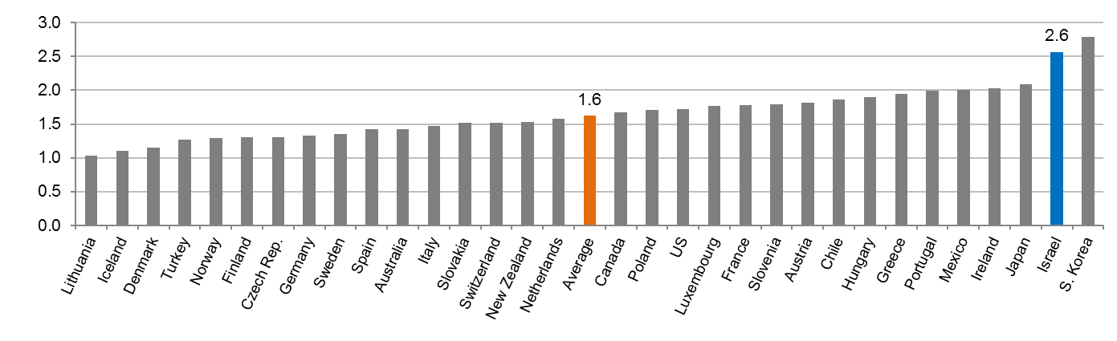
After a Temporary Improvement in Teacher Quality, there was a Negative Turnaround
Figure 2.5
Normalized Scores of Young New Teachers in Language and Mathematics, 2007–2017
Figure 2.6
The Ratio between the Salaries of Teachers at the Top of the Wage Scale and Those Starting Out in Primary Education, 2017 (percent)
14
14
Source: CBS and Bank of Israel calculations
Notes:
הגרף הראשון מעביר את המספר בכותרת. הפיק ב2014 זה התחלת הגדלת מספר הכיתות, מה שהצריך גיוס המוני יותר של מורים ולכן ירידה באיכות
הגרף השני יכול להוות סיבה לכך: צעירים איכותיים לא נמשכים להוראה, מקצוע לא מתגמל עבור מורה מתחיל.
אפשר גם לומר שזו בעיית תמריצים עם השפעה יותר רחבה: התגמול הוא על וותק ולא על איכות ההוראה, מה שמסביר חלק בהישגים המנוכים של התלמידים.

Slide 15

So What are the Recommended Human Capital Policy Guidelines?
Creating an incentive to divert quality teachers to schools from disadvantaged backgrounds, raising teachers' wages and in future salary agreements at the expense of reducing non-performance-based seniority remunerations.
Improving the remuneration of qualified teachers in teaching math, English and science.
Building an infrastructure for effective teacher evaluation based on credible quality metrics, such as their success in improving student grades or promoting other educational goals.
Improving the teaching environment of teachers and students in the school.
Improving daycares for ages 0-3 while increasing the pedagogic component and the accessibility for children from a weak socio-economic background.
Encouraging ultra-Orthodox to study relevant professions and especially: reading comprehension,, mathematics, computers and English.
Especially in schools that accommodate students from disadvantaged backgrounds

Slide 16
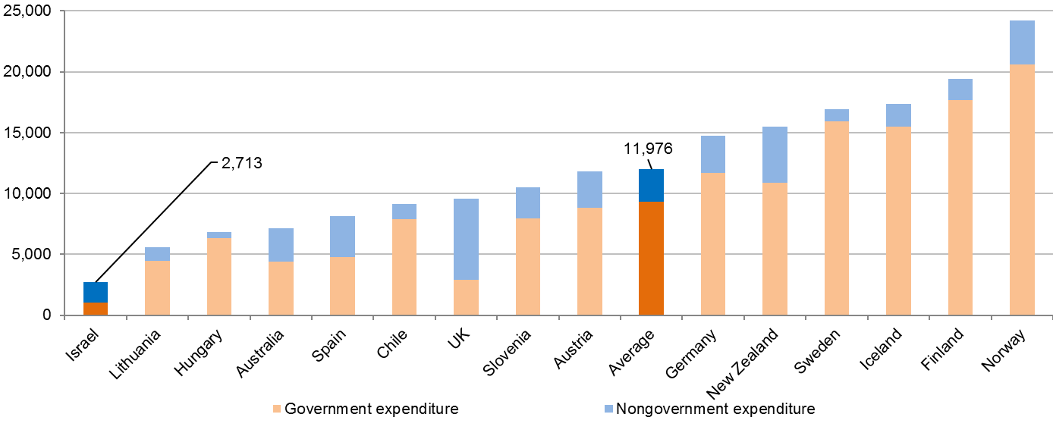
Early Childhood Education - Israel and the OECD Countries
Figure 2.4
Total Per-Child Expenditure on Early Childhood Daycare
(Age 0–2), 2015 (2015 PPP dollars)
Investment in early childhood education in Israel is significantly low.
The current programs are designed to allow parents to work and are not focused on starting an educational process
SOURCE: Based on OECD.
Due to a specific problem in the OECD data on Israel, the source for the expenditure distribution for Israel between governmental and nongovernmental is a Bank of Israel calculation based on the 2015 budget and based on additional information from the Central Bureau of Statistics. The amended figure is higher than what the OECD originally reported.

Slide 17
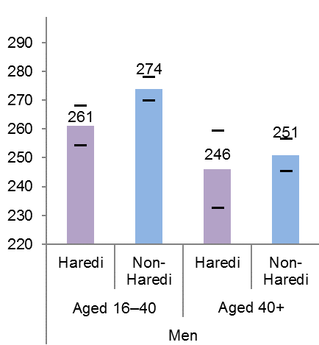
The Challenge of Human Capital in the Ultra-Orthodox Society
Figure 2.11
Average Scores in Mathematical Skills Test, Haredi and Non-Haredi Jews, by Age Group and Gender, 2015
The basic skills of young ultra-Orthodox men are significantly lower than those of non-Orthodox Jewish men
The horizontal lines represent the upper and lower bounds of the confidence interval at a 5% significance level.
SOURCE: Based on PIAAC survey.

Slide 18

So What are the Recommended Human Capital Policy Guidelines?
Creating an incentive to divert quality teachers to schools from disadvantaged backgrounds, raising teachers' wages and in future salary agreements at the expense of reducing non-performance-based seniority remunerations.
Improving the remuneration of qualified teachers in teaching math, English and science.
Building an infrastructure for effective teacher evaluation based on credible quality metrics, such as their success in improving student grades or promoting other educational goals.
Improving the teaching environment of teachers and students in the school.
Improving daycares for ages 0-3 while increasing the pedagogic component and the accessibility for children from a weak socio-economic background.
Encouraging ultra-Orthodox to study relevant professions and especially: reading comprehension,, mathematics, computers and English.
Especially in schools that accommodate students from disadvantaged backgrounds

Slide 19

Business and Physical Capital

Slide 20
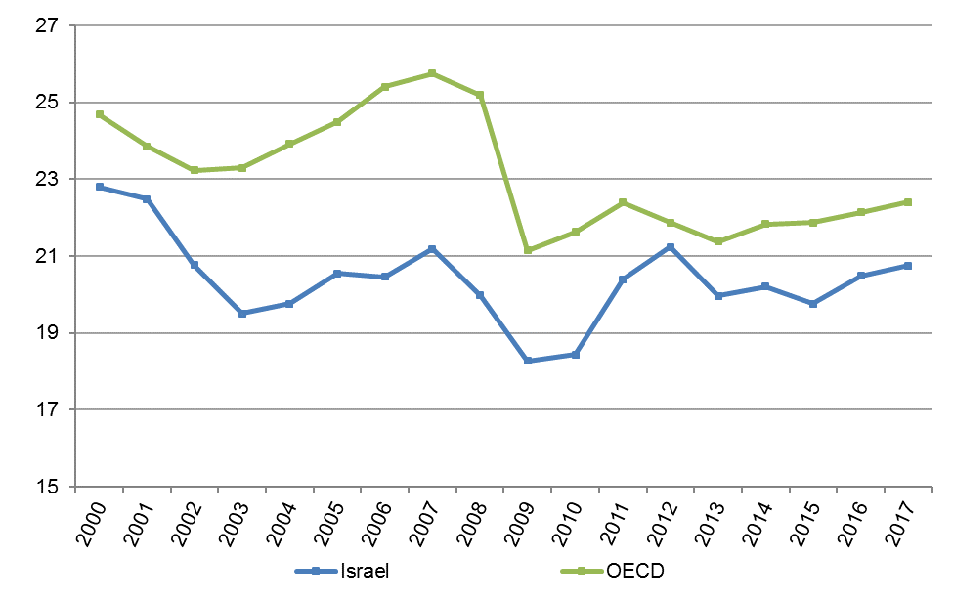
Investment in Business Physical Capital (Machinery, Vehicles, Buildings)
Figure 3.1
Gross Investment As A Share of GDP, Israel and OECD, 2000–2017 (percent)
Israel's investment rates are lower than the OECD average.
Investment rates are particularly low in non-industrial industries.
SOURCE: Based on OECD.

Slide 21

Where are the Tech-Industry Workers
The non-tech industries are having difficulty recruiting tech professionals to help embrace innovation
The Rest
In High-tech

Slide 22
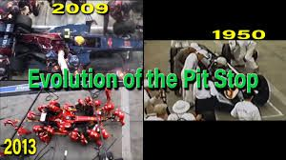
Why is Innovation Required in
Non-High-Tech Industries Anyway??
https://www.youtube.com/watch?v=12lThqXA-Dg

Slide 23
So What are the Recommended Policy Directions for Supporting Investment in the Business Sector's Physical Capital?
Gradual cancellation of the tax benefits provided by the export criterion under the Capital Investment Encouragement Law. Alternatively, benefits should be promoted to encourage activities with positive externalities, or a general reduction in corporate tax.
Promoting innovation in non-high-tech industries through unique programs.
Keep providing benefits to multinational companies rich with knowledge.
Increasing the attractiveness of the economy to all companies by removing bureaucratic barriers and investing in physical and human infrastructure.

Slide 24
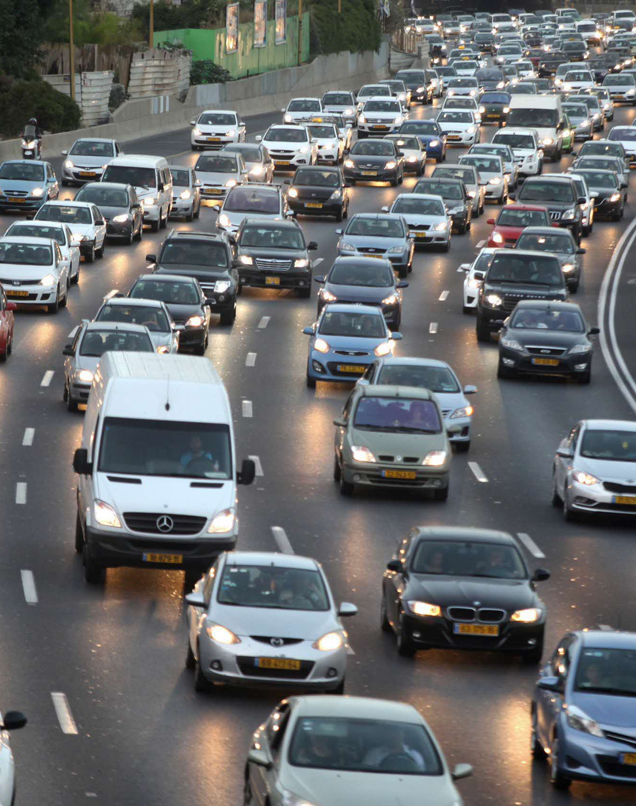
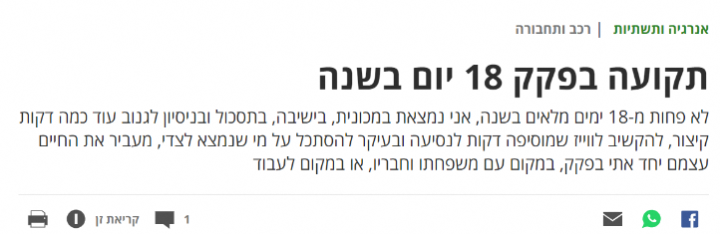

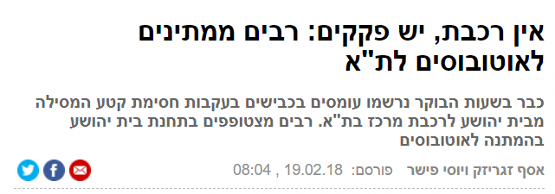

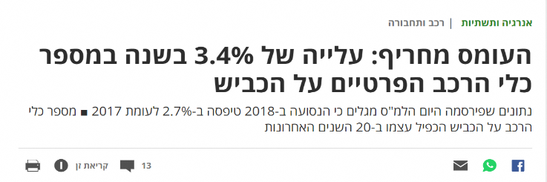

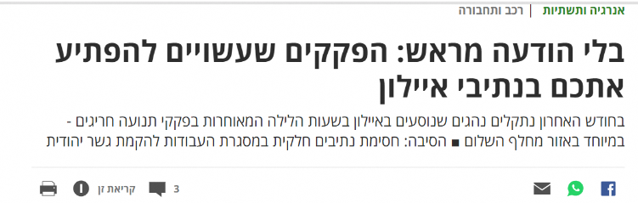

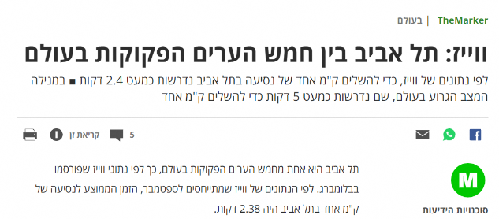

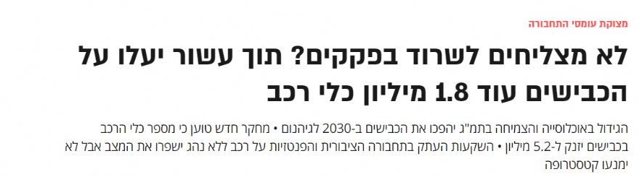
Productivity is also stuck in traffic
Stuck in Traffic 18 Days a Year
No Train, Tons of Traffic: Many Await Busses to Tel Aviv
Infrastructure (Transportation)
Traffic is Worse: Increase of 3.4% of Number of Private Vehicles Per Year
Without Warning: Traffic that May Surprise you on Ayalon Highway
Waze: Tel Aviv Among the Five Most
Dense Cities
Can’t Survive the Traffic? Within a Decade 1.8 Million Additional Cars Expected to Join the Roads

Slide 25
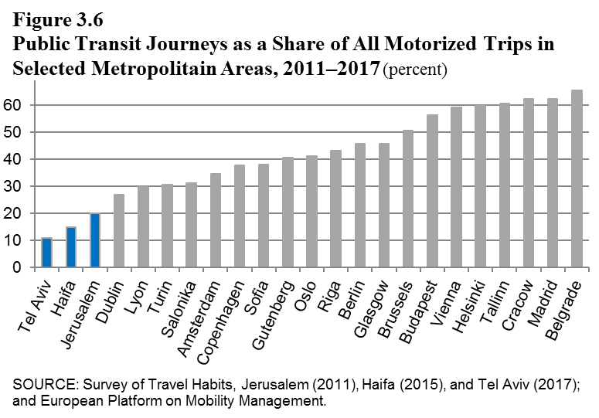
Reducing Traffic through Unrealized Public Transportation in Israel
The use rate of public transport in Israel is low compared to similar metropolitan areas in Europe.

Slide 26
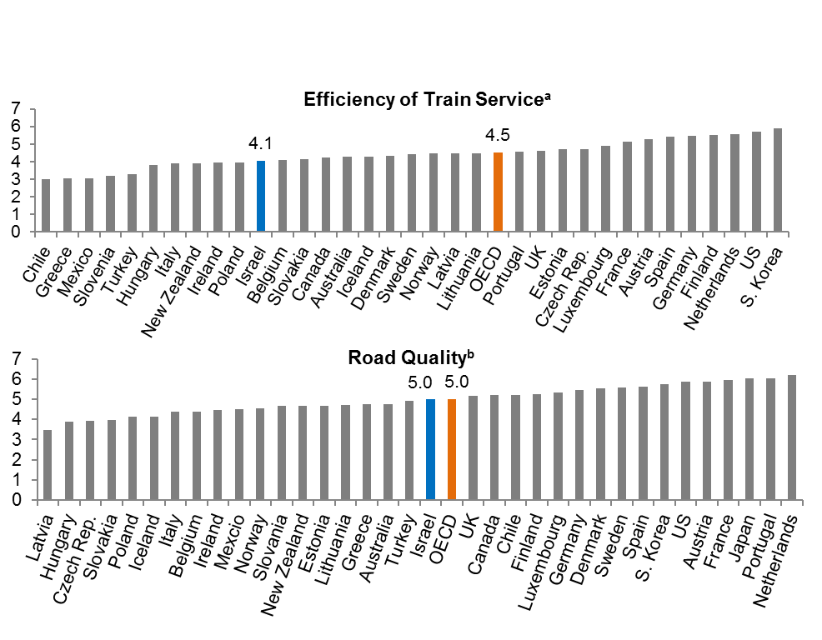
The Quality of Public Transportation Infrastructure in Israel is Low
Figure 3.7
Transport Infrastructure Quality Index (Scale of 1-7) by International Comparison, 2017
The rate of investment in transportation infrastructure in Israel is not enough to reduce, or even preserve, the gap in infrastructure quality with advanced policies

Slide 27

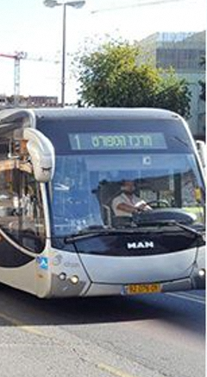
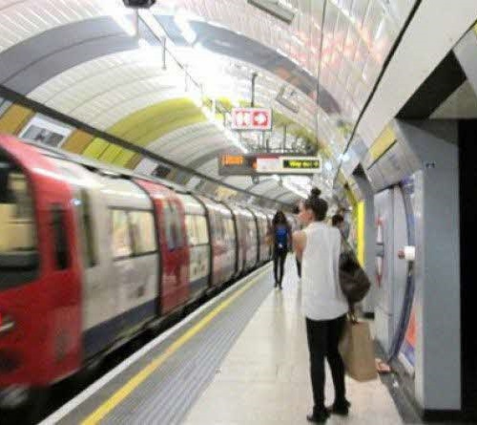

Recommended Transportation Policy Guidelines
Increasing the volume of investment in public transport infrastructure in order to close the gap in inventory compared to the OECD.
Preferring the use of underground public transportation in central Tel Aviv metropolitan area, and public transportation with designated routes in less crowded areas.
Establishing metropolitan authorities with comprehensive authority to synchronize the needs of the various cities in the area, and to facilitate the planning and execution of cross-border infrastructure projects.

Slide 28
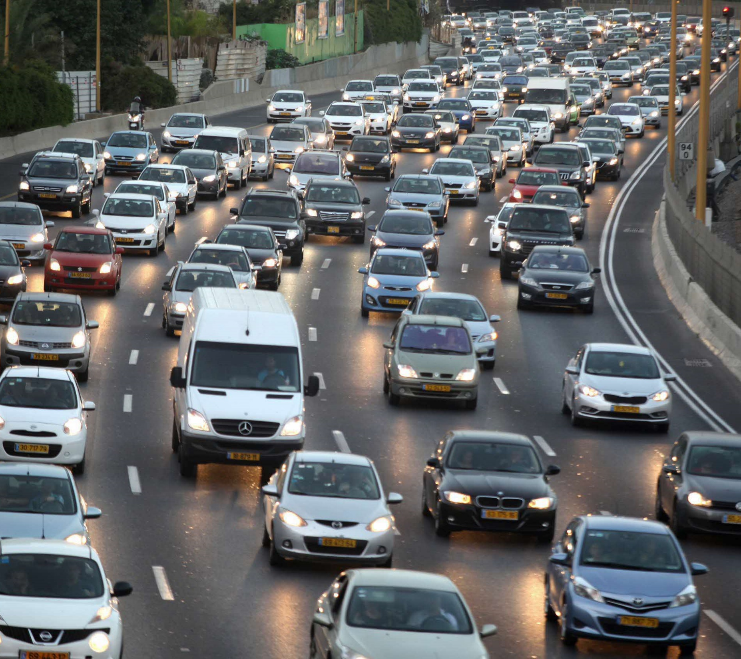
Complementary Steps in the
Field of Transportation
Promotion of Travel Alternatives:
Carpool, Organized Shuttles
Travel Tax
Parking Pricing
Treatment of payroll tax benefits that encourage the use of a private vehicle

Slide 29
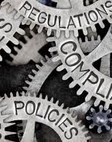
Other Factors (Bureaucracy Regulation)

Slide 30
Bureaucratic Processes Have Improved
Recently, But there is Still Room for Improvement
2018 | 49/190
2019 | 35/190
מקור: Doing Business
30
Notes:
עלינו בדירוג המדינות ב14 מקומות

Slide 31
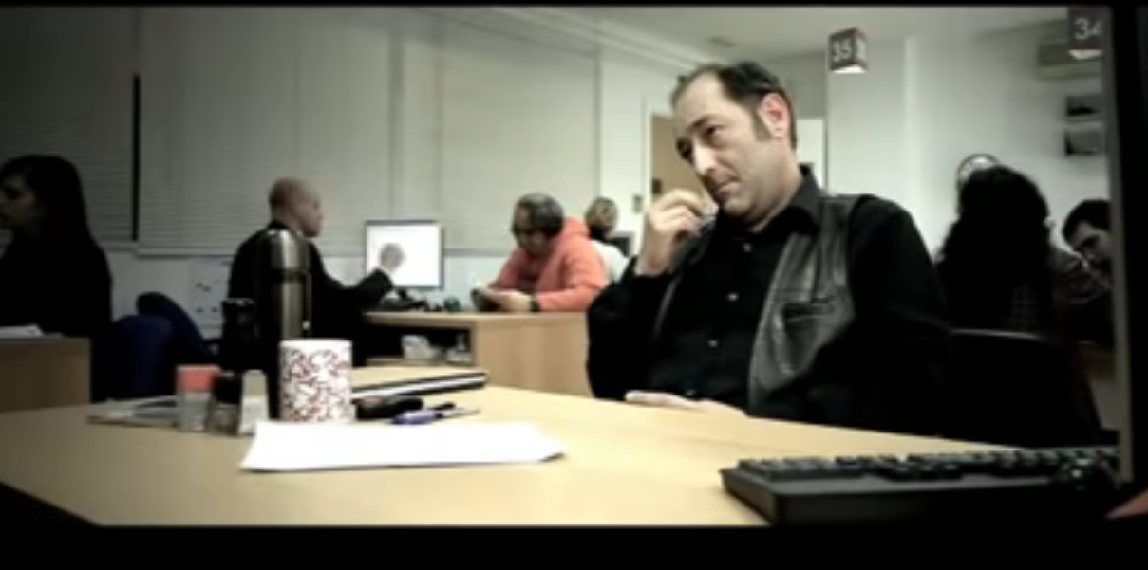
What Does Bureaucracy
Look Like ...?

Slide 32

What Does Bureaucracy
Look Like ...?

Slide 33
Bureaucracy and Technology
Effective execution of administrative processes requires advancing to new technology in order to simplify procedures

Slide 34
So What are the Recommended Policy Directions in the Field of Bureaucracy and Regulation?
Add a dedicated court for commercial disputes. This is similar to, for example, the existence of special family and traffic courts.
Establishing goals in wage agreements for adopting digital processes in the relationship between government and the business sector.
Legislative amendment is needed to shorten pre-licensing business licensing processes and replace them with a retrospective statement and oversight (with appropriate enforcement budgeting).
Public employees should be held personally responsible for the realization of one or the another risk related to regulated areas, except, of course, in cases of extreme negligence.

Slide 35

How Much Does it Cost?
Is it Worth it?

Slide 36



The main Economic Challenges of the Market
Long-term
short range
Increasing productivity
Structural fiscal deficit
(4.0-4.5%)
Israel Bank Plan
Business Improvement
Human Capital Improvement
Business
Physical
Capital Improvement
Infrastructure Improvement
Debt / GDP stabilization at 60%
Public Transport
Encouraging investment in the business sector
Low civilian expenditure per capita GDP
(33% vs. 39% in OECD)
Will probably be required for fiscal stabilization through a combination of cuts and taxes
Digitized and improved bureaucracy
Improving skills
Early education
Improving teachers
The cost (Percentage of GDP) | 0.05% | 2% | 1% | 0.2%
Benefit (Percentage of GDP) | 4% | 7.5% | 6.6% | 2.1%
0.05% 4%
1% 6.6%
Source: Bank of Israel

Slide 37
תודה THANK YOUشُكراً جَزيلاً

