Slide 1

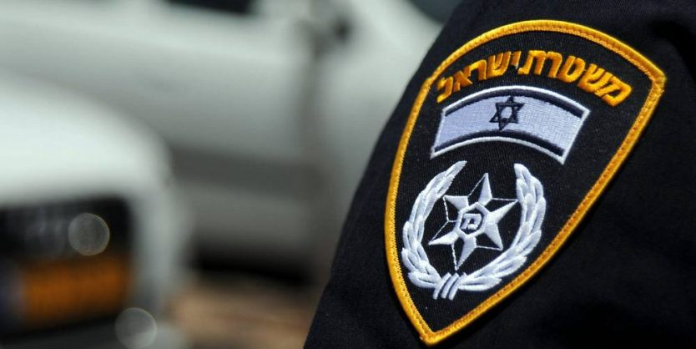
INDC Visit to Israel Police - 15/04/2019

Slide 2
סרט תדמית

Slide 3
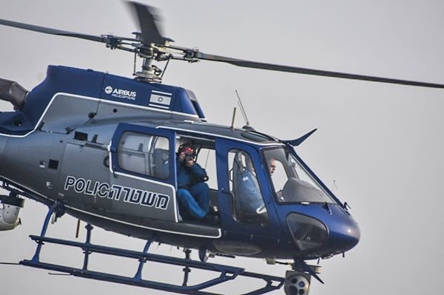
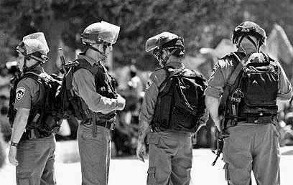
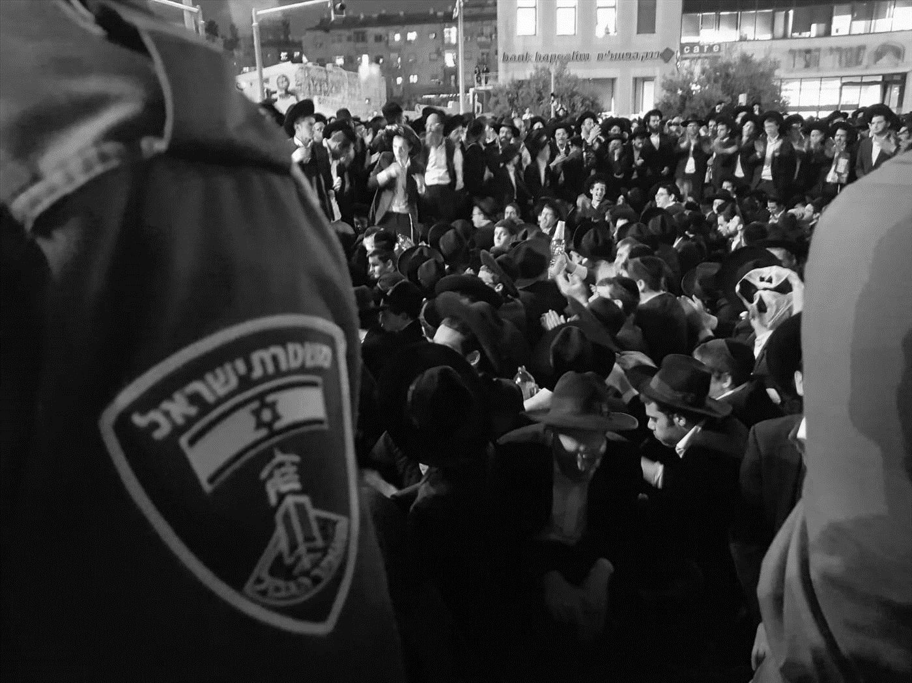
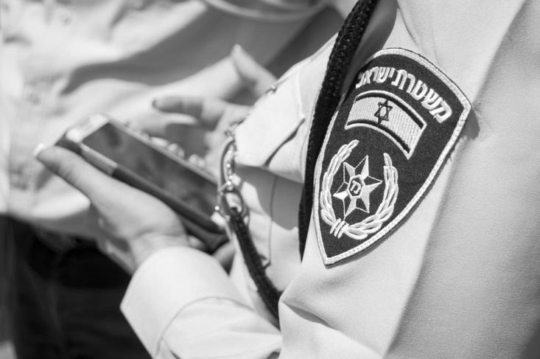
Israeli Police - Purpose
The main functions of the Israel Police as a law enforcement body are set out in section 3 of the Police Ordinance [New Version], 5731-1971.The section states: "The Israel Police will deal with the prevention and detection of offenses, the seizure and prosecution of offenders, the safe guarding of prisoners, and the maintenance of public order and security of the soul and property." The Israel Police operates according to the powers granted to every police officer in the Police Ordinance [New Version], 5731-1971 and other legislation.
Supervision And Regulation of Traffic
Internal Security
Maintaining Public Order
Fighting Crime

Slide 4

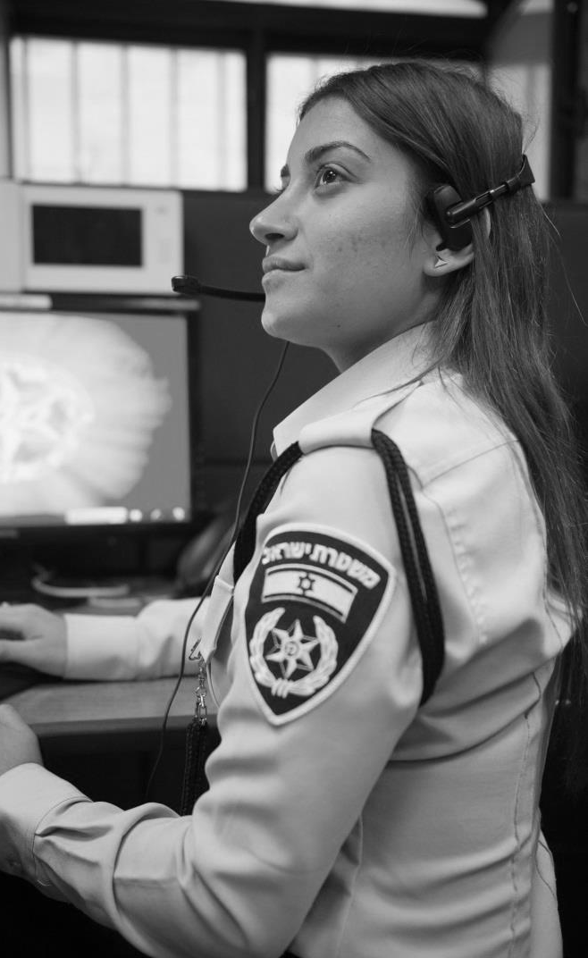
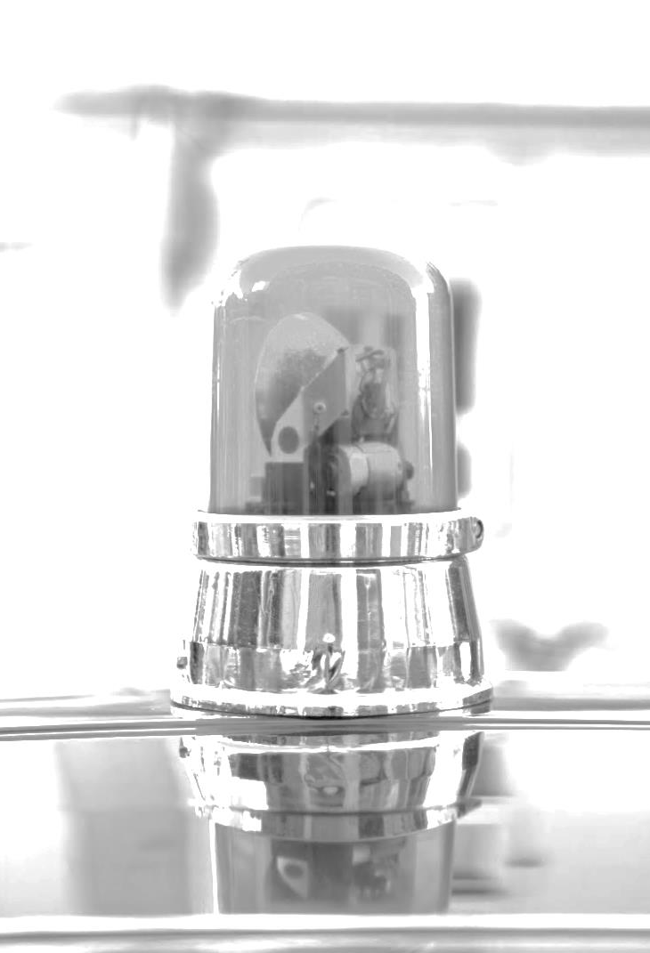
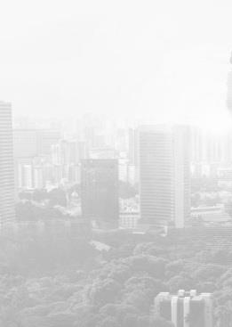
Israeli Police – ID Card
7 מיליון
Police Calls
25%
Women
7 Districts
20 Area
80 Stations
31,000
Cops
33,000
Volunteers
1 מיליון
Calls to the Information Center 110
% 28
Of the Officers are Women
25%
Border Police
46%
Life Quality Events
Calling Center
Statistics
Deployment
Human Capital

Slide 5
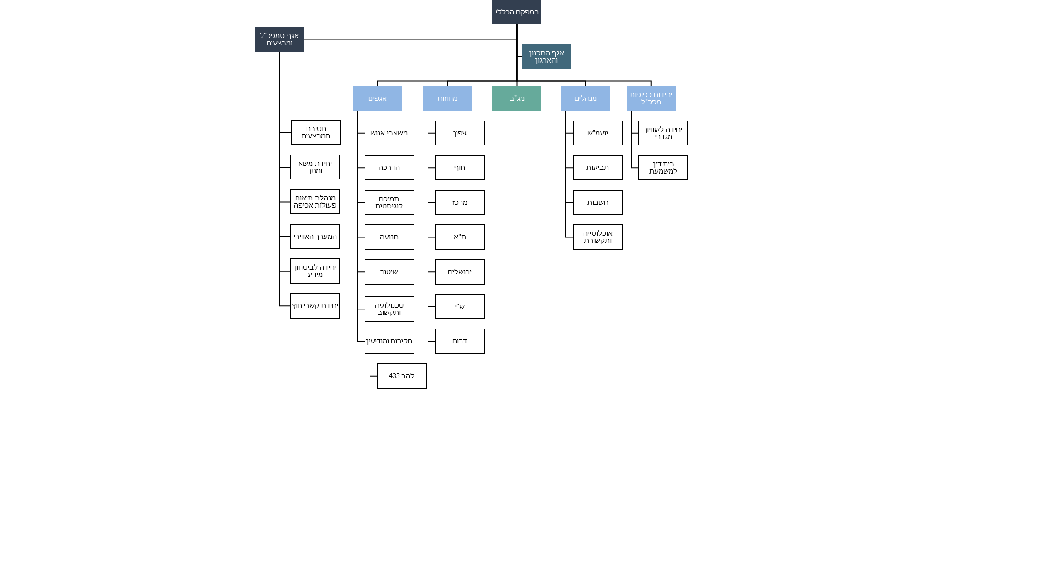
Israel Police - Structure
Chief Inspector
Deputy Chief Inspector
And operations
Planning and Organization Branch
Departments
Districts
Border Police
Administrative
Units under the CI
Operations Division
HR
North
Legal Advisor
Gender Equality
Unit
Negotion
Training
Sea Side
Law Suits
Disciplinary Court
Enforcement HQ
Support and
Logistics
Center
Finance
Air Control
Traffic
Tel Aviv
Media and General
Population
Information Security
Jerusalem
International Relations
Technology
Judea and Samaria
Research and Intel
South
LAHAV 433

Slide 6

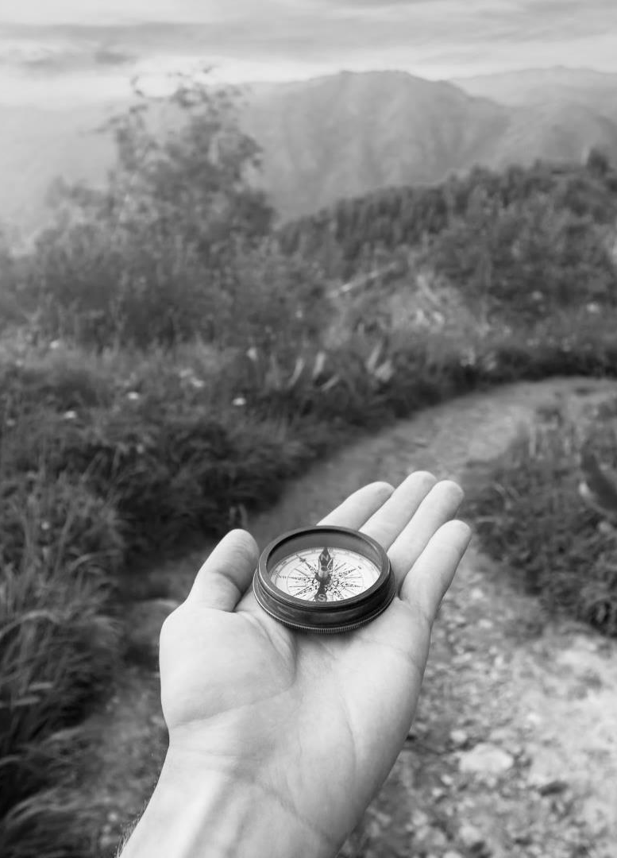


Ammon Reform
Prevention Strategy And Management Focus
Targeted Policing
Situational Prevention
Targeting Activity In Field Cells
Community Oriented Policing
Policing Based on Finding Solutions

Slide 7
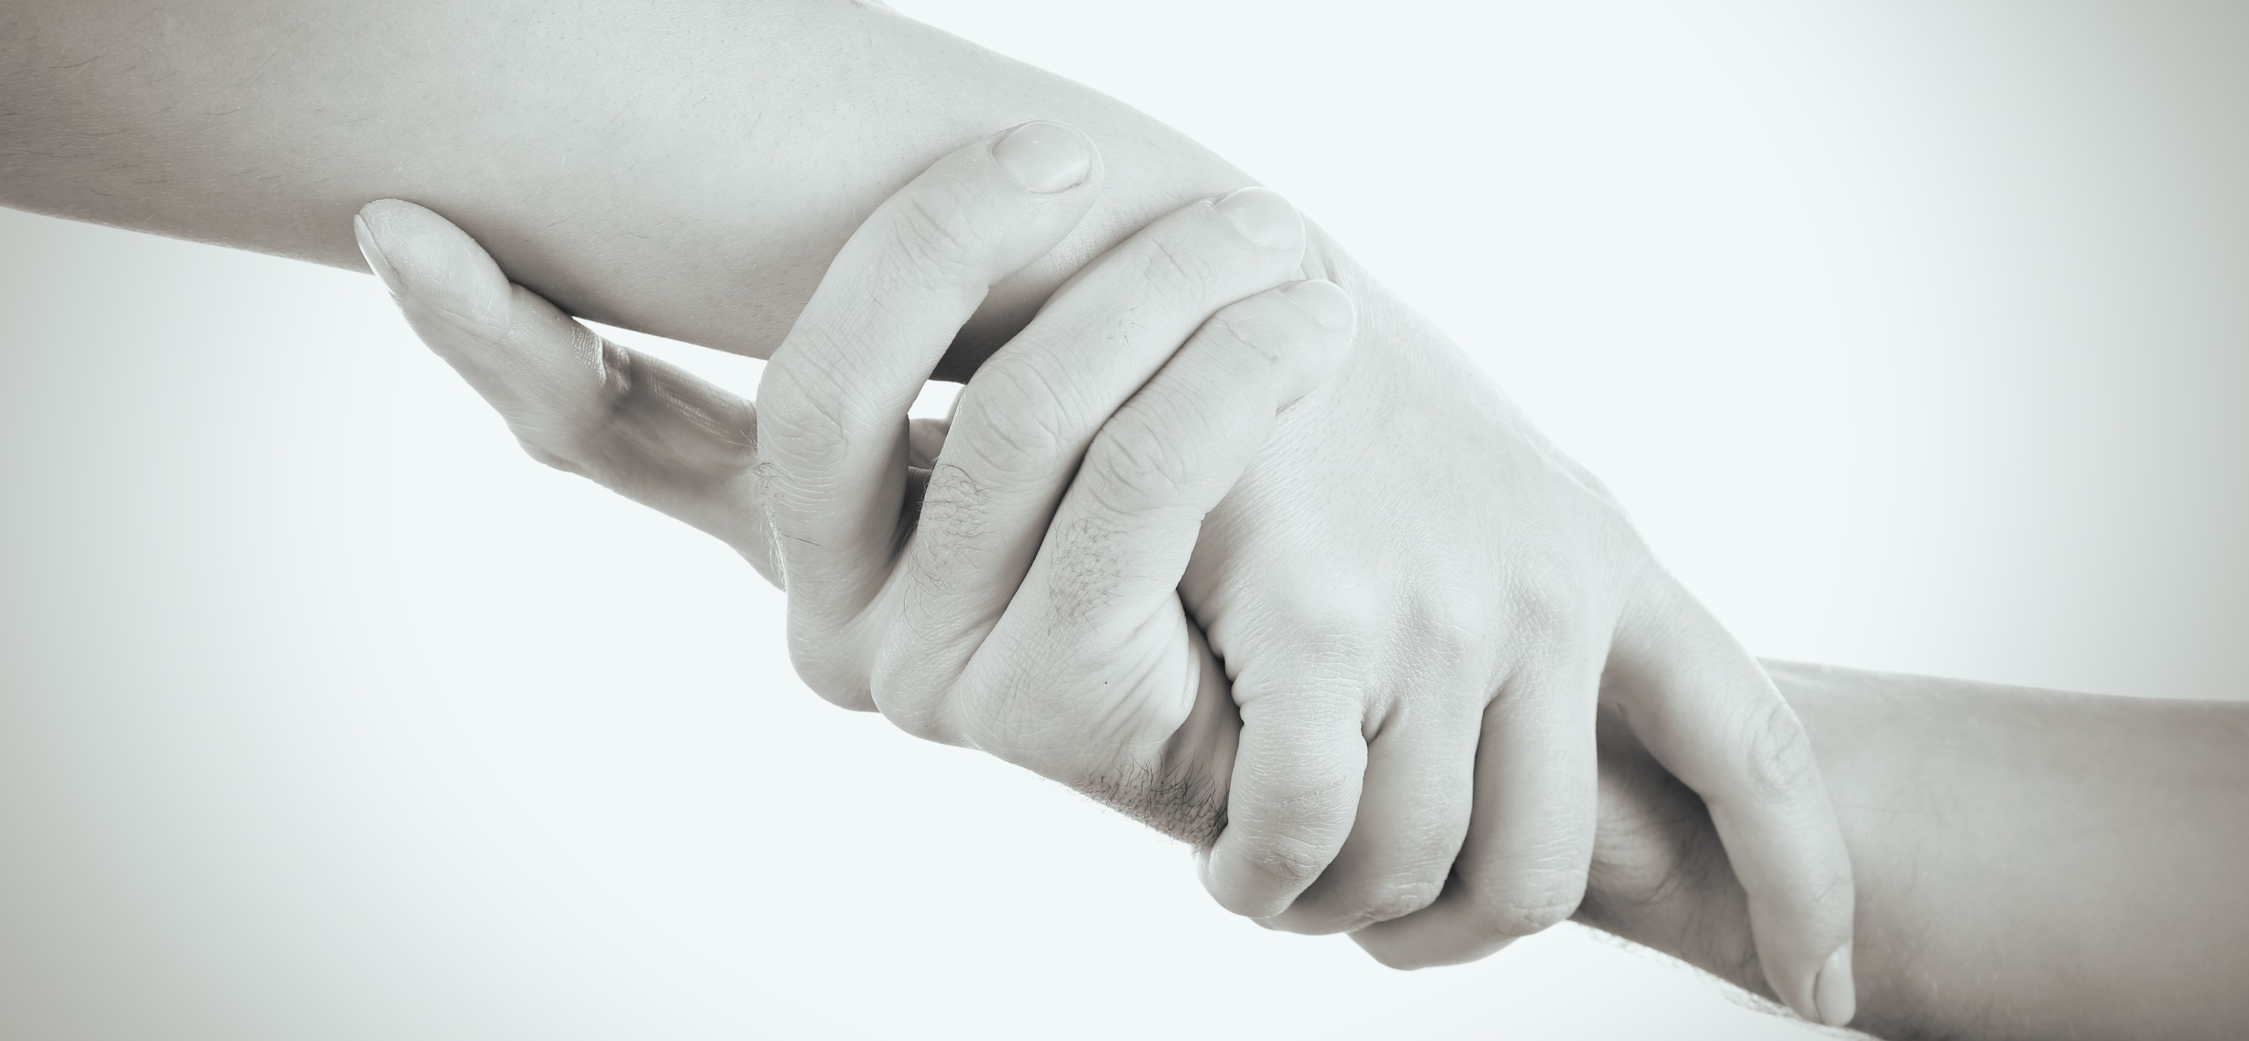
Investment in Community Policing Centers
Including a community policing center dedicated to Arab society and the Haredi population

Slide 8
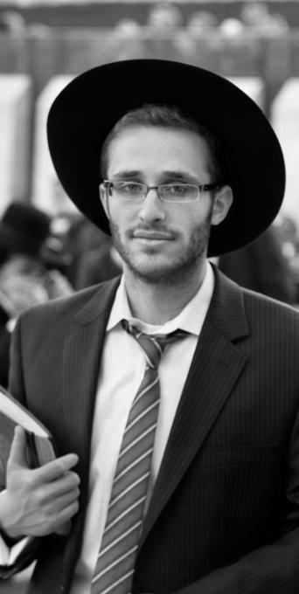
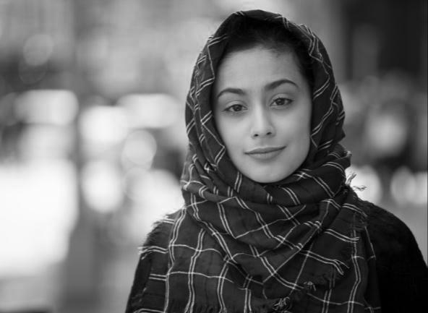
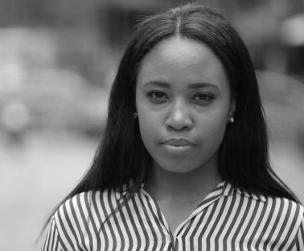
Multi Culture
Segmentation of Specific Populations
Building Policing Strategies and Joint Programs with Community Leaders

Slide 9






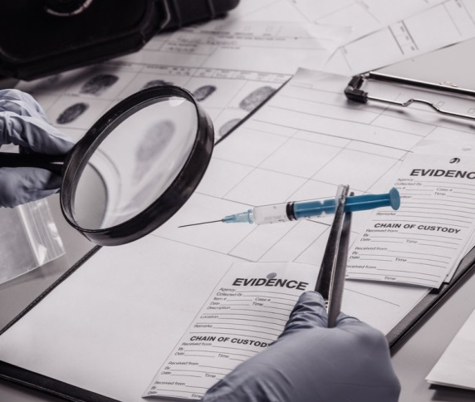
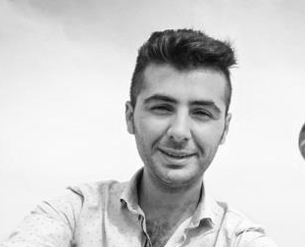

One Of The World's Leading Technological Development Centers
Visint Infrastructure
Supporting Tools in the Offense Scene
ERP
The “Kings Path” Platform
Geographical Platform
Development of advanced IT infrastructure
AI
Strengthening The Means Of Collection
Biometric Tools
Development

Slide 10




Israeli Police on Social Media
Instagram
40,000 Followers
Arabic Instagram Page
Facebook
One Million Surfers A Week
435,000 Likes
Of Which 430 Thousand Are Permanent Followers
Pages In Arabic, Recruitment Office And Border Police
Twitter
36,000 Followers
Police.gov.il
Internet
Various Online Services
Form Downloads
News updates

Slide 11
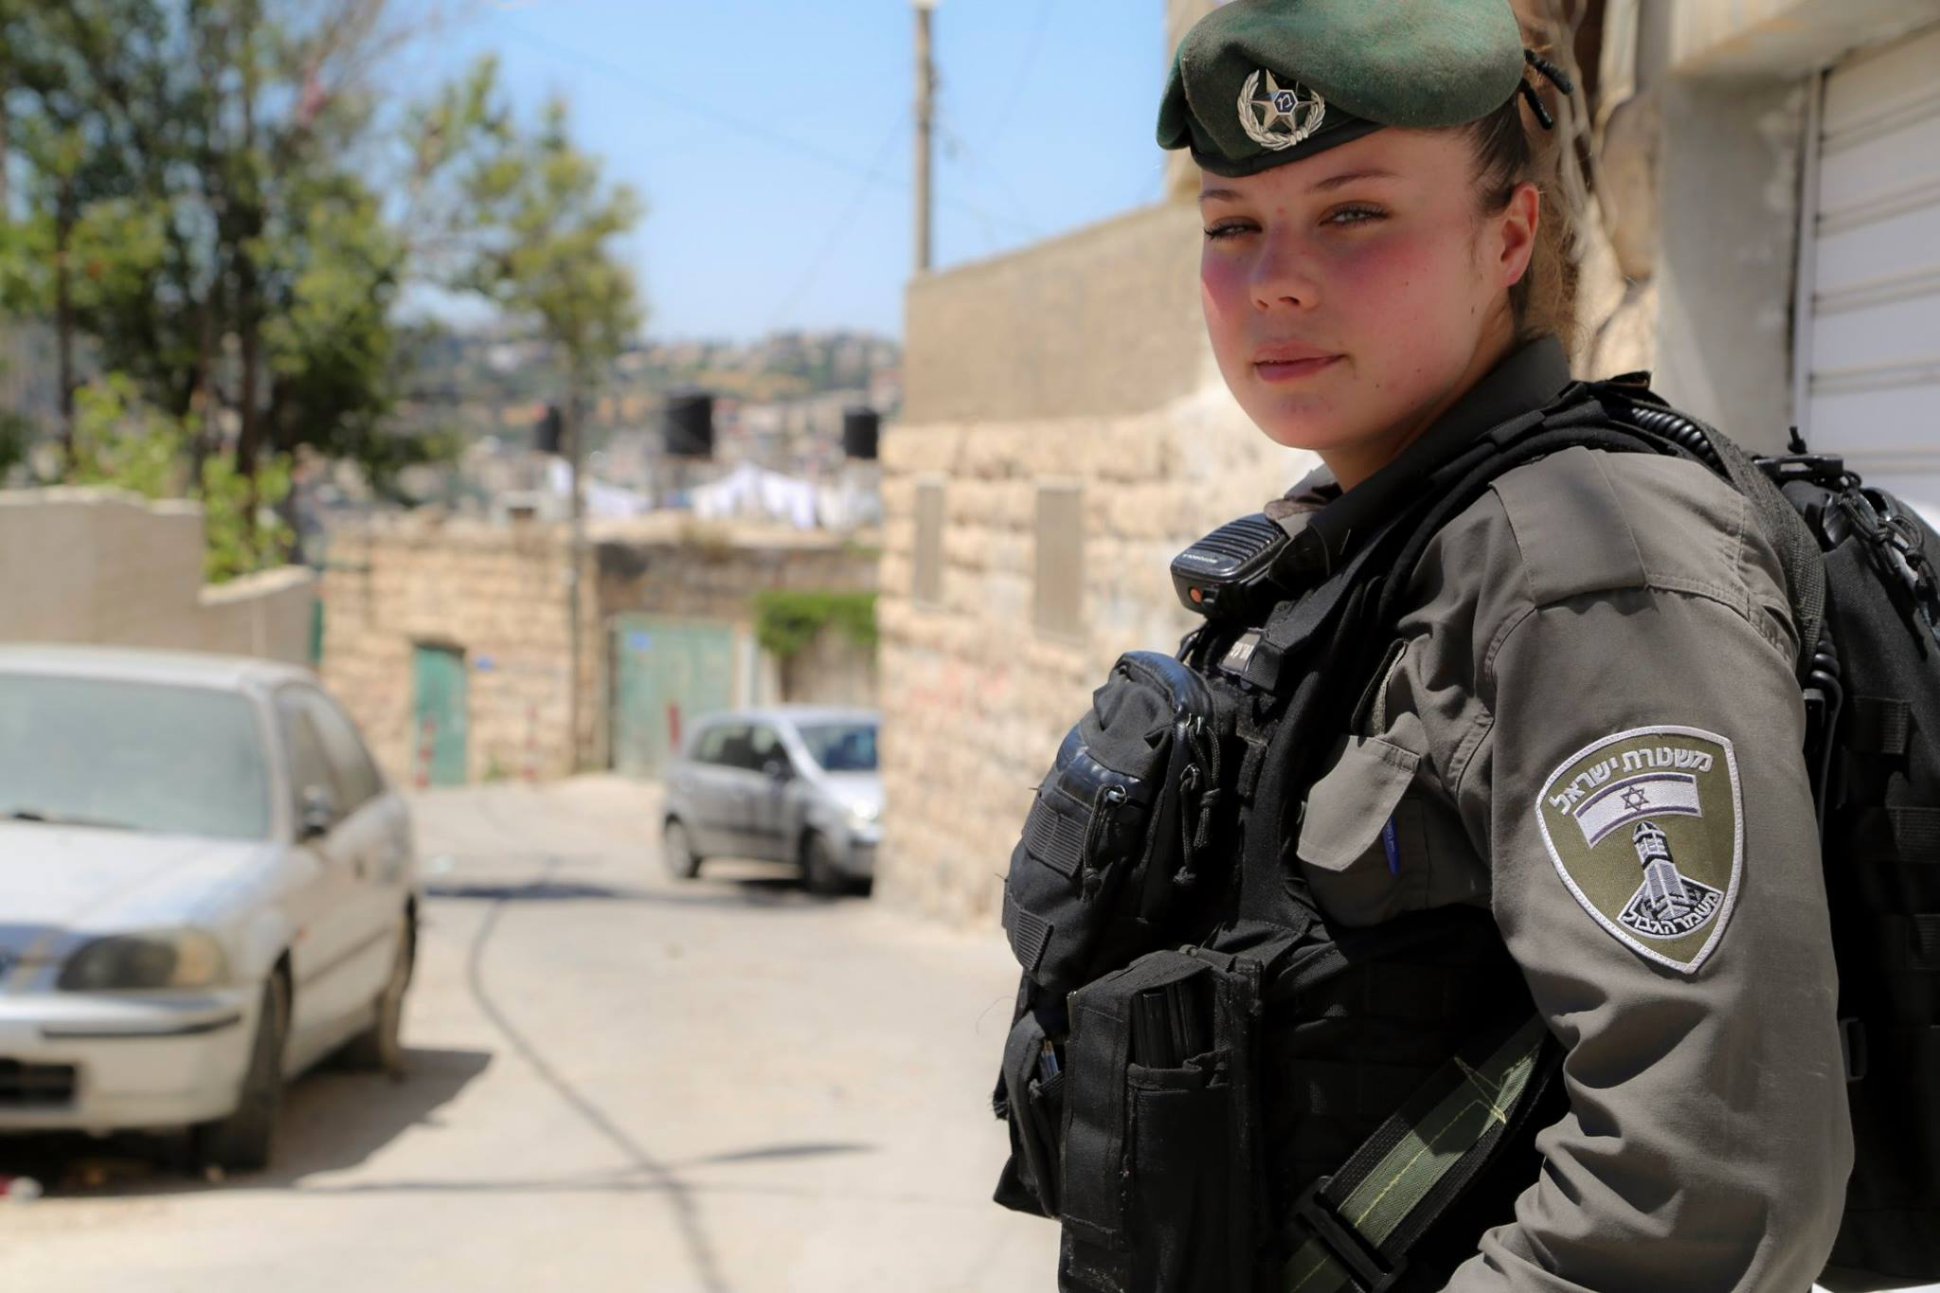
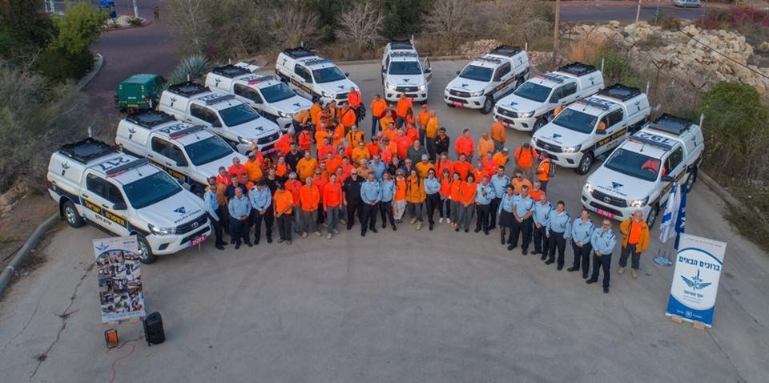
Deepening the knowledge of the participants of the Israel National Defense College, 46th class, with the Israel Police, with an emphasis on the roles and responsibilities that are relevant to the components of the national security of the State of Israel.
Visit’s Purpose

Slide 12
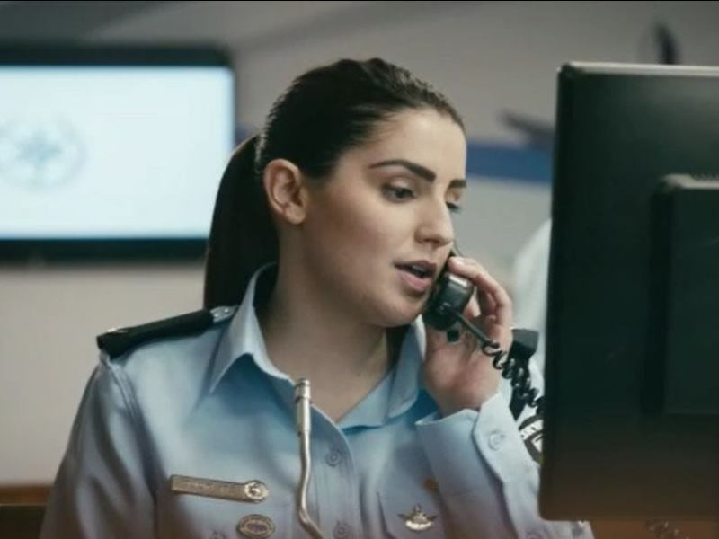
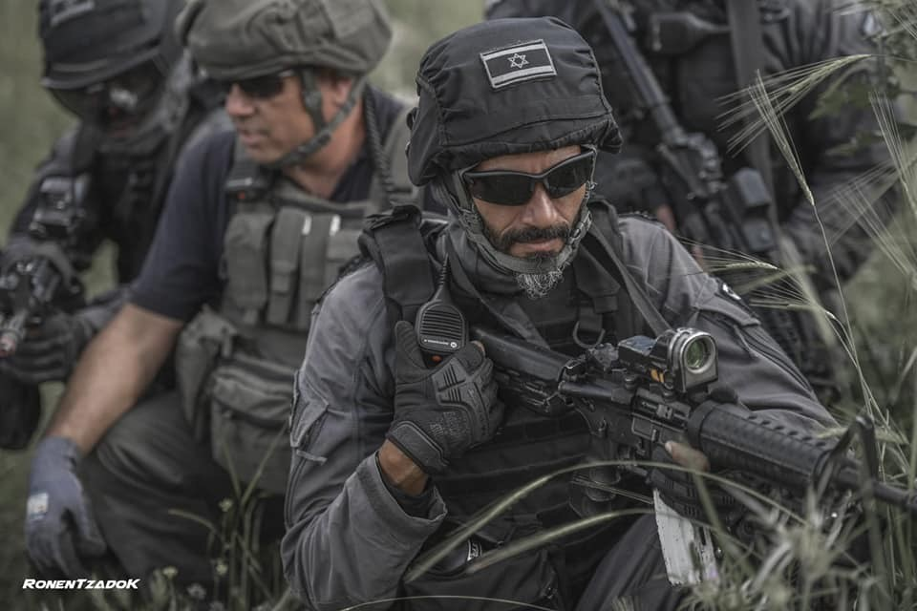
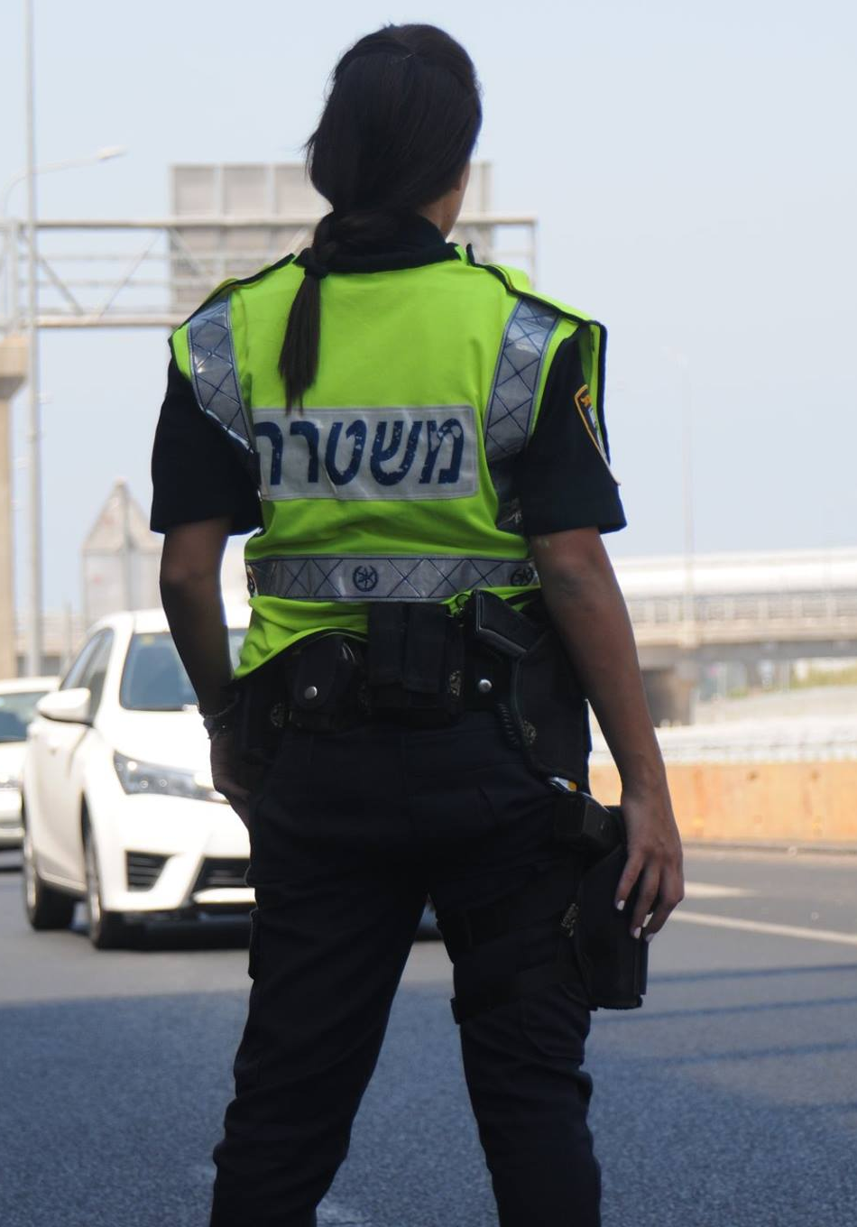
Exposure to police activity in the field of global and national threats - public corruption, economic crime, international crime and cyber crime.
Familiarity with the complexity of the social sphere involved in dealing with weaker populations and the phenomena that characterize them, such as high rates of poverty, crime and violence.
Familiarity with the regular operation of the police in a routine that involves the use of forces to ensure personal safety, public order and quality of life, alongside direct contact with the public.

Slide 13

Systemic layer - classic policing
National level - high policing, organized crime
Local level - society
Contact - Area

Slide 14
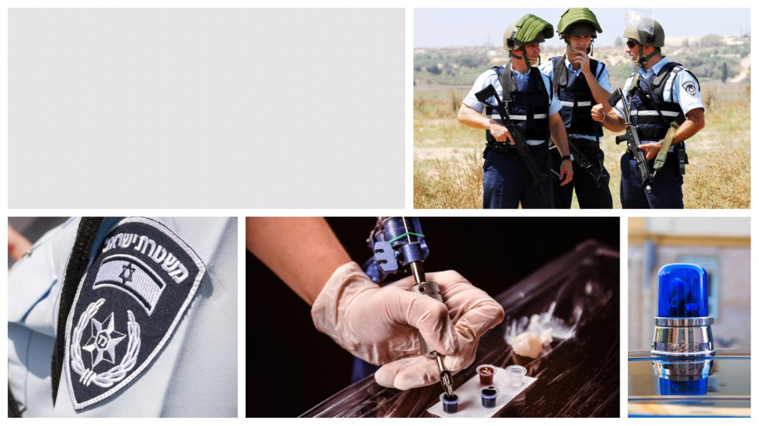
Israel Police – 360º
A visit to Shuafat
Chief Inspector talks
Meeting of the Commander of the North and South District

Slide 15
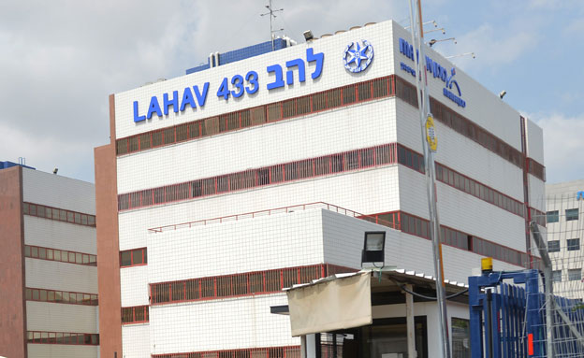
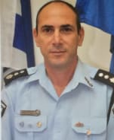
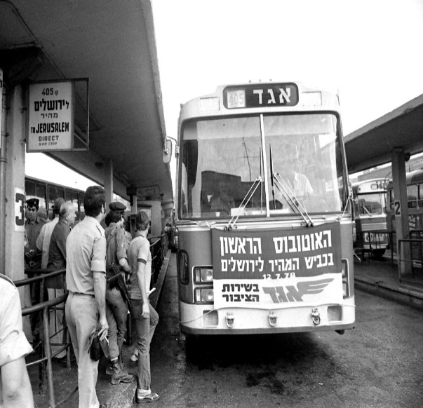

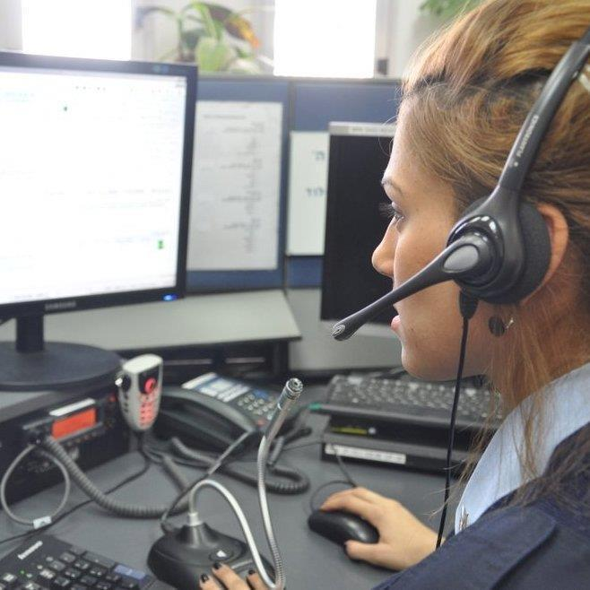
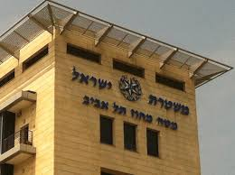
Visit Schedule
14:30 Public Corruption
13:30 Unit 105
12:45 ר' להב 433
12:15 Gathering
11:45 Depart from INDC
12:00 Pick Up from the Fast Lane
20:30 Summary
19:00 Under server
17:15 Dr Shakshuka Jaffa
16:00 TLV District Calling Center
15:30 En route to TLV District

Slide 17

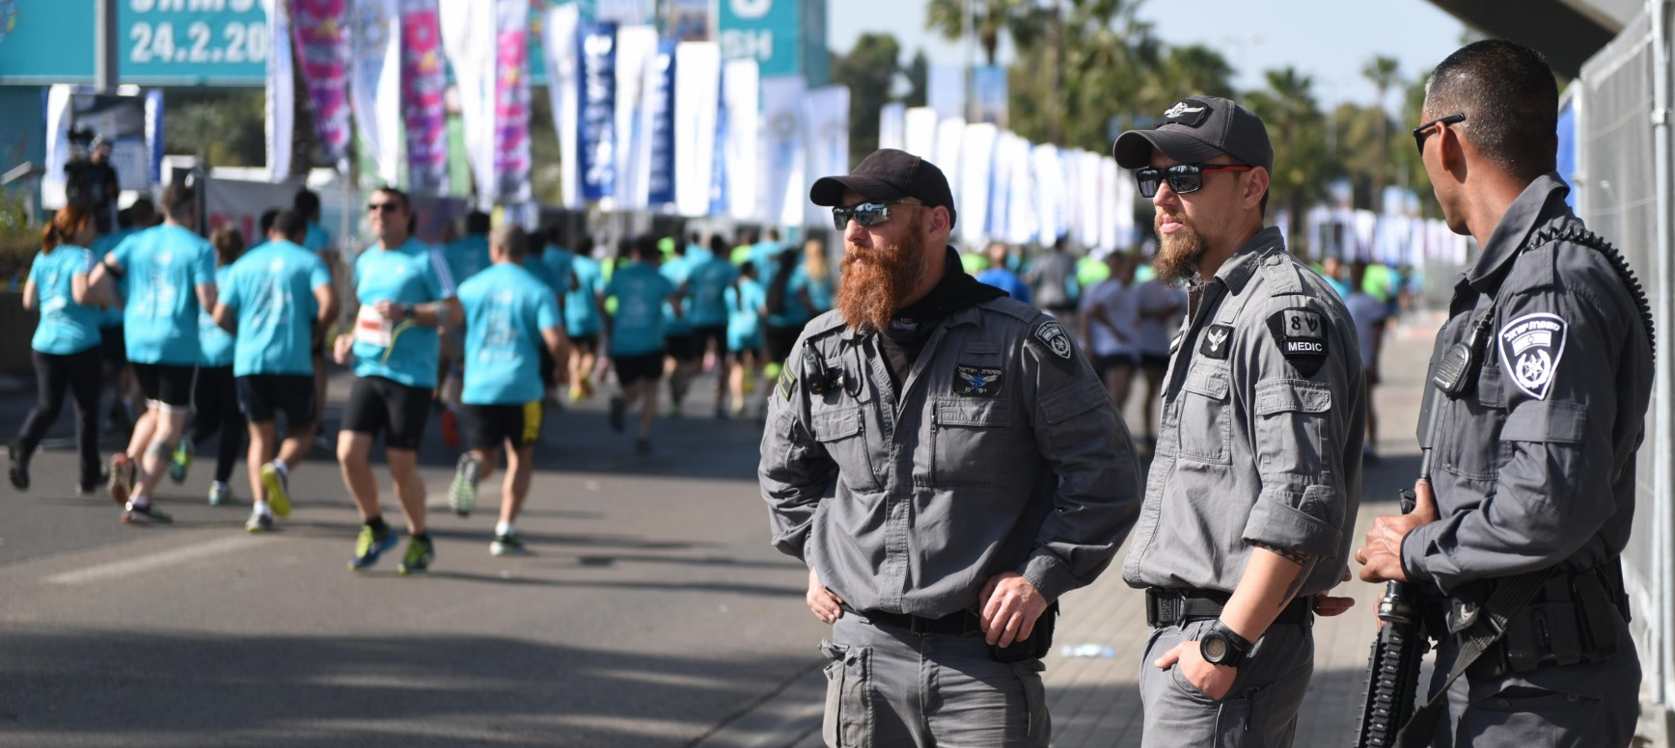
תודה.
አመሰግናለሁ
شكرا
Thank you
Merci

