Slide 1

International Simulation Summit, 2019
Challenges in Force Build-Up

Slide 2


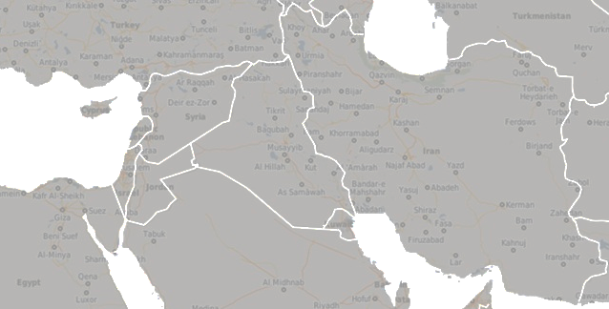






Strategic Assesmnet
The Middle east is the arena for Global and Regional Competition
A rise in affinity between the various Arenas and the areas where Israel is Challenged and in Conflict
USA
    In an “exit” pattern – declining importance in the ME and Transition to the Pacific
    Still is the leading Strategic back rest for Israel
    Superpower competition with China and Russia.
Russia
    A steady presence in the Middle East
    Influence on all players
    A restraining actor in the area
Europe
    An opportunity for a leverage (limited) in foreign relations issues
    “Converging in”
Regional
    Potential for cooperation
    Continuous challenge for regime stability (Demographics, Climate, Under-Development)

Slide 3






Strategic Assesmnet
The Middle east is the arena for Global and Regional Competition
A rise in affinity between the various Arenas and the areas where Israel is Challenged and in Conflict
    SYRIA
    Stabilization, gaining sovereignty, long recovery
    Russian presence – Restraining and challenging power
    Iran
    Long lasting strategic competition
    Potential for a Nuclear turning point
    Direct Friction
    HIZBALLAH
    Precision and narrowing the containment of Israel
    force build-up ambitions
IRAQ
    Direct Iran threat from “2nd circle”
    Iran influence on political arena
    PALESTINIANS
    Deletion of restraints in Gaza and escalation potential
    root problems that drag instability in Gaza and Judea and Samaria
Unification of “axis” actors and increasing the feasibility of confrontation

Slide 4
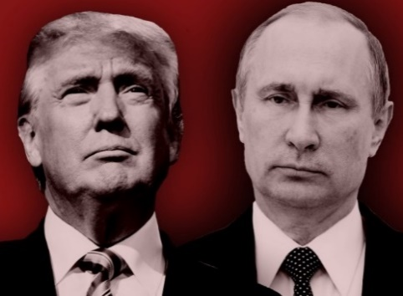
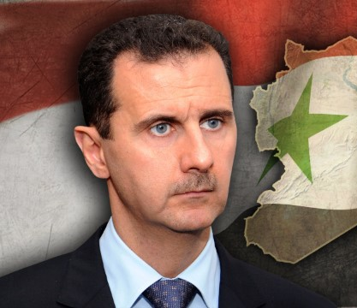
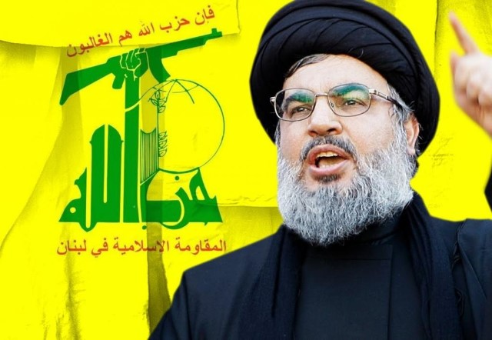


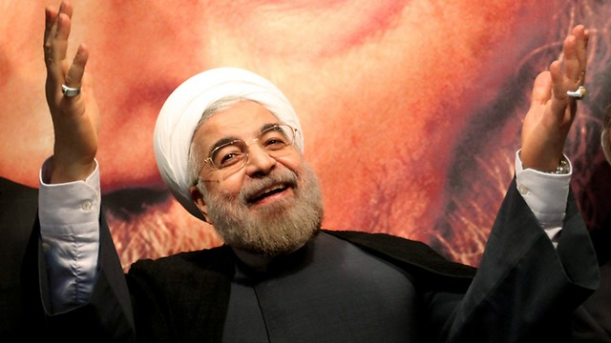


Regional Threats
Iran| Nuclear, Missiles, Regional Entrenchment
Terror Armies
Advanced Threats| Precision Missiles, Cyber, EW
Radiations of the Superpower competition
Instability| Palestinians, Regional Global

Slide 5






Strategic Competition –
Iran in every single area and aspect
Hizaballah
    Iran in Syria
  Iran in Iraq
Iranian Territory
        Terror Army
      Continuous entrenchment and actions against Israel
      Influence on regime
  Cruise Missiles, SSMs
        SSMs, PGMs
      Negative influence on Regime
      Shia militias
Cyber
        Maneuvers and Raids
    Shia militias
      Quds Forces
  Industries
        Cyber and EW
Quds Forces
      Cruise Missiles, SSMs, UAVs
  Nuclear
        Air Defense and anti-aircraft defense
    Cruise Missiles, SSMs, UAVs
      Weapon Transfers and Lines of Communication

Slide 6









      Precision
      industry and self production – Rockets, SSMs, Cruise Missiles
Nuclear Challenge
Advance air Defense capabilities
UAV capabilities
Sub-Terran and Multi Domain warfare
Enemy’s Build-Up
Cyber
ATGM array
EW Spectrum
Offensive and Defensive approach
Cheap Products Drones, kites

Slide 7
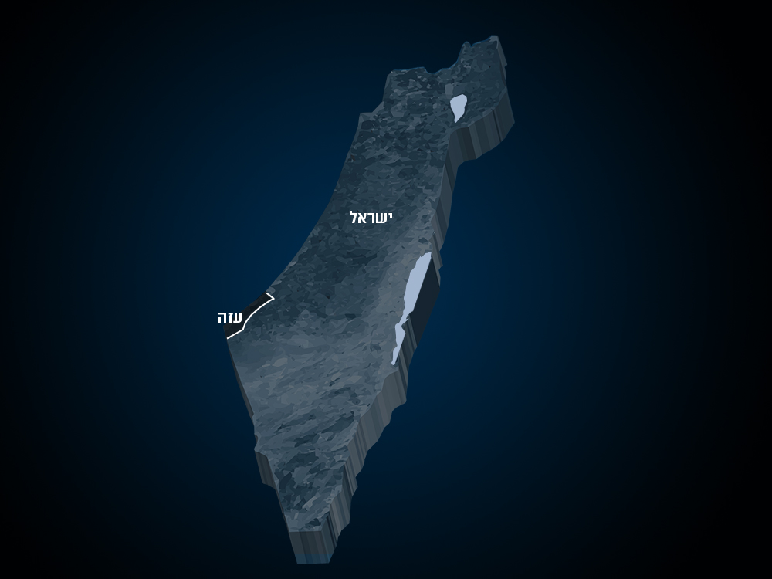
what will the 2030 war look like?

Slide 8
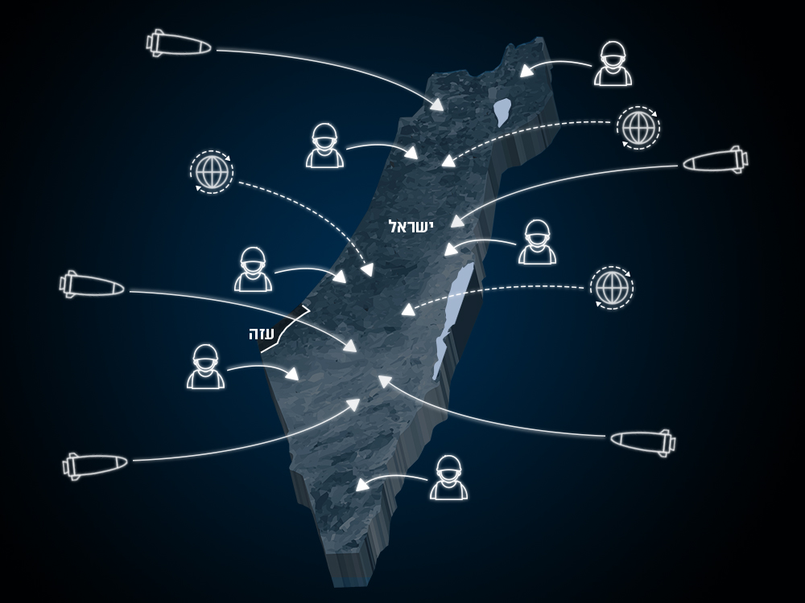
A surprise and a whack

Slide 9
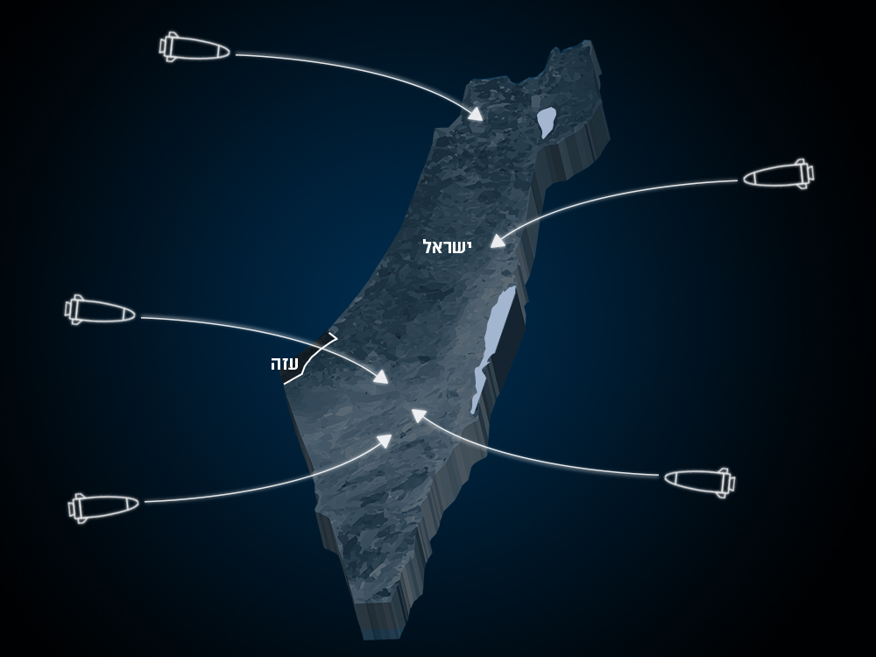
Precision Fire, Lethality,
National and Security infrastructure
ISRAEL

Slide 10
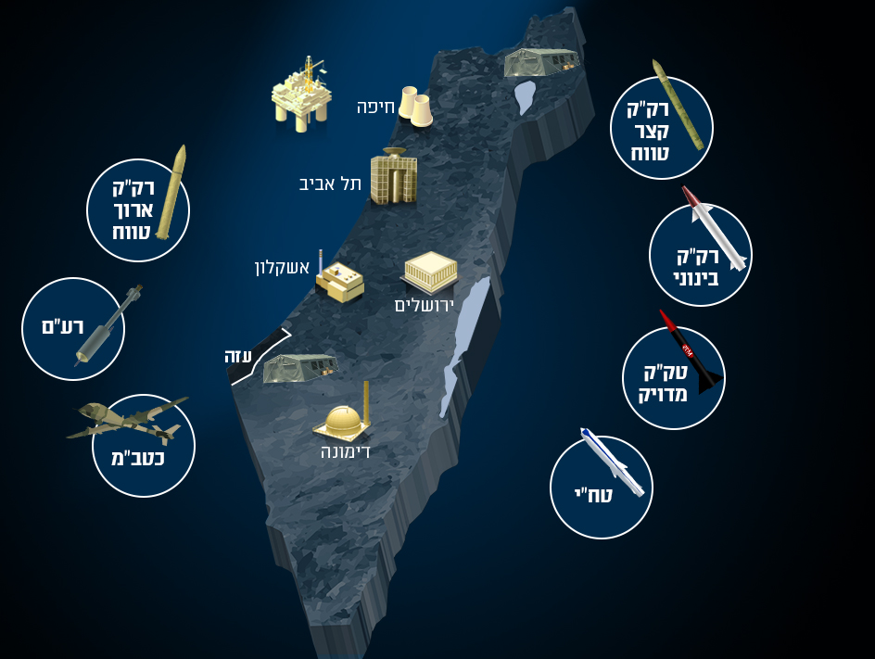
Precision Fire, Lethality,
National and Security infrastructure
LRBM
SRBMS
MRBMS
TBMS
PGMS
CDCMS
UAV

Slide 11
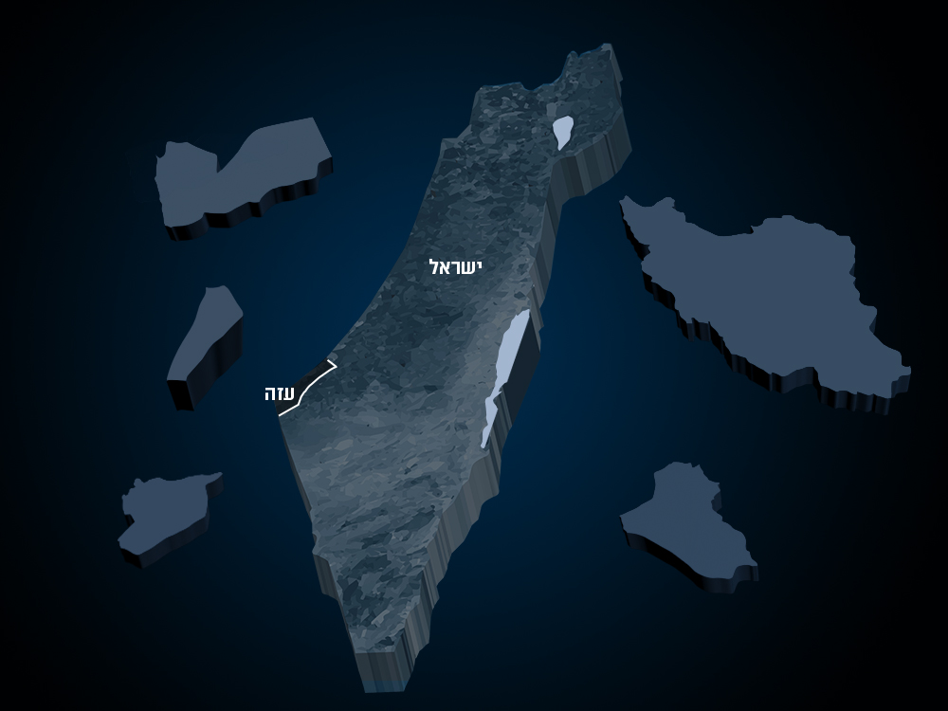
Fire from many locations
YEMEN
IRAN
ISRAEL
LEBANON
GAZA
SYIRA
IRAQ

Slide 12
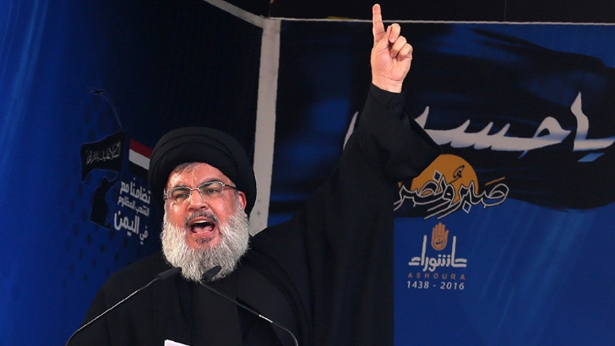
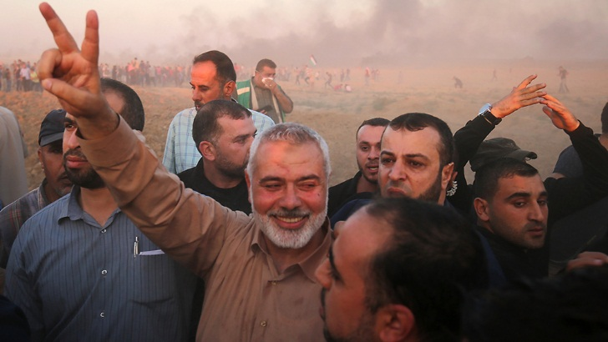
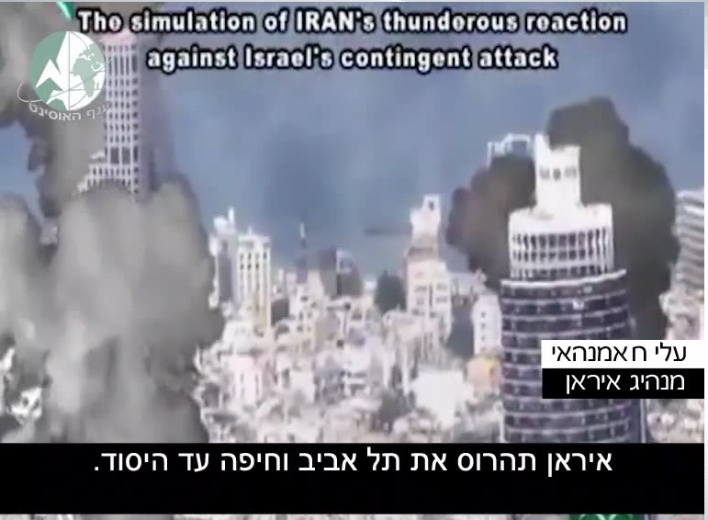
Information Operations

Slide 13
New offset concept:
Decisive and Fast Victory, while Lowering the price and shorten the length
Desired State
achievement
Un-Desired State
achievement
Need for decisive victory
Time
Time
Price
Price
0

Slide 14
Efforts enabling new concept
Enablers
Efforts
Digital
Superiority
Aerial Superiority
Maneuver
Multi Domain
Cyber
Superiority
Intel Superiority
Strikes
Multi Domain
Information Superiority
Maritime Superiority
Spectrum Superiority
Continuity of OPS
Defense
Multi Domain
Act simultaneously
Enhance operation tempo and power
Deny enemy capabilities

Slide 15

Directions in Force Build-Up

Slide 16
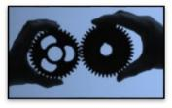
  simultaneity
  Gathering capabilities
  Joint Territorial Capabilities

Slide 17

  Utilization of information in the tactical level
  Develop and protect networks
Joint Digital Spectrum

Slide 18
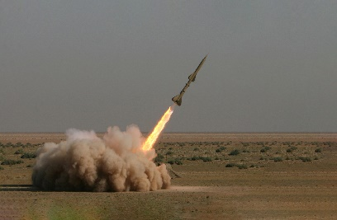
Advanced Capabilities
Precision and Immunity
Advanced Munitions

Slide 19
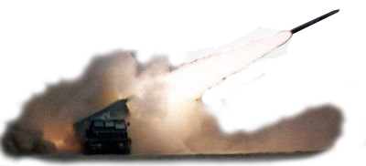
BMD
PGMS and SRBMS
Multiple Launches

Slide 20
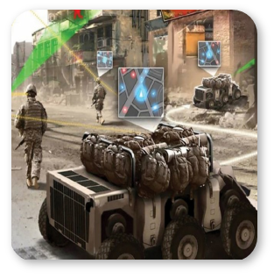
Enhance Technological Capabilities to the tactical end-user
Connectivity
Bandwidth

Slide 21
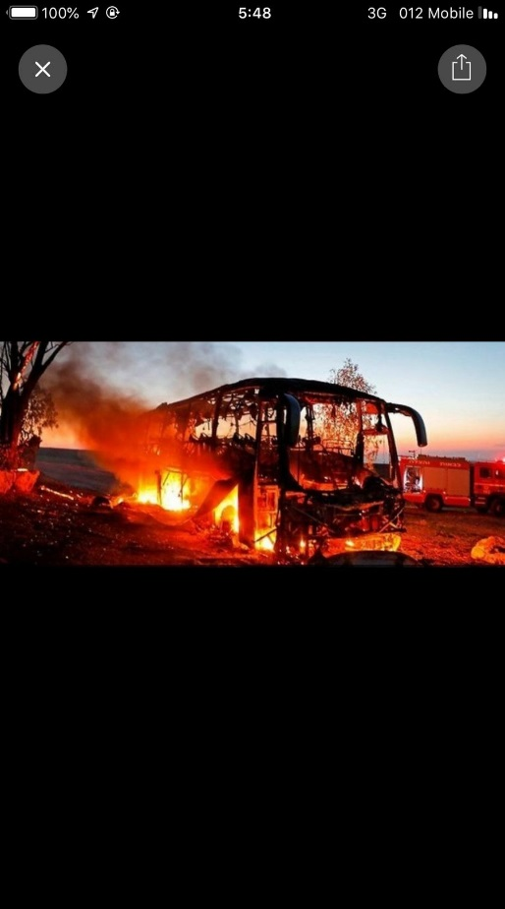
Systemic immunity and survivability
Robust Survivability
ATGMS threats
Cyber and EW protection for critical capabilities

Slide 22

Autonomous Automation and Robotics in the Battlefield

Slide 23

Leap in Data Science and AI to maximize and utilize the information and capabilities in the IDF

Slide 24

Utilize the “world” of sensors and IOT

Slide 25
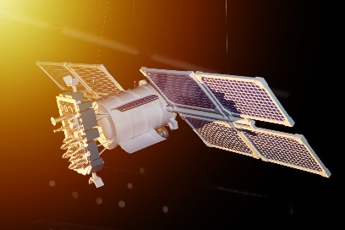
Utilize the SPACE

Slide 26

Spectrum and EW
Utilize Spectrum arena
GNSS jamming challange

Slide 27

  Ground and Air
Directed Energy and Laser Weapons

Slide 28






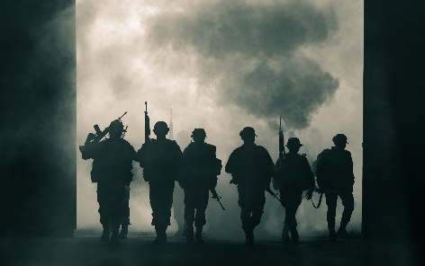

Next Potential…?
Human Capita
Cooperation

