Slide 1

UNCLASSIFIED
Cyber Protection
Legal Aspects
Adv. Amit Ashkenazi
Attorney General
The National Cyber Directorate

Slide 2
-בלמ״ס-
Policy
Law
Cyber Defense

Slide 3
UNCLASSIFIED
The concept of cyber protection
 | Layer 1: Robustness | Layer 2: Resilience | Layer 3: Defense
Focus | Attacks | Attacks | Attackers & campaigns
Context | Offline | Event driven | Attacker driven
Organizations | Execute | Execute | –
Government | Incentivizes & regulates | Execute | Execute
E. Matania, L. Yoffe, M. Mashkautsan, "A Three Layer Framework for a Comprehensive National Cyber Security Strategy“, Forthcoming in Georgetown Journal of International Affairs: International Engagement on Cyber VI (Spring 2016).

Slide 4
Regulation Of The State's Activity In Cyber Defense
01
A legal framework for dealing with security-technological challenges
Technological neutrality and flexibility
The principle of legality
02
Protecting basic rights and working with the civilian economy
"Special" powers for cyber protection
Structuring judgment and inspection
Proportionality
03
The global dimension

Slide 5
UNCLASSIFIED
Key policy questions
Operation
What is the threshold for exercising intervention authority without consent?
Regulation
Distributed or central model
Inspection
An "efficient" division of labor between prior approval or retroactive control and an internal and external mechanism
What are the powers that can be used to deal with an attack?
Setting up a detection and identification system for cyber protection and preventing abuse of it
How to adapt the regulation to the existing context in the segment
Prevention of side effects
Treatment of non-regulated sectors

Slide 6
UNCLASSIFIED
The Legal Basis For Cyberspace Activity
Government decisions on cyber protection:
Law for the Regulation of Security in Public Institutions, 1998
No. 2443 - Promotion of national series and government transportation (15.2.15)
Structuring policy and strategy, promoting and regulating national defense processes, developing capabilities, and promoting international cooperation
מס' 2443 – קידום הסדרה לאומית והובלה ממשלתית (15.2.15)
בניית מדיניות ואסטרטגיה, קידום והסדרה של תהליכי הגנה לאומיים, פיתוח יכולות, קידום שת"פ בינ"ל
מס' 2444 – קידום היערכות לאומית להגנת הסייבר (15.2.15)
הגנת המרחב האזרחי, שיתוף מידע וטיפול באירועים בזמן אמת, הקמת מרכז סיוע בהתמודדות עם אירועי סייבר, הגנה על זכויות ייסוד
מס' 3270 – איחוד המטה והרשות למערך הסייבר הלאומי (17.12.17)
No. 2444 - Promoting National Preparedness for Cyber Protection (15.2.15)
Protecting the civilian space, sharing information and dealing with events in real time, establishing an assistance center in dealing with cyber events, protecting basic rights
No. 3270 - Union of the Headquarters and the Authority for the National Cyber System (17.12.17)

Slide 7
Principles of the National CERT - Protection Of Fundamental Rights
Definition of designation
Determining overall managerial responsibility (accountability)
Technological design
Limitations on collecting, maintaining, processing and distributing information
Focusing on information of security value
Minimum collection of "protected information" (private and commercial information)
Prior to activity in the organization:
Presentation of the principles of activity and obtaining explicit and informed consent
According to the organizational policy - updating employees

Slide 8



UNCLASSIFIED
Computer
Material
Content that can be visually interpreted
Computerized information
and software

Slide 9
UNCLASSIFIED
Information of Security Value
The information will be collected from information systems and is relevant to cyber protection -
Incidents
Artifacts and Malwares
Peripheral information related to the detection, identification and investigation of threats and events, with an emphasis on raw technological information
Methodologies and tools for dealing with cyber threats
Vulnerabilities
Threats

Slide 10
UNCLASSIFIED
From a Distributed Approach to a Unified Arrangement In Cyber Defense
Until -
2015
Sectoral regulation
From -
2015
[2443]
One trend:
- in content
- “in the web of
regulation "
2017
Authority -
Regulation Branch – Defence Doctrine 1.0"
Sectors Division

Slide 11
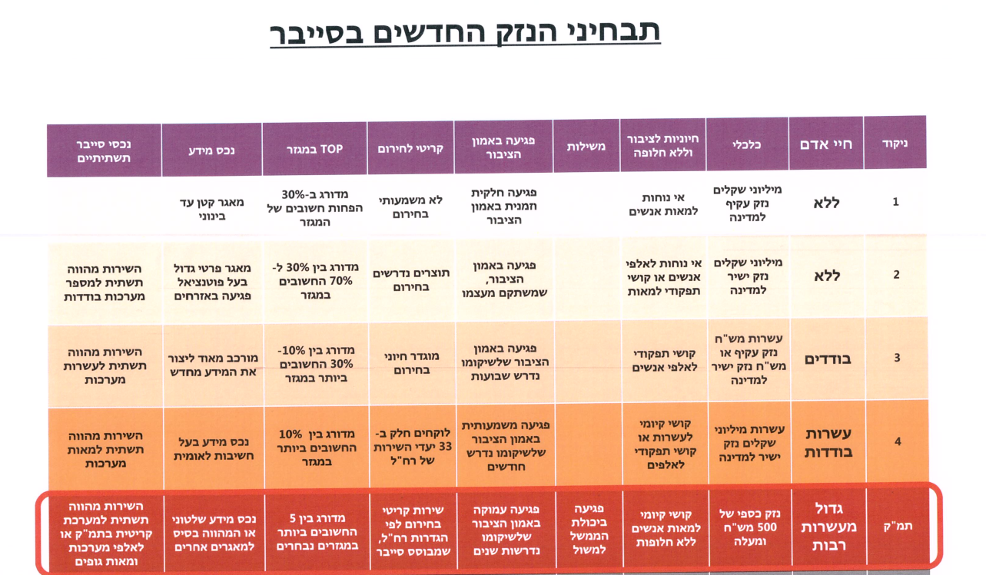
-
UNCLASSIFIED
Full mapping of the economy
The New Damage Criterion in Cyber
Infrastructure Cyber Assets
Information
Top of the sector
Critical for emergency
Damage to public trust
Governance
A necessity for the public without an alternative
Economics
Human Life
Scoring

Slide 12
UNCLASSIFIED
Memorandum of the Cyber Defense Act and the National Cyber Directorate
Organizational aspects of the national cyber Directorate
Internal and external control mechanisms
Powers to deal with real-time aggressiveness
Determining criteria for exercising authority
Powers to regulate cyber protection in the economy
Principles on Regulation (RIA)
Major regulatory processes (sector mapping, guidelines as required)
Determining the range of powers
Privacy design

Slide 13

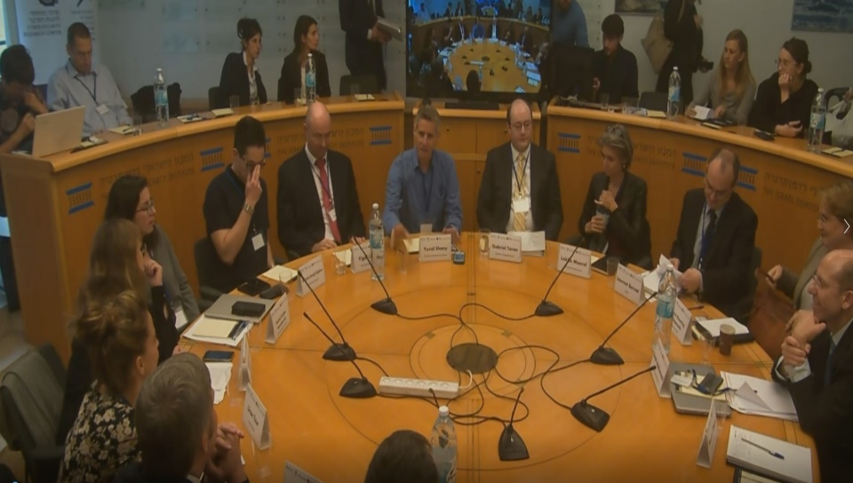
An in-depth academic discourse
Manufacturers Association
Leading jurists
Draft of the Cyber Protection Law and the National Cyber Directorate Act
Government ministries and authorities
The "community" of cyber protection
Civil society organizations

Slide 14
Principles on exercising authority (after public discourse)
UNCLASSIFIED
Structuring managerial discretion
Factual infrastructure for the purpose
Impact on the organization
Default work by organization personnel
Requiring that those who carry out operations be professionals
Transparency towards the organization (as much as possible)
The right to be heard according to the possibility

Slide 15
UNCLASSIFIED
Authority
Regulations of authority after public discourse
The default - authority for consensual assistance - sharing and dissemination of information
"Severe cyber attack" –
    Receiving information and providing instructions for handling the attack
    Actions without consent by judicial order
    Emergency authority of the head of the array for 24 hours
" Detection and Identification System "- collecting “information of defensive value“ in real time

Slide 16
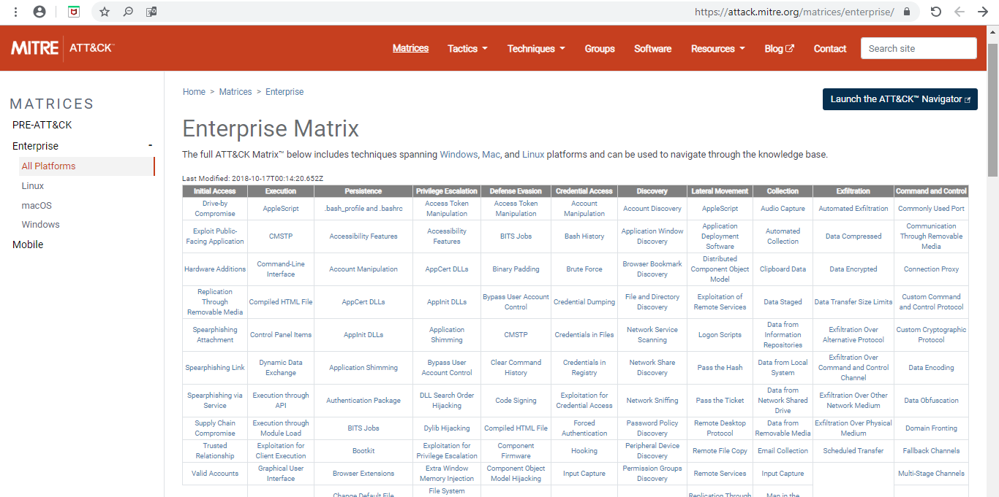
UNCLASSIFIED

Slide 17
UNCLASSIFIED
New terms 0.9
"Attack patterns" - characteristics of a cyber attack pattern;
"Technological auxiliary Data " – Computer-language data that is designed to support the process that is made through a computer, including data about the type of protocol communication between material components;
"Indicators" - technological data and other information that may indicate, in accordance with accepted concepts of cyber protection, suspected actions in the form of cyber attacks; The head of the national cyber network shall publish at least once a year a list of indicators in accordance with these regulations.
Cyber attack pattern" - a series of actions carried out on an organization's computer network as part of preparations for cyber attacks or cyber attacks, in whole or in part, including:
Preparing for a cyber attack–Technical information gathering, technical weakness identification, organizational weakness identification, adversary opsec, establish and maintain infrastructure.
Implementing a Cyber attack - persistence, privilege escalation, defense evasion, credential access, discovery, lateral movement, execution, collection ,exfiltration, command and control.

Slide 18
UNCLASSIFIED
Authorities in the Regulatory Sector
The directorate as the national guidance body for cyber protection
Determining a method for mapping the economy
The directorate should develop and publish a "defense doctrine"
A sectoral reformer is required to adapt its provisions to defense doctrine, unless there are unique professional considerations
Cyber-defense directives require the consent of the head of the cyber / prime minister
The array regulates the professional requirements of the sectoral regulators

Slide 19
UNCLASSIFIED
Regulation Chapter
High Risk Entities:
• "Completion of authorities" to a sectoral regulatory authority
Critical infrastructures
• The directorate directs and indirectly supervises:
Very high-risk entities requiring temporary guidance due to risk.
Entities with a very high risk in a sector with no relevant regulatory authority.

Slide 20
UNCLASSIFIED
Control and balancing mechanisms in the regulatory chapter
The authority to determine the guidelines “structures” the discretion (in conjunction with Resolution 2118):
The regulation will be based as much as possible on international standards.
The regulation will be adapted to the characteristics of the sector, the size of the organization, and the type of cyber risks to which they are exposed.
The regulations will be carried out in accordance with the available information of the costs arising from the regulatory requirements regarding the damage scenarios that it seeks to prevent and its effect on business activity, fair competition and consumer welfare.

Slide 21
UNCLASSIFIED
The International Space
The role of existing international law and the need to proceed cautiously based on experience
Bottom up - It is better to focus on arrangements that help key players
OECD
IGF
Prague 5g
Cyber and trade
Privacy protection and cyber protection
Grey zone

Slide 22



Thank You!
Adv. Amit Ashkenazi
Legal Advisor
AmitAs@cyber.gov.il

