Slide 1

The Defense Budget
Challenges and
Looking Forward
INDC Lecture, April 18, 2019

Slide 2

Getting Acquainted with the Budget Department / Financial Advisor and the Economic System

Slide 3




המערך הכלכלי – מצבת כ"א
419
419
100%
63%
3
16
Brigadier General Excellence and Higher
אחרים
(8%)
אכ"א
(17%)
ח"א ומפא"ת
(14%)
כ-419
חה"י
(6%)
יועכ"ל
(15%)
תקשוב
(6%)
פיקודים
(5%)
אמ"ן
(6%)
זרוע היבשה
(22%)

Slide 4

Areas of activity in the economic system
Management of payroll and manpower budgets
Information systems
Resource management
Efficiency
Budget management and control

Slide 5

The Challenges
Bringing the budget that will provide the best response to security needs and ensure the best use of the budget

Slide 6

The Challenges
Bringing the budget that will provide the best response to security needs and ensuring the best use of the budget

Slide 7
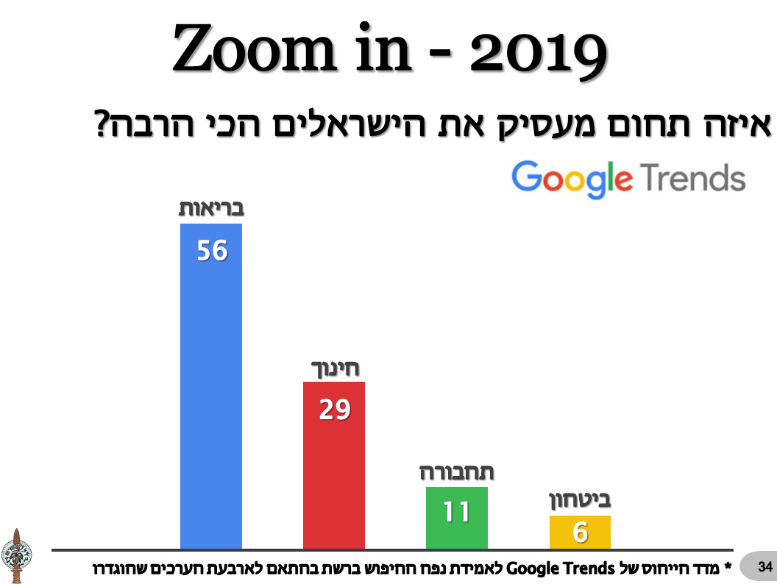
Which employment sector occupies the Israelis the most?
Health
Education
Transport
Security
*The reference index of Google Search volume of trends for network estimation based on the four values that were set

Slide 8
How can we explain the need for security in a relatively peaceful time?

Slide 9
Campaign between the Wars-
the War Behind the Scenes
The Development of the Campaign between the Wars in Recent Years
X 3.7
Since “Operation
Protective Edge”
Until February
The expenditure of the campaign between wars
in 2018 is almost 4 times higher than in 2017
Unclassified

Slide 10


Operational Activity from a Budgetary Angle - How Much Does it Cost Us?
2018, NIS Millions
Quarter 4
Quarter 4
Quarter 3
Quarter 2
29
3
2
2
Days of Activity
Days of Activity
Days of Activity
Days of activity
Total-
Total-
Total-
Total-
64
113
38
41
Millions₪
₪ Millions
Millions₪
₪ Millions
Notes:
צה"ל לא ביקש תוספות בגין המב"מ. ת"ע צה"ל לא לוקחת בחשבון מלחמה (רזרבות חשכ"ל).
הפסקת עבודות בקיר = 2 מש"ח

Slide 11




Between the Campaign between wars and “Operation Protective Edge”
(ammunition costs only, NIS millions)
3
÷
Air
Campaign between Wars Since Operation Protective Edge
Operation Protective Edge
Notes:
מב"מ הוא האופציה הכלכלית הטובה ביותר הנותנת שקט למדינת ישראל.

Slide 12
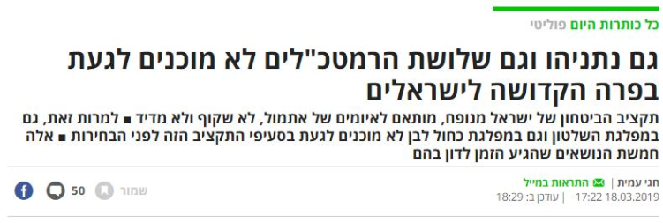
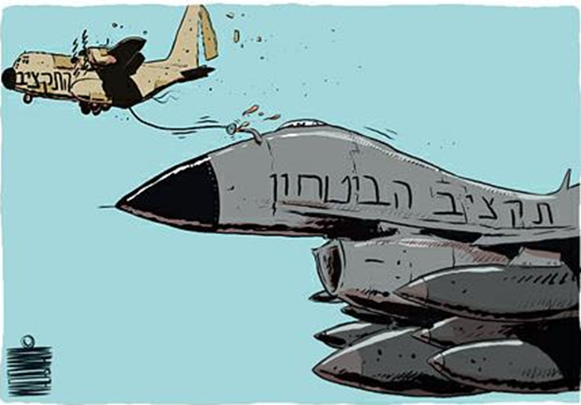
And what do you
hear in the media?
All of Today’s Headlines Politics
Netanyahu and the three Chiefs of Staff are not willing to address the Israeli elephant in the room
Israel's defense budget is inflated, adjusted to yesterday's threats, neither transparent nor measurable |
Nevertheless, even in the ruling party and in the Blue-White Party, they are not willing to touch these budget items before the elections | These are the five issues that the time has come to discuss

Slide 13
The Government's Budget Priorities –
Budget Status 2019
521
NIS Billions

Slide 14
Where Does the Budget Come From?
The State Budget for 2019
Total Budget for Government Ministries
Conditional income Expenditure 41 Billions
Debt Payments 95 Billions
NIS 344 Billions
Interest Payments
NIS 39 Billions

Slide 15
Which Four Government Offices have the Highest Budget?
4 offices – 41% from State Funding

Slide 16


Which Four Government Offices have the Highest Budget?
No budget, pension and rehabilitation
Sources of the economy (no income)
Total sources (including income)
Ministry of Transportation
NIS 21 Billion
10%
Ministry of Defense
NIS 73
Billion
34%
Ministry of Health
NIS 43 Billion
20%
Ministry of Education
NIS 76 Billion
36%
4 offices – 41% from State Funding
Source: Ministry of Finance and According to the Budget Law for 2019 (the state budget includes payment of debts), education includes higher education and development.

Slide 17

Which Four Government Offices have the Highest Budget?
No budget, pension and rehabilitation
Sources of the economy (no income)
Total sources (including income)
Ministry of Transportation
NIS 21 Billion
11%
Ministry of Health
NIS 39 Billion
21%
Ministry of Defense
NIS 53 Billion
29%
Ministry of Education
NIS 72 Billion
39%
4 offices – 41% from State Funding
A source of the Ministry of finance and the budget law for the year 2019 State budget includes paying debts, including education, higher
education and development

Slide 18
Which Four Government Offices have the Highest Budget?
No budget, pension and rehabilitation
Sources of the economy (no income)
Total sources (including income)
Ministry of Transportation
NIS 21 Billion
12%
Ministry of Defense
NIS 42 Billion
24%
Ministry of Health
NIS 39 Billion
22%
Ministry of Education
NIS 72 Billion
41%
4 offices – 41% from State Funding
Source: Ministry of Finance and According to the Budget Law for 2019 (the state budget includes payment of debts), education includes higher education and development: משרד האוצר ועל פי חוק התקציב לשנת 2019 (תקציב המדינה כולל תשלום חובות), חינוך כולל השכלה גבוהה ופיתוח

Slide 19




Development of Government budgets in the past decade
Zero-sum game…
X3.2
X2.5
X2.1
X1.3

Slide 20

The Process of Approving the Defense Budget Book for 2019 in the Knesset
1
2
3
4
5
6
7
8
9
10
11
12
13
14
15
16
17
18
19
20
21
21
22
23
24
25
25
26
27
28
29
30
31
32
33
34
35
36
37
38
39
40
1
2
3
4
5
6
7
8
9
10
11
12
13
14
15
17
Hours of Discussion
Discussions in the Foreign Affairs and Defense Committee
Notes:
תקציב החינוך: 55 דפים , תקציב הביטחון: 680 דפים.

Slide 21
And What About the Education Budget?
2
1
Hours of Discussion
Discussions in the Foreign Affairs and Defense Committee

Slide 22



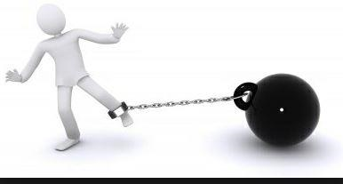
Walking On a Thin Line
100% Transparency
Full implantations of recommendations
and decisions to increase transparency
0 Control
Paralysis
The unique military system

Slide 23

The Importance of US Assistance and the Challenge of Decreasing Exchanges

Slide 24
Assistance grant 2008-2028 (excluding BMD)
Millions of dollars in aid
MOU 2009-2018
Total $ 30 billion, 3 billion average per year
MOU 2019-2028
Total $ 33 billion, 3.3 billion average per year
3.3
3.3
3.3
3.3
3.3
3.3
3.3
3.3
3.3
3.3
3.0
3.1
3.1
3.1
3.1
3.1
3.1
2.8
2.9
2.6
2.4
2008
2009
2010
2011
2012
2013
2014
2015
2016
2017
2018
2019
2020
2021
2022
2023
2024
2025
2026
2027
2028

Slide 25


Exchanges(Off Shore Procurement)
In the framework of the new MOU, it was decided to implement a descending outline until a total cancellation in 2028
As of 1984, a share of the aid money can be converted into shekels for defense procurement in Israel
26.3% of the Total Grant
  Decreasing exchanges framework
2009
2010
2011
2012
2013
2014
2015
2016
2017
2018
2019
2020
2021
2022
2023
2024
2025
2026
2027
2028

Slide 26



The Israeli Perspective
MOU in View of the Ministry of Finance - Decline in the Exchanges Pattern
1 1
1,200
There is no risk of harm to research and development
The purchasing flexibility of the Ministry of Defense is not unitary
The increase in the defense budget will compensate for the drop in the exchanges
The damage to the periphery is about 1,200 employees
1:1

Slide 27
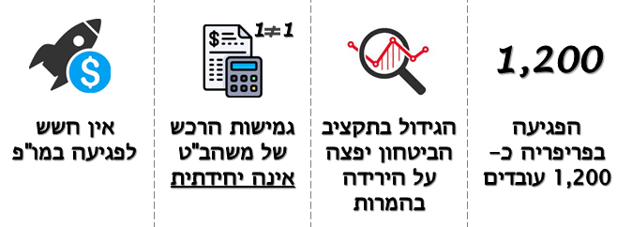


But...
There is no risk of harm to Research and Development
The increase in the defense budget will compensate for the drop in the conversions
The damage to the periphery is 1,200 employees
The purchasing flexibility of the Ministry of Defense is not unitary
לא נלקח בחשבון
1:1
1,200
min
התרומה הביטחונית בעצמאות הייצורית והטכנולוגית וזמינות בחרום
העברת קווי ייצור לחו"ל – התייקרות, לו"ז ופגיעה בעצמאות
The budget is intended to aid procurement
Budget hole expected already in 2020
The Finance Ministry's assessment is only a lower barrier
Moving production lines abroad – more expensive and a
longer schedule
The security contribution to technology empowerment
and routine conduct
Not taken into account

Slide 28



The American Perspective
Situation report- already in the first year of the MOU, more than half of the aid budget has been linked - low decision space
Maintaining Israel's qualitative military advantage by acquiring platforms and acquiring capabilities rather than purchasing raw materials
MOU as a growth engine for the American economy - places of employment + working hands for the American citizen

Slide 29

The Challenges
To bring the budget that will provide the best response to the security needs and to ensure the best use of it

Slide 30
Most effectively

Slide 31




'To the Edge‘ – Efficiency
A team of reserve officers and regular officers from the General Staff
"Cranes Workshop" to examine all the resources and expenses of field units
Building a roadmap for implementing efficiency and
savings measures
Predicting the expenses according to the essence
of the project

Slide 32






Where have we already been?
8200
Unit
Golani
Military Base
460
Brigade
Groundbreaking collaboration
Financial Potential of 5-10 Million Shekels
More than 30 applicable ideas

Slide 33
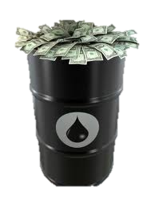

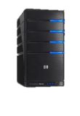


Connecting Tanks to Electricity
200 Meters
Fuel Saving Product
AC-DC Converter
Electric Cable
Electrical Network
Tanks Parked on the Outskirts of the Base
Training Area
Saving 2 million NIS per year with diesel fuel
AC-DC converter
Electric Cable
Electrical Network

Slide 34
And with the most suitable people

Slide 35
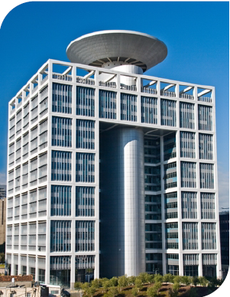

Salaries- A Snapshot
Major of Medicine
10 years of service
₪31K
Major of Technology
8 years of service
24k₪
“The People of the Kiriya”
Shadow People
The World of Officers
Brig.
Today a staff officer
20 years in combat k39₪
Brig.
20 years
As a Staff Officer
29k ₪

Slide 36














X2
דוח הממונה על
השכר 2017
דוח הממונה על
השכר 2017
Salaries in Security Forces, Thousands ₪ , 2017
Report of the Supervisor of Wages 2017
IDF
Security Forces
X2
IDF
Israel Prison Service
Israeli Police Force
General Security Service
And Mossad
The Ministry of Defense
מקור: משרד האוצר

Slide 37
תעשיות ביטחוניות
גופי ביטחון
צה"ל
The Public Sector
Thousands ₪, 2017
Report of the Supervisor of Wages 2017
IDF
Security Forces
Defense industries
Public Sector
IDF
Israeli Police
Water Company
HMO-
Clallit
Elta Industries
Lottery Company
Electric Company
Units under of the Ministry of Defense
Israel Airport Authority
Israel
Aerospace
Industries
Rafael
Development Corporation
Prison Service;’
Secret Service
Israel Security Authorities
Bank of Israel
Haifa Port
מקור: משרד האוצר

Slide 38
Percent change in Gross Wages - 2007-2017
Public Sector
Report of the Supervisor of Wages 2017
Security Forces
IDF
IDF
Average Gov’t Companies
מקור: משרד האוצר

Slide 39
אחוז השינוי בשכר ברוטו – 2007-2017
The Alternative in the public sector pays more
מגזר ציבורי
דוח הממונה על
השכר 2017
גופי ביטחון
צה"ל
מקור: משרד האוצר

Slide 40


The Secret Lies Within People ...
"It's easy to find good players.
Making them play well together is another story "
“Independent players get points.
The whole team wins the game."

Slide 41
Looking Ahead

Slide 42

Looking Towards a New Budget Summary?

Slide 43






Game Theory in the Security Service - A New Agreement?
Against
In Favor
In Favor
No Agreement
Win-Win
Situation
Against
Everyone Loses
No Agreement

Slide 44
Game Theory in the Security Service - A New Agreement?
Against
In Favor
In Favor
No Agreement
Win-Win
Situation
Against
Everyone Loses
No Agreement

Slide 45
The Target of the Budget Summary
A Budget That Allows for the IDF to Win
Budget Stability
A Budget That Enables Long-Term Planning
Embodies Benefits to the Economy
Attractiveness of IDF Service
The Public’s Trust
Without Unilateral Decisions
Relative Quiet in the Media

Slide 46


Budget Summary - What Content Worlds Do We Have?
IDF
Readiness
HR and Salaries
Ministry of Defense
Strengthening
Certainty
Budget and Authority
Transparency
Control
Variability

Slide 47
Two Efforts - One Goal
Outwards Harnessing the political sphere to increase the defense budget while setting priorities for the new government
1
Creating a space for resources
that enable the IDF to succeed!
2
Inwards This is the time to improve efficiency and effectiveness within the existing framework.

