Slide 1
The US economy
Gil Michael Bufman, Ph.D.
Bank Leumi, Capital Markets Division
JUNE 2019

Slide 2
Global economic growth

Slide 3
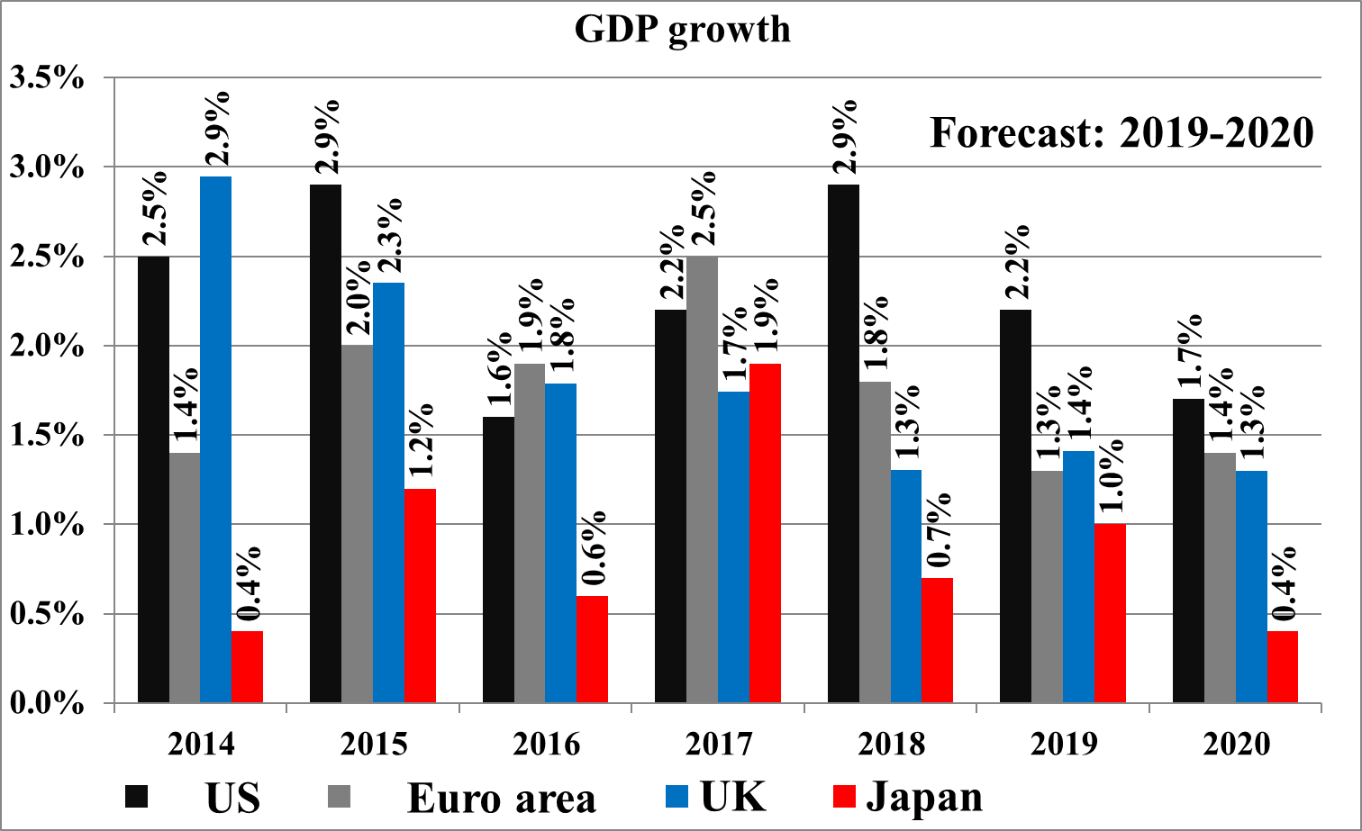
Global economic growth
The Euro Area grew above potential in 2017-2018; US growth benefited from tax cuts in 2018; the UK is struggling with BREXIT uncertainty; Japan’s growth has been supported by widespread policy steps. Growth is now slowing down.
Source: Leumi forecasts

Slide 4
The latest figures and the outlook indicate a substantial slowdown in export growth in most regions

Slide 5

Risks have risen
Source: Economist Intelligence Unit

Slide 6
The US population

Slide 7
US population
US population: close to 330 million, but the growth rate is slowing sharply
Age dependency ratio, old, is the ratio of older dependents--people older than 64--to the working-age population--those ages 15-64. Data are shown as the proportion of dependents per 100 working-age population.

Slide 8
US population
US population: the birth rate has fallen; the median age is rising; life expectancy has declined a bit; and prime working age population growth has slowed
Source: Reuters

Slide 9
US population
US population: ongoing aging
Source: Bureau of Labor Statistics

Slide 10
The US national accounts

Slide 11
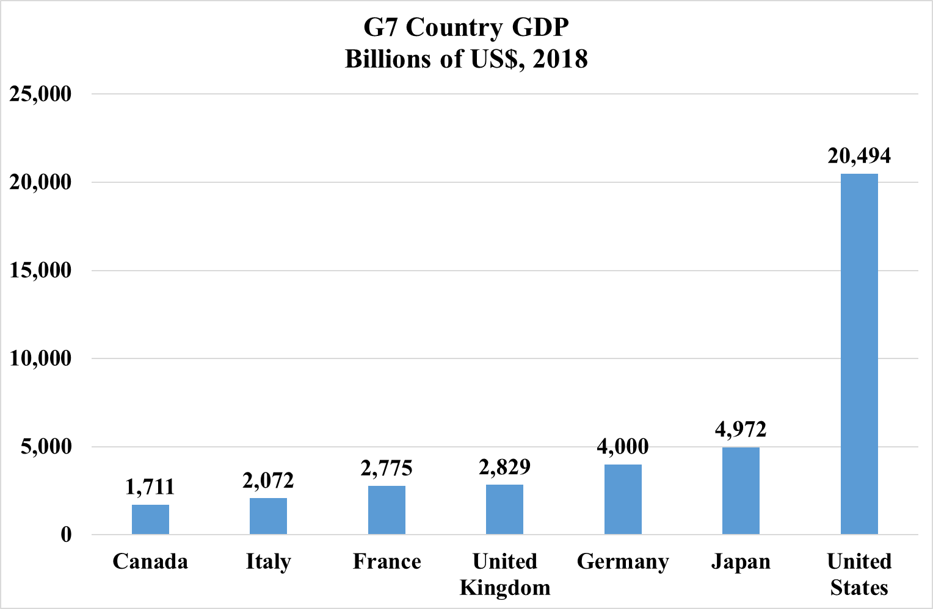
US GDP
Among the G7 countries, the GDP of the US is the largest
Source: IMF

Slide 12
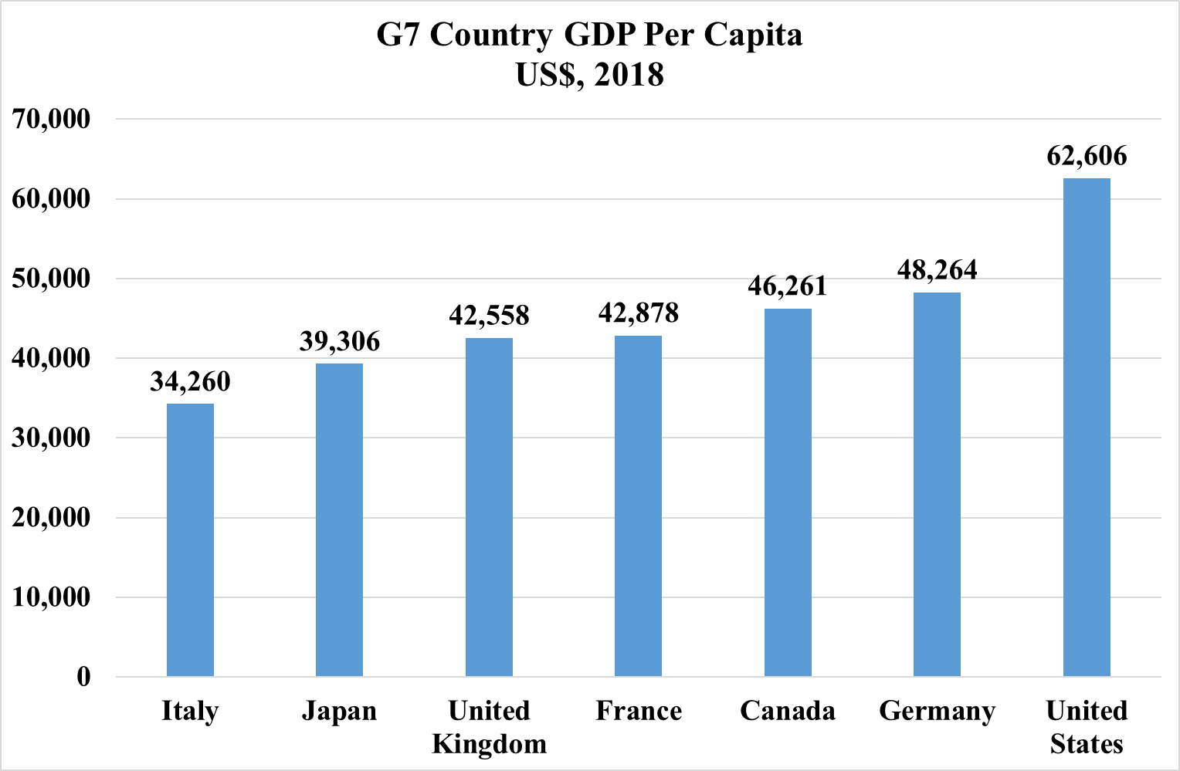
US GDP
Among the G7 countries, the GDP per capita of the US is the highest
Source: IMF

Slide 13
US GDP by state
Millions of US$, GDP, all industries, 2017 data
“Very large”
“Small”
Source: BEA

Slide 14
US GDP growth by state
“Large”
“Small”
Per capita GDP growth, %, 2016-2017
“Large”
“Small”
Source: BEA

Slide 15
Trends in unemployment by county

Slide 16
US GDP composition
Source: The World Bank

Slide 17
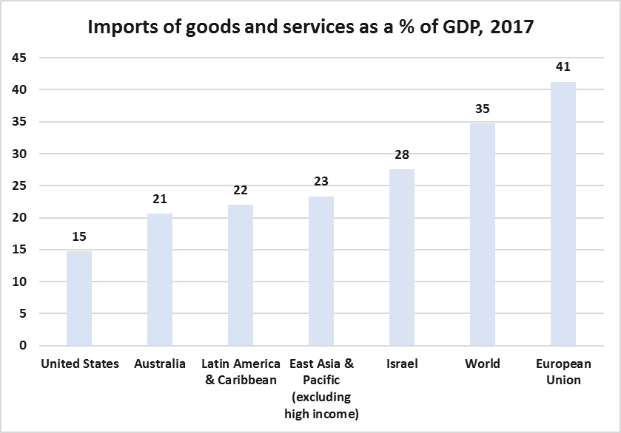
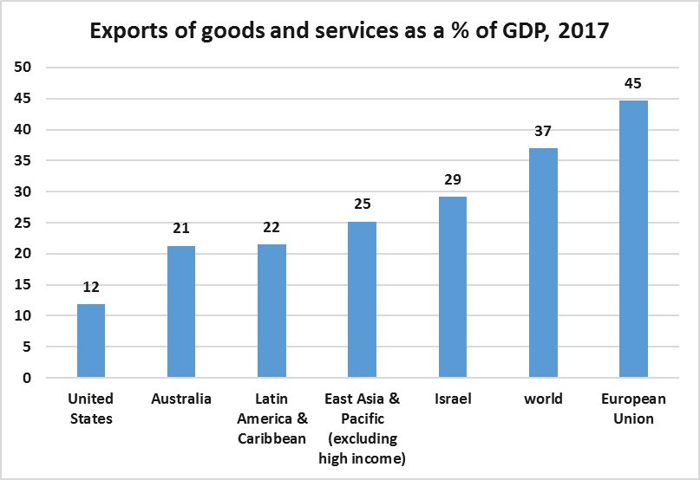
US GDP composition
The share of foreign trade in US activity is relatively small; the US runs an import surplus
Source: Central Bureau of Statistics and the World Bank

Slide 18
US GDP growth
Private consumption remains the largest contributor to growth; Net trade has been a drag on growth; Investments have grown moderately
Source: Reuters

Slide 19
US GDP growth
The US is heading towards full employment and is likely to slowdown in 2020
Source: Reuters

Slide 20
US industries
The digital economy is growing rapidly

Slide 21
US industries
The US service sector industries – finance, business, health, education information -- are the largest contributors to GDP.

Slide 22
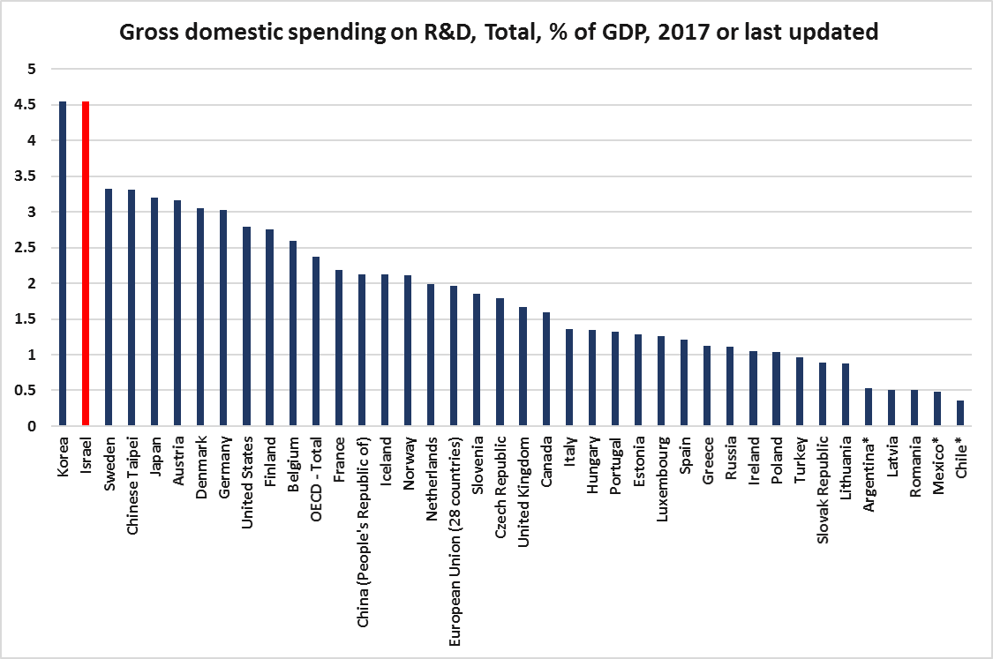
US industries
The US has a relatively high level of civilian R&D as a percentage of GDP

Slide 23
US fixed asset investment
Investments have shown a rebound, primarily due to renewed investment in technology, mining and drilling
Source: Reuters

Slide 24
US fixed asset investment
Productivity growth is getting a boost from investments in IP, IT, AI, software, machinery and equipment

Slide 25
US fixed asset investment
While public infrastructure investments have recovered since the 2008-9 drop, they have just now returned to their pre-crisis levels

Slide 26
Residential construction
Unlike the 2007-2009 crisis, there is good balance between household creation and housing starts
Source: Reuters

Slide 27
US housing / demographic balance
Homeownership is rising from a record low level and this can generate demand; the focus is likely to be on average/below average priced, pre-owned, units

Slide 28
US gas and oil
The US has seen a massive increase in its energy production and exports in recent years

Slide 29
US gas and oil
The US has seen a massive increase in its energy production and exports in recent years

Slide 30
US gas and oil
The US is releasing oil from its “Strategic Petroleum Reserve” (SPR), as part of its progress towards energy independence and as way to counteract the impact of its sanctions on Iran and Venezuela

Slide 31
The US job market

Slide 32
The main components of labor market statistics
Population, work force, employment, unemployment
Total population: 327.2m (2018 data)
Working age population – 16 year and older, non-institutional, civilian population: 257.8m
Percentage of population in the working age: 78.7%
The civilian work force, includes those that are either employed or actively seeking employment: 162.1m (2018)
Work (labor) force participation rate = work force/working age population = 62.9% (2018).
Unemployed: the part of the work force that is not employed – 6.3m (2018 data).
The (civilian) unemployment rate: unemployed as a percentage of the work force: 3.9% (2018).

Slide 33
US job market
The participation rate declined in 2009-2014. Growth requires skilled labor, modern machinery equipment and ongoing productivity growth. Age structure and demographics could lead the overall participation rate further downwards
Source: Reuters

Slide 34
US job market
Participation has risen in the 25-54 age group, but remains low in the 55+ and 16-24 groups.

Slide 35
US job market
Age structure and demographics could lead the overall participation rate further downwards
Source: Reuters

Slide 36
US job market
Age structure and demographics could lead the overall participation rate further downwards
Source: Reuters

Slide 37
US job market
Employees find it relatively easy to look for better jobs
UNDEREMPLOYMENT: Millions of discouraged and part time workers
Source: Reuters
Indicators other than the headline measure of unemployment continue to point to a substantial degree of labor market slack – the U-6 measure, for example which counts discouraged workers, those who are described as marginally attached, and those working part-time who would prefer to work full-time in addition to the unemployed, rose sharply as the recession hit. The gap between the broader U-6 measure, sometimes referred to as a measure of ‘underemployment,’ and headline unemployment has yet to close in any meaningful sense.

Slide 38
US job market
Part time employment could indicate that the market is not yet at full employment yet….but it is getting there

Slide 39
US job market
Small business “jobs hard to fill” could indicate that the market is moving towards “full employment”
With the current unemployment rate so low, firms may have no choice
but to invest in labor-saving capital equipment in order to meet underlying
demand while maintaining their profit margins.

Slide 40
US job market
Wage growth is substantially lower than in past cases when unemployment was at 4-5% or less. What could the consequences of better productivity be for wages, the job market and corporate profitability?
Source: Reuters

Slide 41
US job market
Nominal wage growth=3.0-3.5%; real wage growth=1.0-1.5%; GDP per work hour is growing by 1.7%. Are firms overpaying?
Source: Reuters

Slide 42
US job market
Nominal wage growth=3.0-3.5%; real wage growth=1.0-1.5%; but unit labor cost growth has been slowing due to an increase in productivity, which is good for corporate profitability
Source: Reuters

Slide 43
US job market
What are the expected employment trends, by industry?

Slide 44
US job market
What are the expected employment trends, by industry?

Slide 45
The US fiscal picture

Slide 46
US fiscal spending and revenues
Most of the government’s spending is on:Education, Training, Employment, and Social Services, Health, Medicare, Income Security, Social Security, Defense and Interest

Slide 47
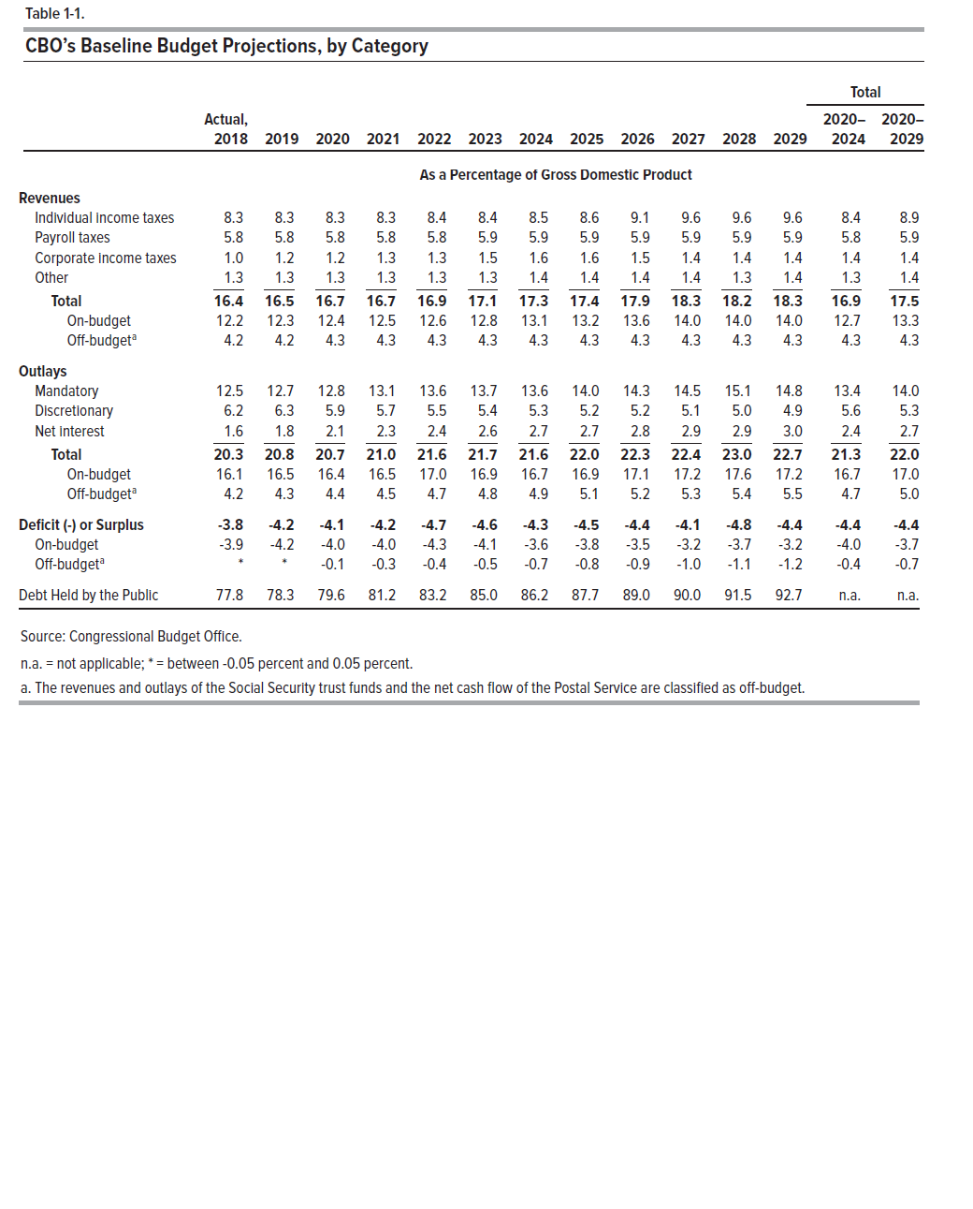
US fiscal figures and projections

Slide 48
US fiscal figures and projections

Slide 49
US fiscal figures and projections
Source: CBO, The Budget and Economic Outlook: 2019 to 2029

Slide 50
US taxation
Most of US government tax revenue comes from individuals and wages

Slide 51
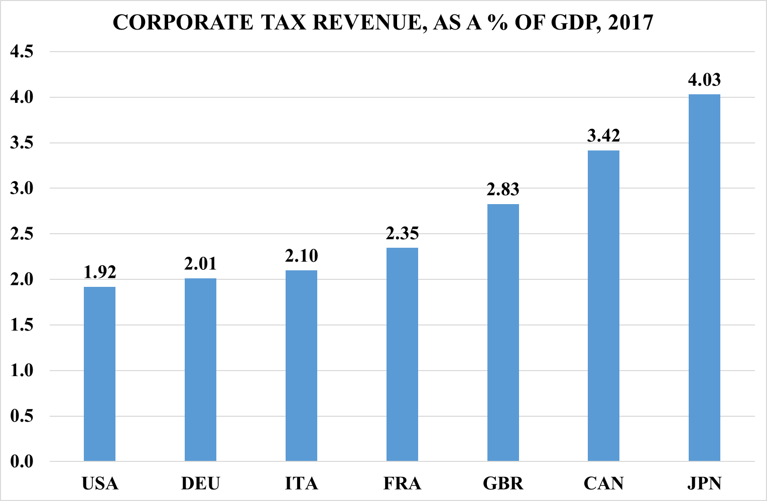
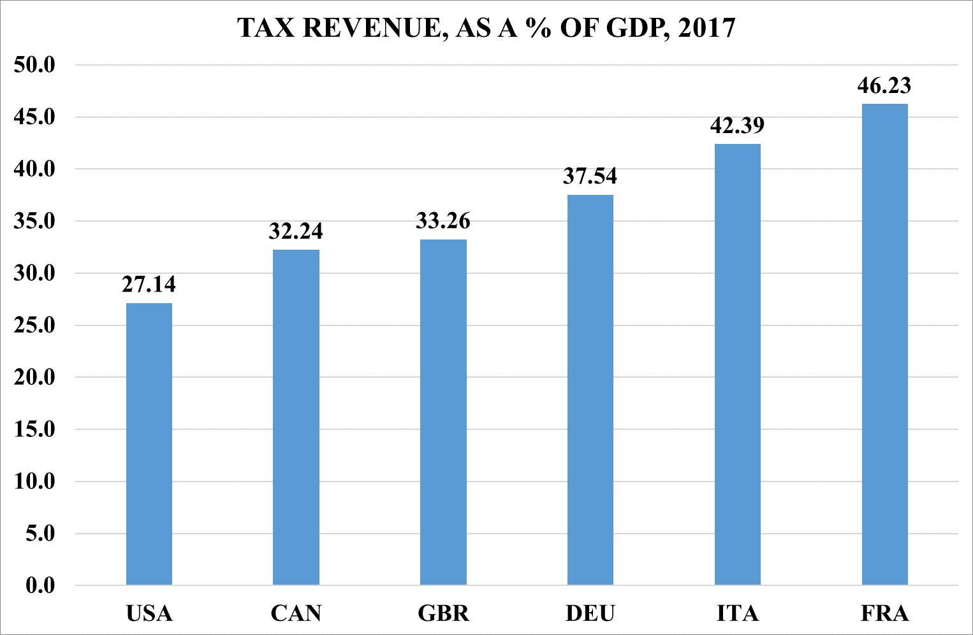
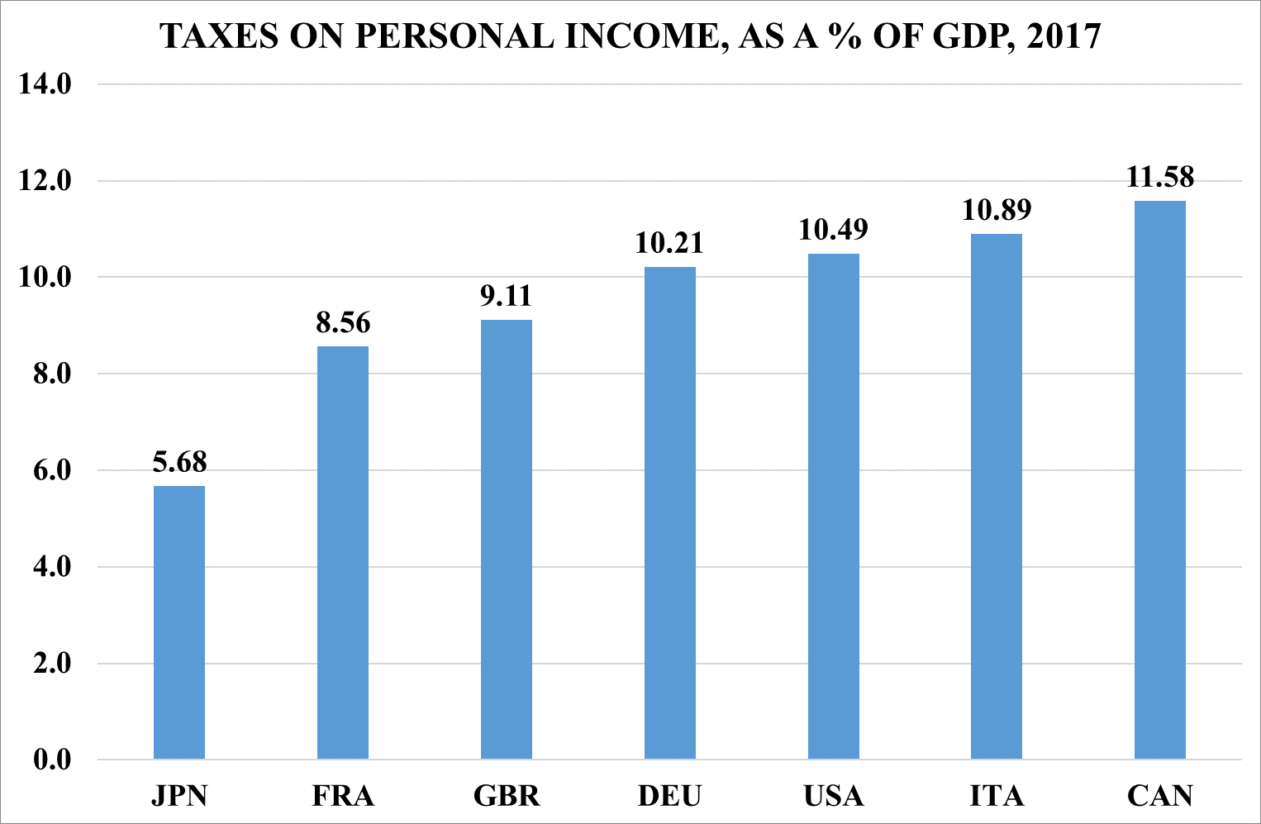
US taxation
Where is the problem? Tax rates or the tax system?
Total taxation: Federal, State, County, City and others
Source: OECD

Slide 52
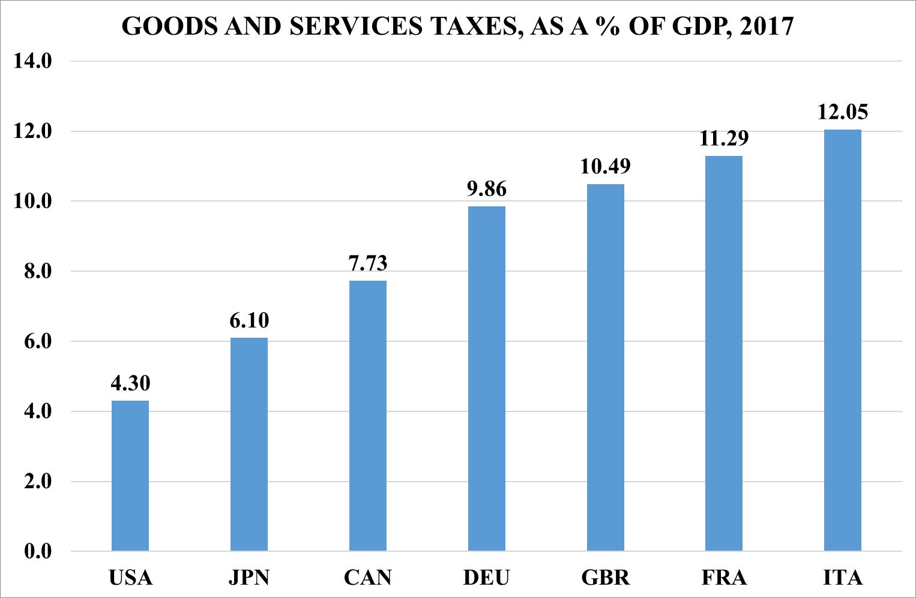
US taxation
Where is the problem? Tax rates or the tax system?
Source: OECD

Slide 53
US taxation
The Tax Cuts and Jobs Act (2018), main items:
Lowers most individual income tax rates, including the top marginal rate from 39.6% to 37%.
Limits or eliminates a number of deductions.
Lowers the corporate income tax rate permanently to 21%, starting in 2018.
Allows full and immediate expensing of short-lived capital investments for five years.
Limits the deductibility of net interest expense.
Repatriation of currently deferred foreign profits, at a rate of 15.5% for
cash and cash-equivalent profits and 8% for reinvested foreign earnings.
Doubles the estate tax exemption from $5.6 million to $11.2 million.

Slide 54
The US balance of payments

Slide 55
The US has a relatively large trade deficit and a moderate services surplus
Notes:
54

Slide 56
The US has a relatively large trade deficit and a moderate services surplus
Notes:
55

Slide 57
The US has a current account deficit that is primarily with Asia and Pacific countries
Notes:
56

Slide 58
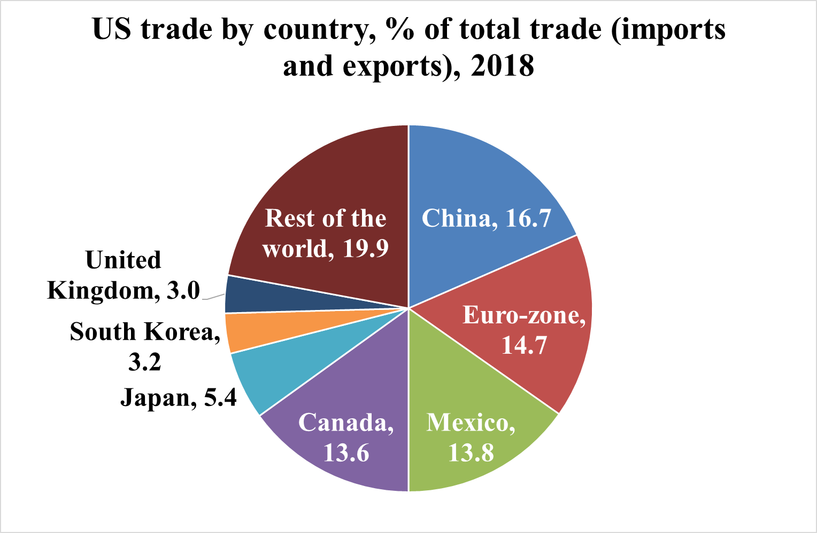
China and USMCA are major trading partners
Total trade in goods = US$4.2trn (US$1.6trn-exports and US$2.5trn-imports)
Source: Bloomberg, IMF and Leumi calculations
Notes:
57

Slide 59
Source: OECD and Leumi calculations
Notes:
58

Slide 60
China is the United States' 4th largest goods export market. China is the United States' largest supplier of goods imports. The US has a large goods trade deficit with China.
Notes:
59

Slide 61
Source: OECD and Leumi calculations
Notes:
60

Slide 62
China is a major trading partner; The US has a large trade deficit with China, but enjoys a surplus in services
Source: Leumi calculations
Notes:
61

Slide 63
China is a major trading partner; The US has a large trade deficit with China, but enjoys a surplus in services
Notes:
62

Slide 64
U.S. exports of services to China: travel, intellectual property (trademark, computer software) and transport sectors. U.S. imports of services from China: transport, travel, research and development sectors.
Source: Leumi calculations
Notes:
63

Slide 65
Which countries might benefit from a shift of manufacturing from China elsewhere?
Source: Leumi calculations
Notes:
64

Slide 66
The “trade war” has been detrimental to US exports to China, primarily in the areas of agricultural and energy exports
Source: Leumi calculations
Notes:
65

Slide 67
US services export destinations: Canada, UK, EU, China
Notes:
66

Slide 68
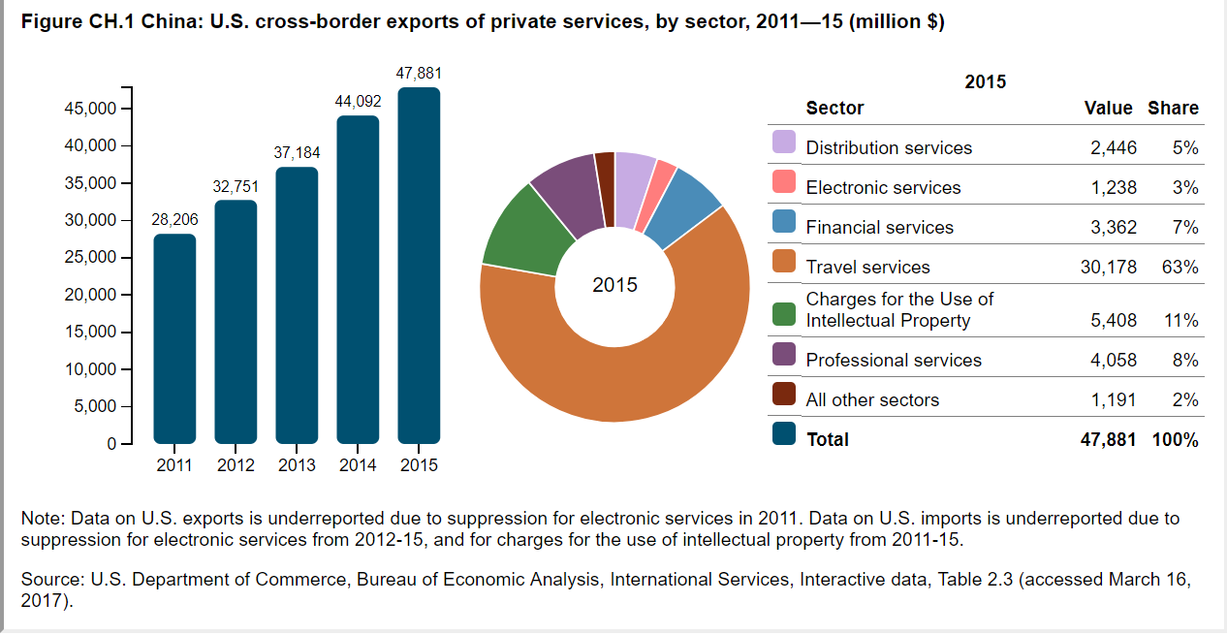

Slide 69
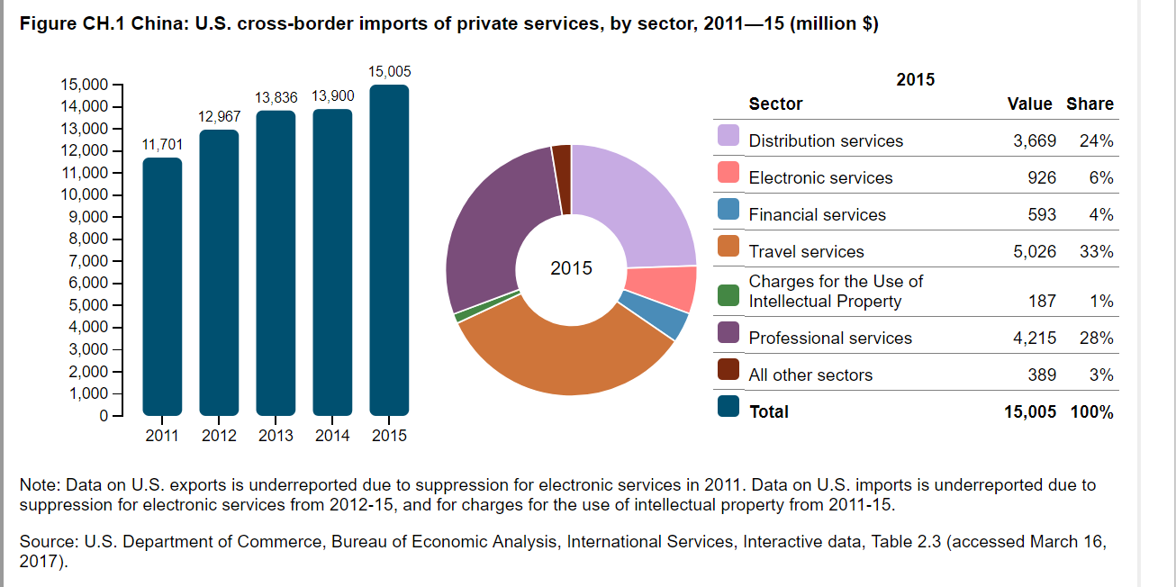

Slide 70
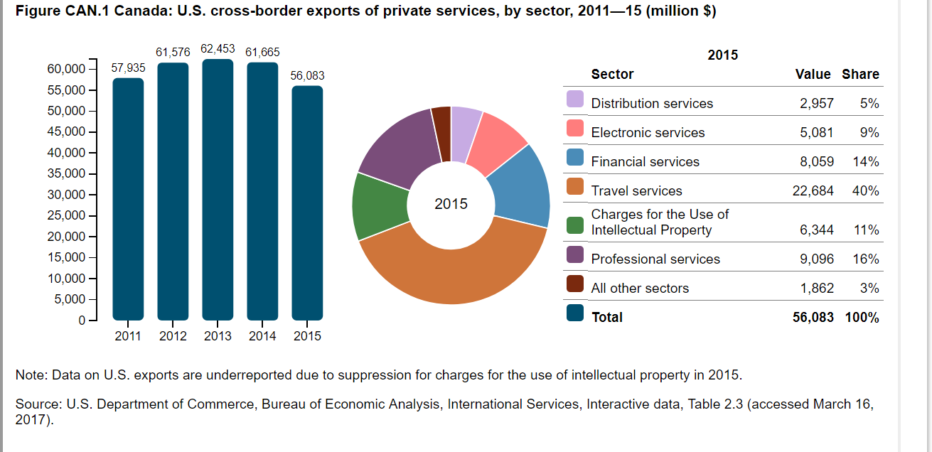

Slide 71


Slide 72
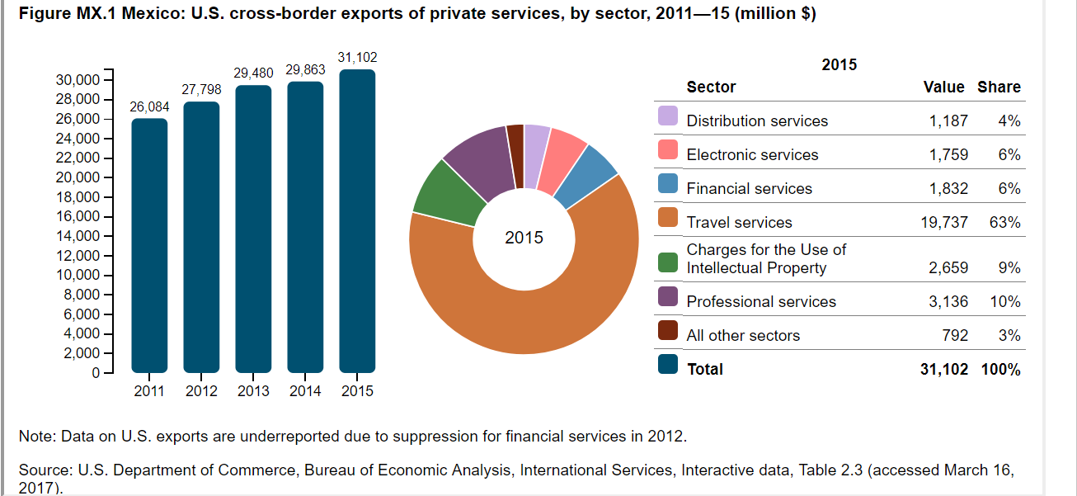

Slide 73
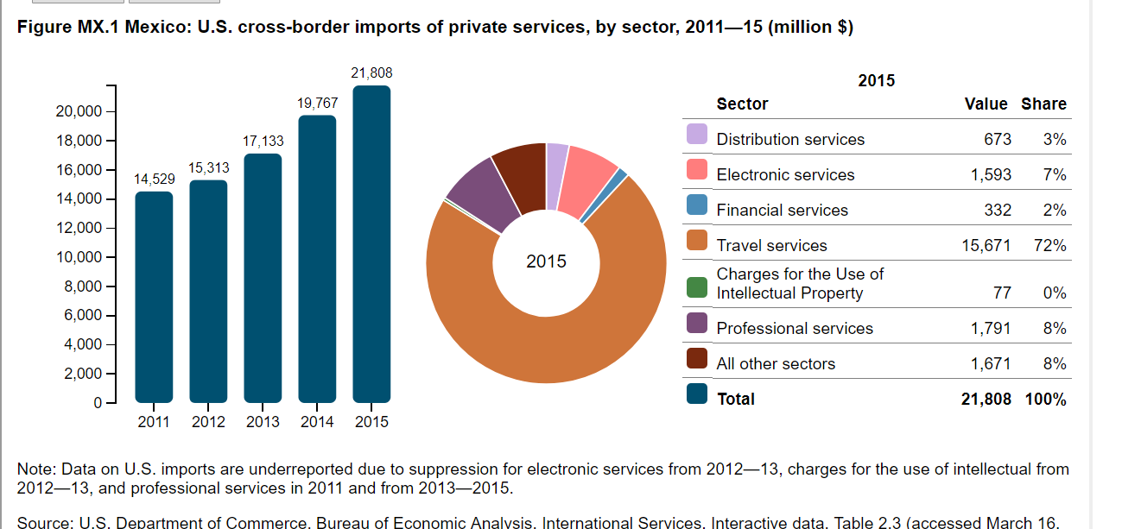

Slide 74
Monetary policy and interest rates

Slide 75
Inflation
Inflation normalization is leading to monetary policy normalization

Slide 76
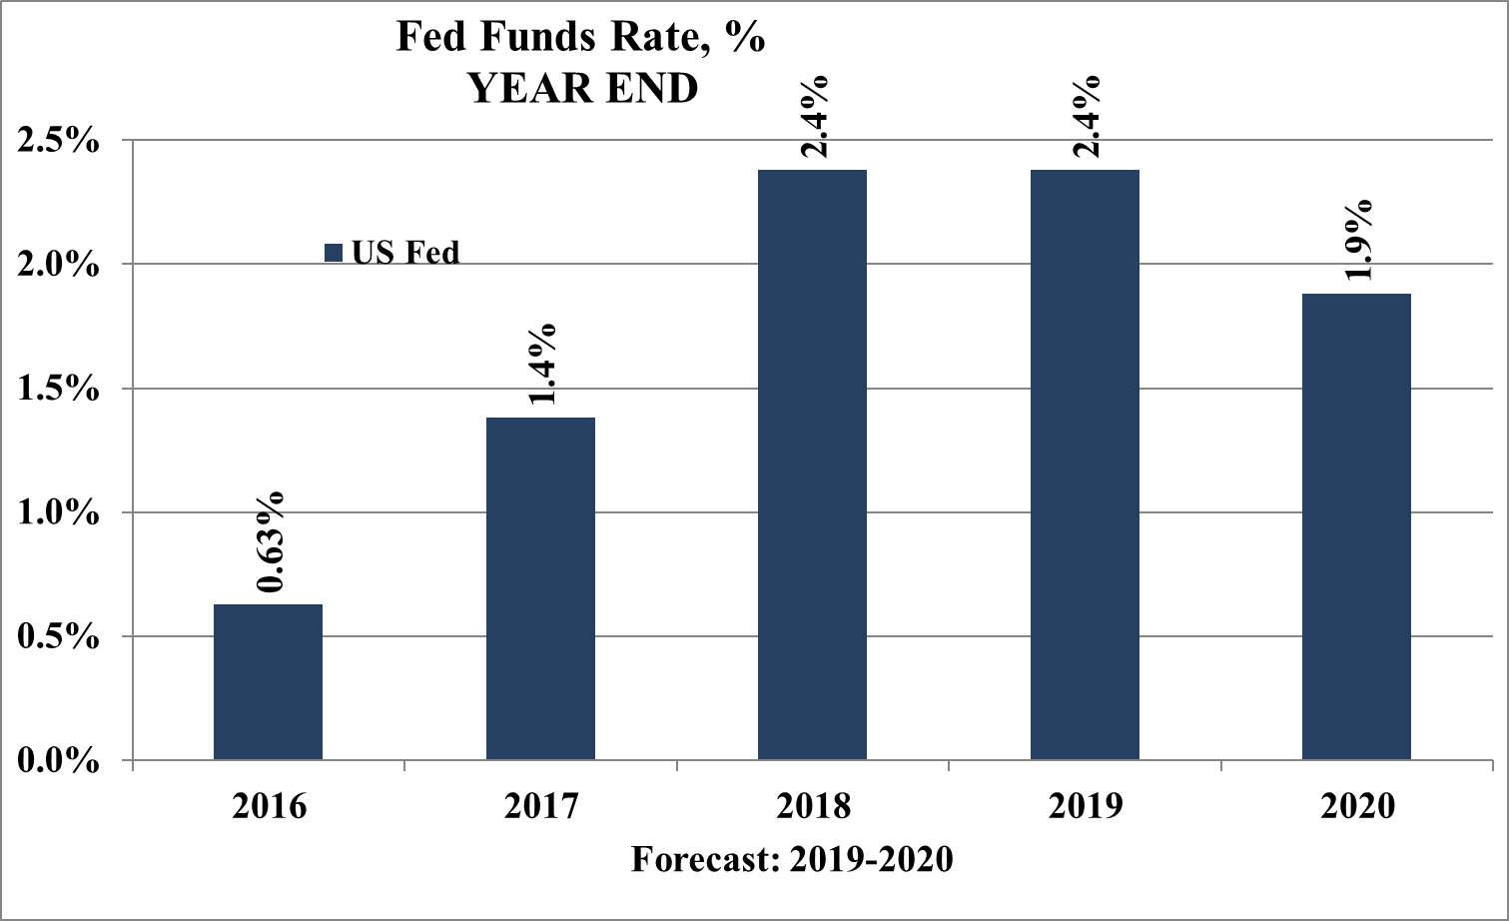
Central bank rates
Divergent monetary policy trends among the leading central banks
Source: EIU

Slide 77
Money and credit
US corporate debt has been rising quickly

Slide 78
Money and credit
US corporate debt has been rising quickly

Slide 79
Disclaimers
Bank Leumi USA (BLUSA) is a subsidiary of Bank Leumi le-Israel, B.M., an Israeli bank founded in 1902. In the U.S., banking products and services are provided through BLUSA, and brokerage products and services are provided by Leumi Investment Services Inc (LISI). LISI is a member of FINRA (www.finra.org) and SIPC (www.sipc.org), and is a wholly-owned subsidiary of BLUSA.
Non-deposit investment products offered through Bank Leumi USA and LISI are:
  Not insured by the FDIC or any other federal or government entity
  Not guaranteed by BLUSA, Bank Leumi le-Israel, B.M., or any other bank
  Subject to investment risks, including possible loss of the principal amount invested
All investors must carefully consider the risks, charges, fees, and expenses, review the prospectus or other offering information if applicable, and consider their personal financial situation and tolerance for risk before making any investment. If the information discussed in this communication concerns insurance, emerging markets, structured products, or other securities or securities-related product sold by or through LISI or BLUSA, please go to www.leumiusa.com/disclosures for possible additional important disclosure information concerning the product or service.

