Slide 1
Why the last always at the end?

Slide 2
استراتيجية حماس
Hamas' strategy

Slide 3
חזון - رؤية
The establishment of a Palestinian Islamic state from the Jordan River to the sea with Jerusalem as its capital

Slide 4
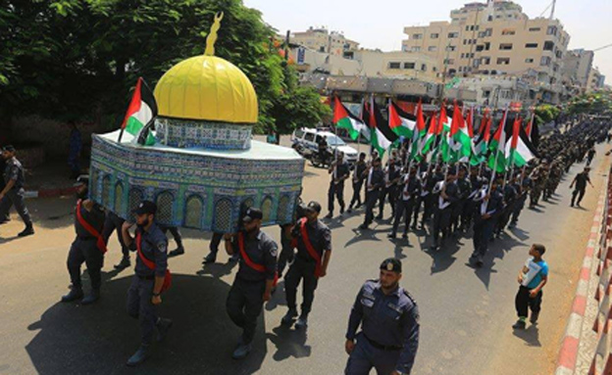
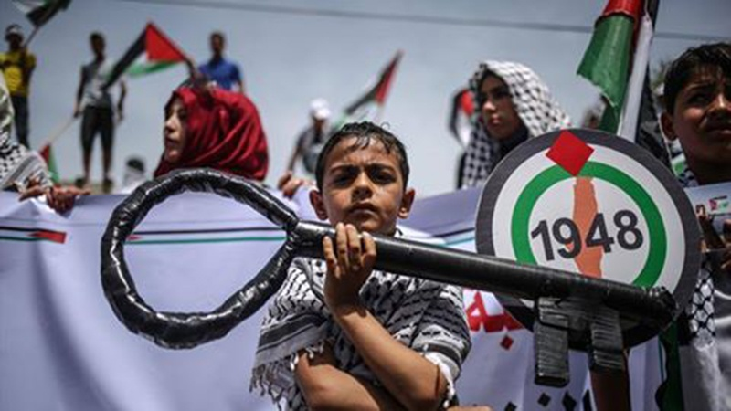
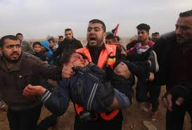
Principles مبادئ
Palestine belongs to the Palestinian people - Israel stole it from us and has no right to it! We will not give up until its full liberation!
Beit Al-Maqdas (Jerusalem) is entirely part of the Palestinian people
The right of return of the Palestinian people - a natural, individual and collective right of anyone who has been expelled since 1948
The Zionist entity is robber, aggressive and colonialist! Hamas does not recognize the Zionist entity!
The makama (resistance) is our natural right, we choose how and when to activate it!

Slide 5
Threats
The loss of control in Gaza (unlike the regime)
A heavy weapon
Damage to influence in the West Bank
PIJ and Salafis
The loss of legitimacy as the leader of the resistance / protector of the people

Slide 6
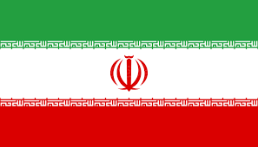
الخريطة المعرفية
Negotiations
interesting's

Slide 7
حدود النظام

Slide 8
Offset - relevance gap
Was formed ...
While we focused on...
Transition from the idea of control over the Palestinian nation through the rule of Gaza
The economic segregation in Gaza and the fear of declining support among the Palestinian public and the irrelevance of external negotiations
West Bank residents are cut off
The establishment of power
Economic strangulation
Deterrence against Israel
Humanitarian crisis
The Hamas headquarters
Lack of relevance as an actor
The Century Plan (pro-Israel))

Slide 9
إمكانية
Positive potential | Negative potential
Maintaining principles / interests | The loss of actual control over the Gaza Strip
(De facto) recognition of Hamas' military force | The loss of military might
To present achievements to Palestinian public opinion | A broad campaign with Israel
Liberated Shalit | Detention in Judea and Samaria
Release the siege from Gaza | The humanitarian crisis is out of control
Legitimate political consolidation in the West Bank | Undermining the legitimacy of the Palestinian people
Oppression or annexation of the PIJ Suppression of the Salafis | Armed outbreak of the PFLP / Salafis, risk of control
Removing Hamas from the terrorist list | Egypt is not mobilized
A jumping-off point for the future realization of the vision | Disengagement from Iran

Slide 10
Goals on / Victory image
Hezbollah model:
Maintaining physical control of Gaza (not necessarily a government)
Maintaining the main weapon and positioning the shields of the Palestinian people
A legitimate political establishment in Judea and Samaria and entry into the government apparatus in Ramallah: parliament, government, security apparatuses, responsibility for the civil burden for the PA / unity government
Creating achievements seems to benefit the public
Achieving economic and humanitarian relief in Gaza
Breaking the Siege
Removal from the list of terrorist organizations
Without giving up (certainly not in a statement) the principles of movement or vision
A jump position for the future realization of the vision (Hezbollah model)

Slide 11
Intermediate goals (achievements in exchange for negotiations)
cash
Economic relief
Water and sewage
energy
health
Borders and transitions
Education
Inmates
a detailed list

Slide 12
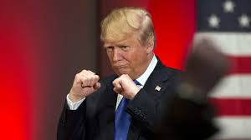
Israel negotiations
Israel negotiations
accomplishments:
Weapon
Street?
Removing a siege
"Hezbollah model "/ a large Hamastan
accomplishments:
Weapon
Street
Removing a siege
Status quo:
time
Weapon
Street
Israel negotiations
"חמסטאן קטן"

Slide 13
campaign
Stage | Communication | Political | Military | Desired outcome
A false consciousness creation | The publication of Hamas policy, and the principles of Hamas by a press release Gaza under siege - the water problem A cartoon about Trump. Posters for demonstration. | Invitation to Egypt meeting, requirements: The Cairo Agreement Rafah crossing Nothing will advance without a dialogue with us. A firm stance against compromise - a call to Abu Mazen to be strong | A call for the millionth demonstration in Gaza and Judea and Samaria to support Palestine, against the agreement, the Temple Mount, on Friday. Demonstrations on the Gaza fence and demonstrations in Judea and Samaria. PIJ / Lightning / Ministry of Defense / Fence. | Egypt is coming to the meeting. Broadcast opposition to the agreement and difficult to achieve.
B The PA cooperates | The difficulties of the siege. Manipulations to Negotiations - A Video on Weapons | Negotiations for a reconciliation agreement based on the reconciliation paper. Commitment to transparency and partnership. Salaries, A commitment to place the closure as a precondition. | Continued demonstrations in the West Bank and Gaza. | Reconciliation Agreement

Slide 14
campaign
Stage | Communication | Political | Military | Desired outcome
stage B' The PA is not cooperating | Alacce. PA corruption Dahlan The blackening of Abu Mazen | Exerting pressure through the Egyptians | Military escalation, rocket fire, attacks in Judea and Samaria. Fence operations in the Gaza Strip. | Return to reconciliation talks.
third' Total disregard | There is no agreement without elections Ferment in Cairo. Communicate the attacks The intensification of messages, an emphasis on channeling the military effort. | Operation of pressure through Egypt, Turkey, Russia. A complaint that there is no democracy - for the whole world. | Suicide bombings A kidnapping event in Judea and Samaria Firing dozens of rockets | A return to reconciliation or small Hamastan talks with Israel or a full explosion.

Slide 15
Principles for a reconciliation agreement
A temporary Palestinian national unity government would be formed, composed of professionals and without politicians
The establishment of an agreed committee to prepare general elections to be held within a year. The elections will be held by the legislative branch and the Palestinian National Council and the presidency
Both sides undertake that even after the elections, a Palestinian national unity government will be established in Yesha
Ratification and signing of significant agreements for the life of the entire Palestinian people will be made after the elections
Uniting the Bodies Towards the Establishment of the State of Palestine:
Hamas' integration into the PLO
The unification of Palestinian institutions in Gaza, the West Bank, and Jerusalem
Security: Keeping the security in Gaza and the West Bank in common coordination and according to the division of forces that exists today. Subsequently, a joint supreme council for security coordination was established.
The release of all political prisoners by Hamas and the PA
A joint demand for the immediate lifting of the blockade of the Gaza Strip as a condition for any progress in the settlement.
Hamas as an organization will not recognize the Zionist entity, but will respect the Hudna as long as the agreement is respected by the parties.

Slide 16
Principles for a separate Hudna arrangement
Hamas will stop the violence and stop the campaign "March of return" for Israeli concessions in the area of ​​the blockade, Egyptian concessions in the area of ​​opening the Rafah crossing and the entry of goods from Egypt and Arab and international assistance massive rehabilitation of the Gaza Strip.
All parties (Israel, Egypt, Hamas, Qatar, the UN) must be involved and agree to such a "regulation."
After two months of Skt- promoting long-term truce called "truce" on the one hand not require Hamas to fire into Israel, to hide the arsenal of rockets, not to dig tunnels and calm the fervor, on a quiet two-give Hamas security and limit the IDF response to the intensification Hamas' military force in the tunnels, rockets and the development of its new weapons.
It will also enable Hamas to recover from its current distress and strengthen its military strength, to restore the humanitarian crisis in Gaza and to reap the fruits of success in the Palestinian public.

Slide 17
tools

Slide 18
Work according to a flowchart
Operation of others (attacks, demonstrations, awareness campaigns)
Activating "agents" to push reality into a desirable situation (such as abducting a soldier)
Manipulation between Turkey and Egypt
The quiet operation of Iran and Turkey
The PA rim on the basis of past closures (with the understanding that not everyone learned the details)
A lot of futile threats and a conscious campaign (creating a false consciousness of a threshold in the bud - "hold me back")
Pre-preparation of a large bank of media per possible script

Slide 19
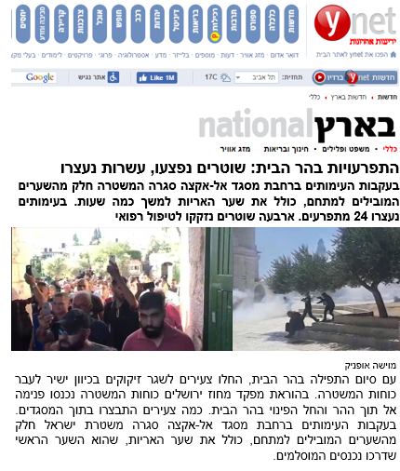
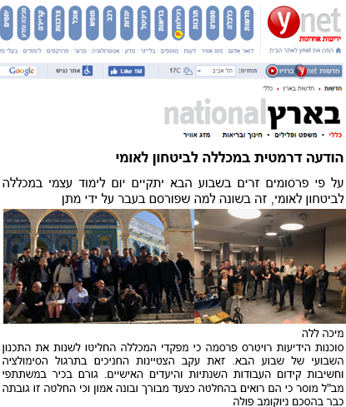
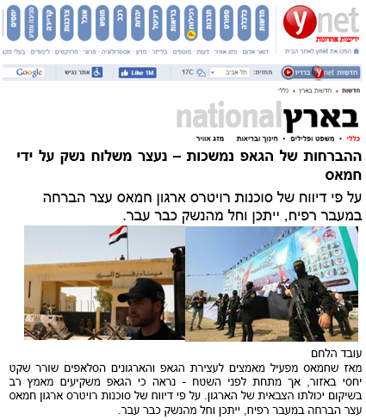
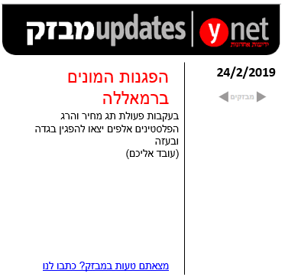
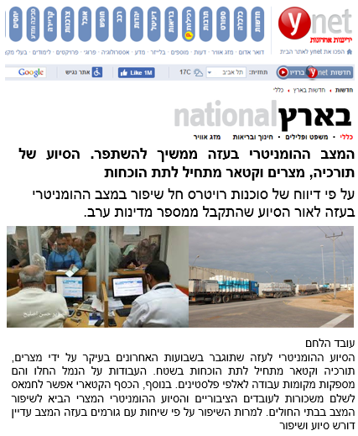
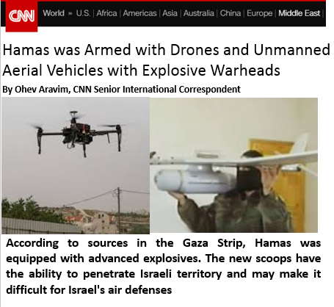
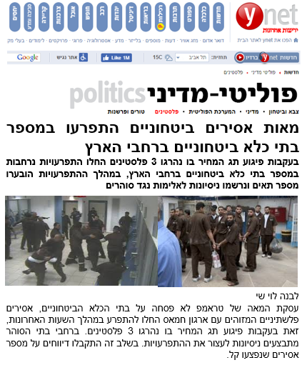
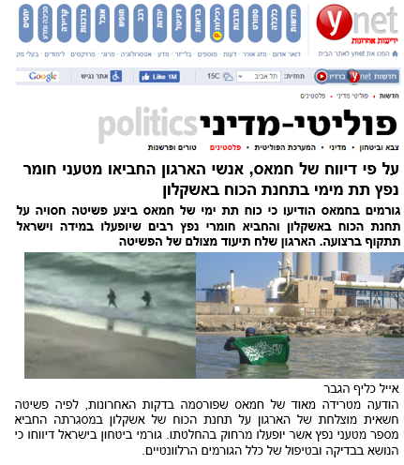
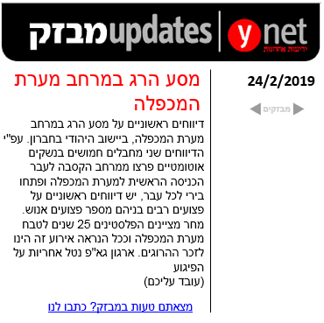
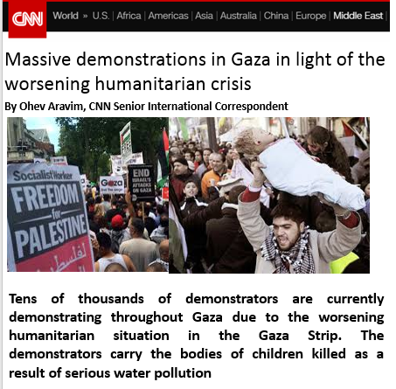

Slide 20
Results

Slide 21
إمكانية
Positive potential | Negative potential
Maintaining principles / interests | The loss of actual control over the Gaza Strip
(De facto) recognition of Hamas' military force | The loss of military might
To present achievements to Palestinian public opinion | A broad campaign with Israel
Released Shalit? | Detention in Judea and Samaria (partial, released)
Release the siege from Gaza | The humanitarian crisis is out of control
Legitimate political consolidation in the West Bank | Undermining the legitimacy of the Palestinian people
Oppression or annexation of the PIJ / Salafists | Armed outbreak of the PFLP / Salafis, the risk of control
Removing Hamas from the list of terrorism (a political arm) | Egypt is not mobilized
A jumping-off point for the future realization of the vision | Disengagement from Iran

Slide 22
Hamas, a political achievement
We kept all the principles
The agreement does not contain concessions that contradict the Hamas charter
Under the Cairo agreement, on the way to elections
All the concessions - by permission, we pushed for what is important to us
We are part of the Palestinian Authority
Spoke to us in practice - everyone (including the United States, despite the law)
Our weapons
Hamas' political wing has been recognized
Good relations with Egypt
A siege was actually lifted (Rafah, seaport)

Slide 23
Interim goals achieved in the negotiations

Slide 24
The Rafah crossing is open
Transfer of antibiotics from Iran
Turkish / Egyptian desalination plants
Turkey: 20 mm of resistance in secret (monthly)
25 MD from Qatar (monthly)
Massive humanitarian aid from Egypt, including extensive medical,
Rafah
Qatari money
Maritime Port in Gaza (Turkey)
Israel-PA Agreement: Upgrading Medical Treatment, Work Permits, Additional Desalination Plant, Gas Reservoir, Fishing Space Doubled, Overseas Treatment Quotas

Slide 25
الله يعيننا

