Slide 1
Nice to Meet You

Slide 2
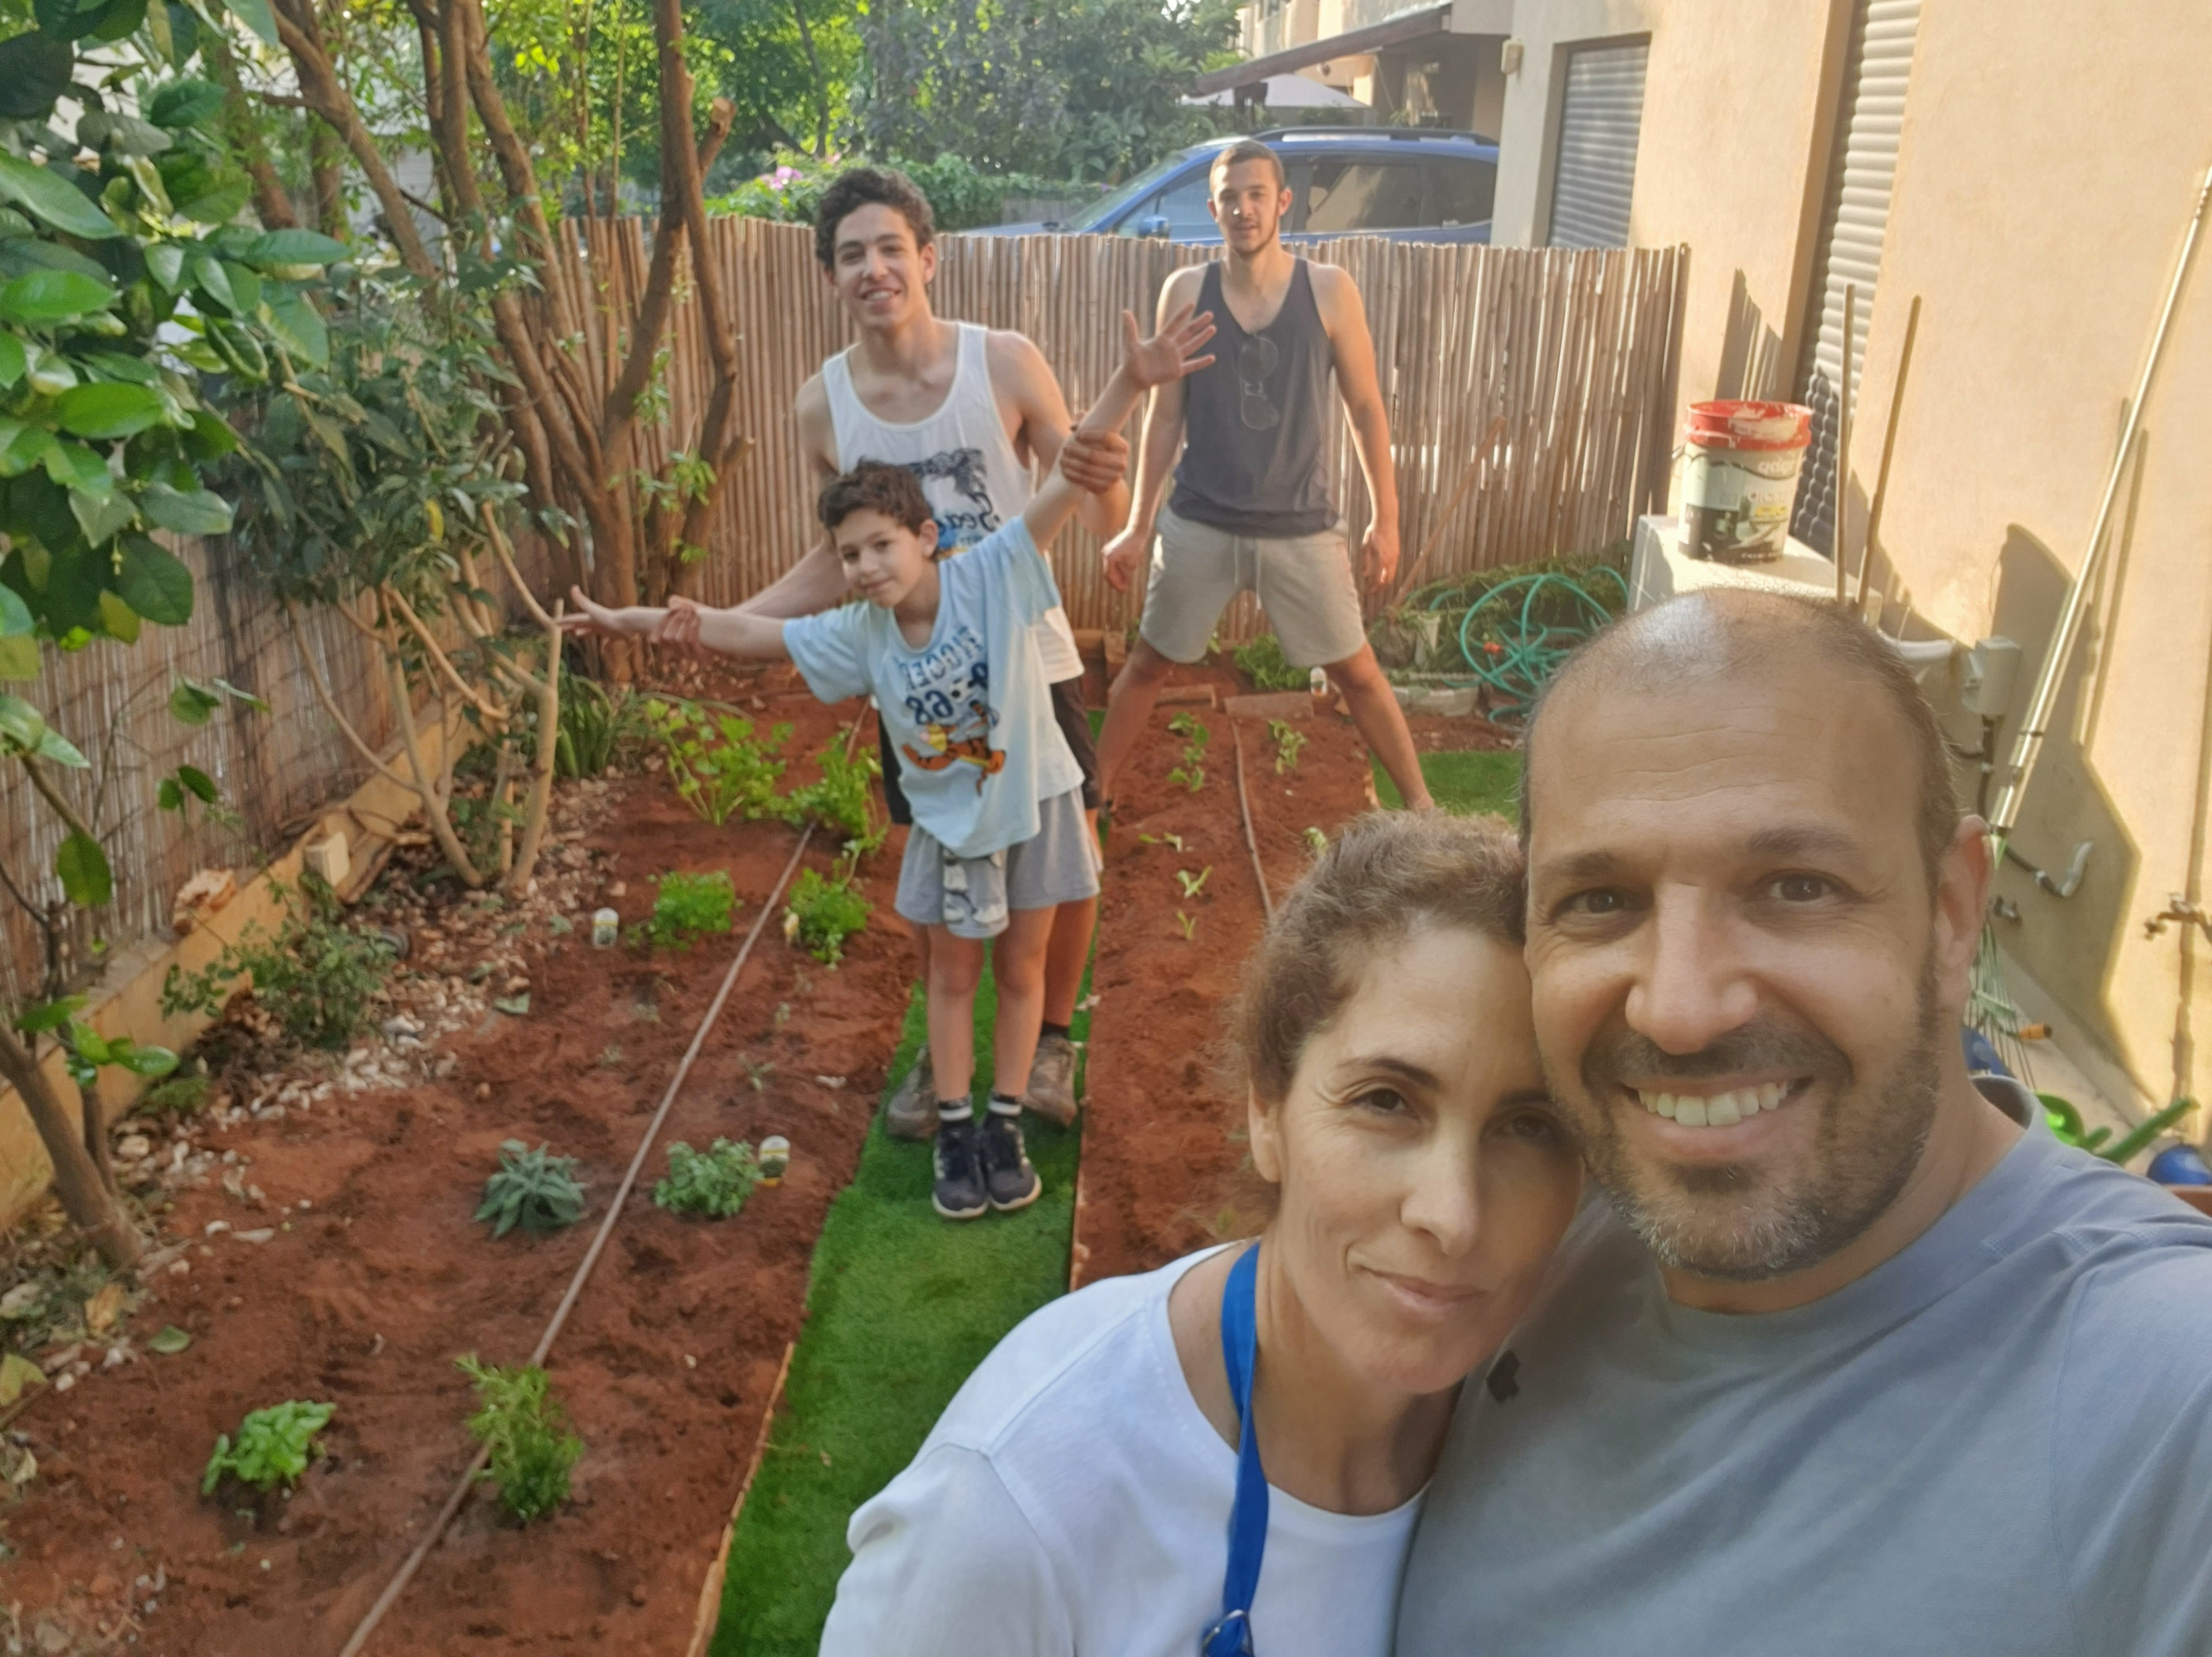

Slide 3
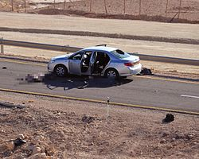
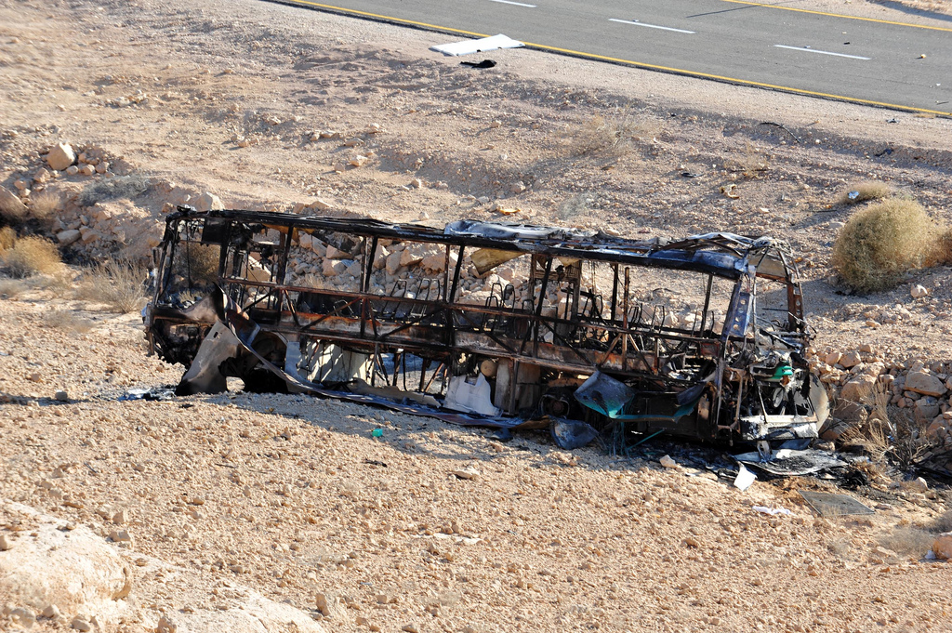

Slide 5
National Defense
Presentation of the Field of Study in the INDC Class 48
http://www.free-powerpoint-templates-design.com

Slide 6
The Field of National Defense – Class 48
Comprehensive Application in the Context of National Defense
Guest Lectures
Visits in National Defense Organizations
Strategy in the Field of National Defense
National Defense Study Tours in Israel and Abroad
.
National Defense for Seniors
Systemic View
Conceptualization and Theory
Introduction Course to Geo-strategy and Geo-politics
From the chapter on Basics and the Strategic Thought Course

Slide 7
The Technological Field
Presentation of the Field of Study in the INDC Class 48

Slide 8
The Technological Field – Class 48
 | Cyber Defense Day
 | National Cyber Defense System
 | Digital Transformation Workshop
 | Dr. Tomer Simon
 | Elective Seminar Cyber
 | Prof. Eviatar Matania
 | Digital World for Decision Makers Course
 | Prof. Danny Raz
Applied
Technology
for Seniors
Visits and Tours
Guest Lectures
Strategy
National Defense

Slide 9
THANK YOU

