Slide 1
Law Enforcement Agencies in Operational and Combat Operations
INDC
Major General Sharon Afek
Chief Military Advocate
December 2019

Slide 2
Topics
Law enforcement agencies in operational activities?
Investigation and Investigation
"Operating ratio"
The shooting incident in Hebron

Slide 3
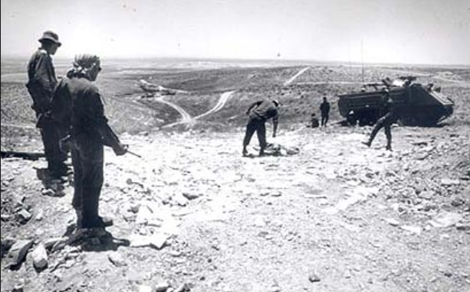
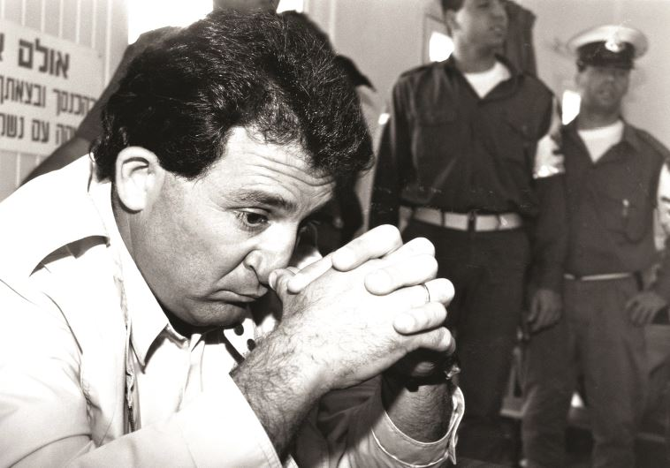
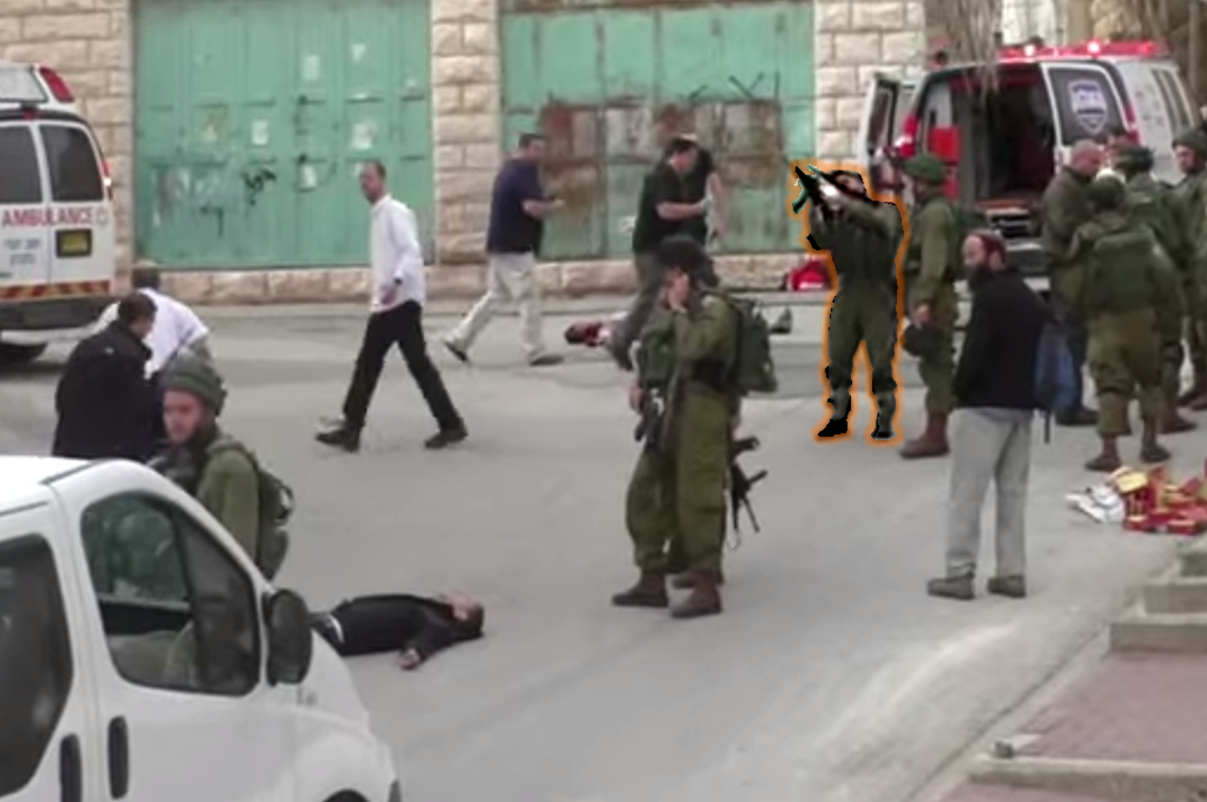
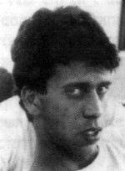

Slide 4
Brigadier General Yehuda Meir ordered the Intifada during January 1988

Slide 6
It was in military conditions and even in difficult times that the IDF managed to maintain the purity of weapons and fulfilled the obligations imposed on the State of Israel by common law ... It was in military conditions and even in difficult times that the IDF managed to maintain the purity of weapons and fulfilled the obligations imposed on the State of Israel by common law ... Even if the IDF faces a difficult task in the face of an uprising in territories where it is sometimes necessary to use force to control the order that is being violated, it is still imperative to carry out a command of this kind .... and to bring to justice those responsible for the material offence attributed to them".

Slide 7
Military Investigation
Notes:
בשיעור הקודם דנו בשאלה, למה לחקור.
והגענו למסקנה, שצריך לחקור אירועים בהם חיילי צה"ל הורגים אזרחים.
השאלה היא – איך לחקור.
בהקשר הזה יש בצה"ל שני כלים.
מהם שני הכלים?
תחקיר וחקירה.

Slide 8
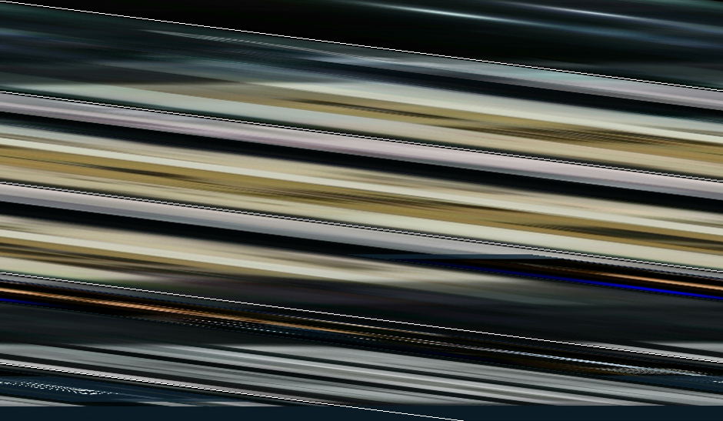

Slide 10
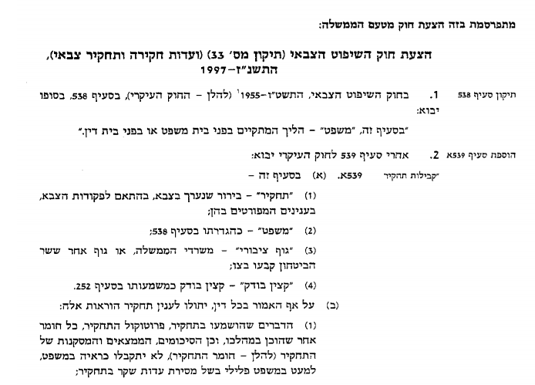
Military Jurisdiction Bill and Military Inquiry Committees – 1997
In the Military Jurisdiction Act, 1956 (, the following is added:
After section 539 if the main law, the following shall be added
In this section –
"Request" is a request made in the army, the first of army orders, on the following detailed questions:
(2) "test", as defined in section 538; (3) "public body", government ministries or another body designated by the Minister of Defence.
(4) "Auditor", by the officer in story 252.
(B) Notwithstanding anything contrary to law, the following provisions shall apply to an investigation:
(1) The things heard in the proceedings, the summary record of the proceedings, any other material produced in the proceedings, and the summary, conclusions and conclusions of the proceedings (hereinafter referred to as the proceedings, will not be admitted as evidence in the proceedings, unless false testimony is given in the proceedings).

Slide 11
Investigations
Research
Investigative Tools (Military Police Investigating)
Commanding Tool (Commanders)
Investigative Tool (Military Police Investigates in accordance with Criminal Procedure Rules
Quick, and at the commander's discretion
Evidence collection tool to clarify suspicions
A tool for learning lessons for the future
A warned investigation is “Right to Silence ."
All truth must be told
Investigative material
Total secrecy
Right of consultation and attorney representation
Without a lawyer

Slide 12
"Operating Ratio"

Slide 13
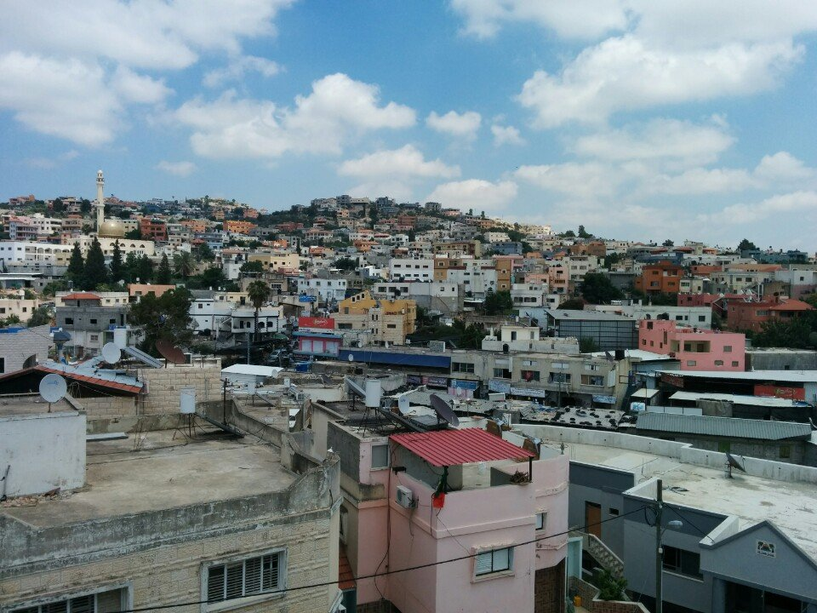
Notes:
תמונת אישה + תמונת הכפר ברטעה

Slide 14
"We must not study the actions of security forces in combat situations that pose a real risk to their lives and well-being in a way that is not related to the specific situation in which they acted.[...]
This court has often ruled that the "margin of error" should be left to police and soldiers operating in a combat or operational environment. The reason for this position is to understand that "it is appropriate to leave soldiers with a reasonable margin of error which may be due to the conditions of the place, area and time which constitute the basis of the contested operational event and require a prompt decision and lack of legal advice on what is permitted and prohibited at that point". "
Notes:
אפשר לתאר את הדברים גם באמירות בפסק דין ג'ילאני

Slide 15
The Shooting Incident in Hebron

Slide 16
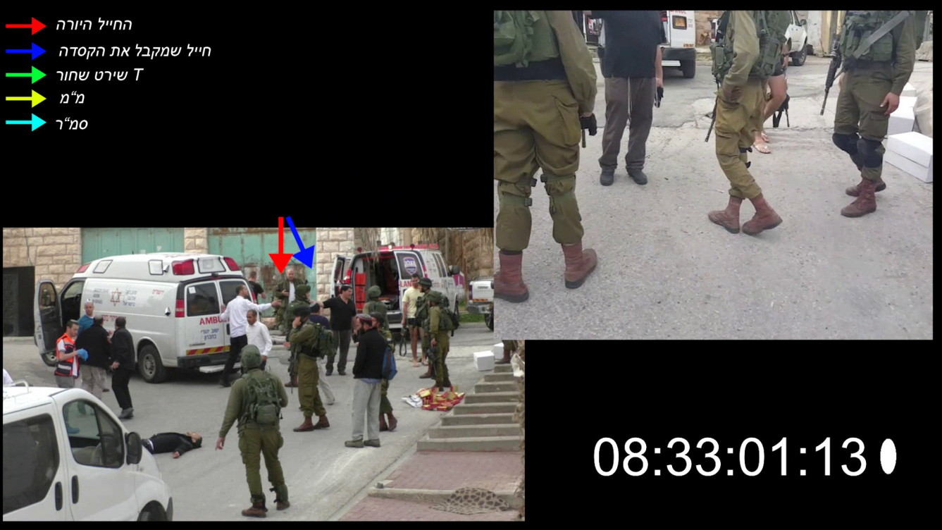
The shooter soldier
The soldier who receives the helmet
Black T Shirt
Platoon leader
First sergeant

Slide 18
Factual Tenure
The reason for the shooting was not any danger to the defendant, but the explanation that he immediately gave at the end of the shooting - "because the terrorist died" ... ».
"[The shooting took place] because of a vengeful motive -" stabbed my friend, wanted to kill him, and so he deserves to die, "not because of a real sense of danger and sincerity from a knife or an explosive device.
"The appellant must shoot a person, even if the terrorist has a malicious, helpless, useless intention to commit a terrorist act about his actions, his crimes in themselves ...".
Notes:
לציין מהיכן כל ציטוט

Slide 19
Valuable and Legal Definitions
"The use of force unnecessarily for the purpose of performing a specific task that deprives human life, even if it is a terrorist, is unacceptable.
The actions of the Azaria sergeant, which contradict the values of the IDF and undermine the moral firmness of the IDF, do not correspond to the behavior expected of a soldier, as she adheres to a noticeable degree of moral misconduct".
Notes:
לציין מהיכן מגיע כל ציטוט
"שימוש שלא לצורך או מעבר למידה הנדרשת בכח ובנשק, בוודאי באופן קטלני, הוא, אפוא, אסור, אינו מוסרי, אינו מועיל ואף מזיק. "
"צה"ל אינו מיליציה פורעת חוק. הוא צבא הגנה מאורגן של מדינת חוק מתוקנת. לוחמיו מצווים להילחם במחבלים שבאים עליהם להורגם. אולם אל להם לבוא עימם חשבון לאחר שחלפה הסכנה שנשקפה מהם. זו מלאכתה של מערכת אכיפת החוק".

Slide 20
Valuable and Legal Determinations
"These values... are the moral backbone of the Israel Defense Forces, which distinguishes it from its enemies. They promise that the military will act with courage, determination and selflessness to protect the country and its inhabitants, however - without using the force and authority given by its troops ... "
"The unnecessary use or transfer of the necessary force and weapons is certainly lethal, so it is prohibited, immoral, ineffective and even harmful. The IDF is not an offending police force. It is an organized state defense force, as amended. Its fighters are ordered to fight the terrorists who are going to kill them. But they should not go with them after the danger they face. This is the work of the law enforcement system
Notes:
לציין מהיכן מגיע כל ציטוט
"שימוש שלא לצורך או מעבר למידה הנדרשת בכח ובנשק, בוודאי באופן קטלני, הוא, אפוא, אסור, אינו מוסרי, אינו מועיל ואף מזיק. "
"צה"ל אינו מיליציה פורעת חוק. הוא צבא הגנה מאורגן של מדינת חוק מתוקנת. לוחמיו מצווים להילחם במחבלים שבאים עליהם להורגם. אולם אל להם לבוא עימם חשבון לאחר שחלפה הסכנה שנשקפה מהם. זו מלאכתה של מערכת אכיפת החוק".

Slide 21
Verdict Meaning
Factual Decision (Historical Narrative)
Deciding Value (Purity of Weapons)
Independence of the IDF Judicial System
Statehood (One Commanding Authority in the IDF)
Notes:
--------------
עצמאות הפצ"ר ותקינות שיקול דעתו בהעמדה לדין
אין וואקום בלחימה - יש כללים
לא יורים במי שלא משקף סכנה
חובה להישמע למפקדים ולא למקורות סמכות חיצוניים
לחריגה מהערכים הצבאיים יש משמעות שהיא גם פיקודית וגם משפטית
אחריות המפקד היא לטפל, למנוע, ולתחקר - גם במקביל להליך החקירה והמשפט העצמאי

Slide 22
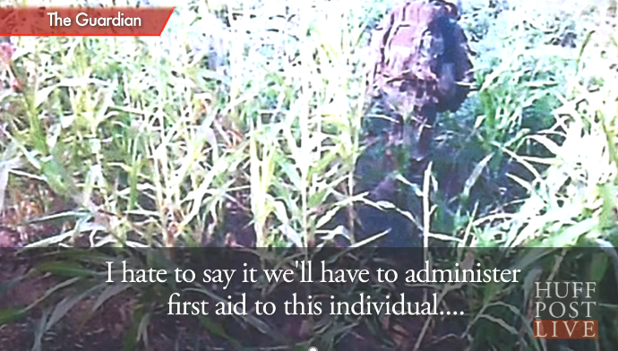
Helmand Province killing (2011)

Slide 24
Major Matthew Goldstein

