Slide 1
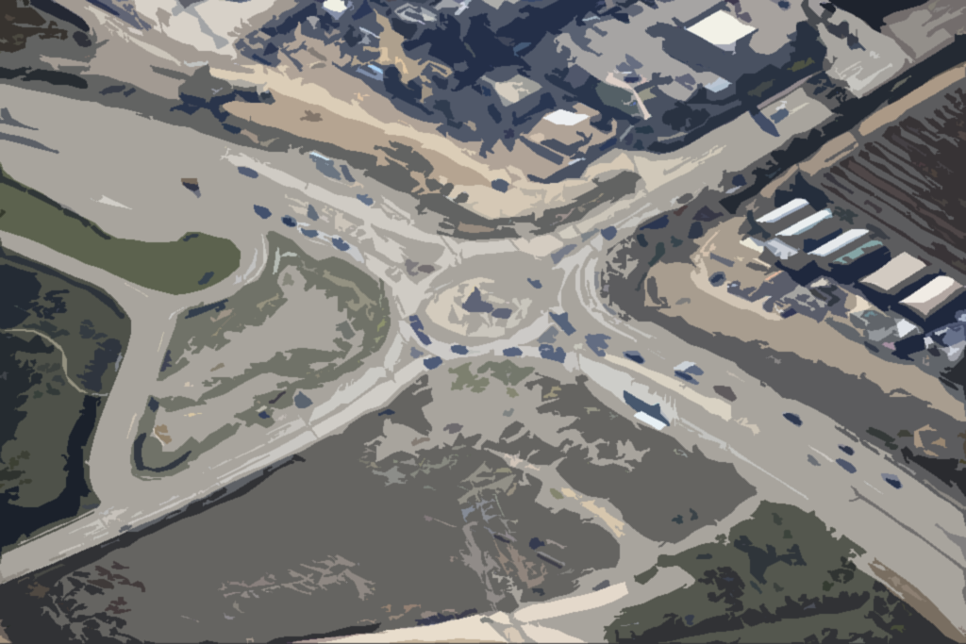
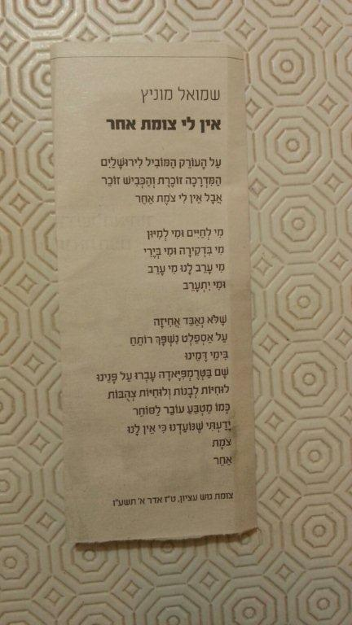
"מהלאה למגדל עדר- אתרא דמתמן עתיד לאיתגלי מלכא משיחא בסוף יומיא"
(יונתן בן עוזיאל,
פירוש לבראשית ל"ה, פס' טז'-כא')
A Brigade
Commander in Judea & Samaria
At noon we reached Rachel’s Tomb, the locals threw stones at us…
Judith Montefiore, 1840

Slide 2
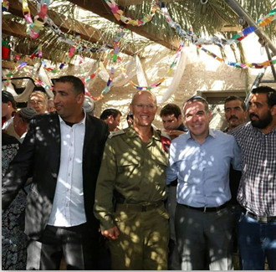
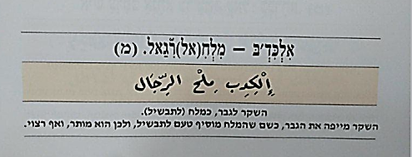
Siamese Twins?
Otherness
“Lies are for men, like salt (for cooking). The lie decorates the men, as much as salt adds flavor to stew, and is thus allowed and even desirable”

Slide 3
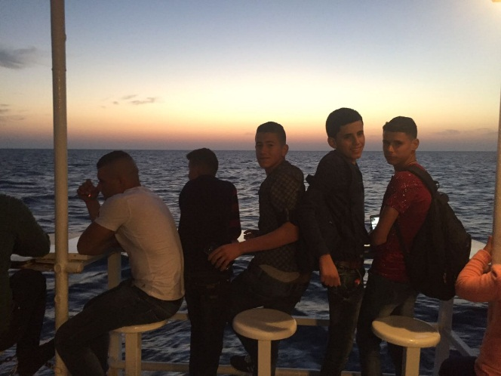
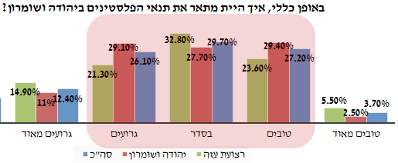
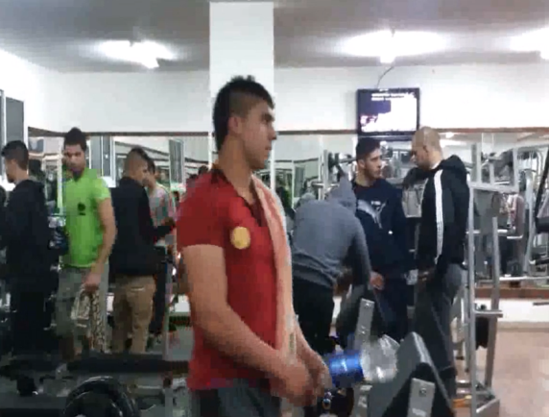
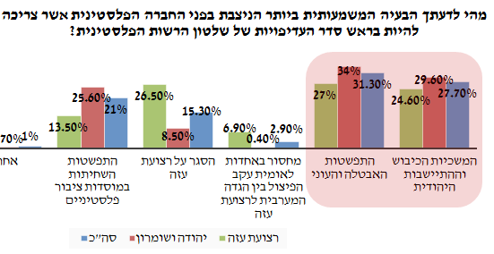
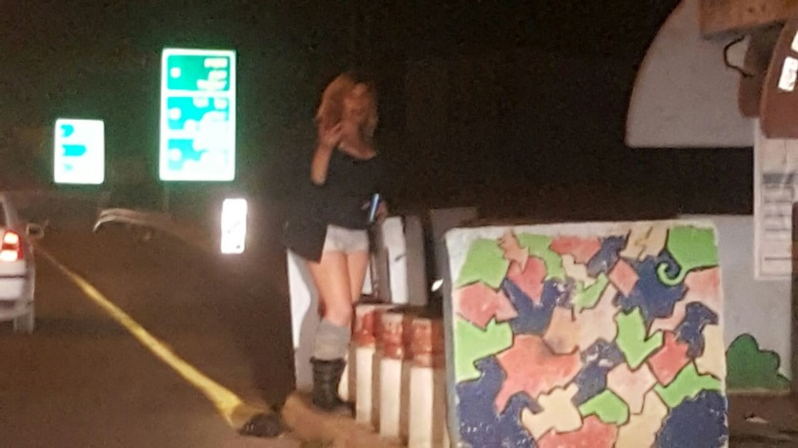
Quality of Life
The Mind-set of Struggle
Generally speaking, how would you describe the conditions of Palestinians in Judea & Samaria?
Very bad
Bad
Okay
Good
Very good
Total
Judea & Samaria
Gaza Strip
In your opinion, what is the most significant problem facing the Palestinian Society which needs to be a top priority of the PA leadership?
Other
Increased Corruption in Palestinian Public Institutes
The Gaza Strip Blockade
Lack of national unity due to the Split between the West Bank and Gaza Strip
Increased Unemploy-ment and Poverty
Continued Occupation and Jewish Settlement
“Only once we have a first Hebrew thief and a first Hebrew prostitute, we will be as all the nations”
Total
Judea & Samaria
Gaza Strip

Slide 4
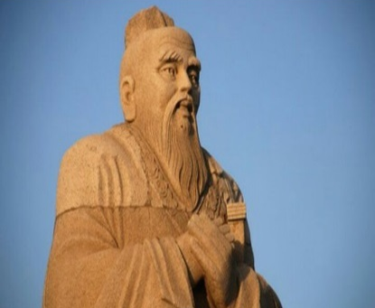
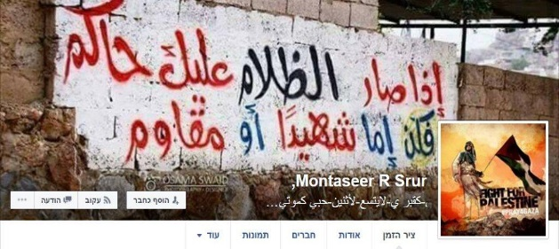
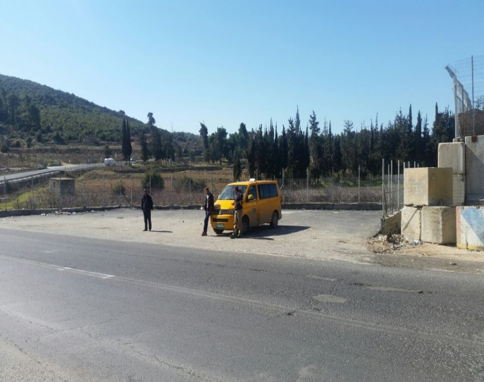
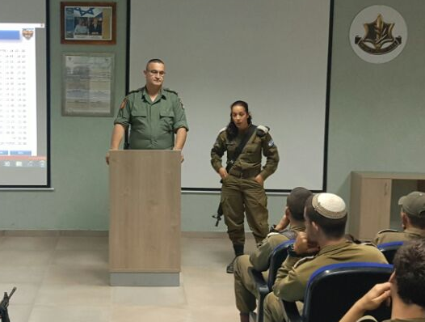
Strategy, Tactics and Other Paradoxes
It is only when a fly lands on your testicles, that you understand that there are ways of solving problems without using violence
Red Campaign
Blue Campaign
Reconciliation
Deterrence
Victory

Slide 5
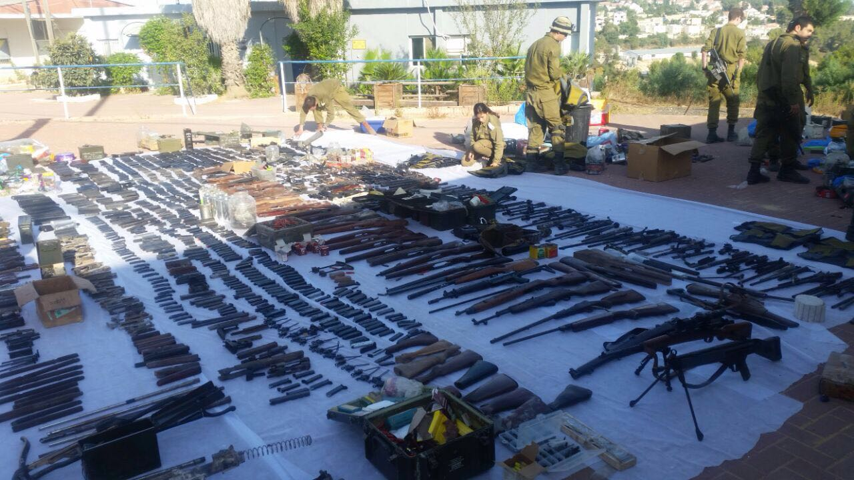
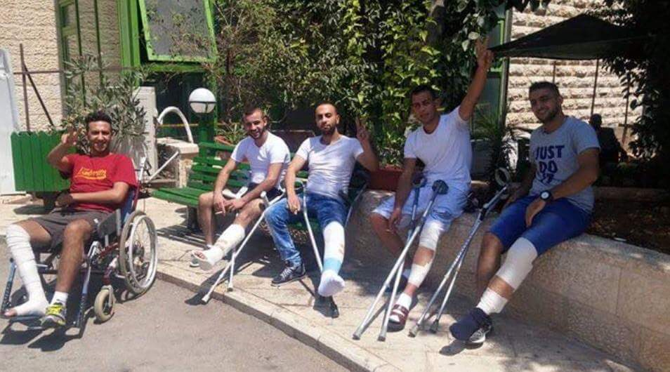
Something Familiar…
Infiltration Operations (Mista’aravim Unit)
6
Search for arms
217
Brigade-level Operation
38
Terror Funds
9
Terror Funds
25
Incitement Targets
Handled- 51
Arrested - 26
Arrests- 1113
שיחות אזהרה- 87
Mappings-
554
זימונים- 832
מבצעי תודעה
Terror Funds
25

