Slide 1
Ministry Of Transport And Road Safety
Lecture to the National Security College
June 2019

Slide 2


Assaf Asher
Head of the Infrastructure Division of the Ministry of Transport - 2019
Deputy Controller of the Ministry of Transport - 2016-2019
(On behalf of the Ministry of Finance)
Coordinator of the Defense Ministry in the Ministry of Finance, 2013-2016
Referent Administrative Offices in the Ministry of Finance 2012-2013

Slide 3
Director General of the Ministry of Transport
Traffic Administration
Infrastructure Administration
Israel Airports Authority
National Road Safety Authority
Shipping and Ports Authority
Civil Aviation Authority
National Authority for Public Transportation
National Meteorological Service
Economic Planning Division

Slide 4
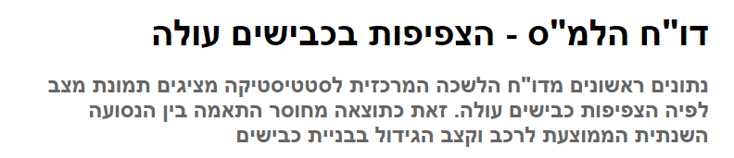
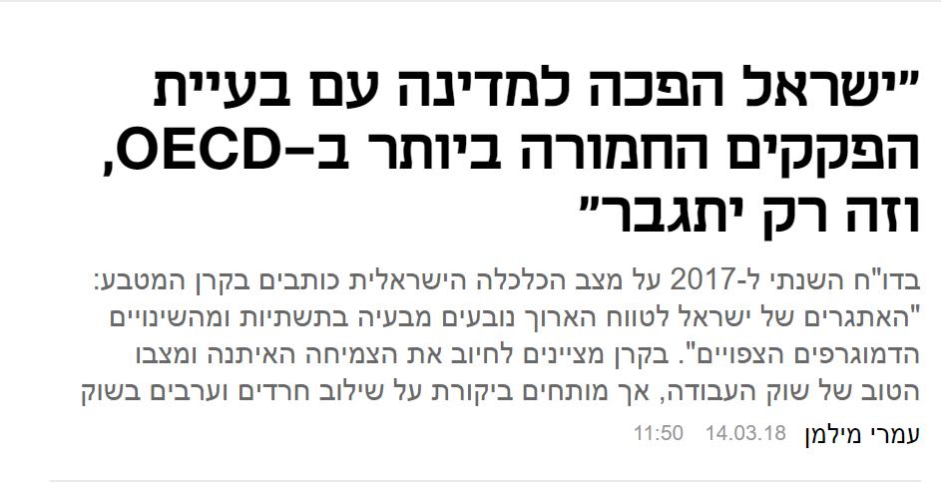
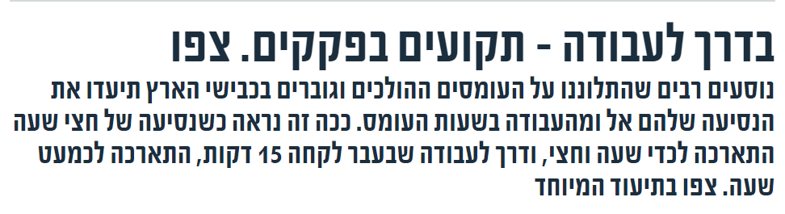
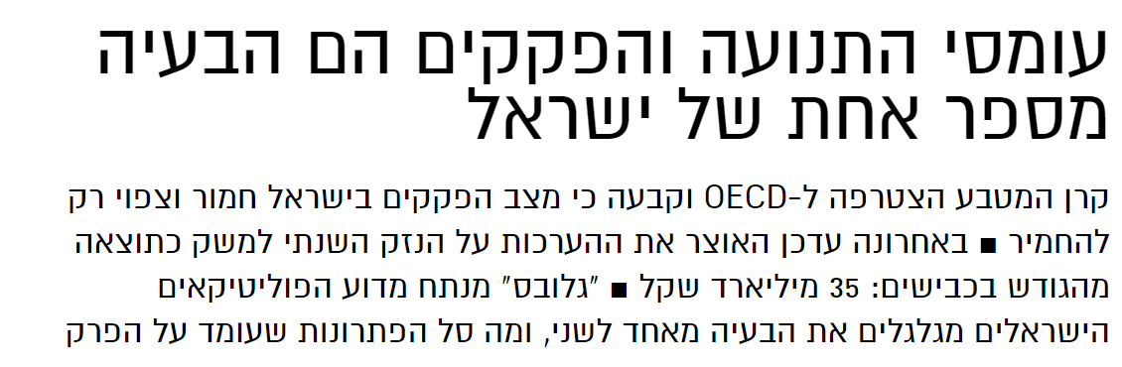
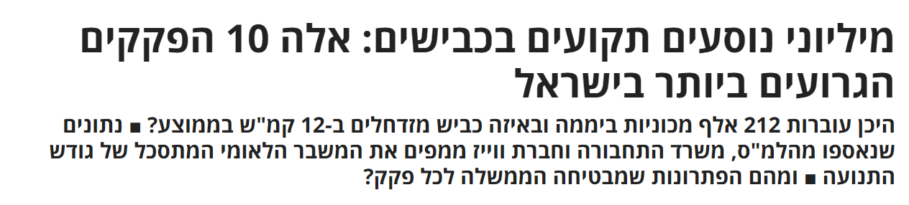
Center for Statistics Report – Road Traffic is Increasing
“Israel has turned into the state with the most serious traffic jam problems in the OECD, and it will only get worse.”
On the Way to Work – Stuck in Traffic. Watch
Heavy Traffic and Traffic Jams are Israel’s Number One Problem
Millions of Drivers are Stuck on the Roads: These are the Ten Worst Traffic Jams in Israel

Slide 5
The Level Of Motorization In Israel
384

Slide 6
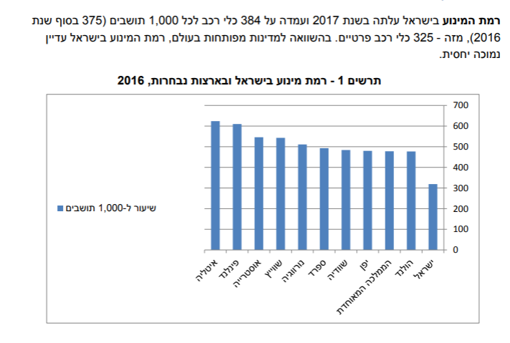
The rate of motorization in Israel increased in 2017 and stood at 384 vehicles per 1,000 residents (375 at the end of 2016), of which 325 were private cars. Compared to other countries in the world, the level of motorization in Israel is still relatively low
Diagram 1 – The rate of motorization in Israel and selected countries, 2016

Slide 7
Trends In The World - Population Growth

Slide 8
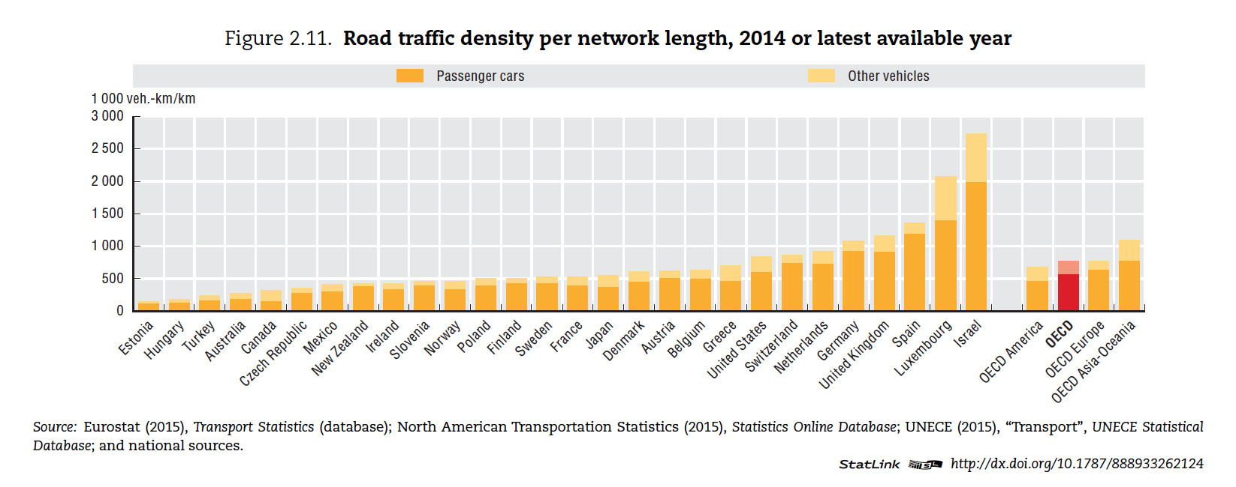
Trends In The World - Congested Density

Slide 9
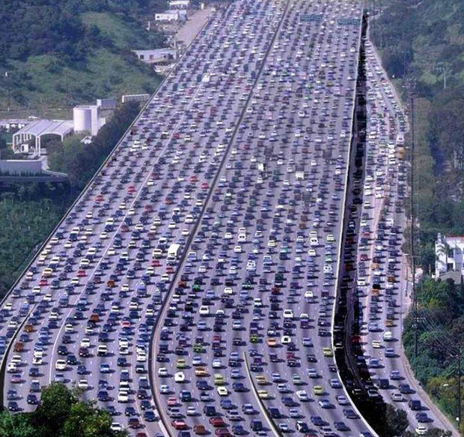

Slide 10
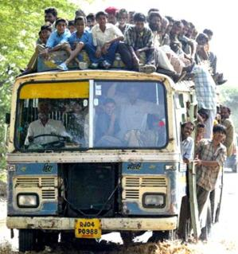

Change Perception
Additional investments
Reducing investments

Slide 11
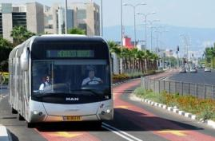
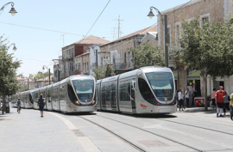
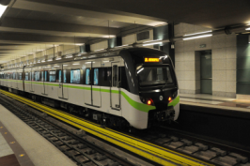
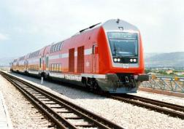
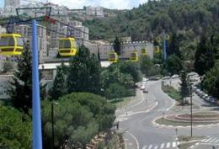
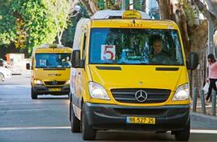
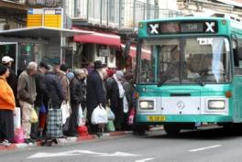
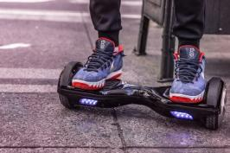
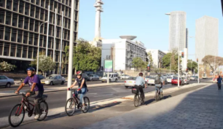
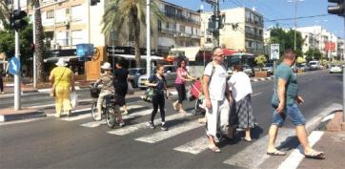
A Sustainable Transportation Hierarchy
MRT – Mass Rapid Transit
A motorized provision network
NMT – Non Motorized Transport

Slide 12

Metropolitan Tel Aviv Strategic Plan

Slide 13
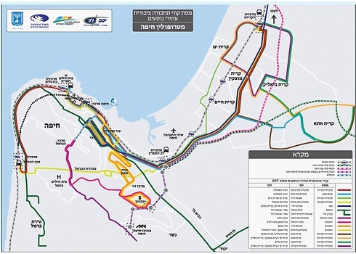
Haifa Metropolitan Strategic Plan

Slide 14
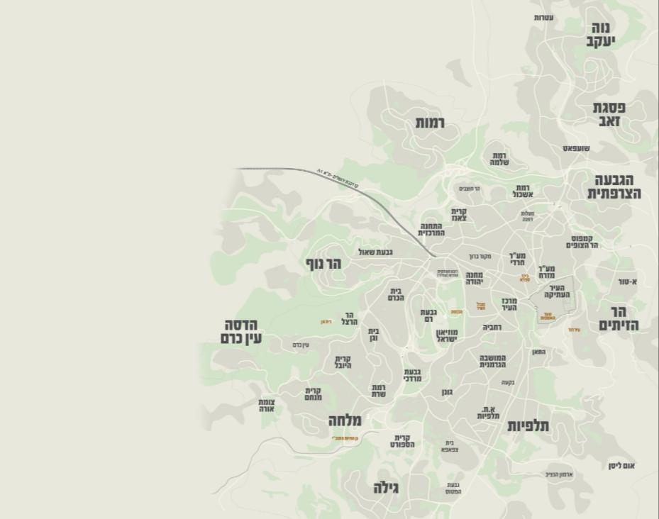

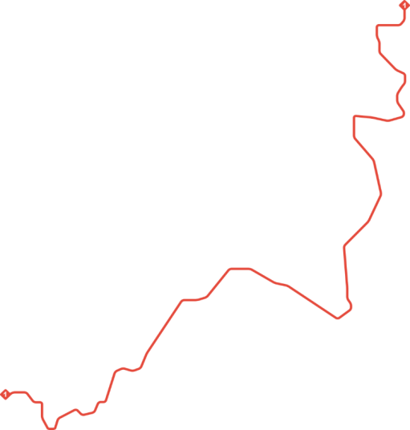

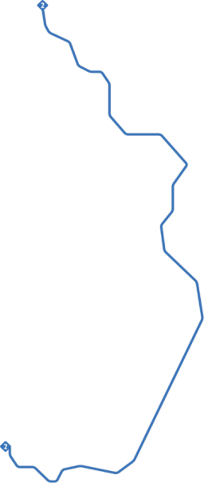







Metropolitan Jerusalem Strategic Plan
BRT
גבעת זאב
5
נווה יעקב
4
BRT
מבשרת ציון
BRT
מעלה אדומים
6
מעלה אדומים – הגבעה הצרפתית
4
גבעת זאב – רמות
5
מבשרת ציון – ת. מרכזית ירושלים
6
ציר הזנה
ציר הזנה

Slide 15
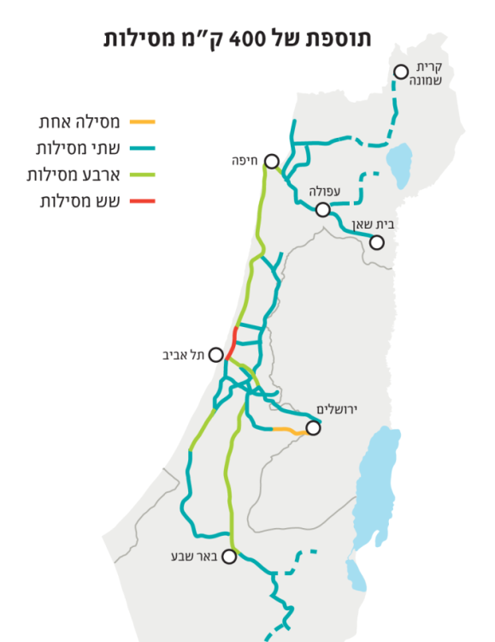
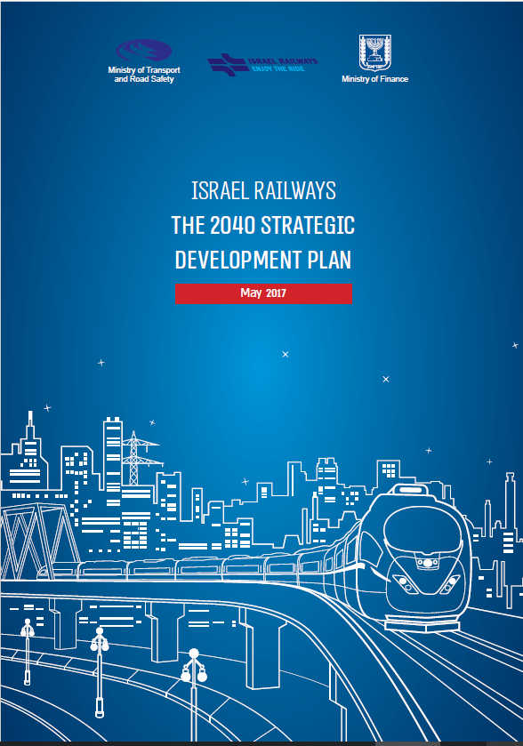
Israel Railways Strategic Plan

Slide 16









From Initiation To Realization
Policy
strategic planning
Initiation
Budgeting, supervision and control
Regulation
Management of early and detailed planning
Execution Management
Quality control and execution
Service, operation and traffic management

Slide 17
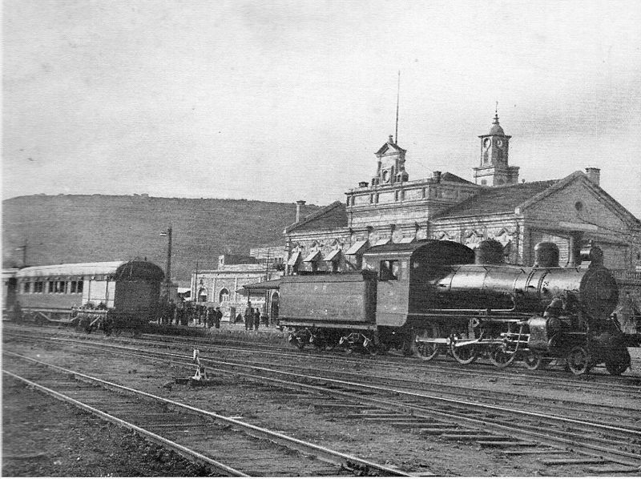
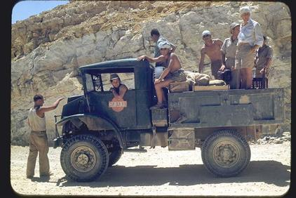
Changing The Perception infrastructure Companies - You Can Not Think Small

Slide 18

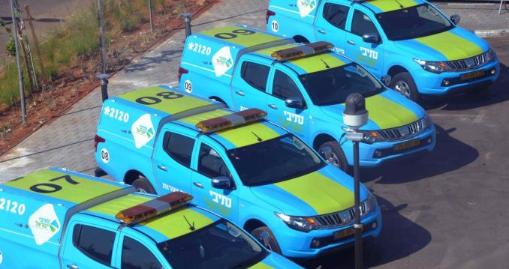
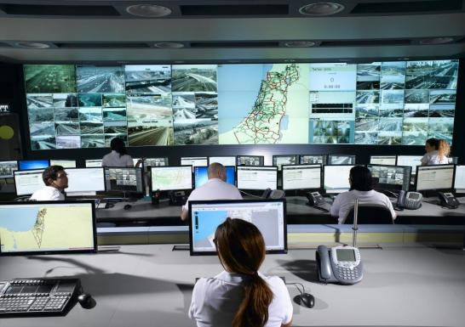
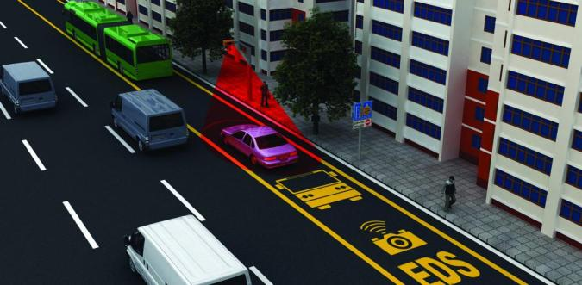
Public Transportation, Monitoring, Management, Service

Slide 19
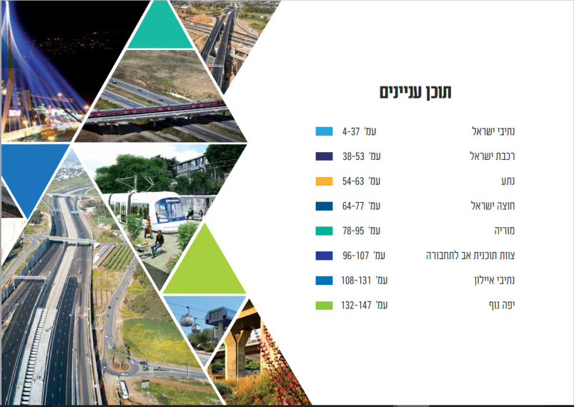


Slide 20
Budget Summaries And Government Decisions

Slide 21
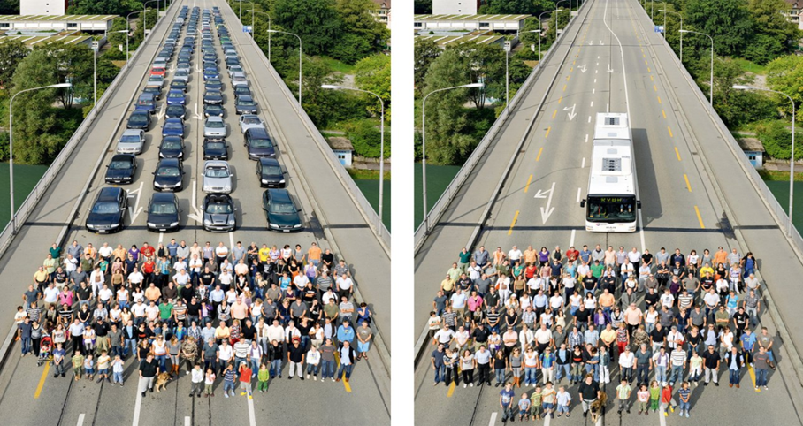
Investments in Transportation infrastructure - Mass Transit Systems

Slide 22
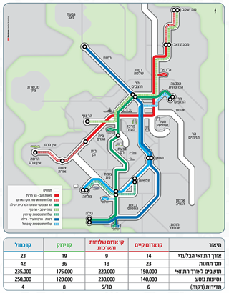
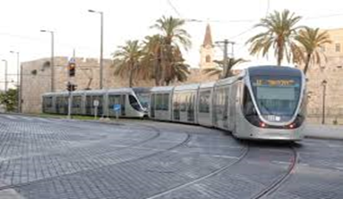
Multi-Year Plans For Transportation Solutions For Mass Transportation Within The Metropolis
Tel Aviv - A green and purple line of light rail
Metro lines M1, M2, M3
Haifa – Nazareth Light Rail
Jerusalem Light Rail JNET
New Israel Railways
Eastern road, roads 4, 5 and 6 in Ayalon.

Slide 23
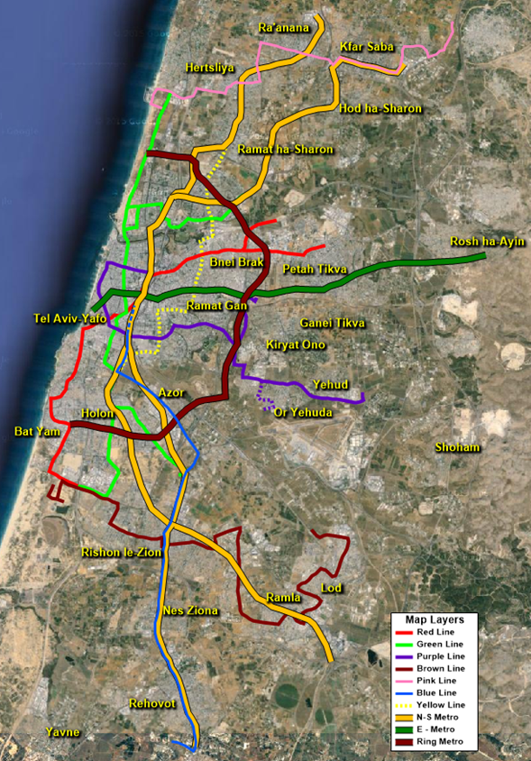
Mass Transit System In Tel Aviv

Slide 24
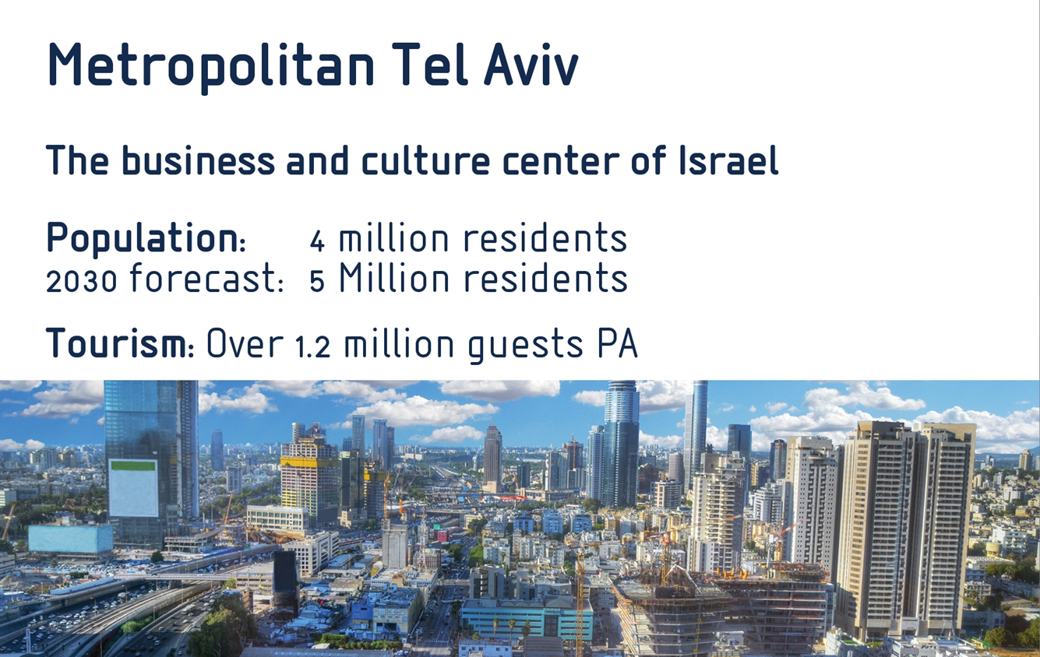

Slide 25
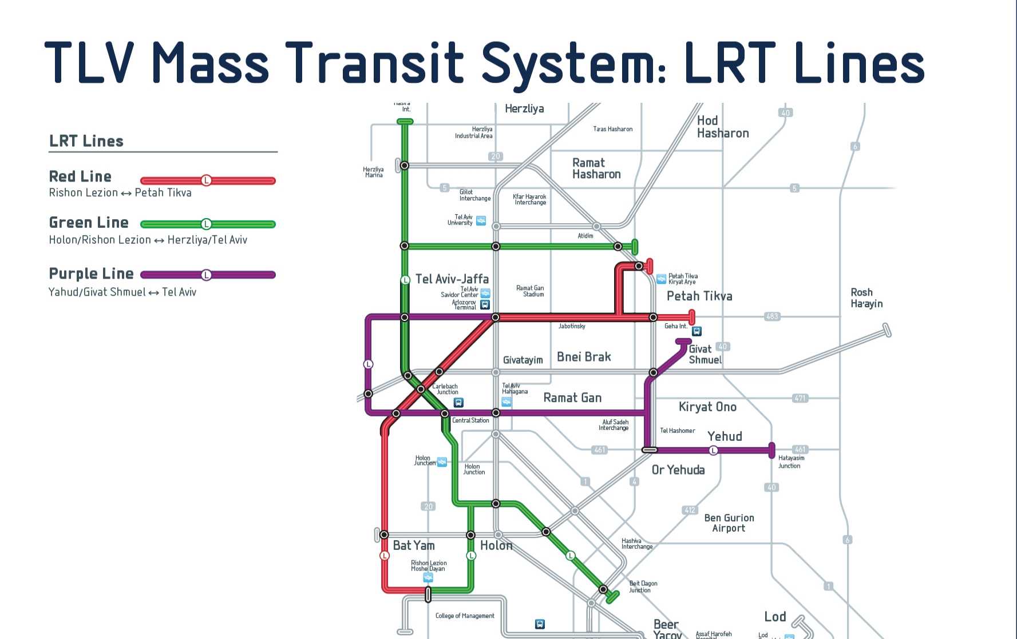

Slide 26
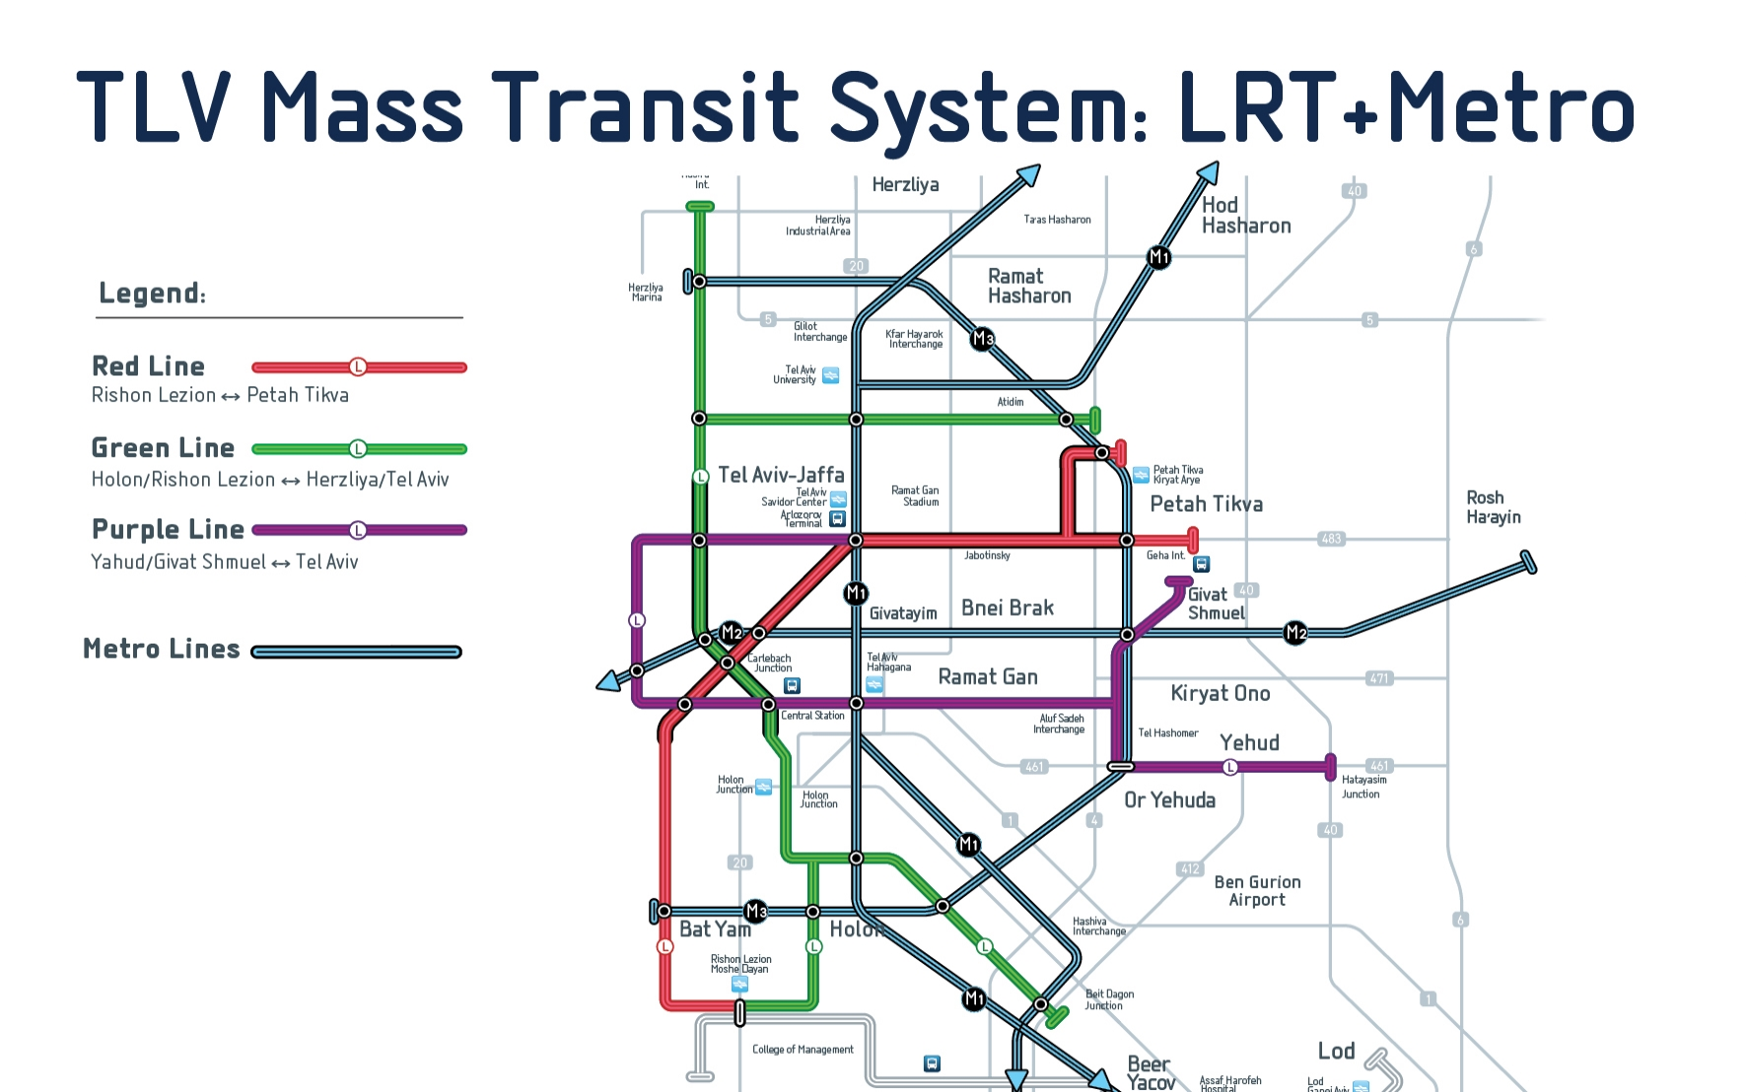

Slide 27
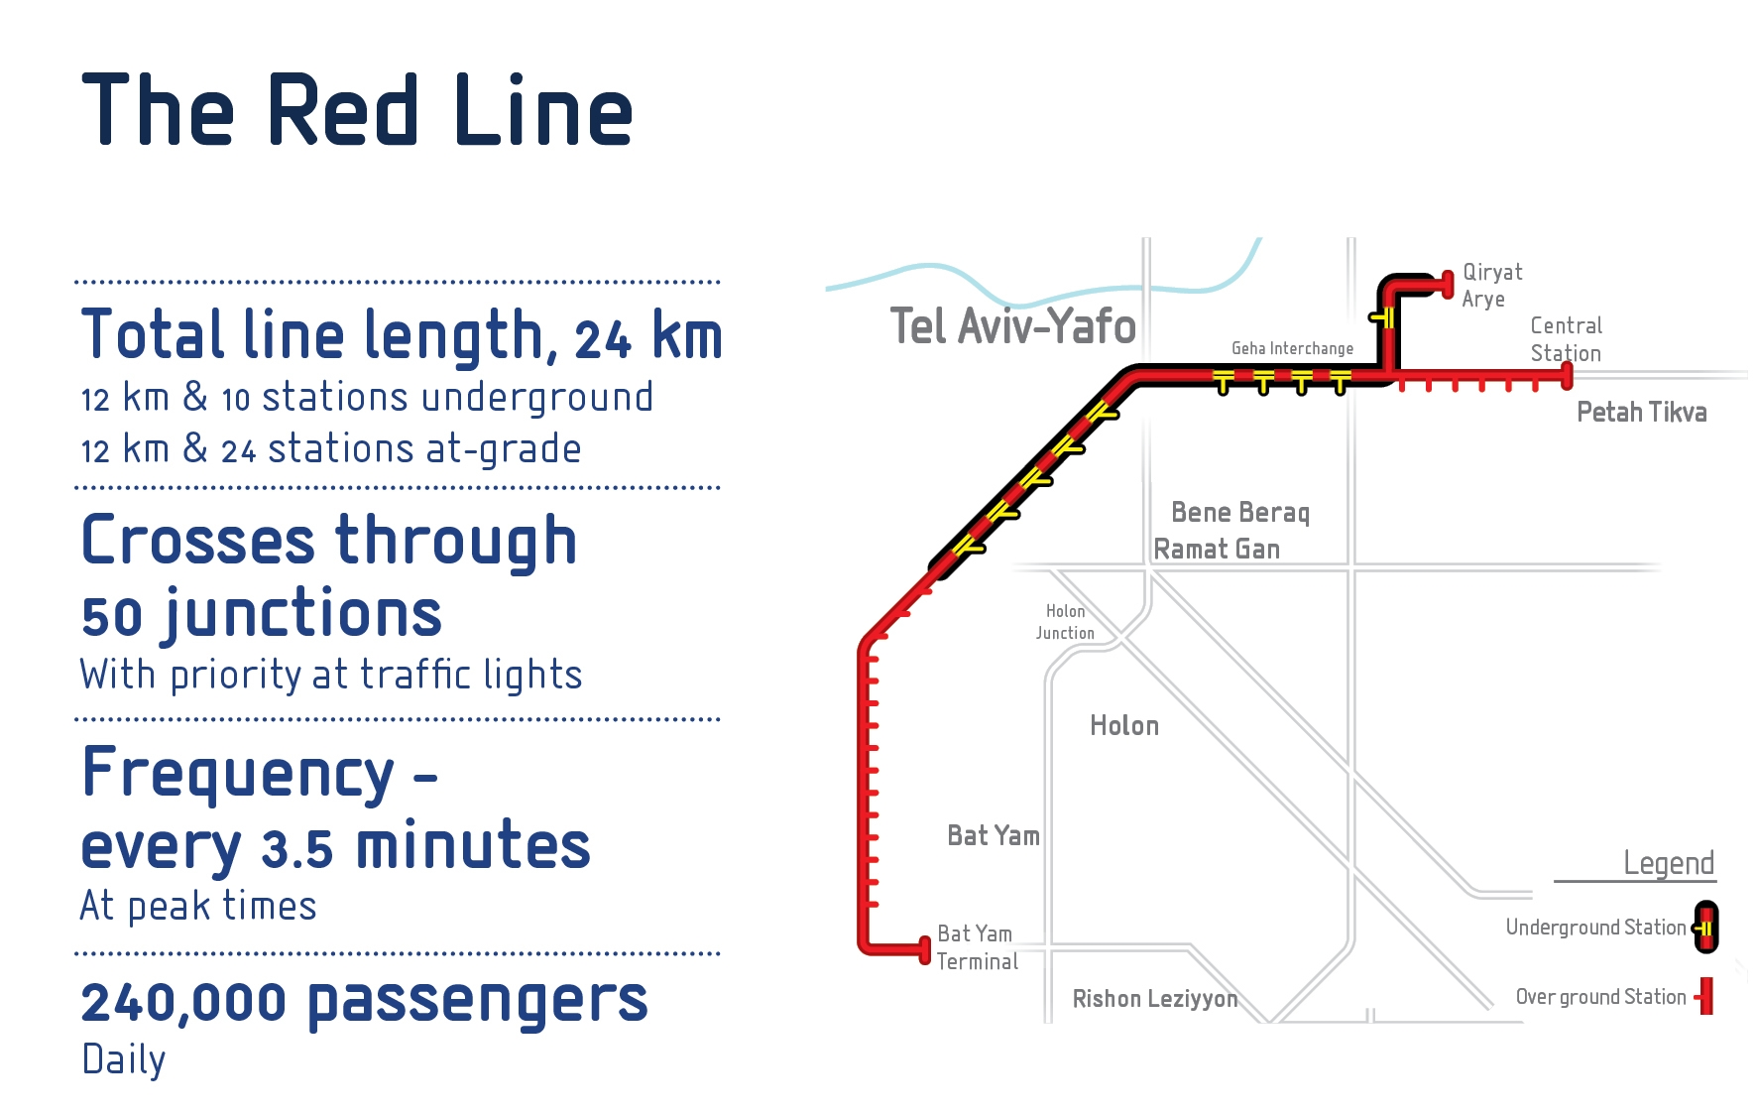

Slide 28
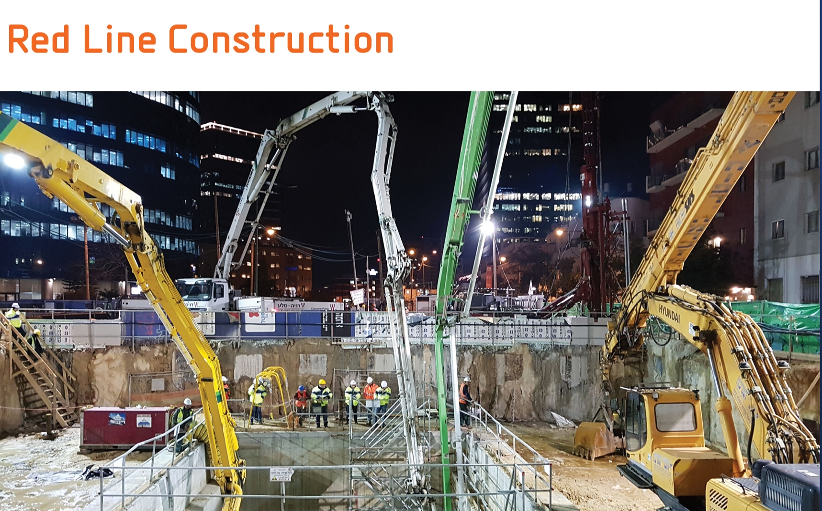

Slide 29
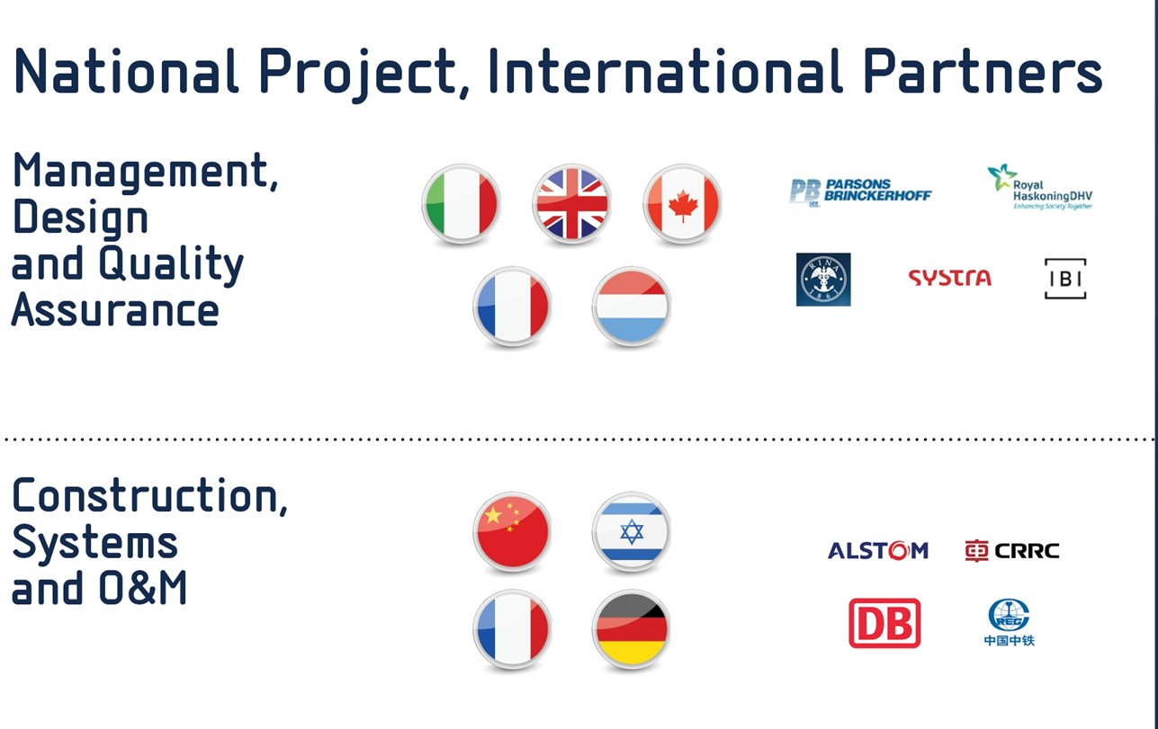

Slide 30
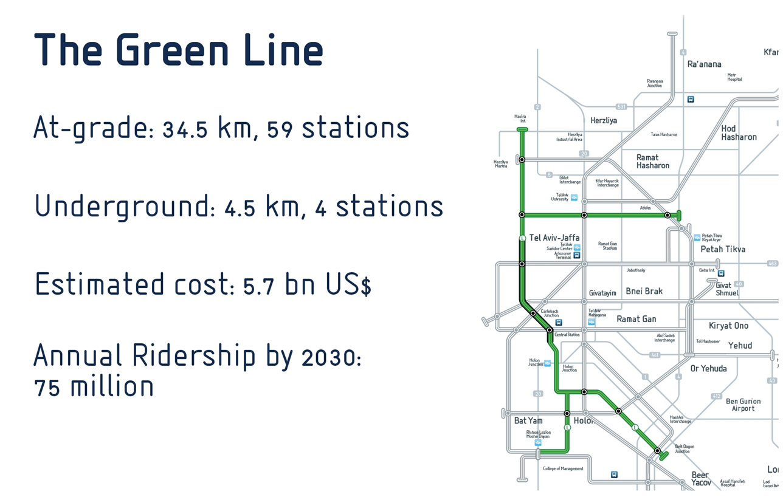

Slide 31
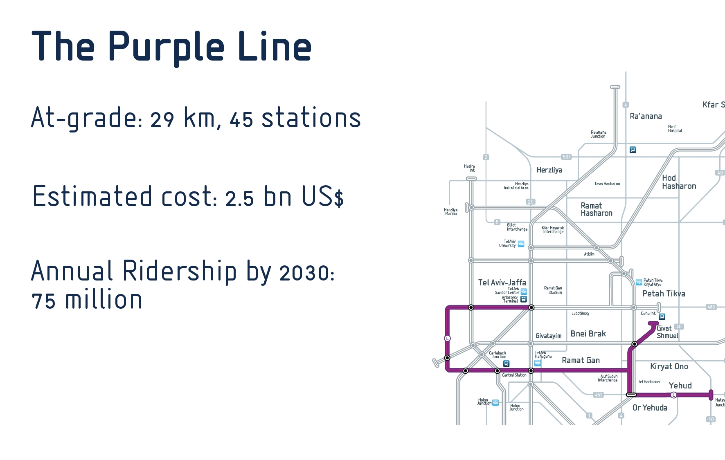

Slide 32
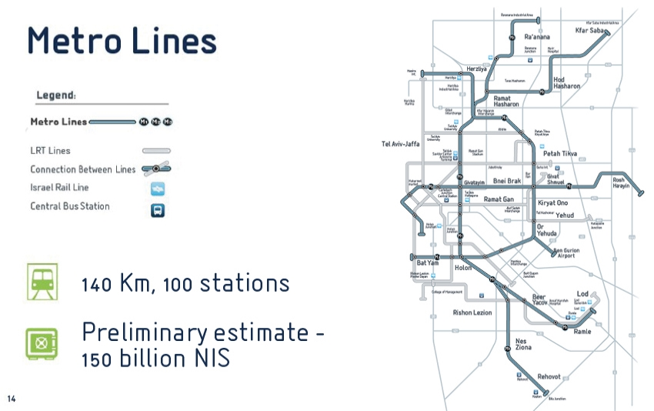

Slide 33

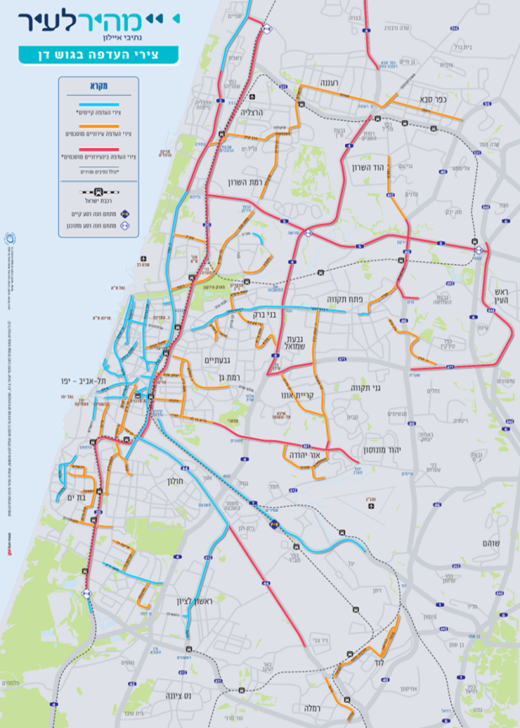
"Quick to Town" project-a preference for public transportation in the metropolitan area of Tel Aviv
Creating a continuous network of priority routes for urban and interurban public transportation throughout the Dan Region
The addition of 164 km urban deputies
The addition of 101 km interurban coordinates
Start of implementation of the first axes – 2017
Estimated: NIS 7 billion (urban + urban)

Slide 34
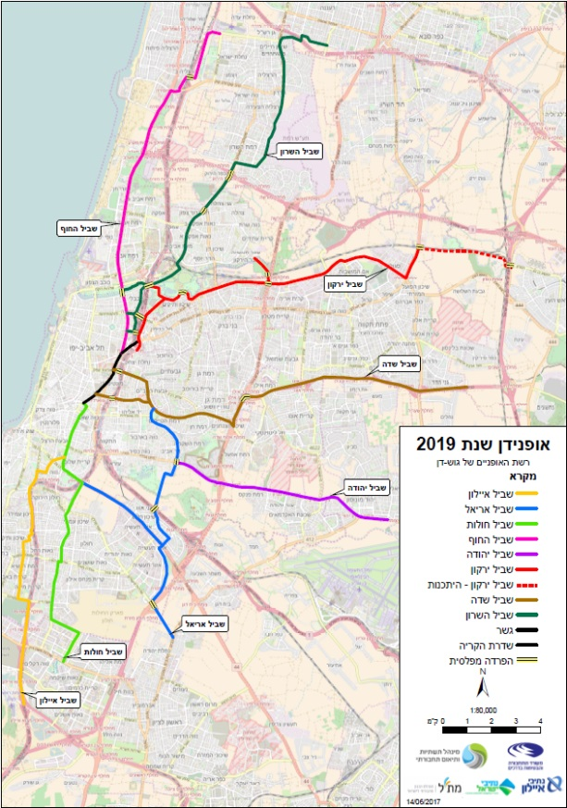
Dan-Cycling
A network of metropolitan bicycle paths in the Dan region
A network of bicycle paths throughout the Dan region of 8 high standard bicycle paths
Total length of about 100 km
The project budget is approximately NIS 600 million
Notes:
תקציב

Slide 35
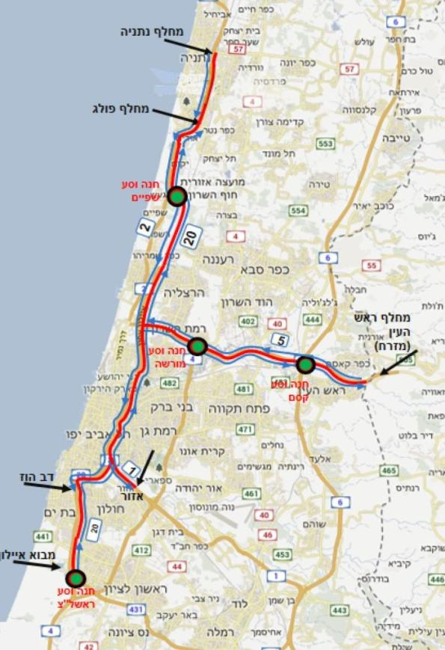
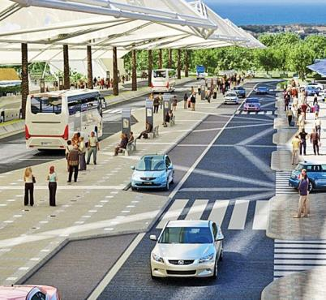
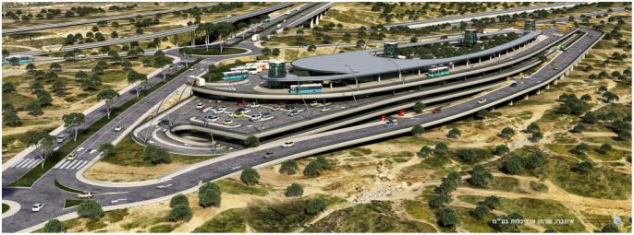
The Fast Paths
Stage 1 - Highway Rishon Lezion to Netanya + Public Transport lane on Highway 5 as a base for a future highwayשלב
B - Fast lane on Highway 5
Construction of two parking lots in the north (7,000 parking spaces), Rishon LeZion in the south (4,000 parking spaces).
Notes:
תמונה

Slide 36
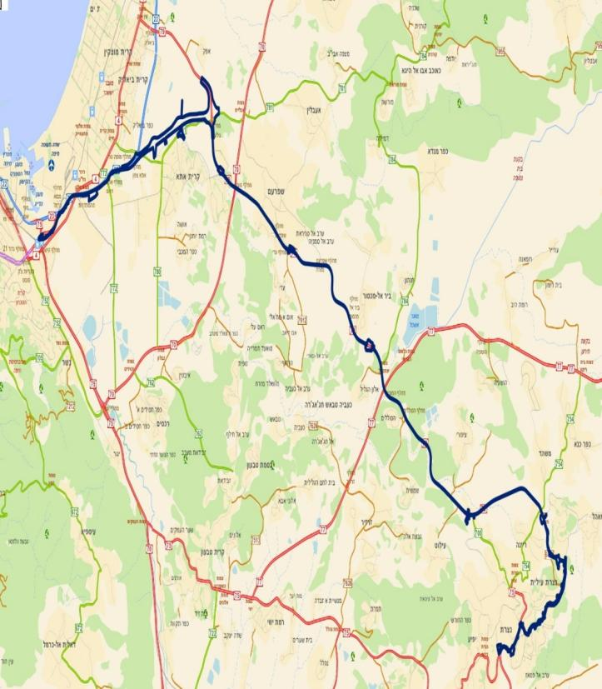
Haifa – Nazareth LRT
41 Km., 19 stations
Passengers Forecast – 25 million passengers in 2030
Preliminary estimated cost – 6.5 billion NIS

Slide 37

Project Description:
The project, ca. 41 km in length, includes 19 stations and 16 parking lots.
Project Scope:
Infra 1 – Infrastructure works, divided into five segments along the line.
Tenders expected to be issued in the second half of 2021.
Infra 2 – Includes a concession tender for the structures, systems, rolling stock and the operation and maintenance.
  Tender expected to be issued in the second half of 2023.
Current Stage: Preliminary design.
NAZARETH

Slide 38
Aviation and Shipping

Slide 39




Development of Marine Infrastructure
Southern Port
HaMifratz Port
Finish in 2021
Budget estimate: NIS 3.3 billion
Budget estimate: NIS 4 billion
  Establishing two new ports that will be operated by private international companies
  Port reform includes upgrading existing ports
Notes:
לו"ז ותקציב

Slide 40

HaMifratz Port- Haifa

Slide 41

HaMifratz Port- Haifa
The length of the main platform - 800 meters
The area of the terminal is 720 dunams
Lightning the breakwater - 900 meters
A secondary breakwater - 2100 meters
Acceptability - 1.5 million TEU per year
Completion of construction
The cost of construction - NIS 4 billion

Slide 42
Southern Port- Ashdod

Slide 43

Southern Port- Ashdod
The length of the main platform - 800 meters
The area of the terminal is 640 dunams
Illuminating the breakwater - 600 meters
A secondary breakwater - 1500 meters
Acceptability - 1.3 million TEU per year
Finish construction - 01.06.2021
Construction cost - NIS 3.3 billion

Slide 44
Total passengers from Ben-Gurion Airport divided by routes
Increase in passenger traffic in international aviation

Slide 45


Increase in passenger traffic in international aviation
Air response
Ground response
Improved coordination between civil aviation and aviation for efficient use of airspace
The opening of the fourth arm at Ben Gurion Airport

Slide 46


Ground infrastructure of international aviation in the future
Long-term planning - establishing a complementary airport
Short term - opening of the Timna named after Ilan & Assaf Ramon airport
נבטים
Ramat David
Continued planning activity
Completion of feasibility studies

Slide 47


A supplementary airport to Ben-Gurion Airport
Nevatim
Galil
Offshore
Ramon
Ben-Gurion

Slide 48



In the past, the challenges were less complicated.

Slide 49

TOD – Transit Oriented Development

Slide 50








A variety of mobility options

Slide 51










Main steps to realization – the side of demand
Parking policy
Positive and negative incentives for car maintenance
Positive and negative incentives for travel
Encouraging joint travel
Car free zone
Passengers
Leasing vehicles

Slide 52

The Question of Autonomous Vehicles!
-Increase capacity
-Car sharing
-Travel sharing
-Added users
-Empty rides
-Parking needs

Slide 53

Significant challenges for the coming years
2030
Metro
Railways 5 + 6 Ayalon
Integration and dealing with different interfaces
Operational infrastructure for public transport
Public transportation and bicycle paths
TOD

Slide 54
בטיחות בדרכים
Road Safety
התמודדות עם סוגיית הבטיחות בדרכים בצורה רחבה ומקיפה תוך ביצוע המטלות אשר בסמכות ובאחריות משרד התחבורה ועבודה משותפת עם שאר הגורמים הנוגעים לסוגיה
Dealing with the issue of road safety in a broad and comprehensive manner, while carrying out the tasks that are under the authority and responsibility of the Ministry of Transport and working together with the other relevant bodies

Slide 55

Accelerated treatment of infrastructures and risk centers:
Investment in municipal safety projects (NIS 200 million per year)
A budgetary framework of NIS 1.15 billion for dealing with risk centers in the interurban network
A budgetary framework of NIS 600 million for handling left-wing applications in the rural area
A budgetary framework of NIS 400 million for the upgrading of roads crossing in minority communities
Upgrading single-lane roads with high traffic accidents (71, 38, 3, 65, 264, 293, 31, 85, 89)
Improving vehicle safety - charging and providing incentives to install safety systems
Supervision and enforcement - increased supervision and enforcement of garages, licensing institutes and safety officers

Slide 56









Cooperation and commitment of all parties
Notes:
בשביל לקדם את הכל נדרש שיתוף פעולה של הרבה מאוד גופים ומחויביות לצמצום הנסועה הפרטית ועידוד שימוש באמצעי תחבורה בת קיימא

