Slide 1
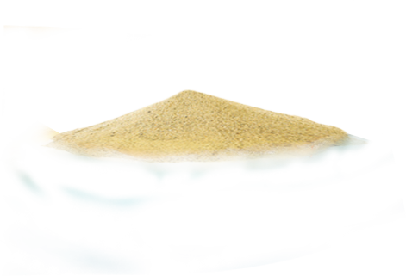
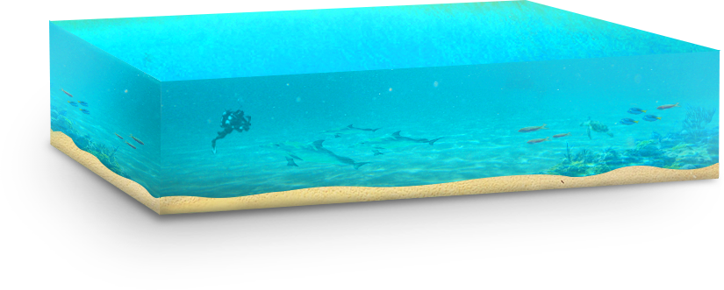
Welcome!

Slide 2
About Me
Member of the General Staff
JCOM Commander
Commander of the IDF Colleges
INDC Commander
BG Course Commander

Slide 3
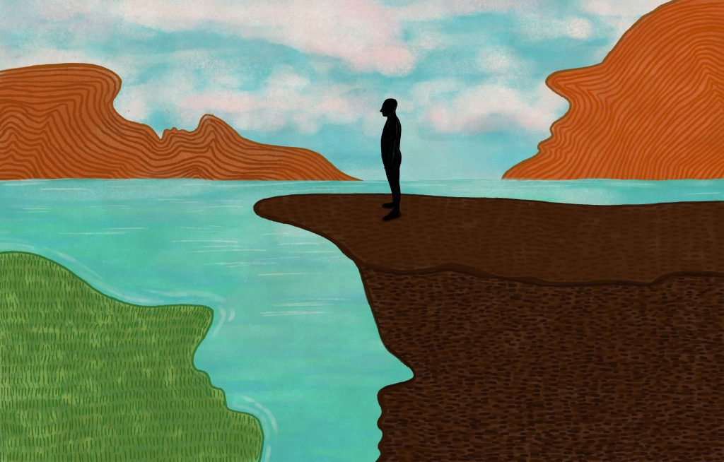
Biography
Joined the IDF paratroopers
Kibbutz Ramat HaKovesh
Aysha-Reichan battalion commander
The First Intifada
The Second Intifada

Slide 4
What does it mean to live on an island?

Slide 5
What does it mean to live on an island?
You are unaware of other places, and are sure that you are the entire world

Slide 6
What does it mean to live on an island?
You improvise with what you have,
and are sure that this is how things should be

Slide 7
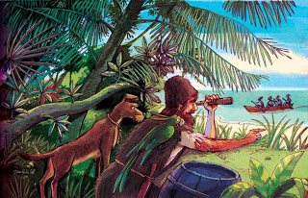
What does it mean to live on an island?
You are surrounded and besieged,
and anyone who is not for you, is against you

Slide 8
What makes up our national DNA?

Slide 9
No one is (really) from here, and so there is no such thing as "Israeli"

Slide 10
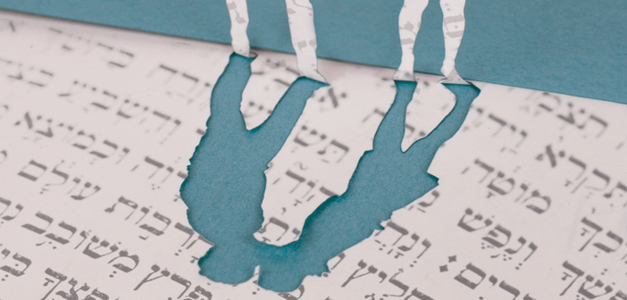
A 4000-year-old language, with only 30,000 words. So...

Slide 11
We speak with our hands, in pantomime and can be loud
Foreigners find it hard to understand

Slide 12
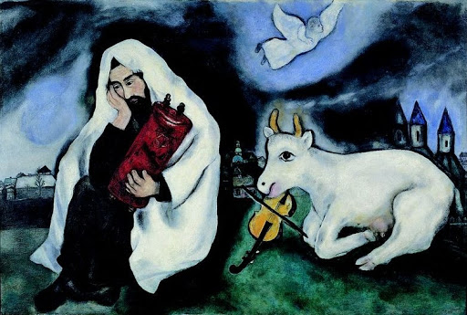
A "small town" and "oy vey" culture

Slide 13
A nation in schizophrenia

Slide 14
The Holocaust completes every sentence

Slide 15
The legend of Masada

Slide 16
“An economy of scale”

Slide 17
A “huge balagan”

Slide 18
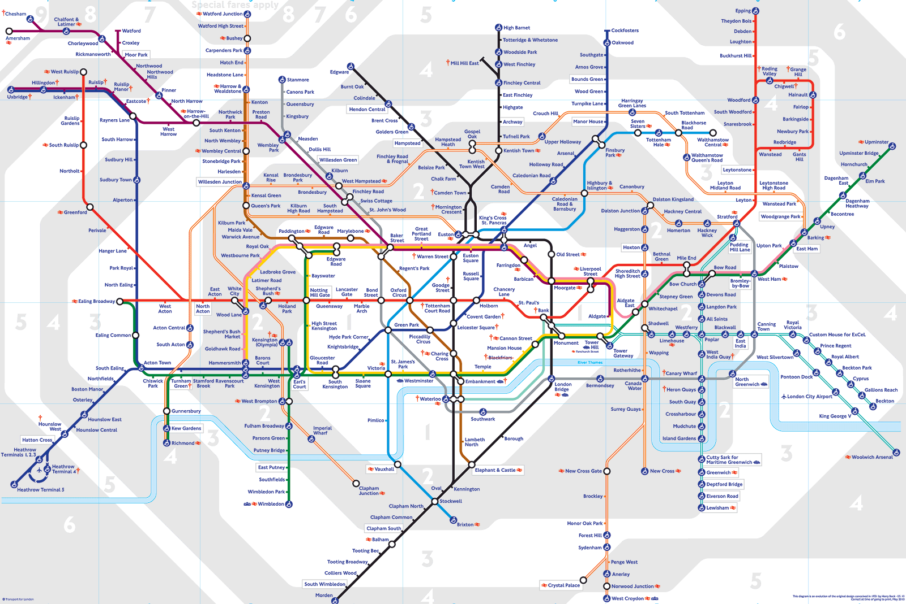
INDC

Slide 19
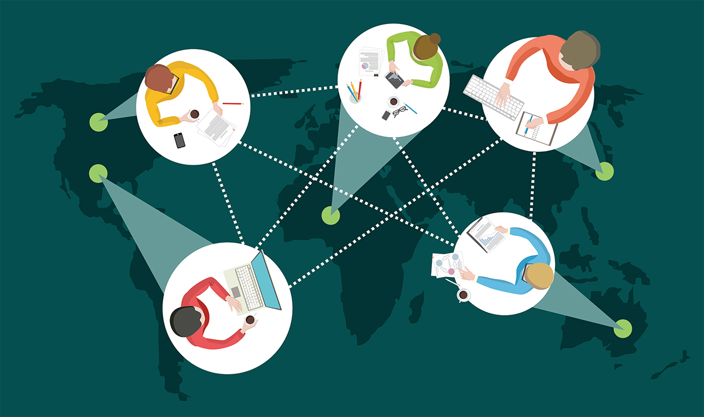
Learning and Influence

Slide 20
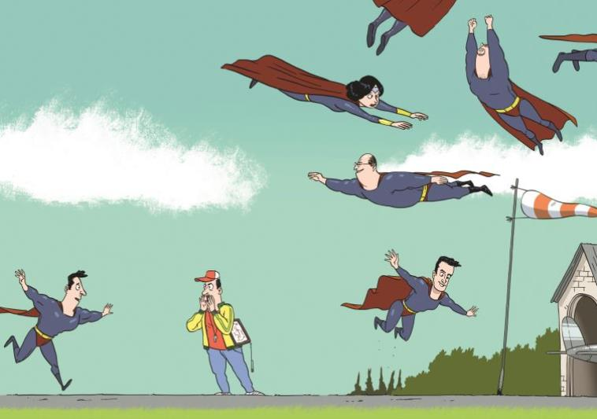
Breach Boundaries

Slide 21
A villa in the Jungle

Slide 22
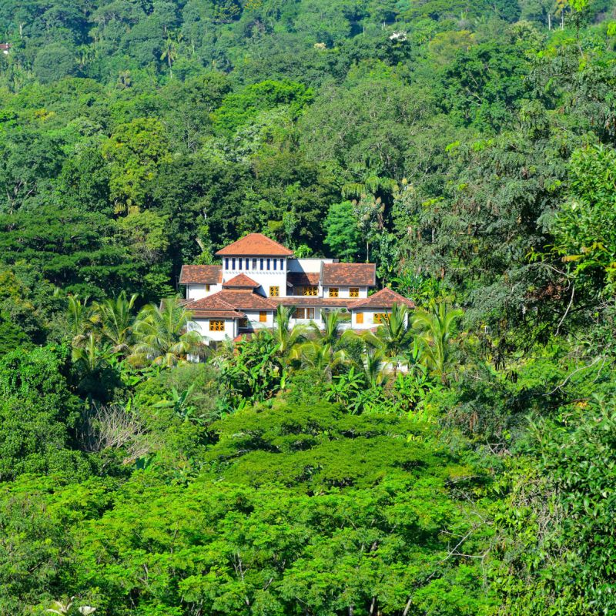
A villa in the Jungle

Slide 23
Jewish and democratic
A Jewish and democratic state:
Most people haven't really understood the problematics
Declaration of Independence

Slide 24
Thank you very much!

