Slide 1
National Security College
The Field of National Defense
Leading guide: Avi Almog
47th Class INDC

Slide 2
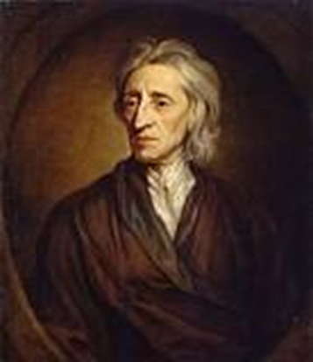
The Development of Thoughts About Individual Rights and Liberty
"There is no presumption among us of degrees, which gives us the authority to destroy each other, as if we were created for the use of his friend ..."
John Locke 1632-1704

Slide 3
General Background: The Right to Life and the Right to Security
The right to life - Everyone has the right to life, personal freedom and personal security.
The State's Right to Protect its Citizens - It is mandatory for a state to protect the lives and security of its citizens within the state and beyond its borders for the purpose of exercising its right of defense.

Slide 4
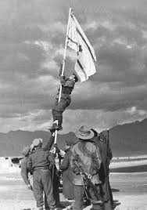
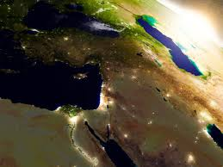
The Field of National Defense in INDC - The Concept of Order
National Security
National Defense
The Digital World
National Defense in Israel
Middle East
Global and Israel

Slide 5
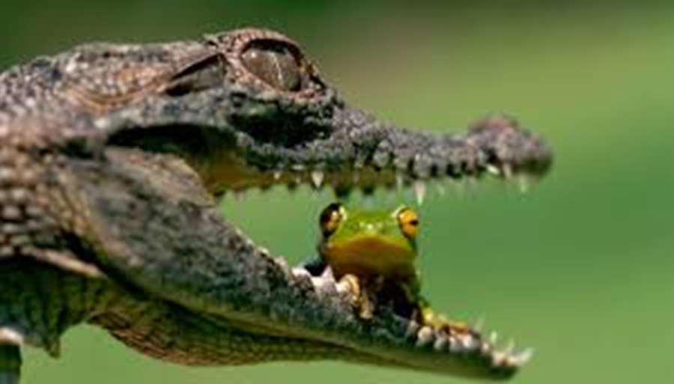
National Defense Field Goals
Familiarity with basic concepts of national defense and digital world
Knowledge of the adversarial system of Israel –
"players", interests, threats and opportunities
Familiarity with the field of national defense in Israel: Basic Concepts, Organizations, Process Strategies and Capabilities
Ability to make connections between national defense in Israel and the digital world and other areas in national security

Slide 6
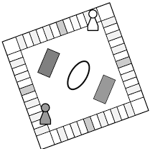
National Defense - The Global Season
The Awakening of Sunni Islam - Uriah Shavit
Rise of the Shiite Crescent in the Middle East - R. Zimet
Shia VS Sunnah M. Litback Military Strategy - D. Adamski
Lectures
National Security Fundamentals in Global View – A. Stern
World Terrorism - Lecturer? World Terror Day - 9/11 Globalization approaches and schools of thought- D. Navot Muslims in Europe
Europe tour National Defense elements will be implemented
Foreign Ministry visit
Course / Seminar
Tours
And what else?
Head of the National Security Council- M. Ben Shabat Nuclear Agreement - M. Zafri Udiz, A. Ster

Slide 7
National Defense - The Israeli Season
Security Concept and IDF Strategy - Chief of Staff
The Iranian threat - R. Zimet
Lectures
Regional tours
Jordan Tour North, South, West Bank and Jerusalem National defense technicalities (Hezbollah, ISIS, the Palestinian issue) were embedded (and more digital / cyber world
Basic Concepts in National Security - A Component of Defense - Planning: Boogie A. Shelah, Y. Amidror D. Meridor
National Defense Component in National Security College Commander Lectures
Nation states- A. Shavit Strategy - Experiments and Simulation
Course / Seminar
Tours
And what else?
Inspirational Terrorism - R. Elshich
Turkey's prime minister - a regional power – Ethan Nae

Slide 8
Head of the Intelligence Unit, Head of the GSS,
Head of the Mossad,
Police Commissioner, Commander of the Israeli Air Force
Head of the Operations Branch Israel's Nuclear Policy -
National Defense - Selection Season
Senior Lectures
Digital World Course- D. Raz Cyber Workshop - Cyber Headquarters –
Currently one day painted The politics of the technology Army and Society-
East tour
Intelligence Division 8200 GSS police institution Infrastructures
The content of the General
and Digital World will be embedded
Tours
Course / Seminar
And what else?
National Resilience - Defense of the Home Front
Space - Aspects of the General

Slide 9
Digital World Course
The Goal: The participant will be familiar with advanced technologies and their impact.
Will be exposed to the dilemmas and tensions involved in developing and using these technologies.
Content:
Basic concepts in computing, G5 communication, Artificial Intelligence (AI) IOT, Machine Learning (ML), BIG DATA, Robotics, Autonomous tools, Blockchain Computational Biology and more
Impact Analysis: Threats and opportunities - democratic state, ethics, regulation, privacy and more ...
Implementation and assimilation: Digital strategy, digital transformation
Professor Danny Raz Technion Faculty of Computer Science
Winner of the Yanai Award for Academic Excellence

Slide 10
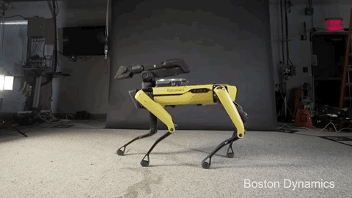
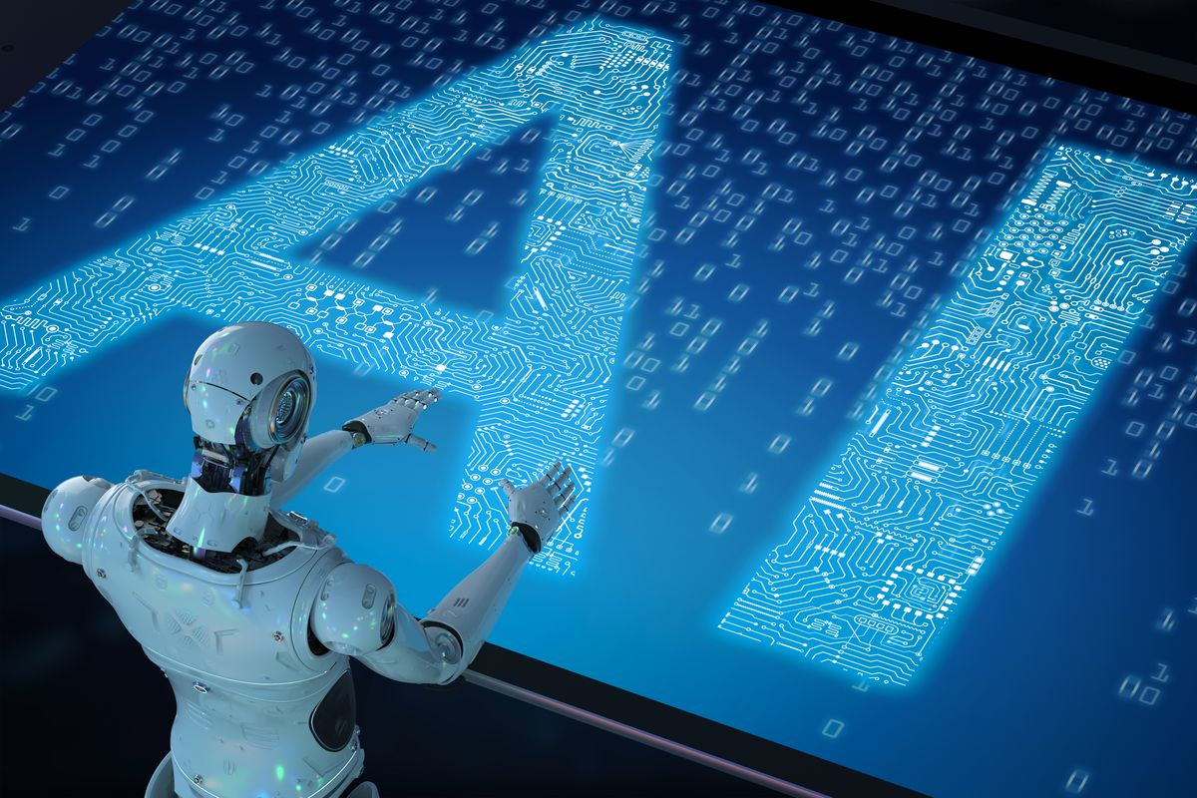
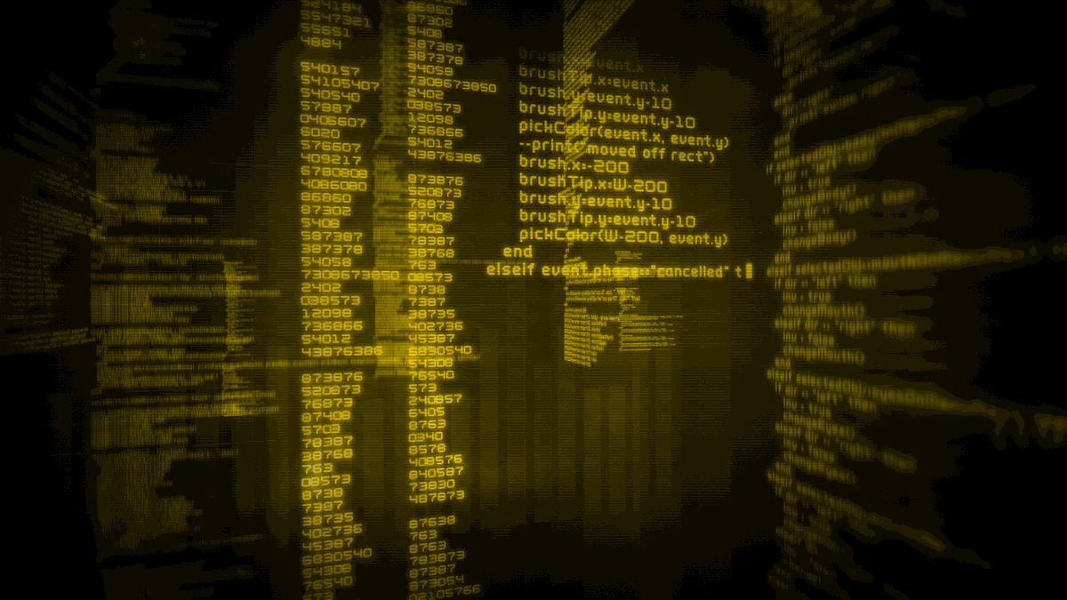
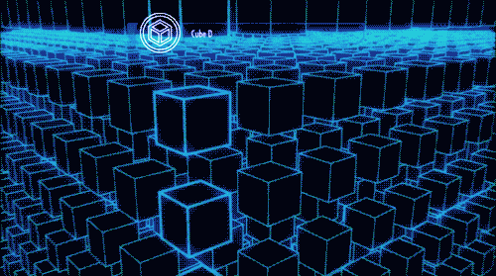
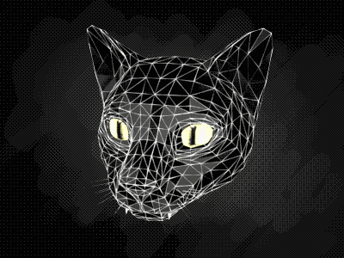
Robotics
Spacial Internet
AI
IOT
Internet 0.3
Internet 0.2
Internet 0.1
Technology
BIG DATA
BLOCKCHAIN
3D
ENERGY
Extended Reality
GEN EDITING

Slide 11
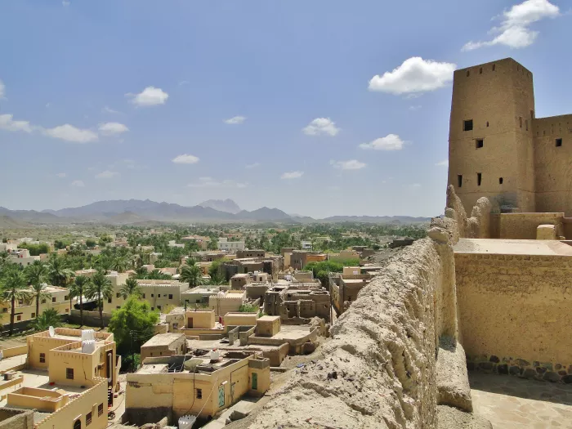
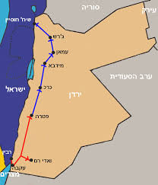
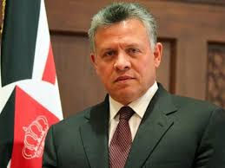
Yafit / Jordan Tour

Slide 12
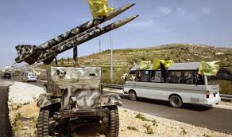
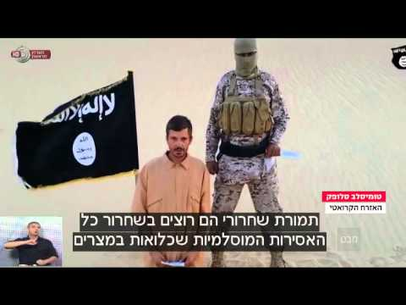
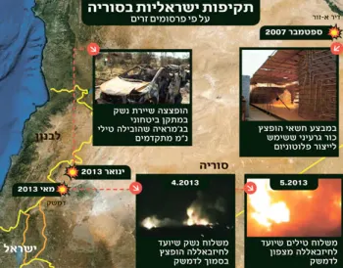
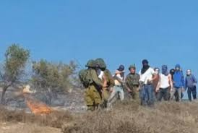
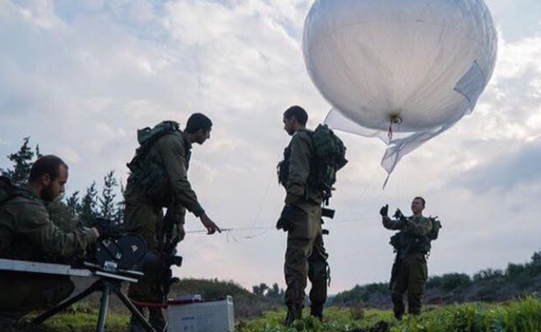
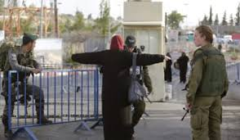
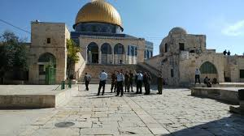
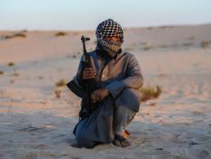
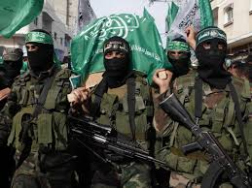
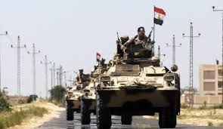
Tours: North, West Bank and Jerusalem, South

Slide 13
Tours
MOSAD Tour, Intelligence Division, Police, General Security Services
Familiarity with the organization
Exposing the organization's strategy and responding to threats
Familiarity with doing in the field of technology and cyber
Familiarity with dilemmas and tensions in her actions

Slide 14
National Defense - Integrative Season
Redundancy
Senior Lectures
General Financing Assistance Project
US General Tour + Digital World
Course / Seminar
Tours
and what else?
Field Research

