Slide 1
The Challenges of Economic Growth: How Narrow Interests and Economic Ignorance Dictate Public Policy
Omer Moav
June 2019

Slide 2
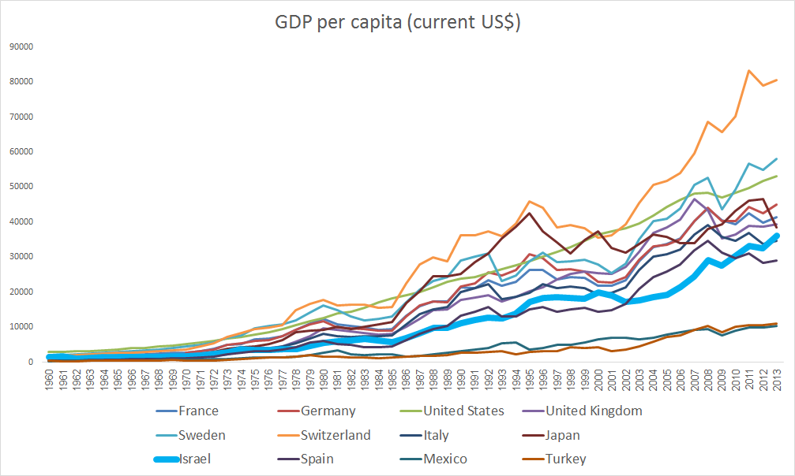
The State of Israel: Is it impossible to succeed any more?
Source: The World Bank

Slide 3
Policy: Objective And Means
Goal: Welfare and poverty reduction
The purpose of the policy: public welfare, with an emphasis on improving the welfare of the weak. Focusing on reducing poverty rather than reducing inequality.
The way: an increase in labor productivity and reducing the prices of consumer goods

Slide 4
Policy: Objective and Means
Means:
1. Free international trade
During the 1990s, many products were imported: iron and steel for building, chemicals, pharmaceuticals, fertilizers, film, tires and leather products, footwear, ceramics, glass, motors, electric conductors, textiles and more.
To date, there are many barriers to imports, especially in agriculture and food. The barriers are not only quotas, they are also standards, regulation and bureaucracy, preference for local produce and requirements of mutual acquisition in public and government auctions.

Slide 5
Policy: Objective and Means
Means:
Free international trade
Flexibility in the labor market (canceling tenure)
Private schools financed by the public (and Ochers)
Privatization / Outsourcing
Reducing regulation in transportation and adoption of congestion fees
Reduction of tax rates and cancellation of exemptions and benefits
Reducing the right to strike
Further reforms increase economic freedom ...

Slide 6
Public Opinion In Israel:
69% of Israelis support a social-democratic approach in social services (investment in social services, raising the minimum wage)
20% identify more with the capitalist approach to economic and social issues
(A somewhat problematic survey by the Berl Katznelson Foundation)

Slide 7
The "Chicago Boys" Reform In Chile
1. Free international trade
2. Focusing on reducing poverty rather than inequality
3. Privatization of government companies
4. Flexibility of the labor market
5. Personal pension
6. Property rights in mines
7. Parental authority in the choice of schools
8. Freedom of choice in health
9. Private infrastructure
10. Independence of a central bank

Slide 8
 | 2010 © www.josepinera.com

Slide 9
The Case Of Sweden
(Lecture By Prof. John Hassler)
After a century of growth at the highest rate in the world, an economic slowdown from the 1970s
Excess regulation
Marginal taxation at high rates
Determining wages regardless of performance, inflation
Lack of sufficient competitiveness
Non-sustainable budget policy
“Success breeds stupidity”

Slide 10
The Reform
Massive cuts in government spending
Independence of the Central Bank
Reducing corporate taxes, lowering the marginal tax from 90% to 50%, expanding the tax base and consolidating VAT rates
New wage agreement - the basis according to the export industries
Pension reform - a sustainable system that does not impose a burden on future generations
Privatization is widespread: trains, communications, taxis, schools, post offices, electricity

Slide 11
Swedish Real GDP per capita relative to average of peers*
* AUS, AUT, BEL, CAN, DEN, FIN, FRA, GER, GRC, ICE, IRE, ITA, JAP, KOR, MEX, NTH, NEZ, NOR, POR, SPA, SWE, SWI, TUR, UK, US

Slide 12
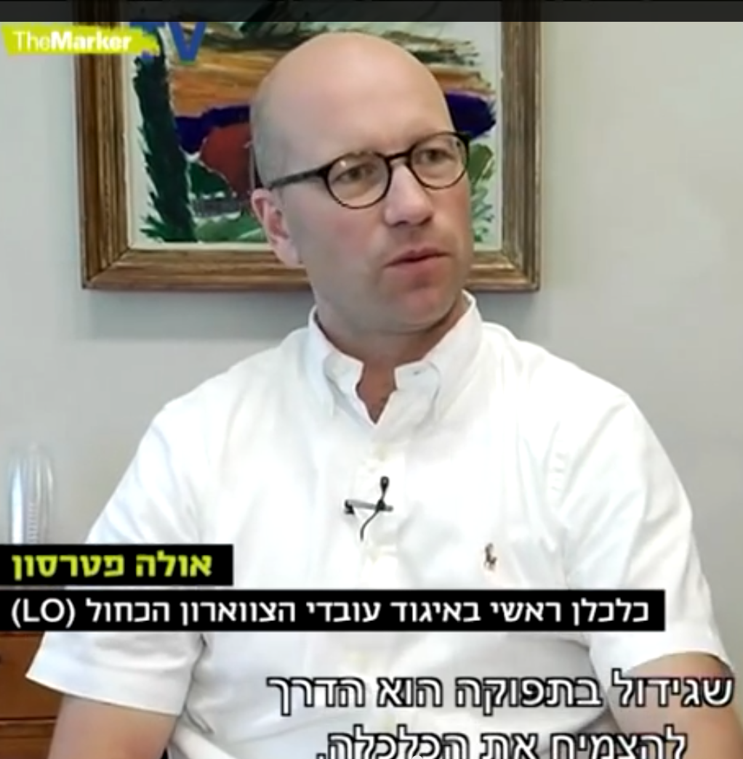
Worker’s Committees In Sweden
From an interview conducted by the TheMarker with the chief economists of the two largest labor organizations in Sweden:
"Increasing productivity and efficiency is the path to economic prosperity ... This is the way we want our economy to grow, and this is the best way to get high salaries for our employees."
Notes:
קישור לראיון של גיא רולניק:
http://www.themarker.com/markerweek/thisweek/1.2262810

Slide 13
Worker’s Committees In Sweden
"Companies that can not afford to pay minimum bar of raising wages have to disappear ... The idea is to save the sailor, not the ship."
Notes:
קישור לראיון של גיא רולניק:
http://www.themarker.com/markerweek/thisweek/1.2262810

Slide 14
Worker’s Committees In Sweden
"We used to have a textile industry, and it disappeared completely, we had shipyards, and we do not have any more ... This has not led to an increase in unemployment, but to an increase in efficiency and productivity."
Notes:
קישור לראיון של גיא רולניק:
http://www.themarker.com/markerweek/thisweek/1.2262810

Slide 15
Worker’s Committees In Sweden
"It's not hard to fire people in Sweden," he says, "With collective layoffs, for example, during a recession, it’s very easy to fire employees”
"I do not think that the tax system should be based on corporate taxes, and they should not be a large part of the tax base because they are very mobile"
Notes:
קישור לראיון של גיא רולניק:
http://www.themarker.com/markerweek/thisweek/1.2262810

Slide 16
International Trade

Slide 24
Import And Export
"And the most outrageous of them is the Minister of Finance's "magic solution": to allow the importation of dairy products, to flood the country with cheap dairy products from Turkey, for example, a destructive solution, and to bring about the closure of factories and layoffs on the “fashionable altar” of the “cottage storm excuse.” "Exactly the opposite should be done: not an opening for imports, but encouragement and active assistance for the export of Israeli cottage cheese and similar products to Europe."

Slide 25
Be sure to purchase
OUR PRODUCTS !
The banana from the Transjordan Valley, from the Sharon, stamped with the lead stamp of the Union for Local Produce –
IS THE HEBREW BANANA !
The foreign banana, forcing its way into the Hebrew market, is undermining the very foundations of the Hebrew economy
The agriculture Department,
The Union for Local Produce

Slide 26
Import and Export
Export
Import

Slide 27
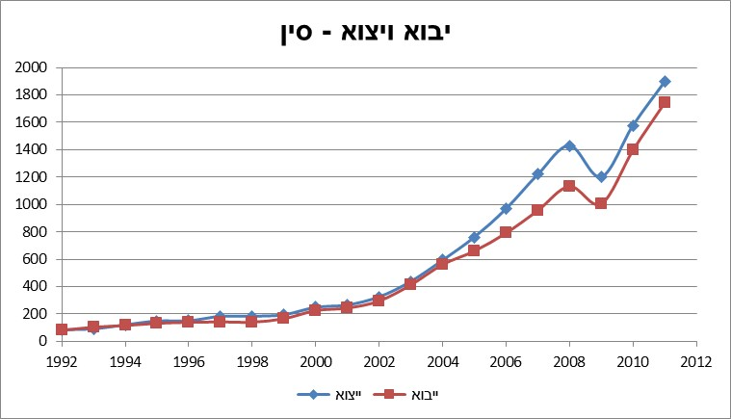
Import and Export
Import and Export- China
Source: United Nations Commodity Trade Statistics Database

Slide 28
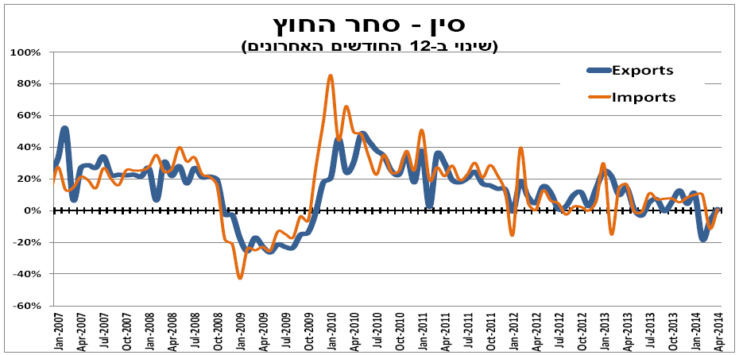
Import and Export
Import and Export- China
(Change in the last 12 months)

Slide 29
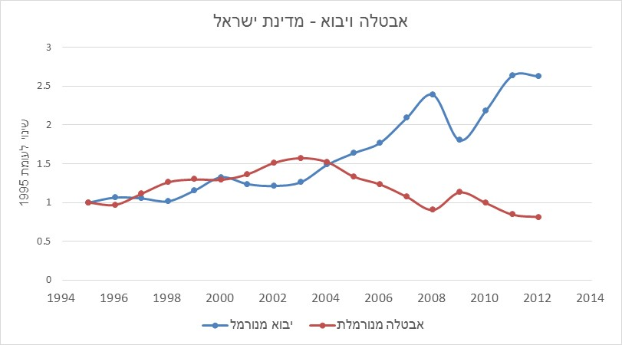
Imports and unemployment
“Unfortunately, just about every attempt to quantify the overall employment effect of trade is an exercise in futility. This is because the impact of trade on the total number of jobs in an economy is best approximated by zero. Total employment is not a function of international trade.” Irwin, Douglas. Free Trade Under Fire. Princeton University Press, 2009. p. 104.
Unemployment and Imports - State of Israel
Source: Central Bureau of Statistics, Bank of Israel

Slide 30
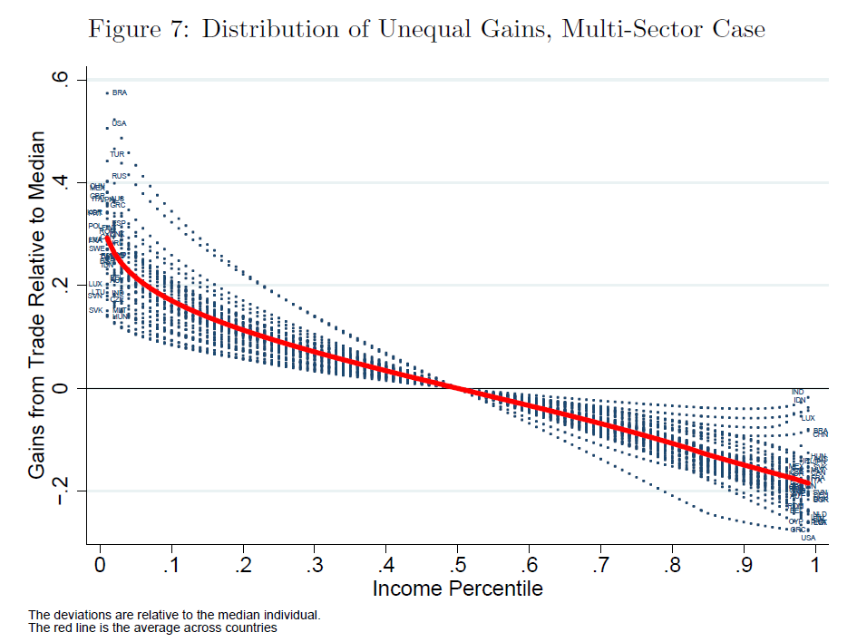
Who benefits from imports?
Poor people benefit from trading far more than rich people, especially in countries with high inequality
According to new studies, the profits of poor people as consumers outweigh the potential harm to their wages as a result of opening the economy to trade
Source: Khandelwal, A., & Fajgelbaum, P. (2013). Measuring the Unequal Gains From Trade. In 2013 Meeting Papers (No. 456). Society for Economic Dynamics.

Slide 31
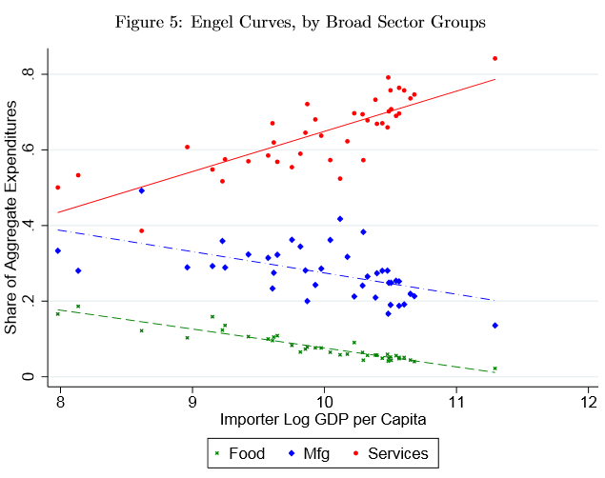
Who benefits from importing?
A main reason for the result: access to cheap imported products
The poor are more likely than the rich to consume (in relation to their income) tradable goods whose prices fall when the economy opens to imports
Source: Khandelwal, A., & Fajgelbaum, P. (2013). Measuring the Unequal Gains From Trade. In 2013 Meeting Papers (No. 456). Society for Economic Dynamics.

Slide 32
How to "Grow Hondas"
“There are two way we can produce automobiles. We can build them in Detroit or we can grow them in Iowa. Everyone knows how we build automobiles. To grow automobiles, we first grow the raw material from which they are made — wheat. We put the wheat on ships and send the ships out into the Pacific. They come back with Hondas on them.
From our standpoint, growing Hondas is just as much a form of production — using American farm workers instead of American autoworkers — as building them. What happens on the other side of the Pacific is irrelevant; the effect would be just the same for us if there really were a gigantic machine sitting somewhere between Hawaii and Japan turning wheat into automobiles. Tariffs are indeed a way of protecting American workers — from other American workers.”
David Friedman – Hidden Order

Slide 33
Parking and transportation

Slide 35
Housing

Slide 36
Housing prices
“A few years ago, and you and my ministerial friends remember this, we said, and I said in the south, 'Buy apartments - not just in Be'er Sheva, buy apartments in Dimona, in Yeruham, buy apartments.' There are those who have heard, and implemented, and some did not"
Prime Minister Netanyahu (December 2016), about his predictability regarding his government's failure to curb housing prices

Slide 37
Housing prices
"There are economists ... who object to VAT reduction, and it's fine because the VAT reduction is not intended for economists ... "
(Yair Lapid, justifying his plan for zero VAT on apartments)
"Eventually they will come down, even an elevator eventually comes down"
(Moshe Kahlon, proving that house prices will drop)
Notes:
הציטוט – מעמוד הפייסבוק של יאיר לפיד

Slide 38
Housing prices
VAT is zero
Price per occupant
Taxation of a third apartment

Slide 39
Supervision of rental rates
A shortage
Inadequate maintenance
Black market
Destruction of the rental market
Injury to employment mobility

Slide 40
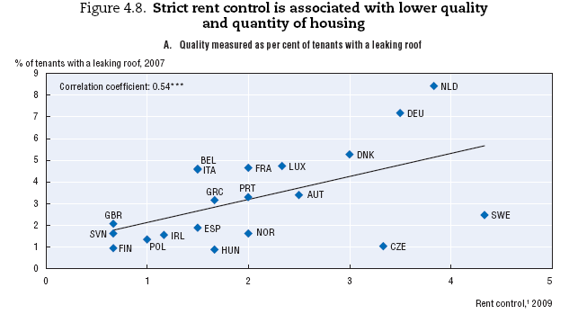
Supervision of rental rates
Source: Andrews, D., Sánchez, A. C., & Johansson, Å. (2011). Housing and the economy: policies for renovation. Economic Policy Reforms 2011: Going for Growth. OECD
Notes:
מקור:
דוח OECD שהורדתי, www.oecd.org/dataoecd/42/11/46917384.pdf
Andrews, D., Sánchez, A. C., & Johansson, Å. (2011). Housing and the economy: policies for renovation. Economic Policy Reforms 2011: Going for Growth. OECD

Slide 41
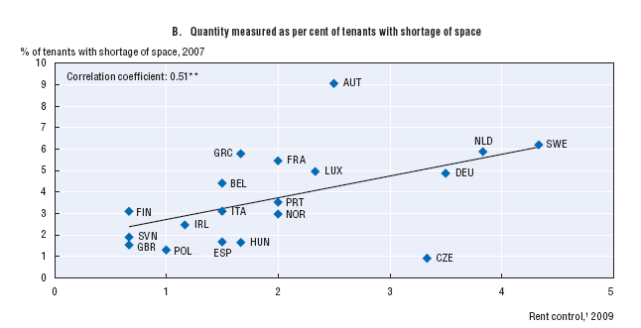
Supervision of rental rates
Source: Andrews, D., Sánchez, A. C., & Johansson, Å. (2011). Housing and the economy: policies for renovation. Economic Policy Reforms 2011: Going for Growth. OECD
Notes:
מקור:
דוח OECD שהורדתי, www.oecd.org/dataoecd/42/11/46917384.pdf

Slide 42
Supervision of rental rates
Source: Andrews, D., Sánchez, A. C., & Johansson, Å. (2011). Housing and the economy: policies for renovation. Economic Policy Reforms 2011: Going for Growth. OECD
Notes:
מקור:
דוח OECD שהורדתי, www.oecd.org/dataoecd/42/11/46917384.pdf

Slide 43
Supervision of rental rates
“There are, effectively, two rental markets in Manhattan. Roughly half the apartments are under rent regulation, public housing or some other government program. […] most housing programs tie government support to an apartment unit, not a person. […] It creates enormous incentive for people to stay in apartments that no longer fit their needs […]. […] those who are lucky enough to have a rent-regulated apartment can live in the best parts of the city for next to nothing and everyone else is shunted aside.”
Notes:
מקור:
http://www.nytimes.com/2013/07/28/magazine/the-perverse-effects-of-rent-regulation.html?pagewanted=all&_r=2&

Slide 44
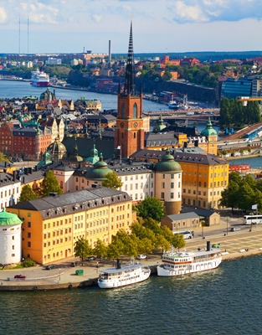
Supervision of rental rates
“A charming one-bedroom apartment in what may be Stockholm's trendiest neighborhood for a mere 410 rent-controlled euros a month: sound too good to be true? It is.
And the catch was steep. To lay his hands on the rental contract, Johannes, a 36-year-old engineer, had to pay a whopping 130,000 kronor (15,000 euros) under the table.
Notes:
שבדיה:
http://www.swedishwire.com/economy/5978-stockholm-egalitarian-rental-boost-black-market

Slide 45
Supervision of rental rates
Berlin: Supply and Demand is Challenging Affordable Housing
While in Israel the berlin rental system is celebrated, the shortage in affordable housing is reaching half a million units at a rate of 4,500 per year, and the rent itself is rising in the free market.
Albeit the regulator is trying to handle this problem, he cannot keep the ideal; affordable housing in the city.
"... The hot spot of the Berlin housing market are apartments vacated by the departure of tenants. Here the owner of the apartment is entitled to specify a higher rent, as he sees fit and according to the rules of the free market ... Apartment owners do much to evict tenants from their apartments in order to sell them at a market price or to rent them at free market prices.
The common step amongst apartment owners is the imposition of economic pressure, inter alia, by installing "repairs", particularly energy saving, thus imposing a monetary burden on the tenant - expressed in a mandatory 11% share of the cost of the improvements, or alternatively negotiating the payment of a single evacuation fee - for leaving the apartment. "
Notes:
ברלין:
http://www.themarker.com/realestate/1.2304284

Slide 46
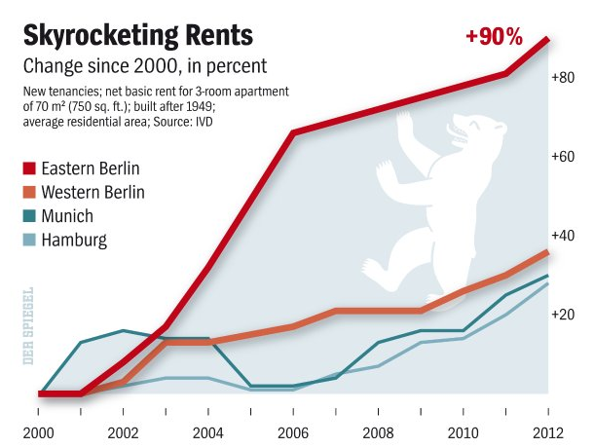
Supervision of rental rates
מקור: Spiegel online international
Notes:
מקור:
http://www.spiegel.de/international/germany/bild-859420-408913.html
להוסיף שקף על דמי מפתח, ועל ניו יורק, בנו יותר בתי יוקרה

Slide 47
Israel - Protection of the tenant law of 1954
A terrible law that has transferred properties from their owners to tenants has led to a neglect and greatly harmed the rental market
It's hard to cancel a bad laws ...

Slide 48
Only a bomb is more effective than rent control with the aim of destroying a city (Swedish Socialist economist, Isser Lindback)
Gunnar Myrdal Nobel Prize laureate in the economy of the Swedish welfare state:
“Rent control has in certain Western countries constituted, maybe, the worst example of poor planning by governments lacking courage and vision.”

Slide 49
“A Rent Affair” PAUL KRUGMAN
“Sky-high rents on uncontrolled apartments, because desperate renters have nowhere to go -- and the absence of new apartment construction, despite those high rents, because landlords fear that controls will be extended? Predictable.”
“Bitter relations between tenants and landlords, with an arms race [] to force tenants out [] and constantly proliferating regulations designed to block those strategies? Predictable.”

Slide 50
The Economic Journalism in Israel?
"Calcalist" "The regulation that could help tenants“
About half a year later, the Finance Ministry and the Justice Ministry are preparing a memorandum of the Fair Lease Law. If the law were implemented in 2011, the renters would be spared a 20%
"Globes" "A new bill purports to bring about a turnaround in renting apartments“
The article presents only the arguments of the initiators of the bill
“TheMarker" "Global experience shows: supervision of rent may also harm tenants“
The content of the article mainly presents the arguments of the law's proposers, but also reservations

Slide 51
YNET
"The Fair Lease bill will generate stability and fairness in the leasing market," Lapid said today. "With its help, we can provide the tenants assurance about the price of their rent for a period longer than a year. We can assure that the rented places are livable. We will encourage the establishment of a rental registry - which will include a pool of leases"
Minister of Justice, Tzipi Livni added: "The law determines that a livable apartment needs to be larger than 26 squared meters, with running water, electricity, sewage, [...]“

