Slide 1
National Security in an Era of Transformations
and Changes
Lesson No.2 [The Global System]
September 2020

Slide 2
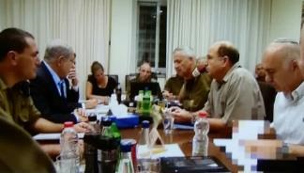
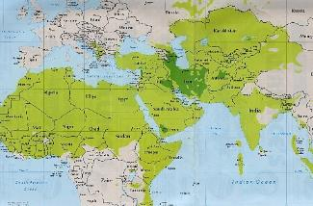
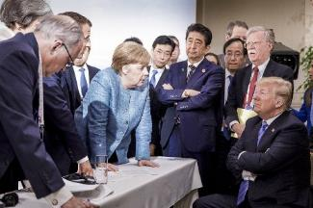
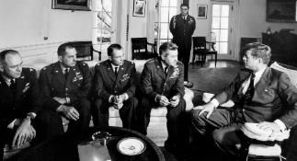
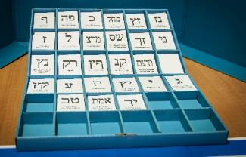
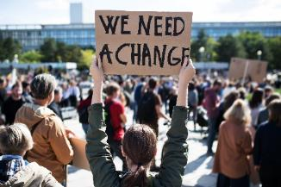
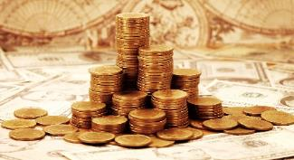
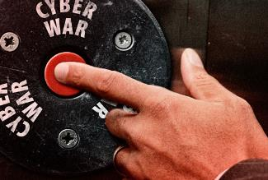
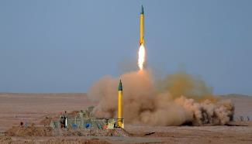
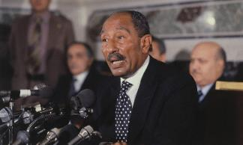
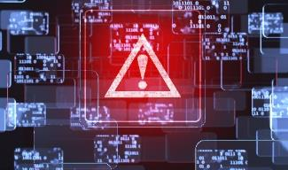
4
3
2
1
Thinking & Making Decisions
The Regional System
The Global System
Introduction and Basic Concepts
8
7
6
5
Contemporary Societies
National Security in the Post-truth era
Regime
Political Economy
12
11
10
9
Corona Crisis
National Defense (2)
National Defense (1)
Politics & Diplomacy
13
National Security on the 21st century

Slide 3
2
1
The Regional System
The Global System
National Security
Threats and Opportunities
Thinking Patterns
The National System
4
3

Slide 4
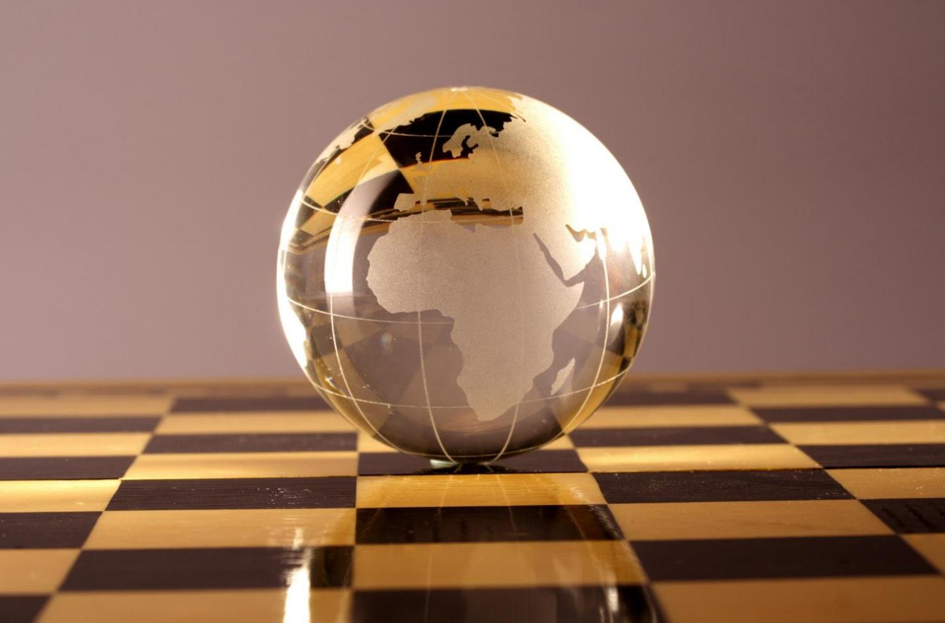
The Global System - 30 Years to the End of History I Disciplines and Theories

Slide 5
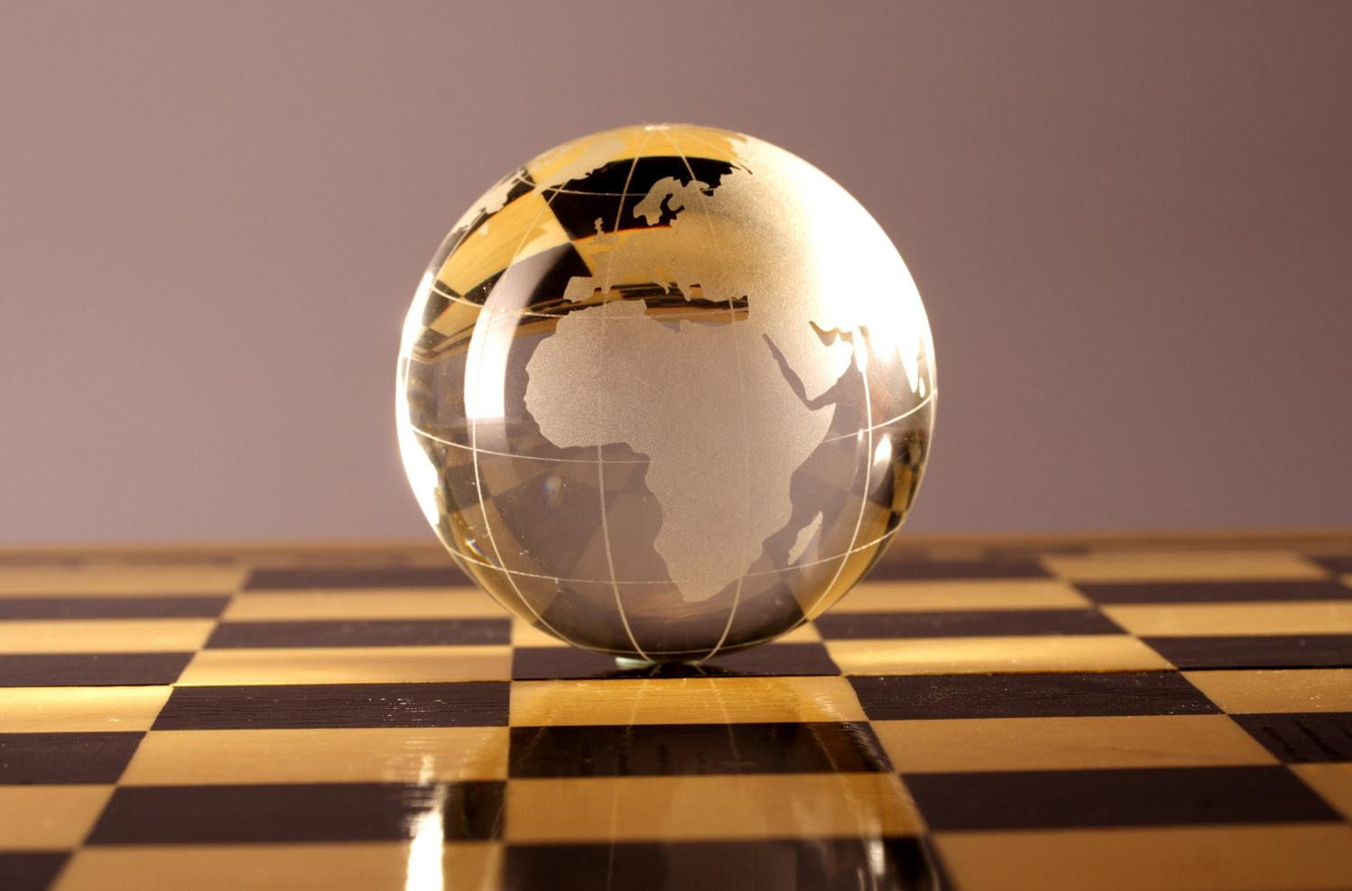
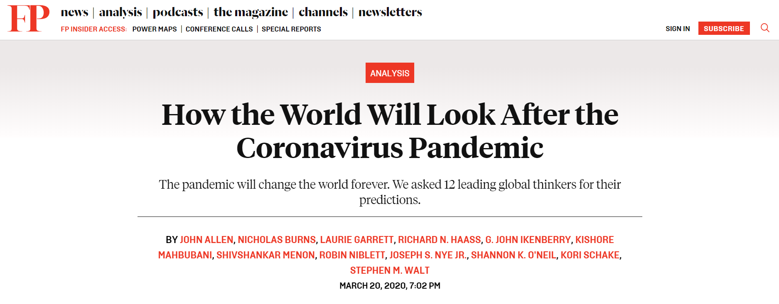
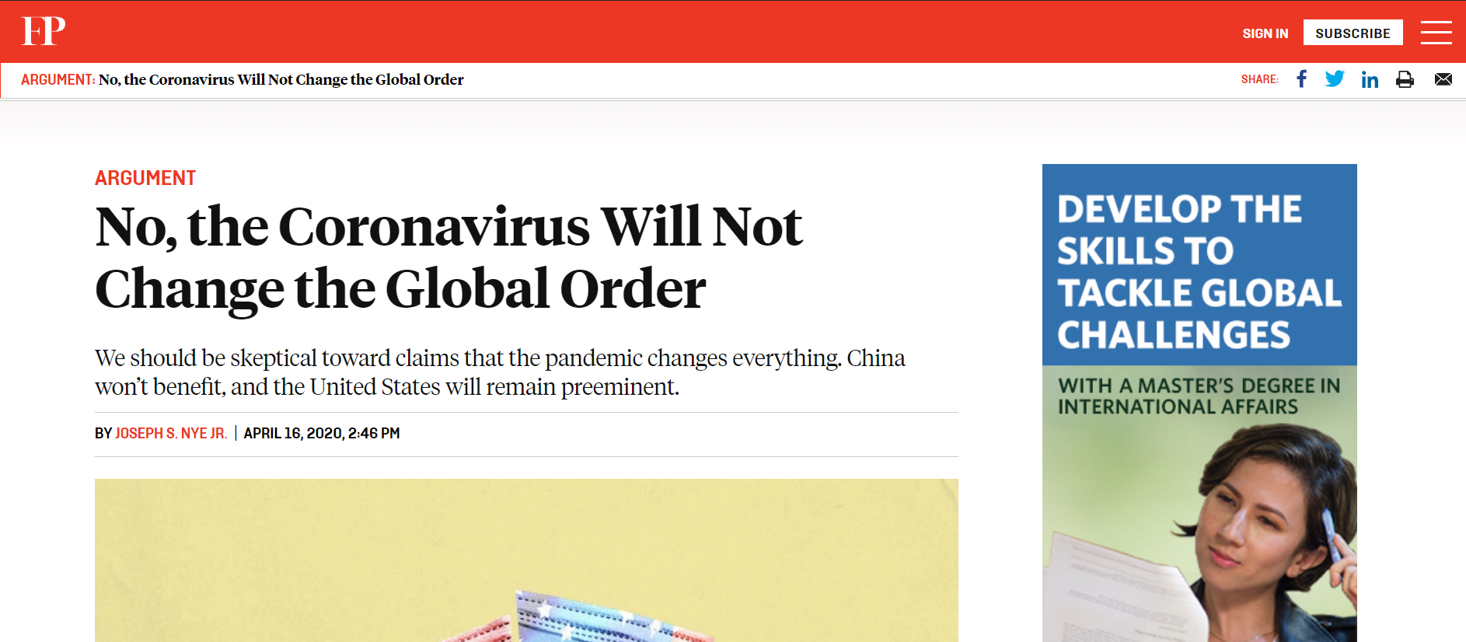
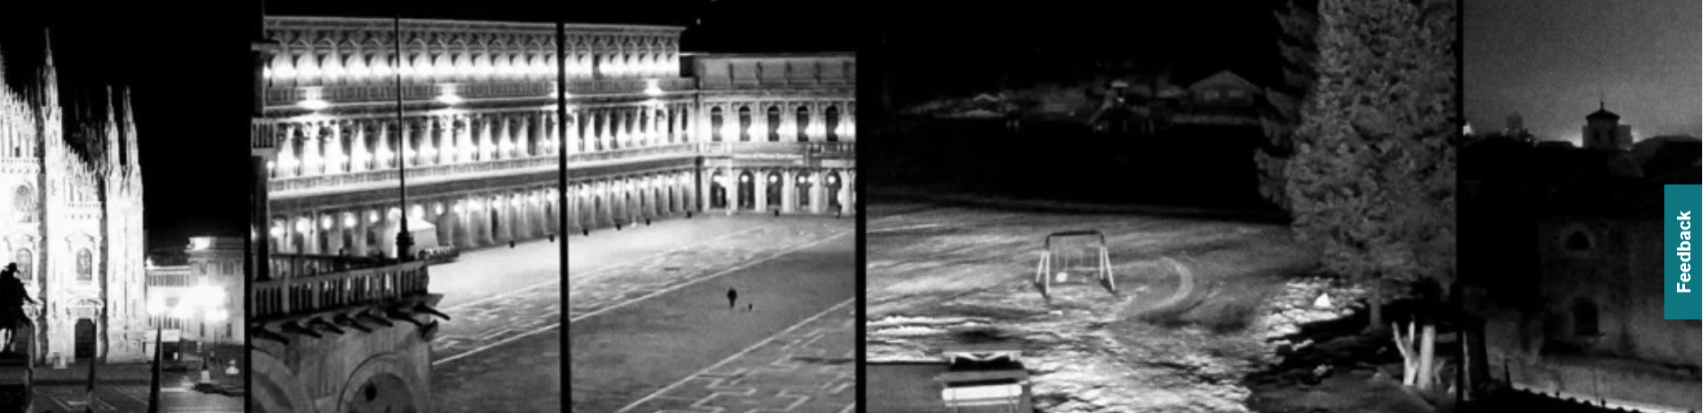
The Global System - Consequences of the Coronavirus Crisis

Slide 6
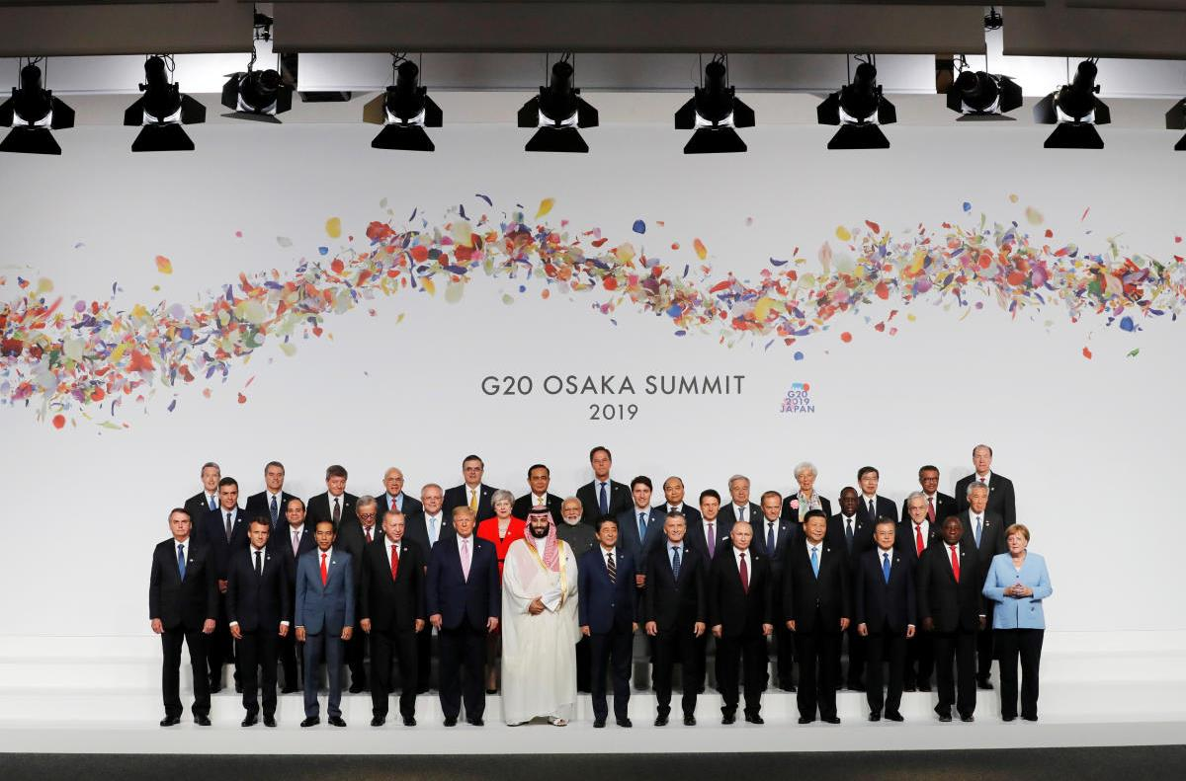
"Global System" - Conflict Structure (Rivalry) | Images and Ideas

Slide 7
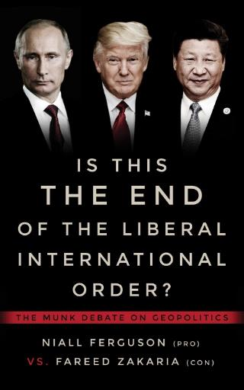
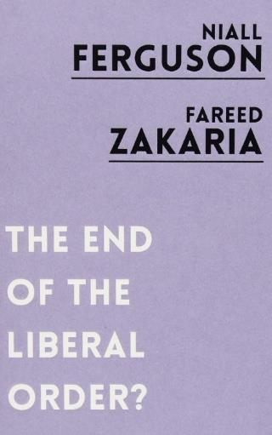
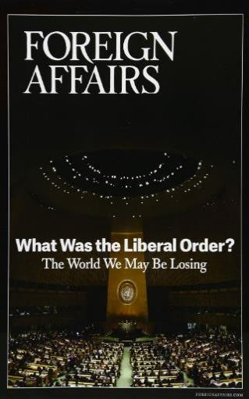
"The Global System" - The Scenes of Struggle of the "Liberal Idea"

Slide 8
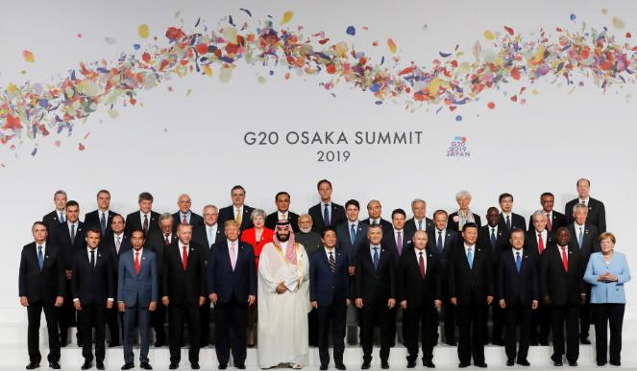
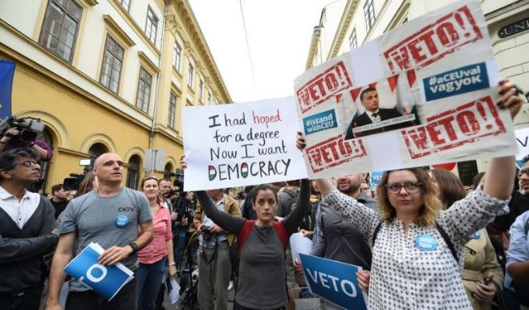
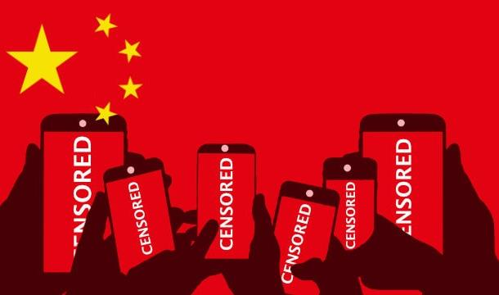
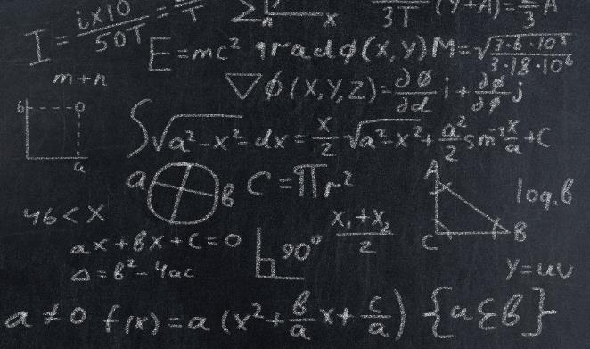
1
2
Scene of Struggle # 1 -
World Arrangement
Scene of Struggle # 2 - Democracy
3
4
Scene of Struggle # 3 - Authoritarianism
Disciplines and Theories

Slide 9
1989 - Start Point I The Series of Dramatic Events I The End of the Cold War

Slide 10
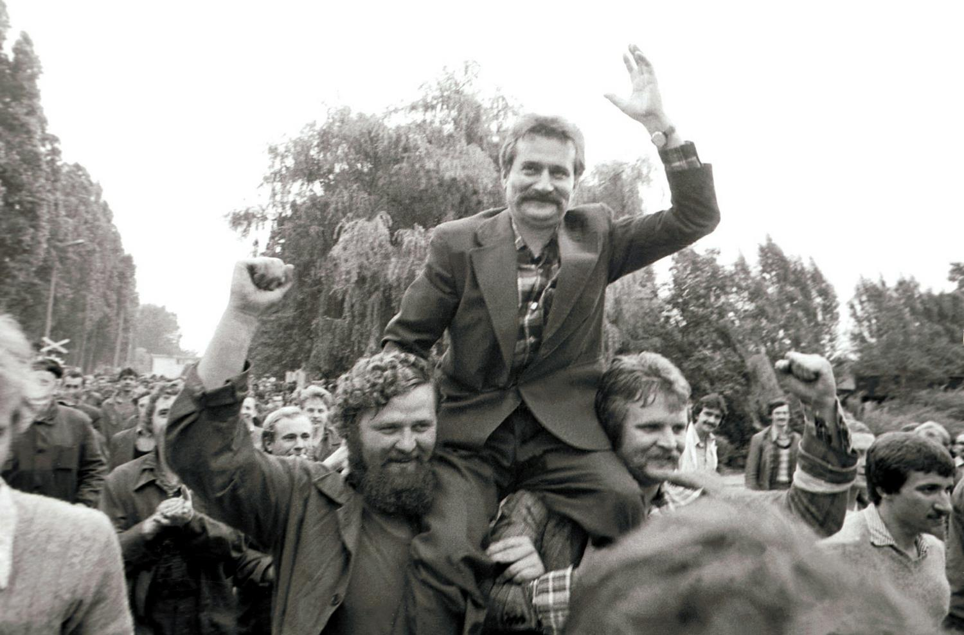
1989 - June - Solidarity Wins Polish Elections

Slide 11
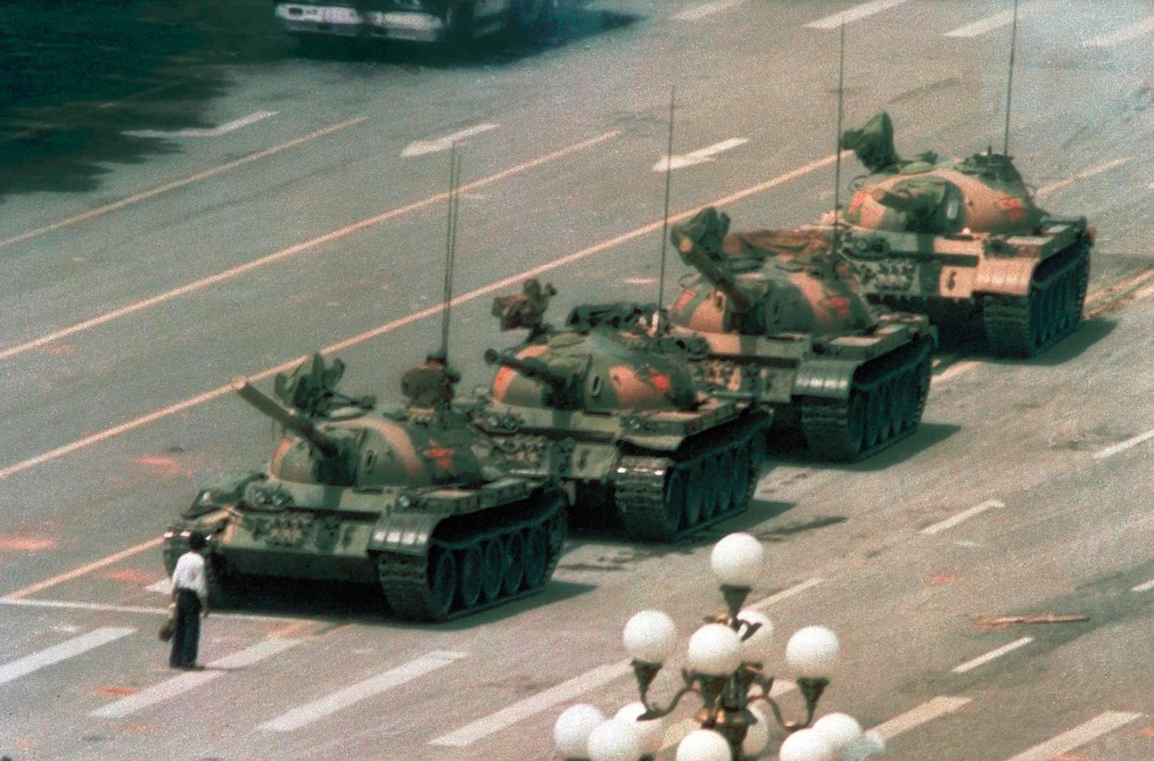
1989 - June - "The Unknown Rebel"

Slide 12
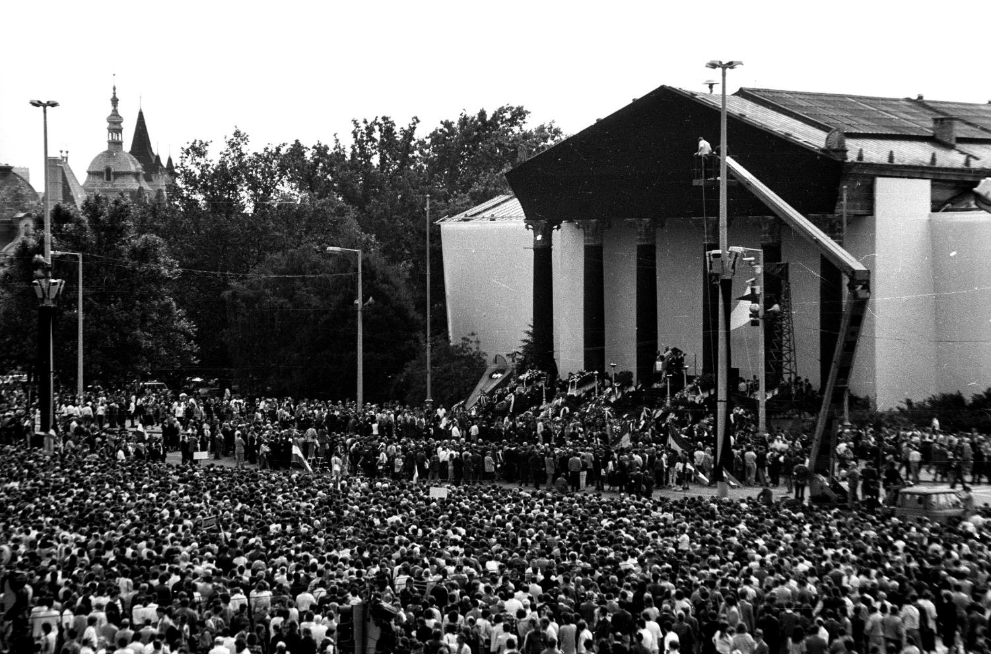
1989 - October - Hungary Becomes a Democratic Republic

Slide 13
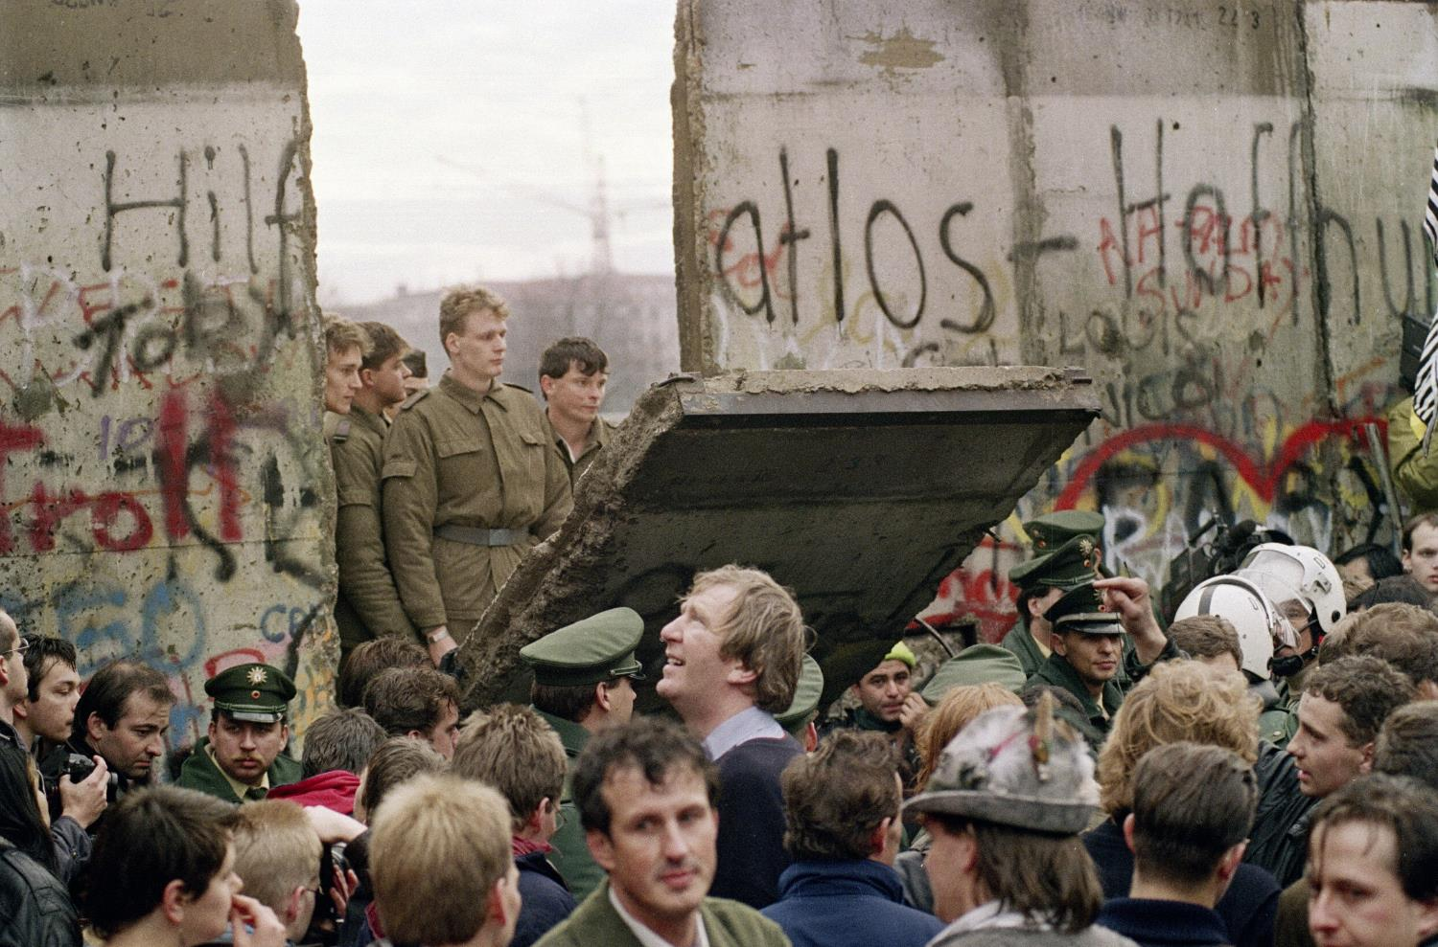
1989 - November - The Berlin Wall Falling Down

Slide 14
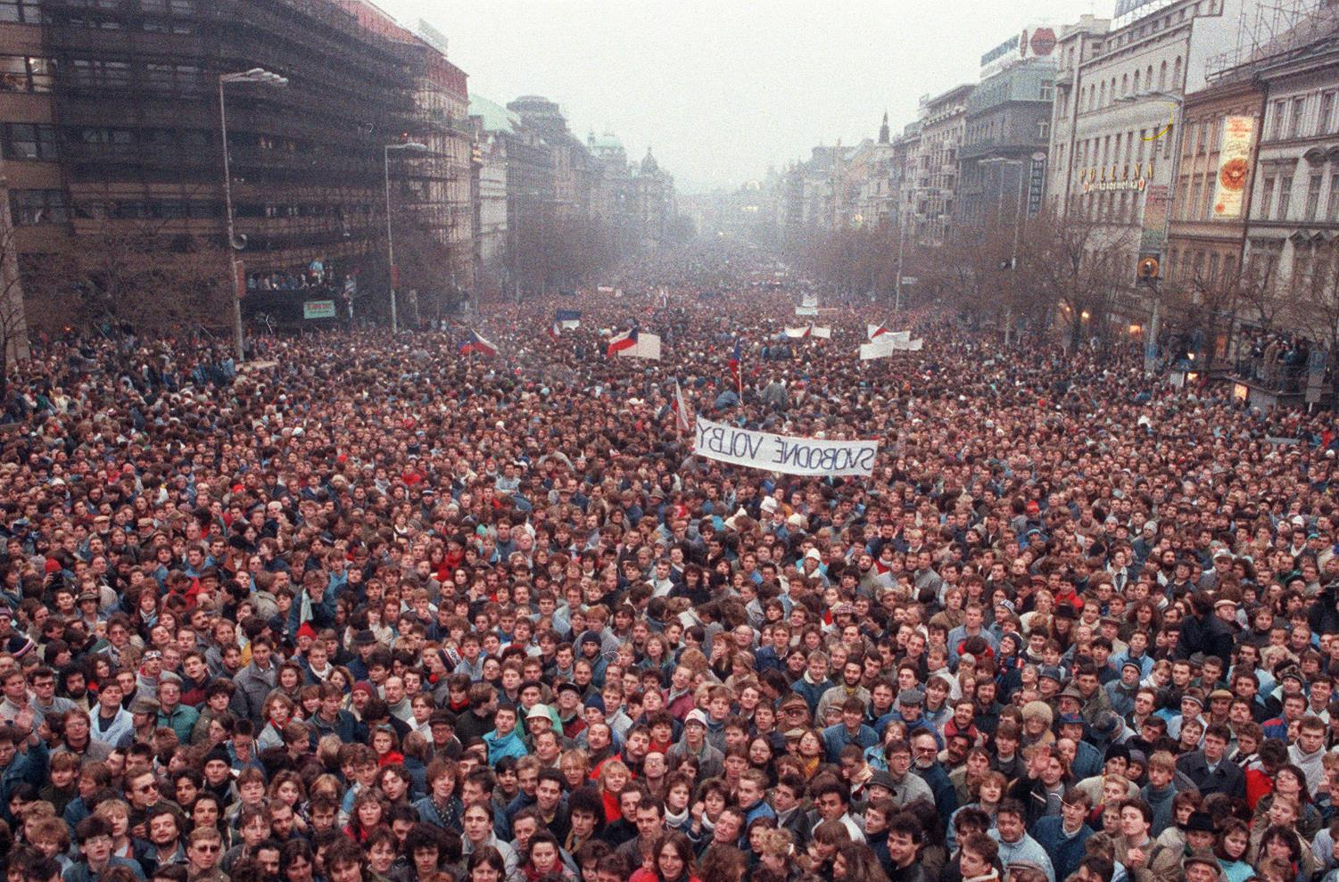
1989 - November - The Communist Regime in the Czech Republic Collapses

Slide 15
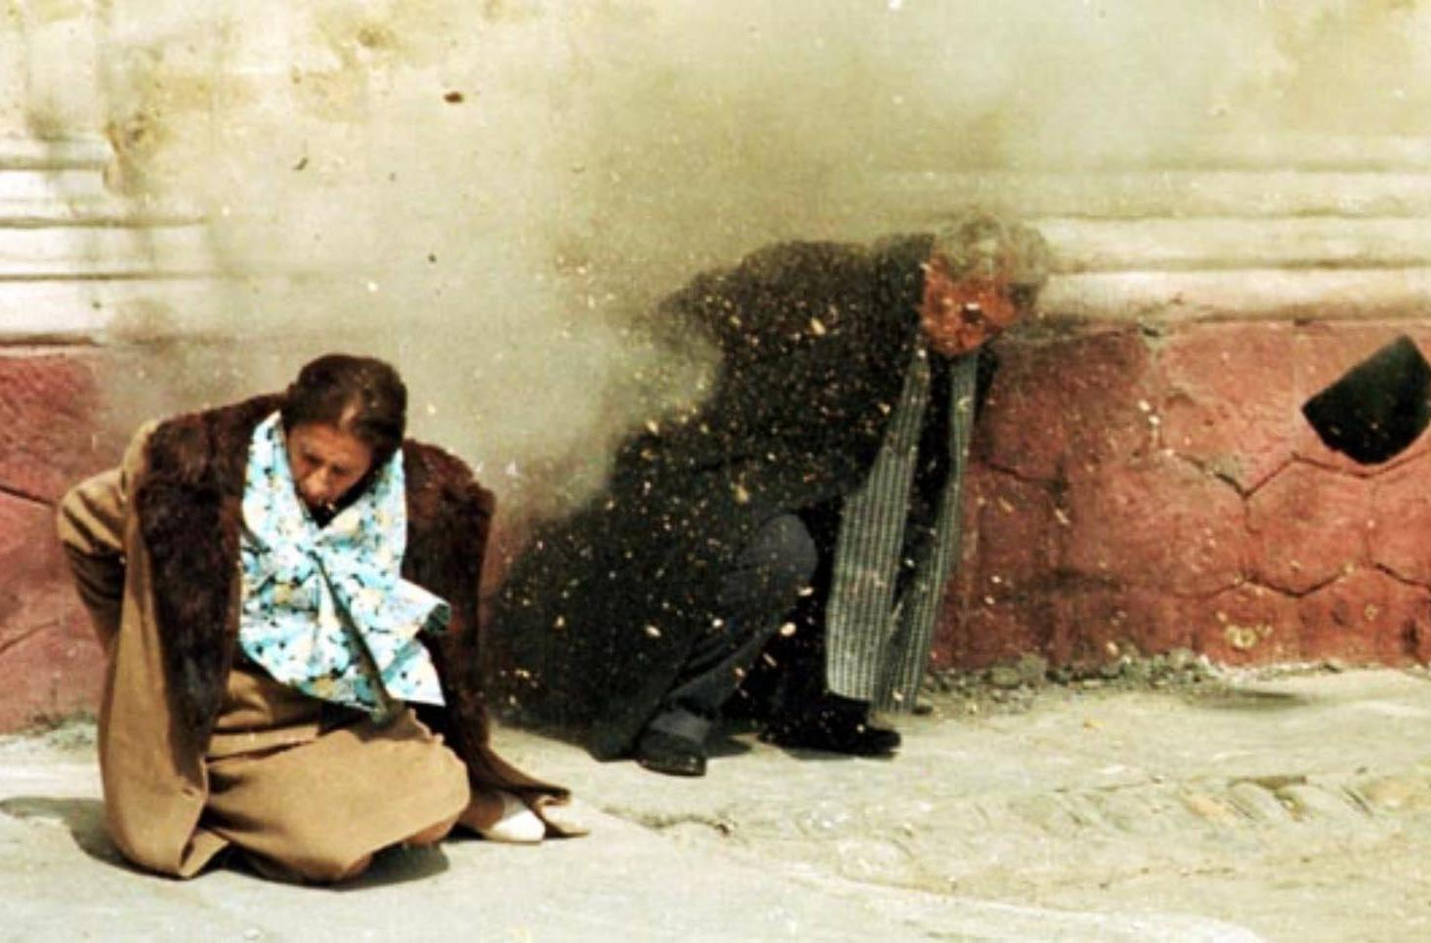
1989 – December – The Execution of Ceaușescu Couple

Slide 16
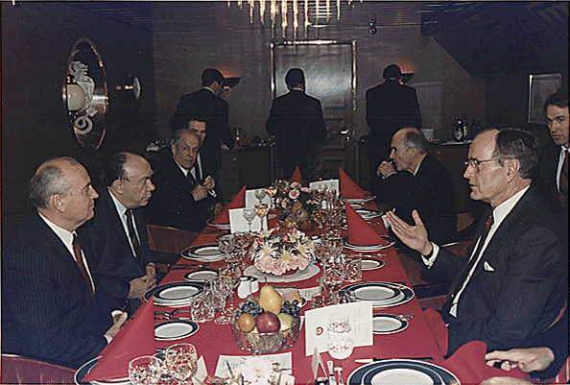
1989 - December - Declaration of the End of the Cold War (Malta Conference)

Slide 17
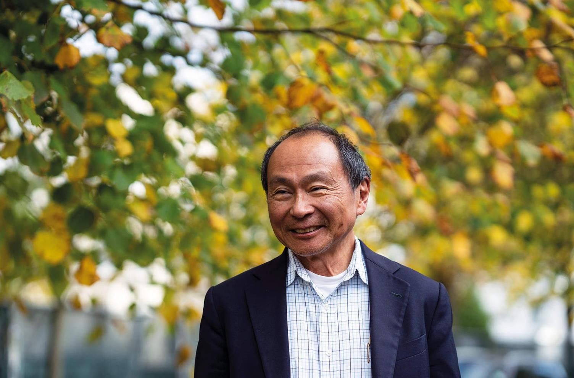
Francis Fukuyama – “The End of History” (1989, 1992)

Slide 18
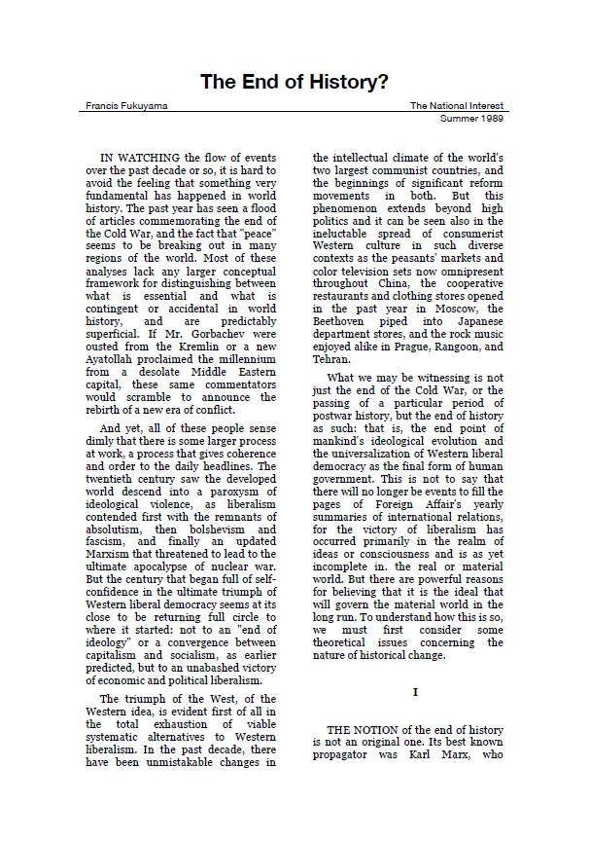
"… [humanity has reached] not just ... the passing of a particular period of post-war history, but the end of history as such: That is, the end-point of mankind's ideological evolution and the universalization of Western liberal democracy as the final form of human government." …"
Francis Fukuyama, The End of History?, 1989

Slide 19
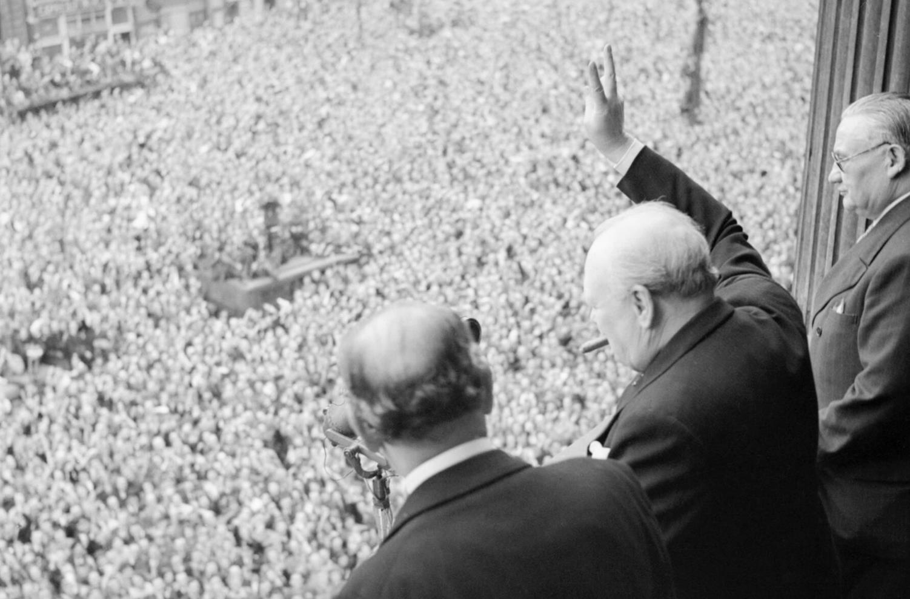
In Western Perception - An Analogy to the Victory of Nazism and Fascism (1945)

Slide 20
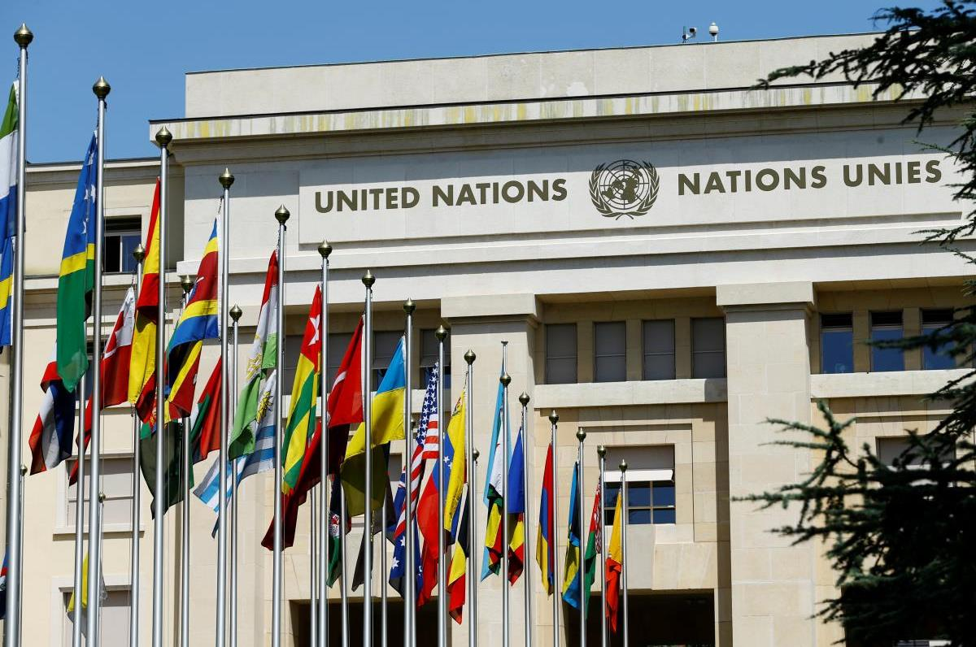
"The Liberal Idea" - International Institutions

Slide 21
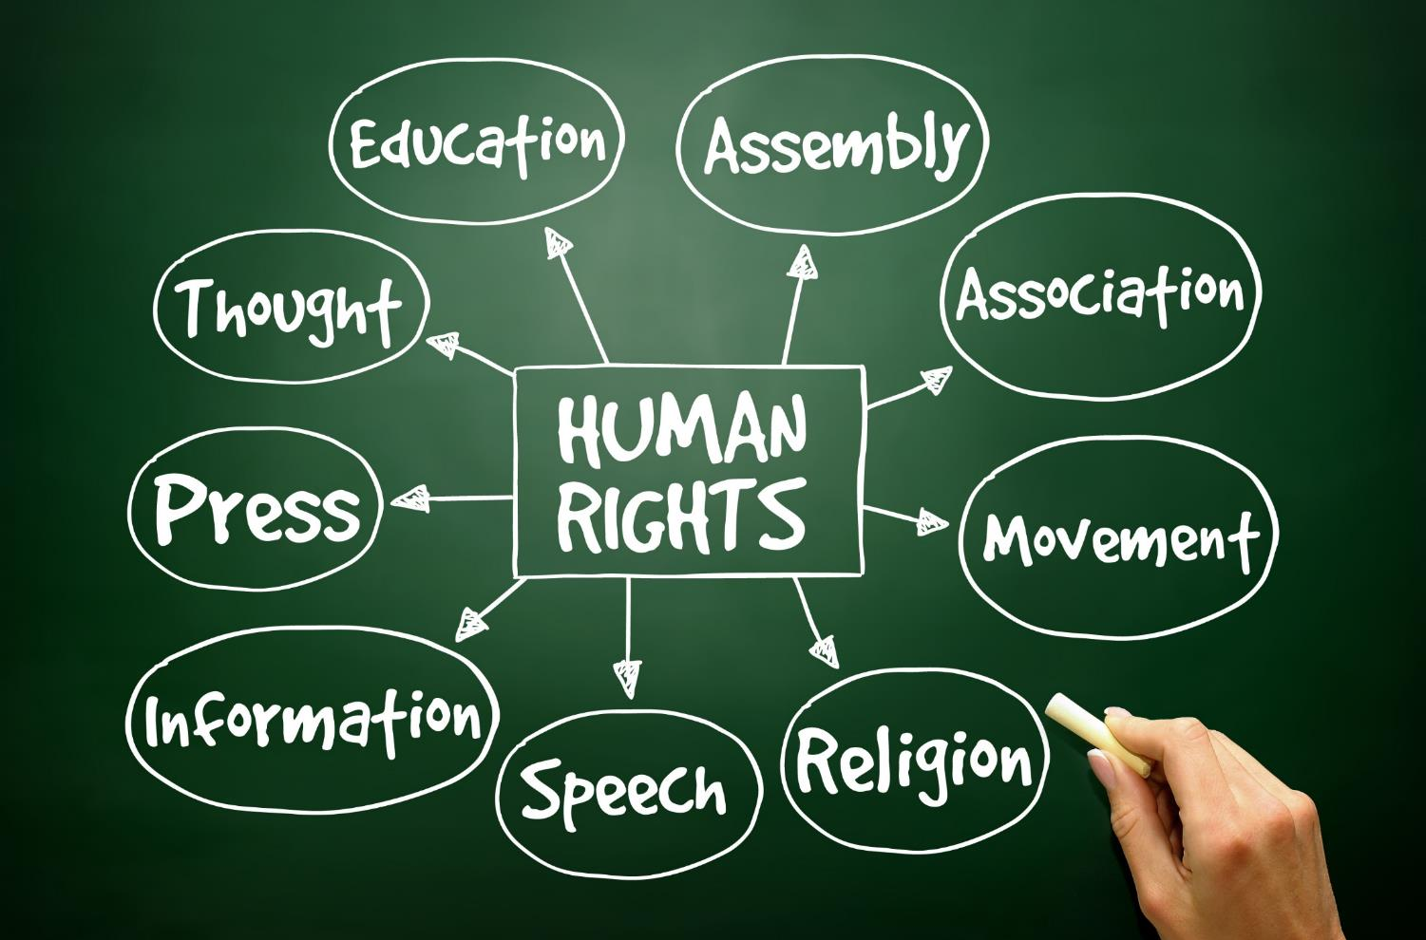
The “Liberal Idea” - Universal, Basic, Equal and Absolute Human Rights

Slide 22
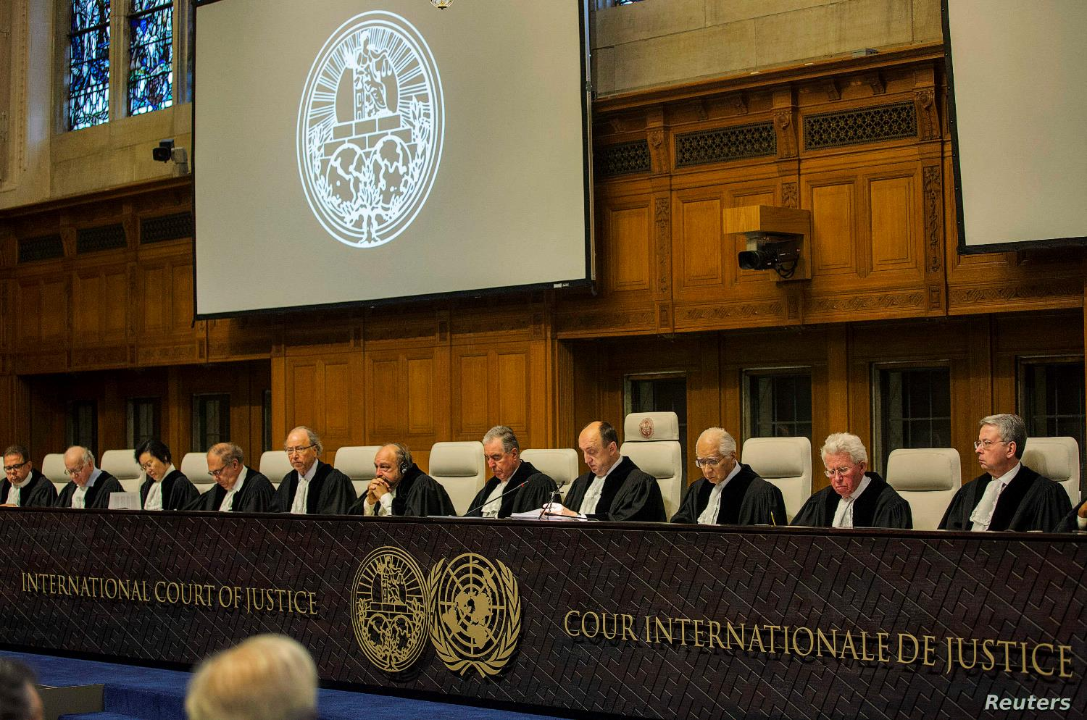
"Liberal Idea" – Enforcement Mechanisms

Slide 23
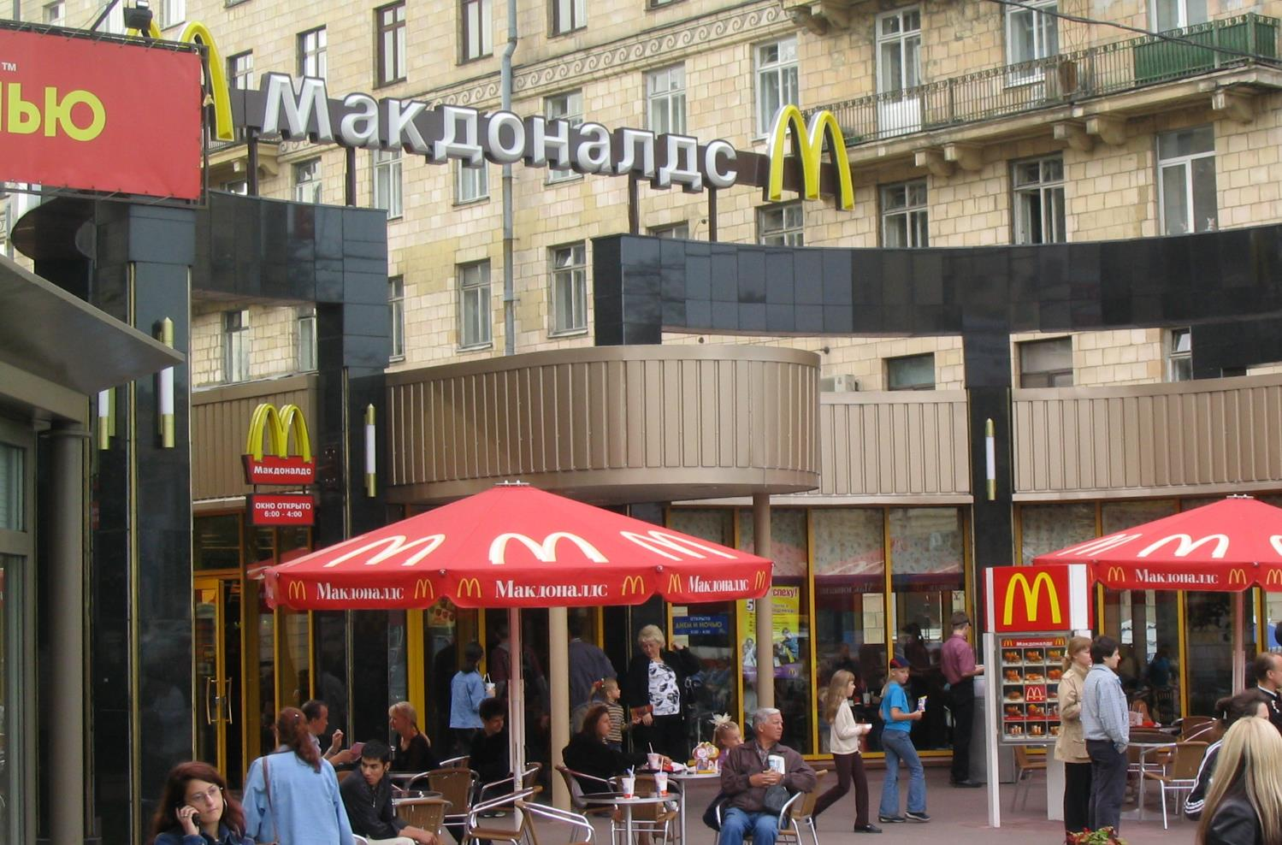
"The Liberal Idea" - Globalization | Economically, Culturally and Politically

Slide 24
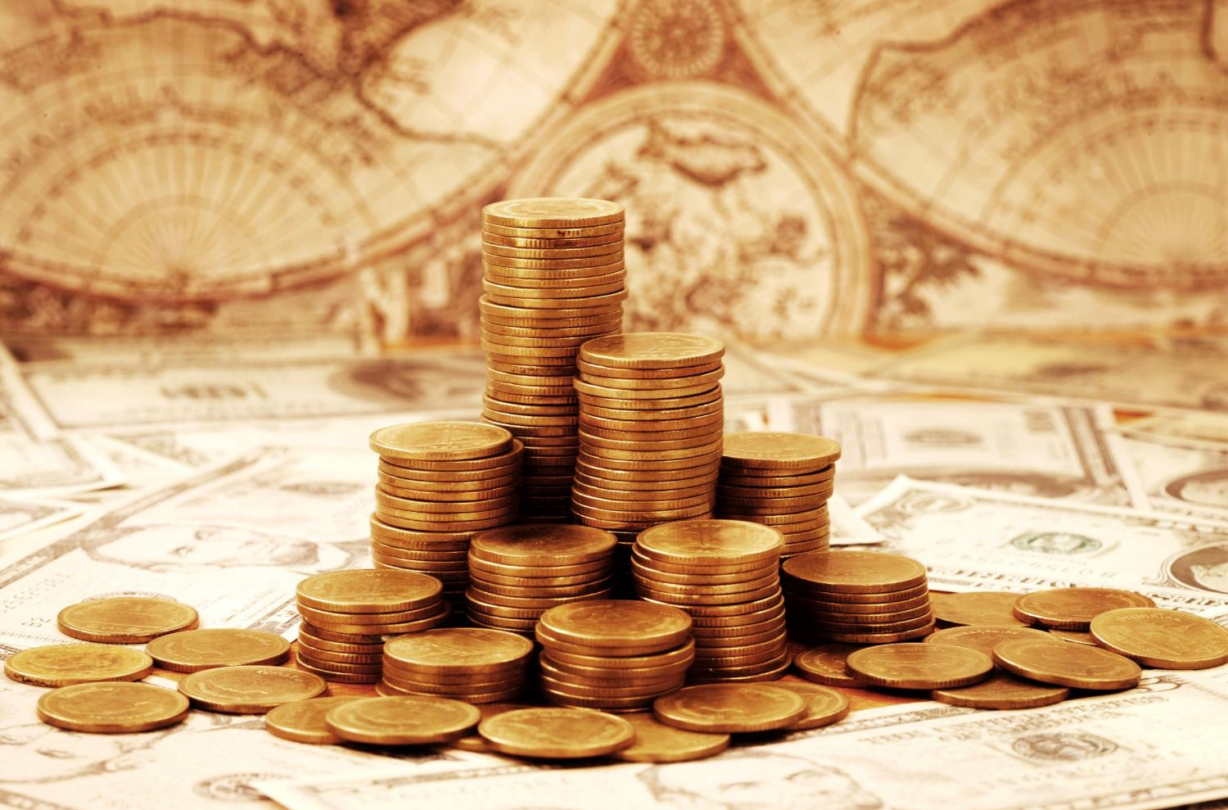
The “Liberal Idea” - A Capitalist Market Economy

Slide 25
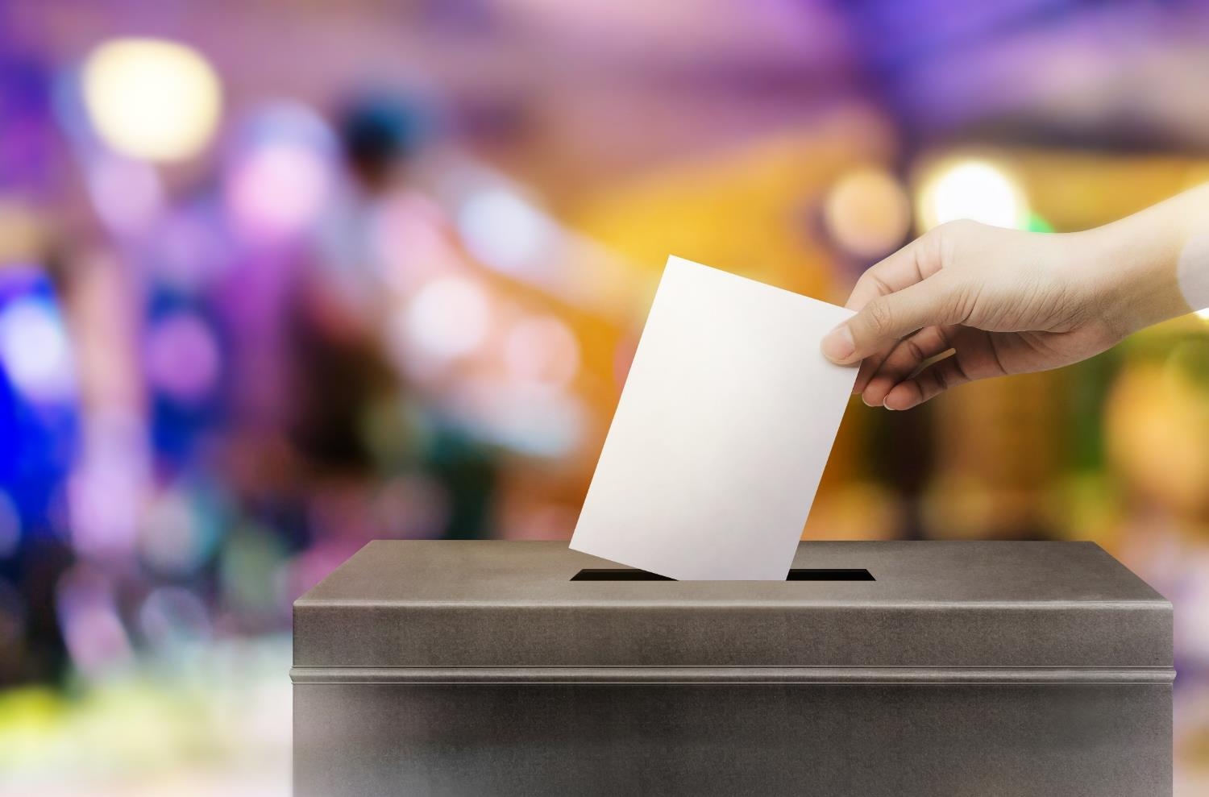
The “Liberal Idea” - An Open and Competitive Political System

Slide 26
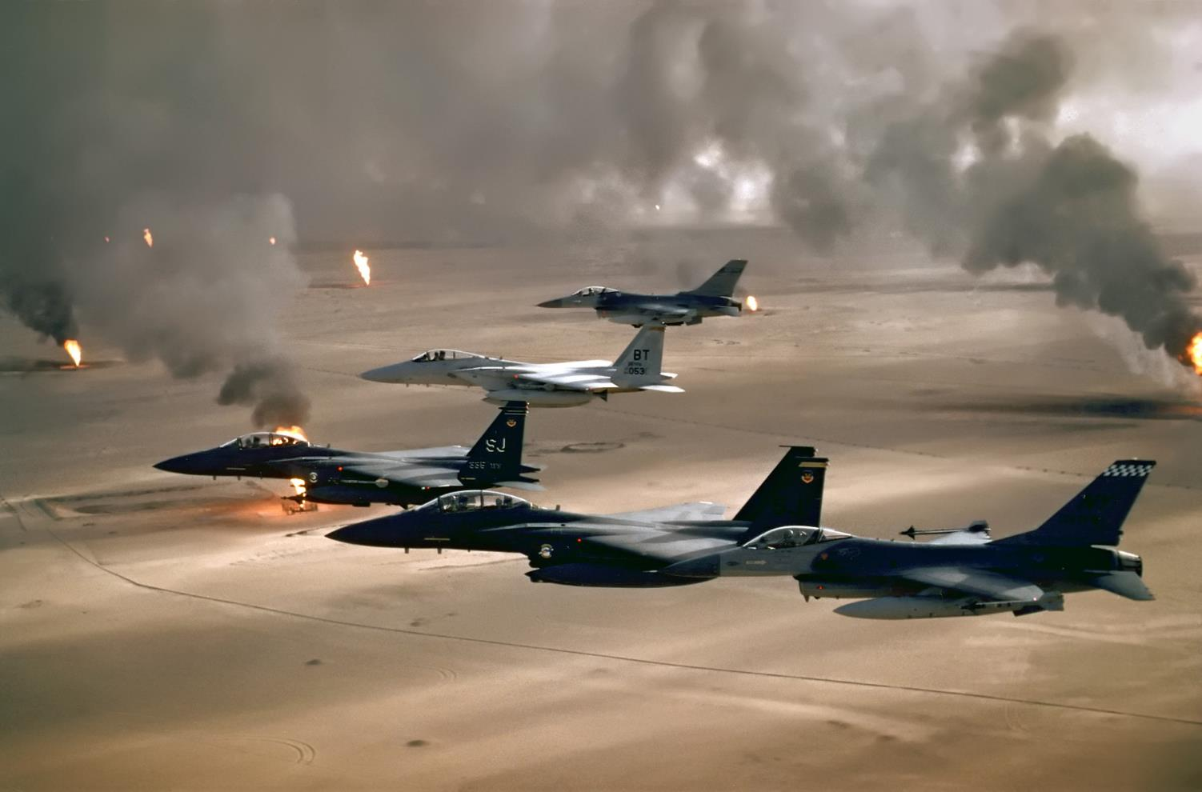
1991 - The First Gulf War - "The Unipolar Moment"

Slide 27
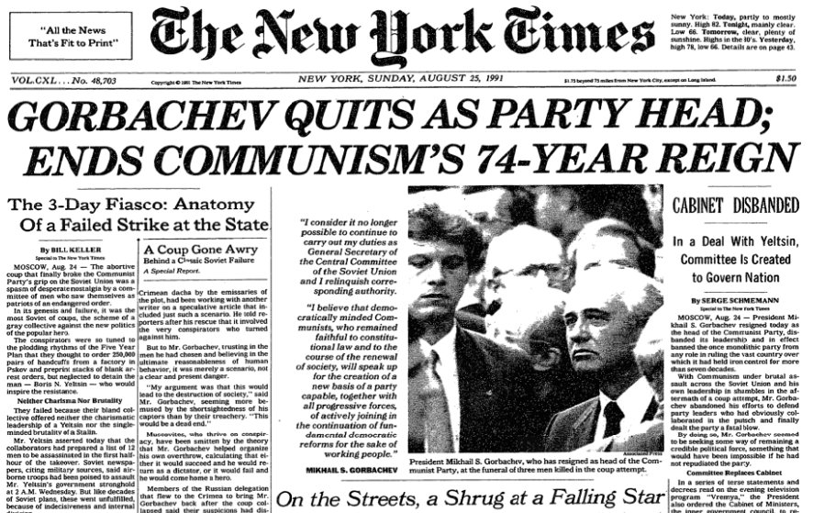
1991 - Gorbachev Resigns I USSR Collapses

Slide 28
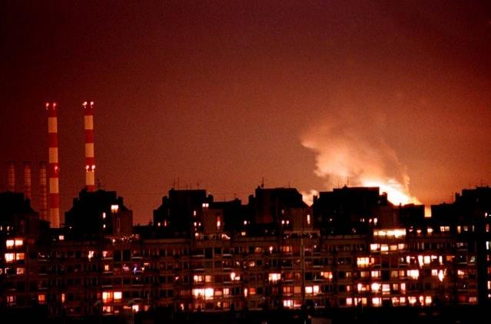
1999 - The War in Yugoslavia

Slide 29
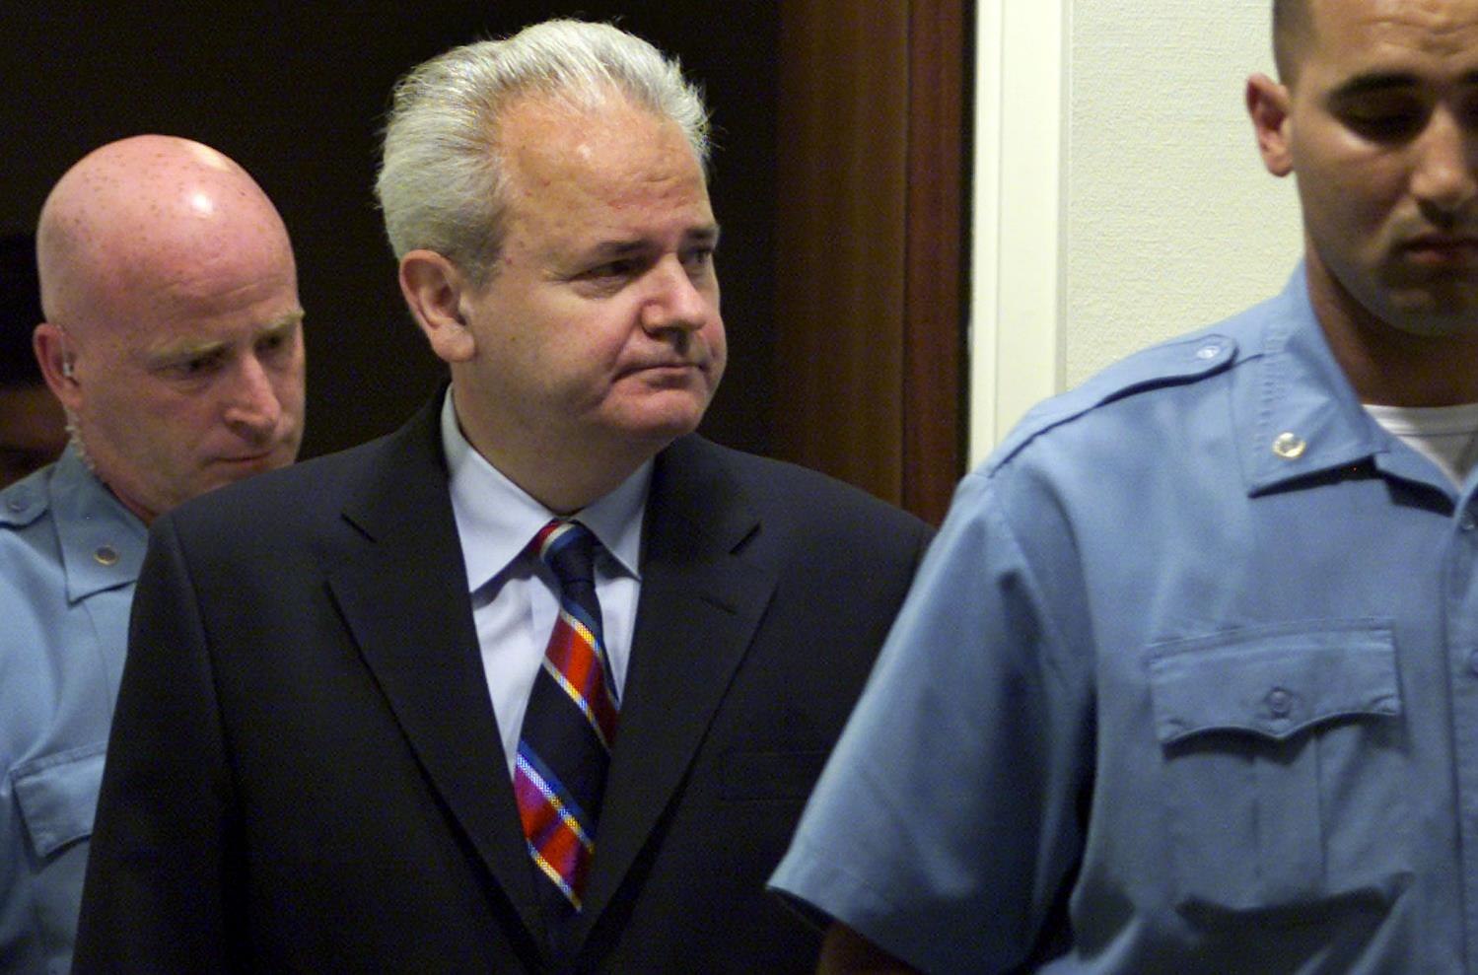
1999 -The War in Yugoslavia – Milošević in Hague

Slide 30
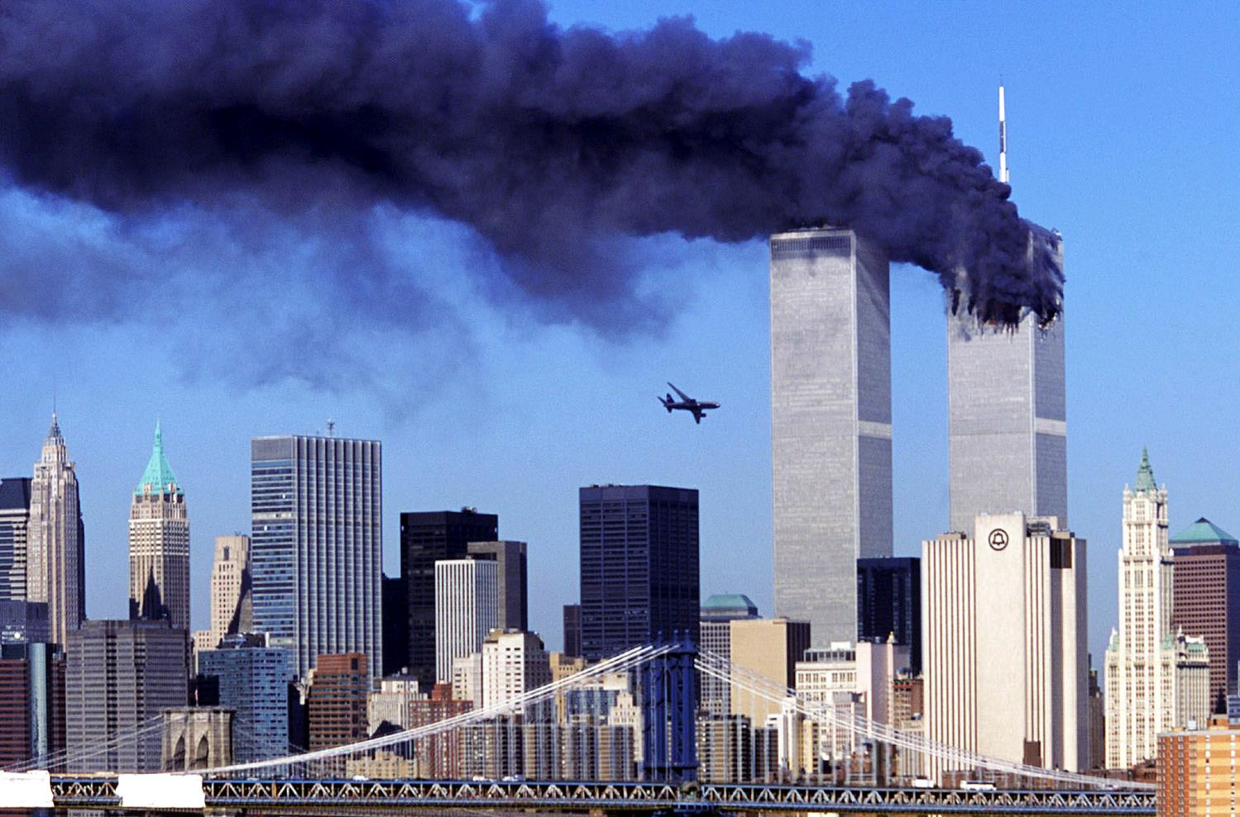
2001 - From the Terror Attacks in the United States to the War in Afghanistan

Slide 31
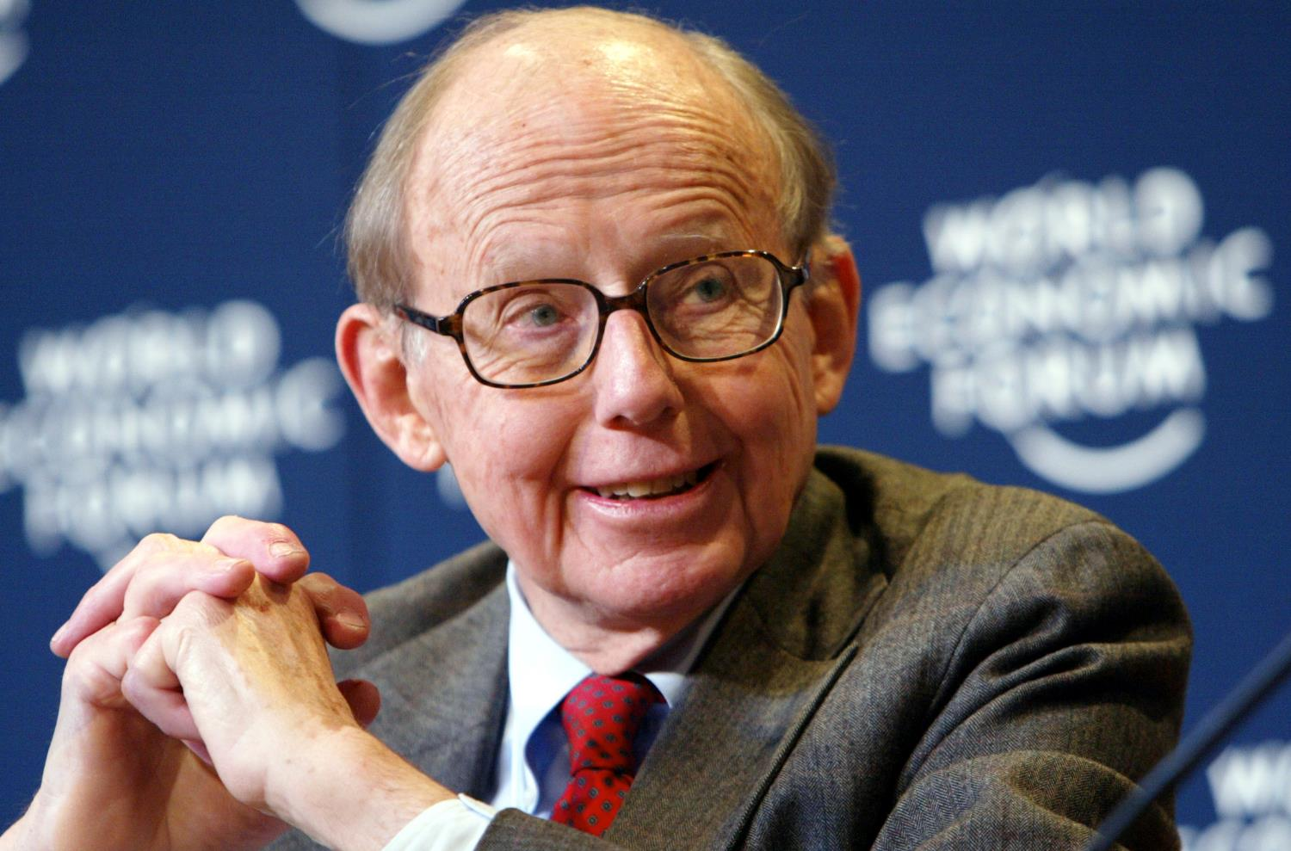
Samuel Huntington - "The Clash of Cultures" (1993, 1996)

Slide 32
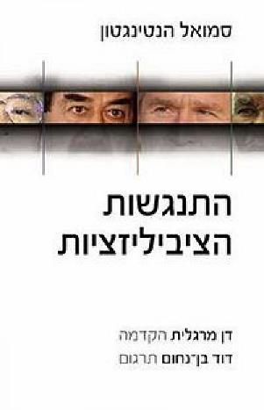
“…The central theme of this book is that culture and cultural identities, which at the broadest level are civilization identities, are shaping the patterns of cohesion, disintegration, and conflict in the post-Cold War world… In this world the most pervasive, important and dangerous conflicts will not be between social classes, rich and poor, or other economically defined groups, but between nations belonging to different cultural entities…”
Samuel Huntington, Clash of Civilizations, 1996

Slide 33
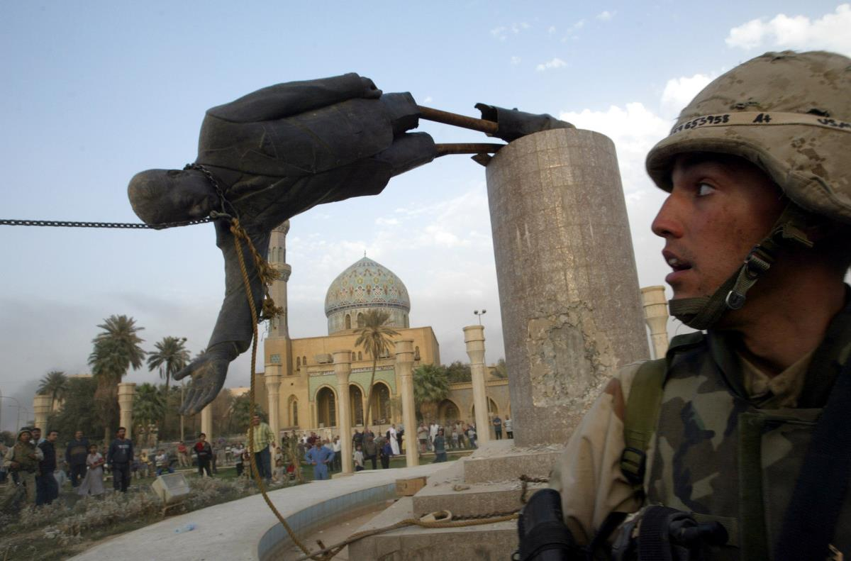
2003 - The Second Gulf War

Slide 34
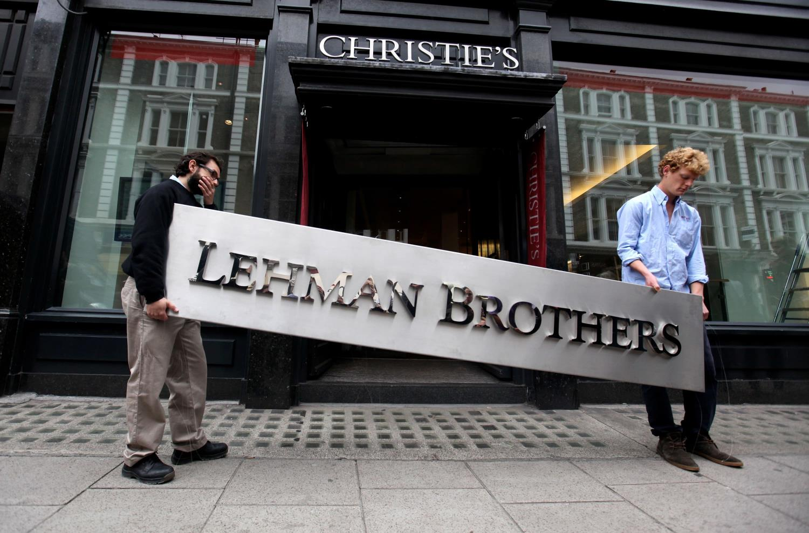
2008 - Financial Crisis

Slide 35
1
2
Scene of Struggle # 1 -
World Arrangement
Scene of Struggle # 2 - Democracy
3
4
Scene of Struggle # 3 - Authoritarianism
Disciplines and Theories

Slide 36
1
2
Scene of Struggle # 1 -
World Arrangement
Scene of Struggle # 2 - Democracy
4
3
Scene of Struggle # 3 - Authoritarianism
Disciplines and Theories

Slide 37
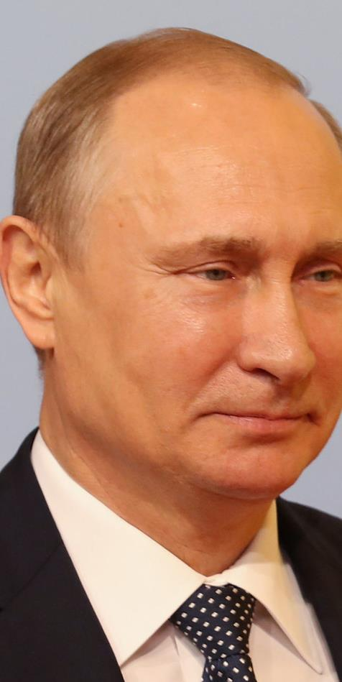
Scene of Struggle # 1 - Competing Forces | “The Rise of the Rest”

Slide 38
2019- Leaders of the Western World at the Ceremony of the 75th Anniversary of D-Day

Slide 39
June 6th 1944 I I I 1566 Soldiers I At least 4,413 were Killed

Slide 40
2018 - G-7 Summit | US Retreat from the “Global Policeman” Position

Slide 41
Xi Jinping – “The Chinese Model” | “Authoritarian Capitalism”

Slide 42
China - "The Belt and the Road"

Slide 43
Putin- “The Russian Model”| Status of “Superpower” |"A Multi -Polar World"

Slide 44
"… The world will then be divided into distinct nation-states, each with its own sacred identity and traditions. Based on mutual respect for these differing identities, all nation-states could cooperate and trade peacefully with one another …"
Yuval Noah Harari, We need a post-liberal order now, 2018

Slide 45
"… It will be a world without immigration, without universal values, without multiculturalism, and without a global elite — but with peaceful international relations and some trade. In a word, the 'Nationalist International' envisions the world as a network of walled-but-friendly fortresses …"
Yuval Noah Harari, We need a post-liberal order now, 2018

Slide 46
Non-State Players (1) | Global and Regional Organizations

Slide 47
Non-State Players (2) Multinational Corporations & Technology Giants

Slide 48
Non-State Players (3) I Terror Organizations

Slide 49
Global Phenomena |Climate, World Order and National Security

Slide 50
1
2
Scene of Struggle # 1 -
World Arrangement
Scene of Struggle # 2 - Democracy
4
3
Scene of Struggle # 3 - Authoritarianism
Disciplines and Theories

Slide 51
Scene of struggle # 2 - The "Crisis of Liberalism" inside Democracies

Slide 52
Putin- “Liberalism has become Obsolete"

Slide 53
The Brexit in the United Kingdom

Slide 54
Trump’s Election

Slide 55
The Strengthening of the Left Wing in the Democratic Party in the USA

Slide 56
Populist Leaders

Slide 57
“I-Liberal Democracy”

Slide 58
A Popular Revolt against Elites, Globalization and the Liberal Idea

Slide 59
1
2
Scene of Struggle # 1 -
World Arrangement
Scene of Struggle # 2 - Democracy
4
3
Scene of Struggle # 3 - Authoritarianism
Disciplines and Theories

Slide 60
Scene of struggle # 3 - An Alternative Government Model in Non-Democracies States

Slide 61
Deepening of the Mechanisms of Supervision and Repression

Slide 62
Freedom House Report - Democracy in Retreat

Slide 63
Global Democracy Index

Slide 64
The instability in the Middle East did not lead to Democratic Processes

Slide 65
Capitalism - Implemented by some of the agents of the I-lliberal Order

Slide 66
1
2
Scene of Struggle # 1 -
World Arrangement
Scene of Struggle # 2 - Democracy
4
3
Scene of Struggle # 3 - Authoritarianism
Disciplines and Theories

Slide 67
Relevant Disciplines: History, Geography, Political Science, Economics

Slide 68
Key Approaches in Foreign Relations: Realism | Liberalism I Constructivism Constructivism

Slide 69
Realism - Sovereign States |Struggle for Power | National Interests

Slide 70
Liberalism - Norms | Institutions |Consent |Reciprocity| Trade | Diplomacy

Slide 71
Constructivism - Meanings and Images| Social Context |Constructing Meaning

Slide 72
The World’s Order after the Corona Virus - Possible Scenarios

