Slide 1
National Security in an Era of Transformation
and Change
Lesson No. 1 [Introduction and Basic Concepts]
September 2020

Slide 2
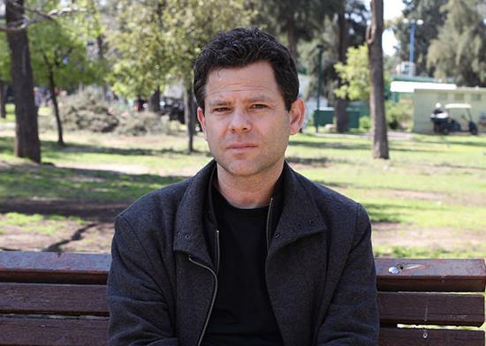
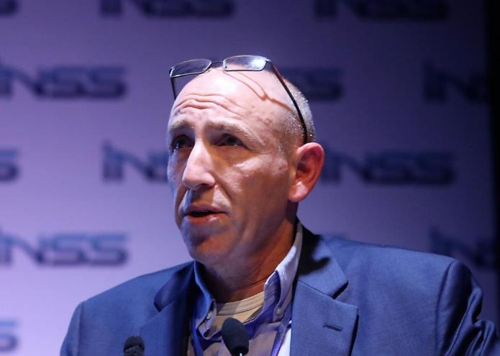
Dr. Doron Navot
BG (Res.) Itai Brun

Slide 3
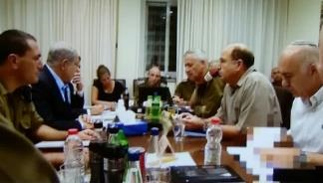
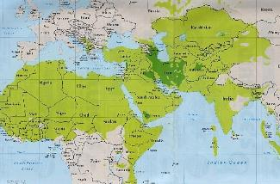
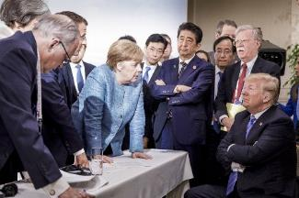
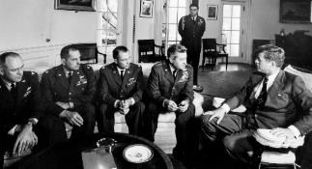
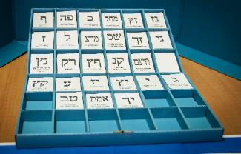
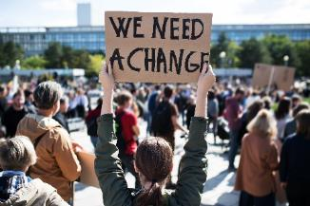
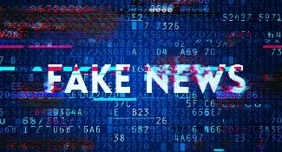
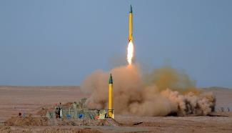
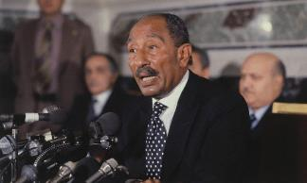
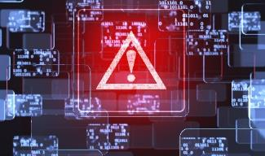
4
3
2
1
Thinking & Making Decisions
The Regional System
The Global System
Introduction and Basic Concepts
8
7
6
5
Contemporary Societies
National Security in the Post-truth era
Government
Political Economy
12
11
10
9
Corona Crisis
National Defense (2)
National Defense (1)
Politics & Diplomacy
13
National Security on the 21st century

Slide 4
What is "National Security"?

Slide 5
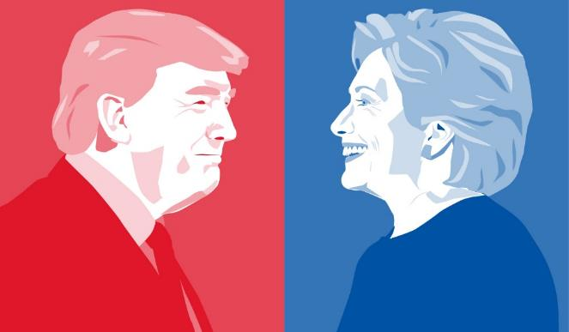
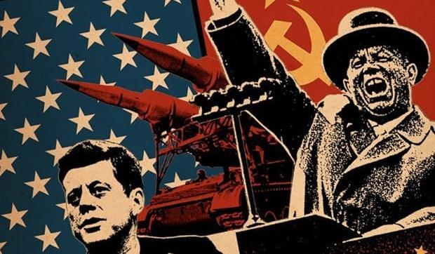
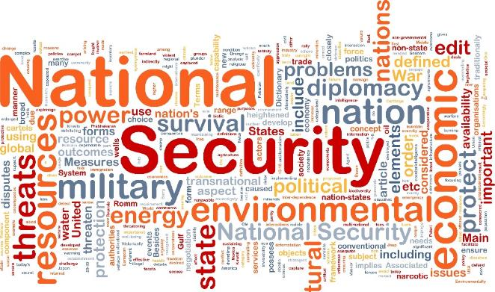
2
1
National Security in
the Current Era
National Security in the Cold War Era
4
3
The Course - Structure, Goals and Assignments
Definitions and Basic Concepts of the National Security

Slide 6
2
1
National Security in
the Current Era
National Defense In the Cold War Era
4
3
The Course - Structure, Goals and Assignments
Definitions and Basic Concepts of the National Security

Slide 7
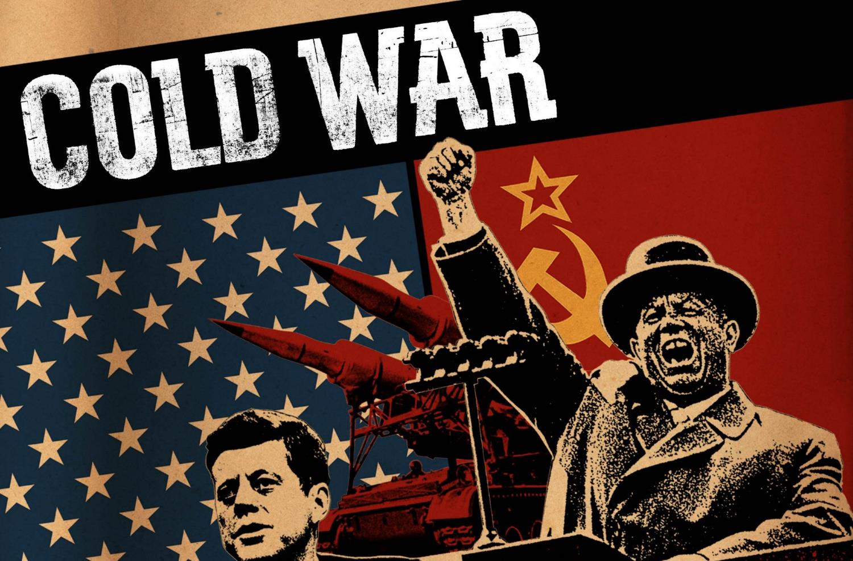
"The Cold War" - Physical Security | Armies & Countries | Existential Anxiety

Slide 8
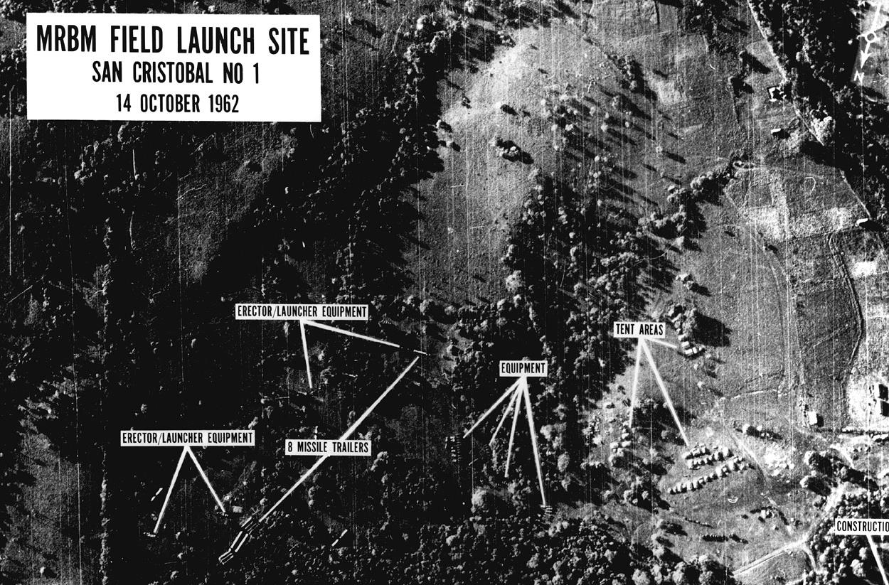
Cuban Missile Crisis, October 16-28, 1962 | On the verge of WW3

Slide 9
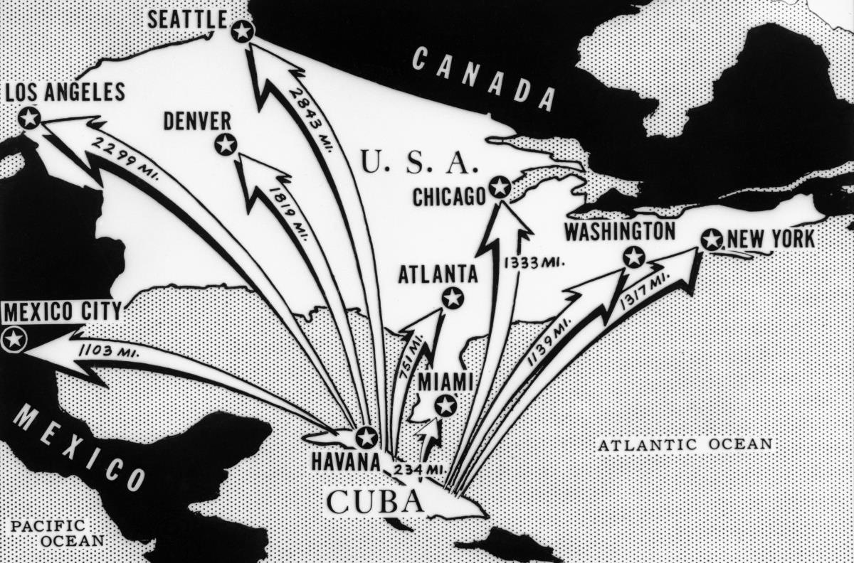
Cuban Missile Crisis, October 16-28, 1962 | The Distance from Cuba

Slide 10
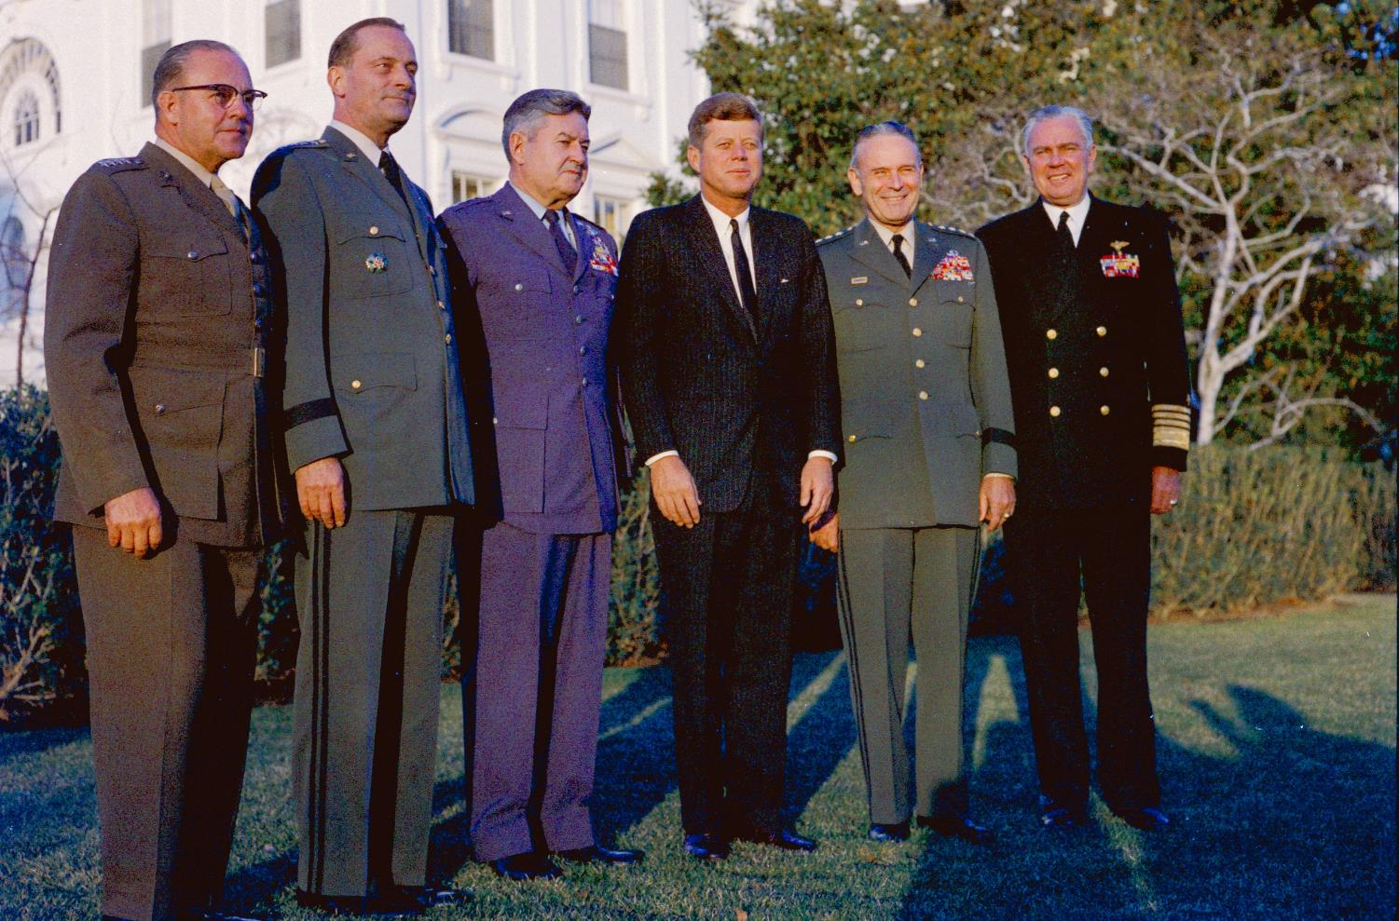
Cuban Missile Crisis, October 16-28, 1962 | Kennedy and the Generals

Slide 11
Cuban Missile Crisis, October 16-28, 1962 | Kennedy and the Generals

Slide 12
2
1
National Security in
the Current Era
National Security in the Cold War Era
4
3
The Course - Structure, Goals and Assignments
Definitions and Basic Concepts of the National Security

Slide 13
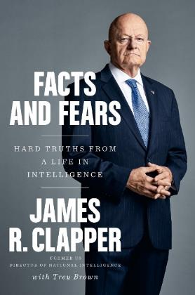
"... for me, there has not been a single particular moment in this period in which I realized that our main rival throughout the half-century of my intelligence career, penetrates - just like that - into the deep roots of our democracy. This understanding slowly became clear to me during 2016 after the elections "Even after I left office when the new government came into force ..."
James Clapper with Trey Brown, Fact and Fears: Hard Truths from a Life in Intelligence, 2018

Slide 14
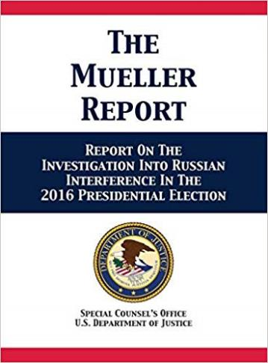
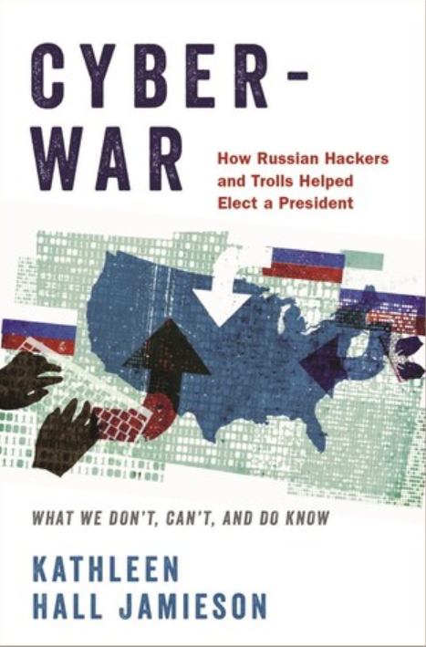
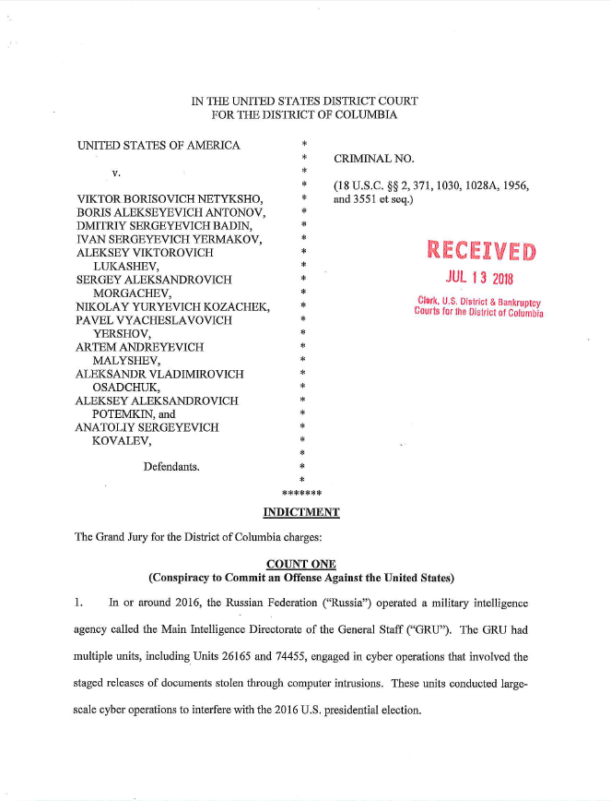
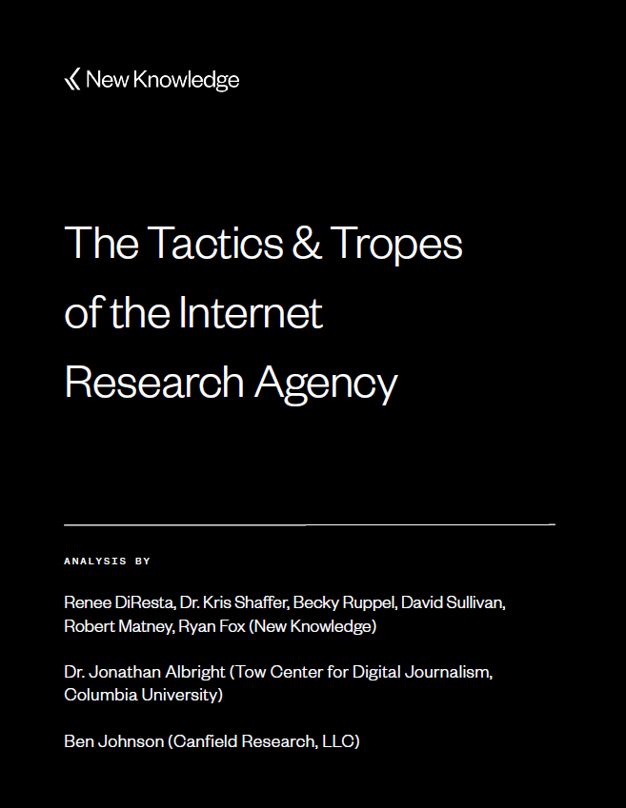
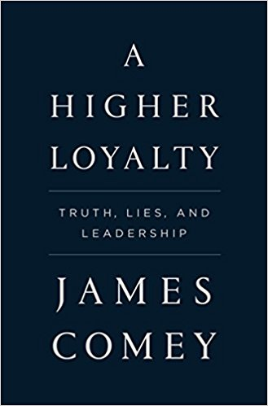
Russian Involvement in the 2016 US Elections
Comprehensive Documentation
A series of indictments; Reports of commissions of inquiry and the report of Special Investigator Mueller; Academic Research; Memoirs of the incumbents during the relevant period

Slide 15
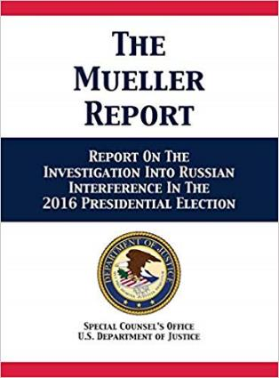
"…The Russian government interfered in the 2016 presidential election in sweeping and systematic fashion … The Russian government perceived it would benefit from a Trump presidency and worked to secure that outcome … The [Trump] campaign expected it would benefit electorally from information stolen and released through Russian efforts …"
US Department of Justice, Report On The Investigation Into Russian Interference In The 2016 Presidential Election, 2019

Slide 16
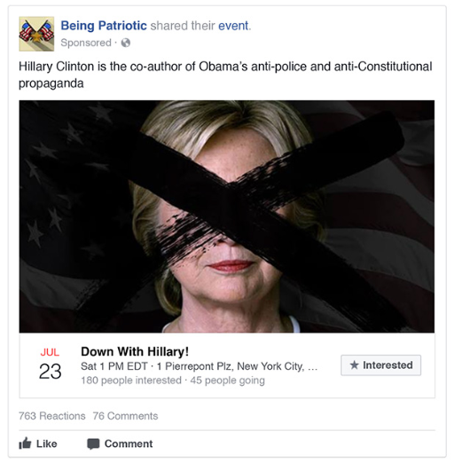
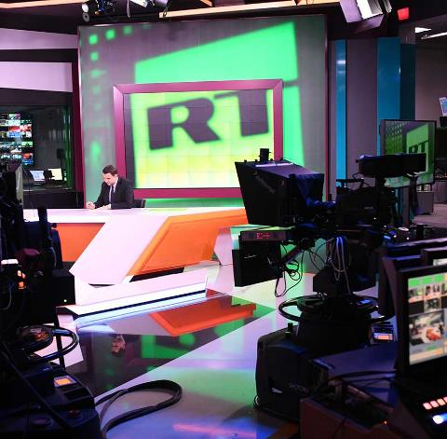
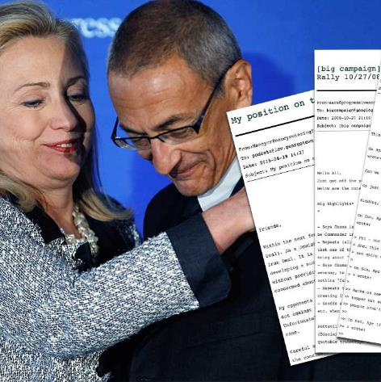
The Russian Campaign Interference in the 2016 Elections
"Troll Army"
Media
Cyberattacks
Russian intelligence agencies; Cyber-attack systems; Media funded by the Russian government; A large army of virtual entities ("trolls") built over the years

Slide 17
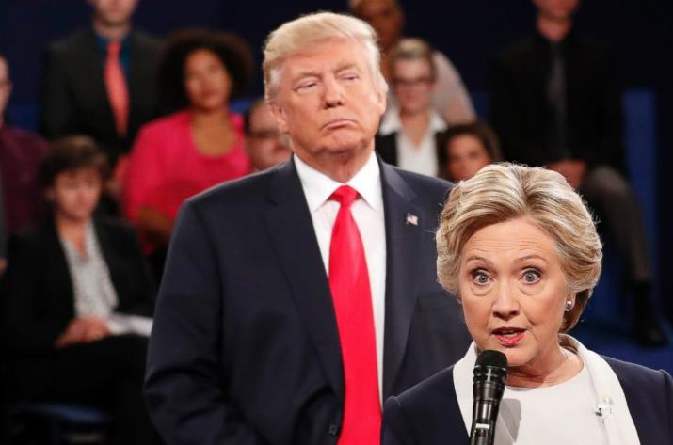
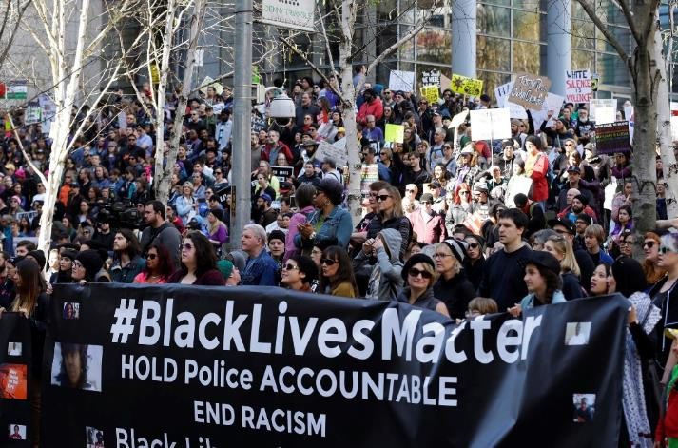
The goals of the Russian Operation
"Elections as a Goal"
"The Election as an Opportunity“
Take advantage of the rifts to deepen the polarization and cause the public to lose confidence in the electoral process and democracy; From an early stage - an effort to hurt Clinton; Then - an effort to improve Trump's chances

Slide 18
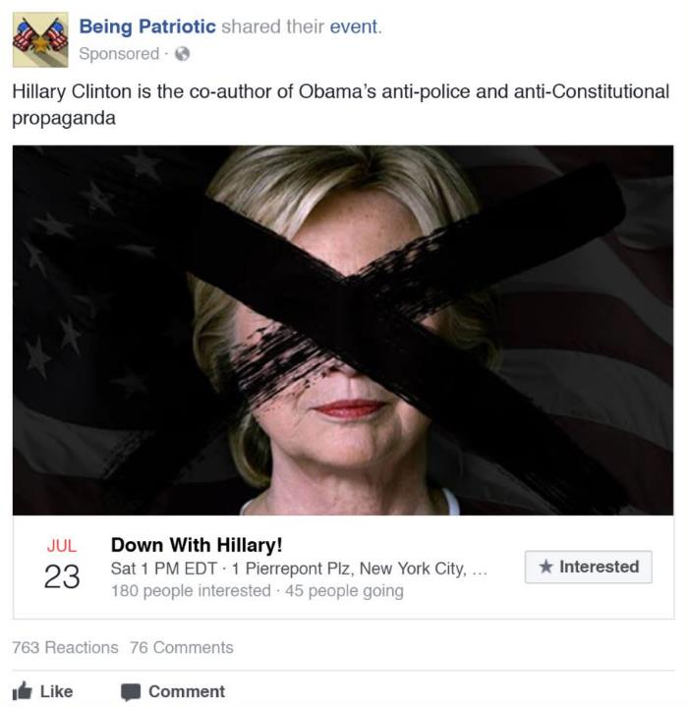
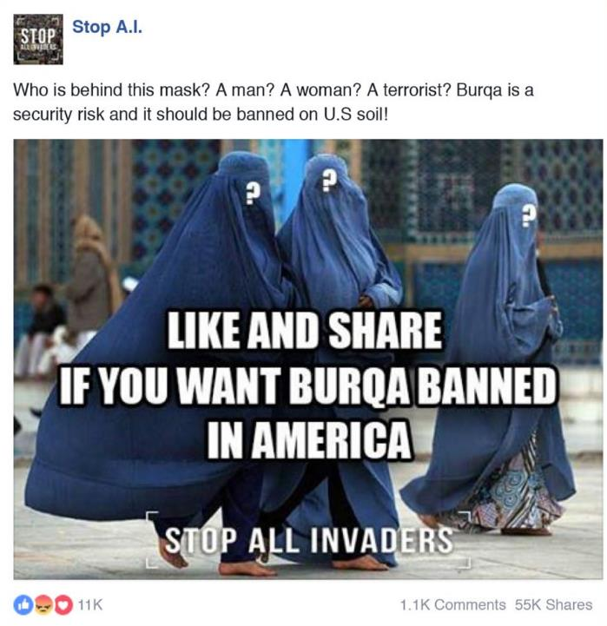
2
1
Messages that match those of the Trump campaign: Hillary is corrupt; With physical and mental problems; And has connections to radical Islam
Target audiences: African Americans (boycott of elections); Mexican-Americans and Hispanics (deepening mistrust); Right-wing voters (confrontation)

Slide 19
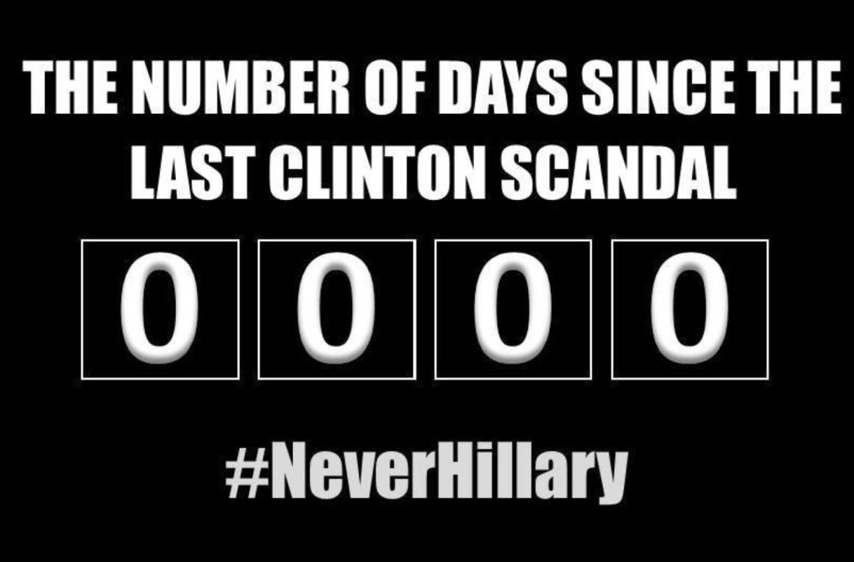
Cases: Email Server; The Family Foundation; Benghazi; War Support
.

Slide 20
"... the goal of the Russians was not for anyone to believe the crazy stories they published. The idea behind their influence campaign was to shock the facts, to cast doubt on the very ability to know the facts ..."
James Clapper with Trey Brown, Fact and Fears: Hard Truths from a Life in Intelligence, 2018

Slide 21
"… The investigation did not establish that members of the Trump campaign conspired or coordinated with the Russian government in its election interference activities …"
US Department of Justice, Report On The Investigation Into Russian Interference In The 2016 Presidential Election, 2019

Slide 23
Outside
Influence’s
Effort
Inside Influence’s Effort
Outside Messages
Inside Messages

Slide 24
Sharing, Re-tweeting, Distributing in Groups (including , ) Diverting attention
Outside Messages
Inside Messages

Slide 25
"… We understood coordination to require an agreement — tacit or express — between the Trump Campaign and the Russian government on election interference. That requires more than the two parties taking actions that were informed by or responsive to the other’s actions or interests …"
US Department of Justice, Report On The Investigation Into Russian Interference In The 2016 Presidential Election, 2019

Slide 26
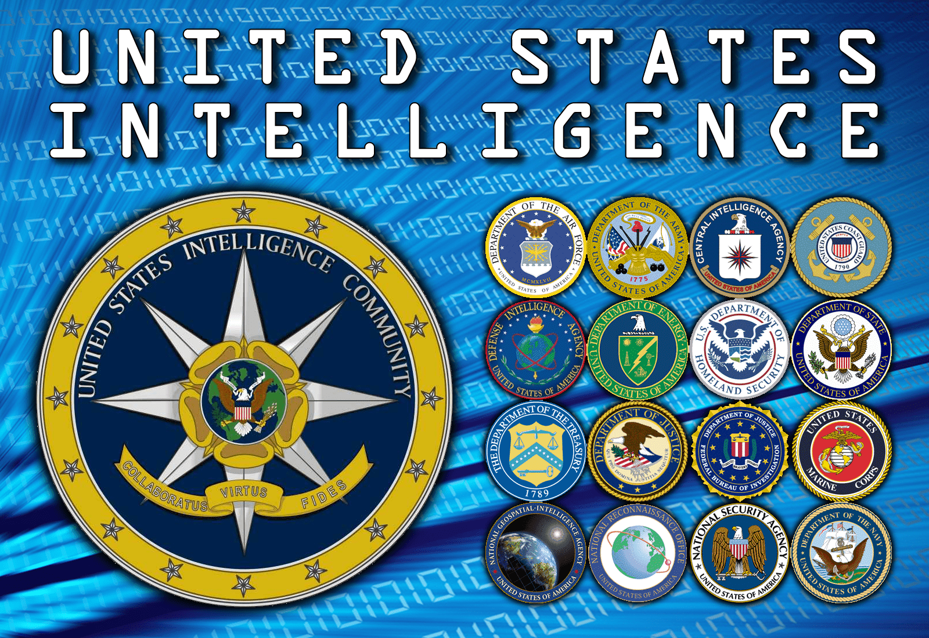
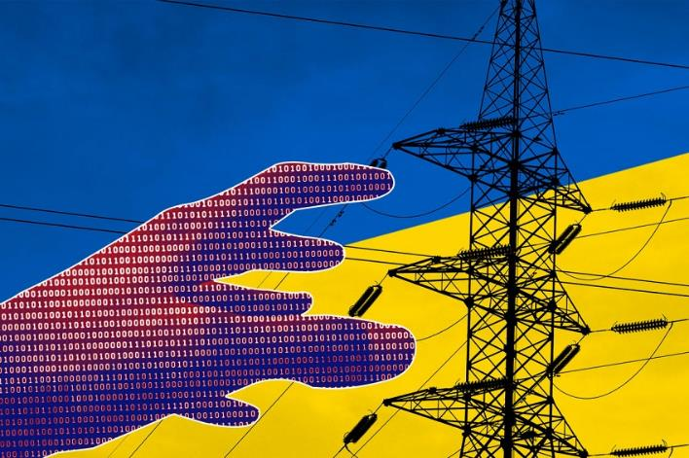
Why was the American National Security Community Surprised?
Legal-Organizational Problem
Perceptual Problem
Difficulty in understanding the nature of the activity, due to a different perception of cyber; The connection between the "inside" and the "outside"; A legitimate problem creating the overall image; The result - a late warning and very limited action.

Slide 27
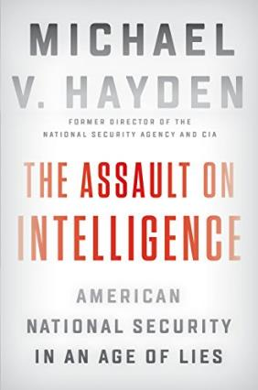
"... [in the 1990s] we were preoccupied with the question of whether we are in the cyber business or the information supremacy business. Do we want to control networks as a tool of war or influence, or are we more ambitious and want to shape the way rivals and companies collect & process their information? Because of today the United States has a cyber command (and not a superior command in information) you can guess how this debate ended ... Russia, however, chose the second door ..."
Michael Hayden, The Assault on Intelligence: American National Security in An Age of Lies, 2018

Slide 28
"... the American intelligence community did not have the authority or ability to assess how Americans accept Russian propaganda or what they think and do in the polls ... Simply put, it was not our job. We saw the Russian influence effort against the electorate, but not the impact. "We did not have empirical data to assess the impact and only on election day did I unfortunately discover that the Russian effort probably did have an impact ..."
James Clapper with Trey Brown, Fact and Fears: Hard Truths from a Life in Intelligence, 2018

Slide 29
Announcement to the Public, October 7, 2016
(mainly about hacking into emails and servers)

Slide 30
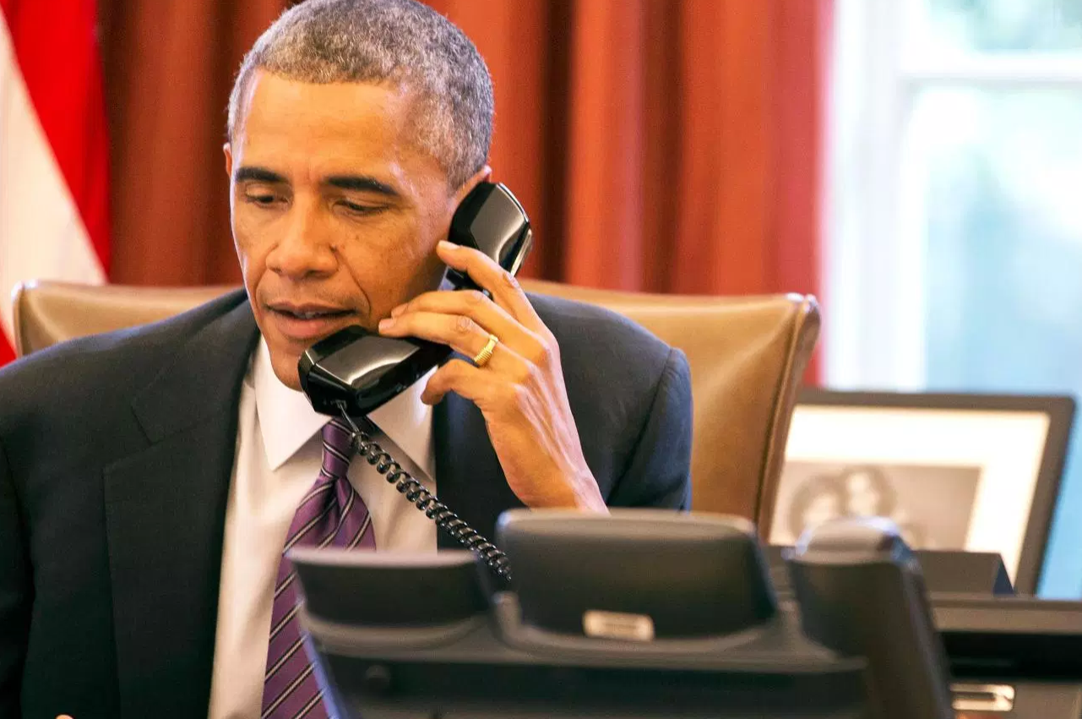
Obama's phone call to Putin, end of October 2016

Slide 31
The role of Facebook and Cambridge Analytica

Slide 32
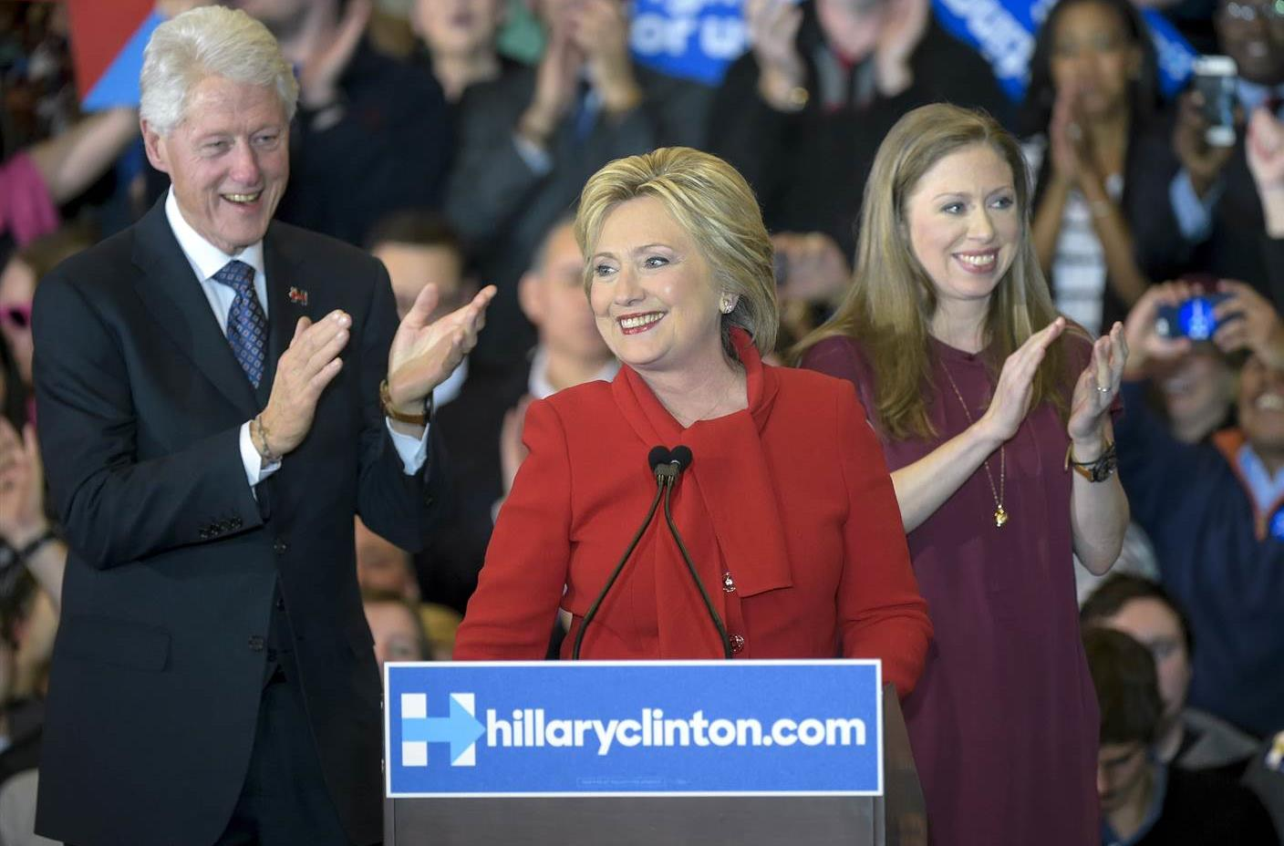
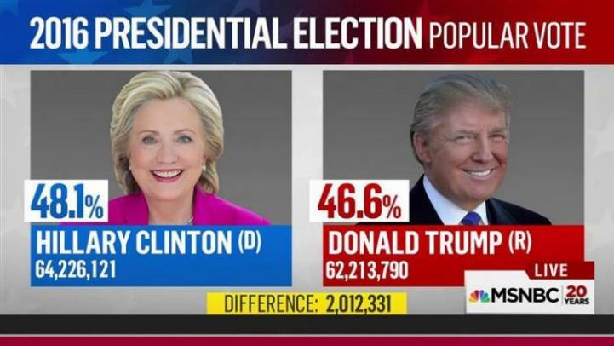
Impact Question:
Clinton, as a Poor Candidate, Managed to Win Most of the Votes

Slide 33
"... Trolls did not vote for Donald Trump, US citizens did ... but the Russians caused negative publicity against Clinton through targeted social media posts, tweets, new’s videos and ads ... they influenced the decisions of the head of the -FBI ... and they also managed to influence the media coverage and the confrontations through the leaked information ... "
Kathleen Jamieson, Cyberwar: How Russian Hackers and Trolls Helped Elect a President: What We Don't, Can't, and Do Know, 2018

Slide 34
Kathleen Jamieson on the Question of Actual Impact

Slide 35
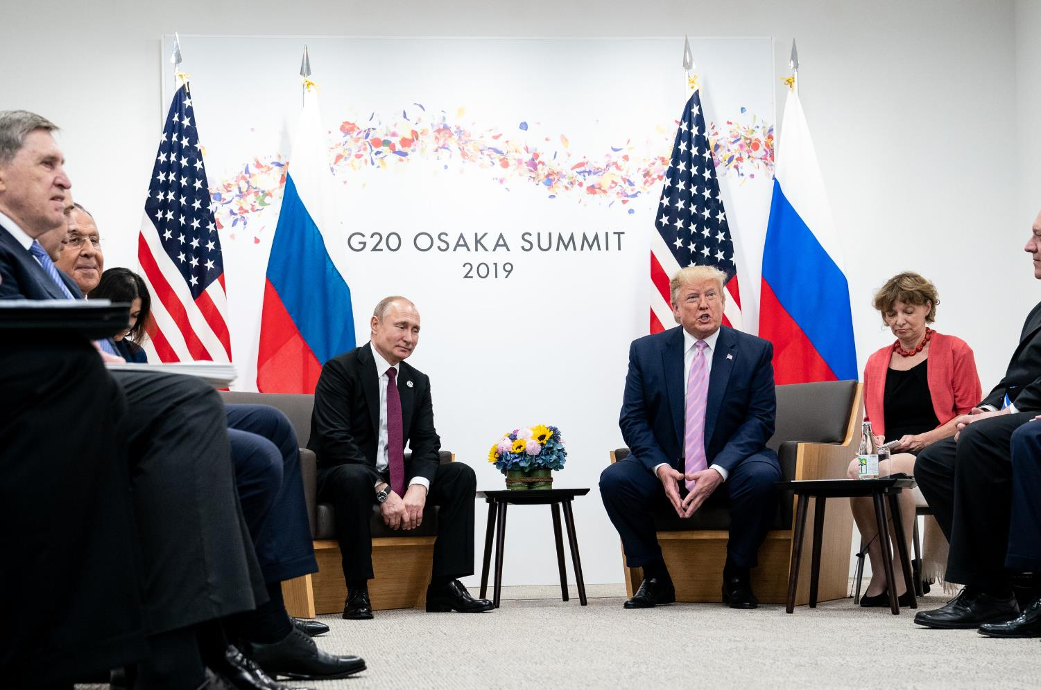
Continuation of the Political and Public Debate

Slide 36
2
1
National Security in
the Current Era
National Security in the Cold War Era
4
3
The Course - Structure, Goals and Assignments
Definitions and Basic Concepts of the National Security

Slide 37
"… The ability of nation to protect its internal values from foreign threats …"
International Encyclopedia of the Social Sciences, 1968

Slide 38
"... National Security is a situation that ensures the national ability to deal effectively, in all possible circumstances, with threats to national existence and national interests ..."
Gadi Eisenkot and Gabi Siboni, Guidelines for Israel’s National SecurityStrategy, 2019

Slide 39
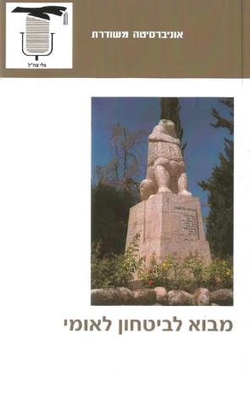
"... The practice of national security carries many question marks as to the scope of the issue. Proponents of the narrow conception ... define it as an area that deals with the challenge facing the state in dealing with external threats, which are manifested in the use of force ... proponents of the broader conception argue. .. Because dealing with it is related not only to threats that use force, but also to the state's ability to function in the face of other threats that endanger it ... "
Yaakov Amidror, "What is National Security?", Within: Introduction to National Security, 2011

Slide 40
" "... Some argue that the pursuit of national security must consider all the components of society's power in the country and address them, since they are built on the defense capability ... Based on this approach National Security has to deal with economic, social rifts, education, taking care of weakness, in the identity of the society, in its ability to create unity between its parts and so on. These issues determine the ability of the to society withstand pressures, threats and wars ... "
Yaakov Amidror, "What is National Security?", Within: Introduction to National Security, 2011

Slide 41
"... We, at the National Security College, have decided to take an intermediate path. Our work on national security focuses on the question of readiness in the face of external threats from rival countries and enemies that non-state bodies, and in the face of internal threats from Israeli society. "However, we do not abandon our involvement in the fields of economics, society, foreign relations and ethics, while emphasizing their direct effects on national security ..."
Yaakov Amidror, "What is National Security?", Within: Introduction to National Security, 2011

Slide 42
"... it can be said that everyone agrees that the national security system must ensure the existence of the state. The controversy focuses on how legitimate to see threats to 'interests' of various kinds and 'values', or even the use of force by hostile elements that do not threaten existence. The state, an issue that the national security system must deal with (or defend against ...) "
Yaakov Amidror, "What is National Security?", Within: Introduction to National Security, 2011

Slide 43
National Security as a "National" Matter | "National Interests"

Slide 44
"...The definition of national security includes ... components that invite dialogue, and even open the door to controversy - 'Who is the nation that the Israeli National Security serves?', 'What are its vital interests?', And so on, many questions are opened that invite clarification about the conceptual and practical content of the word 'national', as a key concept in guiding the practice of the security act ... "
Gershon Hacohen, "What is national in National Security?", 2014

Slide 45
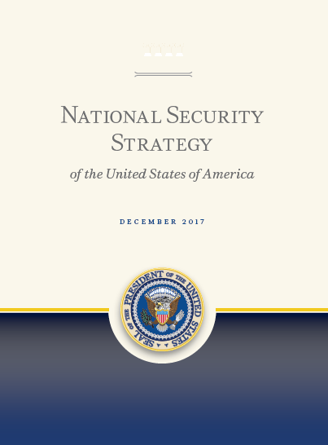
"… Strategic confidence enables the United States to protect its vital national interests. The Strategy identifies four vital national interests, or 'four pillars' as: (1) Protect the homeland, the American people, and American way of life; (2) Promote American prosperity; (3) Preserve peace through strength; (4) Advance American influence. …"
Donald J. Trump, National Security Strategy of the United States of America, 2017

Slide 46
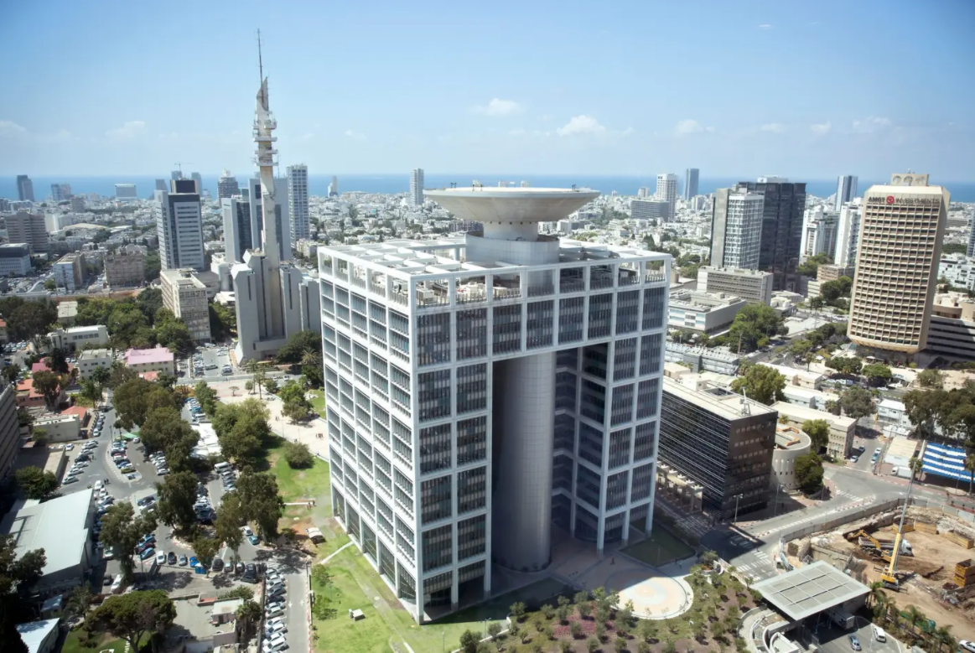
What is at the Root of the Controversy?
The Role of the “Security System" (1)

Slide 47
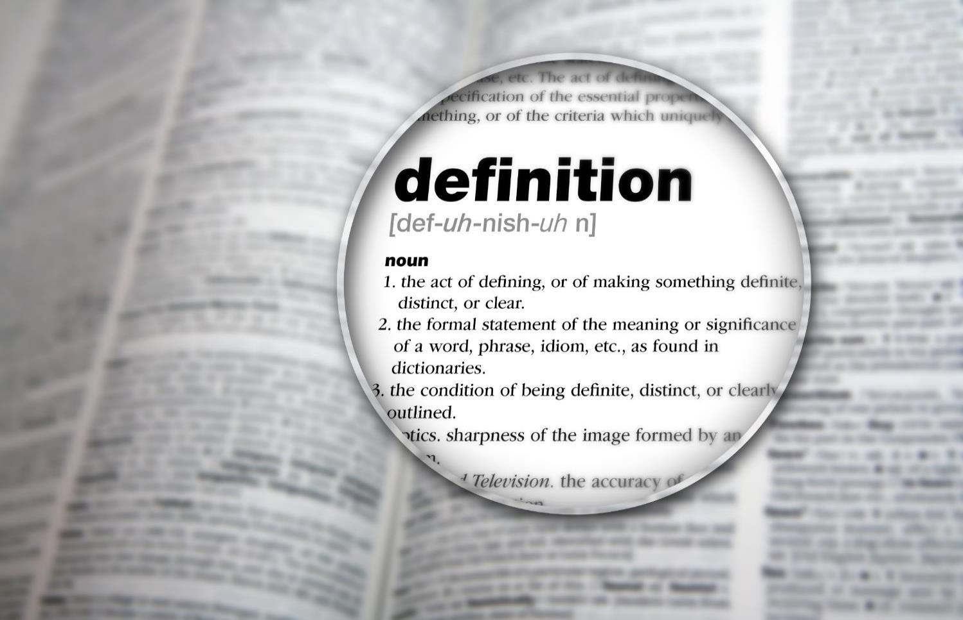
What is at the Root of the Controversy?
Between Definition and the meaning (2)

Slide 48
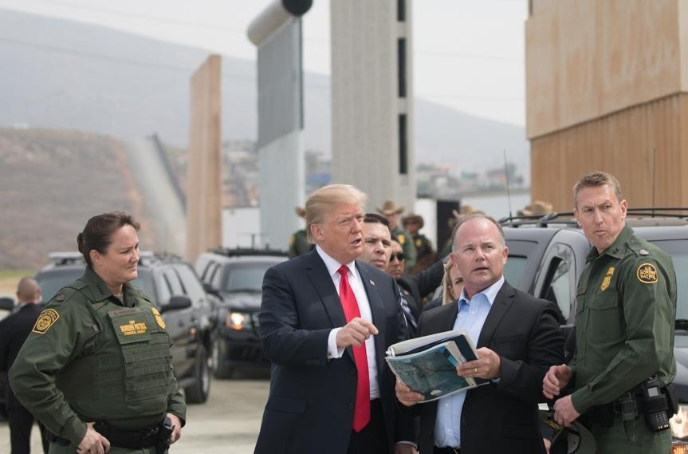
What is at the Root of the Controversy?
Denial of the Political and Ideological Aspect (3)

Slide 49
A Player- Individual, Group, Country, Organization or Company Influences the National Security (1)

Slide 50
A Player- Individual, Group, Country, Organization or Company Influences the National Security (2)

Slide 51
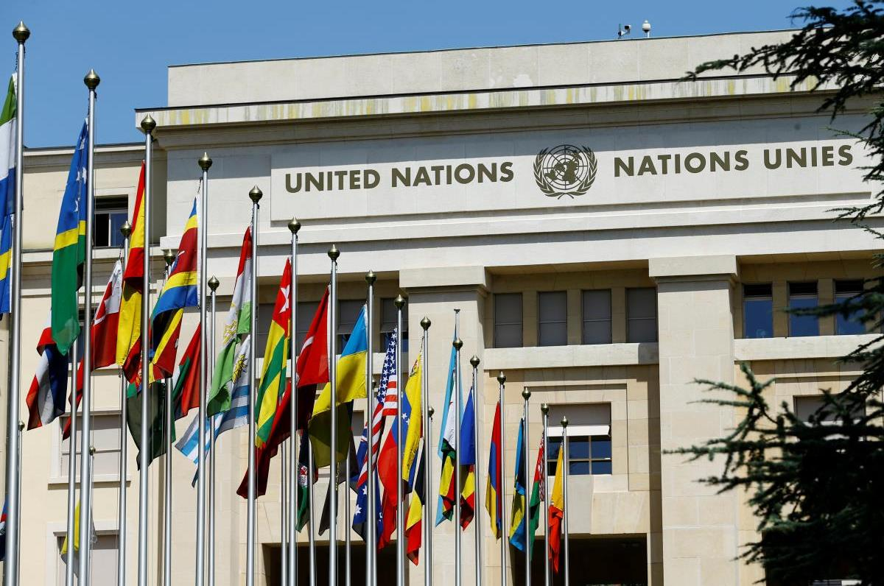
A Player- Individual, Group, Country, Organization or Company Influences the National Security (3)

Slide 52
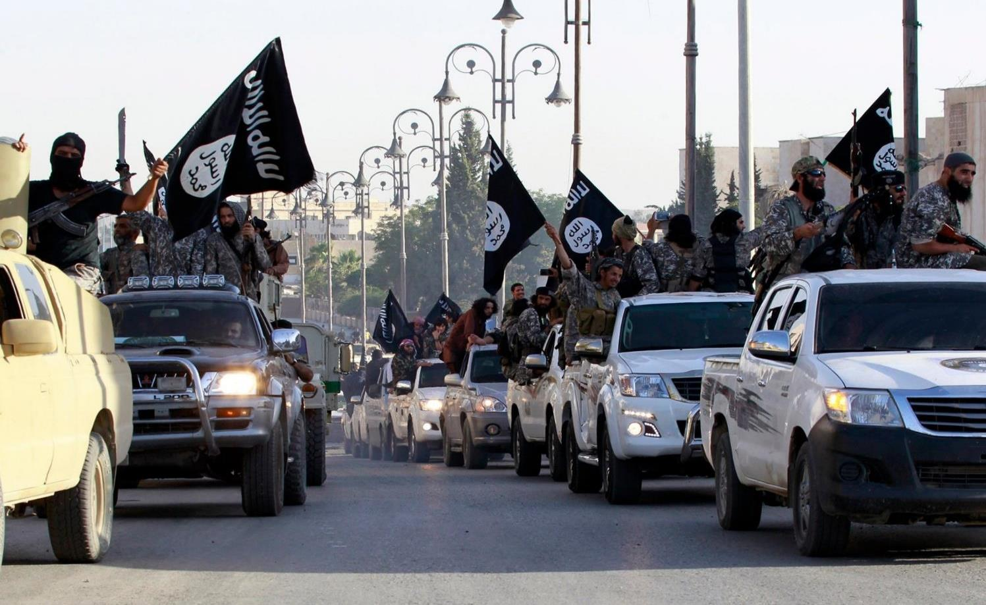
A Player- Individual, Group, Country, Organization or Company Influences the National Security (4)

Slide 53
A Player- Individual, Group, Country, Organization or Company Influences the National Security (5)

Slide 54
Power - the Ability to Act in the World

Slide 55
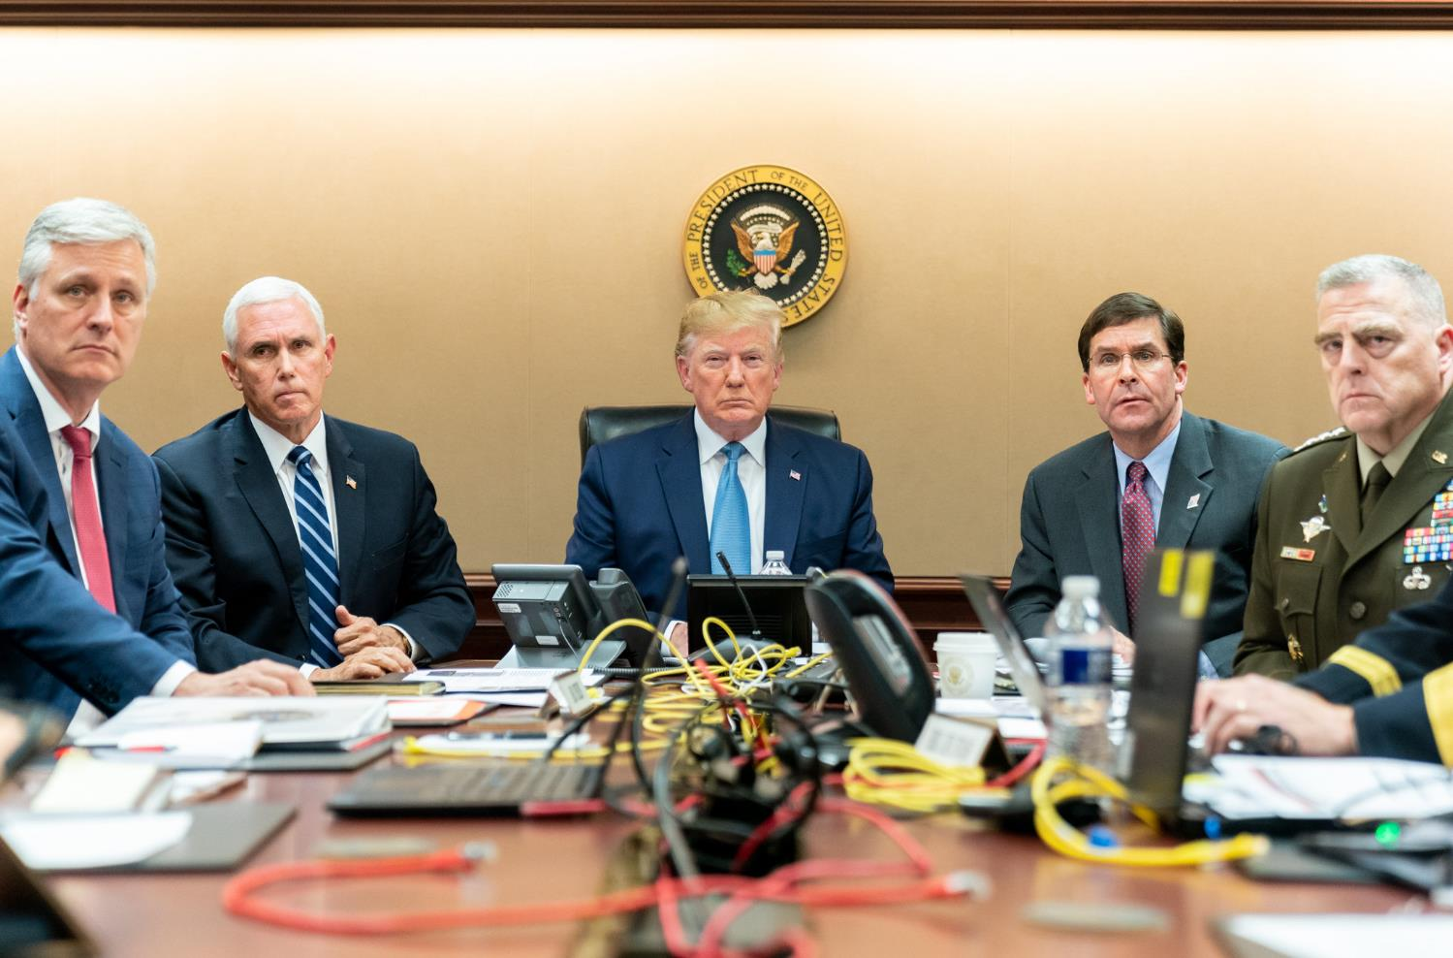
National Security - the Institutional Aspect
The National Security System

Slide 56
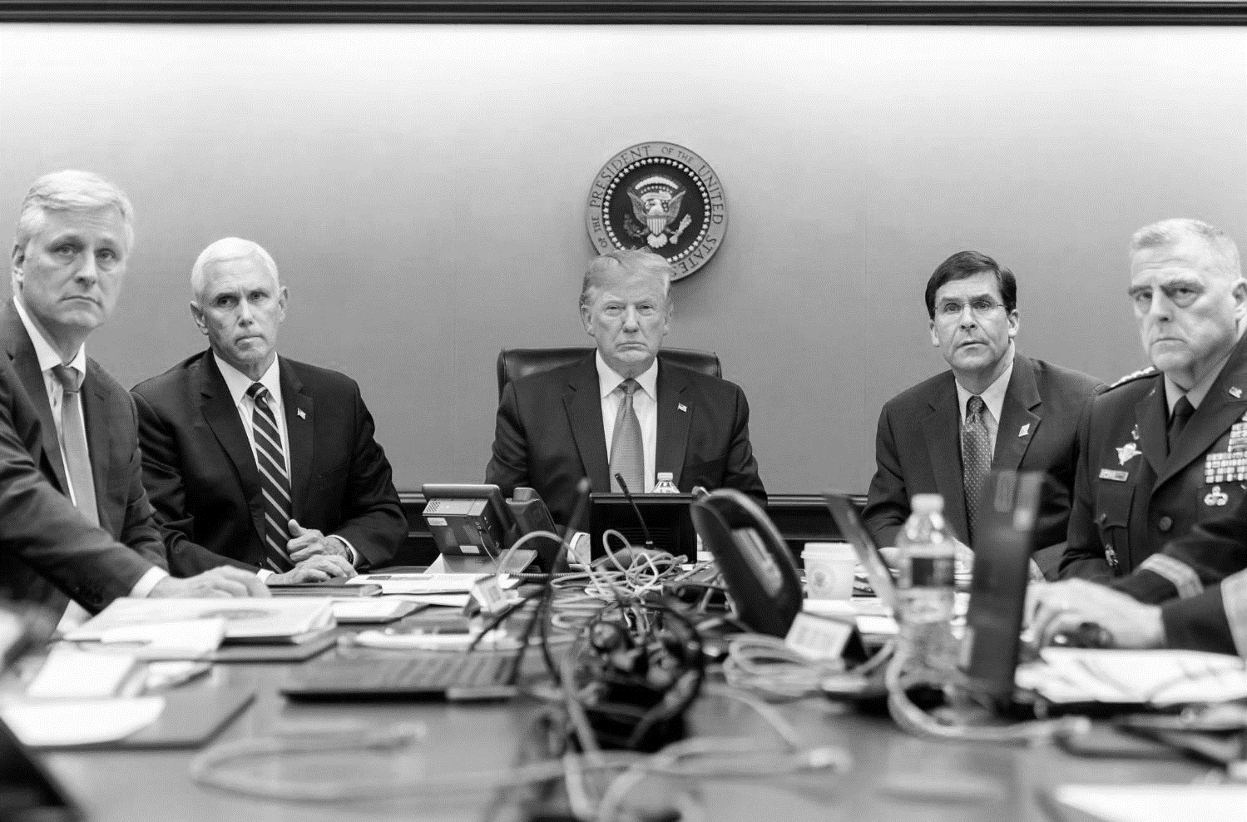
National Security - the Institutional Aspect
The National Security System
3
2
1

Slide 57
National Security - The Institutional Aspect
The Role of Research Institutes

Slide 58
National Security - The Institutional Aspect
The Role of Academia

Slide 59
2
1
National Security in
the Current Era
National Defense In the Cold War Era
4
3
The Course - Structure, Goals and Assignments
Definitions and Basic Concepts of the National Security

Slide 60
4
3
2
1
Thinking & Making Decisions
The Regional System
The Global System
Introduction and Basic Concepts
8
7
6
5
Contemporary Societies
National Security in the Post-truth era
Government
Political Economy
12
11
10
9
Corona Crisis
National Defense (2)
National Defense (1)
Politics & Diplomacy
13
National Security on the 21st century

Slide 61
2
1
The Regional System
The Global System
National Security
Thinking Patterns
The National System
4
3

Slide 62
The Global System - 30 Years to the End of History I Disciplines and Theories

Slide 63
3: The Regional System - A Struggle for the Image of the Middle East| Geopolitics

Slide 64
4: "National Security Rooms" - Forms of Thinking &
Decision-making Processes

Slide 65
5: “National Security Rooms”- National Security in the Era of Post-Truth and Fake News

Slide 66
6: Political Economy - Capitalism, Market Failures,
Neo-Liberalism, Populism

Slide 67
7: Contemporary Societies - Rifts, Solidarity, Social Capital,
Trust, Social Resilience

Slide 68
8: Government - Democracy, Liberalism, Rule of Law

Slide 69
9: Politics and Diplomacy I Sadat shapes the "logic"
of the Egyptian System

Slide 70
11-10: National Defense I Implications of the Change
in the Characteristics of the War on the National Security

Slide 71
12: The COVID-19 Crisis as a Crisis in of National Security|
Group Work (50% of the Score)

Slide 72
13: Summary | National Security in the 21st Century

Slide 73
Personal Graduation Assignment
What is the Most National Security challenge? (50% of the grade)

Slide 74
So Did You find?!

Slide 75
So You found?!
We mostly enjoyed the searches. Thanks!

