Slide 1
INDC
27.3.2019
Israel Land Authority - Goals, Background, Roles And Activity, Challenges And Work Plan
Housing Changes in Israel 2008-18 (if we have enough time ...)

Slide 2
Israel Land Authority - Goals and Roles
The ILA will –
Management of the lands in the State of Israel as a resource for the development of the State of Israel for the benefit of the public, the environment and future generations, including leaving sufficient reserves of land for the future needs and development of the State, while maintaining a proper balance between conservation needs for development purposes and marketing land for the preservation of land reserves for public purposes;
Promote competition in the land market and to prevent concentration in the holding of land.
The ILA’s Roles:
Allocation of land for residential purposes, affordable housing, public housing, employment, open spaces and other purposes, in places and in the extent required by the needs of the economy, society and the environment, including future needs;
Acquisition of land and assistance to the State in land expropriation under any law, including for environmental purposes;
Preserving the rights of the owners in Israeli lands;
Promoting the registration of land rights in land registers;
Providing services to holders of rights in Israeli land, as required, for the purpose of managing or exercising their rights;
Publication of information relating to Israeli land, including details of the Authority's agreements regarding land under its management, as well as data on the availability of Israel Lands for the planning, development and preservation of open spaces;
Any other function relating to the administration of the State of Israel, which is imposed upon it by law or by government decision.

Slide 3
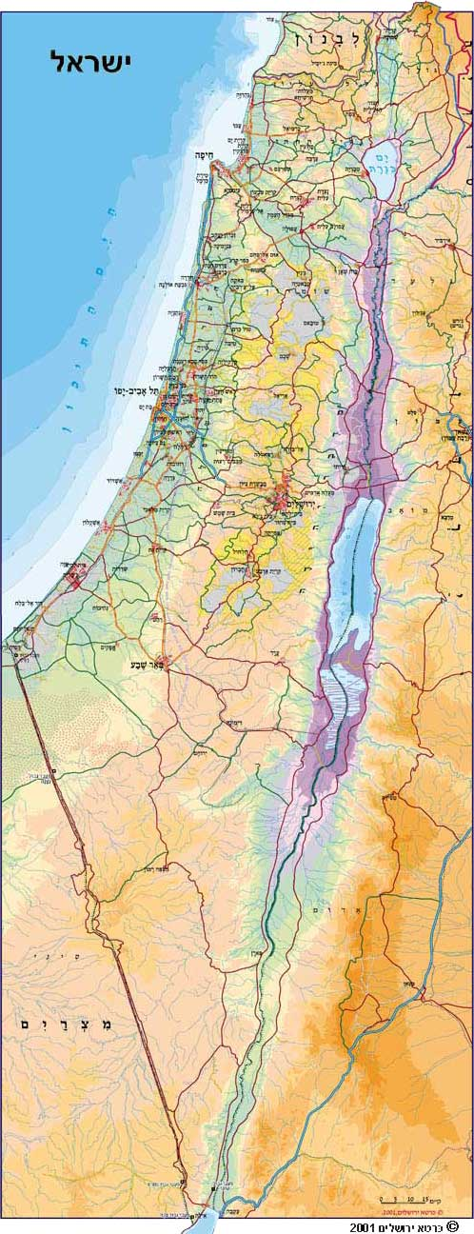

Operating Environment
Broad range of partners and customers: from micro-resident to macro-assimilation of national policy
Culture
Defense
IDF
National Infrastructure
Israel Train
Industry and Trade
Ministry of Construction
Prime Minister’s Office
ILA
Local authority
Health
Agriculture
Treasury
Planning Administration (Ministry of the Interior)
שותפים משולבים
Government ministries and national organizations
Education
Stakeholders, field of operation, partners, customers
Tourism
Entrepreneurs, contractors - real estate market
???
The North and South
Stakeholders,
Regulation, service provision
Social Services
Envierment protection
Residents / businesses lessees
Service Provision

Slide 4
Historical Background
"The Israel Land Administration (ILA) is the body that administers the land, the State of Israel, the Jewish National Fund and the Ministry of Construction (MOC), which constitute about 93% of the State of Israel's land (about 22 million dunams) To the policy established by the Israel Land Council. "Until the establishment of the ILA, the land was managed by several entities: The JNF managed the land it had purchased from the beginning of the Zionist settlement period”.
The MOC, the body established under the Development Authority Law (1950), managed the lands deposited by the Custodian of Absentees' Property after the War of Independence and land expropriated under the Land Acquisition Law (Approval of Actions and Compensation) C - 1953.
The State of Israel, as the successor to the British Mandate, managed all the lands registered until the establishment of the state in the name of the High Commissioner. Because of the need to concentrate the land management of the nation by one state institution, the legislature initiated the laws that constitute the legal basis for the work administration. "

Slide 5
The Main Principles Of Land Management Policy Are Determined By Virtue Of Three Laws And One Convention :
Basic Law: Israel Lands, 1960
This law provides that ownership of the lands of Israel shall not be transferred by sale or otherwise, except for exceptions prescribed by law.
The Israel Land Law, 1960
This law determines the exceptions to the rule set forth in the Basic Law: Israel Lands.
The Israel Land Authority Law, 1960
Updated to 6.6.12 The Law regulates the activity of the Israel Lands Council, according to which the Israel Lands Authority was established as a body responsible for the management of the Israel Lands.
Convention between the State of Israel and the Jewish National Fund, 5721-1961
•The Convention states that the management of state lands, the Development Authority and the Jewish National Fund will be coordinated by the State. The Government will establish an administration for the management of the said lands, the Israel Land Administration.
The convention also establishes the principle that state lands will be handed over only under lease and ownership will not be transferred to them.
In addition, great importance is attached to the Mandatory Tenders Law and Regulations (mainly Regulation 25)

Slide 6
Area analysis conducted by Rami
Topic | Area [million dunams] | Area after reduction - under the management of Rami [million dunams] | % Of the remaining area after reduction
State territory (excluding Judea and Samaria) | 21.7 | 20.2 | 93%
Areas of fire | 9.3 | 13.9 | 64%
Nature reserves + national parks + forests | 8.5 | 10.1 | 47%
Agricultural Units | 3 | 7 | 32%
Infrastructure * | 0.5 | 6.5 | 30%
Private* | 1.25 | 5.25 | 24%
* Infrastructure - roads between urban areas
* Private - non-geographical - based on the assumption that individuals in the territories
City

Slide 7
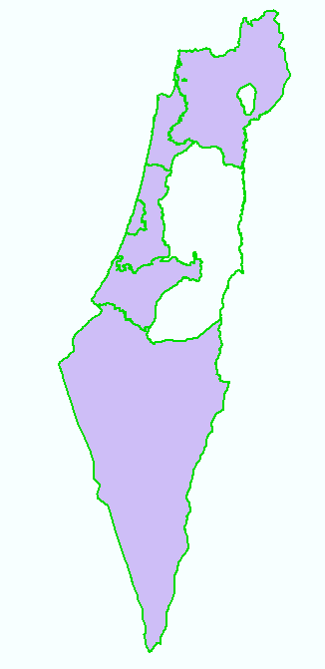
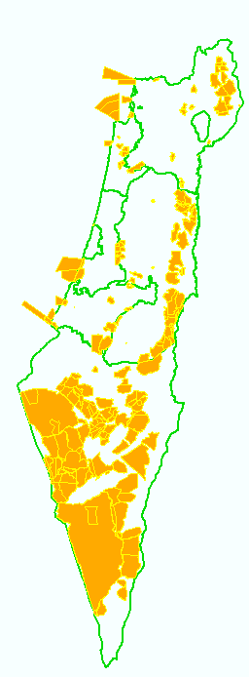
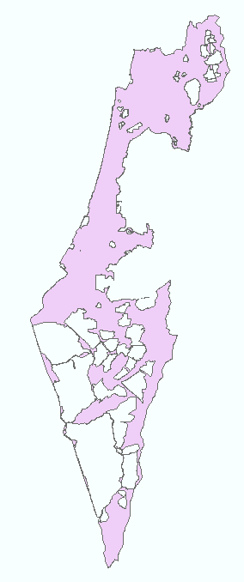
Area of state General (regulated + unregulated)
Areas of IDF fire
After Reduction
21.7 million hectares
13.9 million dunams

Slide 8
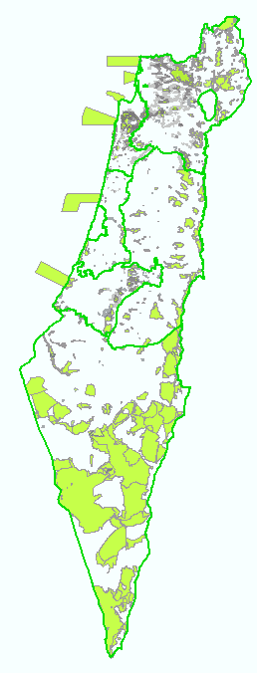
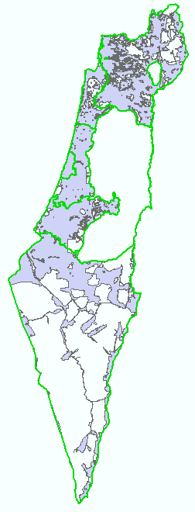
After Reduction
Without firing zones
Nature reserves, national parks, KKL-JNF forests
13.9 million dunams
10.1 million dunams

Slide 9
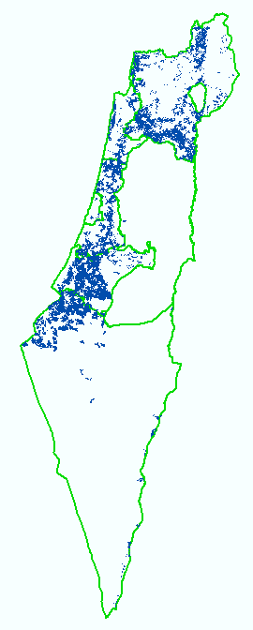
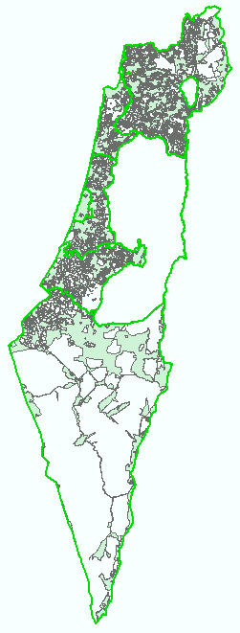
Without fire zones, reserves and gardens
Agricultural Units
After Reduction
10.1 million dunams
7 million hectares
(32.2%)

Slide 10
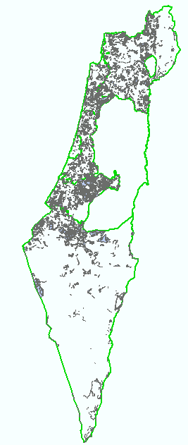
Unplanned territory in the area of national lands under the management of Rami
Locating without fire zones, without national parks, reserves, forests and squares
Reduction of Planned Areas
7 Million Dunams
1.9 Million Dunams

Slide 11
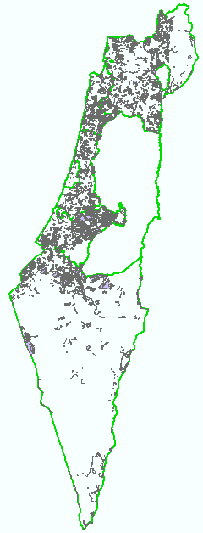
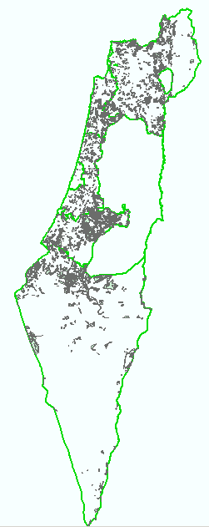
Reduction of lands in a planned process (reserve active lands)
1.85 Million Dunam
1.59 Million Dunam

Slide 12
Reduction of private lands + local government + Himtuna
1.85 מיליון דונם
1.59 מיליון דונם

Slide 13
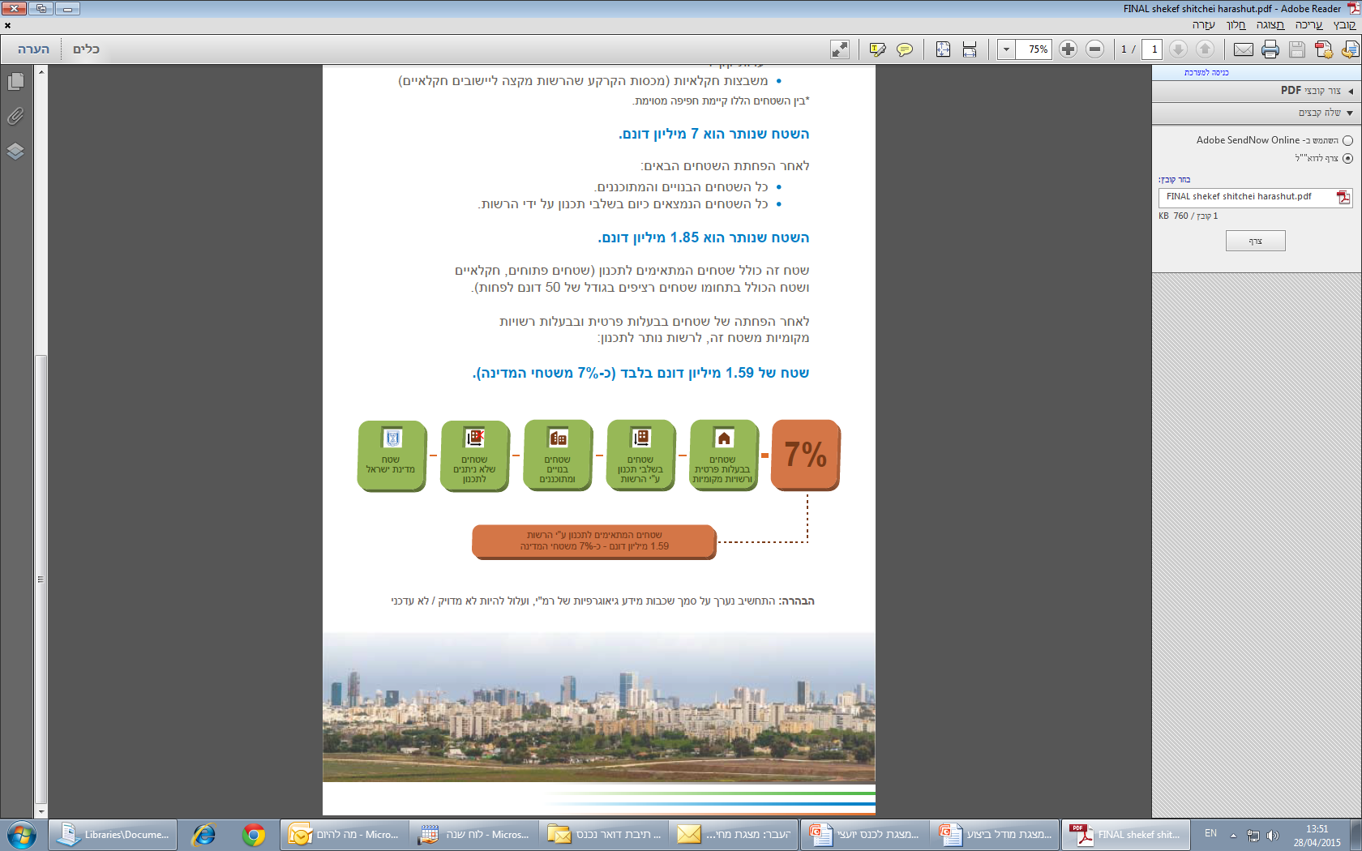
Area left for planning
In Rami land - summary of cuttings
Without firing zones
Without national parks
Without nature reserves
Without KKL forests
No slots
Areas designated for agriculture or open areas or areas
Not planned at all
No planning projects
Without private areas (private + local government + Himnuta)
The minimum area of 50 dunam
Land Of Israel
Lands that cannot be designated
Built and Planned Areas
Areas Under Planning by the Authority
Lands owned by Private and Local Authorities
Areas suitable for planning on the Authority’s residents are 1.59 dunams of the state land

Slide 14
Major activities
Land Allocation for Housing and Employment (in the Tender)
Planning, development, marketing, registration
Land allocations for designated uses (exempt from tender)
Additional rights and applications to owners of rights, infrastructure, rural and agricultural sector, local authorities and within the framework of a designated policy
Protection of the land and enforcement (removal of intruders and nuisances)
Regulation of registration, transfer of ownership
And the expropriations
Information (asset book, past transactions, planning situation, GIS)
Service to rights holders

Slide 15
Land Allocation for Housing and Employment (in the Tender)
Marketing
(Advertising, announcing the winner, allocation, building incentives)
Development arrangements
(Linked infrastructure, infrastructure and national infrastructure)
Seven Agricultural
Kark ("Redemption of Land")
Planning
(Surveys and initiation, promotion of programs until validation)
Roof agreements
With local authorities to accelerate marketing planning and development support
Strategic agreements
(The Green Line-Tel Aviv, the evacuation of the IDF camps, Nativ to Apartment 1-2, Israel Railways, Shaar Ha'ir in Jerusalem, Netanya - garbage dump, Haifa sea front)

Slide 16
Revolution of Roof Agreements - Principles
A roof agreement
Closing the development budget and a package of public institutions vis-à-vis government ministries and authorities
Setting an agreed development schedule with the local authority
Local Authority
Country
Involvement in determining project characteristics
      Ensuring the pace of marketing and building permits in accordance with pre-determined targets

Slide 17
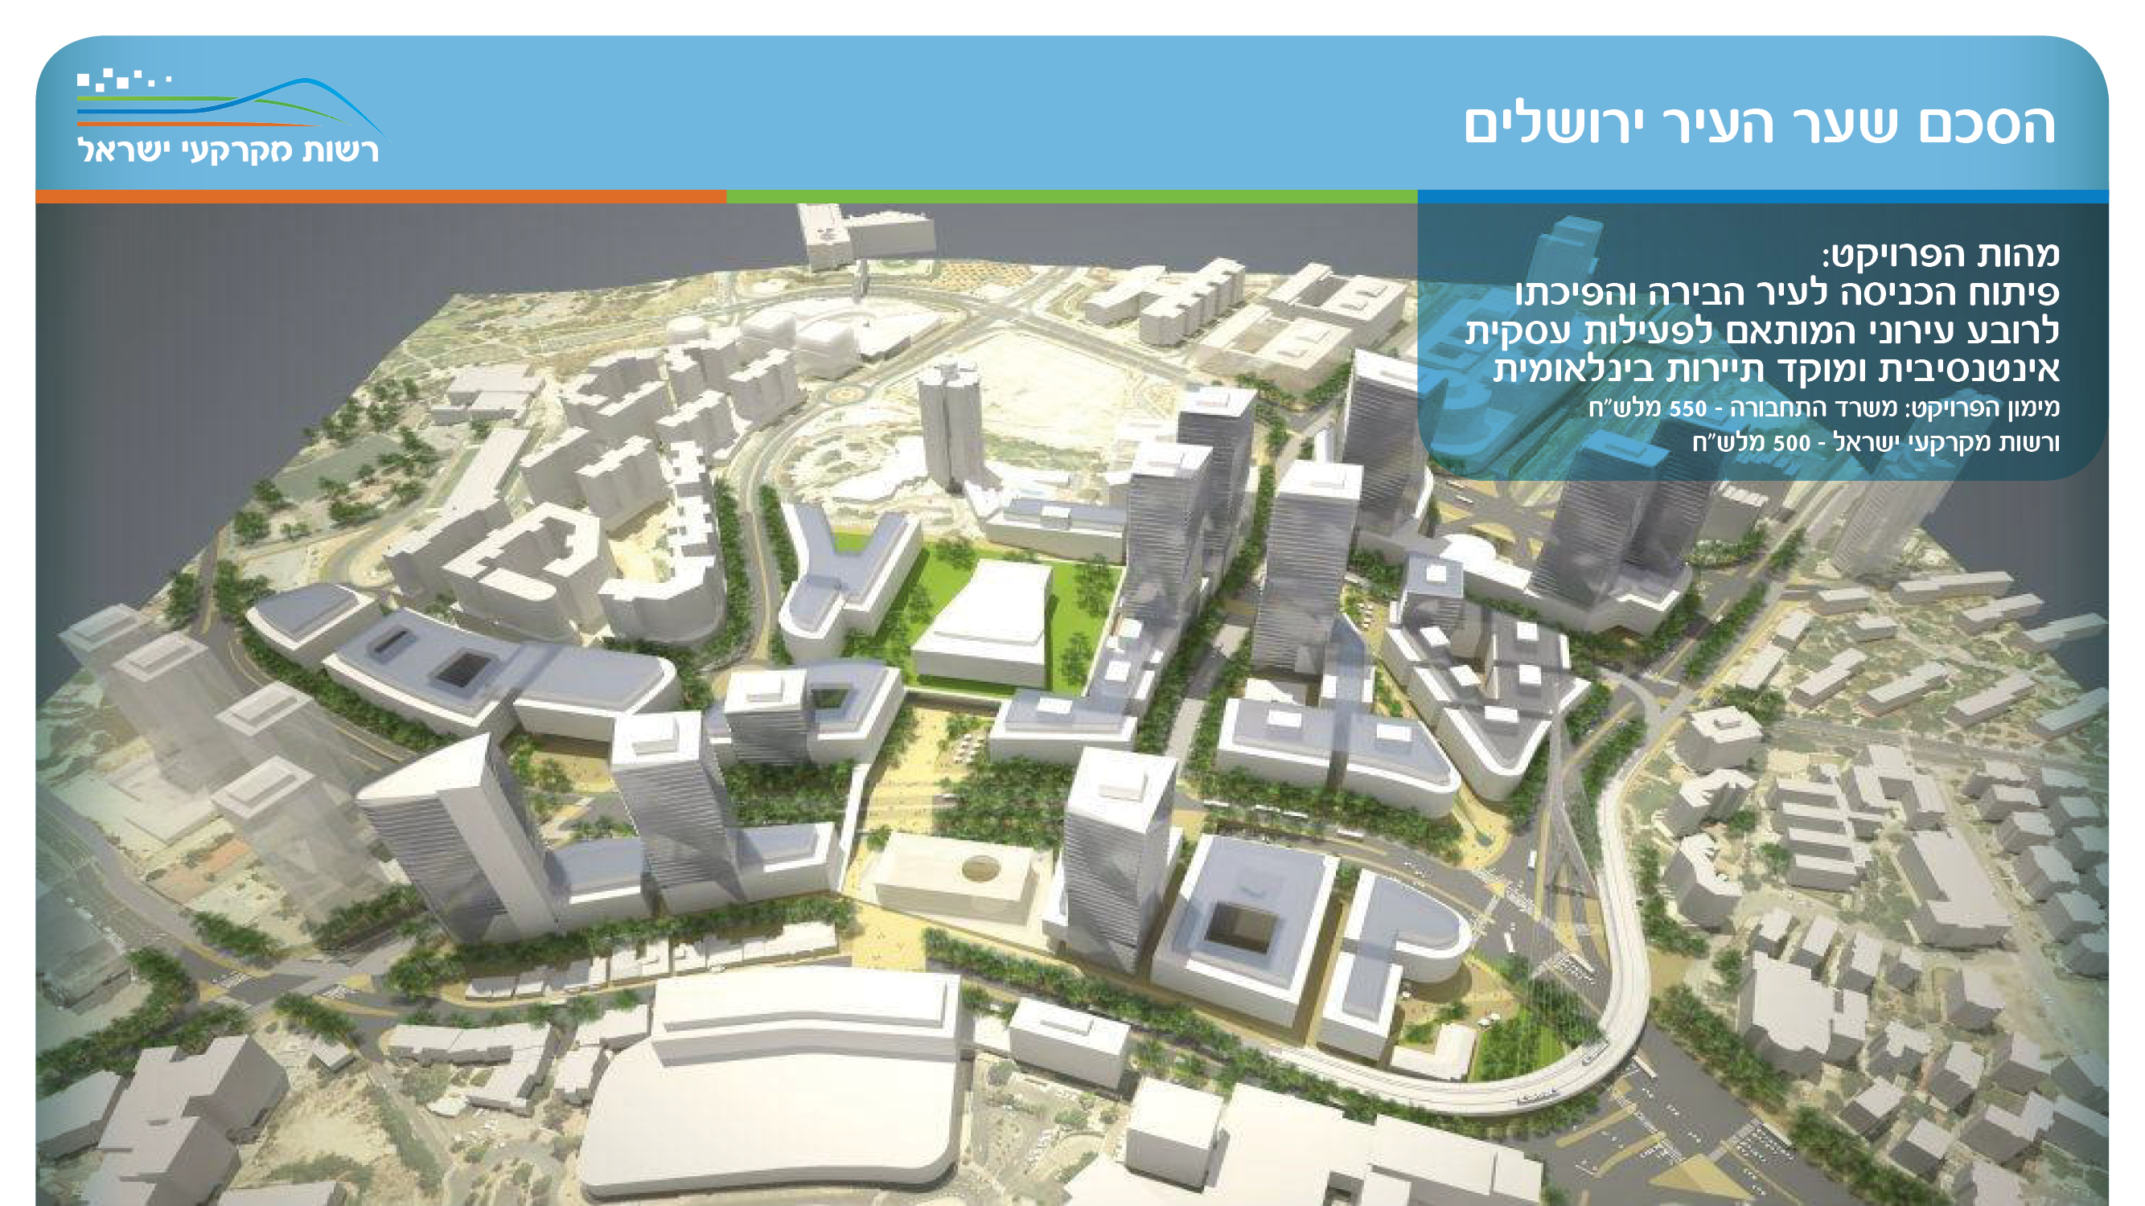
THE MAJIC GATES OF JERUSALEM
The essence of the project: development of the entrance to the capital city and its transformation into an urban quarter adapted to intensive business activity and an international tourism center

Slide 18
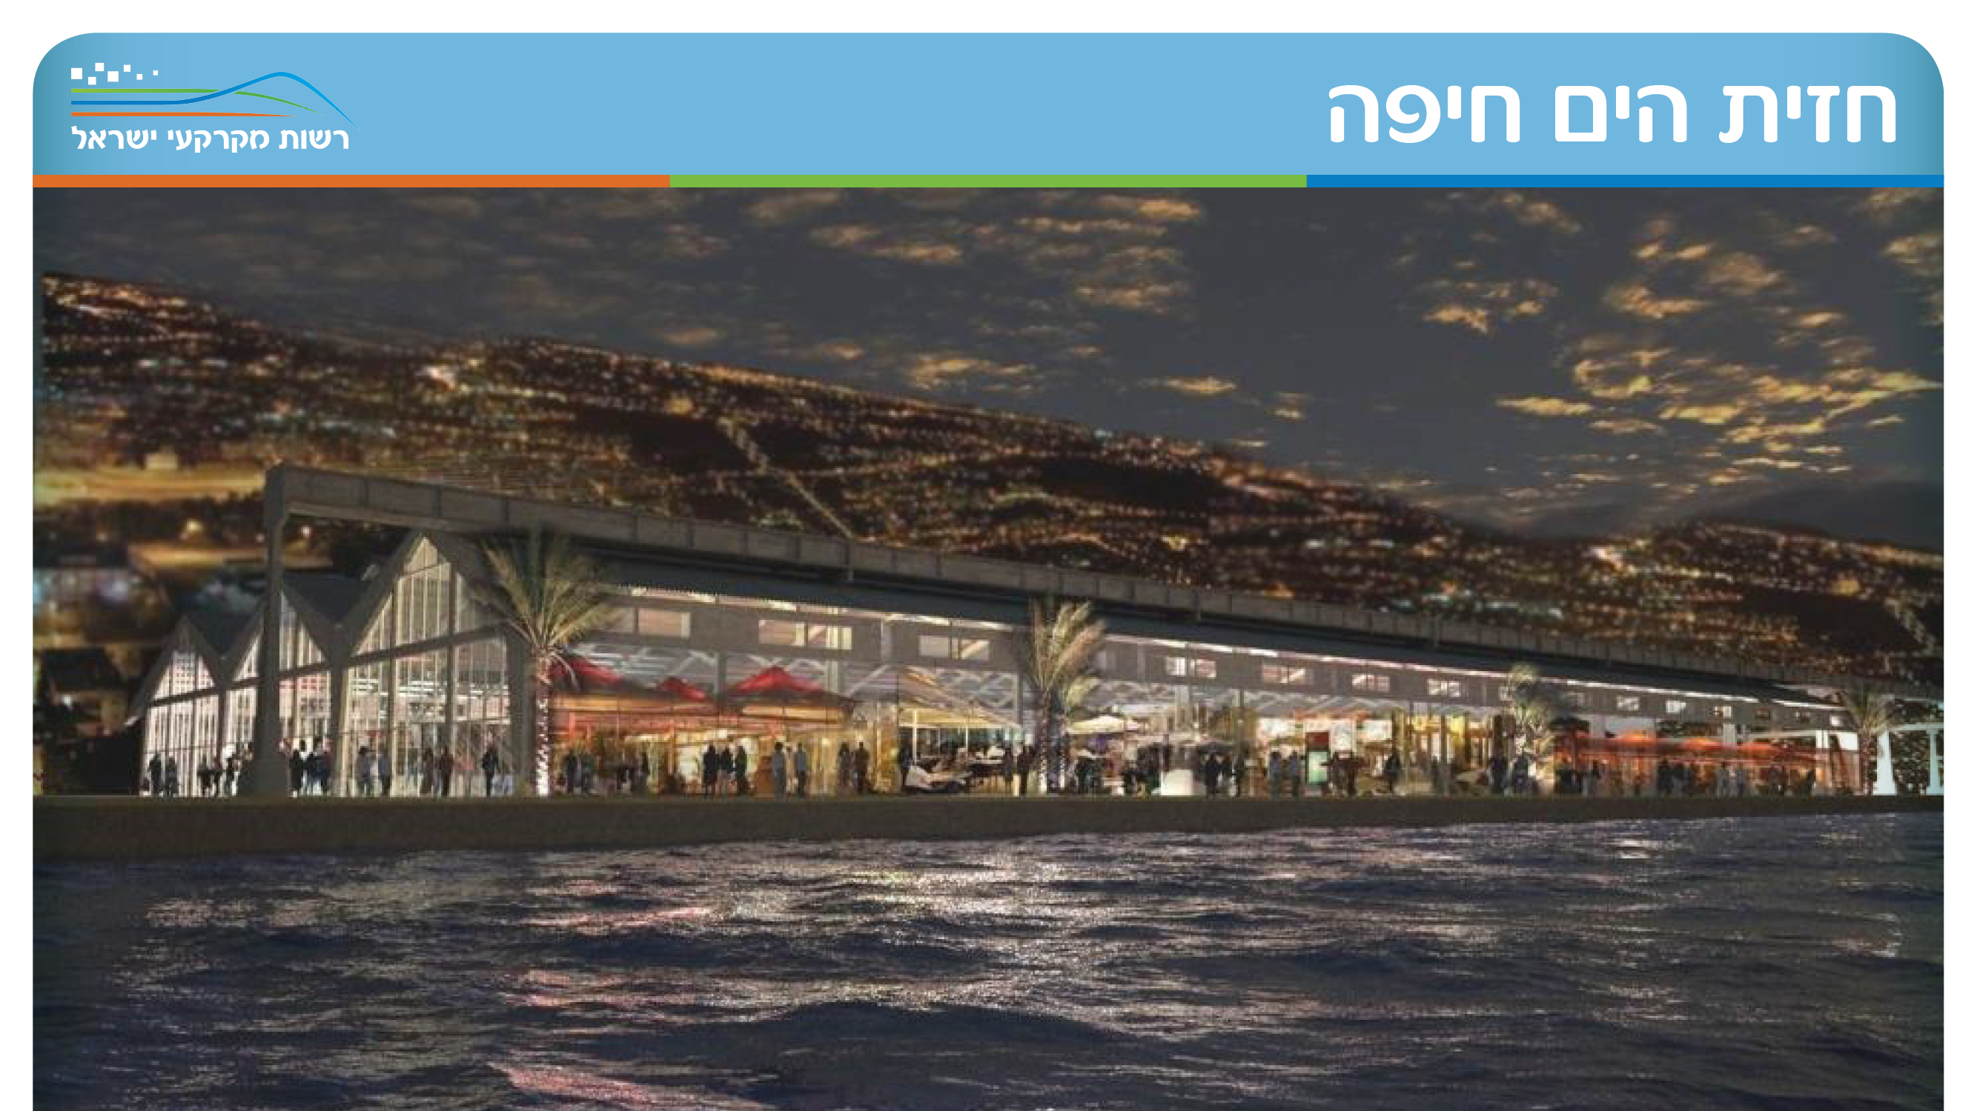
Sea Front Haifa

Slide 19
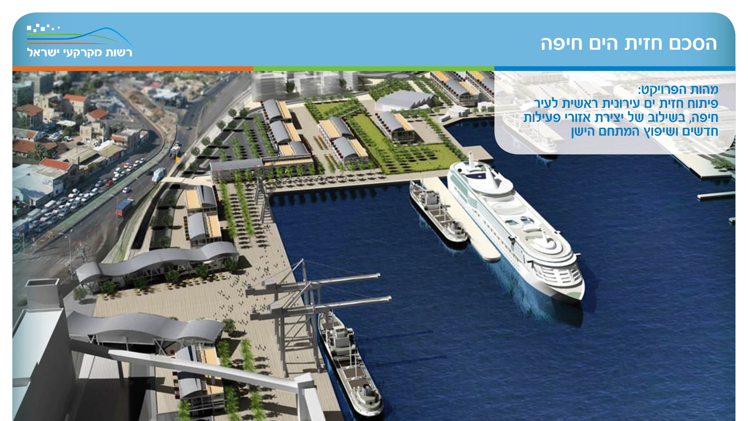
Haifa Seafront Agreement
The essence of the project: development of a main urban front for the city of Haifa, combined with the creation of new areas of activity and renovation of the old complex

Slide 20
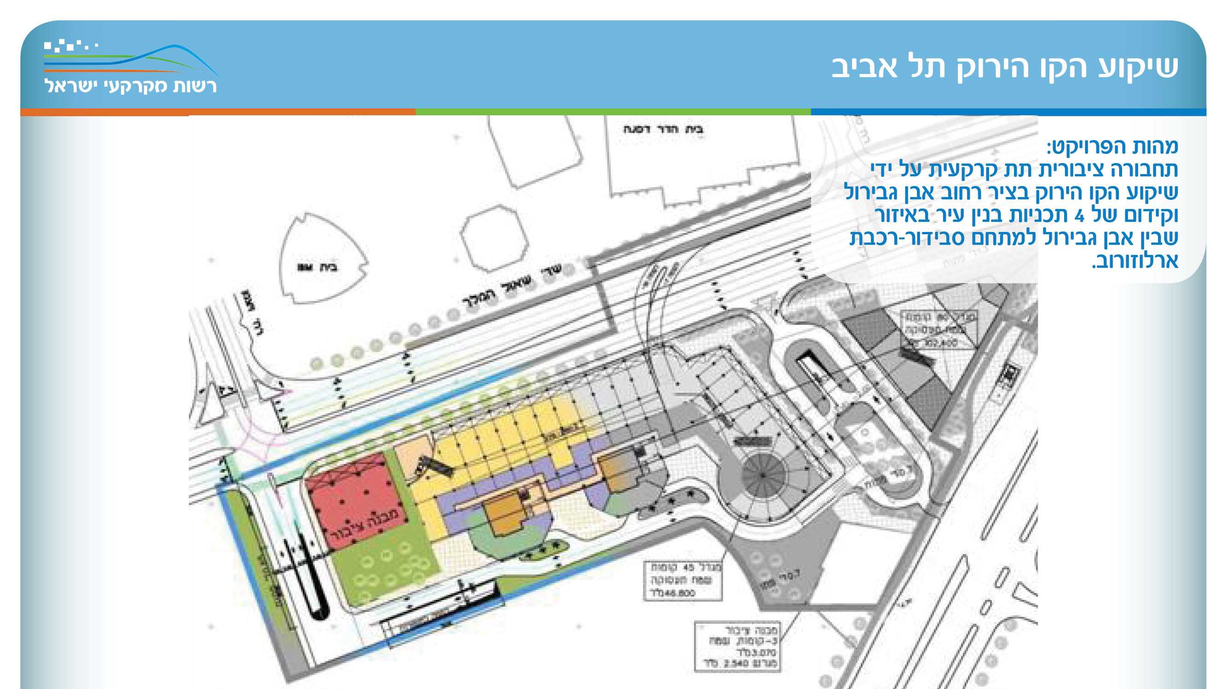

Slide 21
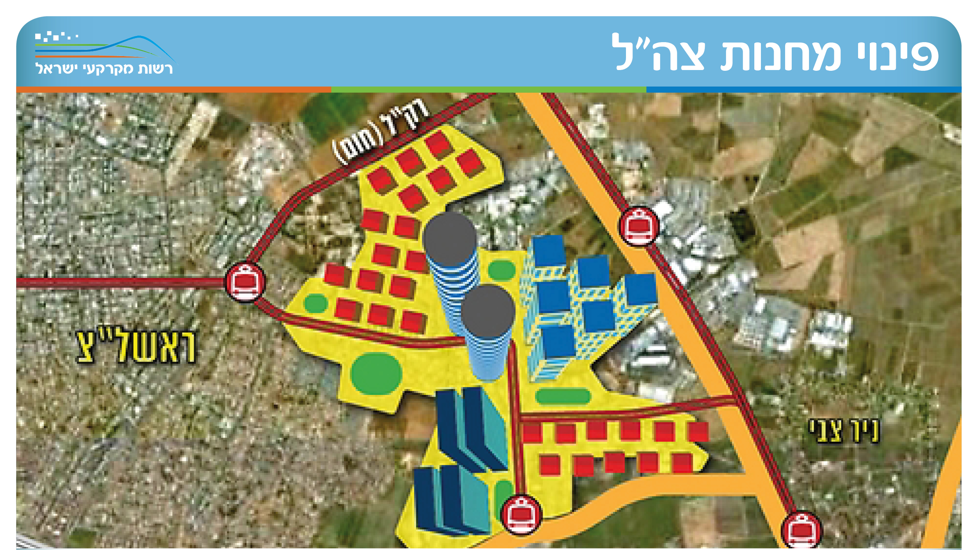
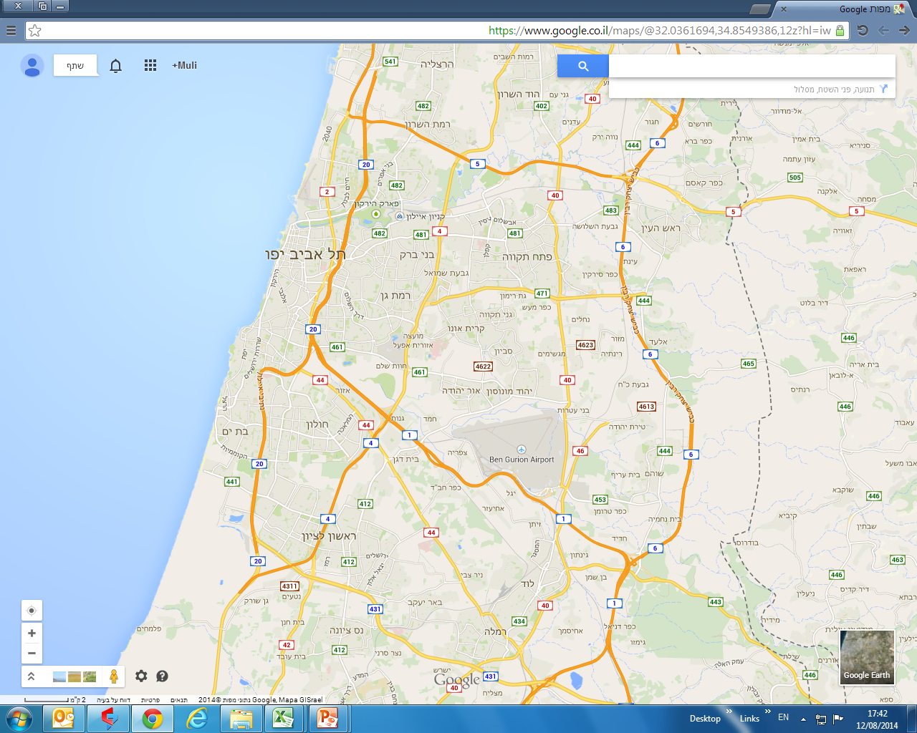
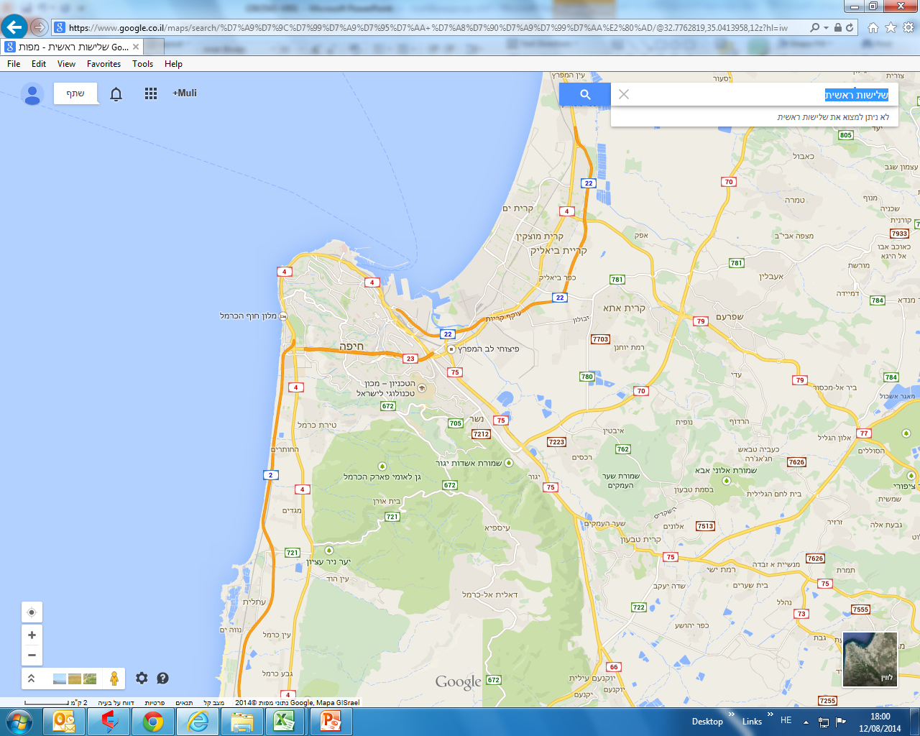
Evacuation of IDF camps
Marketing units
Sde Dov
16,500
שדה דב
Housing units for marketing 4,000
2016
Housing units for marketing 4,904
2017
12,000
סירקין
1,200
Machlef camp
Syrkin
שלישות ראשית
8,776 Housing units for marketing
2018
4,708 Housing units for marketing
2019
390
HaKirya
5,775 Housing units for marketing
2020
5,400 Housing units for marketing
2021
10,100
Tel Hashomer
- 9,203 Housing units for marketing
2022
תל השומר
10,596 Housing units for marketing
2023
7,500 Housing units for marketing
2024
ואילך
15,800
Syrkin
צריפין
3,600
מ.ק. 148
שיווק של כ-60 א' יח"ד

Slide 22
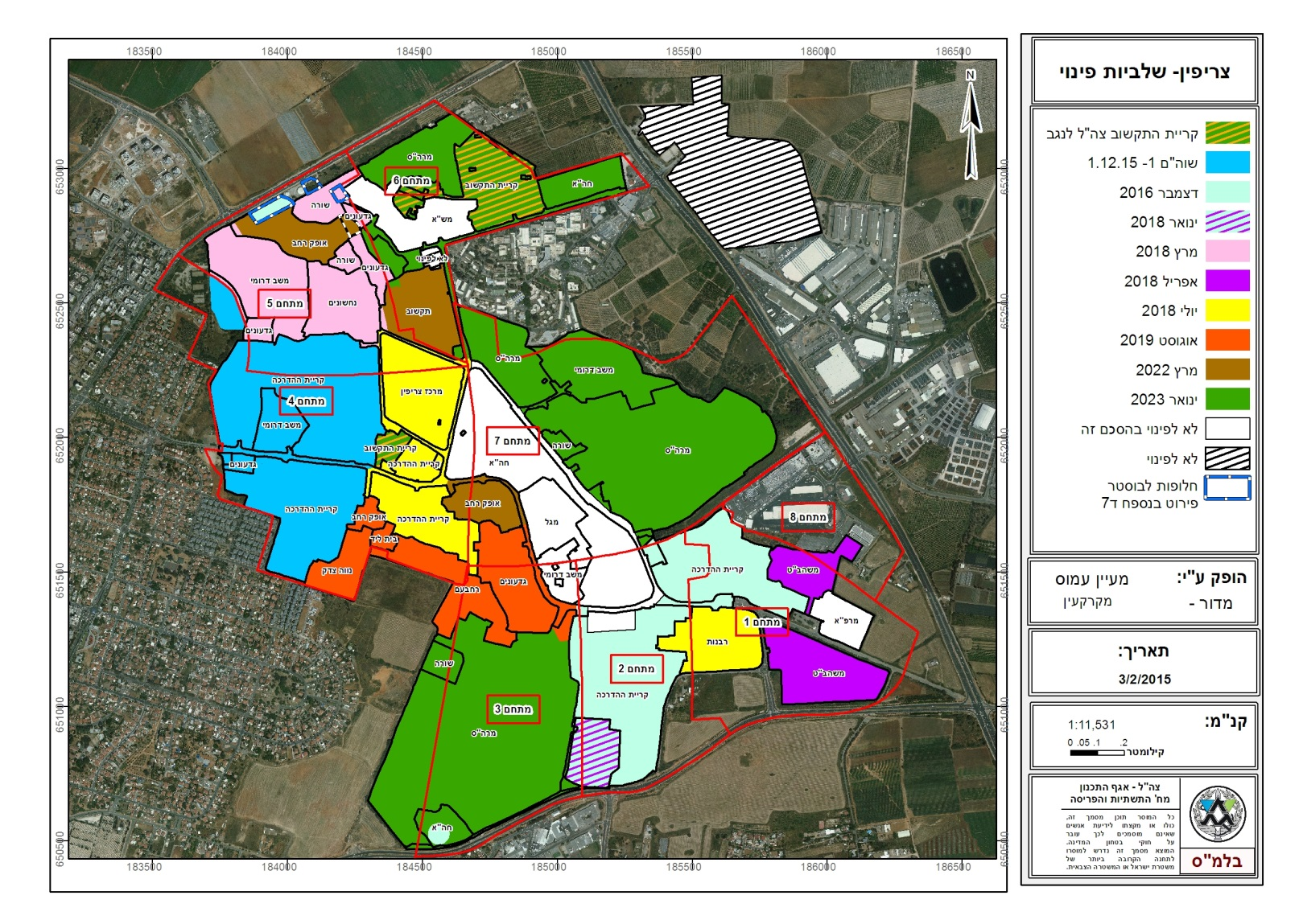
Tzrifin camp
Evacuation of IDF camps

Slide 23
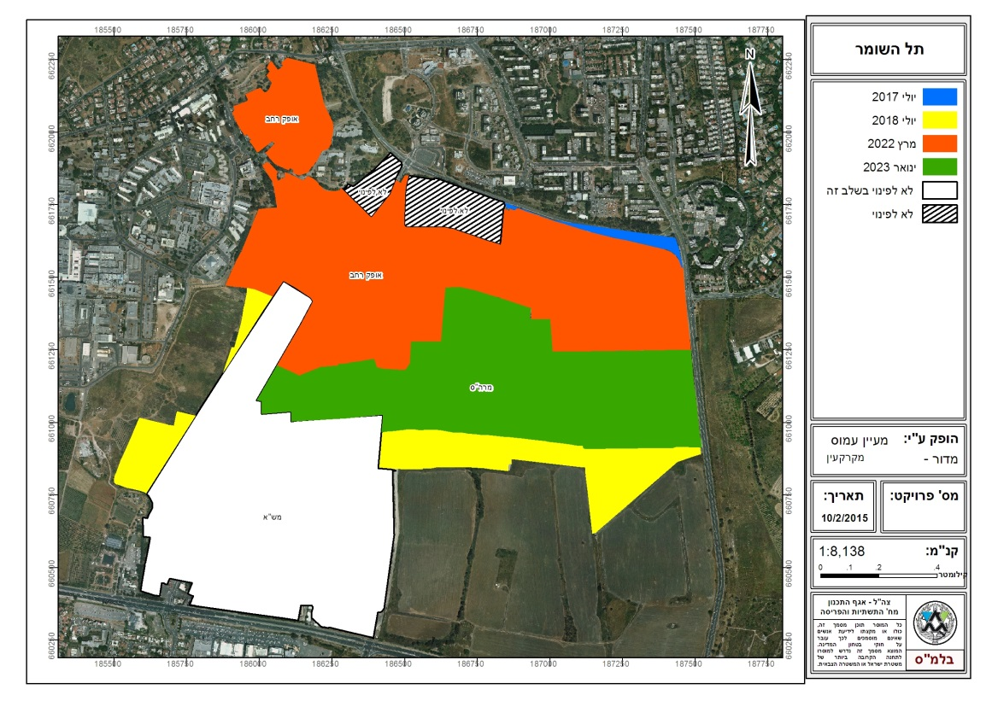
Tel Hashomer camp
Evacuation of IDF camps

Slide 24
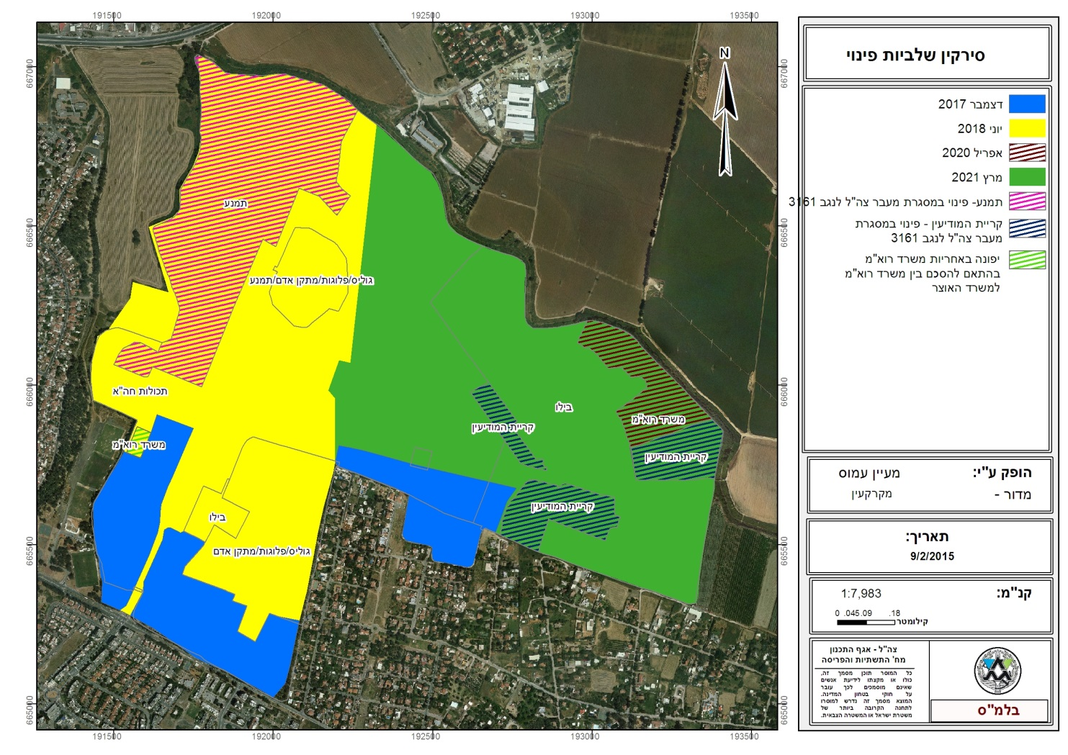
Syrkin camp -
Evacuation of IDF camps

Slide 25
Major Activities
Land Allocation for Housing and Employment (in the Tender)
Planning, development, marketing, registration
Land allocations for designated uses (exempt from tender)
Additional rights and applications to owners of rights, infrastructure, rural and agricultural sector, local authorities and within the framework of a designated policy
Protection of the land and enforcement (removal of intruders and nuisances)
Regulation of registration, transfer of ownership
And the expropriations
Information (asset book, past transactions, planning situation, GIS)
Service to rights holders

Slide 26
The process of approving a transaction exempt from a tender
Land allocations for designated uses (exempt from tender)
For new lessees
Housing, industry and tourism, rural and agricultural sector, by virtue of historical rights, as part of the return of agricultural land
Rights holders
Construction additions, rezoning and utilization, completion plots, long-term lease and employment / Palmach transactions in a moshav / kibbutz
Others
Local authorities, higher education institutions, government ministries, government companies and corporations, and the Military Police
Infrastructure factors
Mekorot,, the Israel Electric Corporation, the IAA,
,Israel Railways , Israel Natural Gas Lines, BAZAN
Receiving
Completing details
Mapping
Planning and supervision
Assessment
Completion of data reception
deal verification
Signature of an agreement

Slide 27
Challenges and work plan
Management in the public service
National politics
Business enterprise to the face of the regulator
Recommendations to the next government
Innovation and service improvement
Rural and agricultural sector

Slide 28

Thanks for listening!

Slide 31
(*) נתוני הכנסות לשנת 2018 אינם סופיים.

Slide 32
(*) נתוני התקבולים לשנת 2018 אינם סופיים.

Slide 33
Subsidized apartments
Other discounts
(*) נתוני הנחות בקרקע לשנת 2018 אינם סופיים.

Slide 34
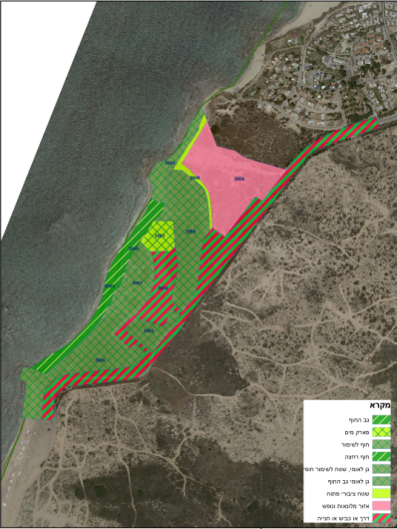
Palmachim Holiday Village
The purpose of the program:
The establishment of a vacation village in Kibbutz Palmahim
Area (dunam):65
Program status:
The plan was made for deposit on 11/1997.
The terms of the deposit were not fulfilled, the program was canceled by a program
Another of the Israel Nature and National Parks Protection Authority
All to a national park and a marine nature reserve (approved in 2000).

Slide 35
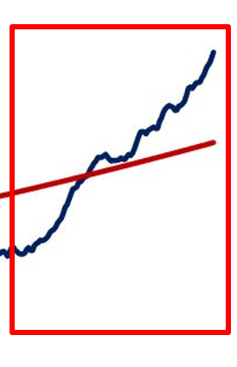
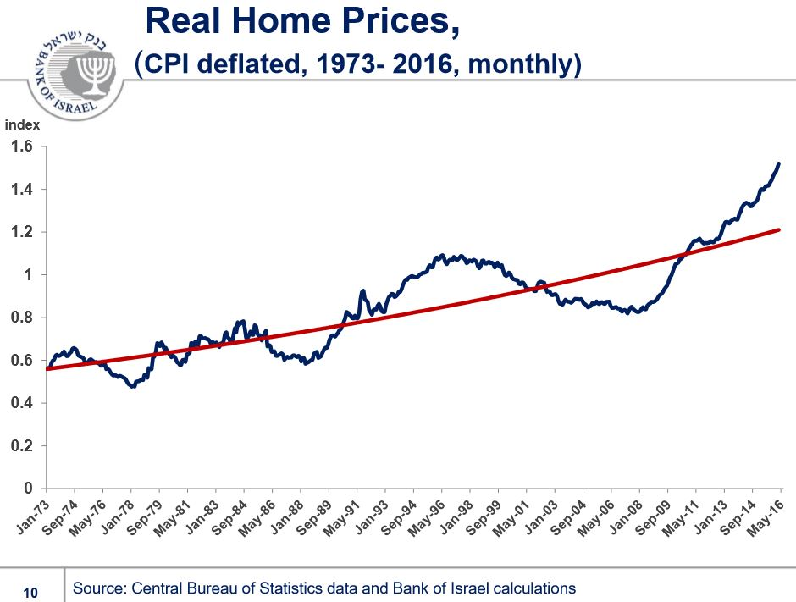

Slide 36
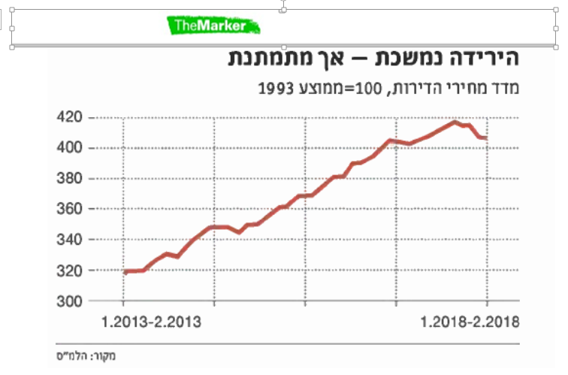
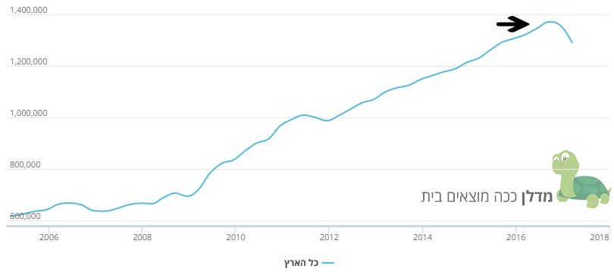
Prices fall in 2018
!!
?
The entire country

Slide 37
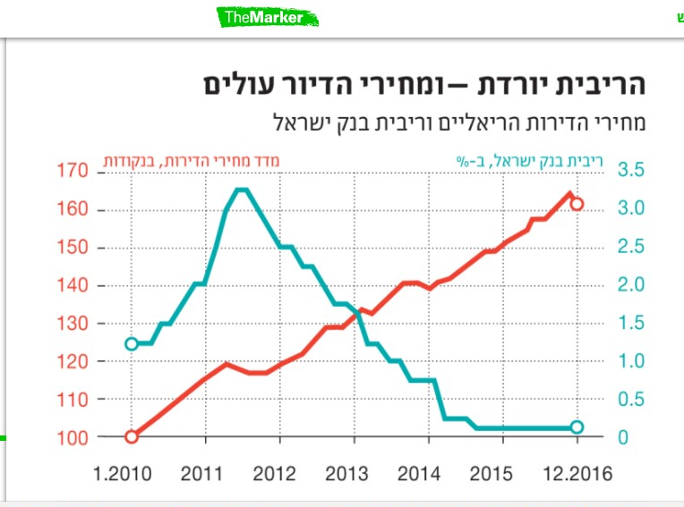
WHY? interest!

Slide 38
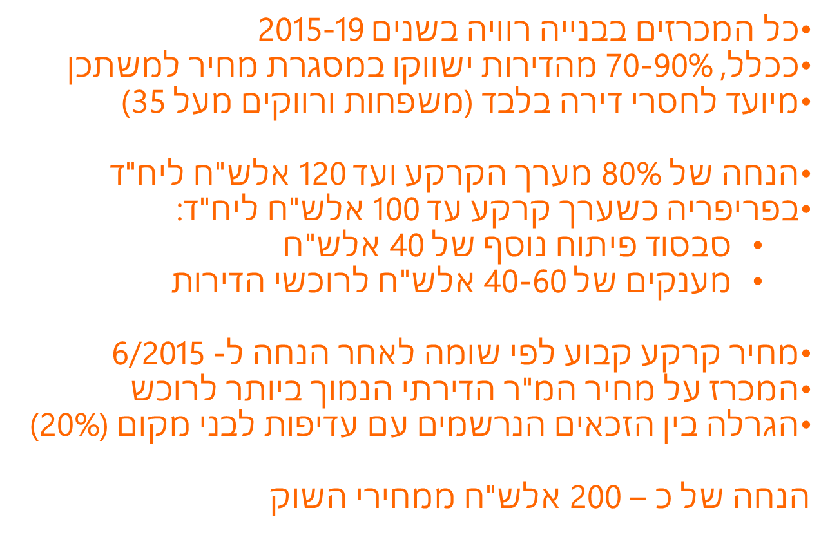
Main principles of subsidized apartments
All auctions in construction between 2015-19
In general, 70-90% of the apartments will be marketed in the frame of subsidized apartments
Meant only for people who do not own an apartment (families and single people over the age of 35)
Discount of 80% off the land’s value and up to 120 thousand NIS for a housing unit
In the periphery, when the land’s value is up to 100 thousand NIS per housing unit:
  Extra subsidization of 40 thousand NIS
  Grants for 40-60 thousand NIS for those who purchase houses
Set price according to assessment, after discount for 6/2015
The auction for the price of 1 sq meter is the lowest available to buyers
A draw amongst the eligible who signed up, with preference to locals (20%)
A discount of about 200 thousand NIS from the prices of market

Slide 39
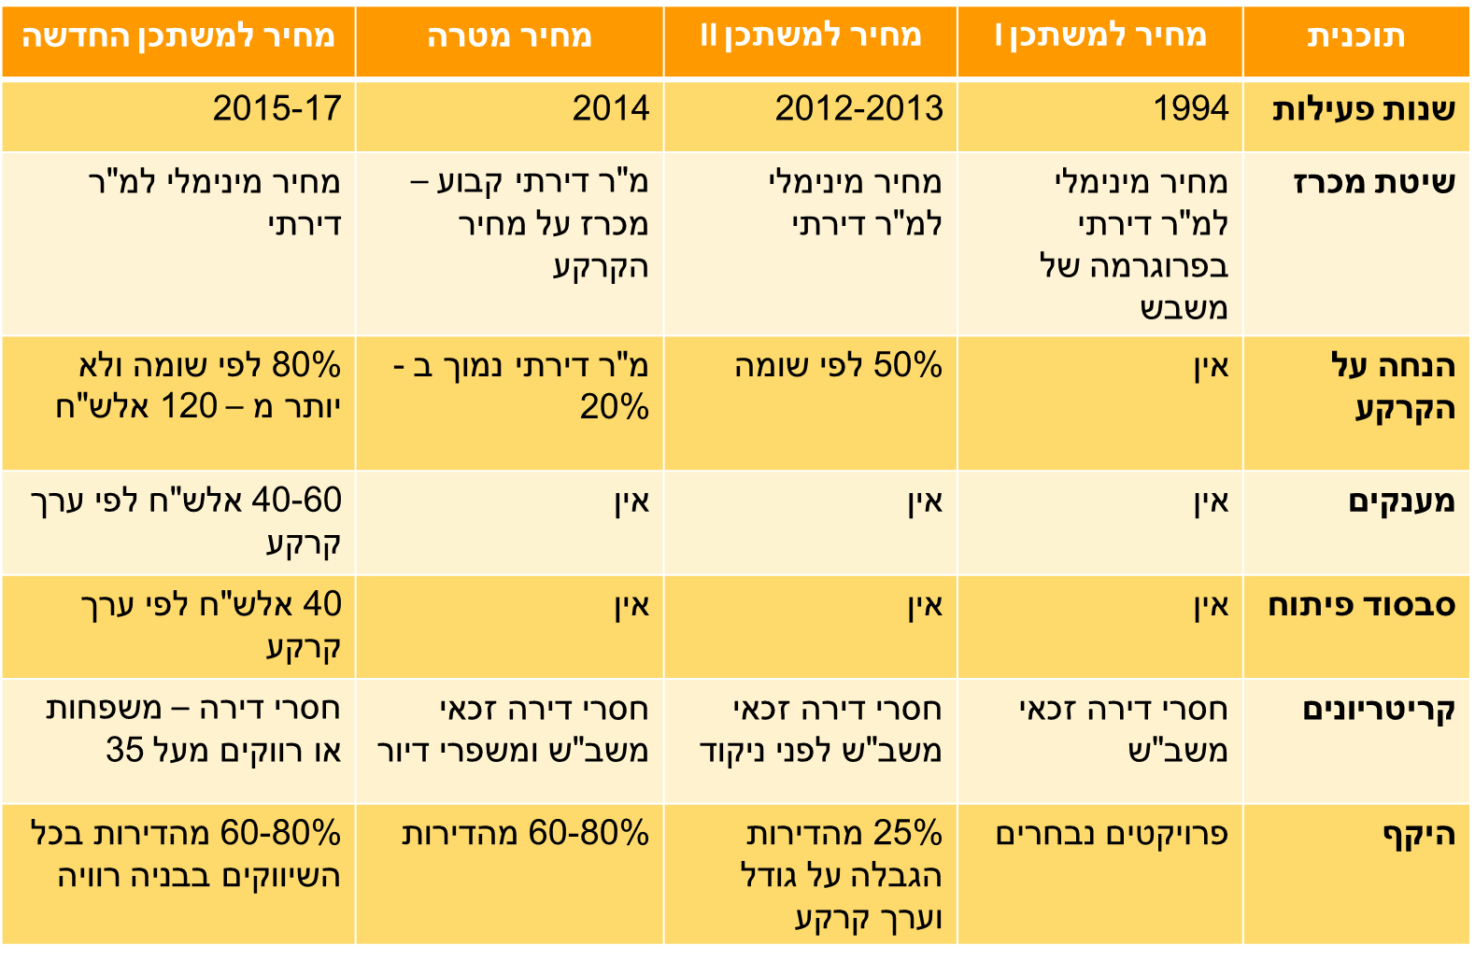
Target price
Subsidized II
Subsidized I
Plan
Years
Center methods
Discount on the ground
Grants
Subsidizing development
Criteria
Scope

Slide 40
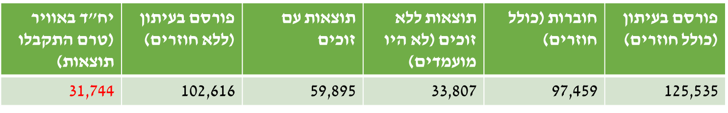
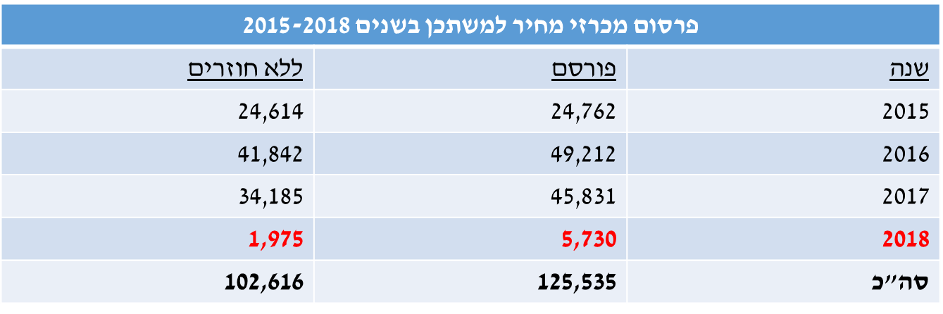
מחיר למשתכן בשנים 2015-2018
Published in the newspaper without winners
Results without winners
As a result
Results with winners
Brochures
Published in the newspaper with winners
Publication of price auctions occupation in the year 2015-2018
Do not come back
Released
Years

