Slide 1
la 'amal fi alkhiana
I'd like to express some concern that the situation is extremely difficult and that the hope is a two-state solution -- a state of Palestine, independent, contiguous, viable Palestine living side by side in peace and stability and security with the state of Israel. This context, this concept, I fear is beginning to erode. And the world is starting not to believe, to distrust that we're able to reach this solution.“
"If we fail to achieve our goal, I don't know what the future will be. The people are becoming disappointed and desperate
"Nobody denies the Jewish history in the Middle East. A third of holy Quran talks about the Jews in the Middle East, in this area. Nobody from our side, at least, denies that the Jews were in Palestine, were in the Middle East."

Slide 2
2 state solution – 1967 borders
The so called deal of the century is destroying the 2 state solution and destroying hope for peace.
Swiss cheese deal.
We are ready to resume negations with Israel, based on the discussion we had with PM Olmert. We do not violence. Deal of the century is pushing us there. It is not our desire. We do not want violence.
The Palestinian people deserve peace and prosperity. To live in a free Palestine. Jerusalem as our eternal capital.
Peace can be achieved via dialogue, not by creating facts on the ground.
One side cannot dictate the future
We are against terror. We want to achieve peace through dialogue.
"unilateral steps that violate international legitimacy and the Arab peace initiative“
"It annuls the legitimacy of the Palestinian rights, our rights to self-determination, freedom, and independence, in our own state," he said.
"It legitimised what is illegal - settlements and confiscation and annexation of Palestinian land," he said, referring to Israel's illegal settlement expansion project in the occupied West Bank and East Jerusalem.
In his speech, Abbas reiterated that peace between the Palestinians and Israelis "is still possible" and "achievable".
"We are still committed to peace as a strategic choice, but this deal is not an international partnership,“
Al Jazeera's Nida Ibrahim, reporting from Ramallah, said the outpouring of support for Abbas's speech came despite many Palestinians feeling hopeless.
"They say they've been promised for years … not any one resolution they say has been implemented on the ground," Ibrahim said.
"From the expansion of settlements, the US embassy move … they don't seem to be holding much hope. Palestinians are not hopeful that the reality on the ground is going to change," she sai
Waving a copy of a map that the US plan envisions for a two-state solution for Israel and Palestine, Abbas said the state carved out for Palestinians looks like a fragmented "Swiss cheese.“
Suggesting violent protests could break out, Abbas said that "the situation could implode at any moment. ... We need hope. Please do not take this hope away from us." Later he said Palestinians would not "resort to terrorism.“
I say: The time has come for my courageous and proud people, after decades of displacement and colonial occupation and ceaseless suffering, to live like other peoples of the earth, free in a sovereign and independent homeland.
Abbas called on Trump to return to negotiations based on existing UN resolutions that call for a two-state solution based on pre-1967 borders, and urged the council to hold an international conference to seek a settlement for the long-running conflict.
This trilateral agreement normalizing ties between UAE and Israel in nonsense. It is a stab in the back for the palestenian casue. A continuos stab in the back. A betrayl.
This is an illusion of peace om exchange for peace. Leaping over the palestenian nation.
Peace, security and stability in the region will only come after the Isreli illegal occupation of Palestine ends.
The illegal occupation of our homeland and people’s freedon.
The continuous bite in our size of land.

Slide 3
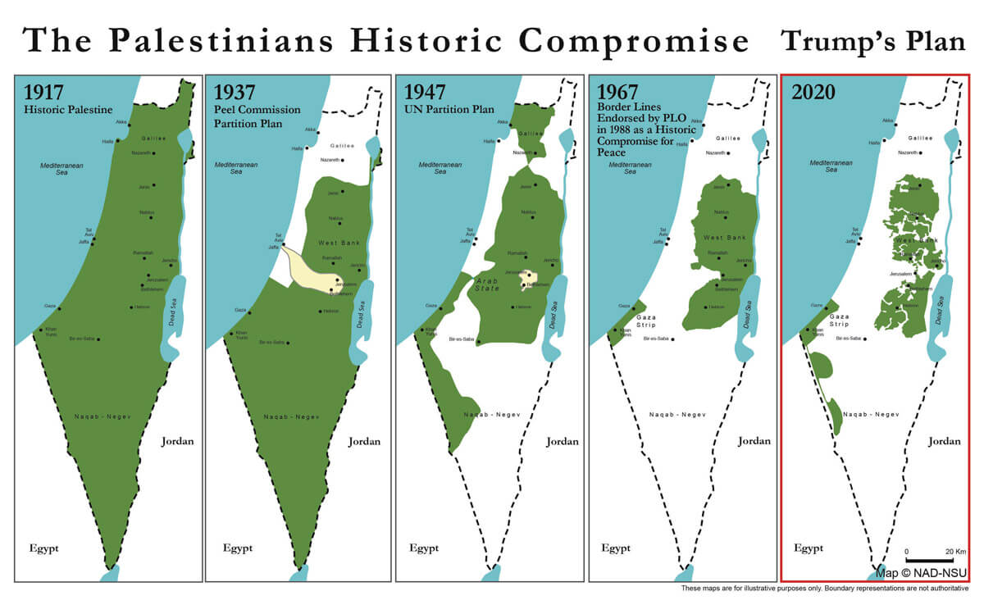

Slide 4
https://churchleaders.com/news/380677-what-you-need-to-know-about-the-abraham-accord.html/2
https://www.israelnationalnews.com/News/News.aspx/285518
https://www.voanews.com/middle-east/how-abraham-accord-might-impact-middle-east
https://www.israelhayom.com/opinions/the-cultural-genius-of-the-abraham-accords/
https://en.globes.co.il/en/article-palestinians-need-to-change-paradigm-1001339349
https://themedialine.org/top-stories/after-abraham-accord-prospects-for-regional-military-alliance-weighed/

