Slide 1
Tour Schedule
' 16/05 | '15/05 | ' 14/05 | ' 13/05 | 12/05
Victory Park + The Great Patriotic War Museum (World War II) | Travel | Power Relations | Ambassador of Israel in Russia | "Halutzim" flight Saturday evening
 | Military Academy tour Official uniform) ) | Internal Policy | Foreign and Security Policy of Russia | Landing at DME (LY 611)
 |  | Russian Policy in the Middle East | Internal political situation | Traveling + getting organized
Travel |  | Lunch | Travel to the Foreign Ministry + lunch
 |  |  |  | Lunch
Concluding lunch (Jerusalem Restaurant) | Travel + Lunch |  | Russia - Middle East Deputy Foreign Minister for the Middle East and Africa and the President's envoy to the region, Mr. Michael Bogdanov Foreign Policy Planning
 |  |  |  | Defense attaché
 |  | Guided tour of the Kremlin
Travel to the train - Weekend St. Petersburg
 | Strategy and National security |  | Free time | Introductory tour Central Moscow / Kremlin Complex
Free Time
 | Dinner + Travel | Lunch + getting organized
Drive to the airport |  | Independence Day Reception at the Embassy of Israel in Moscow (official uniform) | Night tour in Moscow
 | Culture performance
 |  |  |  | Free evening
DME Take-off

Slide 2
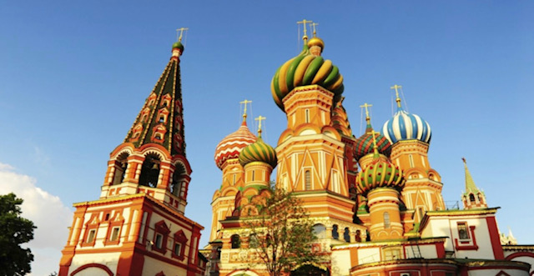
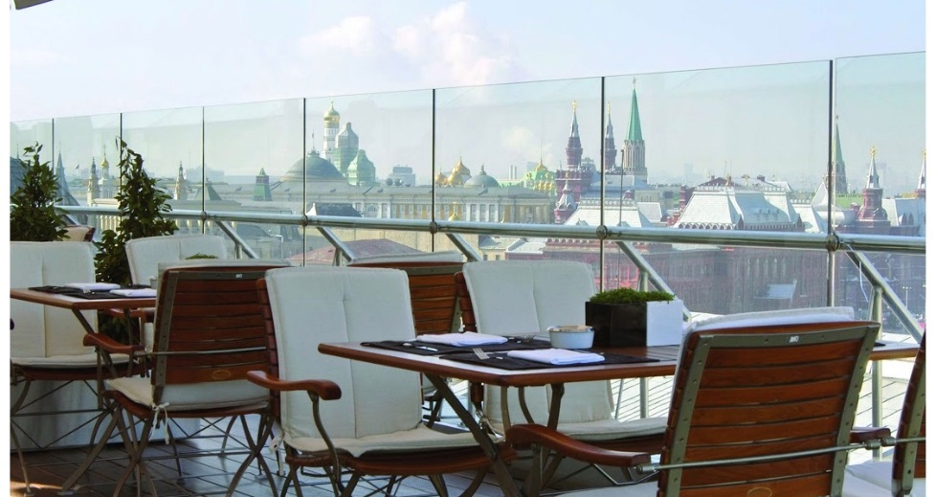
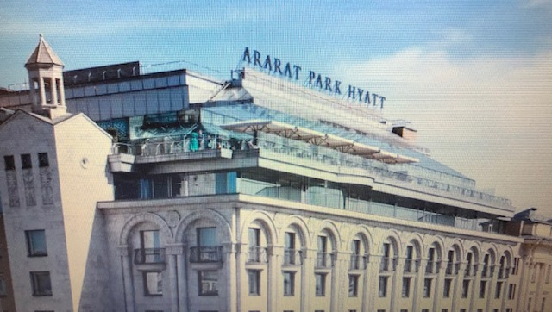
Individual Schedule Tour - Sunday 12/5
Hour | Activity | Speaker | Place
02:30 | "Halutzim" flight
02:30 | INDC en route to Ben-Gurion Airport
05:50-10:05 | flight LY611 |  | The Domodedovo Airport
 | Travel to the hotel + Lunch |  | Ararat Park Hyatt
13:30-15:00 | Israel - Russia relations | Attaché - Colonel German (Hebrew) | Hotel
16:00-20:00 | A guided tour of Moscow | Anya | Central Moscow / Kremlin Complex (Patriarch's Bridge, Alexander Gardens, the Kremlin Compound, Red Square)
23:00 – 20:00 | Free Evening (independent dinner)

Slide 3
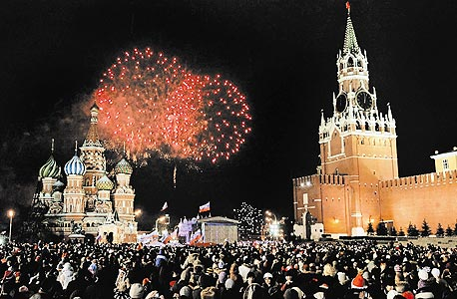
Individual Schedule Tour - Monday, May 13th
Hour | Activity | Speaker | Place | Gift
8:00-9:00 | Breakfast in the presence of the ambassador - Mr. Gary Koren |  | Hotel Dining room PLAZMA restaurant 10th Floor
9:00-10:00 | Bilateral Relations between Russia and Israel | Ambassador of Israel to Russia, Mr. Gary Koren (Hebrew) | Hotel -suit SCHEPKIN Hall, 2nd floor | Shafshak
10:00-10:45 | Foreign policy and security | Mr. Dmitry Training Academic Researcher, Former Colonel (English) |  | Eros
11:00-11:45 | The economic situation in Russia and its effects on internal policy | Mr. Ivgeny Gutmacher Chairman, World Economic Research Institute |  | Eyal Argov
11:00-11:45 | Lunch |  | Outside the SCHEPKIN hall 2nd floor
11:45-12:30 | En route
13:00-14:00 | Russia - Middle East | Deputy Foreign Minister for the Middle East and Africa and the President's envoy to the region, Mr. Michael Bogdanov (Russian) | Ministry of Foreign Affairs - suit | Chen
14:15-15:00 | Planning Russian foreign policy | Mr. Andrey Drobinin, Deputy Head of the Department of Political Planning (English)
15:00-19:00 | Free time- independent dinner |  |  | Maya
19:00-23:00 | Night Tour in Moscow (Anya) |  | Leaving the Hotel

Slide 4
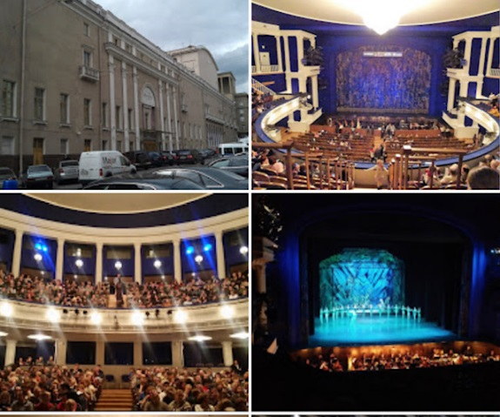
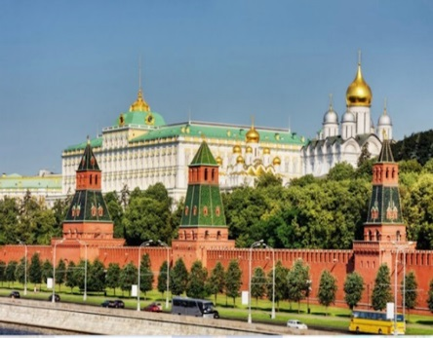
Individual Schedule Tour - Tuesday 14/5
Hour | Activity | Speaker | Place | Gift
8:00-9:00 | Breakfast |  | Hotel - Restaurant PARK Floor 2
9:00-9:45 | Power Relations | Mr. Andrey Kortunov CEO of INSS Russia (English) | hotel a suit SCHEPKIN Hall, 2nd floor | Hanuna
10:00-10:45 | Internal Policy | Mr. Andrey Kalsnikov (English) |  | RAJU
11:00-11:45 | Russia's Middle East Policy | Mr. Yuri Barmin, Researcher and Commentator on Russian Strategy in the Middle East |  | ואך
11:45-12:30 | Lunch |  | Outside the hall SCHEPKIN 2nd floor
12:30-13:00 | Walking to the Kremlin
13:00-16:00 | Guided tour of the Kremlin (Anna) |  | Kremlin - a suit
16:00-18:15 | Back to the hotel + organization
18:15 | En route
19:00-22:00 | Israeli Embassy for Independence Day )Official Uniform) |  | THE STANISLAVSKY AND NEMIROVICH DANCHENKO MOOSCOW ACADEMIC MUSIC THEATRE
22:00 | Drive to the hotel (for those interested)

Slide 5
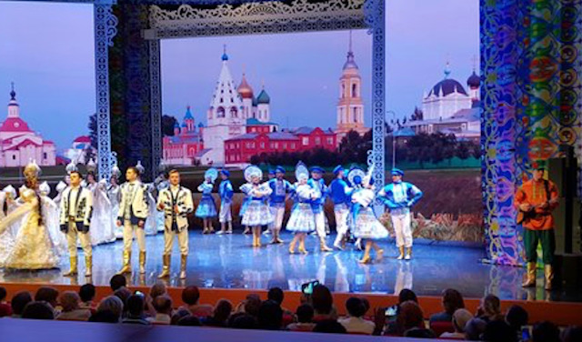
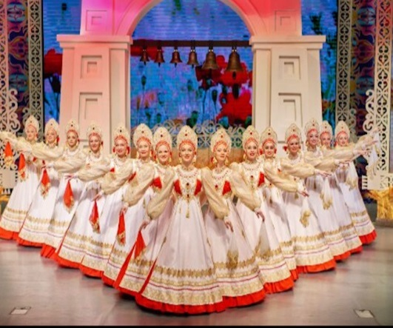
Individual Schedule Tour - Wednesday 15/5
Hour | Activity |  | Speaker | Place | Gift
8:00-9:00 | Breakfast |  |  | Hotel - Restaurant PARK Floor 2
9:00-10:00 | Travel
10:00-11:00 | Visiting the Military Academy | Tour + Joint Photo | (Russian) | Military Academy – Official Uniform
11:00-11:45 |  | Review of the Russian Army | (Russian) |  | Tishler
11:45-12:30 |  | National Security Concept of Russia | (Russian) |  | שי טייב
12:30-13:00 |  | Lessons learned from fighting in Syria | (Russian) |  | Yitzik
13:15-14:00 |  | Lecture Israel | Mr. Eyal Kalif (Hebrew)
14:00-15:30 | Traveling + organizing (sandwiches on the bus)
15:30-16:30 | Processing teams |  |  | Hotel – INDC Dress Code | נתנס
16:30-17:30 | En route
17:30-18:30 | Dinner – Restaurant MAGEN DAVID |  |  | (Kosher)
18:30 | En route
19:30-21:30 | Folklore Show - "Golden Ring" |  |  | Theater - INDC Code
21:30 | En route to the hotel

Slide 6
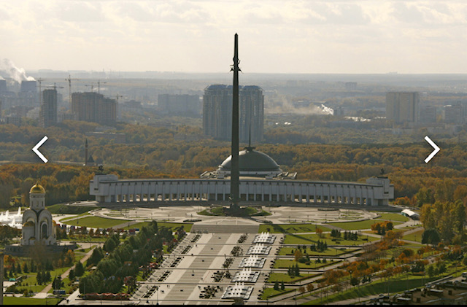
Individual Schedule Tour – Thursday 16/5
Hour | Activity | Speaker | Place |  | Gift
7:30-8:30 | Breakfast + Checkout |  | Hotel - Restaurant PARK Floor 2
8:30-9:30 | Travel
9:30-12:30 | Victory Park + Great Patriotic War Museum | Anya | INDC Code
12:30 | En route
13:30-14:30 | Lunch - Jerusalem Restaurant (Kosher) |  | Kosher
14:30-15:00 | A minibus to train station to St. Petersburg
14:30-17:30 | Free Time
17:30-19:00 | A trip to the DME
21:55 | Flight back- LY614 |  |  | Domodedovo Airport

