Slide 1
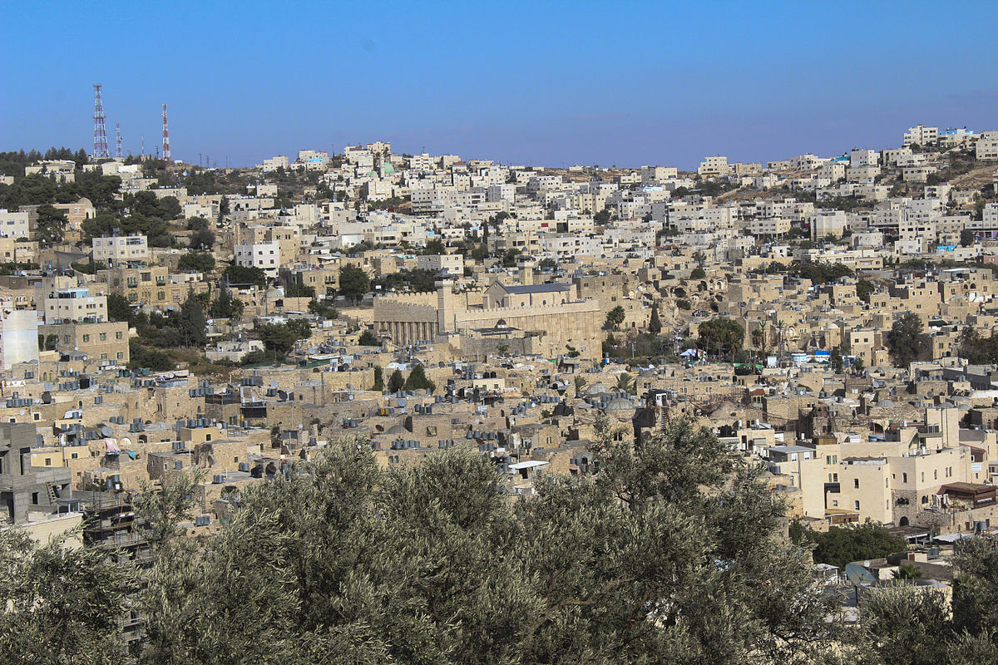
Judea and Samaria Economy
Sima Spiezer
22.1.2020

Slide 2
GDP Per Capita in Judea & Samaria 2018 ($)
39,895$
4,208$
*9.5
Source: Israeli Civil Administration

Slide 3
GDP Per Capita in Judea & Samaria Vs. the Gaza Strip 2018 ($)
Judea & Samaria
Gaza
39,895$
4,208$
* 2.6
*9.5
1585$
* 25
Source: Israeli Civil Administration
Source: Palestinian Bureau of Statistics, March 2019

Slide 4
Judea & Samaria Workforce
Judea & Samaria
2nd Quarter, 2018
880,100 Palestinians in the Workforce 836,800
132,100
(15%) Unemployed 159,500 (19.1%)
737,800 Employed 665,600
767,700
Women Out of the Workforce
746,200
% Unemployment
Gaza
Judea & Samaria
During an ongoing closure in Judea & Samaria, the effective unemployment rate may climb to approx. 45%
46.7% 53.7%
15% 19.1%
Source: Israeli Civil Administration

Slide 5
Growth in Annual GDP Per Capita in Judea & Samaria ($)
Comparing GDP Per Capita in the 2nd Quarter of Each Year Between 2014-2019
1,048
6.8%
2.4%
2019
4.7%
0.8%
1.7%
Source: Israeli Civil Administration

Slide 6
GDP Composition by Sectors
2nd Quarter 2019
Brokerage
3.1%
Agriculture 2.5%
2nd Quarter 2018
VAT 8.4%
Manufacturing and Mining
14.0%
-3.0%
2.7%
8.3%
14.2%
Customs 10.9%
11.2%
Construction 6.2%
6.3%
Largest Sectors
Change in Percentage | Sector
19.4% | Retail
19.1% | Services
14.0% | Manufacturing and Mining
Retail
19.4%
Public Services (including security) 12.4%
19.3%
11.8%
Storage & Transport
1.4%
Services 19.1%
1.6%
Finances & Insurance
4.5%
18.3%
Information & Communications
4.2%
4.5%
4.7%
Source: Israeli Civil Administration

Slide 7
Employment Licenses
מכסה
ניצול
Quota
Utilization
Employment Licenses in Israel
מכסה
ניצול
Quota
Utilization
מכסה
ניצול
Quota
Utilization
September 2019
Employment Licenses in the Settlements
35,193
The number of employment licenses in Israel and the settlements continues to grow, thus contributing to maintaining stability in the region.
Household income as a result of the employment in Israel sector comprise approx. 30% of the GDP
8.9%
4%
5%
1%
4%
5%
September 2019
Source: Israeli Civil Administration

Slide 8
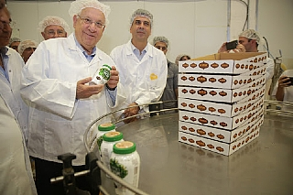
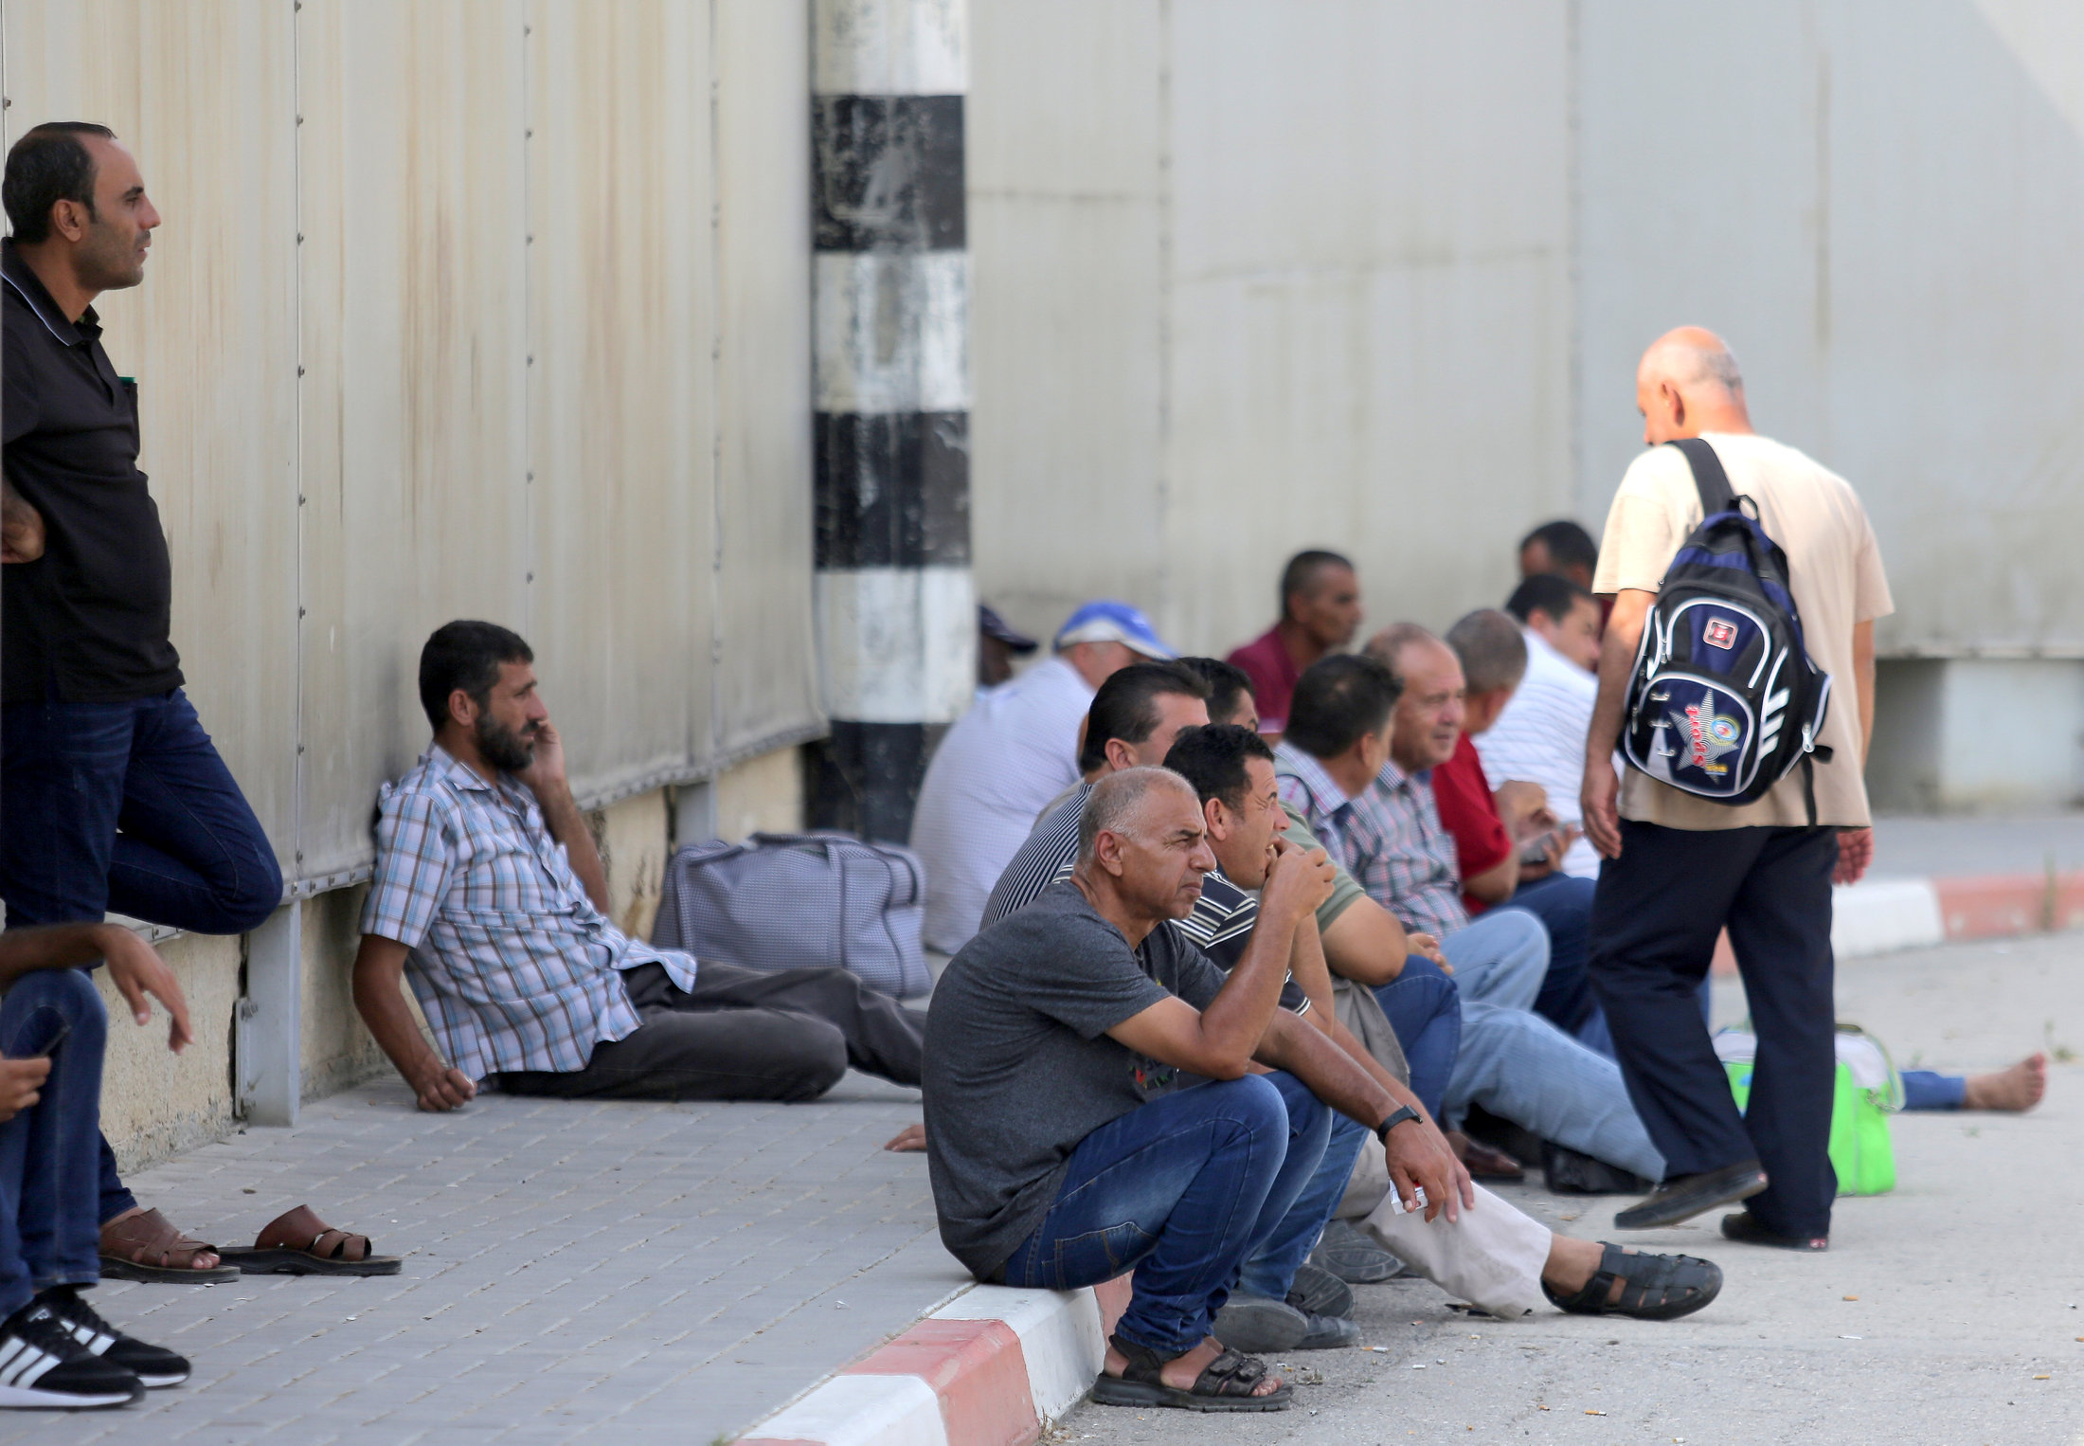
Average Salaries and Unemployment
Average Daily Salary in Judea & Samaria (₪)
Average Daily Salary in Israel (₪)
Increase9.7₪
Increase 6.1₪
2nd Quarter, 2018
2nd Quarter, 2019
2nd Quarter, 2018
2nd Quarter, 2019
שיעור אבטלה באיו"ש
Unemployment Rate in Judea & Samaria
Decrease3.5%
2nd Quarter, 2018
2nd Quarter, 2019
Source: Israeli Civil Administration

Slide 9
General Data Provided by the Palestinian Authority Bureau of Statistics:
In 2018, the Arab population of Judea & Samaria was 2.95m residents; in the Gaza Strip – 1.96m residents.
The size of an average Arab family in Judea & Samaria is 4.8; in the Gaza Strip – 5.6
Population under 16: Judea & Samaria – 36.6%; Gaza Strip – 41.6%
GDP: Judea & Samaria – $10.7B; Gaza Strip - $2.9B
Recreation, culture: in Judea and Samaria there are 495 cultural centers, 23 museums, 10 theatres and 2 cinemas. In in Gaza Strip, there are only 80 cultural centers, 5 museums, 3 theatres and not even one cinema.

Slide 10
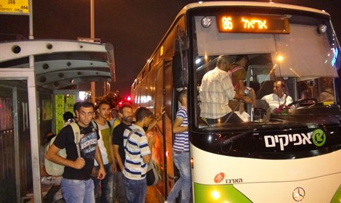
Judea & Samaria – Challenges
Public Transportation
Infrastructure and Roads
Water
Electricity
Sense of Security

Slide 11
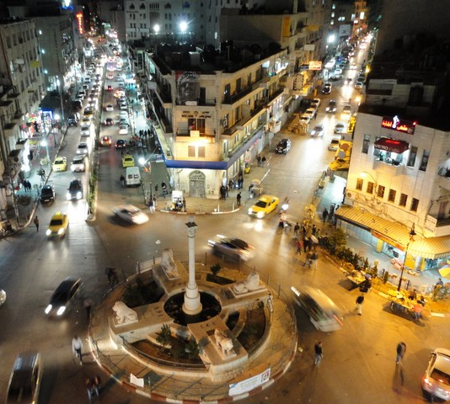
Thank you.

